Slide 1
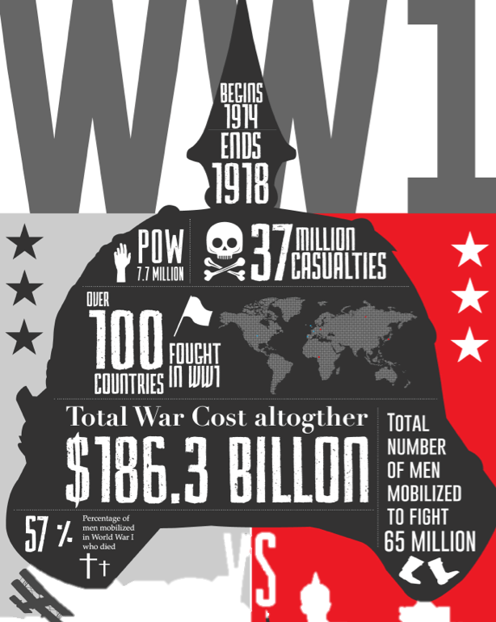
& the Treaty
of Versailles
You need to watch this PPT in Animation format:
Slide Show > From Beginning

Slide 2
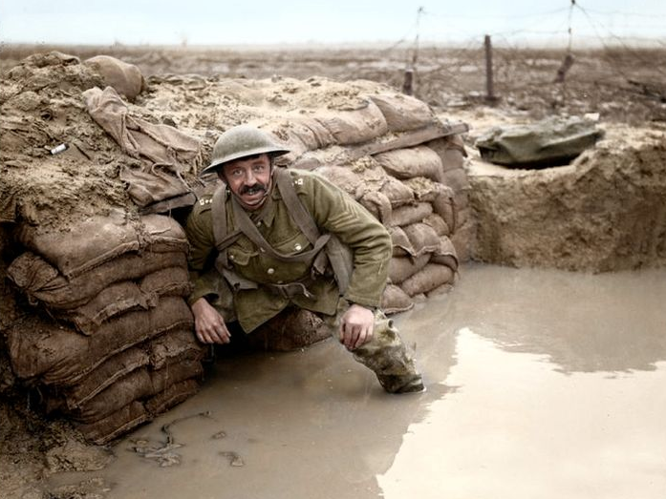
WWI- 1917
By 1917 WWI had already devastated Europe
New technologies caused more destruction than ever before
Many Americans and Europeans believed American troops would quickly bring the war to an end

Slide 3
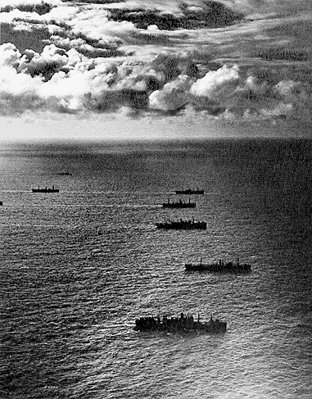
US Joins the War
Americans successfully sailed to Europe with out any casualties.
The war is quickly over once the US enters the war

Slide 4
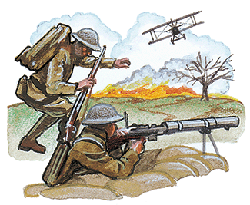
War Comes to an End
Reasons why WWI ended
1. US joins the war. Bringing supplies and fresh troops
3. Germany is weak and German citizens force the emperor to step down
2. Empires Crumble
Ottoman
Austro-Hungarian
Russian
Notes:
4

Slide 5
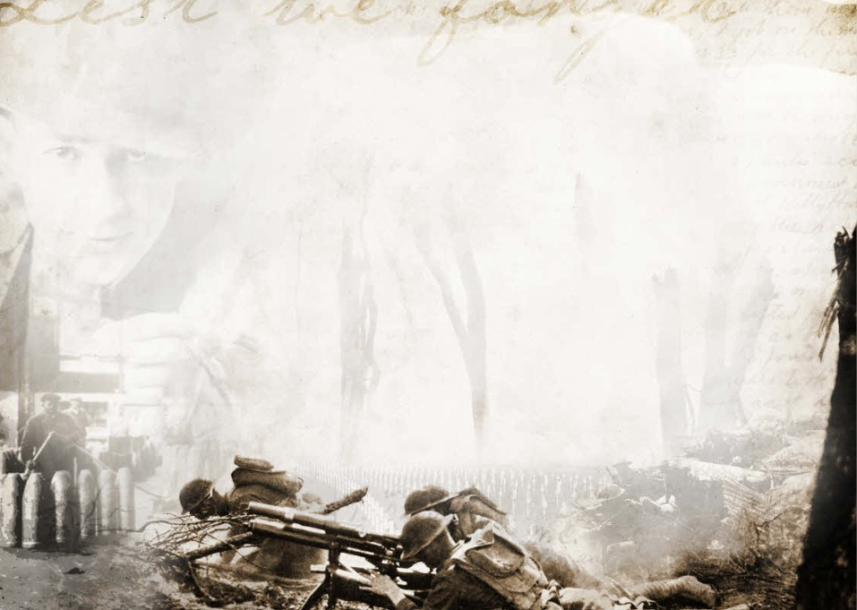
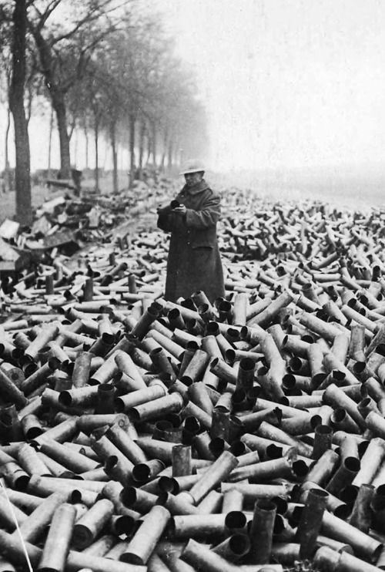
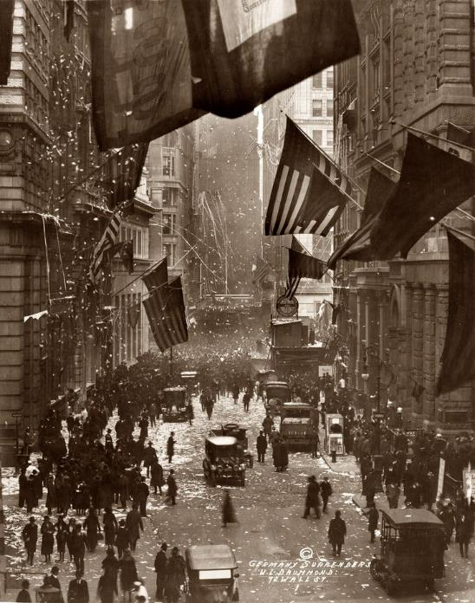
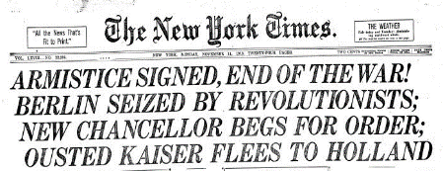
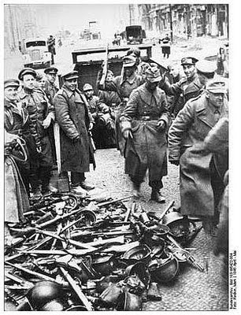
11-11-11, 1918
On the 11th hour, of the 11th day, of the 11th month, 1918 the fighting stopped
Germany finally signed an armistice, or cease fire, that ended the war

Slide 6
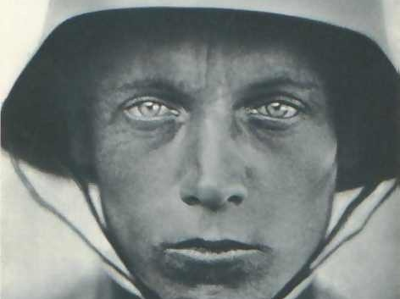
A Flawed Peace

Slide 7
Big Four
A peace conference began in Paris to try and resolve the complicated issues arising from WWI
Germany was not invited
Leaders of the victorious Allied nations, known as the “Big Four”
Wilson- Unites States
Orlando- Italy
George- Great Britain
Clemenceau- France
Woodrow Wilson
Vittorio Orlando
Georges Clemenceau
David Lloyd
George
Notes:
7
Russia was not represented (in the grips of civil war), nor was Germany (they lost)

Slide 8
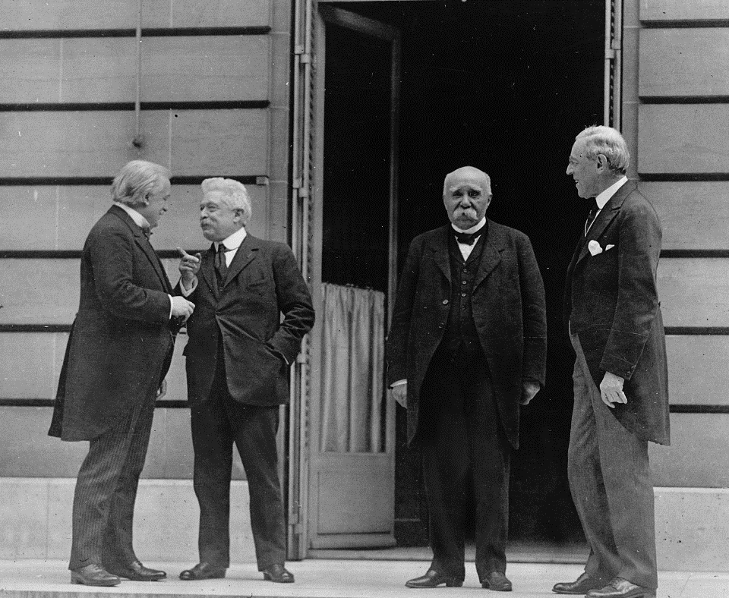
Paris Peace Conference
“The Conference was an affair of three sides – the victors, the vanquished, and Wilson.”
-- Richard Hofstadter

Slide 9
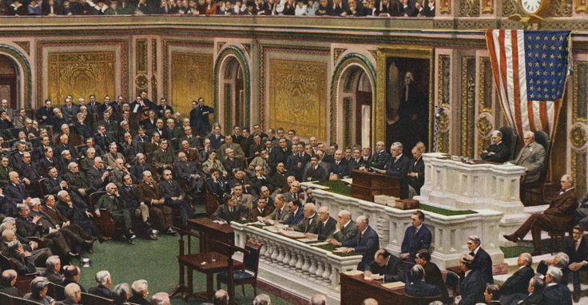
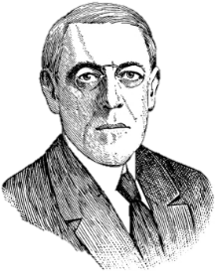
What Wilson Wanted January 8, 1918
1. No secret treaties
2. Freedom of navigation of the seas
3. Removal of economic barriers to trade
4. Reduction of national armaments
5. Adjustment & self-determination for colonies
6. Withdrawal of foreign troops from Russia
7. Restoration of Belgium
8. Restoration of France and return of Alsace and Lorraine
9. Establishment of Italy’s frontiers
10. Independence for Austria-Hungary
11. Independence for Romania and Serbia
12. Establishment of independent Turkey
13. Creation of Poland
14. Establishment of the League of Nations
14 Points
Notes:
9

Slide 10
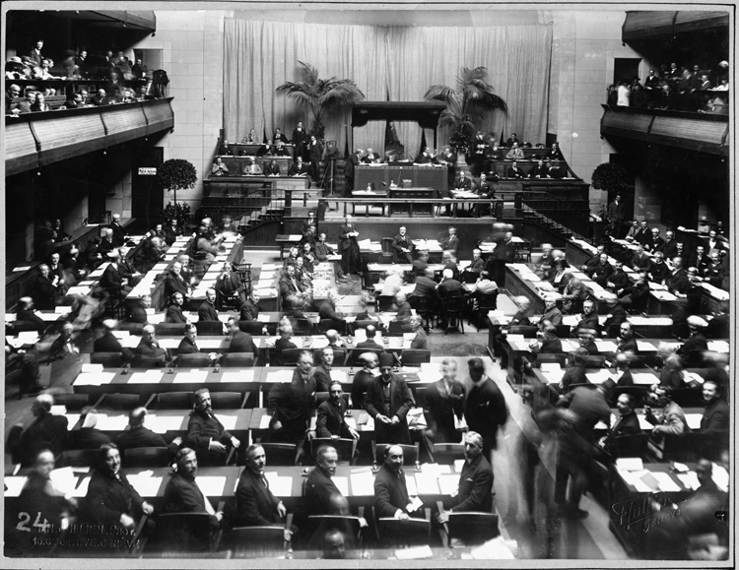
League of Nations
The League’s member nations would help preserve peace and prevent future wars by pledging to respect and protect each other’s territory and political independence.

Slide 11
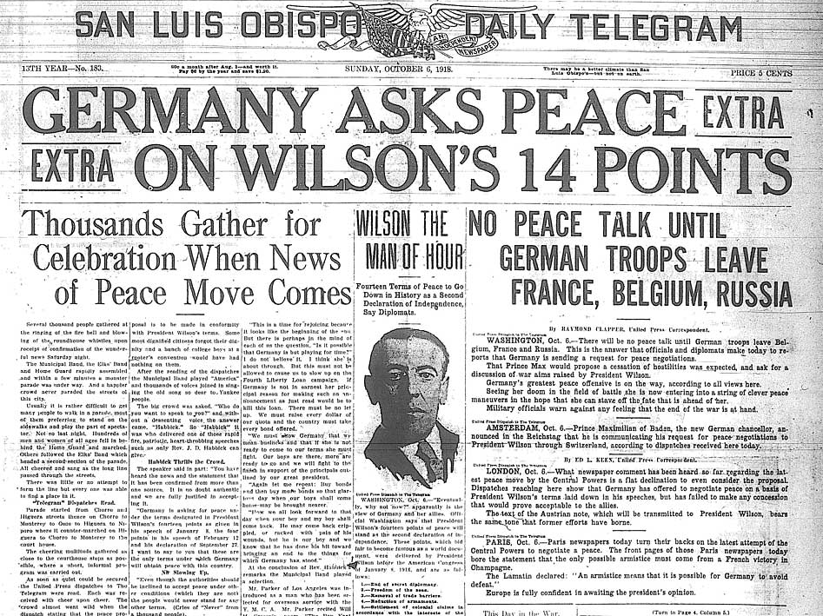

Slide 12
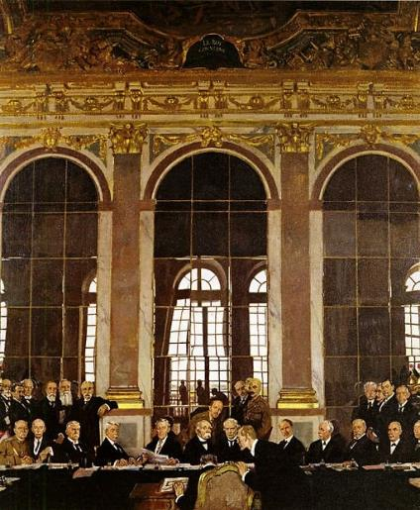
Treaty of Versailles
The other Allied governments saw Wilson’s plan as too lenient towards the “aggressor” nations especially Germany.
Treaty of Versailles, was signed by Germany in 1919 with little influence from Wilson’s 14 points
Goal of the treaty was to punish German more than to create a lasting peace

Slide 13
Treaty of Versailles
What the World Got June 28,1919
1. Germany must admit war guilt
2. Germany loses colonies
3. Germany pays $30 billion in reparations
4. Germany must disarm
5. Blockades on ships are prohibited.
6. Creation of an independent Polish state
7. The Covenant of the League of Nations is to be adopted
8. Member nations all have an equal vote in the assembly
9. Members must respect and preserve independence of all member nations
10. Members must submit to all disputes
11. Members must reduce armaments
12. Members must help set up an international court

Slide 15
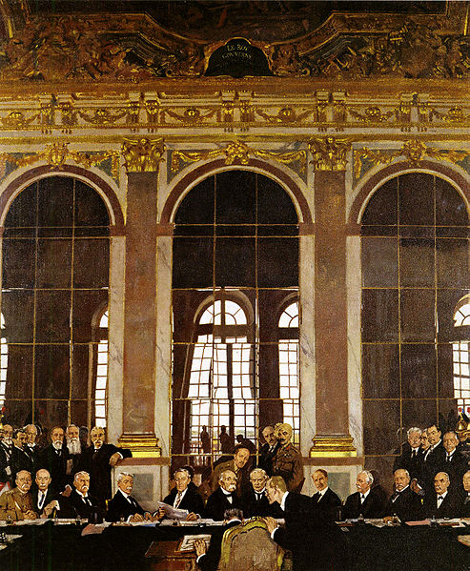
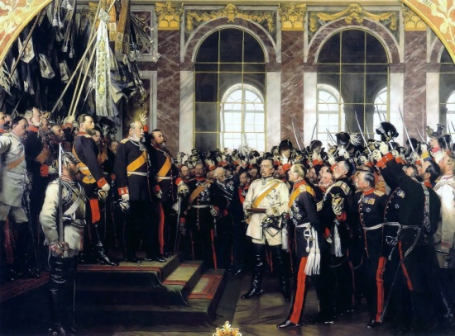
Signing of the Treaty of Versailles
June 28, 1919
Five years to the day of the assassination of Archduke Franz Ferdinand
Look Familiar???

Slide 16
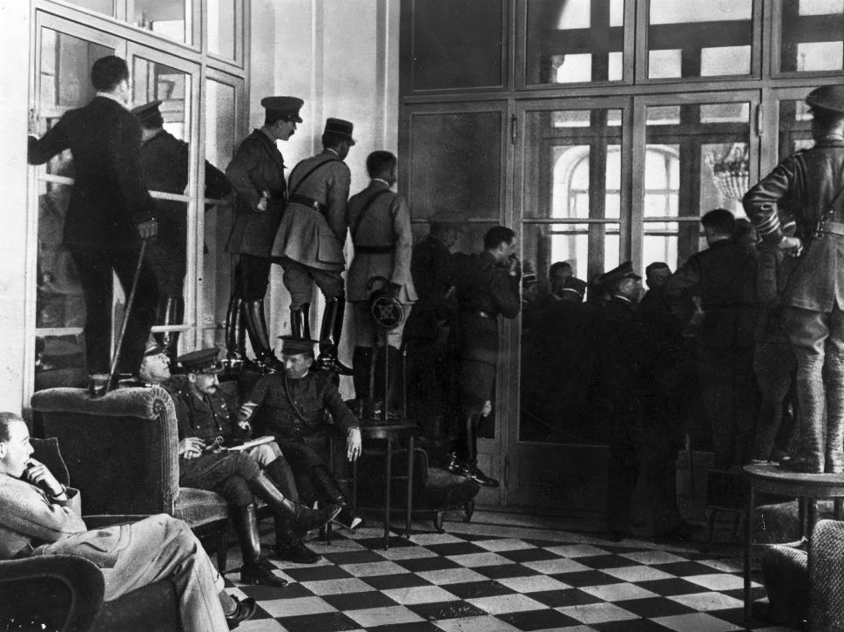
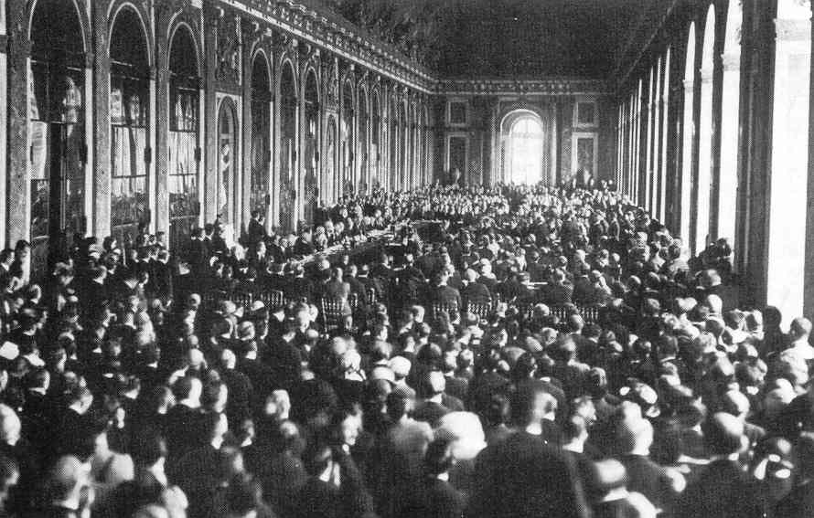

Slide 17
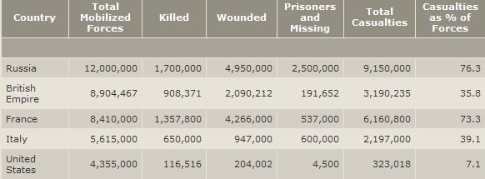
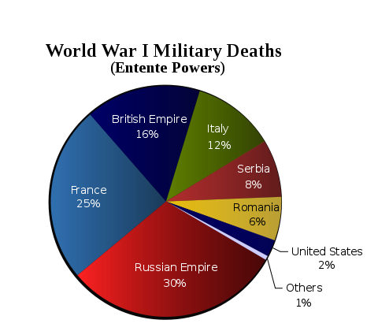
Who should pay for this?

Slide 18
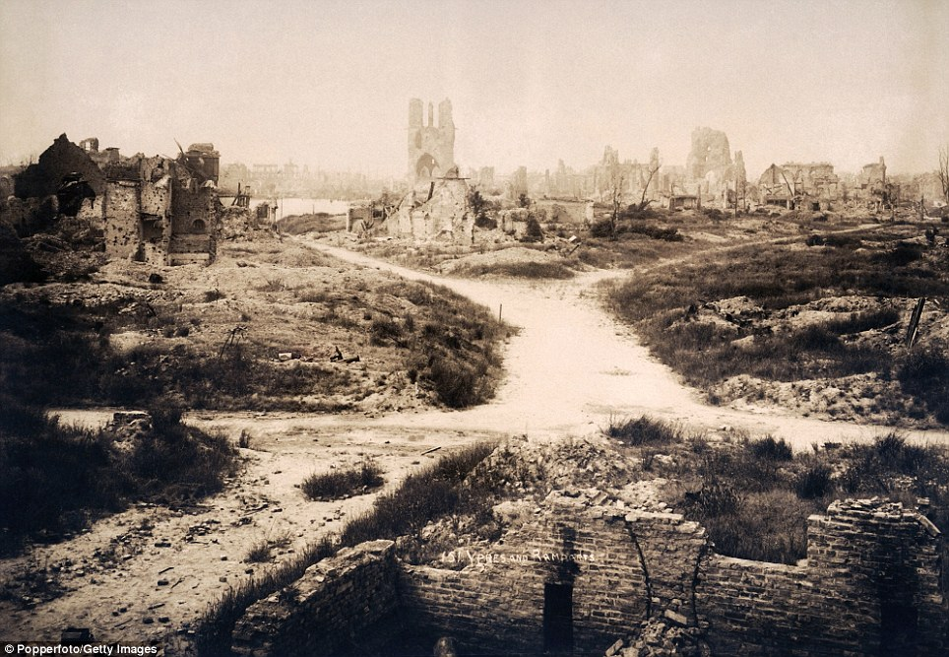
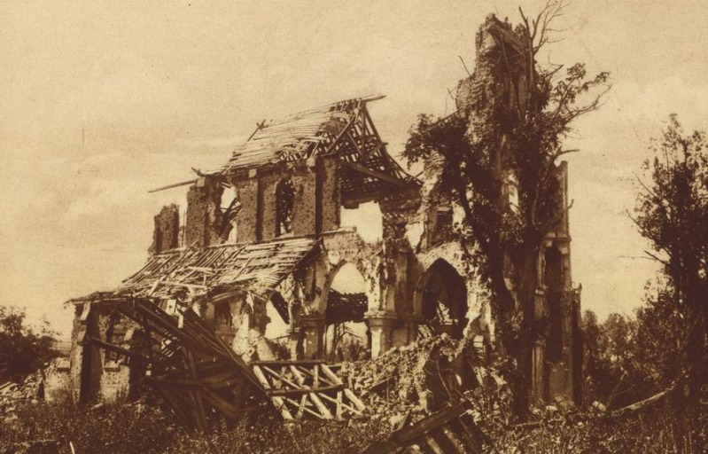
Who should pay for this?

Slide 19
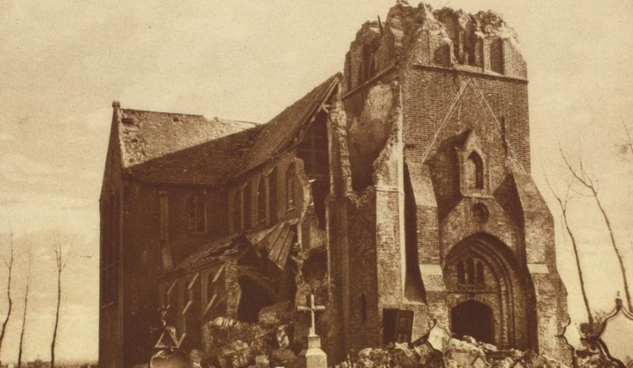
Who should pay for this?

Slide 20
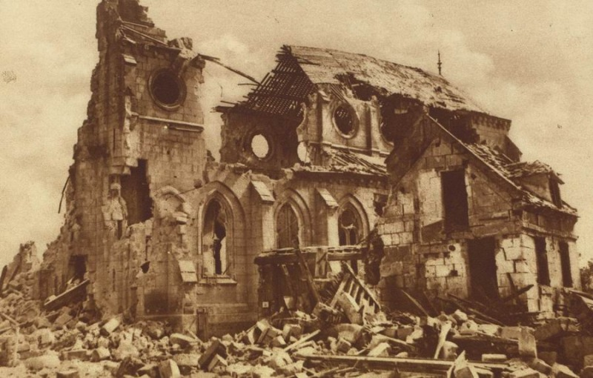
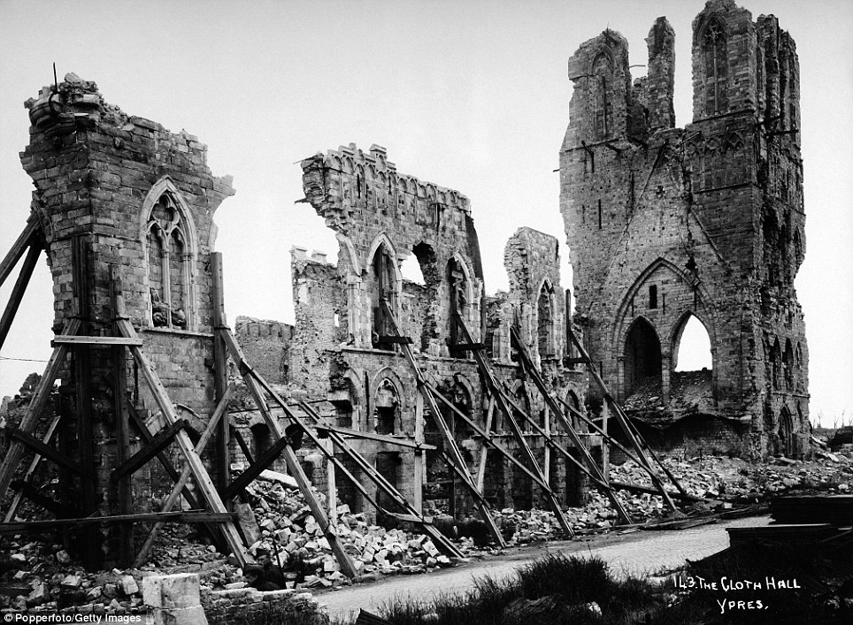
Who should pay for this?

Slide 21
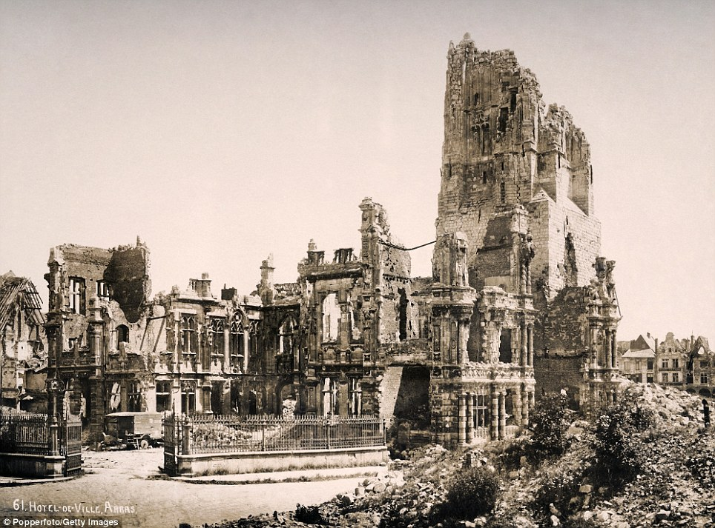
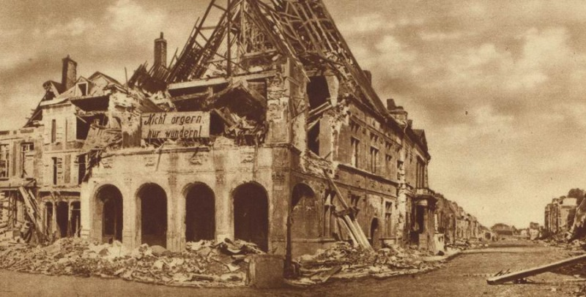
Who should pay for this?

Slide 22
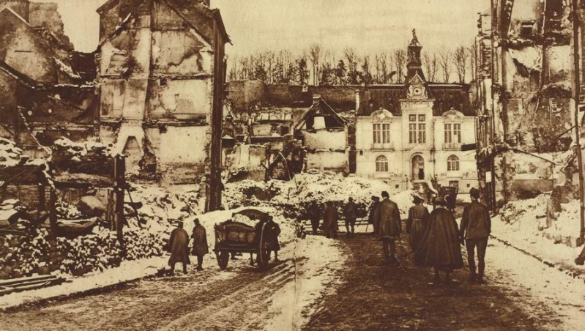
Who should pay for this?

Slide 23
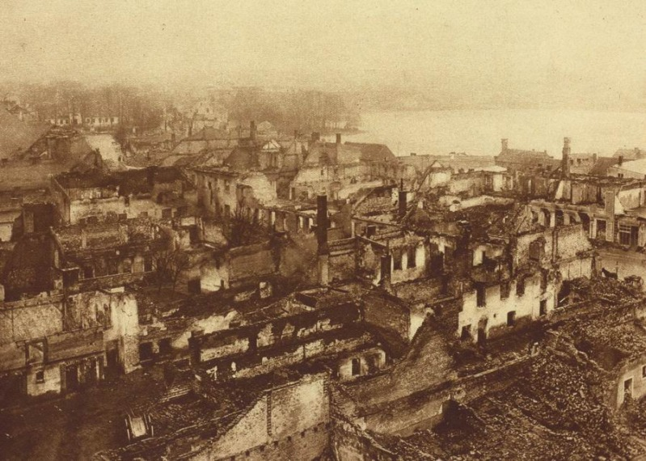
Who should pay for this?

Slide 24
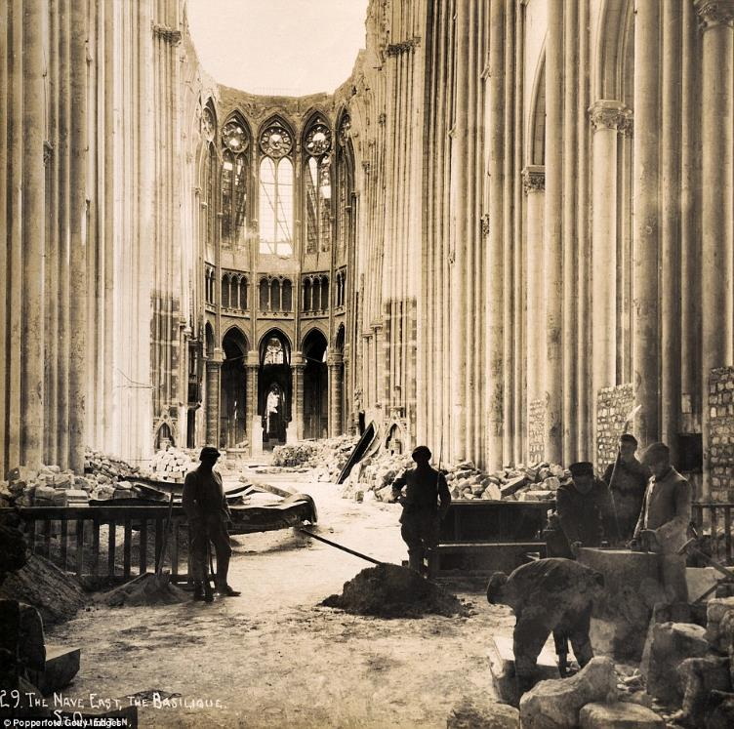
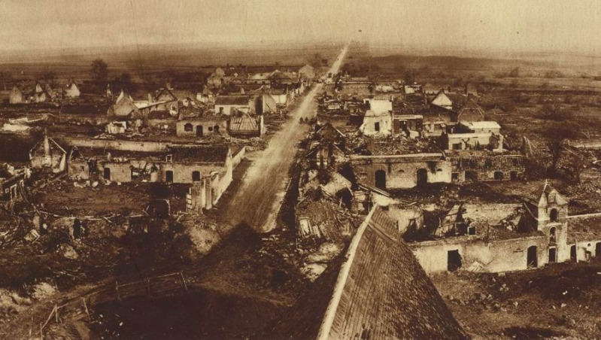
Who should pay for this?

Slide 25
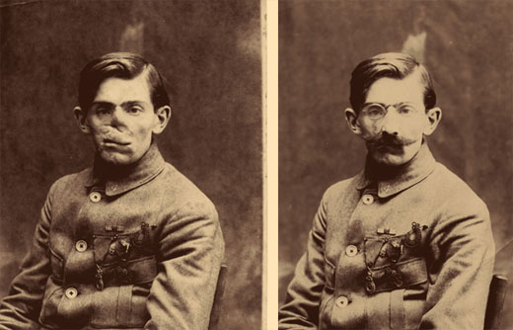
Who should pay for this?

Slide 26
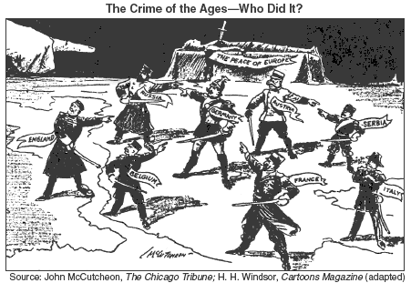
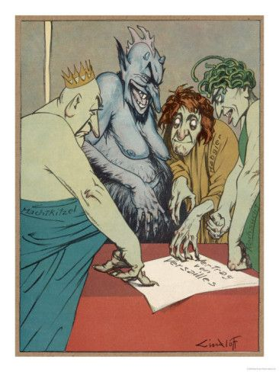
Allies want Germany to PAY

Slide 27
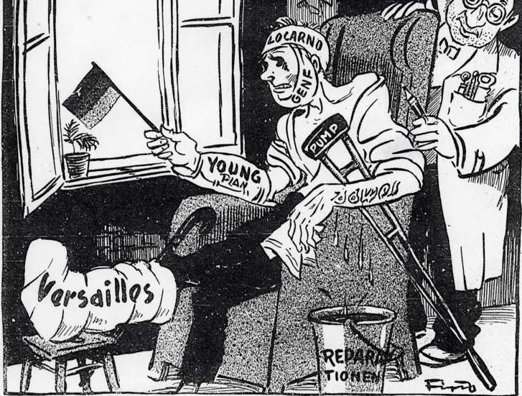
Reparations
Germany was stripped of its military, its territories were split up, and they were required to pay “reparations” to the Allied countries to a total of $33 billion, a sum far beyond its financial means
I can give him one more shot, He wont even notice.

Slide 28
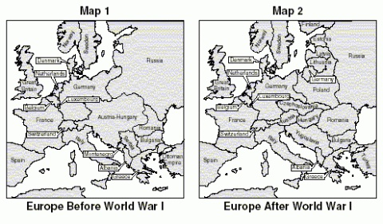
New Boundaries

Slide 29
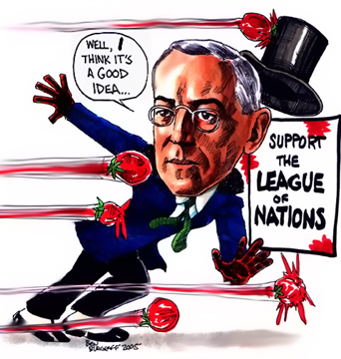
US Senate Rejects Treaty
The Senate was strongly opposed to the Treaty, especially Wilson’s own League of Nations, because they felt it would further entangle the United States in foreign affairs.
They also feared that it might supersede the power of Congress to declare war.
US did not join the league of nations

Slide 30
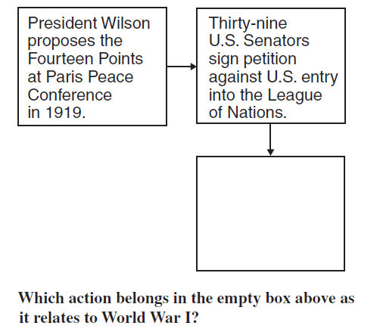
Which action belongs in the empty box above as it relates to World War I?
Checking for Understanding
The U.S. Senate refuses to ratify the Treaty of Versailles.

Slide 31
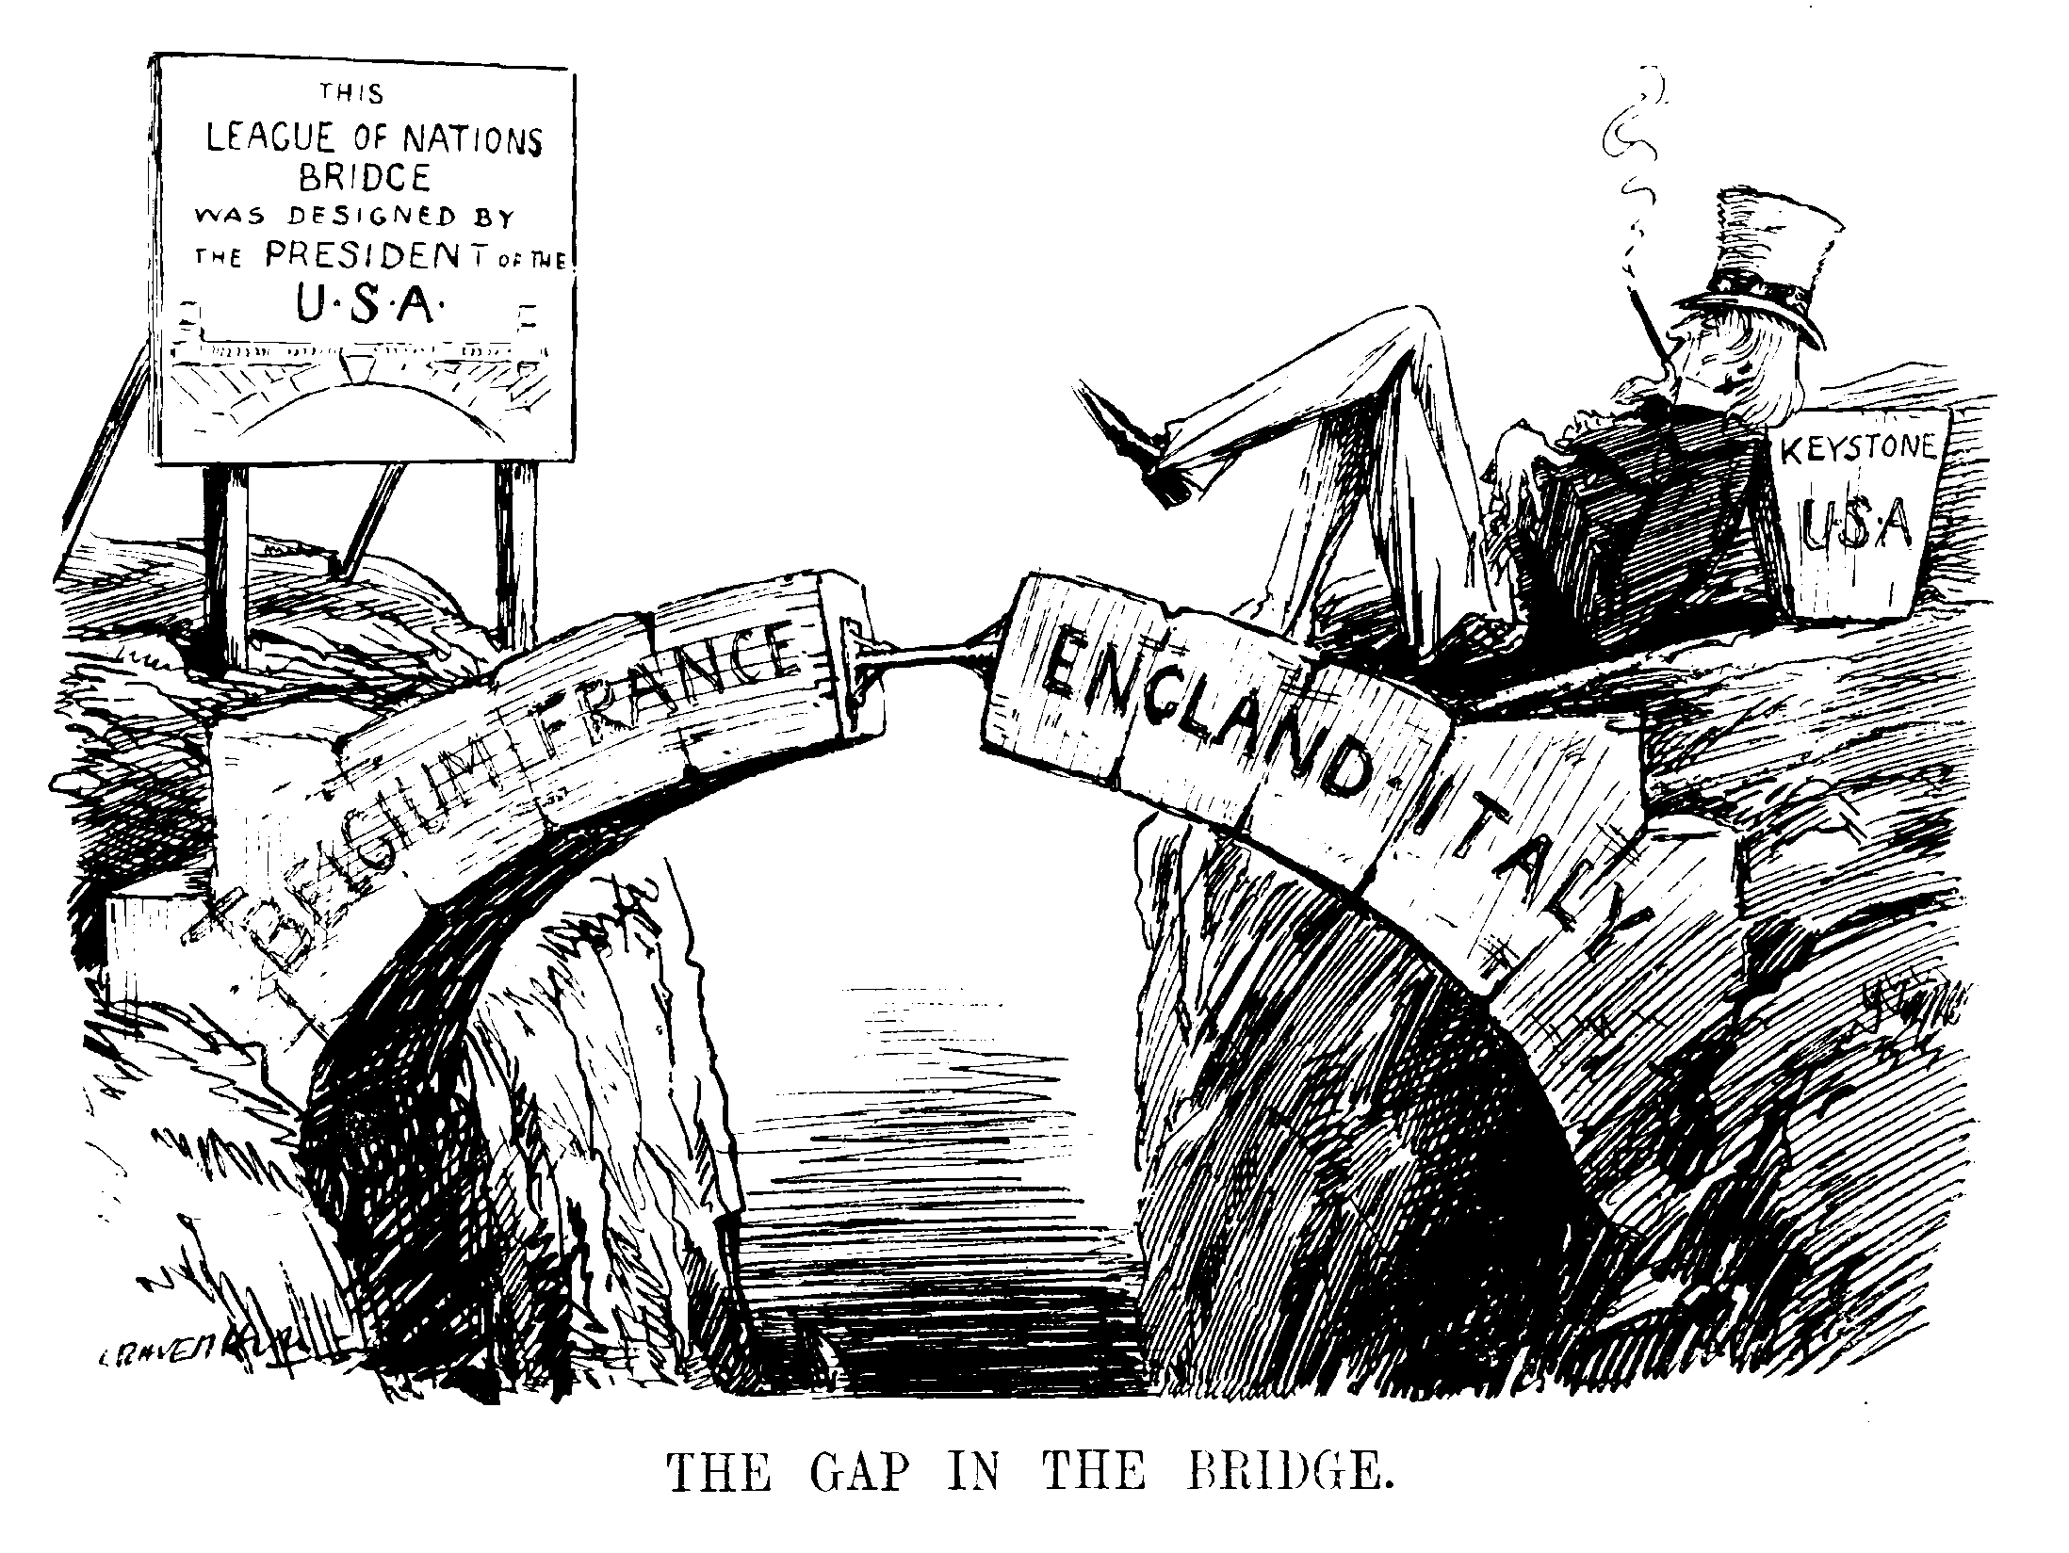
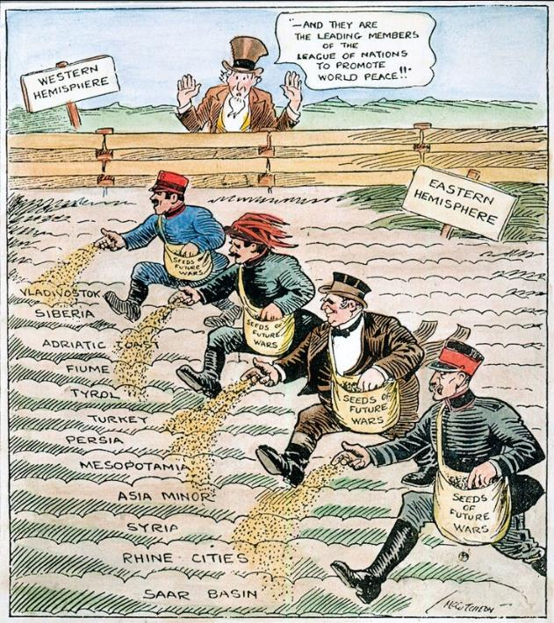

Slide 32
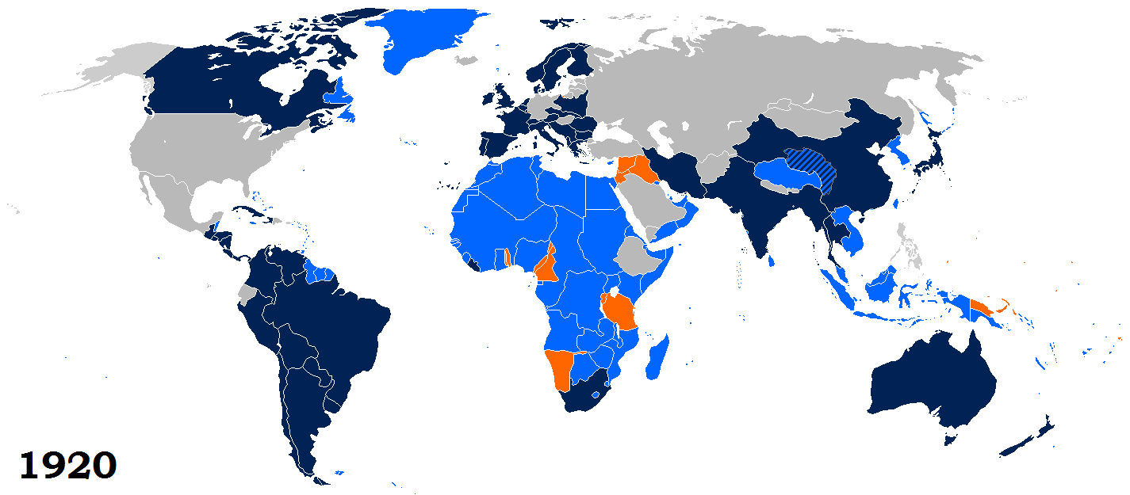
League Membership
1920- 1946
Map Credit: Maps & Lucy
The United States never joined the League. Wilson’s mission to intimately involve the U.S. in global affairs was a failure.

Slide 33
League of Nations: Problems
WAS DUMB!
Weak – the League’s ‘powers’ were little more than going ‘tut-tut’. Sanctions did not work. It had no army.
America – the strongest nation in the world never joined. Britain and France were not strong enough to impose pace on their own.
Structure – the League was jumbled, so it took ages to do anything. Members couldn’t agree – but decisions had to be unanimous. This paralyzed the League.
Depression – the world-wide Depression made countries try to get more land and power. They were worried about themselves, not about world peace.
Unsuccessful – the more the League failed, the less people trusted it. In the end, everybody just ignored it.
Members – the League’s main members let it down. Italy and Japan betrayed the League. France and Britain did nothing to help it.
Big bullies – in the 1920s, the League had dealt with weak countries. In the 1930s, powerful countries like Germany, Italy and Japan attacked weaker countries. They were too strong for the League to stop them.

Slide 34
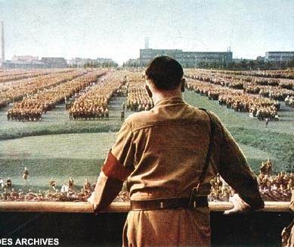
Treaty of Versailles Problems
This treaty took away Germany's land, money, livestock, and natural resources, which forced their trading and population to decline.
It also set limitations on Germany's army, forcing them to have a much smaller army.
This led to the rising of Adolf Hitler and the German Nazis, who eventually started World War II.

Slide 35
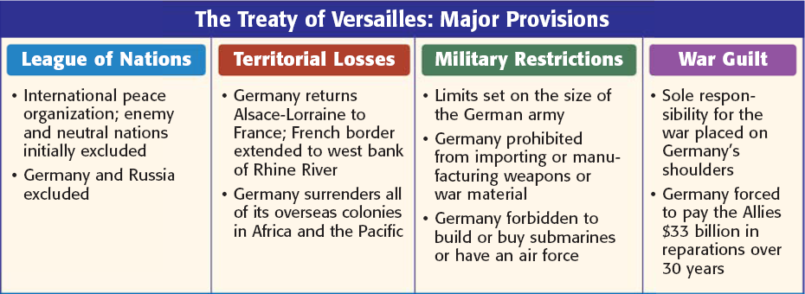
Notes:
35

Slide 36
What was the goal of Wilson’s 14 Points?
Checking for Understanding
To create a lasting peace

Slide 37
What was Wilson’s 14th Point?
Checking for Understanding
Formation of the League of Nations

Slide 38
The Treaty of Versailles overlooked the importance of
Checking for Understanding
treating all nations justly, including the losers of a war.

Slide 39
What country was forced to take blame for the entire war?
Checking for Understanding
Germany

Slide 40
Why didn’t the Senate approve the Treaty of Versailles?
Checking for Understanding
They thought it would involve the United States in future conflicts.

Slide 41
How the War Changed the World

