Slide 1
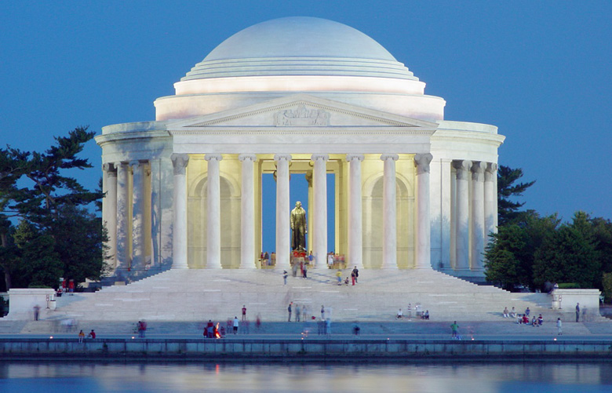
THE AGE OF JEFFERSON

Slide 2
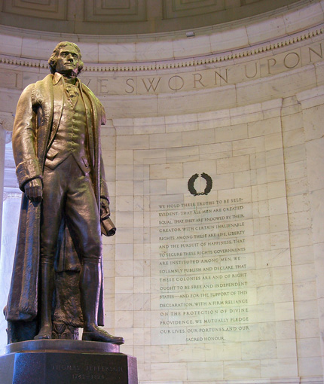
WHAT WE WILL
LEARN TODAY:
What were the successes and failures of the Jefferson administration?

Slide 3
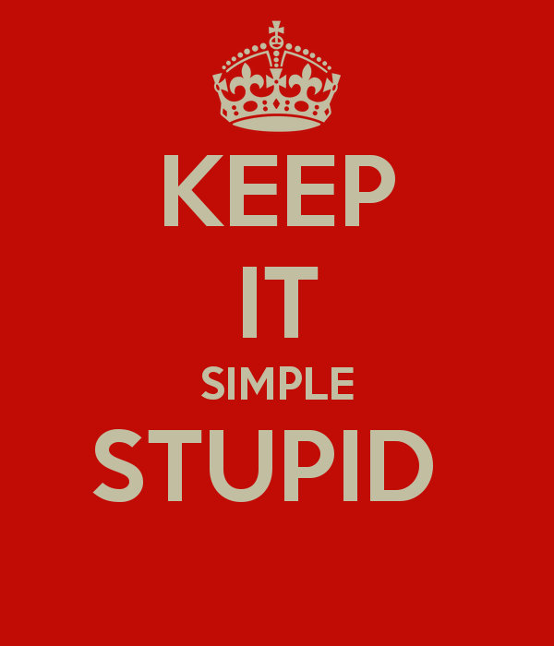
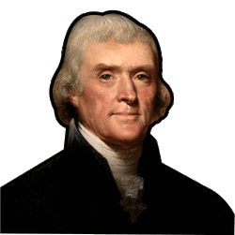
PURSUING REPUBLICAN PRINCIPLES
Jefferson’s administration set out to simplify the presidency with new government policies:
Recognized the popularity of the common style. He symbolically simplified the presidency.
Walked to his own inauguration instead of riding in a carriage.
Took off his powdered wig, wore work clothes & frayed slippers when receiving visitors.
When visitors came to the White House I answered the door.

Slide 4
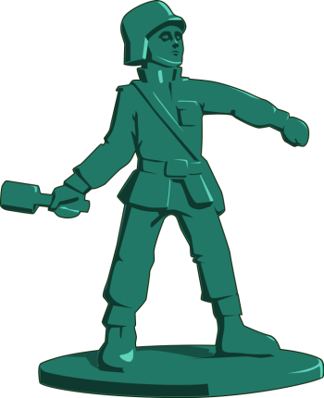
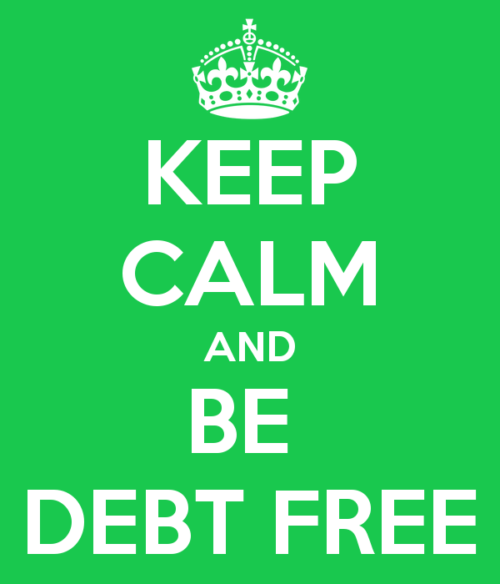
PURSUING REPUBLICAN PRINCIPLES
Jefferson’s administration set out to simplify the presidency with new government policies:
He cut the national debt from $80 million when he took office to $57 million in 1809.
He made major cuts to the army and navy and streamlined the government’s bureaucracy.
Wish the U.S. was only $57 million in debt today!?

Slide 5
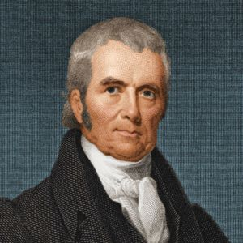
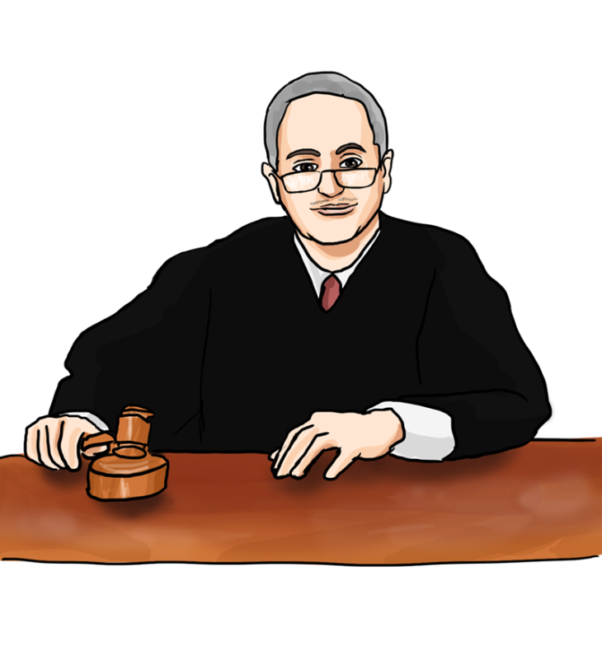
JOHN MARSHALL'S SUPREME COURT
John Marshall became Chief Justice of the Supreme Court when Thomas Jefferson became President in 1801.
Marshall was a Federalist, a last minute appointment by outgoing President Adams.
Under Marshall, the Supreme Court reviewed the case Marbury v. Madison when the Court claimed the power of judicial review when it made its decision.
Judicial Review – power of the Supreme Court to decide whether the acts of the president or laws passed by Congress are constitutional.

Slide 6
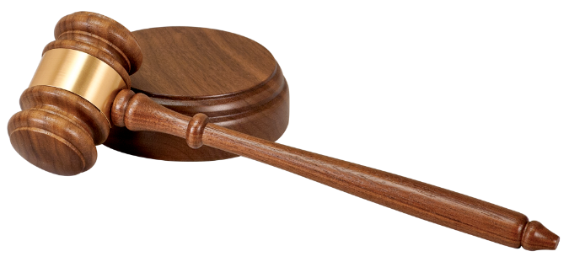
MARBURY V. MADISON
The Facts | The Issue | The Decision
William Marbury asked the Supreme Court to grant him a job as a federal judge, which had been promised by the Adams administration but denied by the incoming Jefferson administration. He also sued Secretary of State James Madison.
The Facts | The Issue | The Decision
William Marbury asked the Supreme Court to grant him a job as a federal judge, which had been promised by the Adams administration but denied by the incoming Jefferson administration. He also sued Secretary of State James Madison. | Marbury argued that the Judiciary Act of 1789, gave the Supreme Court the power to make a government official perform a certain duty.
The Facts | The Issue | The Decision
William Marbury asked the Supreme Court to grant him a job as a federal judge, which had been promised by the Adams administration but denied by the incoming Jefferson administration. He also sued Secretary of State James Madison. | Marbury argued that the Judiciary Act of 1789, gave the Supreme Court the power to make a government official perform a certain duty. | The Court ruled that in passing the 1789 law, Congress had exceeded the powers granted by the Constitution. Since the law was unconstitutional, the Supreme Court could not order Madison to grant Marbury his commission.
Marshall interpreted the Constitution broadly to find the implied powers needed for a strong national government.

Slide 7
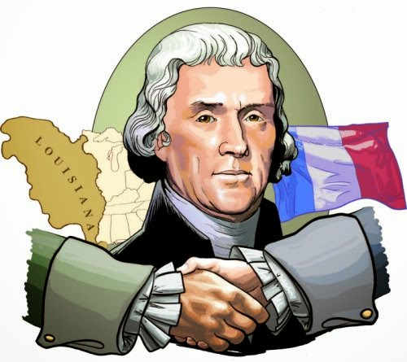
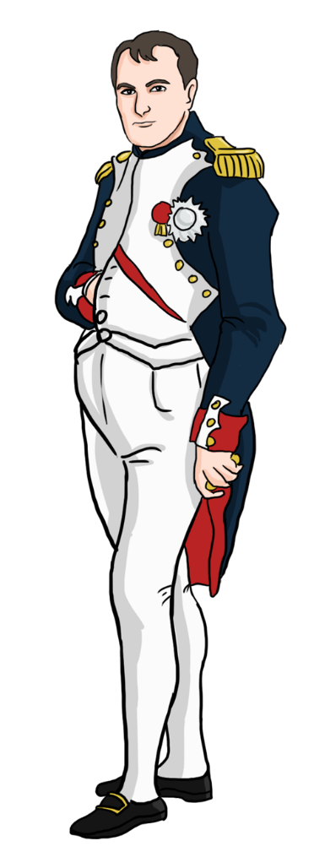
THE NATION EXPANDS
During Jefferson’s presidency, Americans continued their westward migration across the Appalachians.
Although pioneer life was hard, the pioneers kept coming.
Jefferson believed that Spain’s vast Louisiana Territory west of the Mississippi River would be easy to conquer.
Jefferson’s plans went awry, when France, a much more dangerous neighbor, forced Spain to give them the Territory.

Slide 8
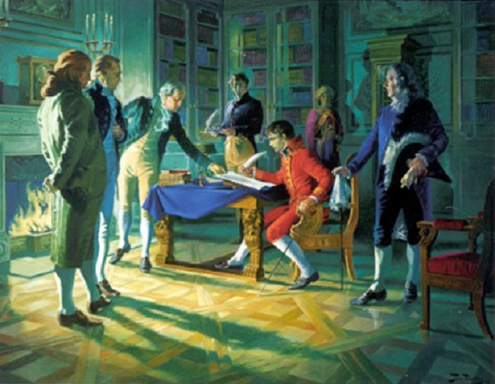
THE NATION EXPANDS
When James Monroe and Robert Livingston approached Napoleon, they found him surprisingly receptive.
Without an army to occupy Louisiana, and needing money to fight the British, Napoleon decided to sell all of the Territory.
It’s all yours… if I get the money right now!
The Territory nearly doubled the size of the U.S. and it only cost $15 million.

Slide 9
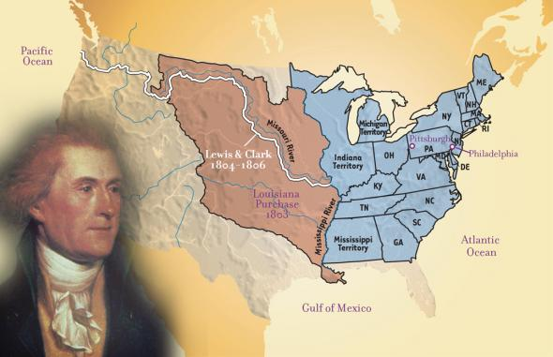
THE NATION EXPANDS
The Louisiana Purchase was a political embarrassment because it contradicted Jefferson’s strict constitutional principles.
(The Constitution did not authorize the federal government to buy territory from a foreign government.)
This is purchase is making me look like a political hypocrite.

Slide 10
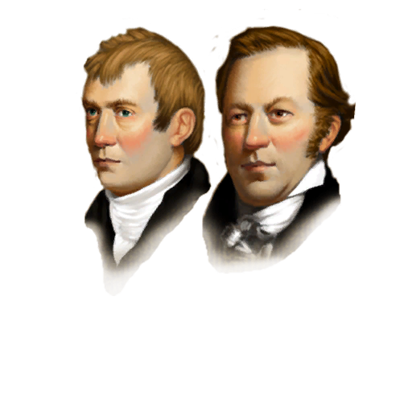
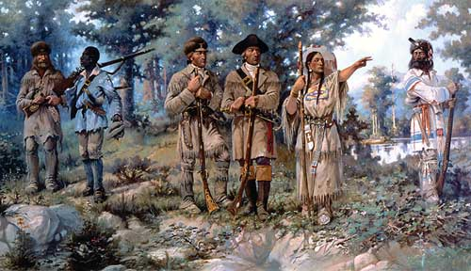
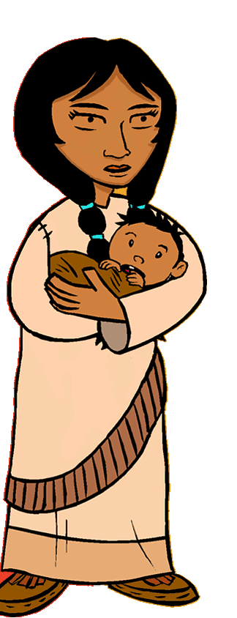
THE NATION EXPANDS
In 1804, Jefferson sent Meriwether Lewis and William Clark to explore the new territory.
The men were guided by a Shoshone woman, named Sacajawea and her husband.
Let me show you the way.

Slide 11
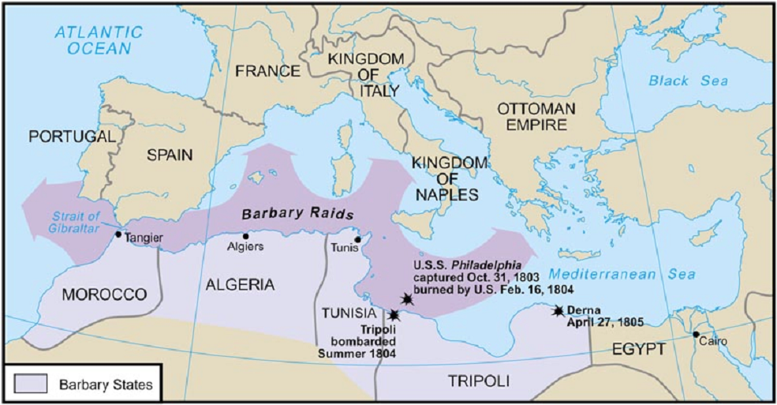
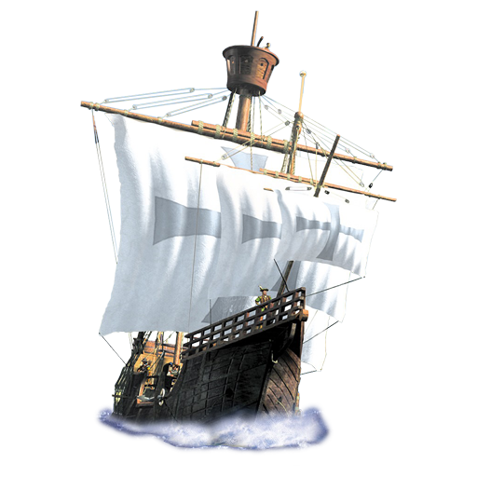
JEFFERSON'S FOREIGN TROUBLE
BARBARY WAR
The Barbary states were seizing American ships and sailors. Washington & Adam administrations had paid protection money to the Barbary States.
Jefferson was willing to do the same until the ruler of Tripoli increased his price. Jefferson ordered for a naval blockade of Tripoli’s port.
Jefferson won a favorable peace in 1805, concluding the Barbary War.

Slide 12
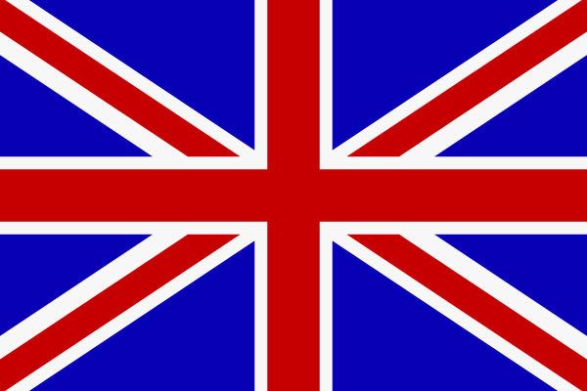
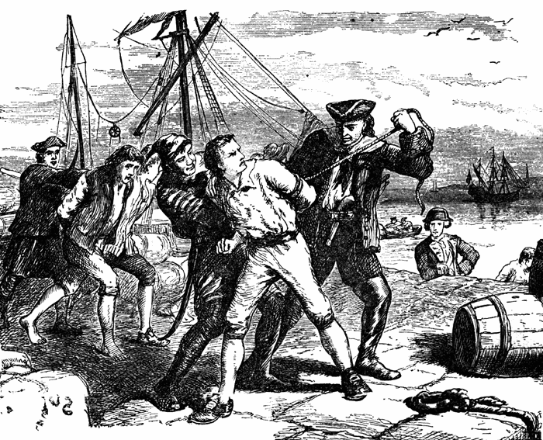
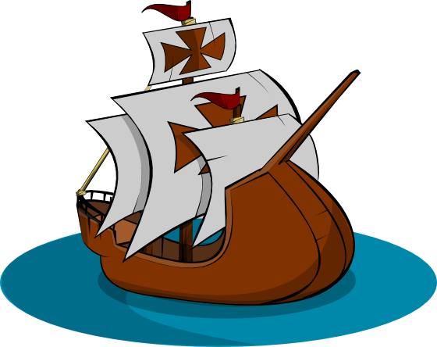
JEFFERSON'S FOREIGN TROUBLE
PROBLEMS WITH BRITISH…AGAIN!
The British navy relied on impressments for their need of sailors for their huge fleet.
In 1807, the British attacked an American warship, the Chesapeake, in order to take some of its sailors. Many Americans, including Federalists, were outraged.
Impressment – the taking of American sailors from their ships and forcing them to serve in the British navy.

Slide 13
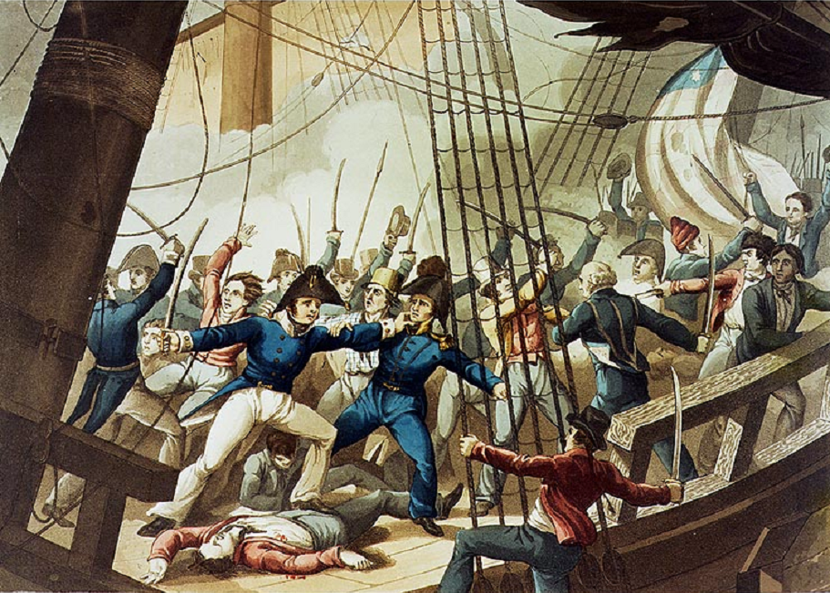
British Sailors taking over Chesapeake

Slide 14
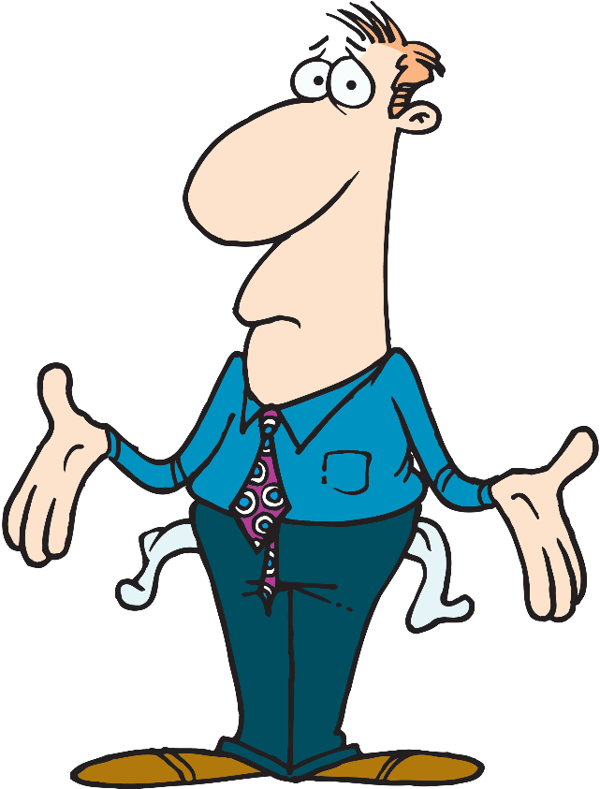
JEFFERSON'S FOREIGN TROUBLE
PROBLEMS WITH BRITISH…AGAIN!
The U.S. lacked a large enough navy to challenge the British fleet.
Jefferson decided on an embargo, suspending trade by ordering American ships to stay at port.
The Embargo Act of 1807 did not have the effects that Jefferson intended.
The embargo bankrupted American merchants, threw American sailors out of work, and hurt farmers, who could no longer export their crops.
That wasn’t suppose to happen.

Slide 15
WHAT WE
LEARNED TODAY:
What were the successes and failures of the Jefferson administration?

Slide 16
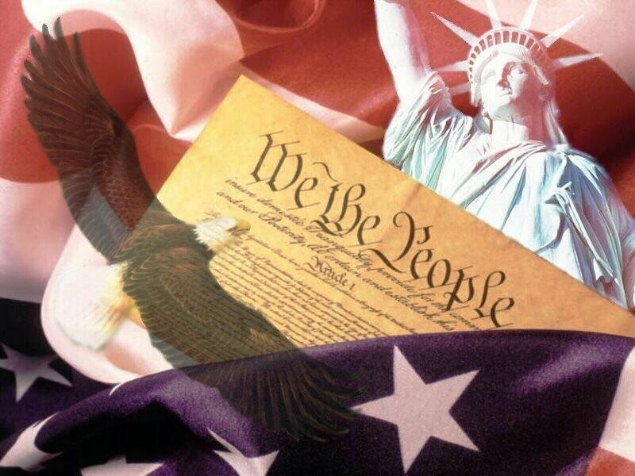
THE NEW REPUBLIC
(1789-1816)
CHAPTER 2
SECTION 4

Slide 17
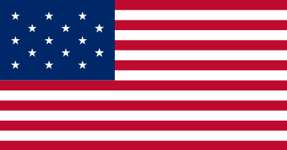
THE WAR OF 1812
PAGES 82-87

Slide 18
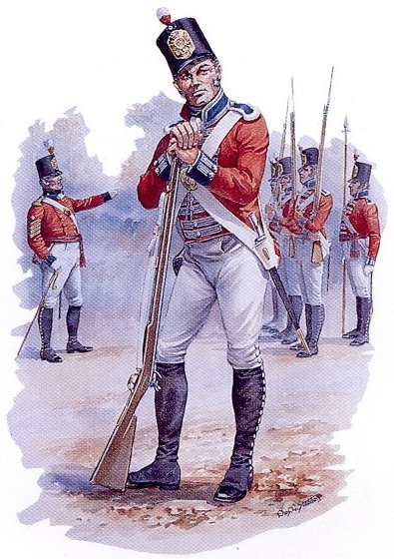
WHAT WE WILL
LEARN TODAY:
Why did the United States go to war with Britain, and what was the outcome of that war?

Slide 19
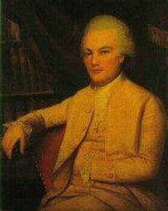
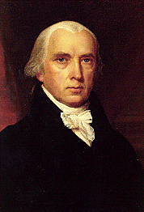
ELECTION OF 1808
ELECTION OF 1808
vs.
Charles Pinckney Federalist
James Madison Democratic-Republican
Jefferson believed strongly in the tradition established by Washington of voluntarily retiring from the presidency after a second term. Jefferson supported Madison, his close friend.

Slide 20
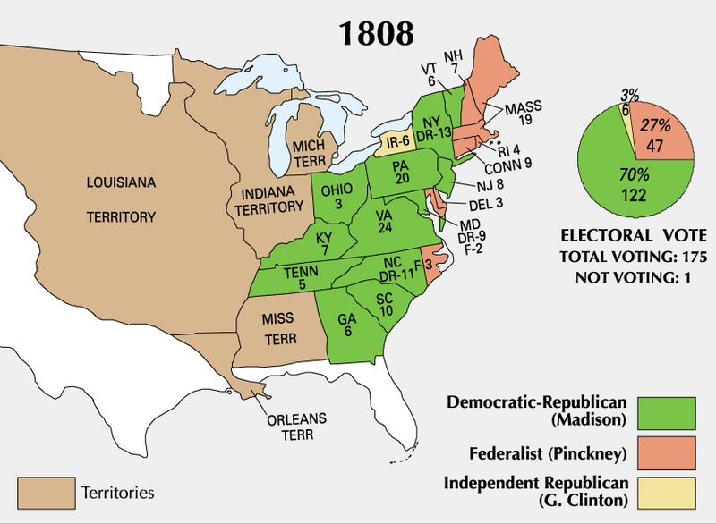
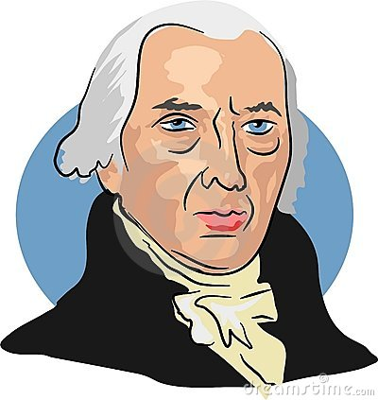
ELECTION OF 1808
Madison also had to fight against other factions of the Democratic-Republican Party.

Slide 21
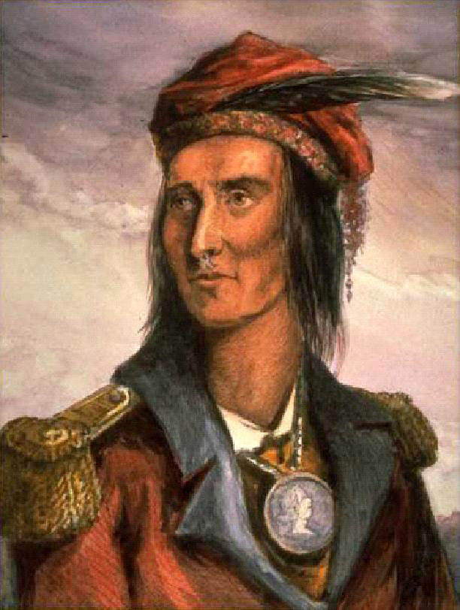
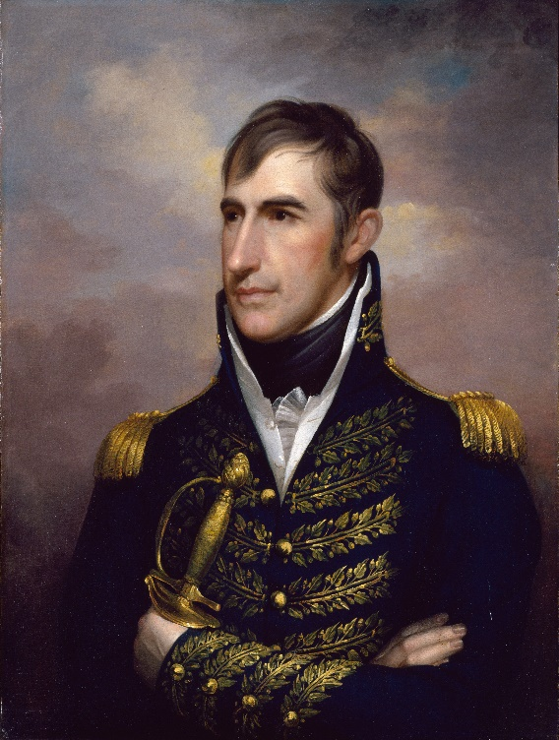
BATTLING NATIVE AMERICANS
Shawnee chief Tecumseh believed that the only way to protect their homeland against intruding white settlers (and the dishonest government) was to form a confederacy, a united Native American nation.
While Tecumseh was seeking allies in the South, General W.H. Harrison led troops to destroy the beginnings of this “uprising” near the Tippecanoe River.
BRITISH WERE
HELPING THE N.A.'s
BY GIVING THEM GUNS.
After the “Battle” of Tippecanoe, the Native American were defeated, but most Native Americans escaped to fight again.

Slide 22
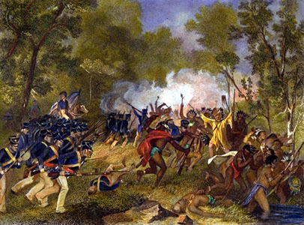
Battle of Tippecanoe

Slide 23
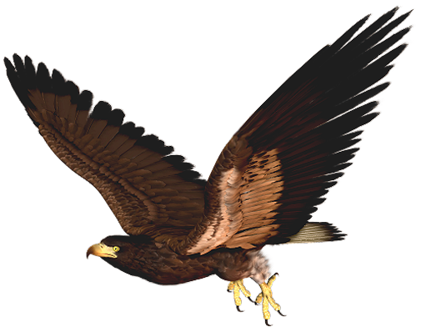
WAR HAWKS DEMAND WAR
“War Hawks” were a group of young congressmen from the South and West that were interested in expanding into British Canada and Spanish Florida.
The war hawks called for war against Britain and in 1812 the call was answered. The war was not supported by all Americans.
Causes for War of 1812:
1. Impressments of U.S. citizens.
2. British giving guns to Native Americans.
3. War Hawks demanding war.

Slide 24
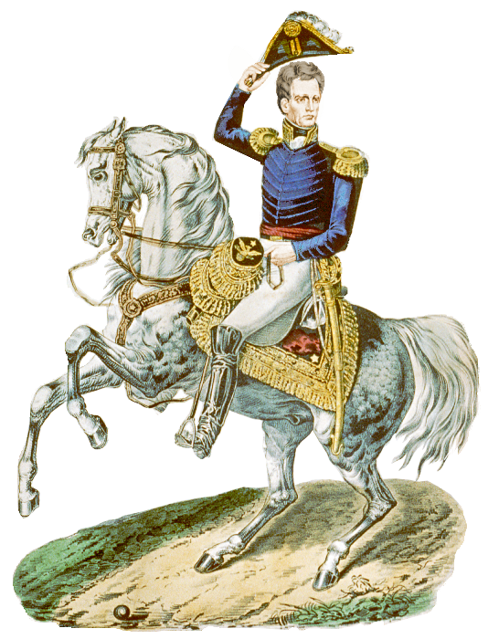
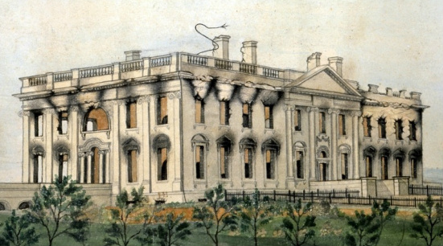
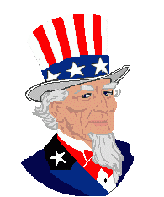
WAR OF 1812
WAR OF 1812
The United States got beaten up at: | Americans won their greatest victory at the Battle of New Orleans.
WAR OF 1812
The United States got beaten up at: | Americans won their greatest victory at the Battle of New Orleans.
Sea – British blockade of America’s ports. Land – British forces burned the White House & Capitol. | General Andrew Jackson lost only 71 men, while the British lost 2,036. By 1814, the British were weary of war, and Madison realized that the Americans would be unable to win a decisive victory.

Slide 25
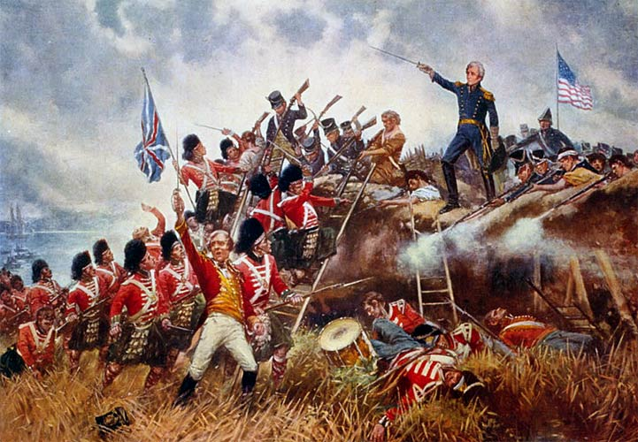
Battle of New Orleans

Slide 26
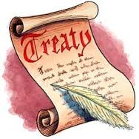
WAR OF 1812
TREATY OF GHENT
A halt to the fighting.
The return of all conquered territory to the prewar claimant.
Recognition of the prewar boundary between Canada and the U.S.
That seemed a bit pointless… at least we got our National Anthem from this war.

Slide 27
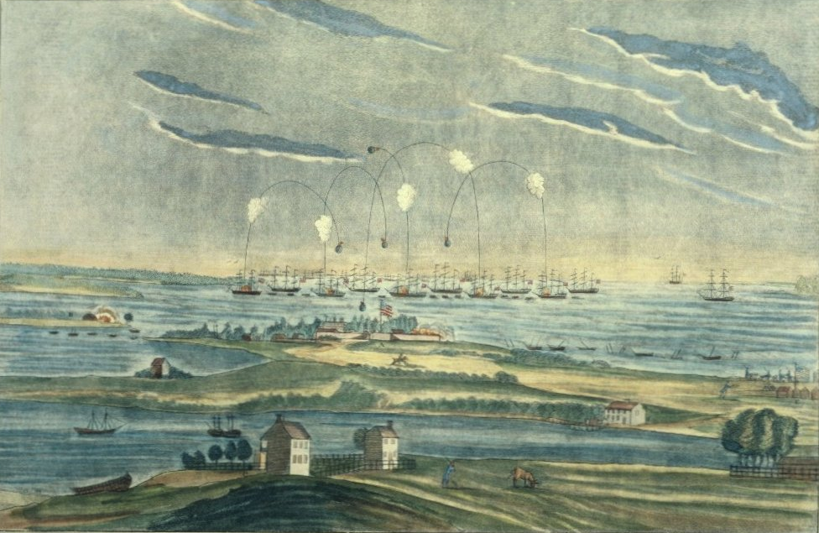
Battle at Fort McHenry, where Francis Scott Key was inspired to write “The Star Spangled Banner”

Slide 28
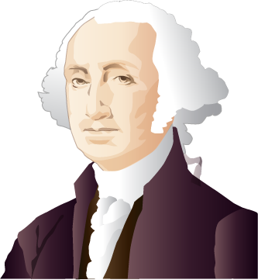
WAR OF 1812 RESULTS
Long-Term Effects for War of 1812:
The war reinforced the belief that a policy of neutrality was justified.
Native American tribes lost Britain as an ally.
Opposing the war weakened the Federalist Party.
I told you… Neutrality is the way to go!

Slide 29
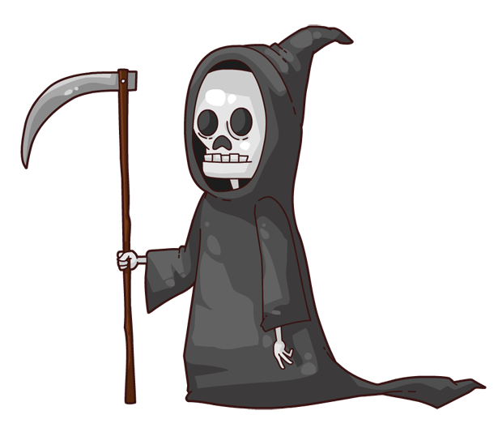
FATE OF THE FEDERALISTS
HARTFORD CONVENTION
The Federalist were opposed to the war. Radical Federalists secretly met and discussed the possibility of voting on secession.
Their talks of secession reached Washington, D.C. at the same time as the news of the peace treaty and Jackson’s victory.
That combination embarrassed the Federalists, who were mocked as traitors. The voters punished the Federalists in the elections that followed. By 1820, the Federalist Party was…
DEAD

Slide 30
WHAT WE
LEARNED TODAY:
Why did the United States go to war with Britain, and what was the outcome of that war?

