Slide 1
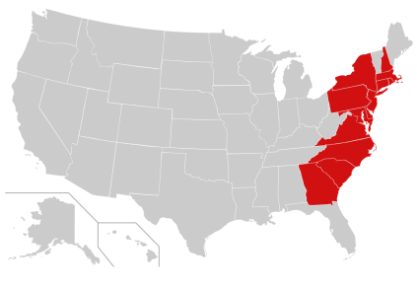
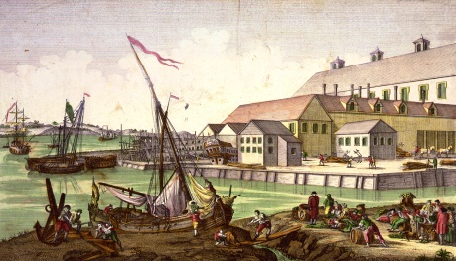
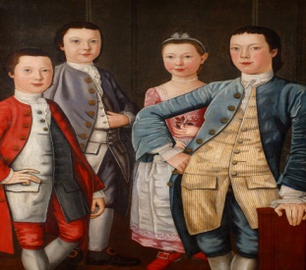
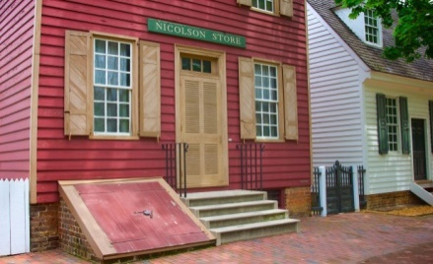
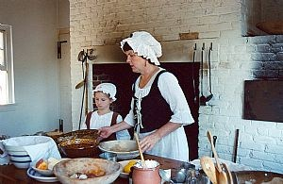
the 13 Colonies:
New England, Middle & Southern
The American Experience
Unit 1: Rebels and Outcasts
Module 1: Beginnings of American Identity

Slide 6
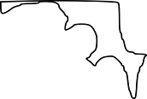

Slide 42
Because of its cold climate and rocky soil, colonists in this region turned to other economic resources to make a living?
New England

Slide 43
Colonists in this region lived the most isolated lives of the three because they were spread out on large farms?
Southern

Slide 44
This region enjoyed the greatest diversity of religion and ethnic backgrounds?
Middle

Slide 45
Slavery, while it existed in all 3 regions, took the greatest hold here because of the need for farm labor?
Southern

Slide 46
This region had the least amount of religious tolerance?
New England

Slide 47
This region contained two of the largest cities in Colonial America?
Middle

Slide 48
This region was the least involved in the Atlantic trade network?
Southern

Slide 49
Despite their differences what did colonists in all 3 regions have in common?
Democratic governmental tendencies
Better standard of living
Better health

