Slide 1
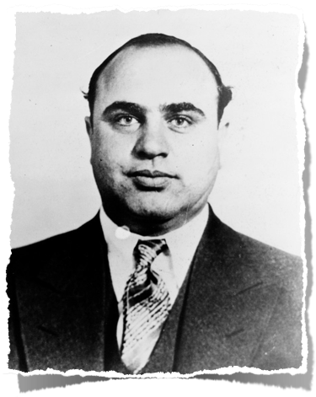
WHO? WHAT? WHY?

Slide 2
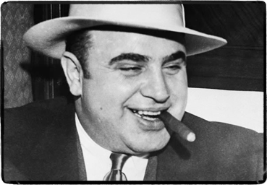
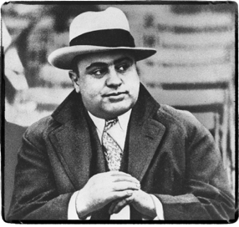
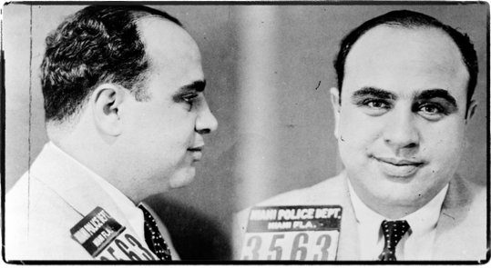

Slide 3
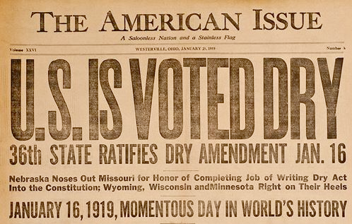
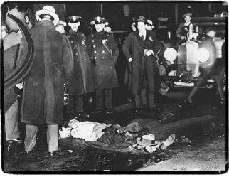
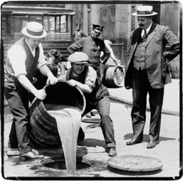

Slide 4
THE JAZZ AGE:
TWENTIES SOCIETY

Slide 5
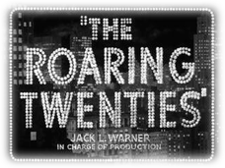
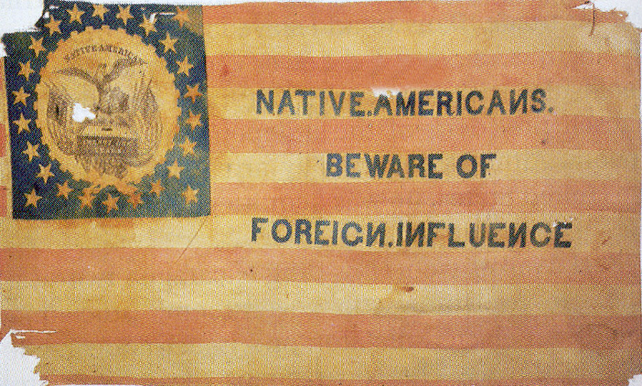
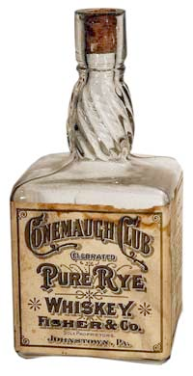
The 1920s was a decade of DRAMATIC social change that forever revolutionized Modern American Society!
THE RED SCARE
NATIVIST REVIVAL
FUNDAMENTALISM
PROHIBITION

Slide 6
Let’s begin with
THE RED SCARE

Slide 7
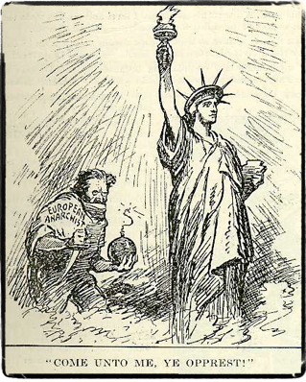
ANTI-COMMUNISM & ANARCHY
World War I caused Americans to favor isolationism & nativism
Americans wanted to stay out of world affairs, distrusted foreigners
Americans began to root out suspected threats at home
many worried that communism would spread to US & overthrow the gov
a US communist party forms & many panic over a “Red” plot
When anarchists mail bombs to important officials, the gov acts

Slide 8
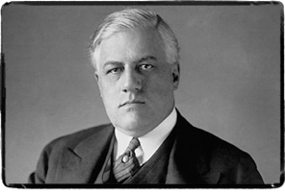
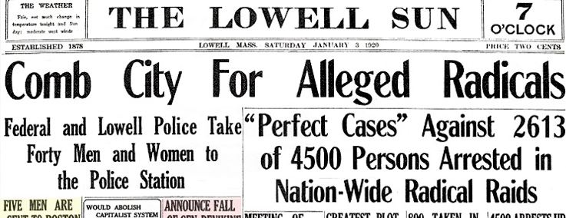
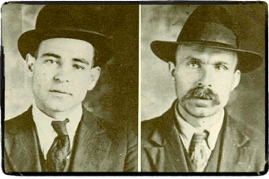
ROOTING OUT THE DANGER
Attorney General A. Mitchell Palmer went after the threat
THE PALMER RAIDS
Palmer and fed. authorities hunted suspected Reds and anarchists
the raids violated people’s legal rights & failed to find evidence
SACCO & VANZETTI TRIAL
two Italian immigrants & anarchists charged w/ murder w/o evidence
both were convicted & executed, some say b/c they were anarchists

Slide 9
NEXT, LET’S LOOK AT THE
NATIVIST REVIVAL

Slide 10
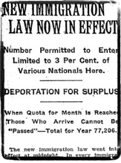
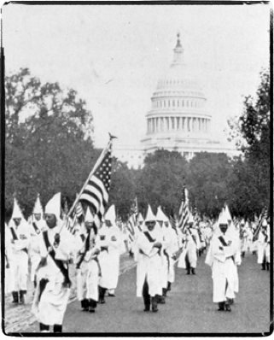
“AMERICA FOR AMERICANS”
The Nativist movement resurged in post-war America
Americans saw immigrants as a threat in the workforce, in society
THE QUOTA SYSTEM
Emergency Quota Act of 1921 put limits on number of immigrants from certain undesirable countries
RESURGENCE OF THE KKK
KKK membership exploded as it pushed nativist agenda and intimidated immigrants with violence

Slide 11
next up...
PROHIBITION

Slide 12
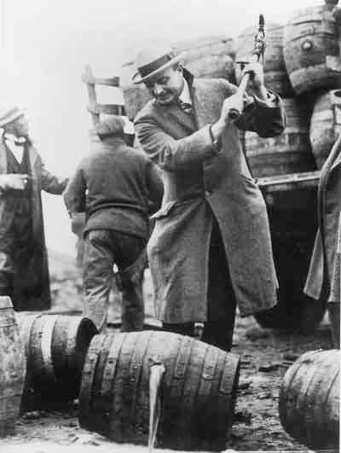
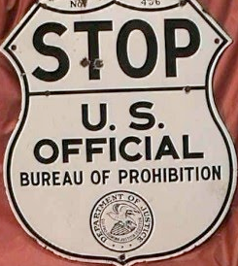
AMERICA GOES DRY
1920 - The 18th Amendment is enacted and alcohol is illegal
the law banned the manufacture, sale, and transport of alcohol
Prohibition was a victory for the temperance movement
however, it was hugely unpopular
The help enforce the law, the Volstead Act was passed
The prohibition bureau was underfunded and undermanned, so the law was difficult to enforce

Slide 13
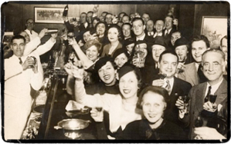
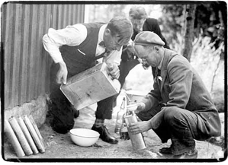
AMERICANS BREAK THE LAW
Prohibition was both unpopular and easy to get around
speakeasies
password-entry underground bars
BOOTLEGGING
Americans distilled their own liquor or bought it from smugglers
ORGANIZED CRIME
every major city had a network of criminal groups b/c of prohibition.
the groups made $$ selling liquor, often killing to keep control.

Slide 14
ANALYSIS: PROHIBITION

Slide 15
last but not least,
FUNDAMENTALISM

Slide 16
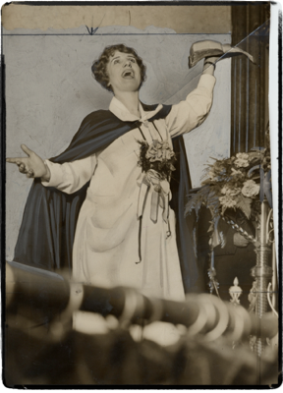
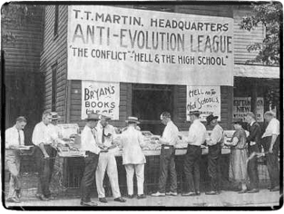
CHANGE & TRADITION CLASH
Christian fundamentalism emerged during the 1920s
the movement believed in a strict interpretation of the Bible
Fundamentalists resisted modern change and science
they reinforced Christian morals
Controversially, they denied Darwin’s evolution theory
the theory that man evolved from apes was blasphemous b/c the Bible states that God created man

Slide 17
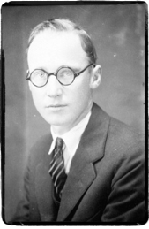
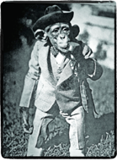
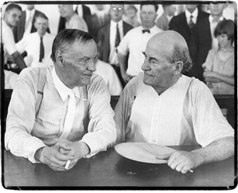
THE SCOPES TRIAL
1925 - Tennessee made it illegal to teach evolution
John T. Scopes, a HS biology teacher, is charged w/ teaching it
Scopes is defended by Clarence Darrow of the ACLU
William Jennings Bryan is the prosecutor in the case
the case itself becomes a symbol of the clash b/w modern & traditional, religion & science in the Roaring Twenties

Slide 18
ANALYSIS: THE SCOPES TRIAL

