Slide 1
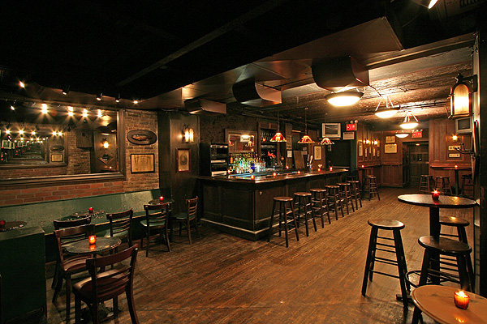
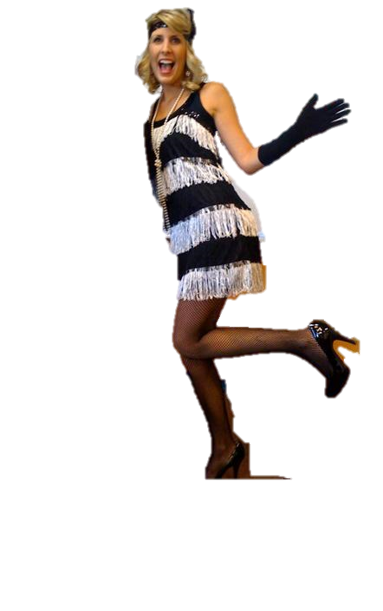



Bell Ringer
If you owned a credit card what are 3 items you would buy right away?
& Vocab
CONTENT VOCABULARY
Flapper
Model T
-Installment Plan
-Consumerism
-Art Deco
ACADEMIC VOCABULARY
Culture
Prosperity

Slide 2
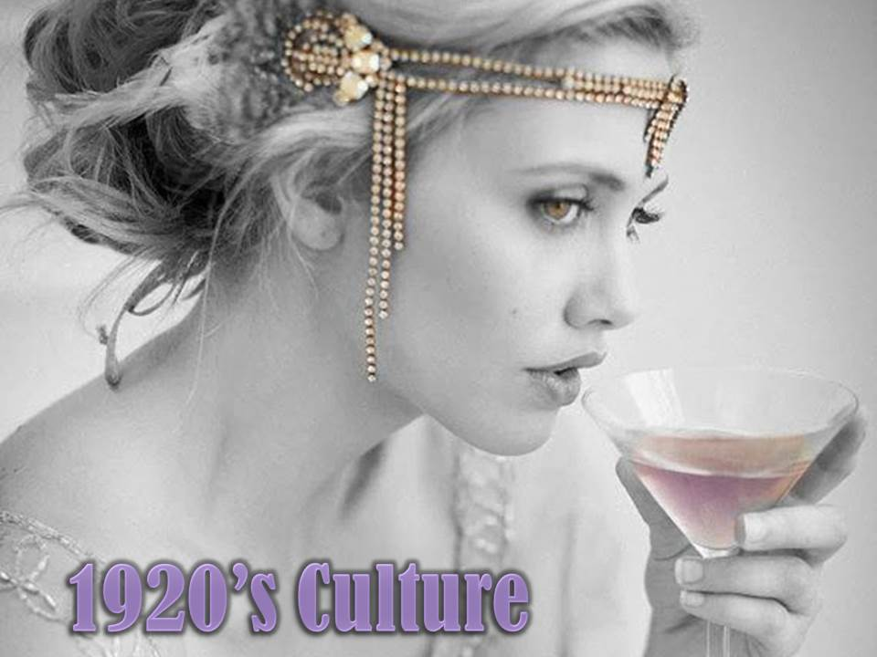
Chapter 7.2

Slide 3

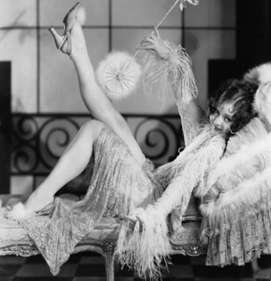
Jazz Age
The 1920's were a prosperous time known as the Roaring Twenties, the Jazz Age, and the Age of Wonderful Nonsense.

Slide 4

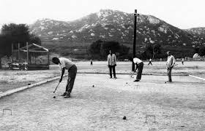
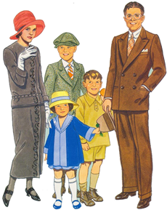
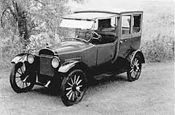
Economic Prosperity
$$$
1920-1929 some of the most prosperous days in US History
Americans owned 40% of the world’s wealth
People’s income increased by 35% on average
Created leisure time
$$$

Slide 5
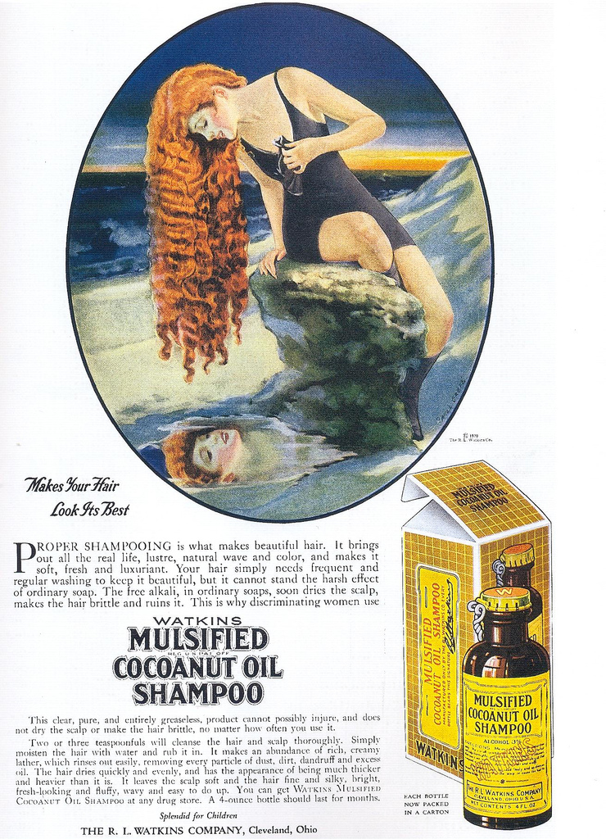
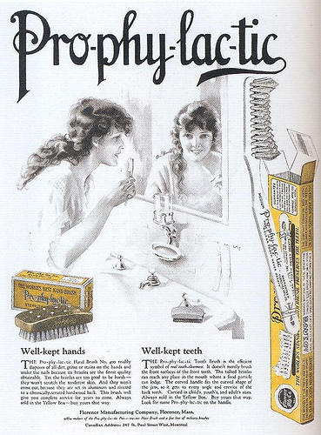
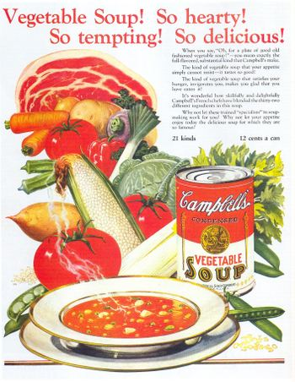
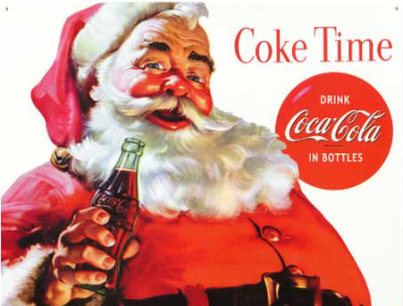
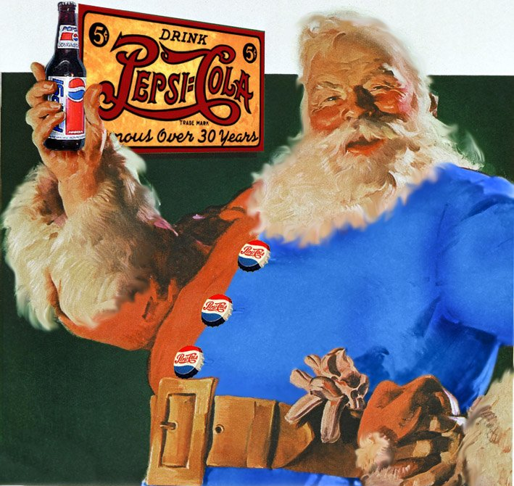
Consumerism
$$$
Consumerism Became a Major Facet of American Life
Due to the growth of mass production techniques during the 20s, there was in increase in advertising.
Ads Used Sexuality to Sell
Especially Female Sexuality
$$$

Slide 6
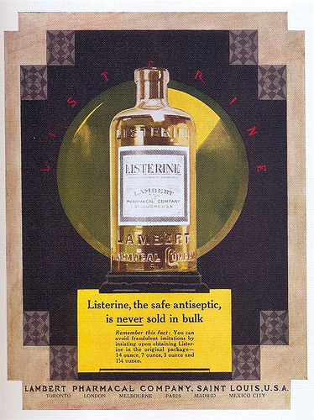

Slide 7
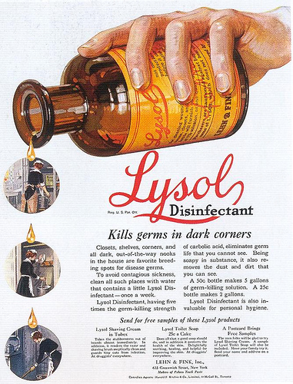

Slide 8
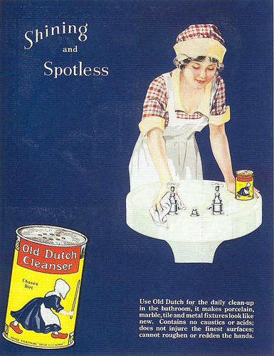

Slide 9
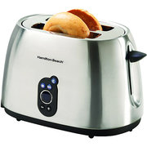
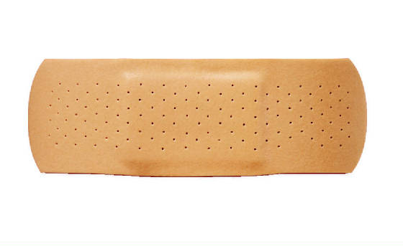

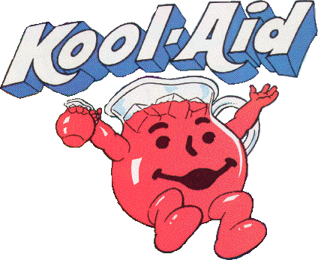

NEW 1920s Products
Q-Tips
Band-Aids
Toasters
Electric Razors
Tissues
Oscar Meyer Wieners
Gum
Jello
Kool-Aid
Kool-Aid
Hair Dryer
Zippers
Scotch Tape
Canned Spaghetti Sauce
Cracker Jacks
Slice Bread

Slide 10


Buying on Credit
Many people bought refrigerators, cars, etc. with money that they did not have.
This system was called installment buying.
With this system, people could make a monthly, weekly, or yearly payment on an item that they wanted or needed.

Slide 11


Buying on Margin
In the 1920s more people invested in the stock market than ever before.
Stock prices rose so fast that at the end of the decade, some people became rich overnight by buying and selling stocks.

Slide 12

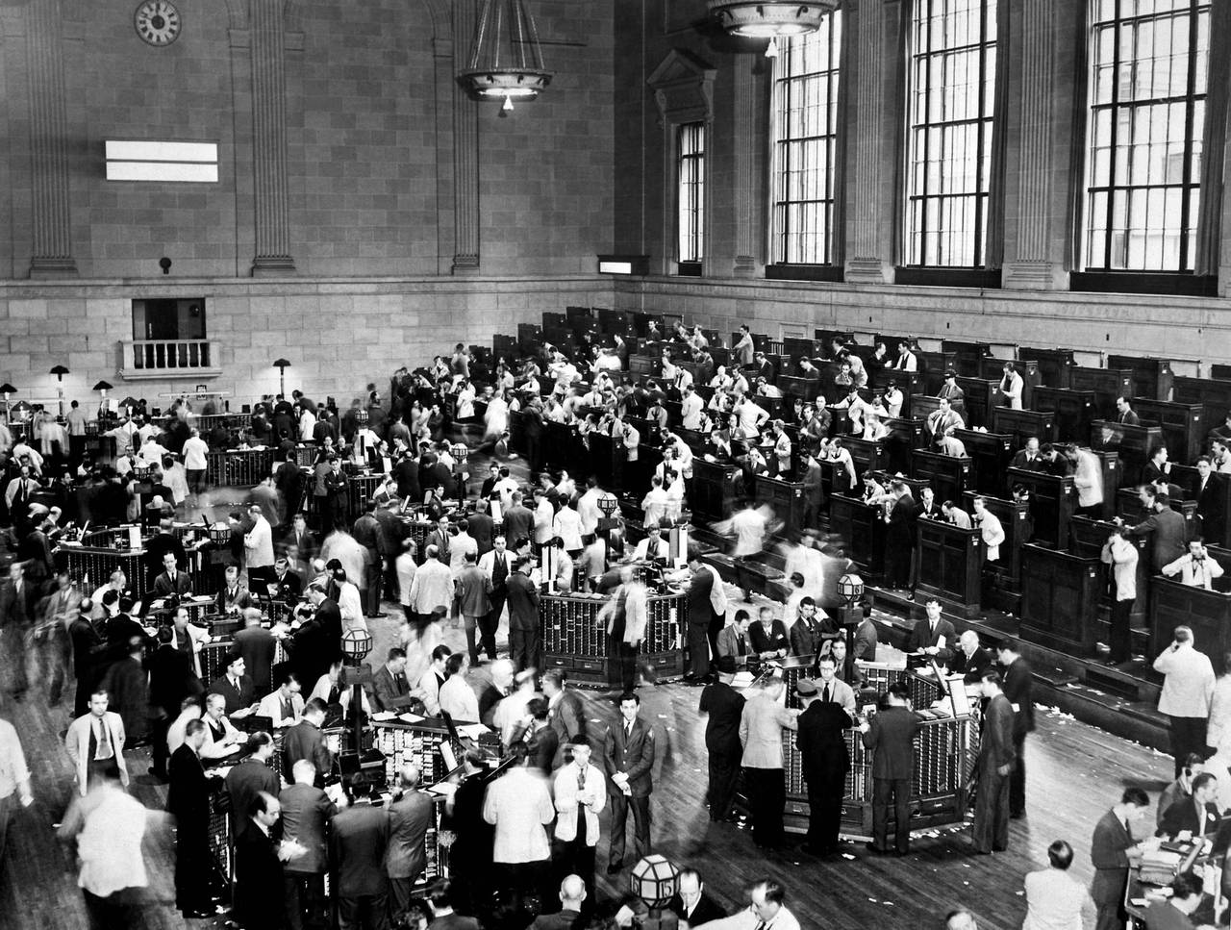

Stock Market
People could buy stocks on margin which was like installment buying.
You could buy stocks for only a 10% down payment! The buyer would hold the stock until the price rose and then sell it for a profit.
As long as the stock prices kept going up, the system worked.

Slide 13
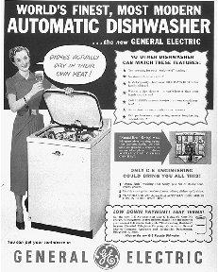
Buying on Credit
Buying on credit was a huge problem in the 1920s.
Since the 20s was a period of great economic boom, not many people took the future into consideration.

Slide 14

Checking for Understanding
How was the economy during the 20s?
prosperous

Slide 15
Checking for Understanding
Why did the advertising industry increase during the 20s?
Due to mass production techniques

Slide 16
Checking for Understanding
What problems might develop from buying on credit?
It is creating debt

Slide 17
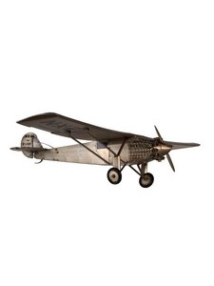
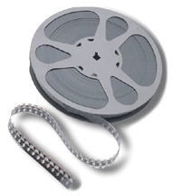
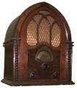
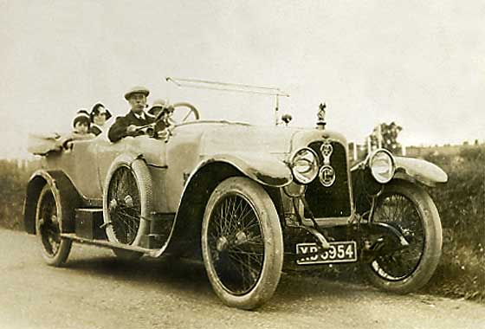
New Technologies
How did mass radios, and movies play a role in popular culture?

Slide 18
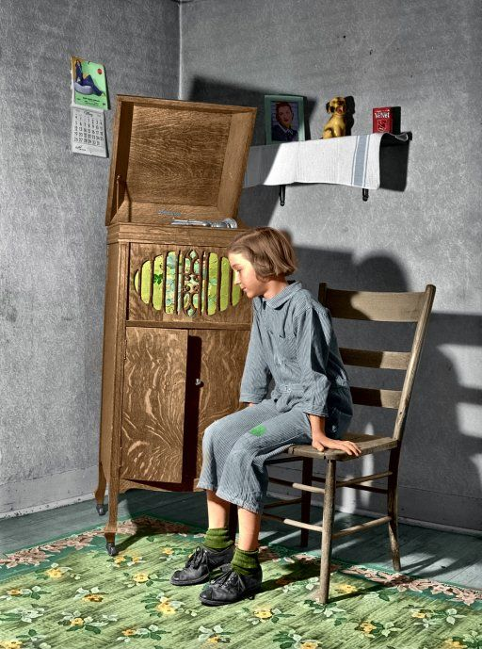
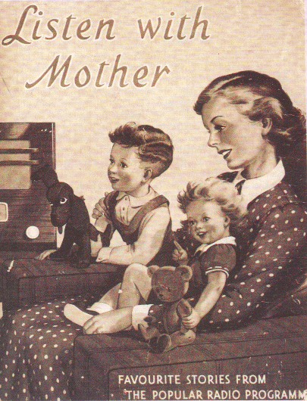
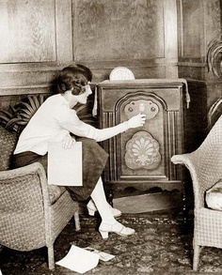
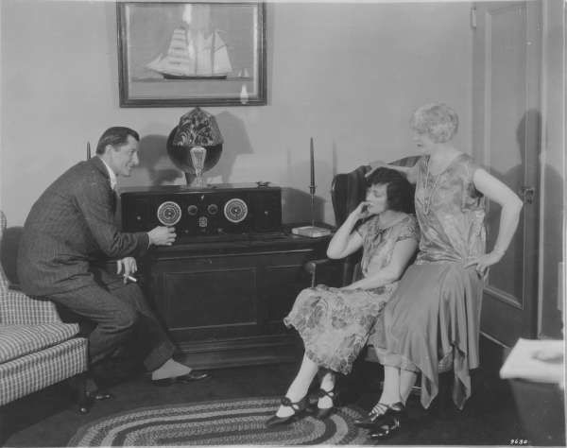
Mass Media: Radio & Music
Was the 1st form of mass media.
Almost overnight radio mania swept the United States.
Every major city had stations broadcasting news, plays, and even live sporting events.
Almost every family owned a radio
Contributed to the world wide diffusion of pop-culture: Helped unify the nation

Slide 19

Silent Movies
Silent movies became "talkies" when sound was finally added.
Charlie Chaplin, the Little Tramp, was one
of the most famous stars in motion-picture history

Slide 20
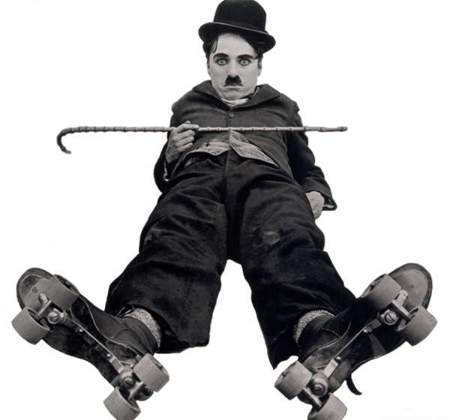
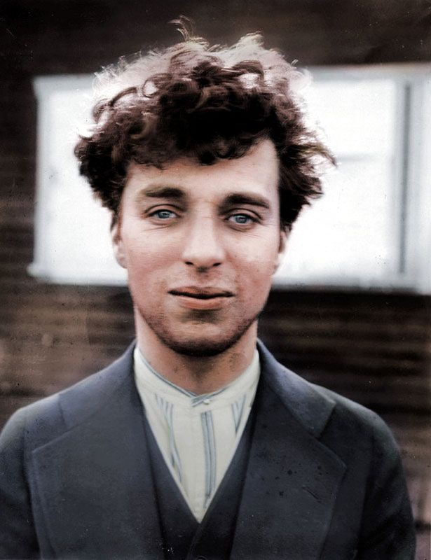


Slide 21
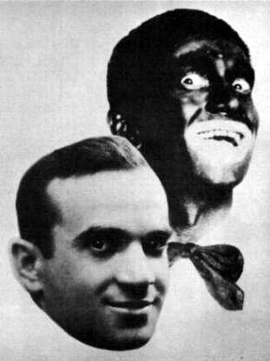
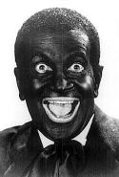
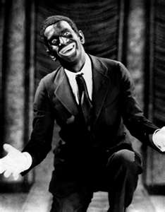
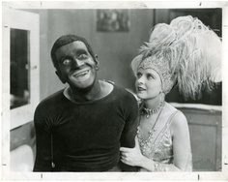
1927- First movie with sound was "Jazz Singer."
Why does he look so funny?

Slide 22
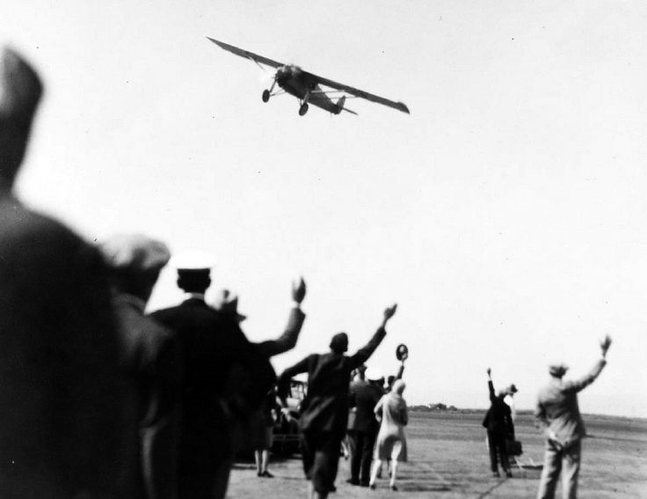
Airplanes
1903: The wright brothers flew first motorized plane
1927: Charles Lindberg- First solo flight across the Atlantic Ocean

Slide 23

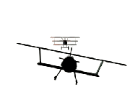
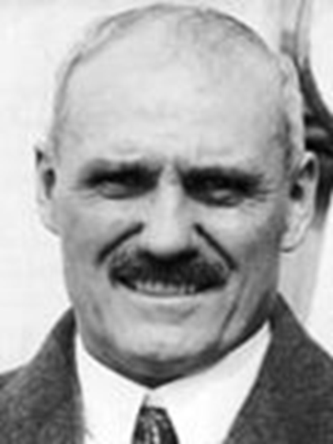
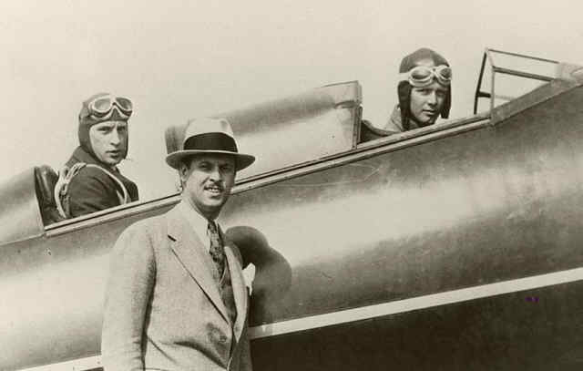
Ortega Prize- 1927
In 1919, a wealthy hotel man, Raymond Orteig, offered a prize of $25,000 to anyone who could fly from New York to Paris. Several pilots tried for the prize. No one collected.
By 1927, competition got fierce. Besides the money, everyone knew there would be much glory for the pilot who first crossed the Atlantic Ocean.
In mid-May, three planes were being made ready. Newspapers were full of their stories. The competition had captured the imagination of people on both sides of the Atlantic.

Slide 24
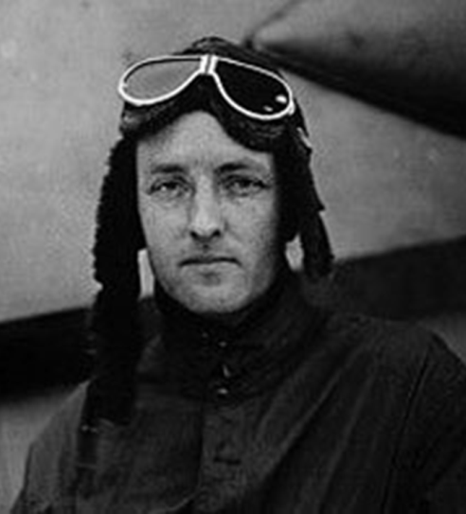
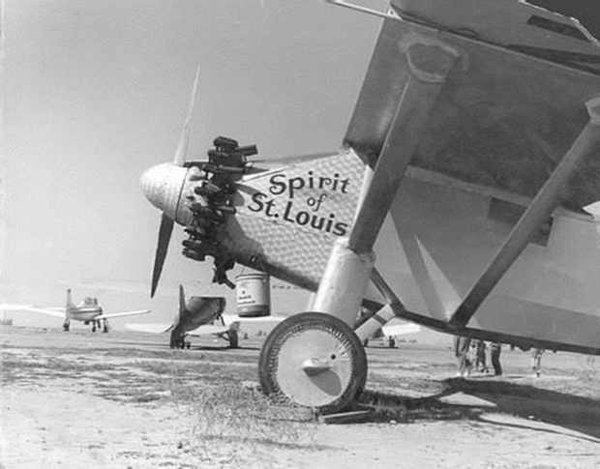
Ortega Prize- 1927
Most of the newspaper attention focused on Richard Byrd, who was famous for his past attempts. His plane had three engines and a well-trained crew.
.
The second plane, with two engines, was to be flown by two experienced pilots.
The third plane, a small single-engine craft, could hold only one person. It was called the Spirit of St. Louis.

Slide 25
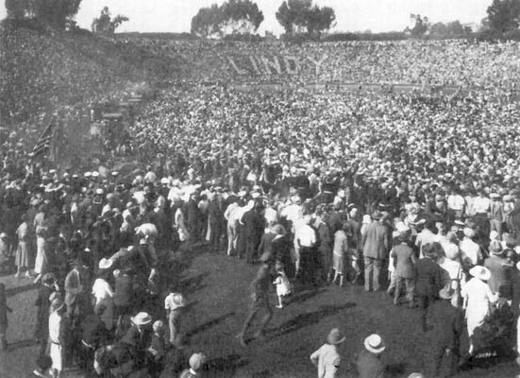
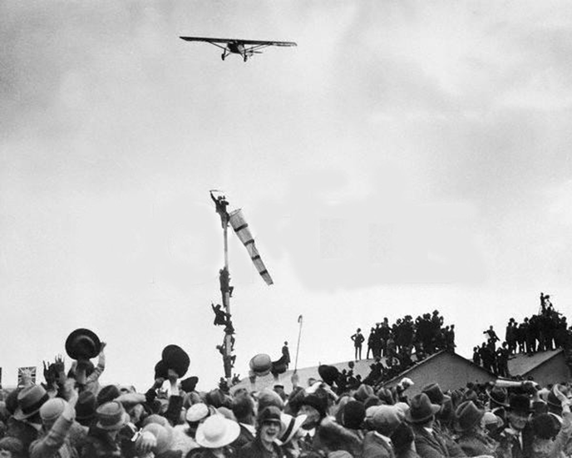
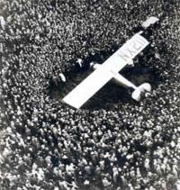
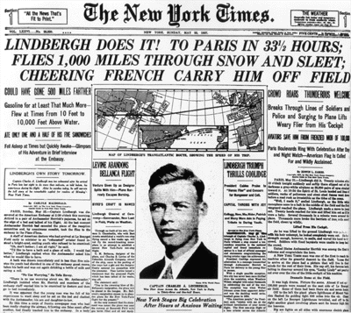
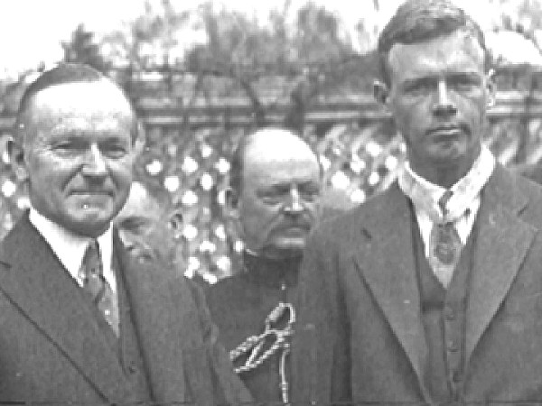
Charles Lindberg
Charles Lindberg was the first man to fly non-stop across the Atlantic Ocean. He became an instant world-wide celebrity
  It had taken less time than he expected, so he was worried that no one would be at the airport to meet him. Then he looked down and saw a mob of people. They were waving and screaming.

Slide 26
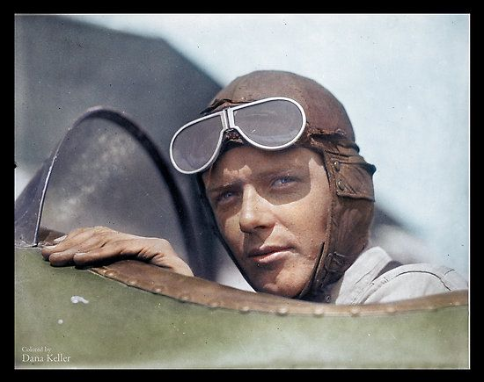
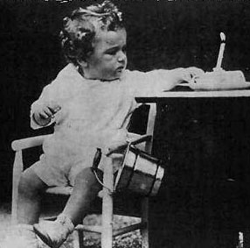
Spirit of St. Louis first solo flight across the Atlantic
Became a world-wide sensation
Lindbergh law: Made kidnapping a federal offense if the victim was taken across state lines
Charles Lindberg

Slide 27
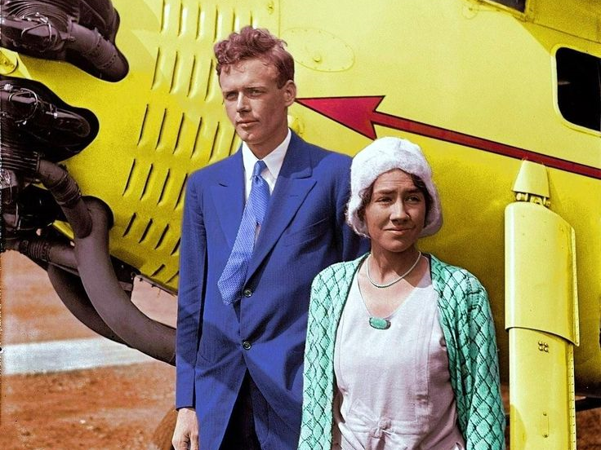

Slide 28
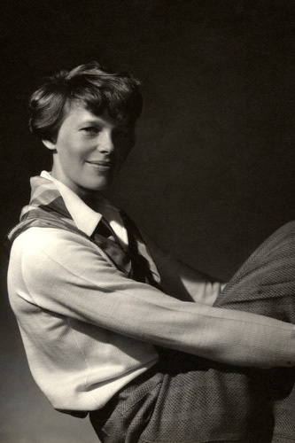
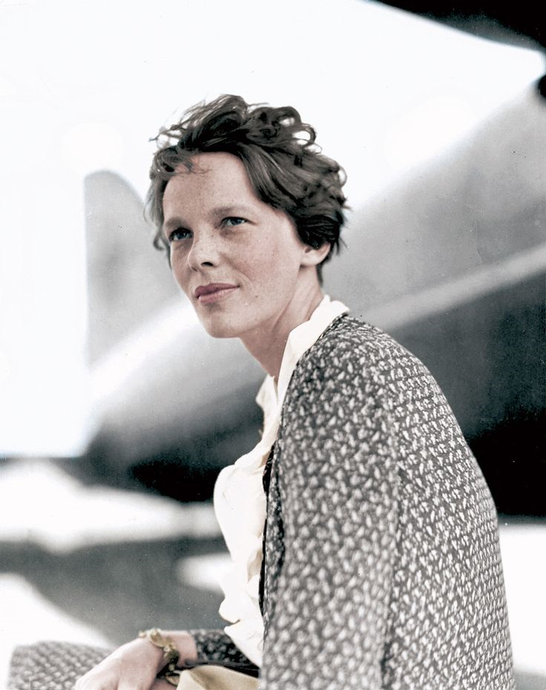



Amelia Earhart

Slide 29

Baseball
1920S: Baseball’s Golden Age
Radio and newspapers helped the enthusiasm for baseball
Cork filled baseballs helped the ball “jump” off the bat
Stadiums were built for the thousands of spectators

Slide 30
Checking for Understanding
How did the radio, mass advertising, and movies effect pop culture?
It led to the diffusions (spread) of popular culture; helped unify the nation

Slide 31
Checking for Understanding
What was the first form of mass media?
The radio

Slide 32

How did the mass production of the automobile affect modern society?
Model T

Slide 33





Model T Changes Culture
Henry Ford began mass production of the "Model T" automobile, the first car priced so the average man could afford one.
54:00

Slide 34


The Automobile Alters Society
After WWI prices of cars dropped
Created factory jobs in the Midwest
They were now affordable to the middle class
Increaser auto use by the average family led to lifestyle changes.
More people traveled for pleasure
People began to commute to work (lived in suburbs)
Women and teens had more independence

Slide 35

Women

Slide 36


What is Women’s Suffrage?
Answer: Right of women to vote

Slide 37

Women’s Suffrage
World War I had disrupted traditional social patterns.
After the War, women’s suffrage became law in many countries including the United States, Britain, Germany, Sweden, and Australia due to their contributions during the war
1920: 8.2 million voter increase from 1916

Slide 38







What are some differences between
these women's demeanor and appearance?
Gibson Girl
3 examples
1880s
1920s

Slide 39


Flappers
Considered as rebels
Cut their hair short
Wore short dresses
Wore make-up
Single
“Working Girl”
Smoked cigarettes
Partied
The Sexualized woman
Scandalous
Danced- Charleston
http://www.youtube.com/watch?v=5J-ckIsitpI

Slide 40





Slide 41






Slide 42






First Miss America Pageant-1921
Miss America 1921
Margaret Gorman

Slide 43


The Charleston
In the 1920's, women who did the Charleston were called "Flappers" because of the way they would flap their arms and walk like birds while doing the Charleston.

Slide 44
New Morality
The rise of young, single women in the workforce brought a new perspective on how women participate in society – as laborers and consumers.
But DON’T expect equal pay
The rise of women attending college altered views of the intellectual status of women and increased their independence.
The automobile allowed young people a chance to escape the confines of their parents’ home and gain their independence with increased private socializing opportunities.

Slide 45
Checking for Understanding
Why was the Model T so affordable?
Ford’s efficient assembly line

Slide 46
Checking for Understanding
Why did people begin to move from the center of the cities in the 20s to suburbs?
The car allowed them to live further from work

Slide 47
Checking for Understanding
Where are most of the car factory jobs?
Midwest

Slide 48
Checking for Understanding
What influenced the Women’s suffrage movement?
Women’s contributions during WWI

Slide 49
Checking for Understanding
What amendment gave women the right to vote?
19th Amendment

Slide 50
Checking for Understanding
How were flappers a “different” type of women?
The challenged societies norms
Partied, shorter skirts, drank, danced

Slide 51


What art styles were popular after WWI?
Artists rebelled against earlier realistic styles of painting.
They wanted to depict the inner world of emotion and imagination rather than show realistic representation of objects
Styles that were dream like or not so literal

Slide 52
20s Art Styles
Les Fauves
Focused more on the colors used in the painting, rather than making sure the painting “looked like” the subject
Cubism
Pioneered by Pablo Picasso. Objects are broken up, analyzed, and re-assembled in an abstracted form
Surrealism
An art movement that sought to link the world of dream with real life, was inspired by Freud's ideas.
Art Deco
Art Deco was an innovative design style popular in the 1920s and 1930s. Its sleek, streamlined forms conveyed elegance and sophistication
http://www.picassohead.com/create.html

Slide 53

Les Fauves-
Henri Matisse – Woman With A Hat

Slide 54

Les Fauves- Red Room

Slide 55





Slide 56


Cubism

Slide 57

Synthetic Cubism

Slide 58


Cubism

Slide 59

Surrealism
Max Ernst

Slide 60




Surrealism- Salvador Dali

Slide 61


Slide 62


Slide 63


Slide 64






Slide 65


Slide 66



Slide 67






Slide 68

Revolution
In the ARTS
REVIEW

Slide 69

Surrealism

Slide 70

Les Fauves

Slide 71

Art Deco

Slide 72

Cubism

Slide 73

Les Fauves

Slide 74

Surrealism

Slide 75

Art Deco

Slide 76

Cubism

Slide 77

Cubism

Slide 78
Art Deco

Slide 79

Surrealism

Slide 80
Checking for Understanding
What art style focused on streamline & sleek shapes?
Art Deco

Slide 81



Conclusion
The 1920s was a carefree lifestyle
  Economic prosperity
  Diffusion of popular culture
  Easy credit
  New forms of entertainment
  New consumer products
  Freedom of the car
  Women’s Suffrage

