Slide 1
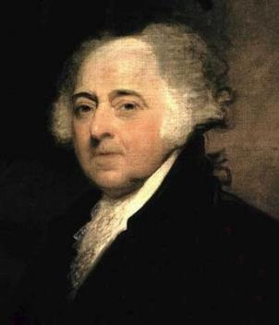
The Presidency of John Adams
EQ – How did John Adams confront internal & international conflicts during his presidency?

Slide 2
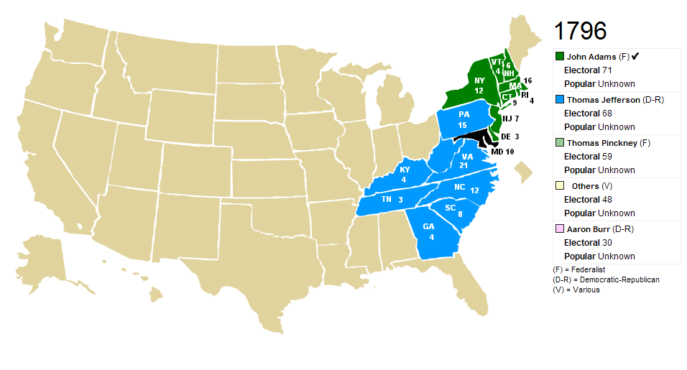
1796
Adams elected President
1 – What problems did this election underscore?
Jefferson, the second place finisher, became Adams’ Vice-President
1

Slide 3
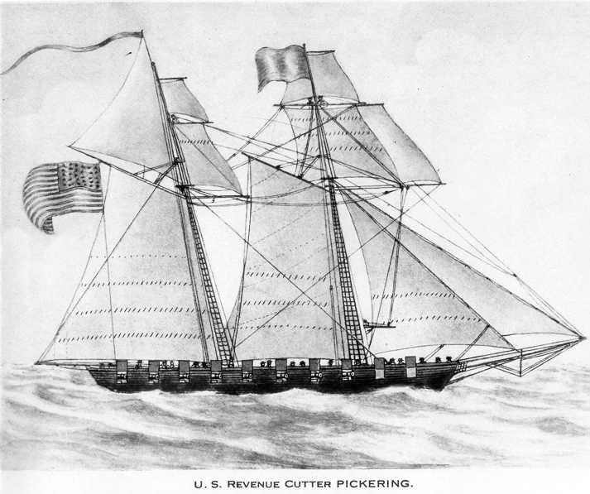
1796
XYZ Affair
2 – What effect did this have on US-French relations?
Hurt US-French relations; fought against French ships (Quasi War)
2

Slide 4
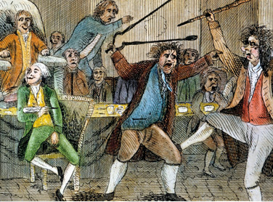
1798
Alien & Sedition Acts
3 – What measures were contained in these acts?
Immigrants who criticize or publicly discredit the government can be arrested & deported
3
Which party passed this law?
How did this law help this party?

Slide 5
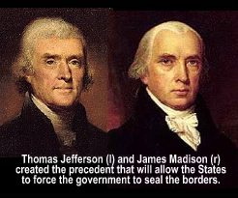
1798
Virginia and Kentucky Resolutions
4 – What did these resolutions declare?
Declared the Alien & Sedition Acts unconstitutional
4
Who wrote these controversial resolutions?
Why does this cause a problem?

Slide 6
Adams wins the Presidency in the Election of 1796
5
French attack US ships (impressment)
6
XYZ Affair
7
Quasi War (undeclared naval war)
8
Alien & Sedition Acts
9
Virginia & Kentucky Resolutions
10
Jefferson is elected President (1800)
11
What was the effect of Adams’ Presidency on the nation?

Slide 7
Policy Issues for President Adams Cause-and-Effect Activity
Analyze the two given concepts and decide how the first concept caused the second concept
Though you may need to define the term, be sure to write the cause in the box between both terms, NOT the definition!
Jay Treaty (1794)
Ask yourself…
French impressment of American ships
How did the Jay Treaty cause (or lead to) French impressment of American ships?

Slide 8
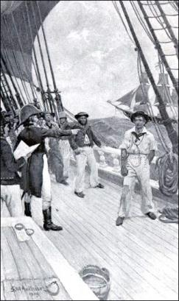
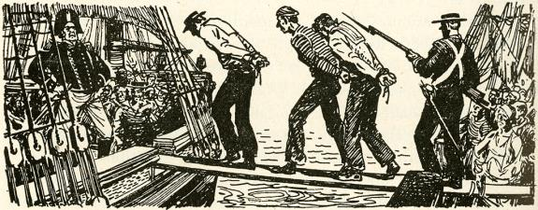
Policy Issues for President Adams
Jay Treaty (1794)
French impressment of American ships
French feel betrayed because the US signed a treaty with Britain

Slide 9
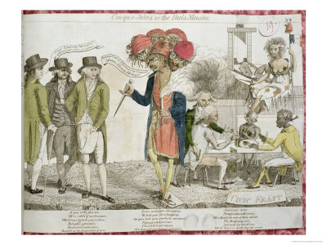
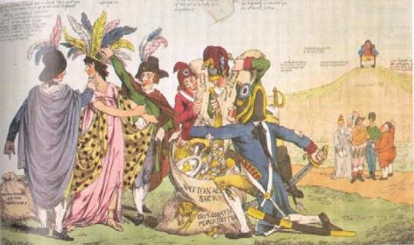
Policy Issues for President Adams
French impressment of American ships
XYZ Affair
Adams sends men to negotiate peace, but French officials demand humiliating bribes

Slide 10
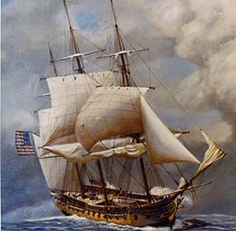
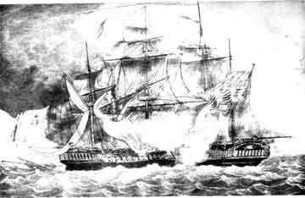
Policy Issues for President Adams
XYZ Affair
Quasi War
Insulated, the US expands the navy & fights an undeclared war with France

Slide 11
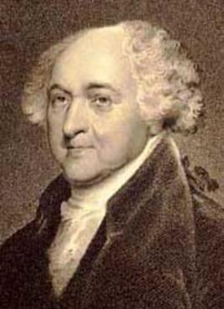
Policy Issues for President Adams
Quasi War
Alien & Sedition Acts
Since most immigrants were French, US begins to arrest & deport those who criticize the government

Slide 12
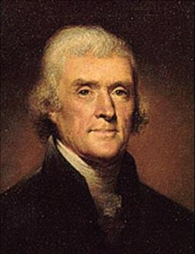
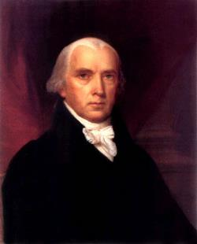
Policy Issues for President Adams
Alien & Sedition Acts
Virginia & Kentucky Resolutions
Most immigrants supported the D-R’s, so Jefferson & Madison declare the controversial law unconstitutional

Slide 13
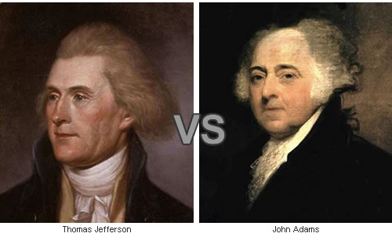
Policy Issues for President Adams
Virginia & Kentucky Resolutions
Election of 1800
Alien & Sedition Acts are unpopular, leading to Adams losing his bid for re-election

Slide 14
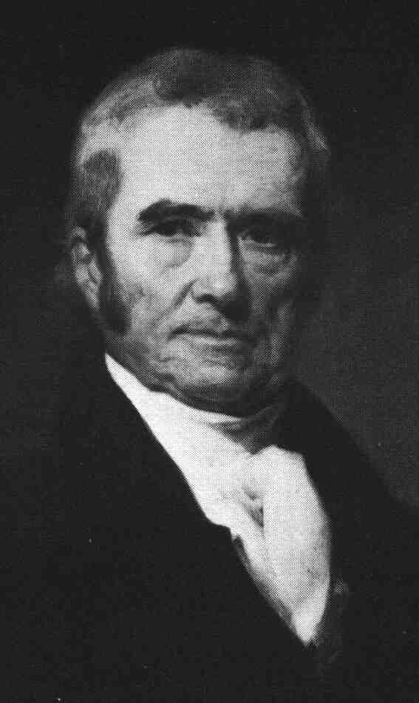
Marbury v. Madison and the “Midnight Judges”
What does Chief Justice John Marshall say is the main duty of the judiciary?
How does Alexander Hamilton uphold the principle of judicial review?
On what point do Marshall and Hamilton disagree?
Chief Justice John Marshall

Slide 15
Quick Assessment
What was the impact of the Virginia and Kentucky Resolutions?
While President, what was Washington’s foreign policy?
What laws gave the U.S. the power to deport immigrants who criticized the government?
Marbury v. Madison established what principle?
How did Jay’s Treaty possibly lead to the XYZ Affair?

