Slide 1
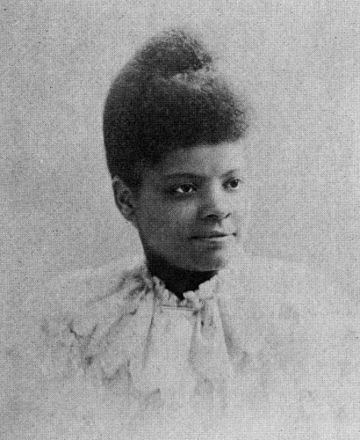
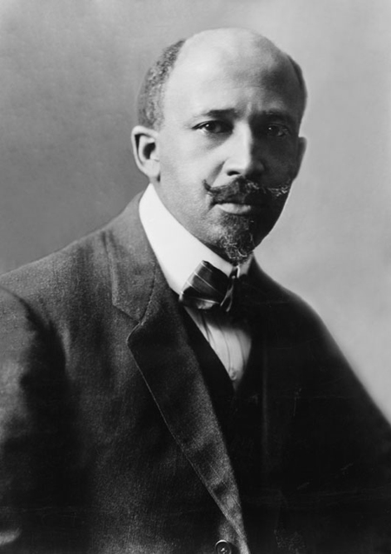
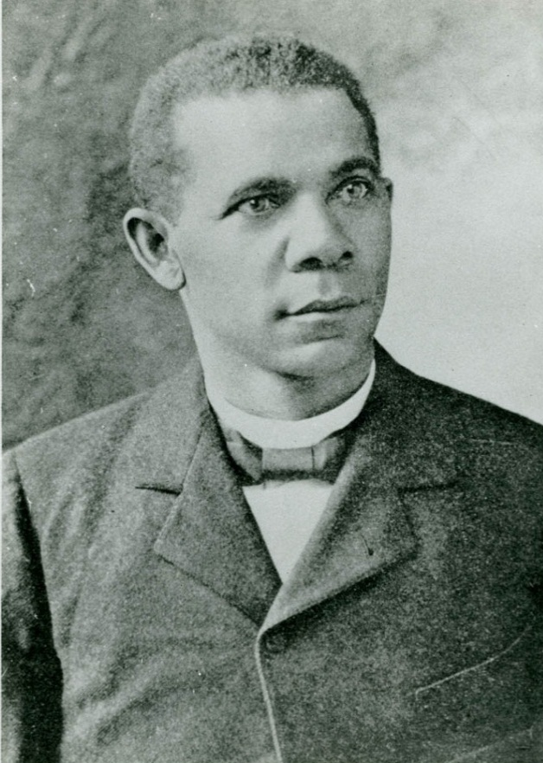
Objective: To examine the contributions of African-American reformers.
Ida B. Wells
W.E.B. DuBois
Booker T. Washington
Notes:
Source:
"File:Ida B. Wells Barnett.jpg." Wikimedia Commons, the free media repository. 4 Nov 2014, 02:38 UTC.25 Jul 2017, 20:48
<https://commons.wikimedia.org/w/index.php?title=File:Ida_B._Wells_Barnett.jpg&oldid=138569758>.
"File:WEB DuBois 1918.jpg." Wikimedia Commons, the free media repository. 7 Oct 2016, 15:51 UTC.25 Jul 2017, 20:49
<https://commons.wikimedia.org/w/index.php?title=File:WEB_DuBois_1918.jpg&oldid=209070918>.
"File:Booker T. Washington circa 1915.jpg." Wikimedia Commons, the free media repository. 24 Nov 2016, 16:53 UTC.25 Jul 2017, 20:50
<https://commons.wikimedia.org/w/index.php?title=File:Booker_T._Washington_circa_1915.jpg&oldid=218734774>.

Slide 2
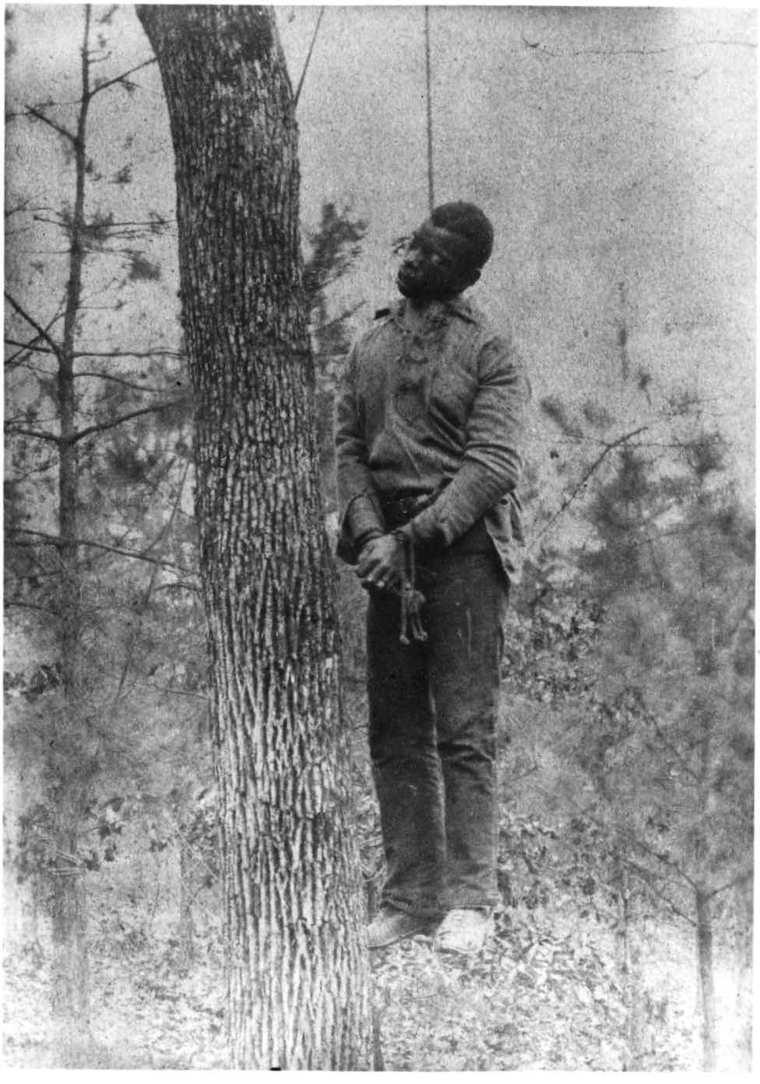
Background: In the 1890’s lynch mobs murdered over 1,000 African Americans, mainly in the South.
Movie: Without Sanctuary
Lynching victim, southern USA, ca. 1889
Notes:
Source: "File:Lynching-1889.jpg." Wikimedia Commons, the free media repository. 28 Feb 2015, 21:54 UTC.25 Jul 2017, 20:51
<https://commons.wikimedia.org/w/index.php?title=File:Lynching-1889.jpg&oldid=151558091>.

Slide 3
“Strange Fruit” by, Billie Holiday
Southern trees bear strange fruit
Blood on the leaves and blood at the root
Black bodies swinging in the southern breeze
Strange fruit hanging from the poplar trees
Pastoral scene of the gallant south
The bulging eyes and the twisted mouth
Scent of magnolias, sweet and fresh
Then the sudden smell of burning flesh
Here is fruit for the crows to pluck
For the rain to gather, for the wind to suck
For the sun to rot, for the trees to drop
Here is a strange and bitter crop

Slide 4
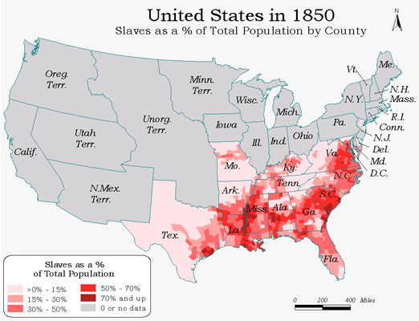
Image courtesy of Digital Initiatives, University Libraries, Northern Illinois University

Slide 5
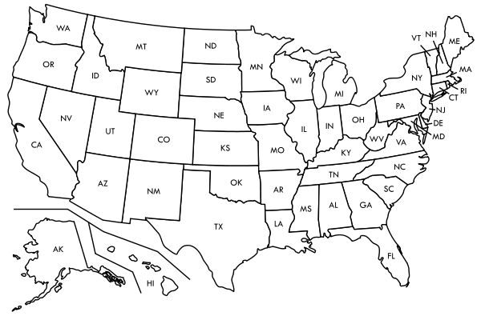
African-American Lynchings in the United States by State (1882 – 1968)
1
0
2
3
4
1
0
0
0
1
1
5
0
2
5
2
6
19
16
28
3
69
14
19
83
2
142
0
3
86
204
156
VT – 0
NH – 0
MA – 0
RI – 0
CT – 0
DE – 1
NJ – 1
MD – 27
40
226
539
299
492
0
335
257
352
0
Notes:
Source: http://law2.umkc.edu/faculty/projects/ftrials/shipp/lynchingsstate.html

Slide 6
African American Reformers
Ida B. Wells
· journalist that used her newspaper Free Speech to protest against anti-black violence
Ida B. Wells-Barnett, a black journalist, was shocked when three of her friends in Memphis, Tennessee were lynched for opening a grocery that competed with a white-owned store. Outraged, Wells-Barnett began a global anti-lynching campaign that raised awareness of the American injustice.
Notes:
Source: "File:Ida B. Wells Barnett.jpg." Wikimedia Commons, the free media repository. 4 Nov 2014, 02:38 UTC.25 Jul 2017, 20:48
<https://commons.wikimedia.org/w/index.php?title=File:Ida_B._Wells_Barnett.jpg&oldid=138569758>.

Slide 7
African American Reformers
· Wells urged African Americans to protest the lynching of three African Americans in Memphis, TN.
Ida B. Wells: Quotations
“OUR country's national crime is lynching. It is not the creature of an hour, the sudden outburst of uncontrolled fury, or the unspeakable brutality of an insane mob.”
“Somebody must show that the Afro-American race is more sinned against than sinning, and it seems to have fallen upon me to do so.”
"One had better die fighting against injustice than to die like a dog or a rat caught in a trap"

Slide 8
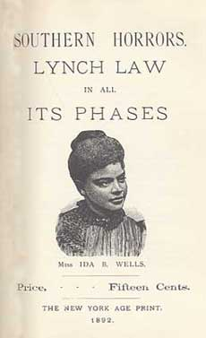
· Wells also urged African Americans to stop riding streetcars or shopping in white stores.
In 1884, Wells was asked to leave the ladies' car and sit in the colored train car. She refused because that car was filled with smokers. Train officials physically forced her to leave; she retaliated but was pushed off the train at the next train stop and was met by a crowd of applauding whites. She engaged in legal recourse and sued the Chesapeake, Ohio and Southwestern Railroad. Although she won in the local court, the Tennessee Supreme Court reversed the decision. During this ordeal, Wells wrote and published her first journalistic piece in the Living Way.
Notes:
Source: "File:Cover Southern horrors.png." Wikimedia Commons, the free media repository. 4 Nov 2014, 02:28 UTC.25 Jul 2017, 20:52
<https://commons.wikimedia.org/w/index.php?title=File:Cover_Southern_horrors.png&oldid=138569404>.

Slide 9
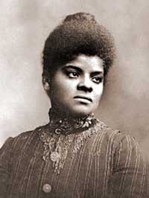
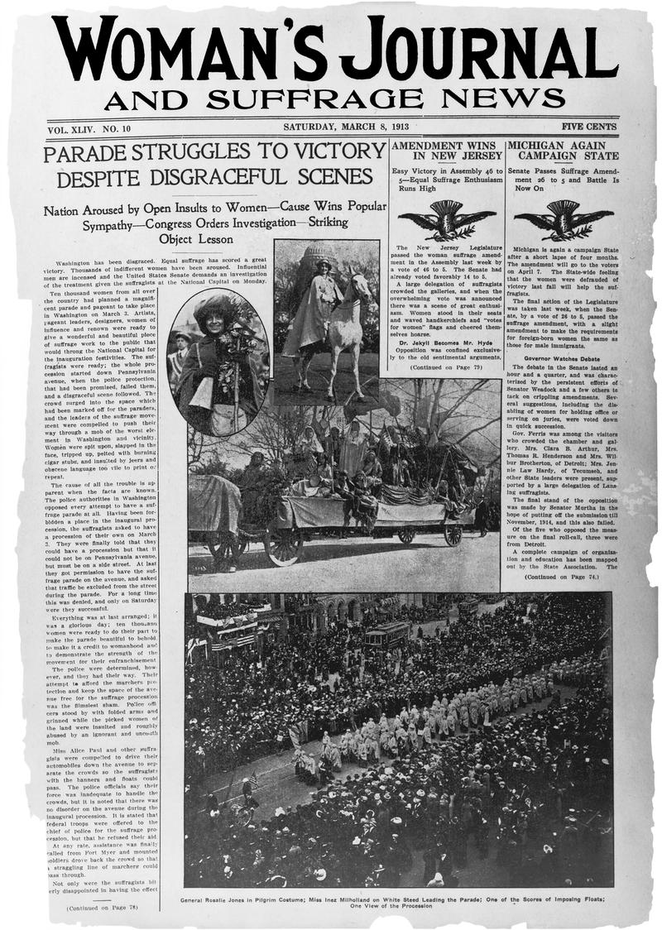
Ida B. Wells successfully integrated the women’s suffrage movement when she refused to walk with the other black women at the rear of the 1913 Washington suffrage parade.
Biography: Ida B. Wells
Iron Jawed Angels – video clip (4:40)
Notes:
Source: "File:Ida-b-wells-barnett1.jpg." Wikimedia Commons, the free media repository. 21 Apr 2015, 19:07 UTC.25 Jul 2017, 20:52
<https://commons.wikimedia.org/w/index.php?title=File:Ida-b-wells-barnett1.jpg&oldid=158304982>.
"File:Woman's Journal of March 8, 1913.jpg." Wikimedia Commons, the free media repository. 24 Jan 2017, 18:50 UTC.25 Jul 2017, 20:54
<https://commons.wikimedia.org/w/index.php?title=File:Woman%27s_Journal_of_March_8,_1913.jpg&oldid=230871668>.

Slide 10
African American Reformers
Booker T. Washington
· a former slave that taught himself how to read
· founded the Tuskegee Institute, still a leading black college today
Notes:
Source: "File:Booker T. Washington circa 1915.jpg." Wikimedia Commons, the free media repository. 24 Nov 2016, 16:53 UTC.25 Jul 2017, 20:50
<https://commons.wikimedia.org/w/index.php?title=File:Booker_T._Washington_circa_1915.jpg&oldid=218734774>.

Slide 11
Booker T. Washington
· wrote about his success in his autobiography Up From Slavery.
* He stressed living in harmony with whites.
* He believed that African Americans needed to learn trades and earn a decent income in order to achieve political and social equality.
Notes:
Source: "File:UpFromSlavery cover.jpg." Wikimedia Commons, the free media repository. 24 Aug 2016, 01:38 UTC.25 Jul 2017, 20:59
<https://commons.wikimedia.org/w/index.php?title=File:UpFromSlavery_cover.jpg&oldid=204674988>.

Slide 12
African American Reformers
W.E.B. DuBois
· African American professor, author and public speaker
* DuBois disagreed with Booker T. Washington’s acceptance of segregation.
Notes:
Source: <https://commons.wikimedia.org/w/index.php?title=File:WEB_DuBois_1918.jpg&oldid=209070918>.
"File:Booker T. Washington circa 1915.jpg." Wikimedia Commons, the free media repository. 24 Nov 2016, 16:53 UTC.25 Jul 2017, 20:50

Slide 13
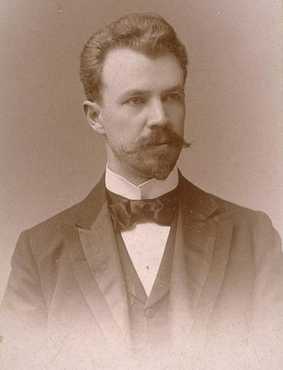
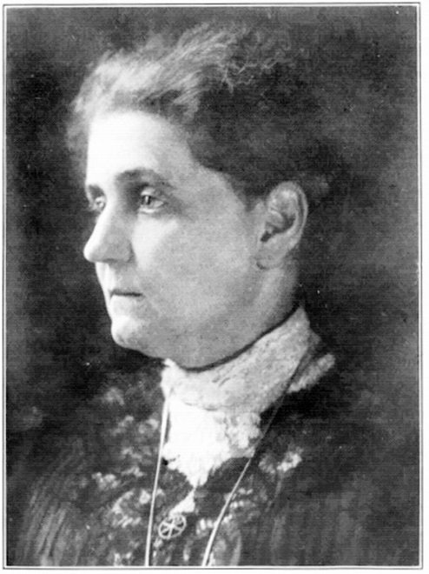
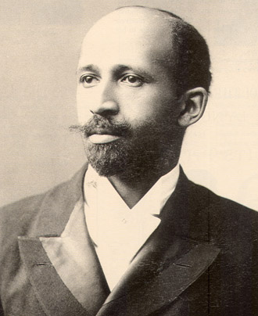
· DuBois formed the National Association for the Advancement of Colored People (NAACP) in 1909 with Jane Addams and Lincoln Steffens.
Lincoln Steffens
Jane Addams
W.E.B. DuBois
Notes:
Source:
"File:WEB DuBois 1918.jpg." Wikimedia Commons, the free media repository. 7 Oct 2016, 15:51 UTC.25 Jul 2017, 21:01
<https://commons.wikimedia.org/w/index.php?title=File:WEB_DuBois_1918.jpg&oldid=209070918>.
"File:Lincoln Steffens.jpg." Wikimedia Commons, the free media repository. 22 May 2015, 15:25 UTC.25 Jul 2017, 21:04
<https://commons.wikimedia.org/w/index.php?title=File:Lincoln_Steffens.jpg&oldid=161449861>.

Slide 14
DuBois v. Washington
W.E.B. DuBois - Rivalry with Booker T. Washington (2:15)
“When Mr. Washington apologizes for injustice, he does not rightly value the privilege and duty of voting, belittles the emasculating effects of caste distinctions, and opposes the higher training and ambition of our brighter minds…we must unceasingly and firmly oppose him.”
– W.E.B. DuBois
“The wisest among my race understand that the agitation of questions of social equality is the extremist folly, and that progress in the enjoyment of all the privileges that will come to us must be the result of severe and constant struggle rather than of artificial forcing.”
- Booker T. Washington

Slide 15
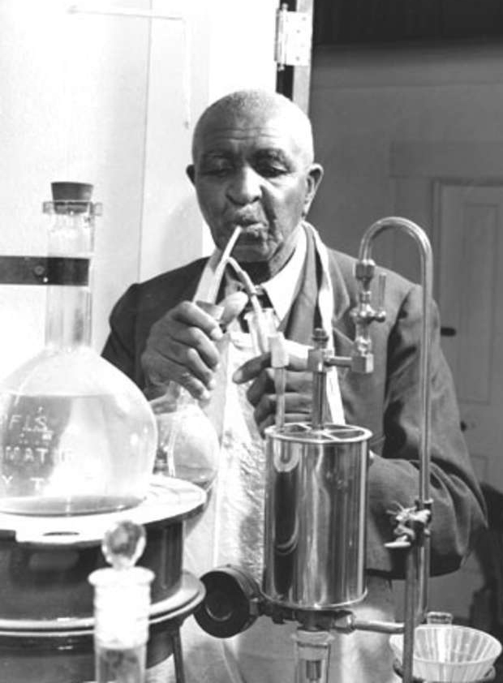
George Washington Carver
· scientist and teacher at the Tuskegee Institute
· discovered hundreds of new uses for Southern crops
Example: peanut butter
List of By-Products From Peanuts By George Washington Carver
Notes:
Source: "File:Carver1web.jpg." Wikimedia Commons, the free media repository. 28 Aug 2016, 19:58 UTC.25 Jul 2017, 21:19
<https://commons.wikimedia.org/w/index.php?title=File:Carver1web.jpg&oldid=205032947>.

