Slide 1
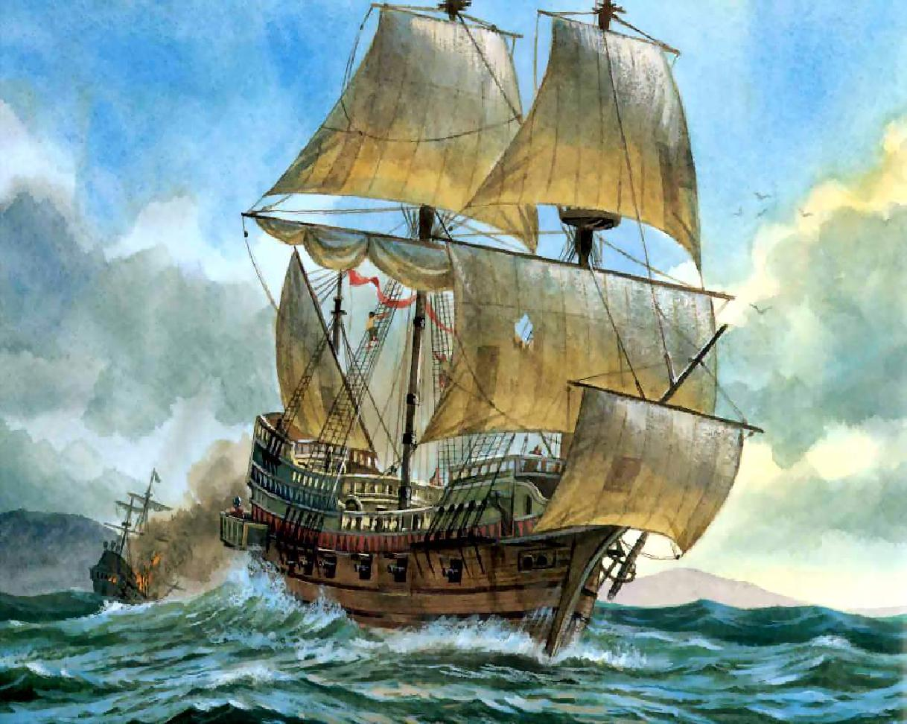
Age of Exploration

Slide 2
Directions
Use your thinking map to follow along and record the information presented in each slide.
For each topic area, you will listen and take brief notes so that you can discuss each section.
You may ask questions at any point by raising your hand quietly.

Slide 3
Causes of Exploration
Sea Route to Asia
Motives
Technology
Sponsors

Slide 4
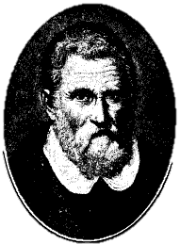
A Sea Route to Asia
Marco Polo (1200s)
Italian merchant who traveled to China
Long journey across the Silk Road
Wrote a book about China’s glory
Inspired Europeans to explore and trade
Trade goods
Asia was home to valuable spices, silk, porcelain, and tea; huge potential for profit!

Slide 5
Motives
Sea trade was much safer and more profitable than overland trade
Why?
Besides profit, explorers could gain:
Adventure
Fame
Glory
Land

Slide 6
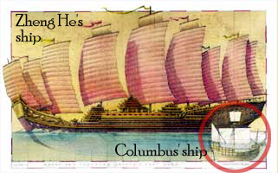
Technology
The compass was invented in Asia and first used for large-scale navigation by Zheng He (1400s)
The astrolabe was a tool that measured the angles of stars along the horizon to help explorers determine their location
The caravel was a new type of ship with square and triangular sails that was capable of long-distance travel

Slide 7
Sponsors
European countries began to compete for control of important trade routes
Sponsors (monarchs or other wealthy figures) supported exploration by paying for ships, supplies, and time; making an investment
Exploration was also a chance to spread religion
A dream come true for an explorer

Slide 8
Think About:
How did finding a sea route, personal motives, technology, and sponsors contribute to the Age of Exploration in Europe?

Slide 9
Major Events
Portugal leads the way
Columbus sails for Spain
Magellan makes history
Conquistadors in the Americas

Slide 10
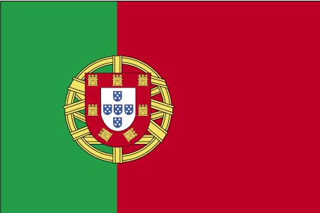
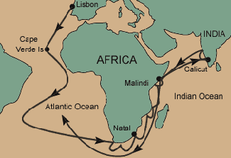
Portugal Leads the Way
Prince Henry of Portugal built a school for exploration around 1420
Bartholomeiu Dias makes it to the southern tip of Africa
Vasco da Gama sails around the Cape of Good Hope and reaches India

Slide 11
Christopher Columbus
Italian navigator with a brilliantly flawed plan
Gained sponsorship from King Ferdinand and Queen Isabella of Spain
Set sail west in 1492; Niña, Pinta, Santa Maria
Returned to Spain in glory (mistakenly)
Made three more voyages to America still thinking he was in India; called the natives Indians
European exploration of the Americas resulted in colonization of the land and removal of the natives

Slide 12
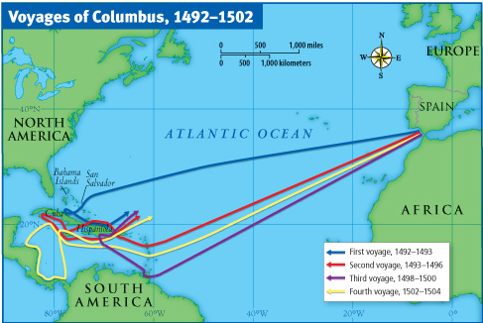

Slide 13
Ferdinand Magellan
A Portuguese sailor hired by Spain to find a route around South America to Asia
Named the Pacific Ocean for its peaceful waters
Magellan ends up killed in the Philippines
18 men survived; over 200 to start
Magellan credited with being the first to circumnavigate the globe; his crewmember Juan Sebastian del Cano finished leading the trip

Slide 14
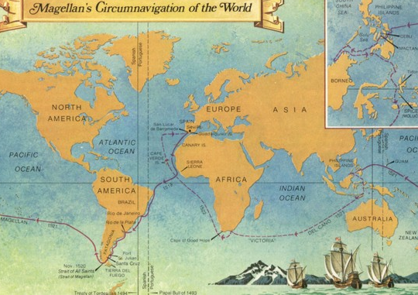

Slide 15
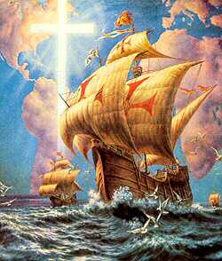
Conquistadors
In the 1500s, many Spanish explorers came to the Americas
Gained control of all of present-day Mexico and Central America
Aided by guns, horses, disease
Hernan Cortes conquered the Aztecs in Mexico
Francisco Pizarro conquered the Incas in South America

Slide 16
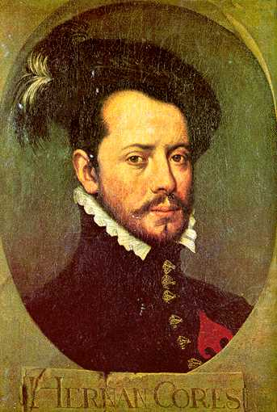
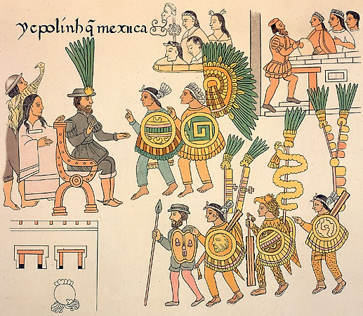
Hernan Cortez & the Aztecs

Slide 17
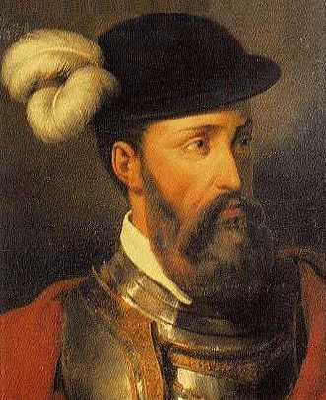
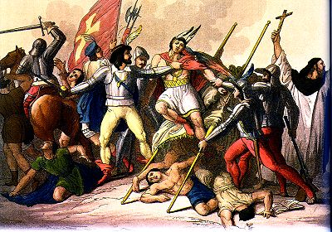
Francisco Pizarro & the Inca

Slide 18
Think About:
What were the major events that took place during the Age of Exploration in Europe?

Slide 19
Effects of Exploration
World-wide trade systems
Development of a new global economy
Colonization of the Americas

Slide 20
New Trade Systems
Columbian Exchange
A system of exchange between the “old” and “new” worlds; plants, animals, disease
From Americas: beans, tobacco, corn, tomatoes, vanilla, turkey, cocoa, potatoes, avocadoes
From Europe/Asia/Africa: bananas, livestock, onions, sugarcane, coffee, grapes, disease
Triangular Trade
A system of exchange between the Americas, Europe, and Africa which brought slaves to the Americas

Slide 21
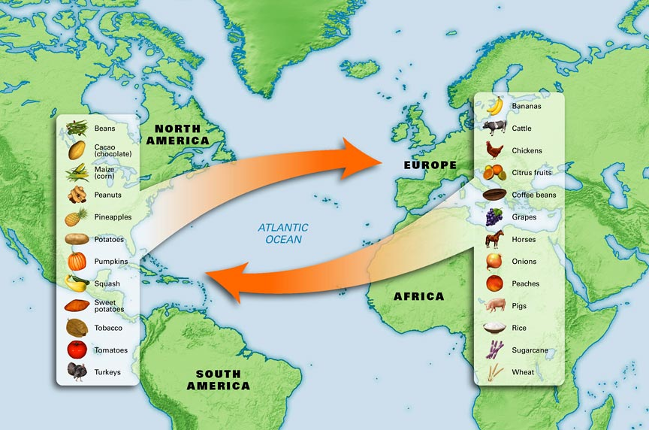
Columbian Exchange

Slide 22
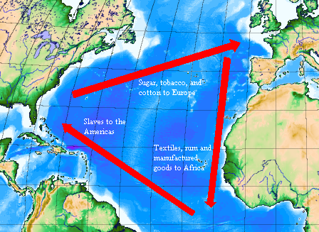
Triangular Trade

Slide 23
Economic Policies
Capitalism: an economic system in which people use resources to turn a profit
Founded in competition!
Investments; patrons; Medici family
Mercantilism: a policy that a country’s power depends on its wealth
Wealth came from trade and gold
Led to rivalry for colonies that sent home gold and produced goods for the home country

Slide 24
Colonization of the Americas
European countries sent groups of settlers to the Americas to build colonies
Europeans turned natives into slaves to work their farms and tobacco plantations
Eventually, they turned to slaves in Africa
Enslaved Africans were tied together and marched down to a European fort on Africa’s west coast where they were traded for cheap goods. If they survived the brutal conditions on the ship, they were sold to plantation owners in the Americas.

Slide 25
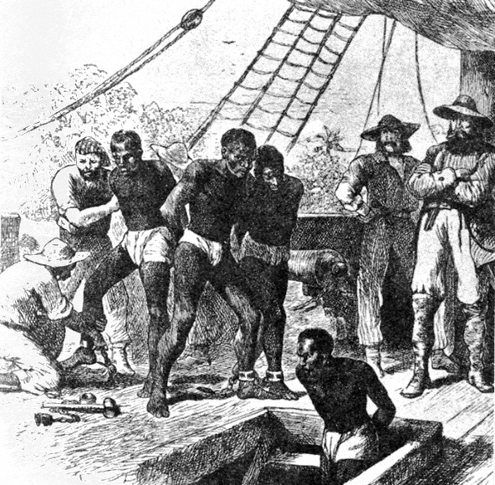

Slide 26
Think About:
How did European exploration result in changes in the Americas and throughout the world?

