Slide 1

Aggression Before the War
Drag and drop on the correct Territory

Slide 2
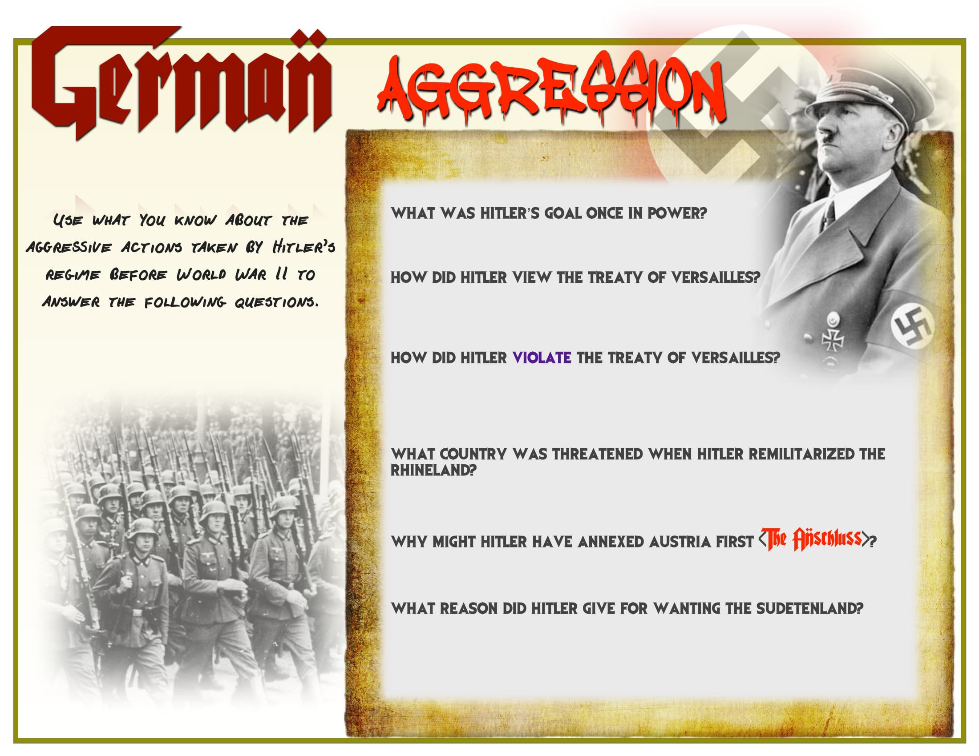
Aggression Before the War

Slide 3

Aggression Before the War
Drag and drop on the correct Territory

Slide 4
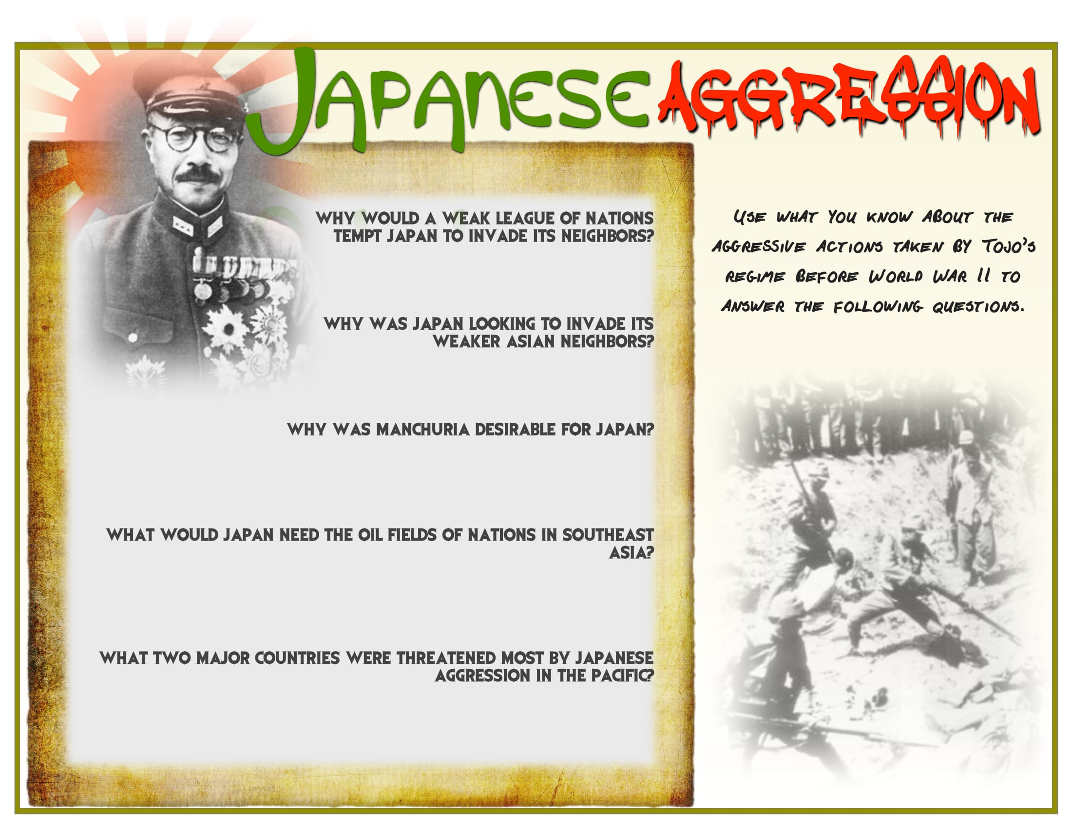
Aggression Before the War

Slide 5

Aggression Before the War
Drag and drop on the correct Territory

Slide 6

Aggression Before the War

