Slide 1
American Imperialism
America: An Emerging World Power

Slide 2
Objectives
“I Can…”
“I can define American Imperialism and associate it with a desire for raw materials and new markets
I can describe the consequences of American imperialism, including…
The annexation of Hawaii ”

Slide 3
What is Imperialism?
Imperialism
Strong nations used their political, military, and economic power to control weaker territories

Slide 4
5 Causes of Imperialism
Extractive Economies
Imperial country extracted (or removed) raw materials and natural resources from overseas colonies
Tea
Rubber
Iron
Petroleum, etc.

Slide 5
Causes of Imperialism, cont.
Export Markets
America needed markets for its surplus of goods (commodities)
“Today we are raising more crops than we can consume. Today we are making more than we can use…Therefore we must find new markets for our produce…”
Senator Albert Beveridge

Slide 6
Causes of Imperialism, cont.
Military Advantage
To expand and protect interests around the world
Alfred T. Mahan
US Naval officer who believed great nations used great navies to dominate the world

Slide 7
Causes of Imperialism, cont.
Frederick Jackson Turner
Frontier settlement had “used up” America’s great “safety valve”
The only safety valve left was overseas expansion

Slide 8
Causes of Imperialism, cont.
Social Darwinism
Life is a competitive struggle in which only the fittest survive
Some nations and races are superior to others & destined to rule over the inferior people groups

Slide 9
Causes of Imperialism, cont.
Social Darwinism, cont.
Americans worried if the US did nothing while European nations gobbled up the rest of the world, America would not survive

Slide 10
The US & the Pacific Region
Matthew Perry
(1853) Sailed a fleet of American warships into Tokyo Bay, Japan
(1854) “Negotiated” a trade deal between the US & Japan
(1867) Midway
(1875) Hawaii
(1887) Pearl Harbor

Slide 11
The US & Alaska
William Seward
(1867) US Secretary of State who negotiated the purchase of Alaska from Russia for $7.2 million
“Seward’s Icebox”
Doubled the size of the US
Turned out to be rich in timber, oil, etc.

Slide 12
The US & Latin America
First International Pan-American Conference (1889)
17 LA countries & the US agreed to build the Pan-American Highway
LA = within the US “sphere of influence” (President Cleveland)

Slide 13
The US & Hawaii
Queen Liliuokalani
A threat to American sugar cane planters
With help from US Marines, Queen Lili overthrown

Slide 14
The US & Hawaii, cont.
Sanford Dole
Wealthy American sugar cane planter who replaced Queen Lili
President Benjamin Harrison annexed Hawaii into the US
Later, President William McKinley proclaimed Hawaii an official US territory

Slide 15
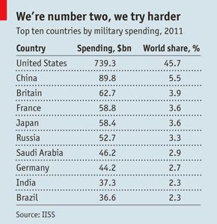
Addendum
Military Power

Slide 16
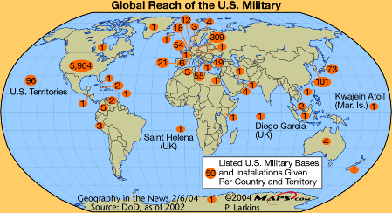
Addendum, cont.
Military Power

Slide 17
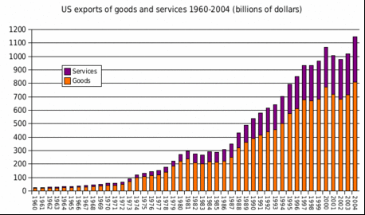
Addendum, cont.
Export Markets

Slide 18
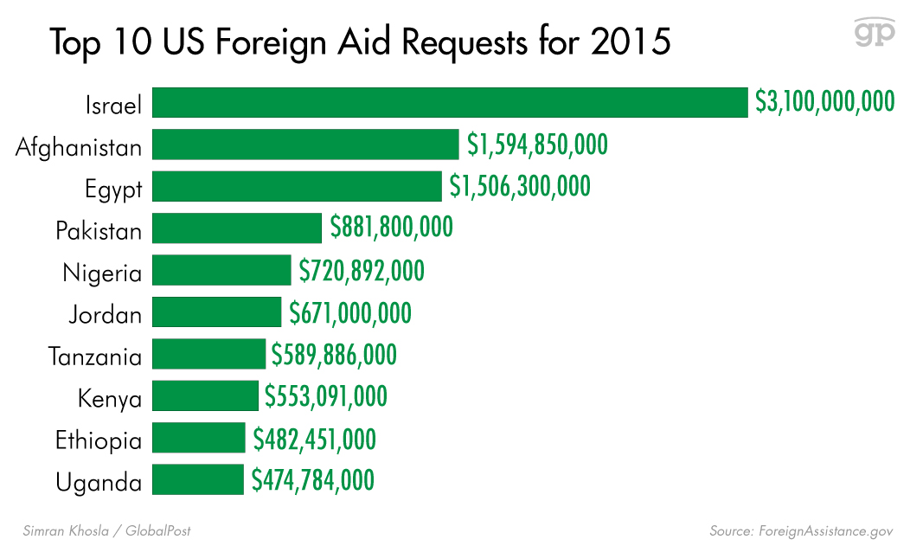
Addendum, cont.
Foreign “Aid”

