Slide 1
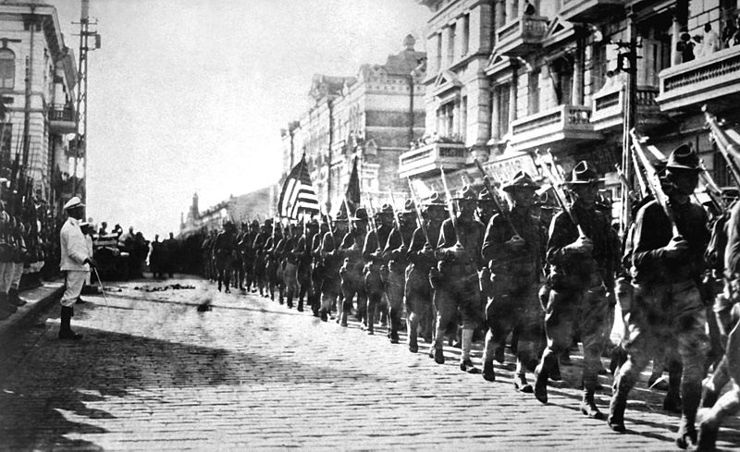
American
Imperialism
Introduction Presentation

Slide 2
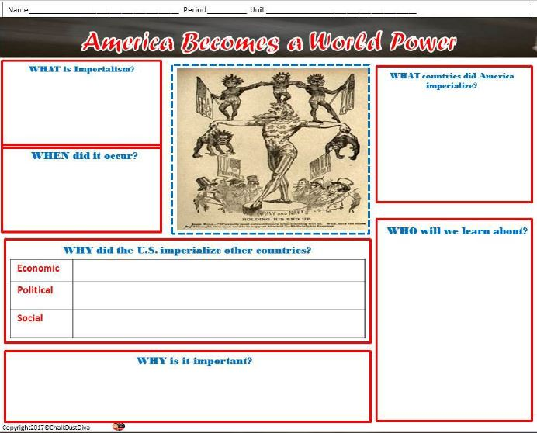
Complete the lecture notes template.

Slide 3
Objective
Students will be able to trace the rise of the United States to its role as a world power in the twentieth century by completing a timeline.

Slide 4
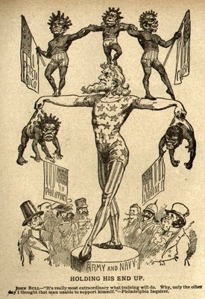
Opening Activity
List 3 things you see.
Who is the man in the center?
Who are the other people?
Who is in control?
What do you think this picture is about?

Slide 5
What is imperialism?
Extending power by acquiring territory around the globe or exploiting weaker nations to serve national interests.

Slide 6
When did it occur?
Europeans began in the 1800s
America will not start until 1898 after it becomes industrialized

Slide 7
What countries did America imperialize?
Hawaii: made an American territory
Philippines, Puerto Rico, Samoa, Guam and Cuba: was “won” in the Spanish American War
Panama: leased America land to build a canal after America encouraged a rebellion
China: was forced to have an “Open Door” trade policy with America

Slide 8
Pair-Share: Why did the U.S. imperialize other countries?
Economic - raw materials for industrial revolution, trade, cheap labor, new markets
Political – nationalism (pride and prestige), national security/border protection, military bases & source of troops. Wanted to compete with Europe for prestige
Social- Social Darwinism (survival of the fittest applied to society; American society = is the fittest), spread cultural values – racial/cultural superiority; white man’s burden (duty to civilize non-whites)

Slide 9
Who Will We Learn About?
We will learn about the Presidents who helped to make America a world power.
Roosevelt – Big Stick Policy
Taft – Dollar Diplomacy
Wilson – Moral Diplomacy

Slide 10
Why is it important?
Along with industrialization, imperialism will help America to become a world power instead of a weak nation.

Slide 11
Film: America in the 20th Century
https://www.youtube.com/watch?v=GLDGKTntTbg
As you watch the film, take notes on the worksheet: Timeline: Imperialism & America.
Be sure you include how the territory was imperialized and why they territory was imperialized.
Notes:
https://www.youtube.com/watch?v=GLDGKTntTbg

Slide 12
Wrap-Up Discussion
Today in class I learned about _________________________________
One thing we are going to learn about is _________________________________
I think that this is important because __________________________________
As you can see _____________________

