Slide 1
American Imperialism
We will explain why Alfred T. Mahan, T. Roosevelt, Sanford B. Dole, and missionaries moved the U.S. into the position of a world power; evaluate the acquisitions of Guam, Hawaii, the Philippines, and Puerto Rico; analyze the impact of physical/human geography on the Panama Canal; explain the Open Door Policy and Dollar Diplomacy.
I will complete a graphic organizer summarizing American Imperialism.
Reasons for Colonial Expansion
Imperialist
The Influence of Sea Power upon History
Control of the Seas
Colonial History
Leading Opponents
American Anti-Imperialist League
Alfred Thayer Mahan
Anti-Imperialists
America in the Pacific
The Philippines
Guam
Samoa and Midway
Hawaii
Queen Liliuokalani
Sanford B. Doyle

Slide 2
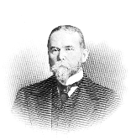
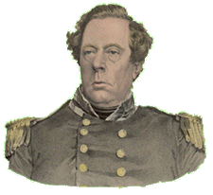
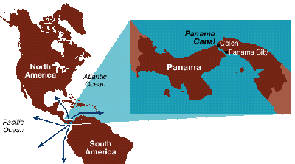
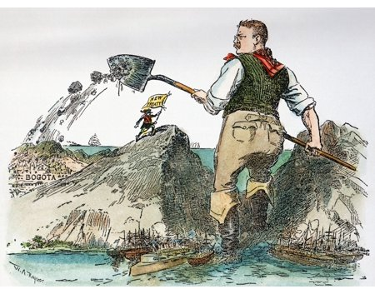
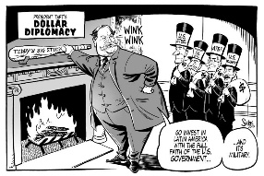
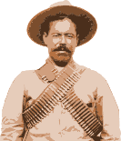
America in China
Spheres of Influence
John Hay
American in Japan
Commodore Matthew Perry
Japanese Imperialism
Reasons for Control of the Caribbean
Puerto Rico
Cuba
Isthmus of Panama
Panama
Panamanian Independence
Panama Canal Zone
American in the Caribbean
The Panama Canal
Challenges of Building the Canal
Caribbean as an “American Lake”
Monroe Doctrine (1823)
Roosevelt Corollary (1904)
Big Stick Diplomacy
Taft and Dollar Diplomacy
Wilson’s Latin American Policy
Moral Diplomacy
Pancho Villa
American Expeditionary Force

