Slide 1
Bell Ringer
Answer the following questions in the EOC Practice Packet in the back of your INB:
QUESTION #51
QUESTION #52
QUESTION #53
QUESTION #54

Slide 2
Question 51
Which of the following best replaces the question mark in the list of information about Puerto Rico?
a. Became a U.S. state during the Reconstruction era
b. Was ceded to the United States as a result of the Spanish-American War
c. Signed an annexation treaty with the United States after World War I
d. Was promised U.S. military protection as part of Woodrow Wilson’s Fourteen Points

Slide 3
Question 52
The Spanish-American War marked a turning point in American foreign policy because the United States—
a. developed a plan for peaceful coexistence
b. emerged as a new world power
c. pledged neutrality in future European conflicts
d. refused to become a colonial power

Slide 4
Question 53
How did these events affect the United States?
a. They increased public support for cuts in U.S. defense spending.
b. They promoted the end of Dollar Diplomacy in Latin America.
c. They set a precedent of including territorial acquisitions in settlements.
d. They helped establish the United States as an imperial power similar to European nations.

Slide 5
American Imperialism
Essential Question: What strategic and political factors led America to become an imperial power?

Slide 6
TEKS and Objectives
We will…
I will…
(4A) explain why Alfred T. Mahan, T. Roosevelt, Sanford B. Dole, and missionaries moved the U.S. into the position of a world power
(4B) evaluate the acquisitions of Guam, Hawaii, the Philippines, and Puerto Rico
(12A) analyze the impact of physical/human geography on the Panama Canal
(15C) explain the Open Door Policy and Dollar Diplomacy
Complete a graphic organizer summarizing American Imperialism

Slide 7
Reasons for Colonial Expansion
Need for Raw Materials and Markets
Colonies provided raw materials for factories
Guaranteed markets for manufacturers
Place for farmers to sell surplus crops
Nationalism
Colonial expansion a means of showing the U.S. was a powerful nation
U.S. should grab its own colonies before nothing was left

Slide 8
Reasons for Colonial Expansion
Social Darwinism
Belief Anglo-Saxon race superior to others
Missionaries wanted to convert natives to Christianity

Slide 9
Alfred Thayer Mahan
Imperialist
President of the Naval War College
America’s leading advocate for imperial expansion
Influenced Theodore Roosevelt

Slide 10
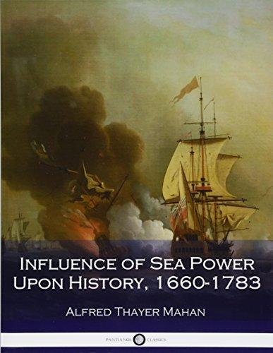
Alfred Thayer Mahan
The Influence of Sea Power upon History (1890)
Argued that to achieve world power, a country needed a powerful navy
Large merchant marine needed to supply sailors
Colonies/naval bases need to provide coaling stations for steamships and trade for merchant ships

Slide 11
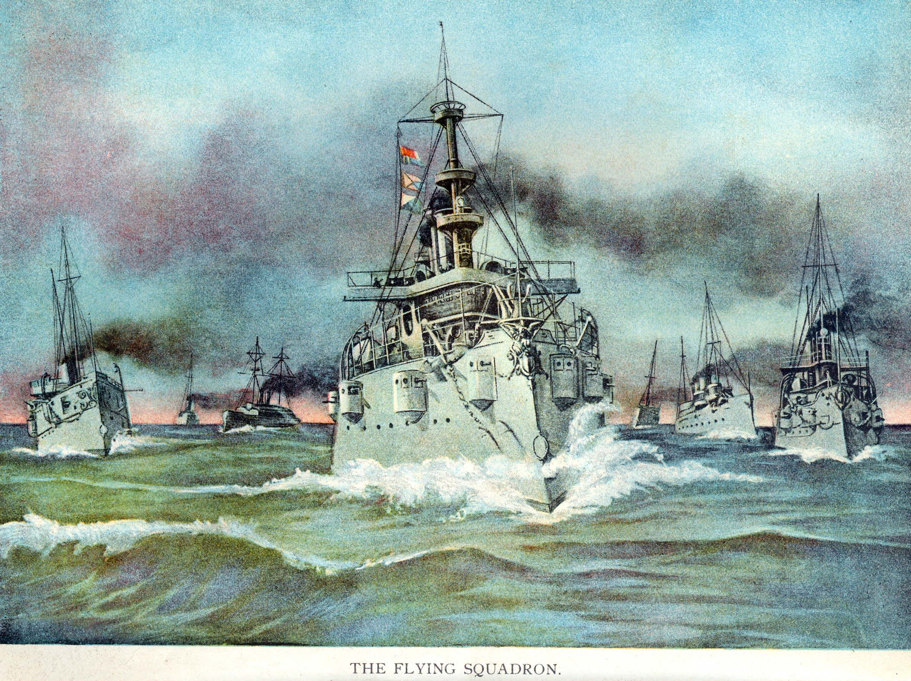
Alfred Thayer Mahan
Control of the Seas
Americans should seize control of Pacific trade routes
Construct a canal through Central America
Dominate Caribbean region

Slide 12
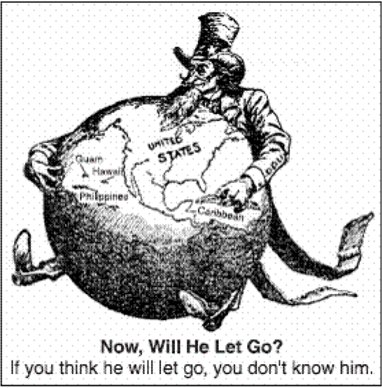
The Anti-Imperialists
Colonial History
Some Americans were uneasy about forcing colonial rule on others
Leading opponents
Mark Twain, Andrew Carnegie
Felt imperialism violated democratic principle of self-government

Slide 13
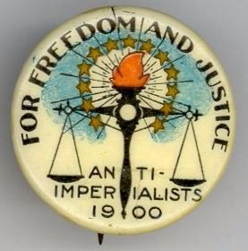
The Anti-Imperialists
American Anti-Imperialist League (1898)
Formed to oppose acquisition of colonies

Slide 15
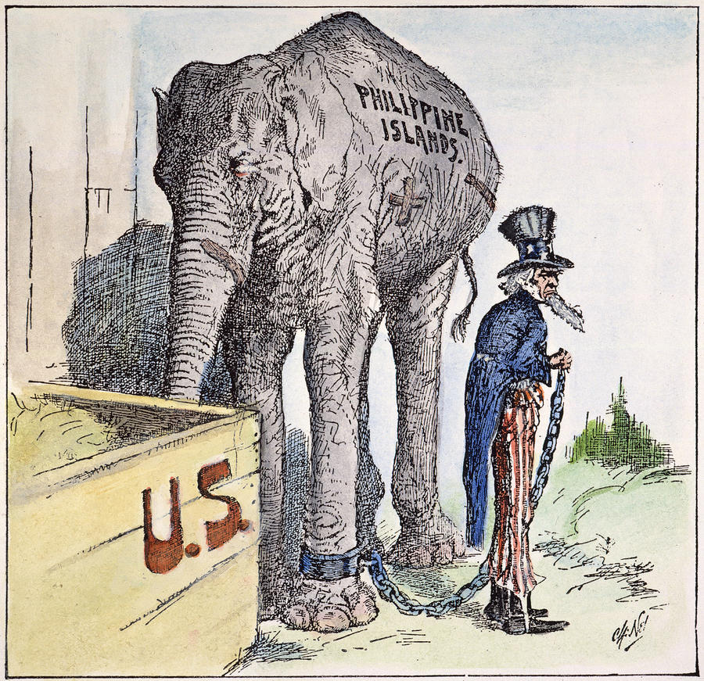
America in the Pacific
The Philippines
U.S. Congress decided to annex the Philippines instead of granting independence
Filipino rebels fought against colonial rulers until 1902

Slide 16
America in the Pacific
Guam
Important Spanish port for ships crossing the Pacific
Today it is an unincorporated U.S. territory
Samoa and Midway
Valuable naval bases and refueling stations
Samoa became U.S. possession in 1867
Divided between Germany and U.S. in 1899

Slide 17
America in the Pacific
Hawaii
Islands provided refueling station for American ships
Americans built sugar and pineapple plantations
Missionaries sent to convert natives to Christianity

Slide 18
America in the Pacific
Queen Liliuokalani
Native ruler of Hawaii
Tried to take political power back from American landowners
Americans landowners overthrew her in 1893
President Cleveland refused to annex Hawaii because of planters’ actions

Slide 19
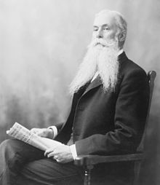
America in the Pacific
Sanford B. Dole
Served as Hawaii’s President and then Governor when annexed
Worked to limit native rights
Congress annexed after Spanish-American War

Slide 20
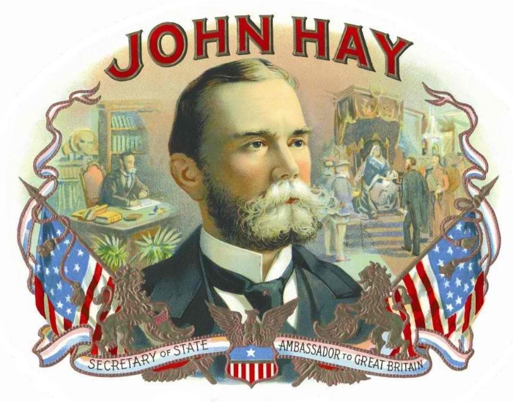
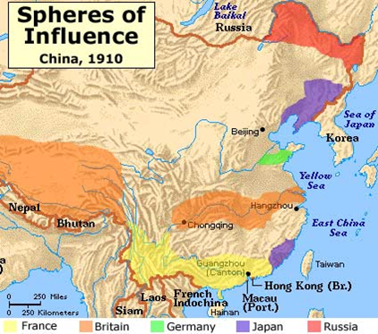
America in China
Spheres of Influence
Areas where Europeans enjoyed special privileges
John Hay
Worried U.S. would be shut out of China by European powers
Saw China as a vital market

Slide 21
America in Japan
Commodore Matthew Perry
Landed in Japan in 1853 with American gun ships
Helped open isolated Japan to Western trade and influence
Japanese Imperialism
Defeated China in 1894
Defeated Russia in 1905

Slide 22
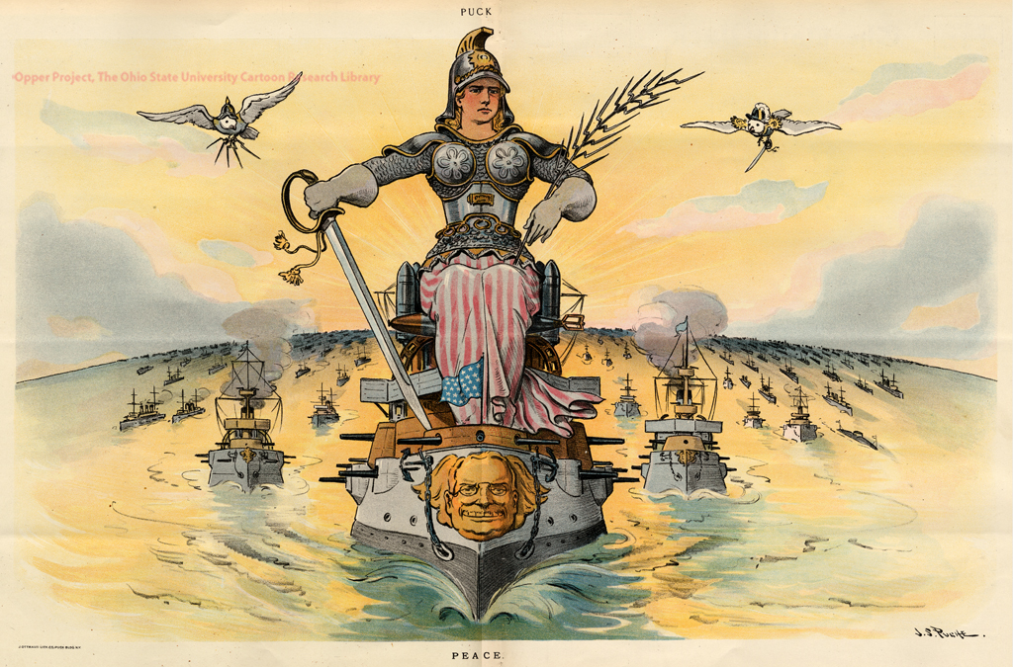
America in the Caribbean
Reasons for Control of Caribbean
Hemispheric Security
Economic Interests
Need for a Canal

Slide 23
America in the Caribbean
Puerto Rico
Became U.S. possession after Spanish-American War
U.S. established a civil government with a governor, upper house picked by President, and lower house elected by voters
Puerto Ricans granted U.S. citizenship in 1917

Slide 24
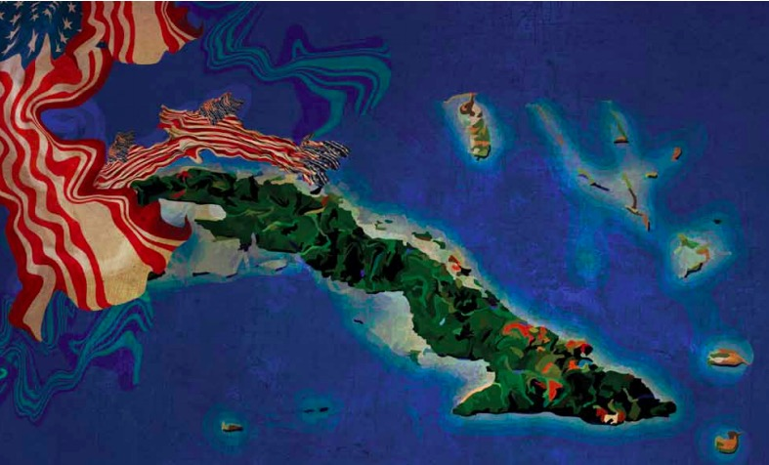
America in the Caribbean
Cuba
Became a “protectorate” under American control
U.S. forces remained on the island
American businesses invested heavily in Cuba
Platt Amendment gave U.S. right to intervene in Cuban affairs at any time

Slide 25
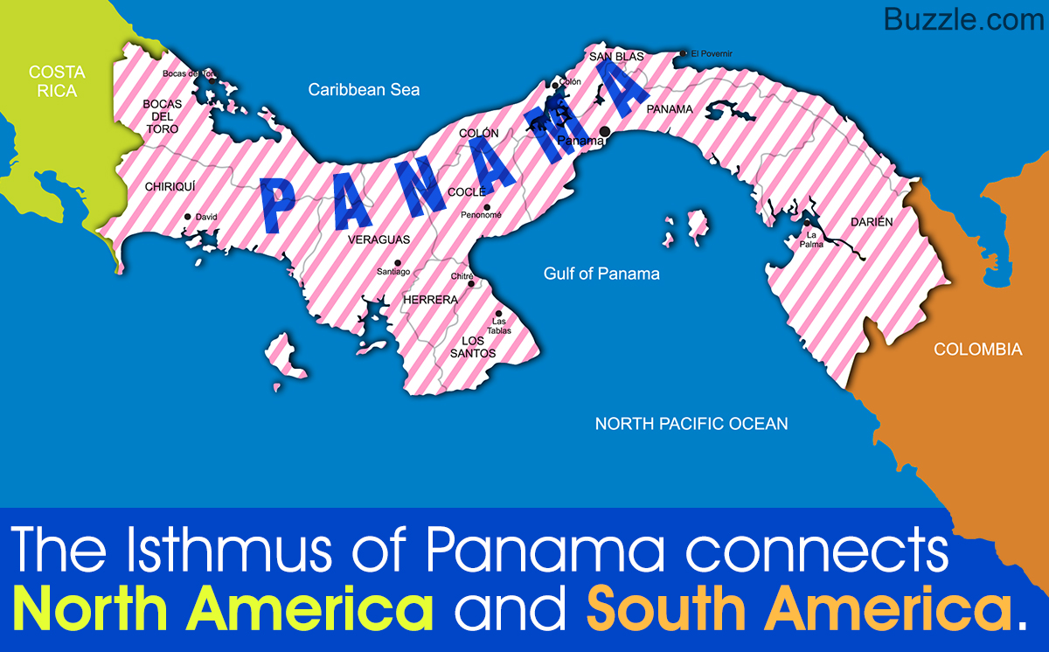
The Panama Canal
Isthmus of Panama
Narrowest point in Central America
Canal needed to send ships back and forth between the two oceans instead of having two separate naval fleets
Panama
Part of Colombia
Colombia and U.S. could not agree on terms for canal

Slide 26
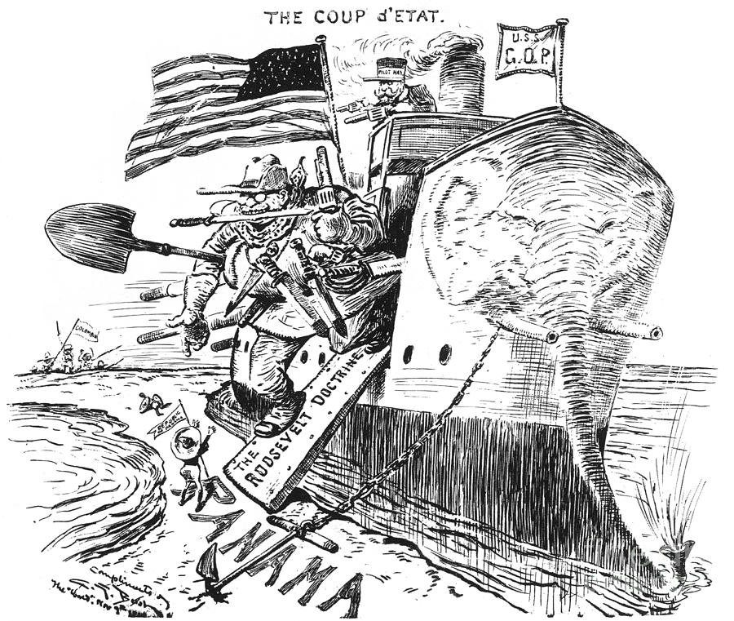
The Panama Canal
Panamanian Independence
Roosevelt sent U.S. warship to help rebels
Panama recognized as a new country
Panama Canal Zone
10-mile strip of rainforest
New government gave U.S. complete control over zone

Slide 27
Challenges of Building the Canal
Geography
Crossed landforms at different elevations
Engineers designed series of six giant locks
Tropical Climate
Intense heat
Heavy rains caused frequent mudslides

Slide 28
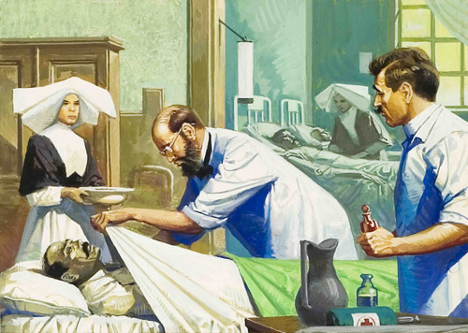
Challenges of Building the Canal
Disease
Dr. Walter Reed discovered mosquitoes transmitted yellow fever
Dr. William Gorgas (U.S. Army) ordered all swamps drained, vegetation cut, and standing water sprayed with oil
Total Cost
10 years to complete, $400 million, and thousands of lives

Slide 29
Caribbean as an “American Lake”
Monroe Doctrine (1823)
Prevented Europeans from establishing new colonies in the Western Hemisphere
Roosevelt Corollary (1904)
Addendum to Monroe Doctrine
Prohibited European countries from using force to collect debts from Dominican Republic
Declared U.S. would act as an “international police power” and collect debt for them

Slide 30
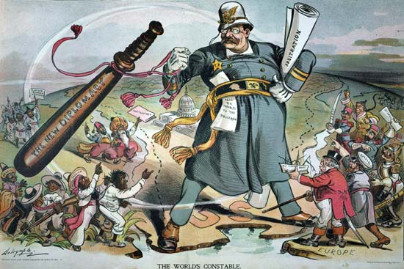
Caribbean as an “American Lake”
Big Stick Diplomacy
Roosevelt boasted he would “walk softly and carry a big stick”
Threat of violence more effective than actual violence
U.S. troops frequently intervened in Latin America (Haiti, Nicaragua, Honduras, Dominican Republic)
Deeply resented by Latin Americans

Slide 31
Taft and Dollar Diplomacy
Dollar Diplomacy
Taft encouraged bankers to invest in Caribbean countries
U.S. sent troops to collect debts by taking control of their assets (ex. Railroads, banks)

Slide 32
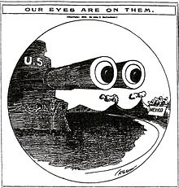
Wilson’s Latin American Policy
Moral Diplomacy
Support given to countries whose morals aligned with U.S.
Mexico undergoing violent revolution
U.S. refused to acknowledge new government of Mexico
Adopted U.S. policy of “watchful waiting”

Slide 33
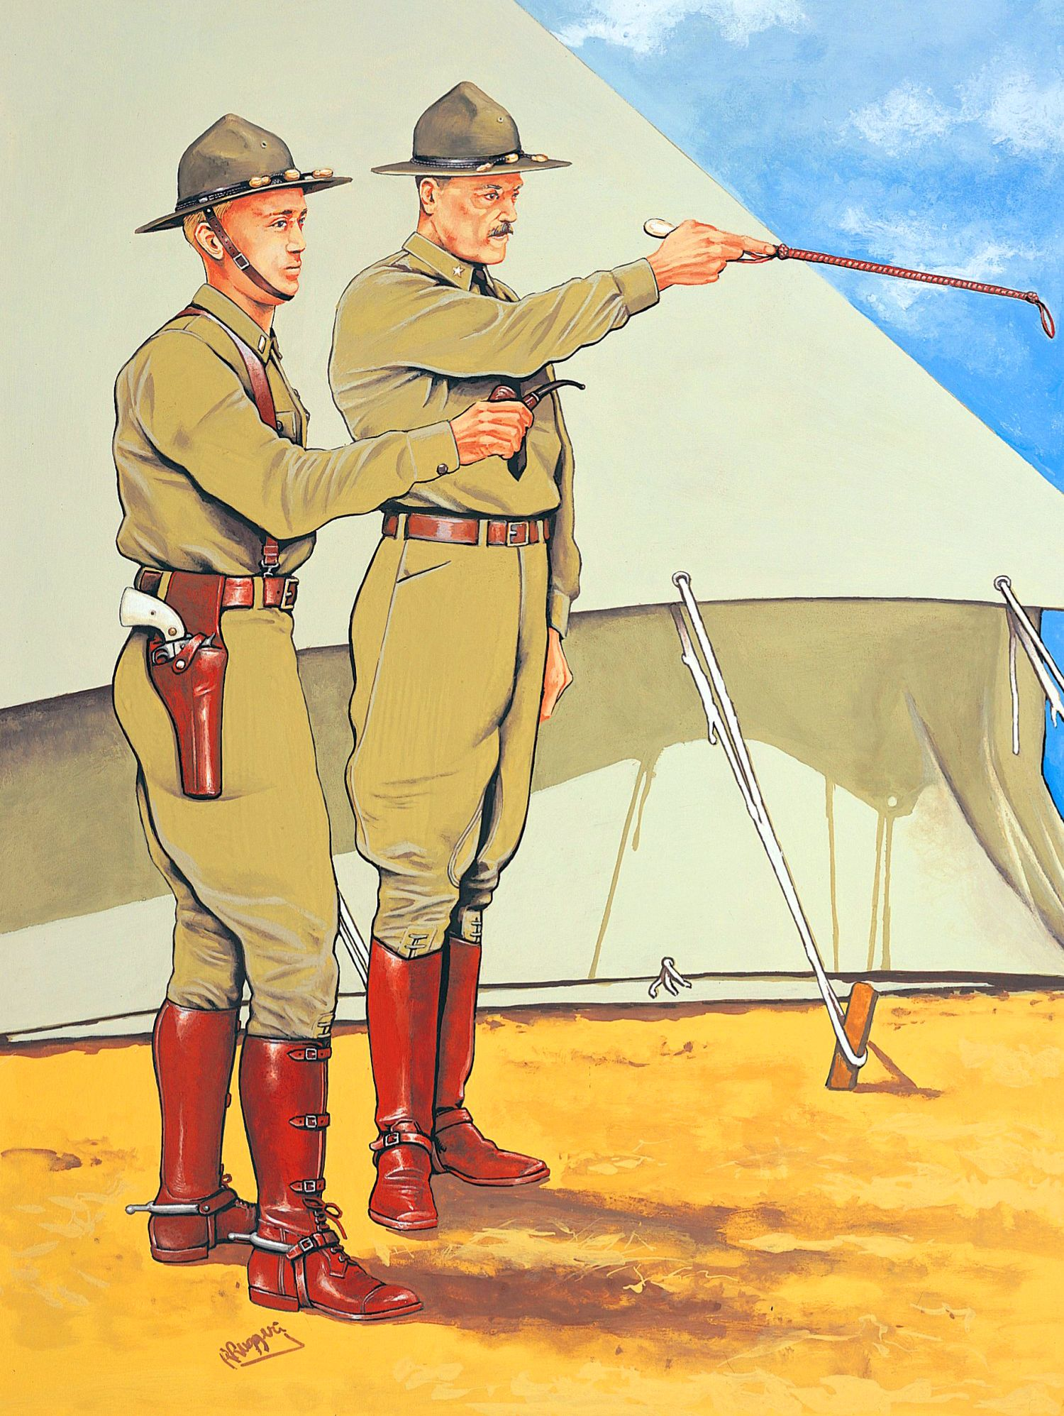
Wilson’s Latin American Policy
Pancho Villa
Mexican rebel
Murdered Americans in New Mexico
Retreated across the border
American Expeditionary Force
Led by General John J. Pershing
Sent to capture Villa but withdrawn in 1917 for WWI

