Slide 1
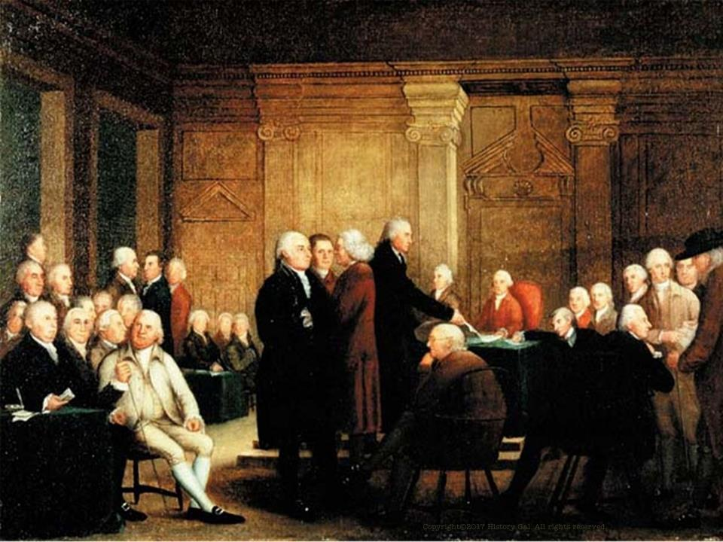
A NEW NATION

Slide 2
The colonies may have won their independence from Great Britain, but they still had to create a government that would keep the colonies together and help the new nation – the United States – prosper.

Slide 3
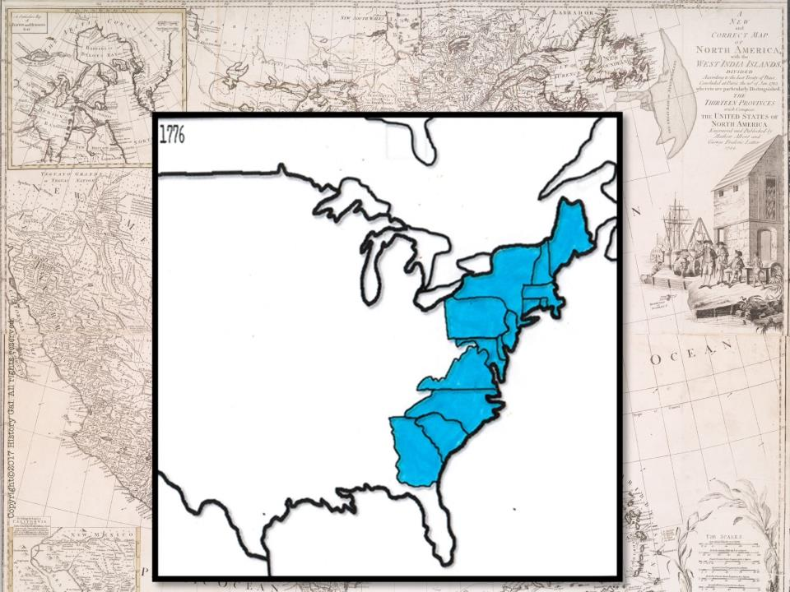
13 COLONIES BEFORE THE AMERICAN REVOLUTION

Slide 4
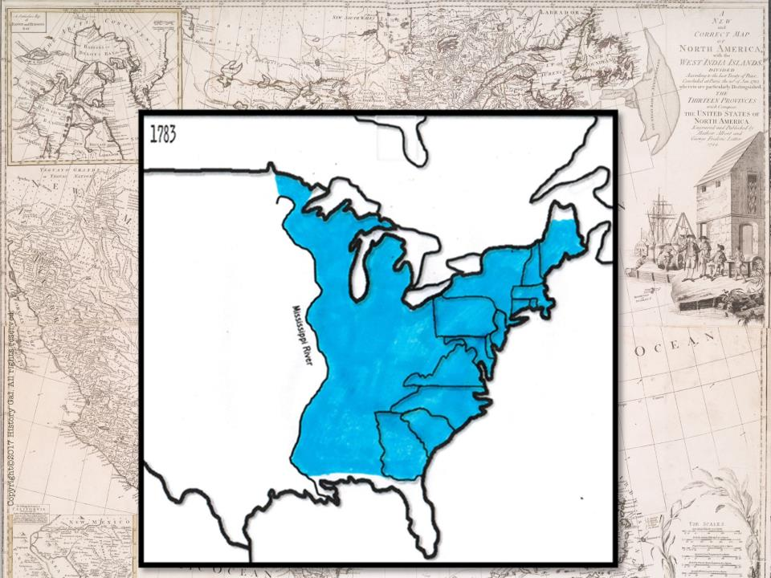
UNITED STATES AFTER THE AMERICAN REVOLUTION

Slide 5
The 1780s were know as the CRITICAL PERIOD - Will the new government/nation be strong enough to survive?

Slide 6
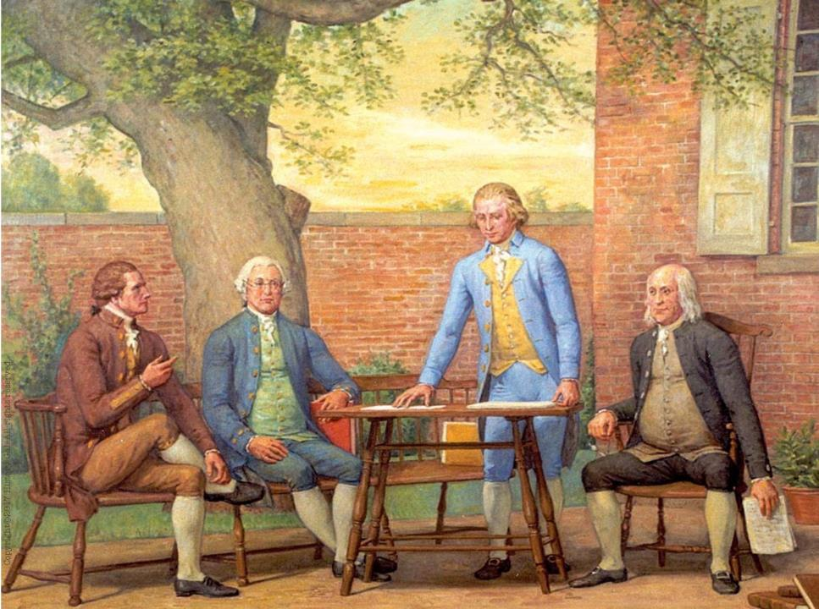
ARTICLES OF CONFEDERATION –
A loose confederation of the states with a weak central government
Articles of Confederation in One Minute

Slide 7
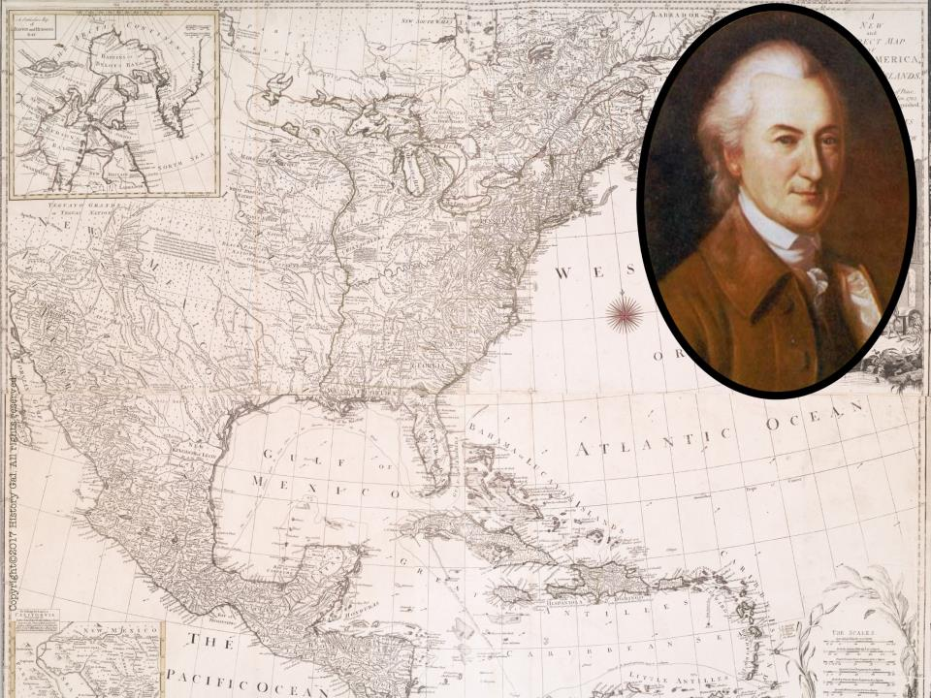
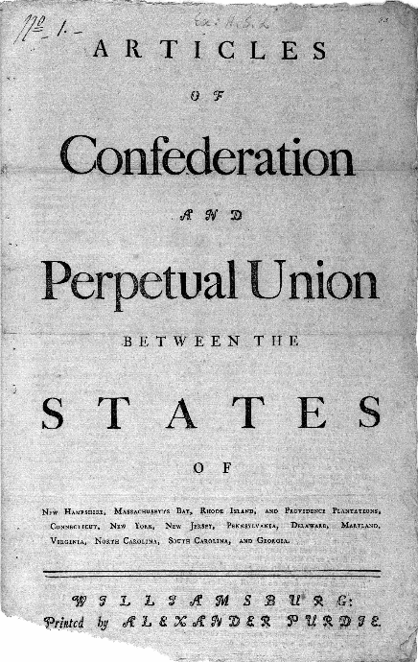
Philadelphia 1776 - JOHN DICKINSON drafted the
nation’s first constitution
called the ARTICLES OF CONFEDERATION
Submitted to the states for ratification (approval)
Ratification was delayed because of land disputes
Ratified in 1781
John Dickinson
John Dickinson

Slide 8
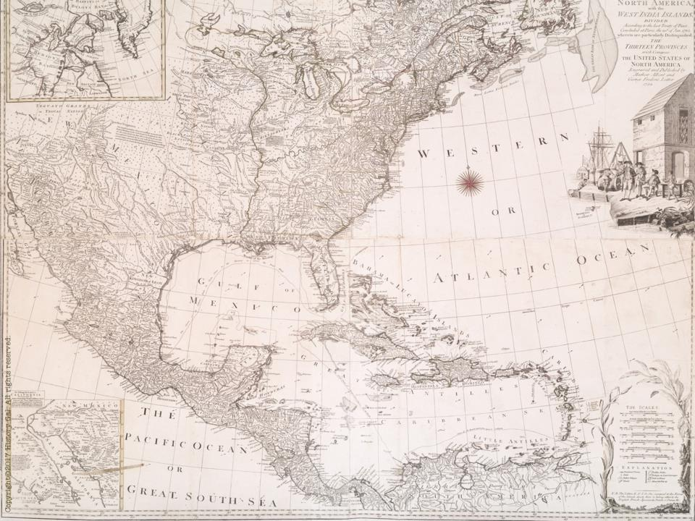
STRUCTURE OF GOVERNMENT
Central government – 1 house (UNICAMERAL) legislature with 1 vote for each state
9 out of 13 states had to approve laws
unanimous vote needed to amend the Articles of Confederation

Slide 9
STRUCTURE OF GOVERNMENT
Powers of the new government: wage war, make treaties, send diplomatic representatives, borrow money
No power to collect taxes, regulate commerce (trade) between the states, enforce its own laws

Slide 10
ACCOMPLISHMENTS
negotiated the Treaty of Paris 1783 (ended the Revolutionary War)
LAND ORDINANCE OF 1785 – public policy for western lands, provided for setting aside one section of land in each township for public education

Slide 11
ACCOMPLISHMENTS
NORTHWEST ORDINANCE OF 1787 – set rules for creating new states, granted limited self-government to that developing territory and prohibited slavery in certain regions
Articles of Confederation Explained

Slide 12
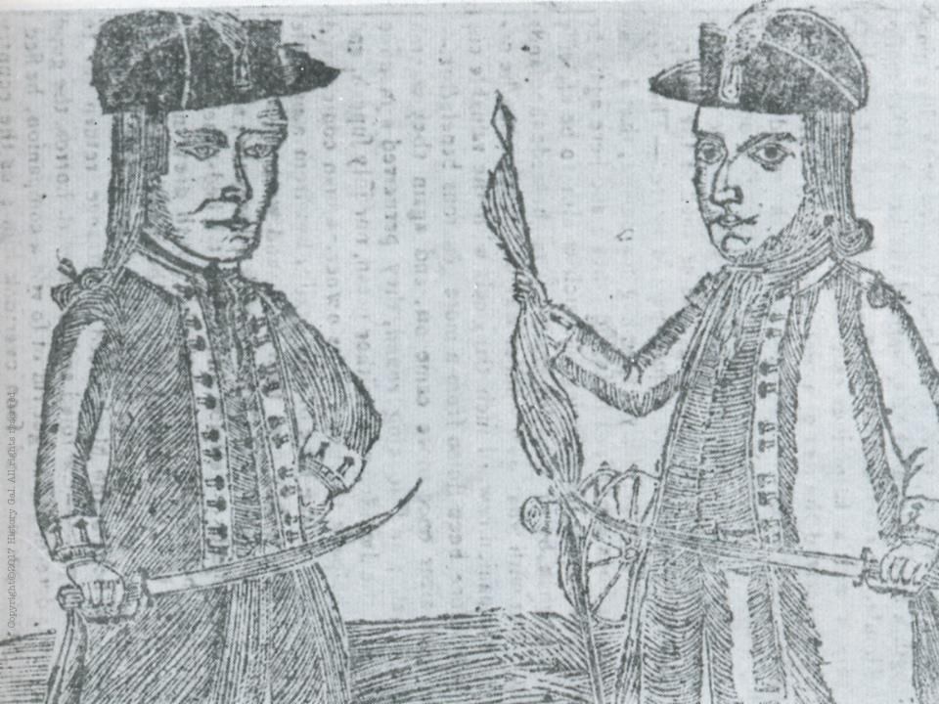
PROBLEMS

Slide 13
#1: Weak central (national) government

Slide 14
#2 Financial Problems:
unpaid war debts, states and congress issued worthless paper money
no power to tax – could only request the states to donate money for national needs

Slide 15
#3: Problems with Foreign (European) nations:
Europe had little respect for a new nation that could not pay its debts
Spain and England expanded their interests in lands west of the new nation

Slide 16
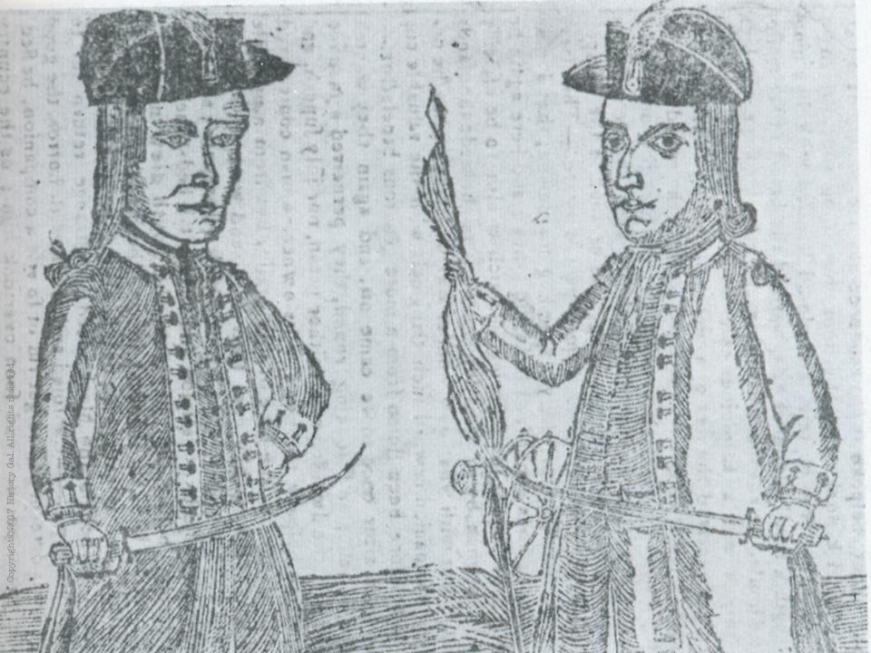
#4: Domestic Problems:
SHAYS’ REBELLION - Summer 1786
Captain Daniel Shays (a MA farmer and war veteran) led other farmers in an uprising against high state taxes, imprisonment for debt and lack of paper money
They stopped the collection of taxes and forced the closings of debtors’ courts
1787 – attempted to steal weapons from the Springfield armory, but the state militia broke it up

Slide 17
Result of Shay’s Rebellion– people realized the national government was powerless to stop such rebellions, convinced many of the need to meet to discuss the weaknesses of the Articles of Confederation
Shay’s Rebellion

Slide 18
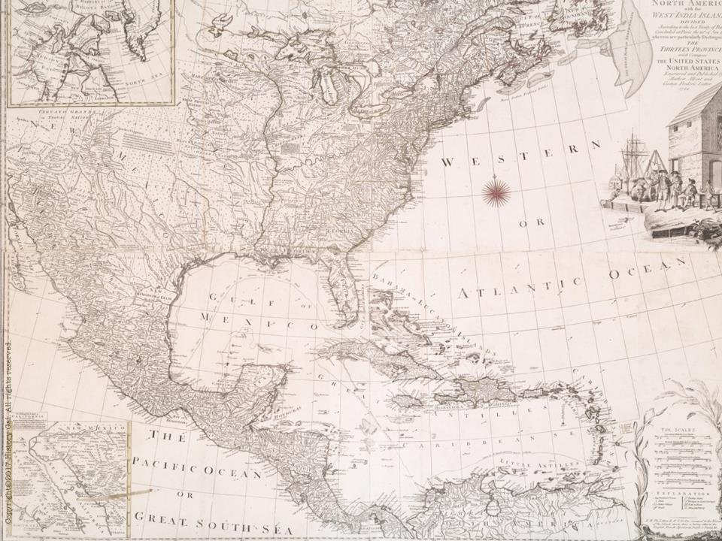
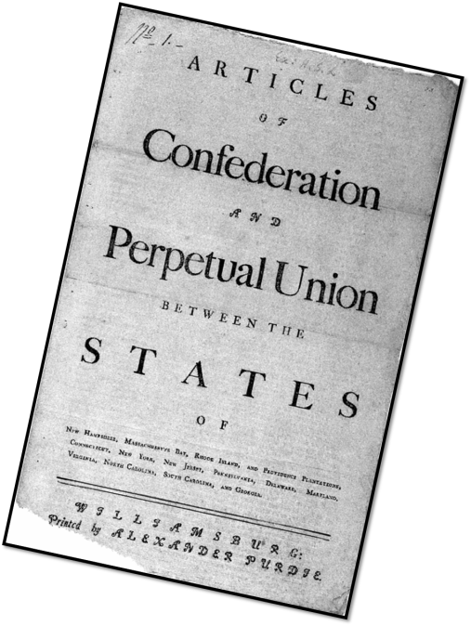
Articles of Confederation:
Time for a change…

Slide 19
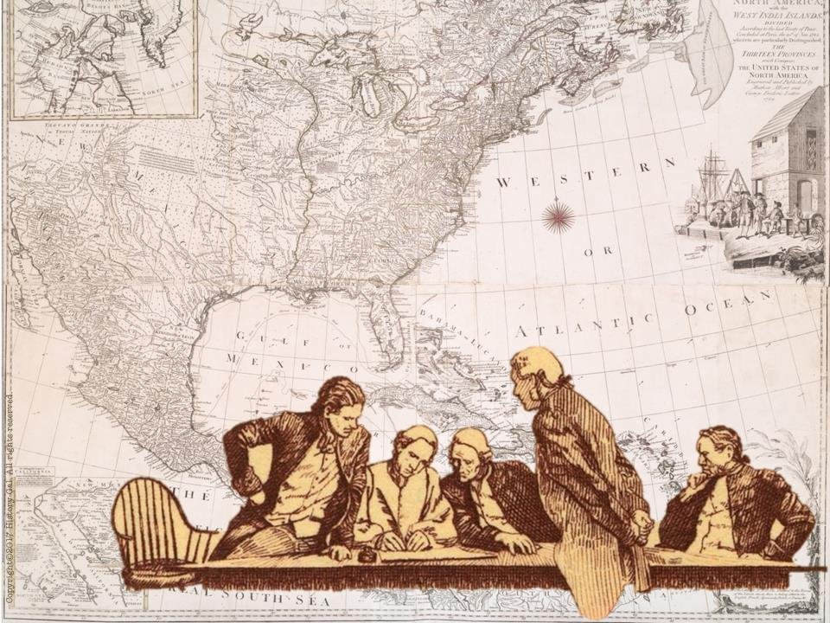
1786 – ANNAPOLIS CONVENTION
5 states sent delegates to discuss improving the commercial (trade) relations between the states
delegates agreed that they needed another convention to revise the Articles and agreed to meet in Philadelphia the following year
Shays’ Rebellion will convince more states of the need to attend the convention
Annapolis Convention

Slide 20
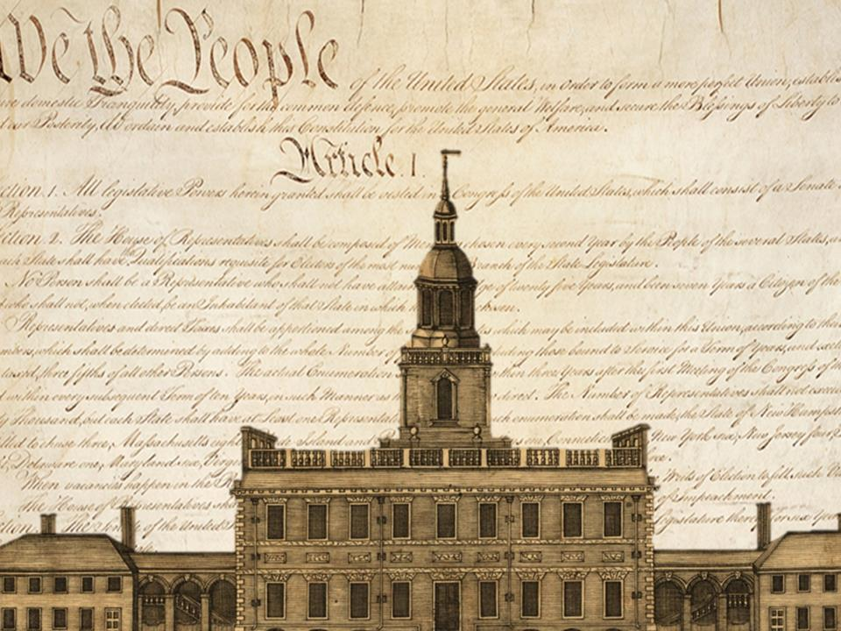
PHILADELPHIA CONVENTION –
All states except
Rhode Island sent
delegates
(total of 55
delegates)
May – Sept. 1787
The Making of the Constitution
History Channel Constitution Convention Video
Introduction to Constitutional Convention Video

Slide 21
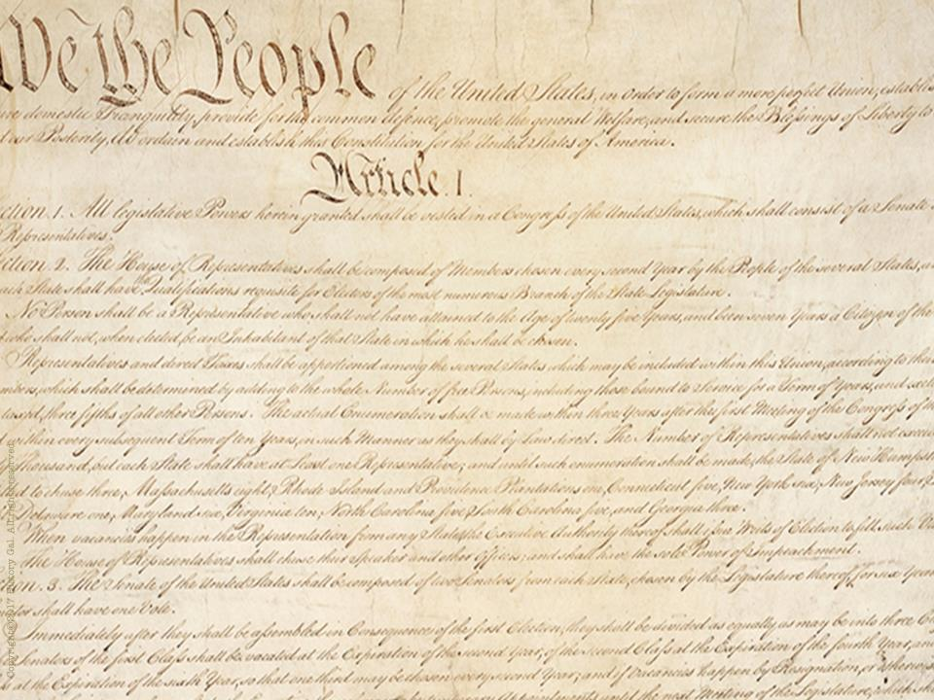
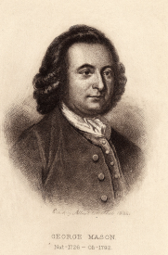
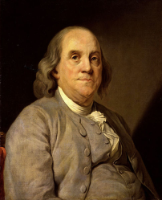
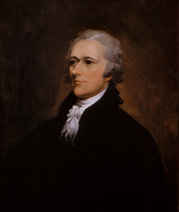
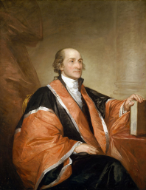
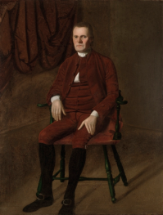
WHO ATTENDED?
George Mason
Benjamin
Franklin
Alexander Hamilton
Roger Sherman
John Jay

Slide 22
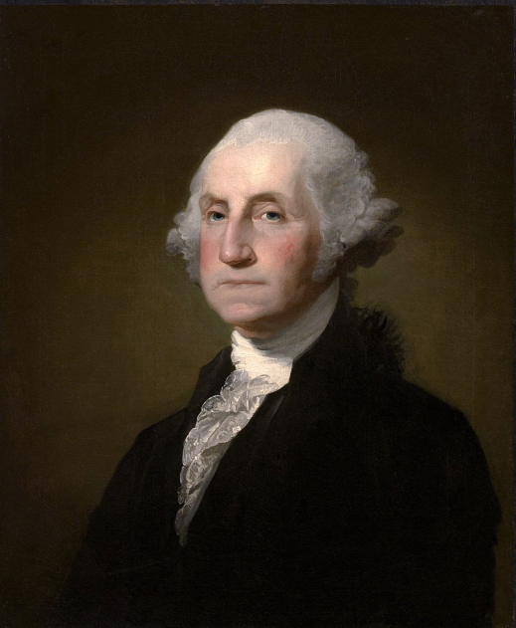
George Washington
Presided over the convention

Slide 23
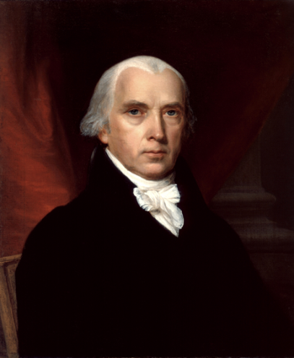
Considered “The Father of the Constitution”
Main author of Constitution
Took diligent notes on every debate and discussion that occurred during the convention (that’s how we know today who said what and the reasoning behind their decisions)
Very well read and educated on democratic philosophies
James Madison

Slide 24
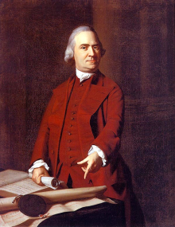
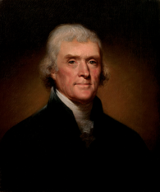
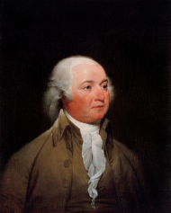
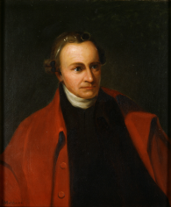
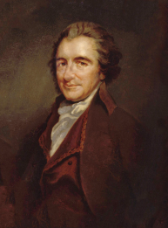
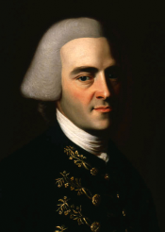
WHO DID NOT ATTEND?
Samuel Adams (declined to go –did not want the central government to have too much power)
Thomas Jefferson (serving as U.S. ambassador in France)
John Adams (serving as U.S. ambassador in Great Britain)
Patrick Henry
(refused to attend saying, he “smelt a rat in Philadelphia, tending toward the monarchy.”)
John Hancock (invited but did not attend possibly due to illness or his responsibilities as governor of Massachusetts)
Thomas Paine (living in Europe)

Slide 25
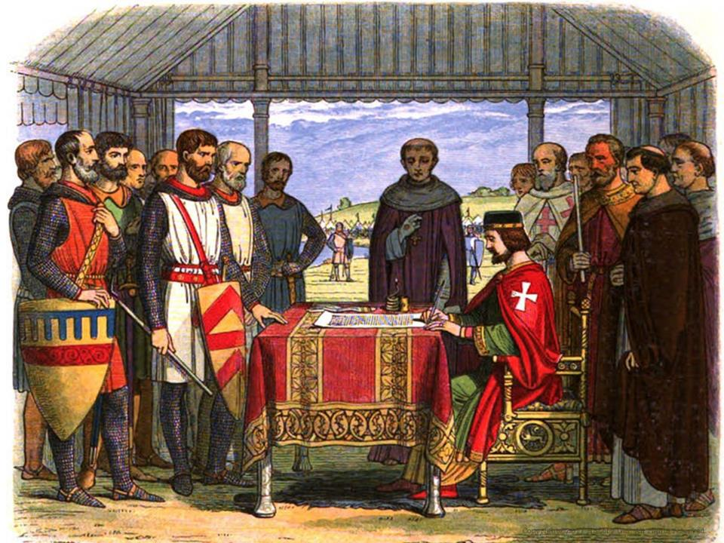
HISTORICAL FOUNDATIONS AND TRADITIONS THAT INFLUENCED THE FOUNDING FATHERS:
From
England
Magna Carta (1215)
John Locke’s “Natural Rights” (1689)
English Bill of Rights (1689)
England’s Parliament – bicameral House of Lord and House of Commons
What Would John Locke Say Song

Slide 26
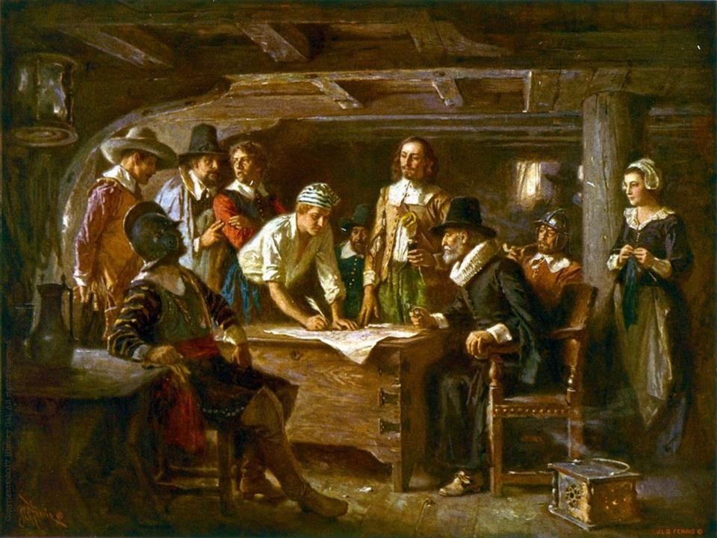
HISTORICAL FOUNDATIONS AND TRADITIONS THAT INFLUENCED THE FOUNDING FATHERS:
From 13 Colonies
Virginia House of Burgesses (1619)
Charter Colonies could elect their own officials vs. Royal and Proprietary Colonies -appointed by the King
Mayflower Compact (1620)
Fundamental Orders of Connecticut (1639)
Maryland Toleration Act (1649)
Peter Zenger Trial (1735)
Peter Zenger Trial Video

Slide 27
BASIC PRINCIPLES CONTAINED
IN THE CONSTITUTION
POPULAR SOVEREIGNTY – power comes from the people
LIMITED GOVERNMENT – government can only do what people give it permission to do
SEPARATION OF POWERS – powers are divided between separate branches of government

Slide 28
CHECKS AND BALANCES – Powers of each branch are checked and balanced by the other branches
FEDERALISM – division of power between a central government and local government
JUDICIAL REVIEW– authority of Supreme Court to declare laws unconstitutional – NOT in the Constitution but will become an important role of the Supreme Court in 1803 with the ruling of Marbury v. Madison

Slide 29
ISSUES

Slide 30
SHOULD THEY MAKE CHANGES TO THE ARTICLES OR CREATE A NEW DOCUMENT?
They decide to create a new document and worked in secret for 4 months at Independence Hall to create a new government.

Slide 31
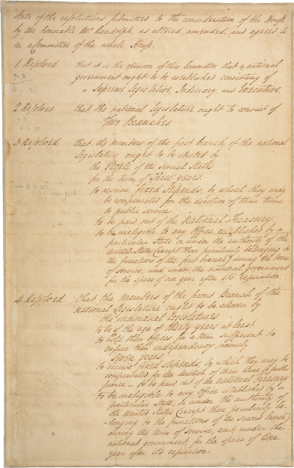
SHOULD STATES HAVE EQUAL REPRESENTATION OR SHOULD IT BE BASED ON POPULATION?
Option #1: VIRGINIA PLAN by James Madison called for 3 branches of government with a BICAMERAL (two house) legislature based on population
James Madison

Slide 32
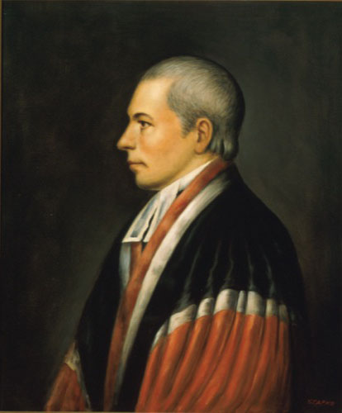
William Patterson
Option #2: NEW JERSEY PLAN by William Patterson called for a unicameral
legislature based on equal representation

Slide 33
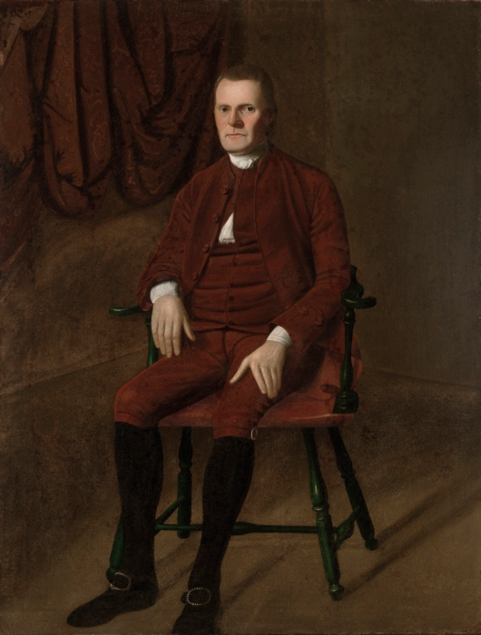
Option #3: “GREAT COMPROMISE” or CONNECTICUT COMPROMISE by Roger Sherman of CT – bicameral legislature
with the Senate based on equal representation and the House of Representatives based on population
Roger Sherman

Slide 34
The Decision?
Option #3: The Great Compromise

Slide 35
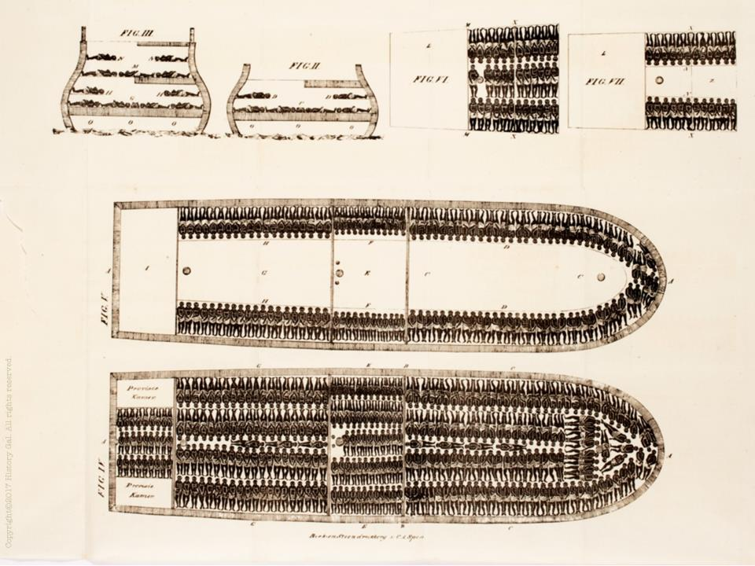
SLAVERY QUESTIONS
1. Would slaves count for population based representation?
3/5 COMPROMISE – slaves would count as 3/5 a person for the House of Representatives and for tax purposes

Slide 36
2. Would slavery be outlawed?
COMMERCE AND SLAVE TRADE COMPROMISE – Congress would not tax state exports and the slave trade would end in 1808
FUGITIVE SLAVE CLAUSE – “a person held to service or labour” who fled to another state would be returned to their owner

Slide 37
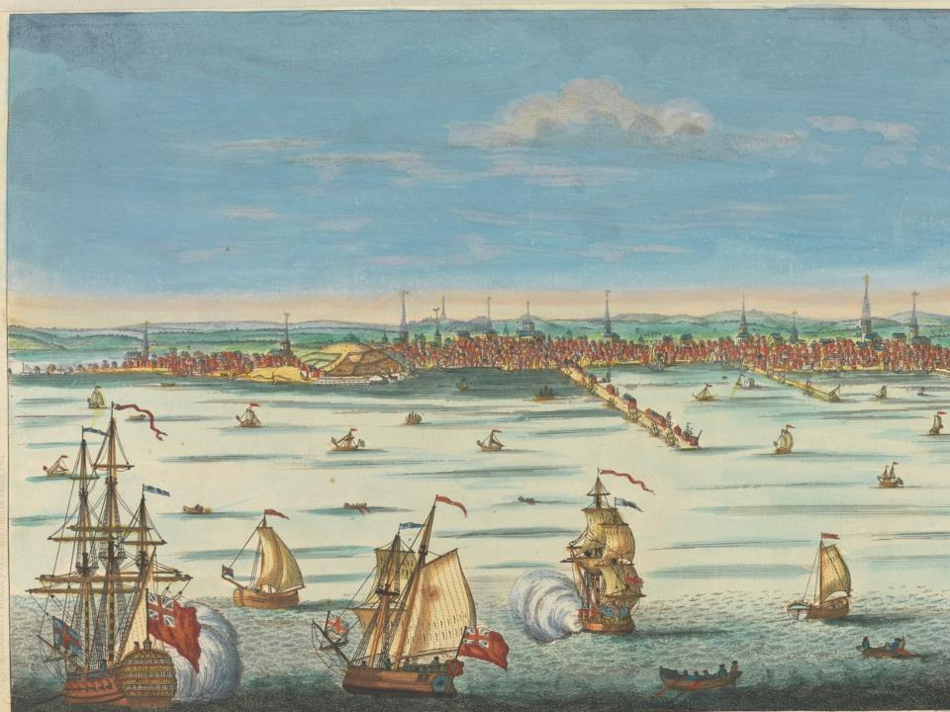
WHO WOULD BE IN CONTROL OF TRADE – STATES OR NATIONAL GOVERNMENT?
Congress can regulate interstate and foreign trade, could put tariffs on imports

Slide 38
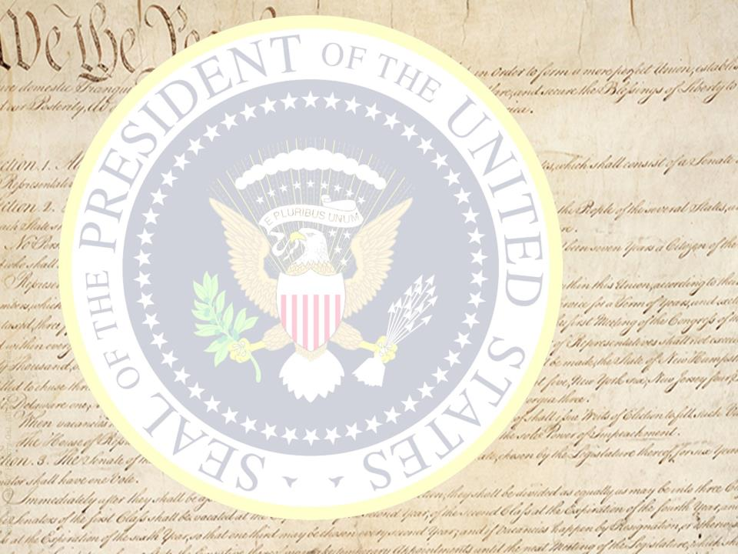
WHO WOULD BE THE LEADER OF THIS NEW GOVERNMENT?
President with power of veto, elected to a 4 year term (no term limit)
elected by the electoral college (voters for President chosen by local elections), winner has most electoral votes, runner up becomes Vice President

Slide 39
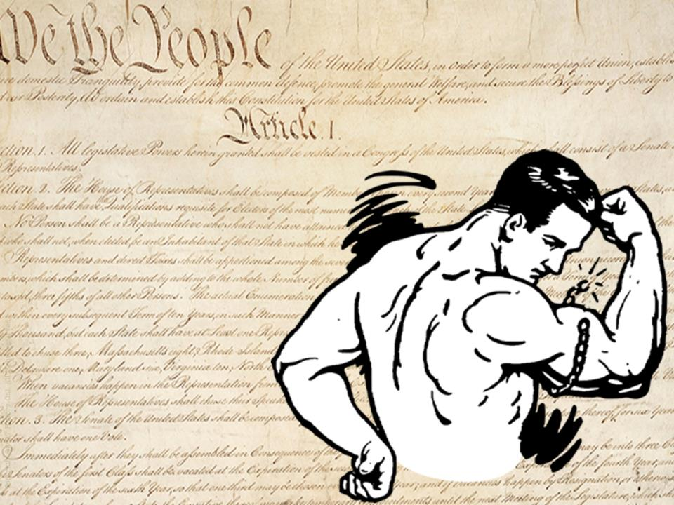
WHO HAS THE SUPREME POWER – STATES OR NATIONAL GOVERNMENT?
SUPREMACY CLAUSE – U.S. Constitution is supreme law of the land
NECESSARY AND PROPER CLAUSE (“elastic clause”) – gives Congress power to carry out the expressed powers listed in the Constitution

Slide 40
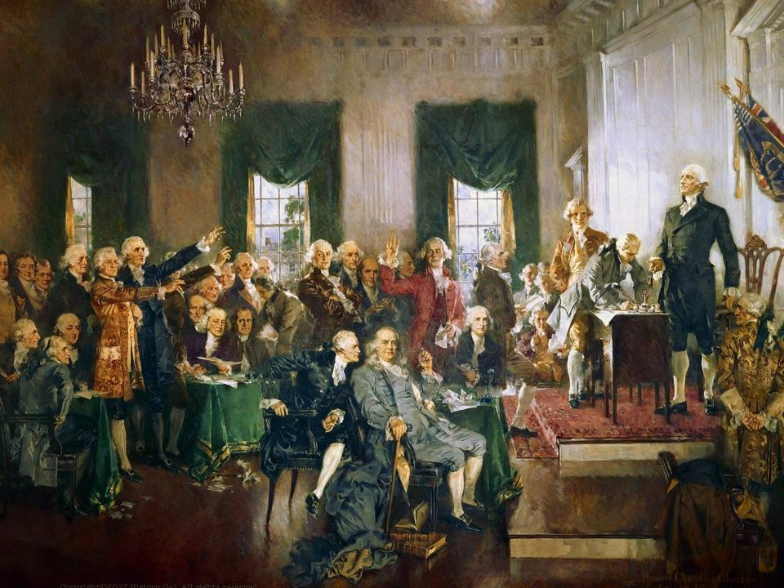
September 17, 1787 – Philadelphia Convention approved a draft of the Constitution to submit to the states for ratification
Constitutional Convention with raps by Alexander Hamilton
Constitutional Convention for Dummies

Slide 41
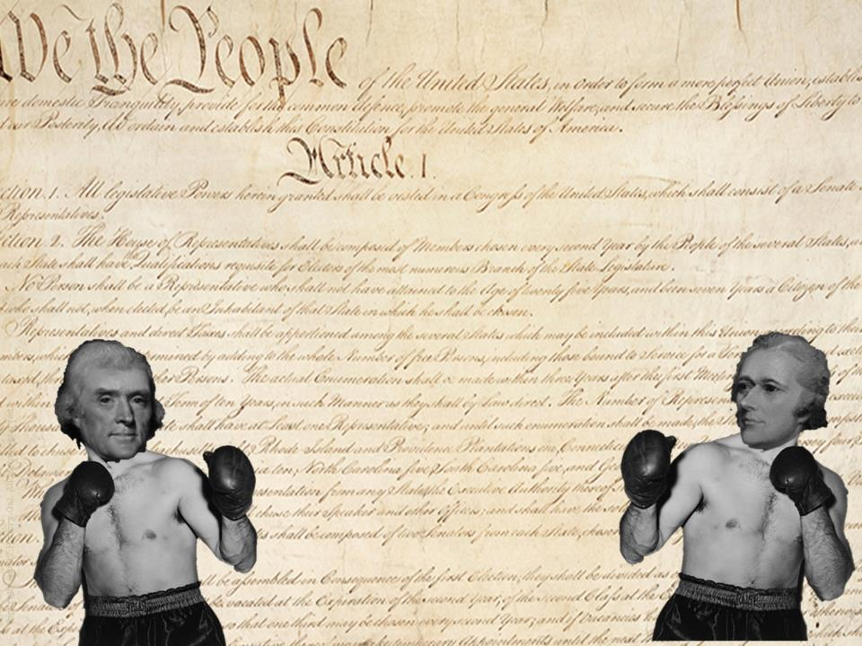
9 out of 13 states had to ratify the Constitution before it could go into effect
Ratification Debate:
FEDERALISTS – supported the Constitution and strong national government
ANTI-FEDERALISTS – opposed a
strong national government
Federalist v. Anti-Federalists
Why wasn’t the Bill of Rights Originally in in the Constitution?

Slide 42
FEDERALISTS
ANTI-FEDERALISTS
George Washington
Ben Franklin
James Madison
Alexander Hamilton
George Mason, Patrick Henry, James Winthrop, John Hancock, George Clinton
LEADERS
A strong national government was needed to maintain order and preserve the Union
A strong central government would destroy the work of the Revolution, limit democracy and limit states’ rights
ARGUMENTS
Emphasized the weaknesses of the Articles of Confederation, showed their opponents as negative with no solutions
Argued that the proposed Constitution contained no protection of individual rights, it gave the central government more power than the British king ever had
STRATEGY
Strong leaders, well organized
Appealed to popular distrust of
government
ADVANTAGES
Poorly organized, slow to respond to Federalist challenge
Constitution was new and
untried, lacked a bill of rights
DISADVANTAGES
Federalists v. Anti-Federalists

Slide 43
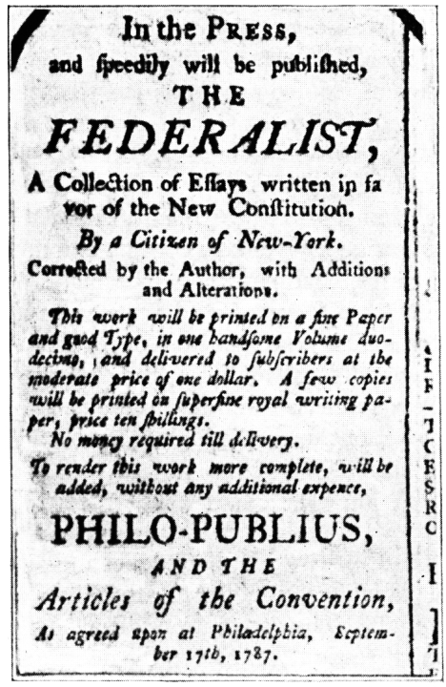
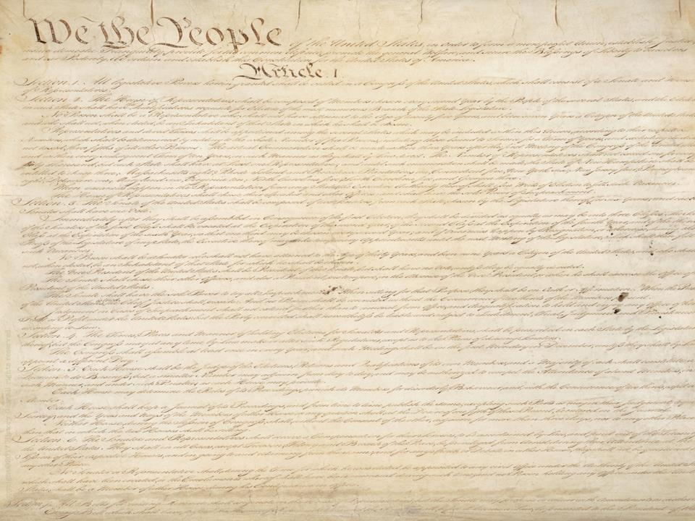
FEDERALISTS PAPERS
To try to convince people to accept the Constitution, James Madison, Alexander Hamilton, John Jay wrote the Federalist Papers (85 essays that gave reasons for ratification)
James Madison
John Jay
Alexander Hamilton

Slide 44
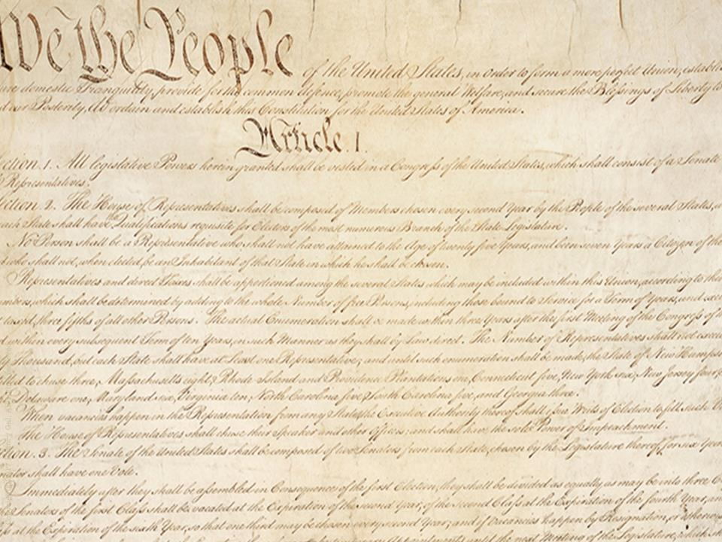
OUTCOME
Delaware, New Jersey, Pennsylvania first to ratify
Promise of adding a bill of rights convinced other states to ratify
June 1788 -Nine out of thirteen states ratified the Constitution
Government created under the Constitution came into effect in 1789
*

Slide 45
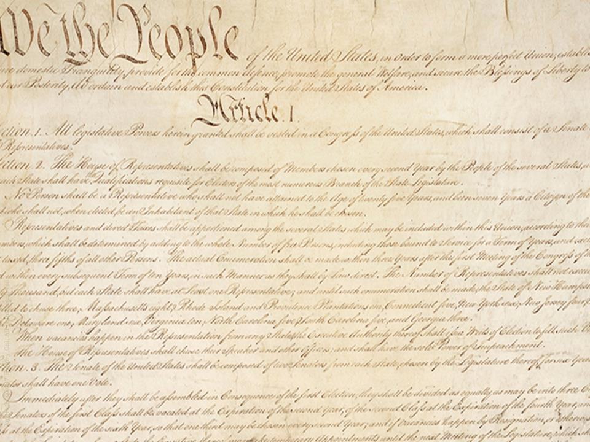
Last to ratify – VA, NY, NC, RI (1790)
NEW YORK CITY was the first temporary Capital
GEORGE WASHINGTON was the first President (only president to be elected unanimously – twice!)
Shmoop Constitution Video
Crash Course – Constitution

Slide 46
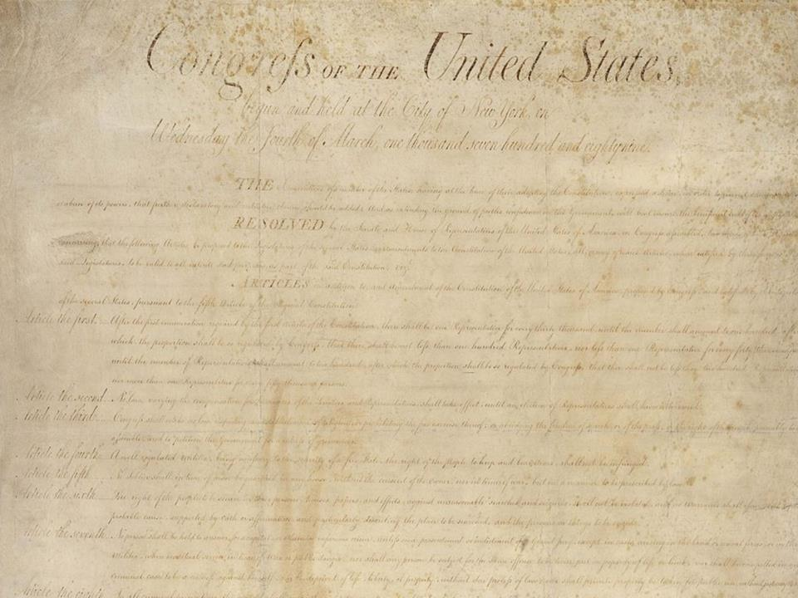
BILL OF RIGHTS
Federalists – against, better to assume all rights protected than to create a limited list
Anti-federalists – for, only a bill of rights could protect Americans from a strong central government becoming tyrannical
Federalists v. Anti-Federalists Song

Slide 47
BILL OF RIGHTS
Sept. 1789 – 12 amendments were approved by Congress and sent to the states for ratification.
10 of the 12 amendments were ratified in Dec. 1791 and added to the Constitution as the Bill of Rights.

Slide 48
BILL OF RIGHTS (Amendments 1-10)
1st – freedom of religion, speech, press, petition, assembly
2nd – right to keep and bear arms
3rd – can’t be required to quarter soldiers in time of peace
4th – protected against unreasonable searches or seizures
5th – right to due process, no double jeopardy, can’t testify against oneself

Slide 49
BILL OF RIGHTS (Amendments 1-10)
6th – right to a speedy and public trial
7th – right to a trial by jury
8th – no cruel and unusual punishment
9th – reserves power to the people
10th – reserves power to the states
Bill of Rights Song

