Slide 1
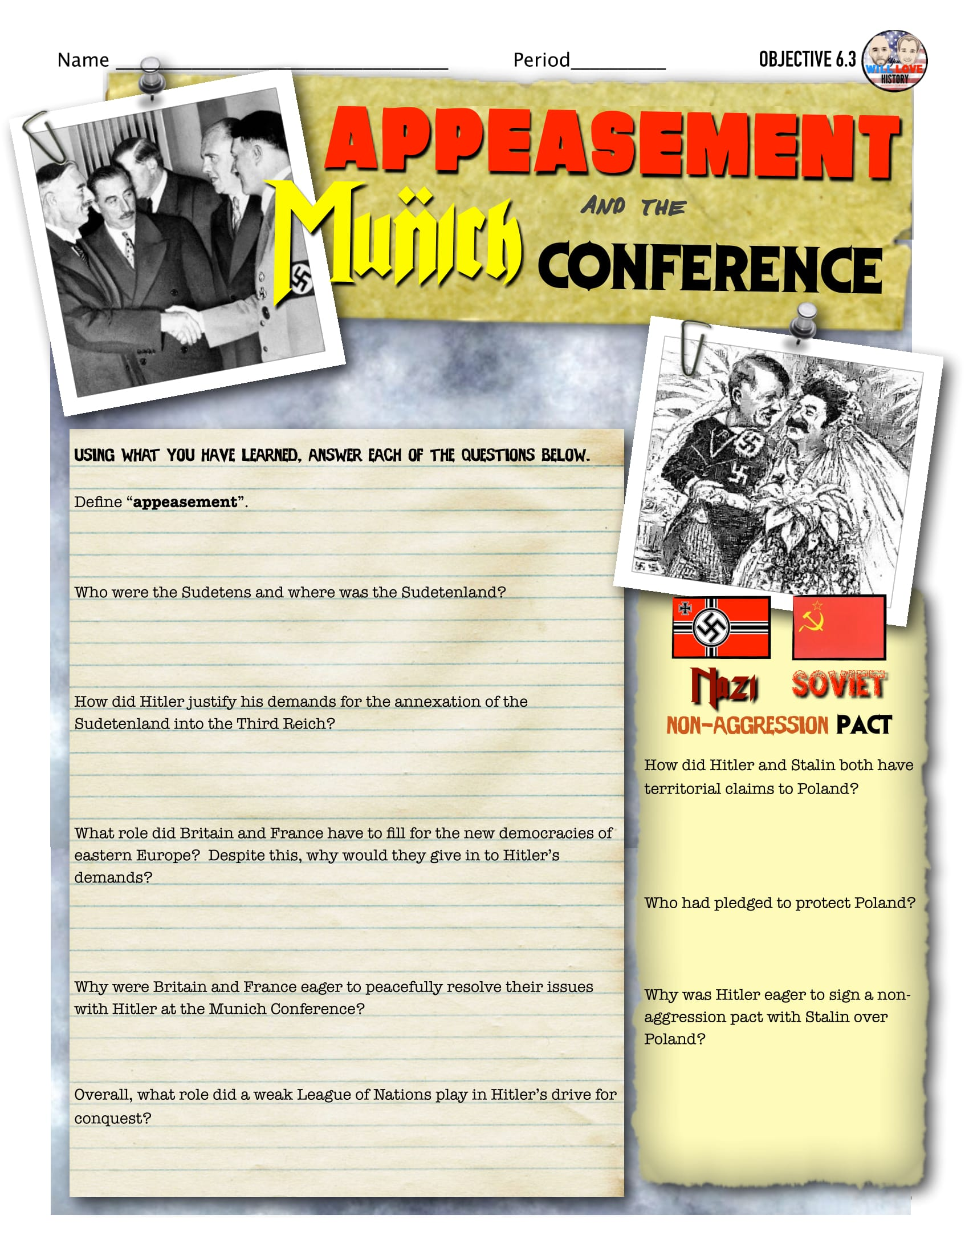
Name:

Slide 2
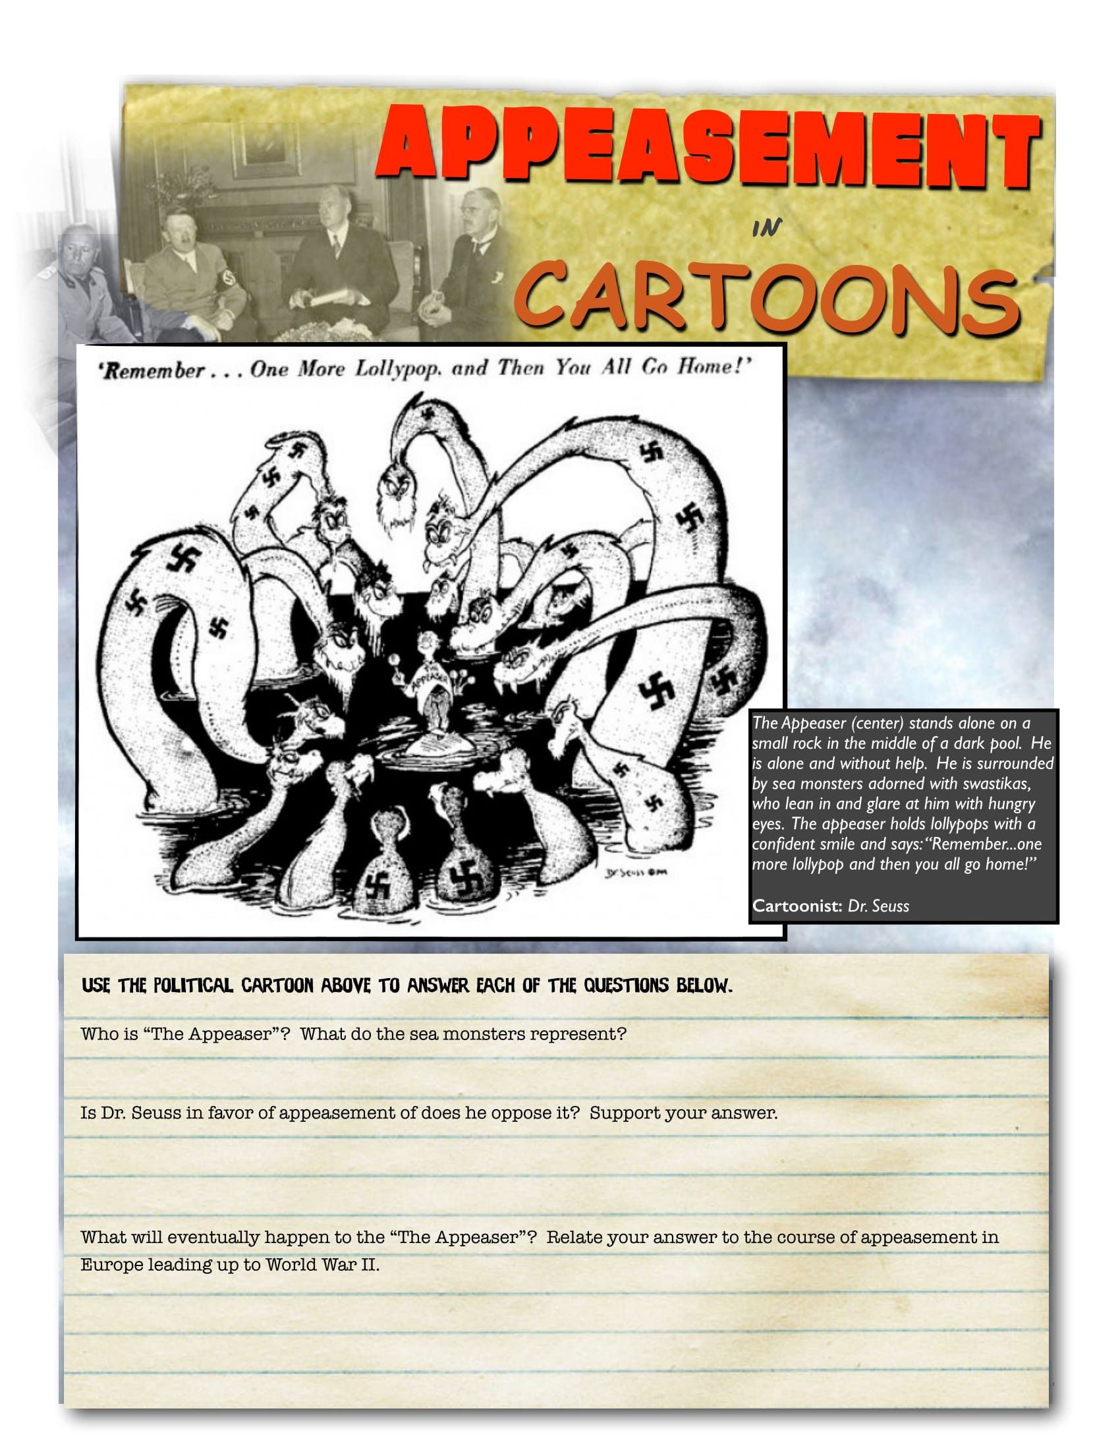
Appeasement

Slide 3
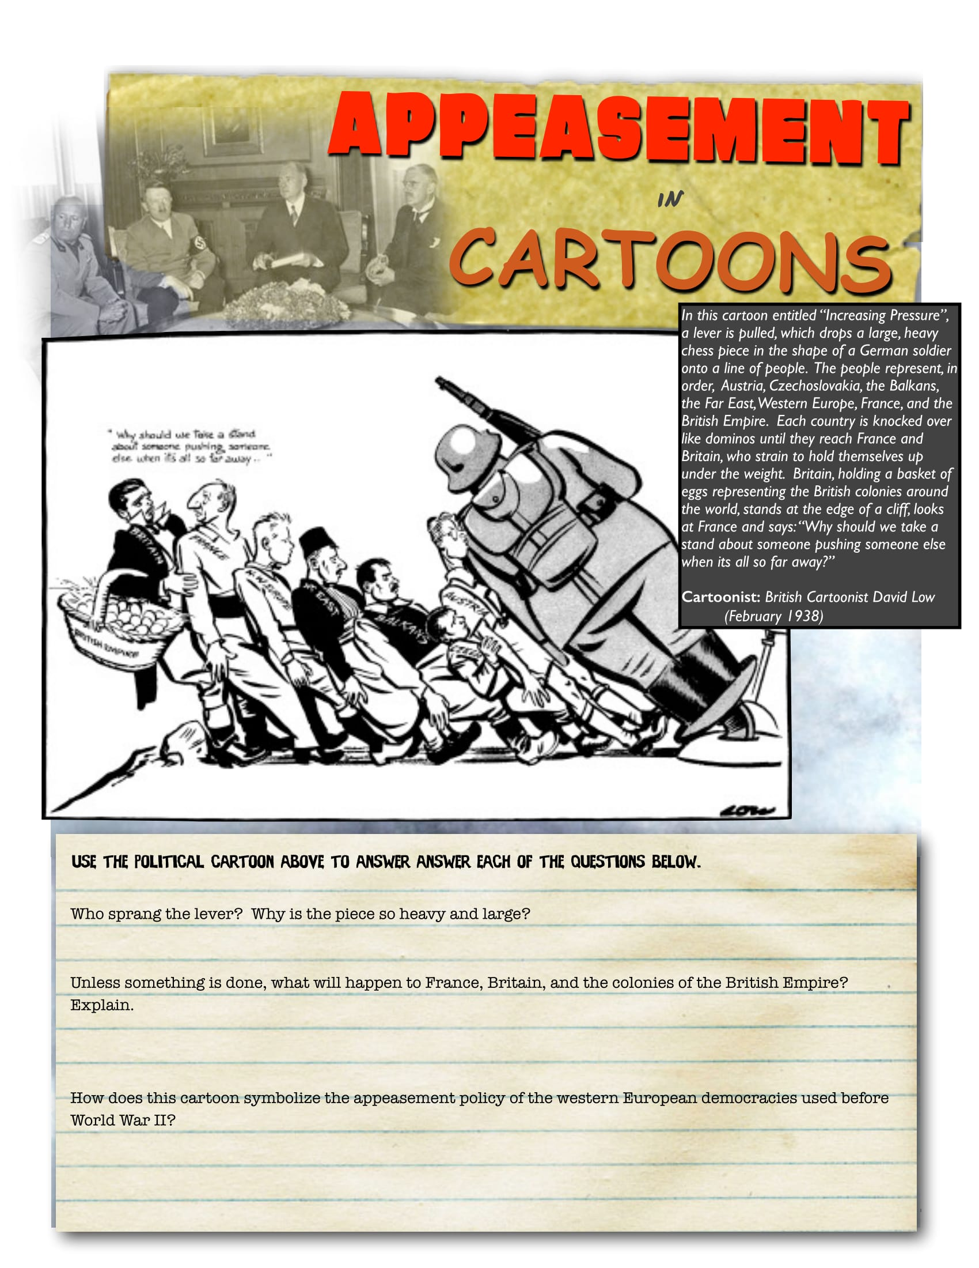
Appeasement
Why should we take a stand about someone pushing someone else, when it’s all so far away.

