Slide 13
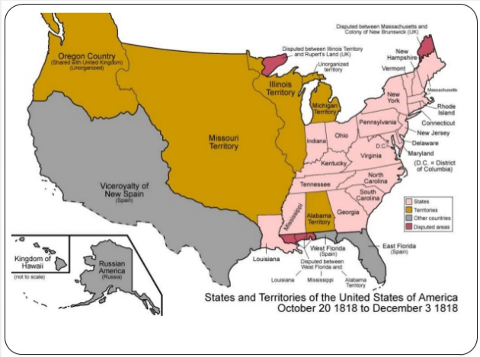

Slide 14
War of 1812
Causes
Orders in Council
Napoleon’s Continental System
Impressment
Battle of Tippecanoe
Events
War in Canada
1812
1813
War at Sea
1812
1813
War in the States
Battle of New Orleans
Effects/Results
Treaty of Ghent
Sense of Victory
Feeling of Patriotism
Rush-Bagot Agreement
Convention of 1818

