Slide 1
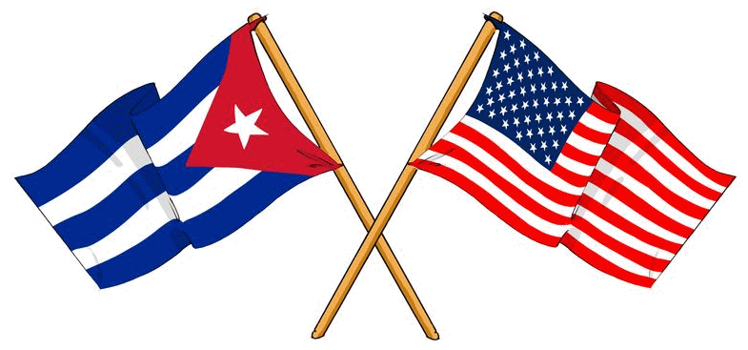
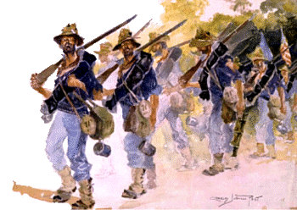
Spanish-American War
Cuban Economy
Cuban Independence from Spain
Newspapers
Yellow Journalism
Causes of the Spanish-American War
U.S. Declares War on Spain
The Triggering Events
Why was this a two-front war?
Manila Bay
San Juan Hill
Other Territories
Why is the Spanish-American War considered a turning point in U.S. History?

