Slide 1
United
States
in the

Slide 2
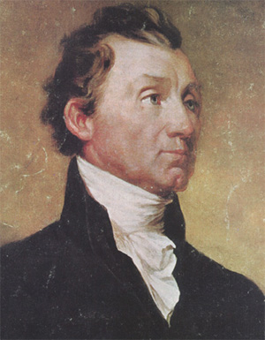
Monroe Doctrine: 1823
European countries should no longer interfere with independent nations in the Americas.
U.S. adopted a neutral policy and a moral opposition to colonialism.
Why do you think this might be the case?

Slide 3
Imperialism Vocabulary
Imperialism: when one country takes control of another country either directly or through economic or political dominance
Diplomacy: relationship between different countries
Annexation: taking control of a territory and adding it to an existing nation (to annex)
“Sphere of Influence:” areas of the world in which one country claims exclusive rights to trade and dominate.

Slide 4
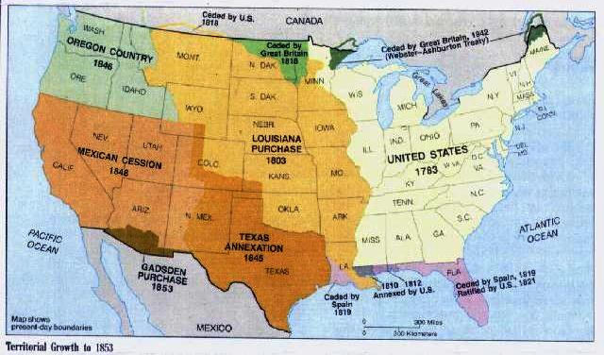
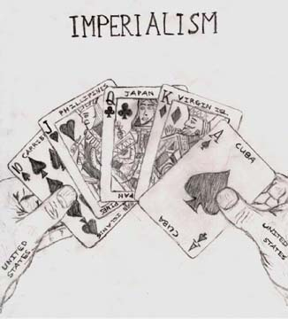
History of U.S. Expansion
1492-present
Three phases:
Phase #1: Colonial America west to the Appalachian Mountains.
Phase #2: Louisiana Purchase, Manifest Destiny and westward expansion.
Phase #3: Extending beyond the continental United States.

Slide 5
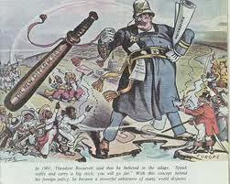
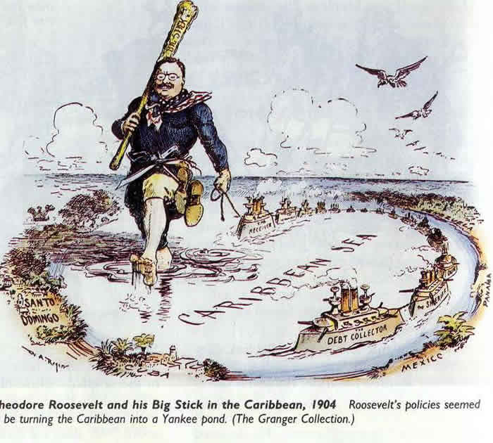
Approaches to Diplomacy
“Big Stick Diplomacy” (President T. Roosevelt)
The U.S. would use peaceful methods to protect its interests whenever possible, but that it would use military force if possible. “Speak softly and carry a big stick”.
“Dollar Diplomacy” (President W.H. Taft)
The U.S. would help maintain orderly societies in other countries by increasing American investment in foreign economies. Investments tended to increase American intervention in foreign affairs- particularly in Latin America.
“Moral Diplomacy” (President W. Wilson)
The U.S. would use negotiation and arbitration rather than force to settle international disputes.

Slide 6
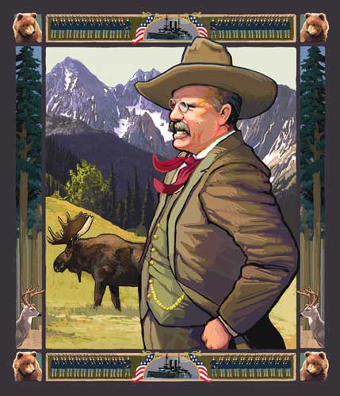
The Roosevelt Corollary
to the Monroe Doctrine…
“Chronic wrongdoing …justifies the exercise of an international police power.”
Expanded Monroe Doctrine allowed U.S. to step in if there were any problems- importance of being a “good neighbor”.
Intervention between 1900-1917 in: Cuba, Panama, Nicaragua, Dominican Republic, Mexico, Haiti

Slide 7
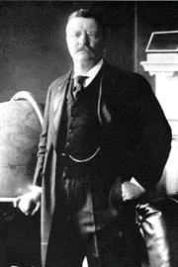
U.S. Becomes A World Power 1898: Theodore Roosevelt
Fought in the Spanish American War
Became president of the United States in 1901 when President McKinley was assassinated.
Focused on imperialism and expansionism.

Slide 8
Causes of U.S. Imperialism
Economic:
Need for natural resources
Desire to expand markets (trade) and invest profits (make money)
Outlet needed for growing population
Technological:
Medical knowledge
Advances in weaponry
Advances in overseas travel

Slide 9
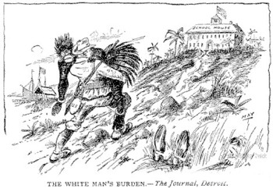
Causes of U.S. Imperialism
Social:
Desire to spread Christianity and Western civilization; a.k.a. “White Man’s Burden”
Belief in Social Darwinism and the superiority. Only the fittest nations rule and survive.
Feeling of Superiority: We are better and we must show them our way is the best way.
Desire to spread Democracy
Political and Military:
Bases needed for merchant and naval vessels or ships
National security
Aggressive Nationalism (jingoism)
Prestige of global empire

