Slide 1
Chapter 1: ​The Nation's Beginnings (Prehistory–1824)
This chapter will cover Native Americans and European colonization, The American Revolution, the creation of a government, and the nation’s early years.
Section 1: Many Cultures Meet
Section 2: The American Revolution
Section 3: The Constitution
Section 4: The New Republic

Slide 2
Objectives
  Discuss the migration of the first people to the Americas.
  Explain why Europeans wanted to develop a sea route to India in the 1400s.
  Describe the importance of trade in West Africa.
  Identify the effects of Christopher Columbus’s voyage to the Americas.

Slide 3
Terms and People
clans - extended family groups upon which most Native American cultures were based
Middle Passage - enslaved Africans’ transatlantic journey to the Americas on a slave ship
Christopher Columbus - Italian mariner sailing for the Spanish who accidentally encountered the Americas while traveling to the Indies in 1492

Slide 4
Terms and People (Continued)
conquistadors - Spanish explorers who established an empire around the Caribbean and throughout Central and South America
Columbian Exchange - the exchange of plants, animals, diseases, and ideas between Europe and the Americas following Columbus’s journey
Notes:
4

Slide 5

What were the causes and effects of European arrival in the Americas?
Europe’s Age of Exploration began as a search for an all-water route to Asia. In 1492, Europeans began to explore the Americas.
The arrival of European settlers and enslaved Africans brought traumatic changes to the many complex Native American cultures.

Slide 6
The first Americans migrated from Asia between 40,000 and 15,000 years ago.
Some scientists believe they crossed a land bridge over the Bering Strait.
Others believe they came by boat along the Pacific coast.
American Indians spread throughout the different landscapes of North and South America.
Notes:
6

Slide 7
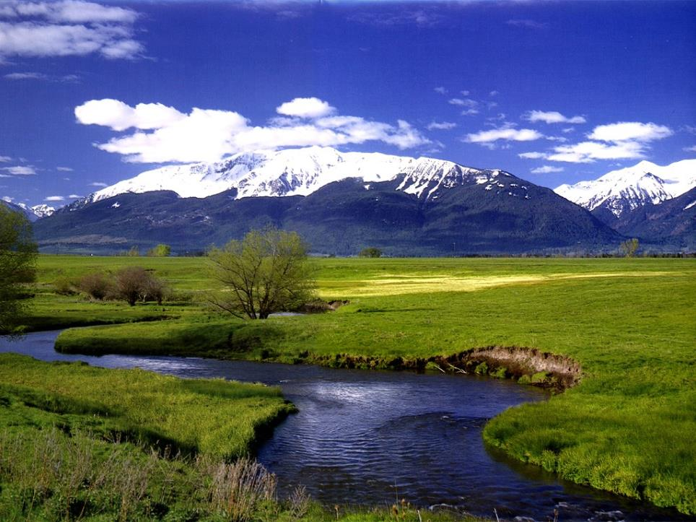
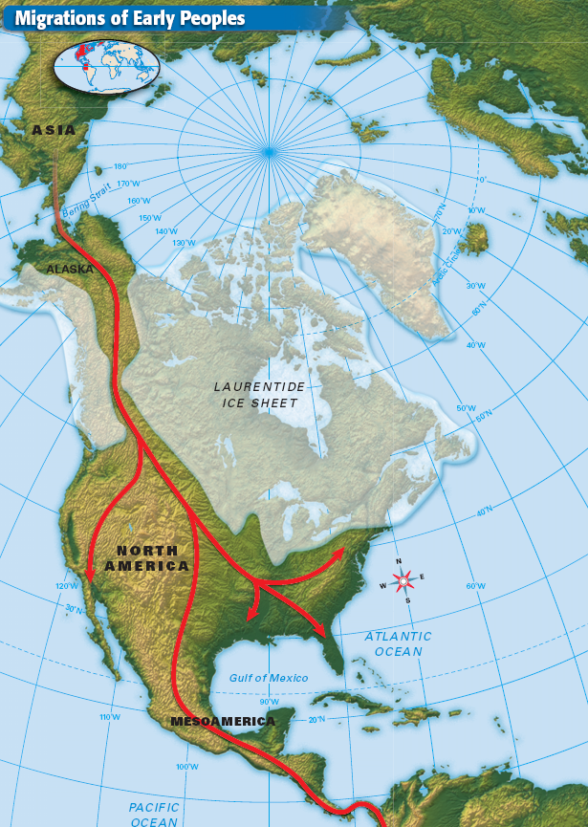
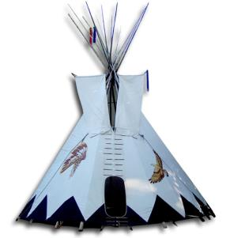
Earliest Americans
Native Americans were living in America between 15,000-30,000 years ago
Nomadic until they learned how to plant and raise crops.
Agriculture→ Civilizations
Diverse and Unique Cultures
a) Language
b) Housing
c) Economics
d) Food
e) Beliefs
Notes:
The first Americans arrived on the continent during the Pleistocene Ice Age (about 1.65 million until 10,000 years ago)
Northern and southernmost parts of the Americas covered by ice
Sea level was about 300 feet lower that it is today
The now-submerged land that connected the Asian and American continent is known as "Beringia."
The Paleo-Indians pursued migratory animals across the "land bridge" about 30,000 years ago
The Paleo-Indians dispersed southward

Slide 8
Culturally diverse Native Americans shared several characteristics:
  1
They lived in extended family groups called clans.
Clans identified with spirits of powerful animals.
American Indians believed powerful spiritual forces were part of nature.
  2
  3
Notes:
8

Slide 9
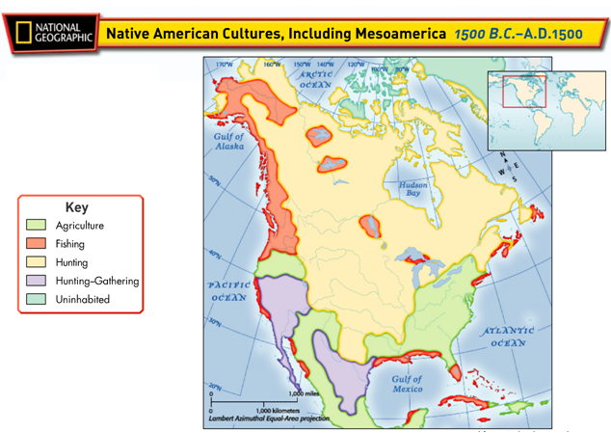
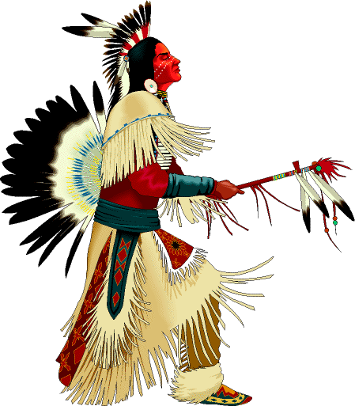
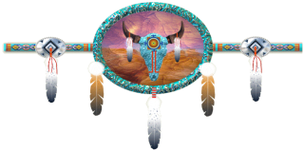

Slide 10
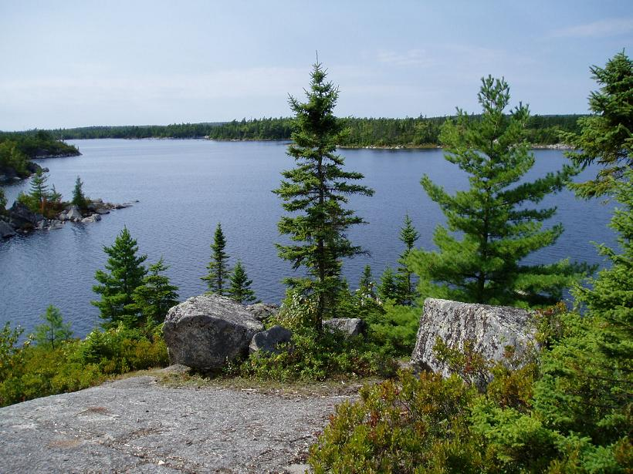
In what ways were Native American tribes different region to region?
Checking for Understanding
housing, language, economy, food, beliefs

Slide 11
  Indians of Central Mexico cultivated squash, corn, and beans 3,500 years ago.
  Expanded food supplies led to towns and cities under powerful chiefs.
Agriculture
led to the growth of civilizations.
Notes:
11

Slide 12
Native American Culture Regions About 1450

Slide 13
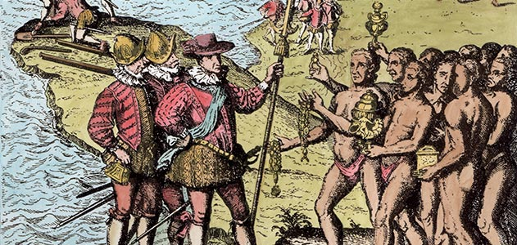
Native American: Way of Life | European: Way of Life
GIVING A respected person is one who gives. A person who hoards is watched with distrust. | SAVING A respected person is someone who saves. Even education is an investment in the future.
COOPERATION Cooperation is healthy and essential. Anyone who tries to stand out is showing off. They believe in team effort for the most part. | COMPETITION Competition is healthy and essential. You do not have to win but you must try to achieve first place. There was some cooperation.
HARMONY WITH NATURE Accepts nature. They do not try to change it. If a log falls across a creek, no one moves it. The creek path might change, but that is harmony. Farmers did plant seed and irrigate their crops, but these are exceptions. | CONQUEST OVER NATURE Controls nature by building dams and power plants. There are preserves set aside where land, plant, and animal life are in their natural state, but these are exceptions.
Based on the information provided how might European explorers and American Indians perceive one another?

Slide 14
Between the 14th and 16th centuries, Europe was changed by the Renaissance.
Scientific advances and an increase in economic wealth gave rise to voyages of exploration.
Economic wealth led to voyages of exploration as monarchs sought trade from Asia and Africa.
Notes:
14

Slide 15
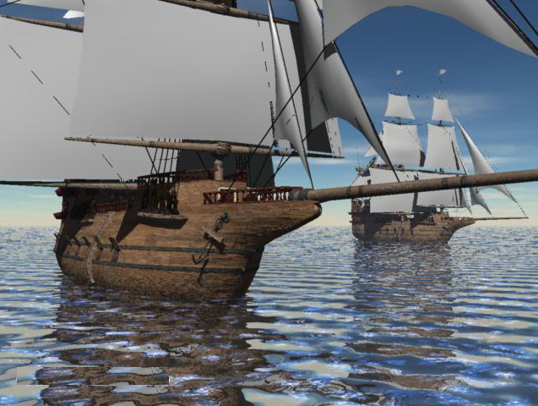
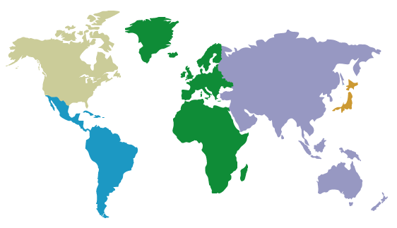
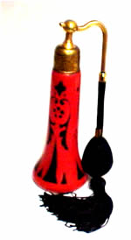
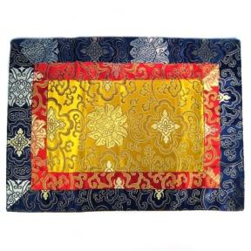

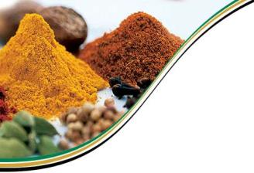
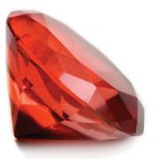

Age of Exploration
1400s Europe was interested in Asia for spices, perfumes, fine silks, and jewels
Hoped to find a sailing route through that would bypass Italy and the Middle East
Gems
Spices
Tea
Perfume
Silk

Slide 16
Portuguese mariners rounded the southern tip of Africa and eventually reached India.
But on the way, some mariners stopped to trade with West African nations.
They sought gold and salt, and they enslaved Africans.
Between 1500 and 1800, 11 million slaves crossed the Atlantic, a trip known as the Middle Passage.
Notes:
16

Slide 17
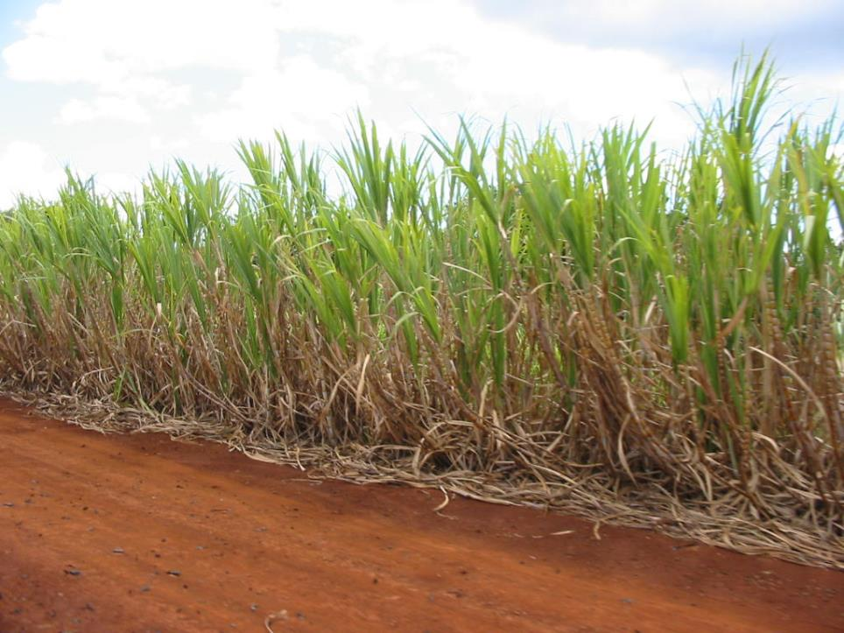
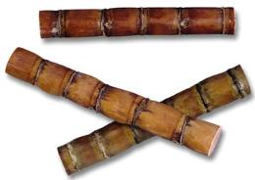
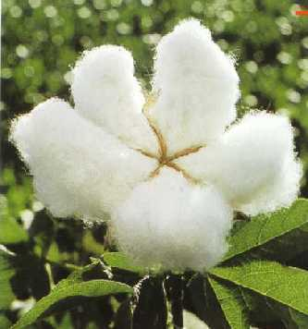
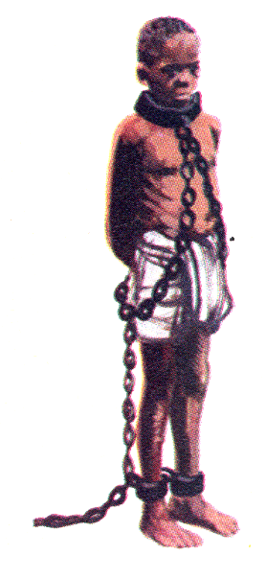
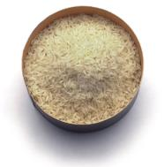
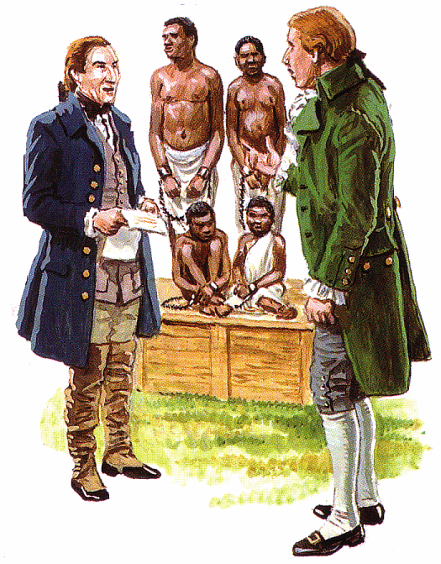
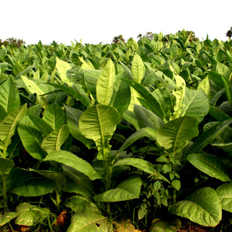
Establishing
Colonies
By the 1600s the French and English had established colonies in the eastern part of North America
They began importing enslaved Africans to grow sugar, rice, cotton, and tobacco.
CASH CROPS

Slide 18
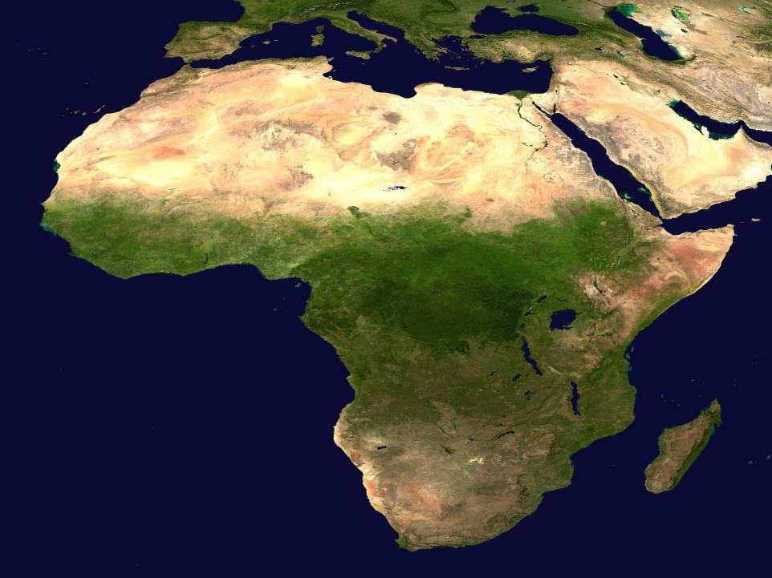
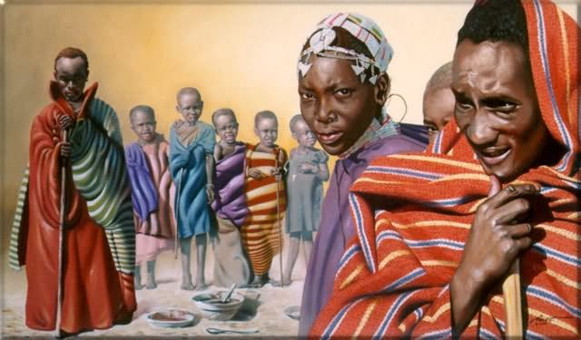
Why Africans for Slavery?
Africans had some immunity to European diseases
Had experience farming
Less likely to escape because they didn’t know the land
Their skin color made it easier to catch them if they escaped

Slide 19
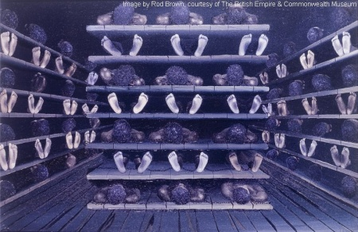
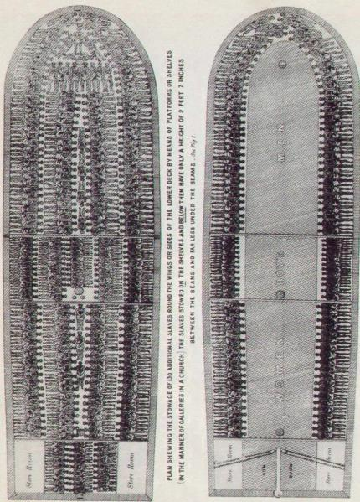
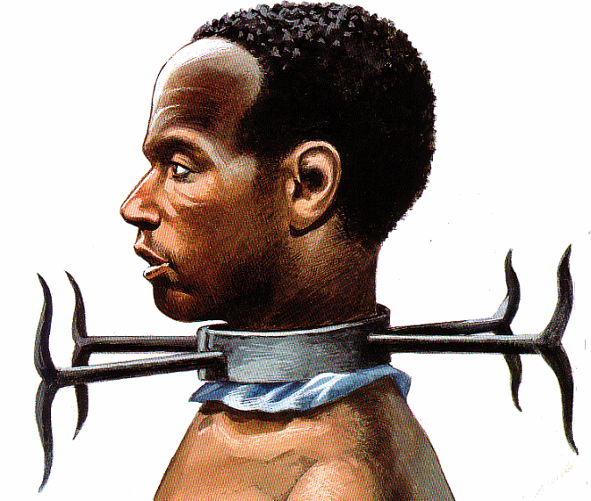
During the 15th century Africans were captured, enslaved and shipped to the New World.
20% of the Africans onboard would not survive the journey

Slide 20
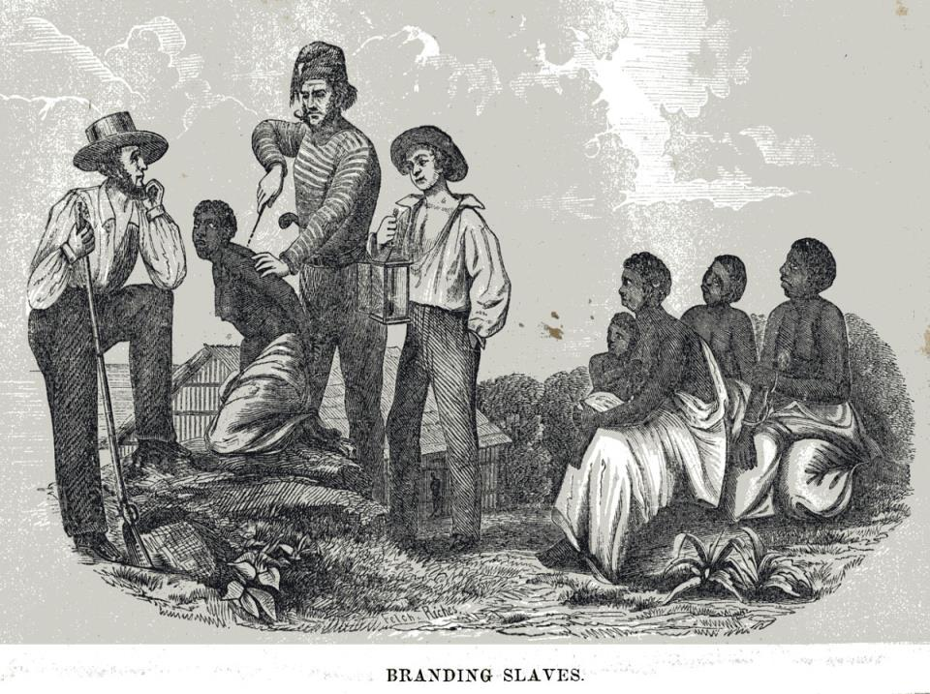
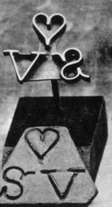
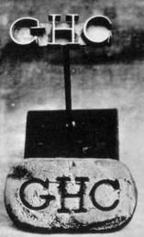
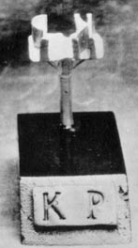

Slide 21
What were some of the positive and negative consequences of the arrival of Europeans in the New World?
Checking for Understanding
Positives- Columbian Exchange
Negatives- brought diseases that killed millions of Native Americans, use of slave labor

Slide 22
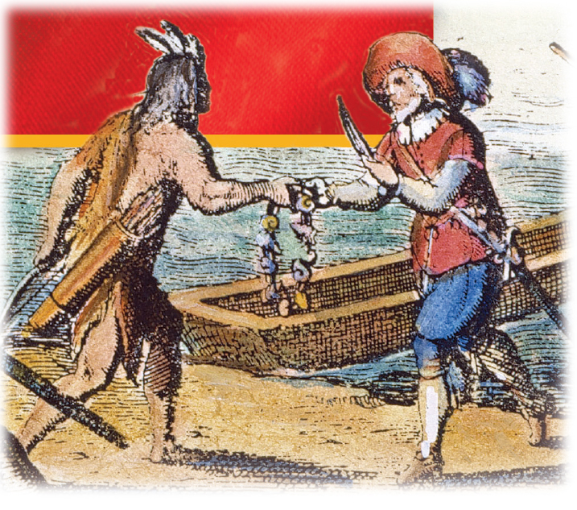
In 1492, Italian mariner
Christopher Columbus sailed westward for Spain seeking an alternative route to Asia.
Although he landed in the Caribbean, he believed the islands were the Indies. He called the natives Indians.
Europeans converted the Indians to Christianity, took their land, and enslaved them.
Notes:
22

Slide 23
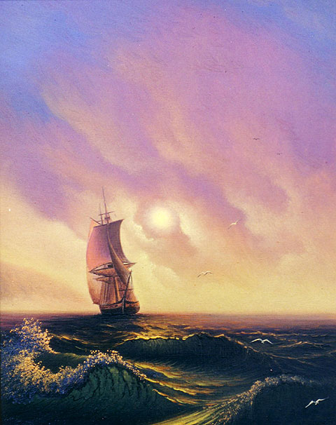
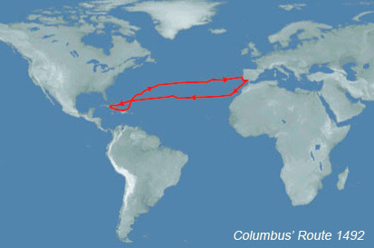
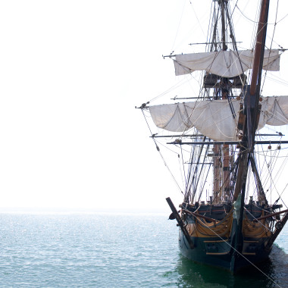
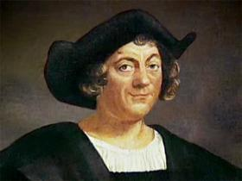

Christopher Columbus
Christopher Columbus, was convinced that he could reach Asia by sailing west.
In 1492 Columbus, set sail with three ships and landed on present-day San Salvador Island.
Notes:
http://www.danielnpaul.com/ChristopherColumbus.html
http://www.history.com/topics/exploration/columbus-controversy#

Slide 24
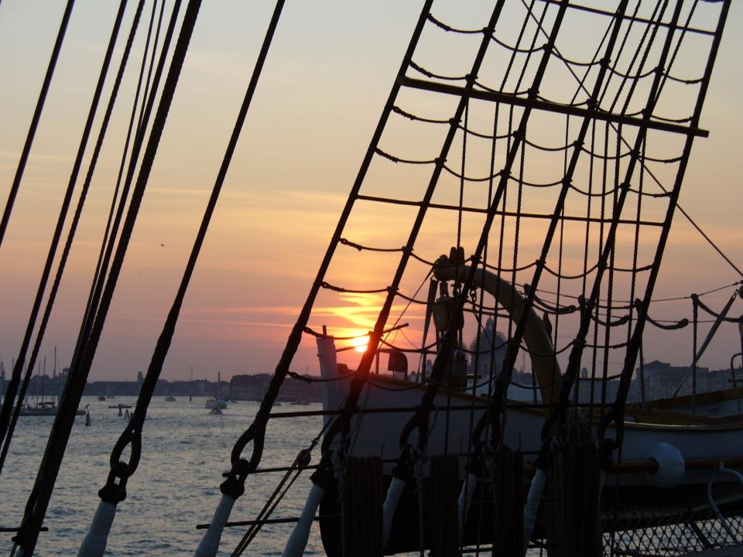
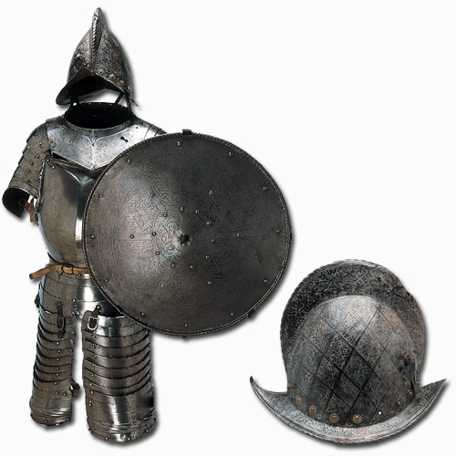
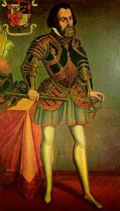
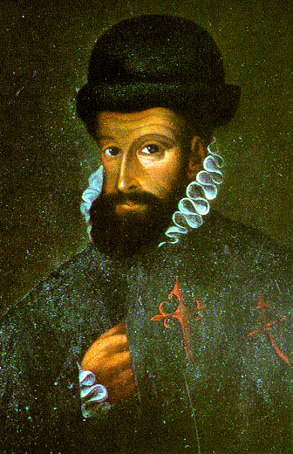
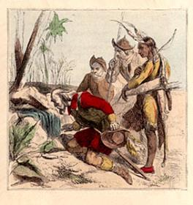
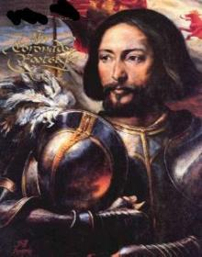
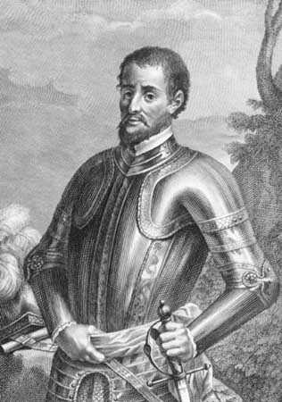
Columbus launched a wave of European exploration and settlement
a) Cortez→ Mexico
b) Pizarro→ Peru
c) Ponce→ Florida
d) Vasquez→ Southwest
e) Hernando→ Southeast
Exploring the New World

Slide 25
Spanish conquistadores established an empire around the Caribbean and in Central and South America.
1519–21 | Hernán Cortés defeated the Aztecs.
1513 | Juan Ponce de Leon explored Florida.
1539–42 | Hernando de Soto explored parts of the Southeast to the Mississippi River.
Notes:
25

Slide 26
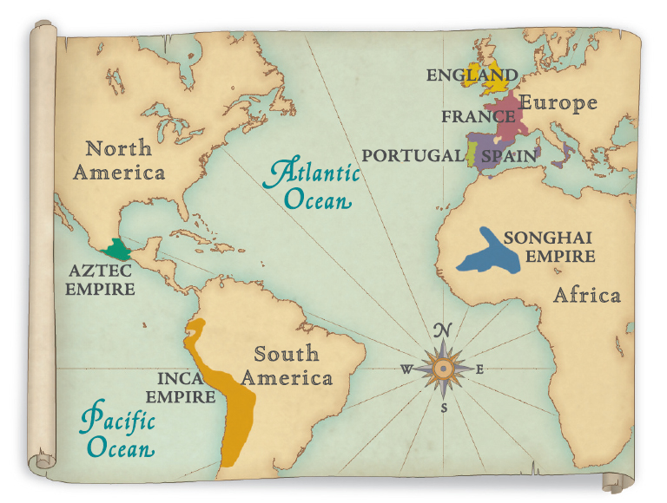
The World in 1500

Slide 27
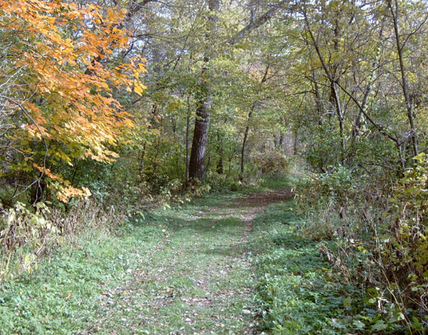
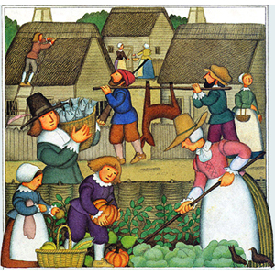

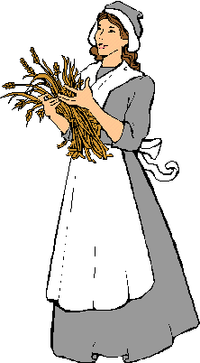

European Impact
Europeans in the Americas had both positive and negative consequences.
  Positives: the exchange of new foods, farming methods, inventions, and technology.
  Negative: Native American population was exposed to diseases that they had no immunity to

Slide 28

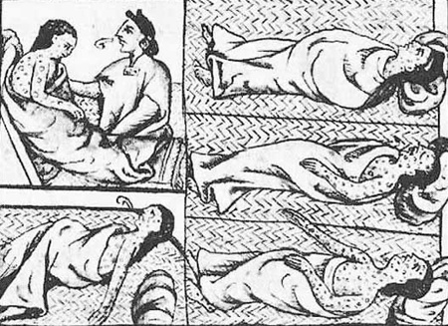
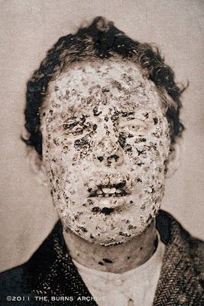
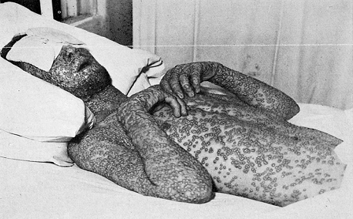
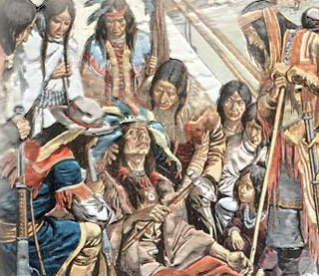

Disease
Disease such as smallpox would kill off 90% of the Native American population.
They had never be exposed to such diseases before and had no immunity to them

Slide 29
The traffic of plants, animals, tools, diseases, and ideas between Europe and the Americas after 1492 is called the Columbian Exchange.
Europeans diversified their own agriculture, adopting American Indian crops such as maize and potatoes.
Animals such as pigs, horses, mules, sheep and cattle were introduced to the Americas.

Slide 30


Columbian Exchange
Where did it originally come from?
  Americas or Europe

Slide 31

Columbian Exchange
Where did it originally come from?
  Americas or Europe

Slide 32
Columbian Exchange
Where did it originally come from?
  Americas or Europe

Slide 33
Columbian Exchange
Where did it originally come from?
  Americas or Europe

Slide 34
Columbian Exchange
Where did it originally come from?
  Americas or Europe

Slide 35
Columbian Exchange
Where did it originally come from?
  Americas or Europe

Slide 36
Columbian Exchange
Where did it originally come from?
  Americas or Europe

Slide 37

Columbian Exchange
Where did it originally come from?
  Americas or Europe

Slide 38
Ch1.1 Recap
Effects of Mixing Cultures
First Americans
Crossed Bering Sea
Diverse cultures
Agriculture
Renaissance
Wealth
Exploration
Trade
Spices
African slaves
Columbus
Conquistadors
Columbian Exchange
+ Agriculture
- Diseased Natives

