Slide 2
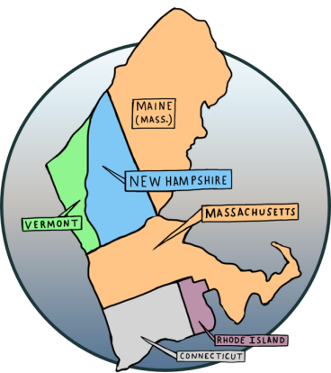
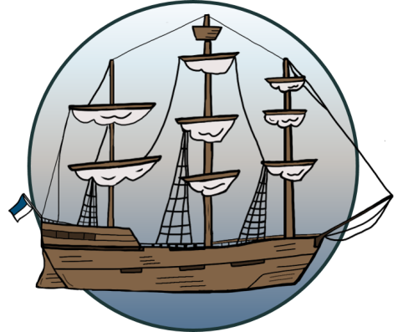
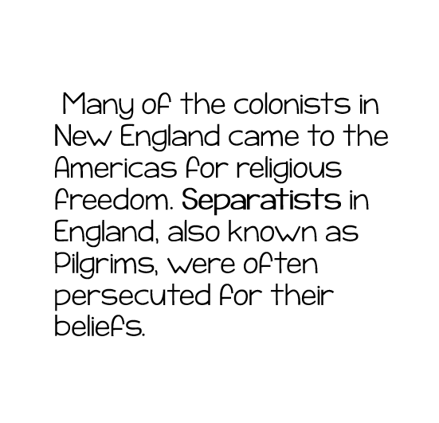
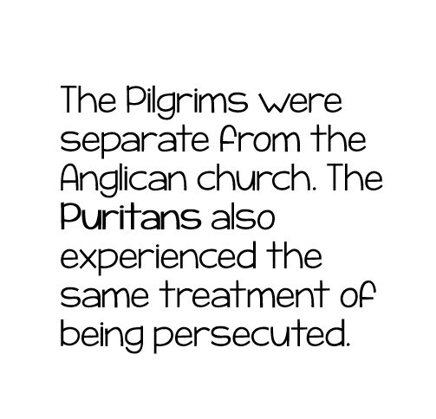
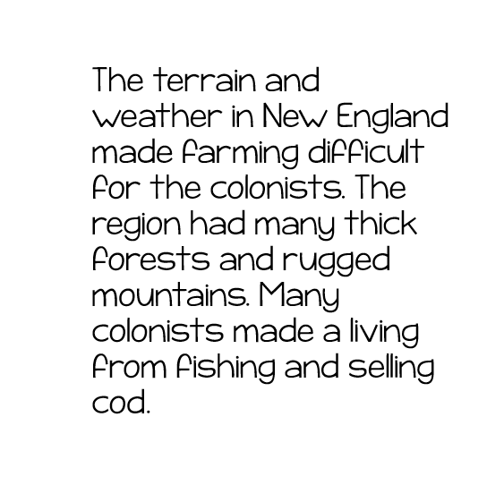

Slide 3
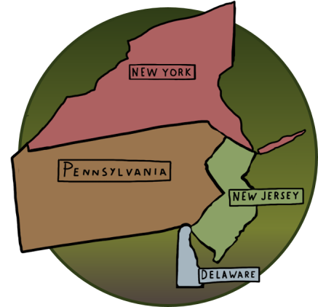
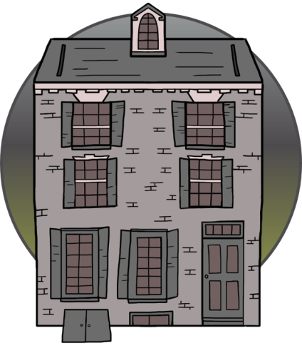
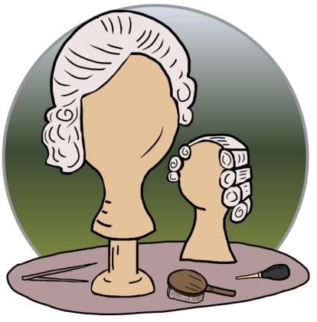
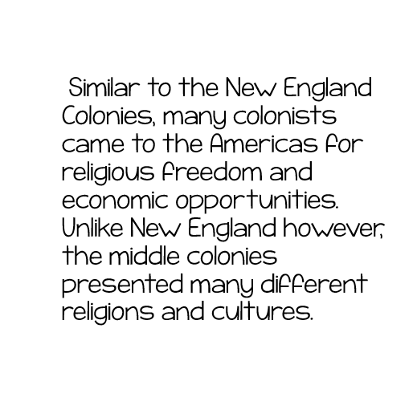
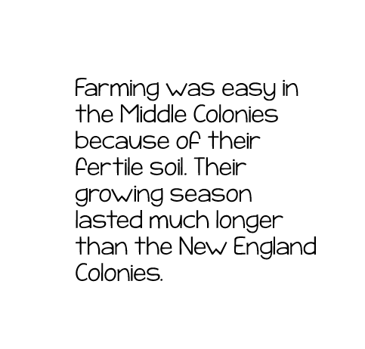

Slide 4
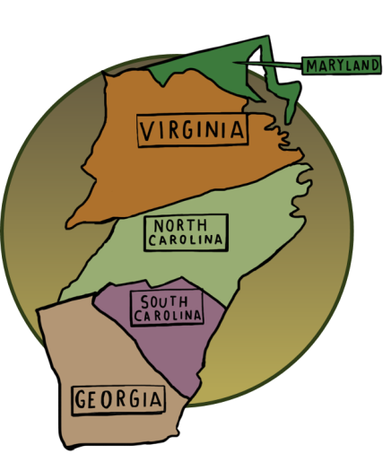
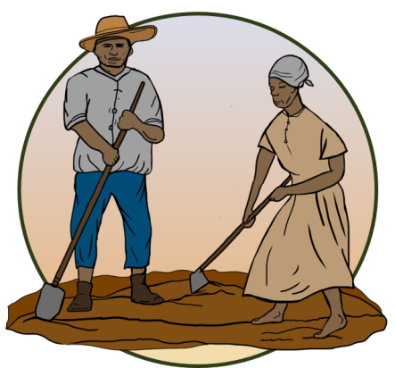
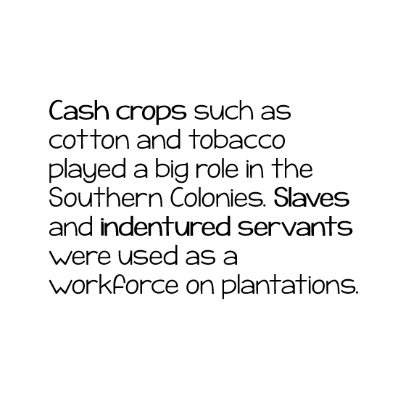
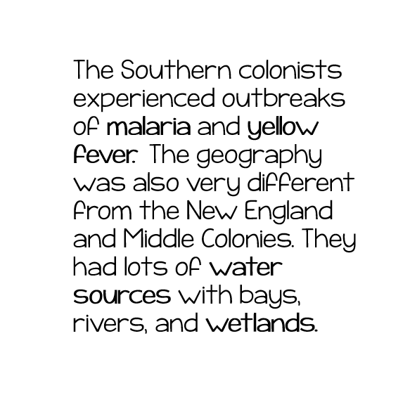

Slide 5
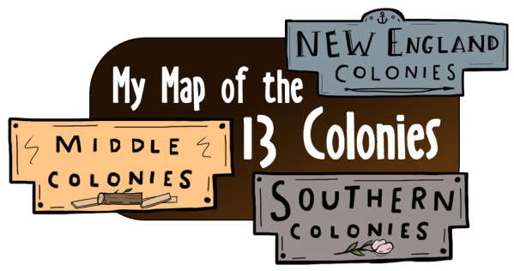
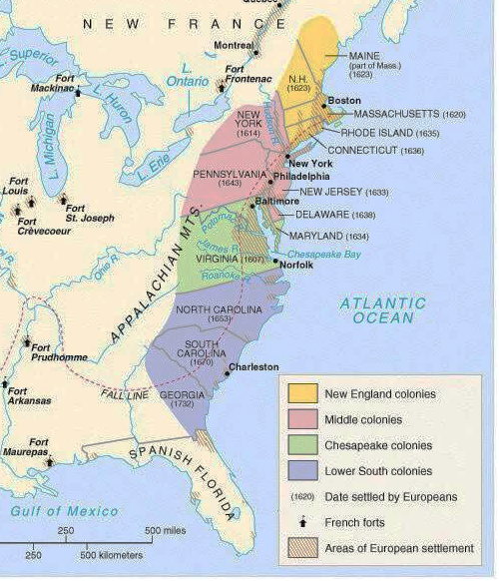

Slide 6
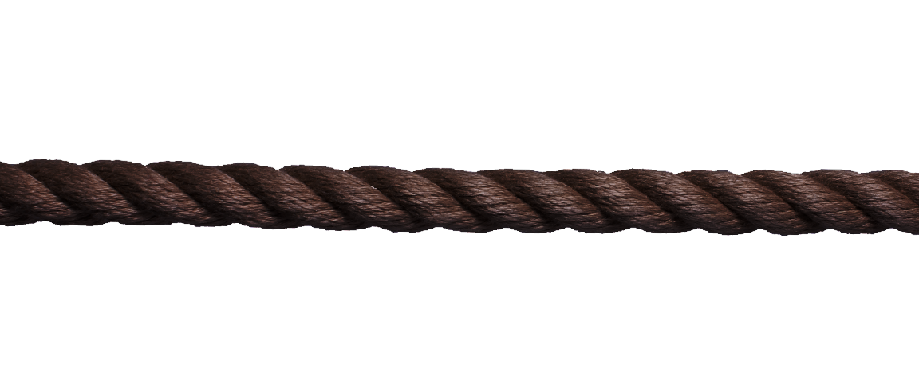
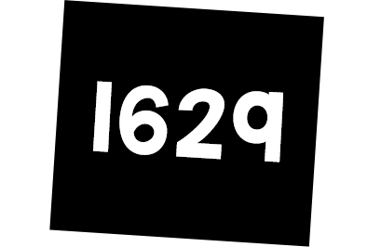
Plymouth
Colony founded
Colony of Virginia
founded
Colony of New Hampshire founded

Slide 7
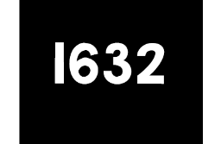
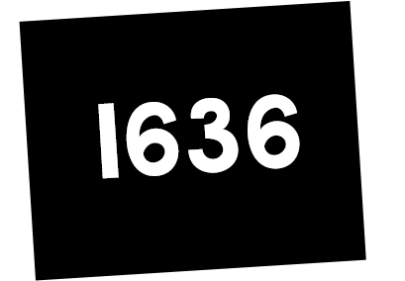
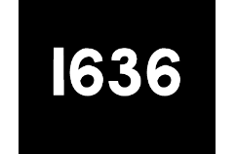
Massachusetts
Bay Colony
Founded
Colony of Rhode Island founded
Colony of Maryland founded
Colony of Connecticut
founded

Slide 8
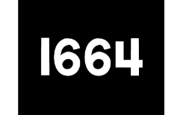
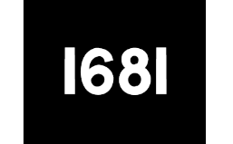
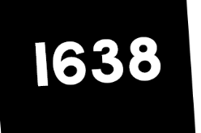
Colony of New York founded
Colony of New Jersey founded
Colony of Pennsylvania
founded
Colony of Delaware founded

Slide 9
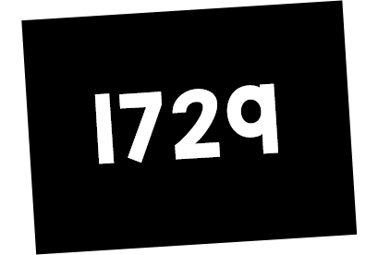
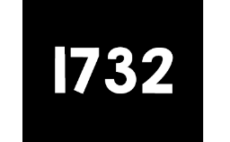
North Carolina and South Carolina become separate colonies
Georgia Colony founded

Slide 10
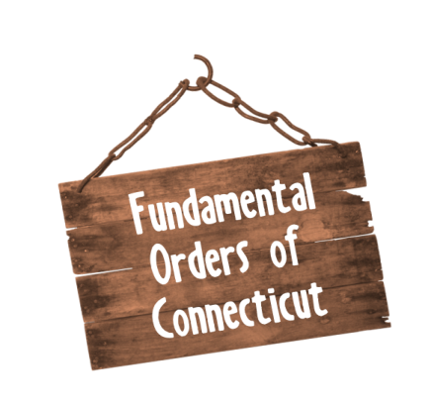
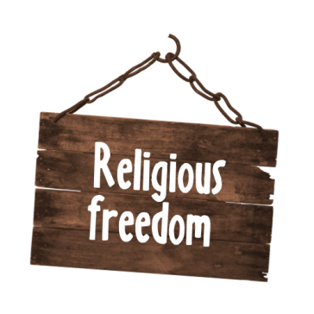
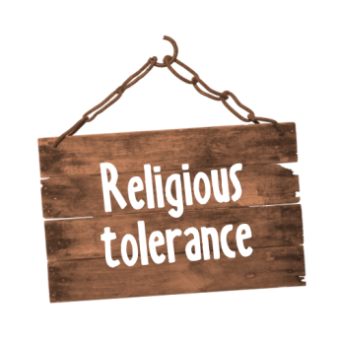
The right to choose a religion (or no religion) without interference by the government.
A member of a non-established church; a Nonconformist. Someone who disagrees with the opinion or beliefs of a religious group.
It was the first written constitution in America. It limited government powers and guaranteed more rights to individuals.
When individuals allow other individuals to think or practice other religions and beliefs.

Slide 11
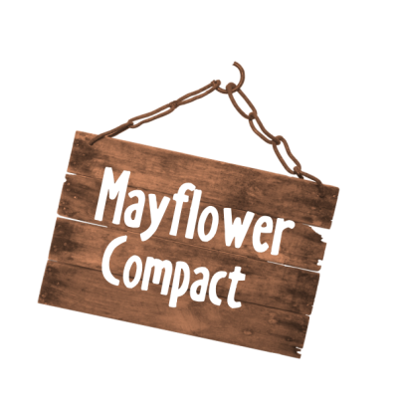
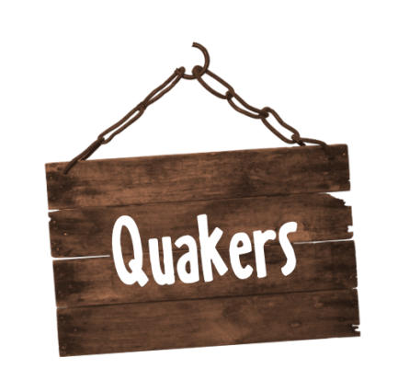
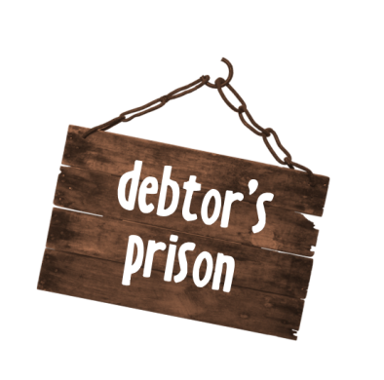
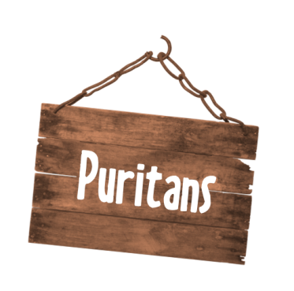
An agreement reached by the Pilgrims on the ship the Mayflower in 1620, just before they landed in Plymouth
A member of a group of English Protestants of the late 16th and 17th centuries
A debtors' prison is a prison for people who are unable to pay debt.
A member of the Religious Society of Friends. They are members of a historically Christian group of religious movements

Slide 12
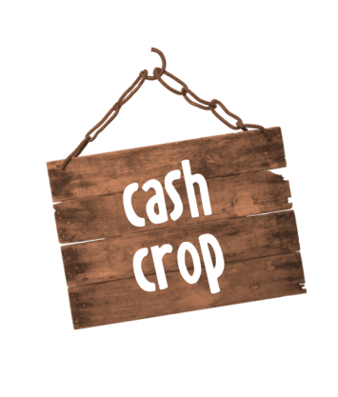
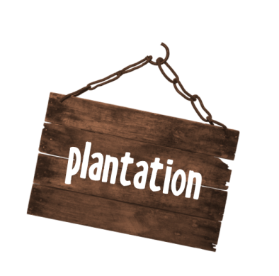
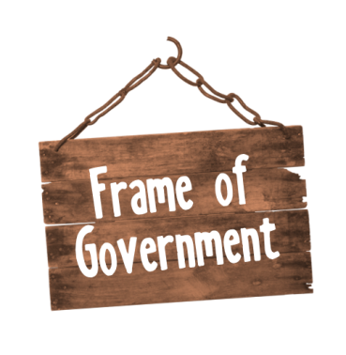
It was a constitution the colony of Pennsylvania granted to William Penn by Charles II of England
An estate on which crops such as coffee, sugar, and tobacco are cultivated by resident labor.
A crop produced for its commercial value rather than for use by the grower
A person who makes and repairs things in iron by hand.

Slide 13
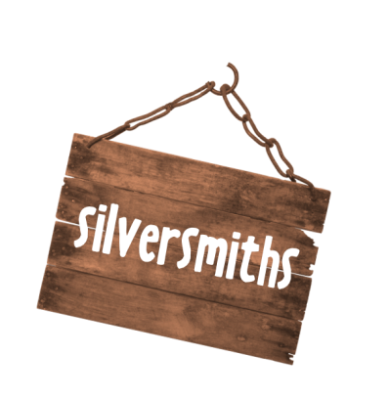
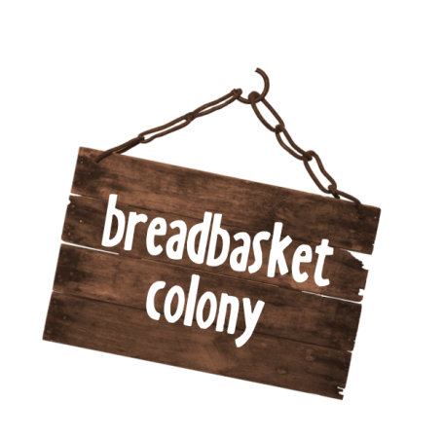
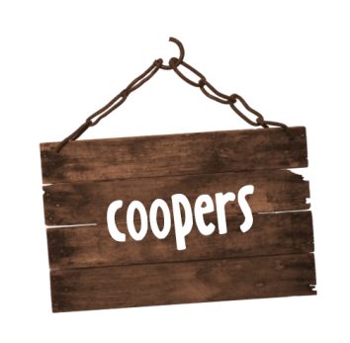
A person who makes silver articles.
A maker or repairer of casks and barrels.
A person employed to make public announcements in the streets or marketplace of a town.
“Breadbasket colonies" were the Middle Colonies, included Pennsylvania, Delaware, New York and New Jersey. They grew more food than the Middle or England colonies.

Slide 14
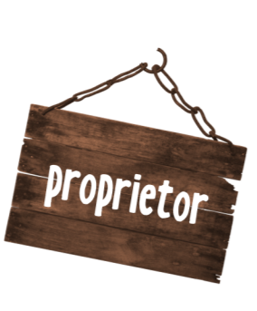
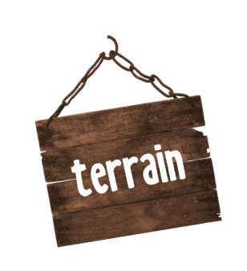
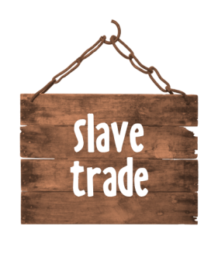
A worker in a skilled trade, especially one that involves making things by hand.
The transporting and selling of human beings as slaves
The owner of a business, or a holder of property.
A stretch of land, especially with regard to its physical features.
A person under contract to work for another person for a definite period of time, usually without pay but in exchange for freedom

Slide 15
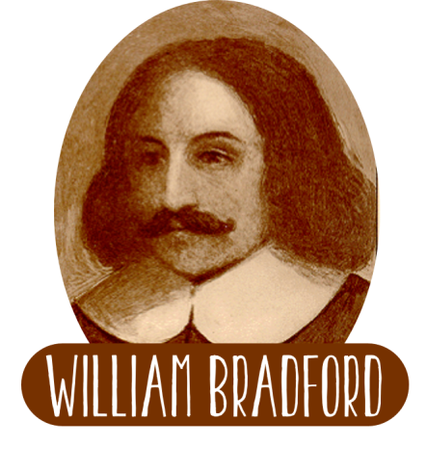
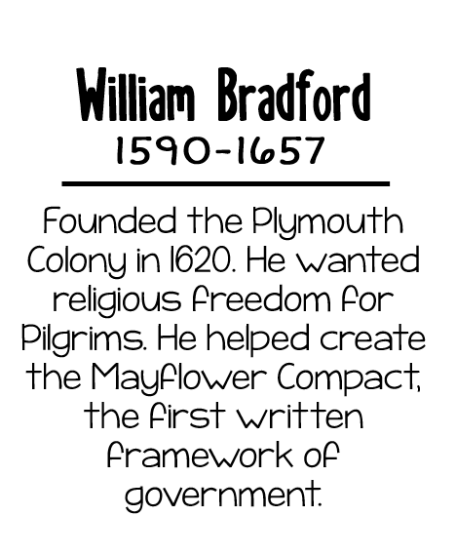
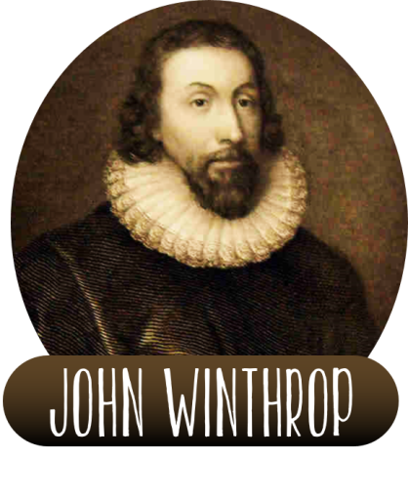
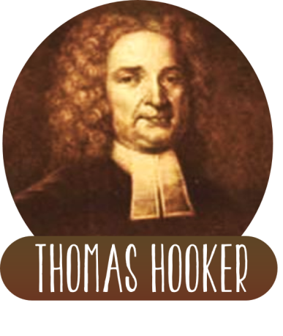
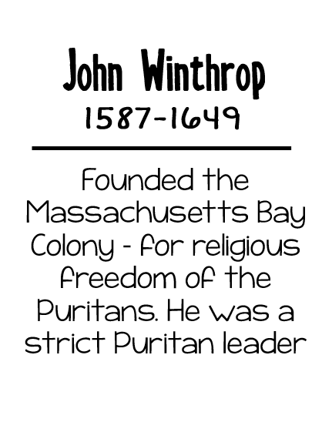
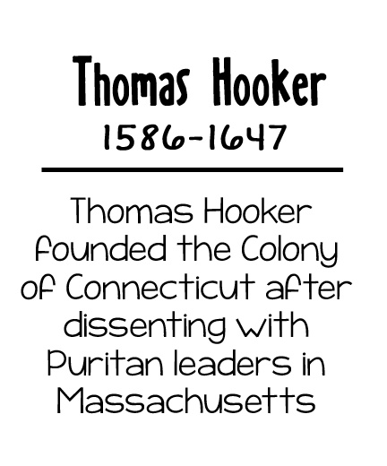

Slide 16
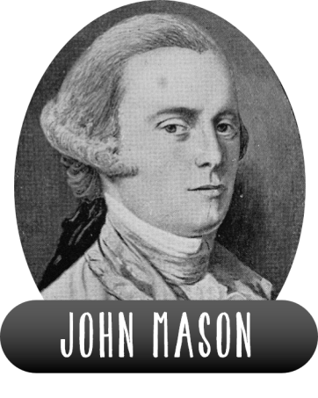
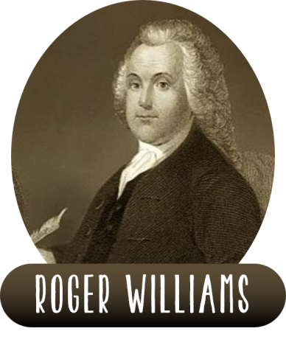

Slide 22
.

