Slide 1
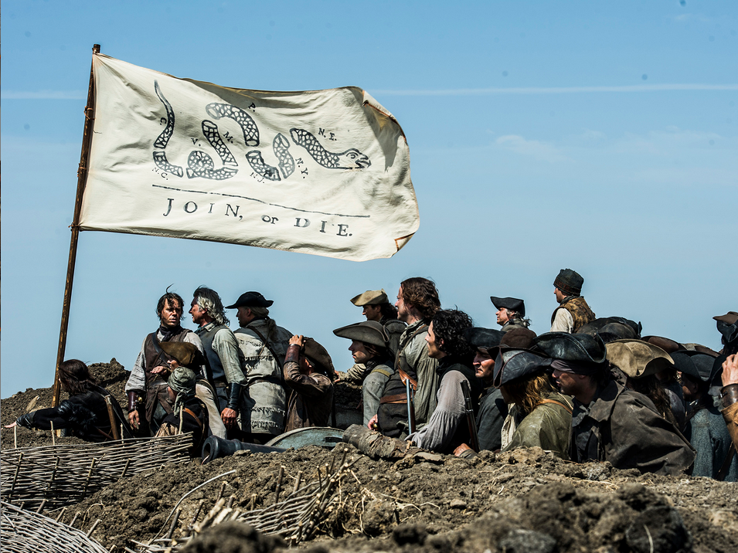
Bell Ringer
What rules do you follow that you feel are unfair?

Slide 2
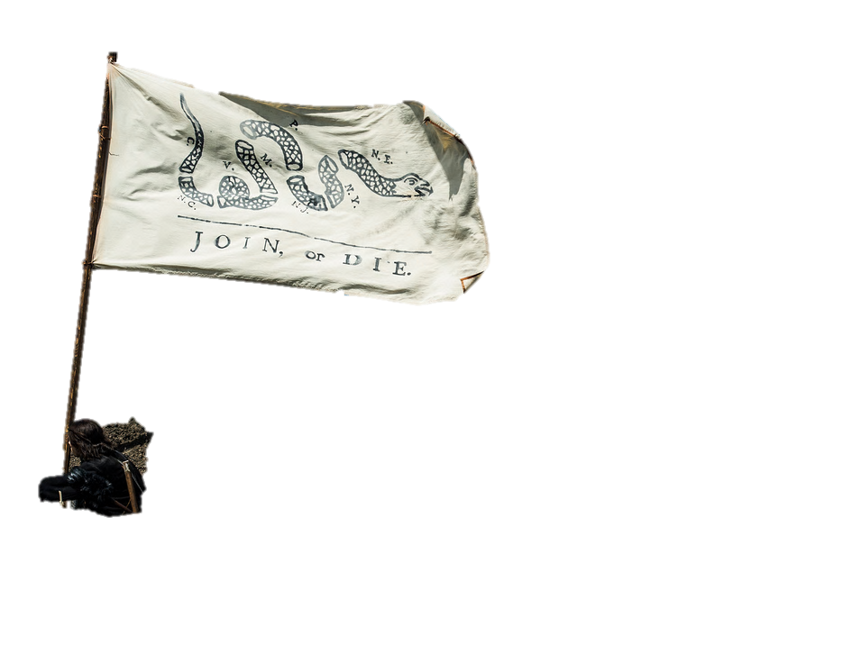

Slide 3
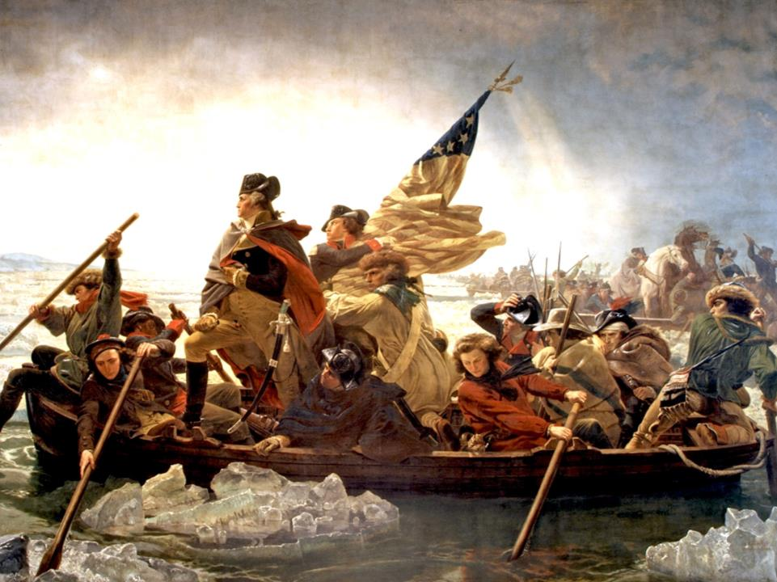
BIG IDEA: The war of independence waged by the American colonies against Britain will later influenced political ideas and revolutions around the globe.
OBJECTIVE: Students will participate in an interactive PowerPoint simulation to better understand the reason why the events leading up to the American Revolution and its significance.

Slide 4
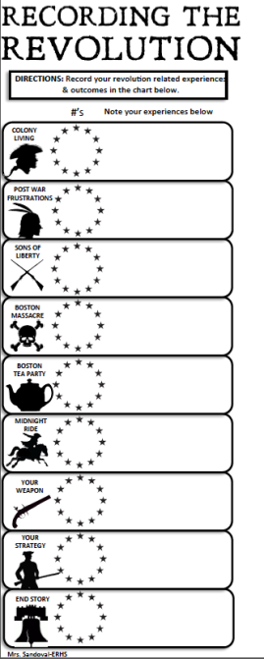
Directions:
Use this side of the handout during the simulation. Events are in order.
Then when told to do so record your “experience” in the corresponding box
When asked to do so record your # choice in the circle
*Also complete the fill in notes

Slide 5
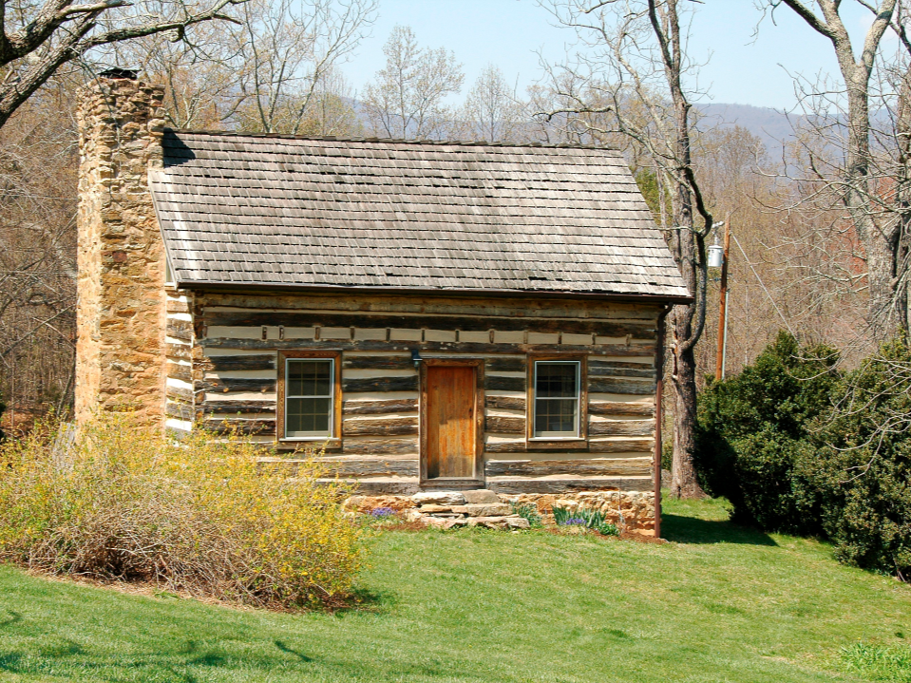
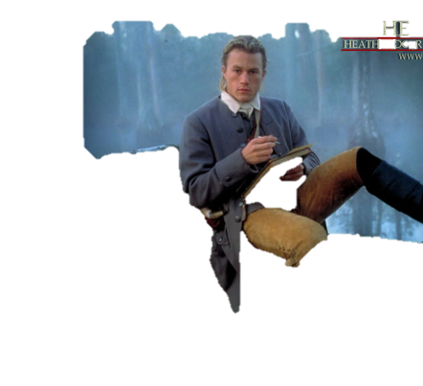
You are a young male living in the American colonies during the mid-1700s. Life for you has settled into a comfortable rhythm.
Loving Life!

Slide 6
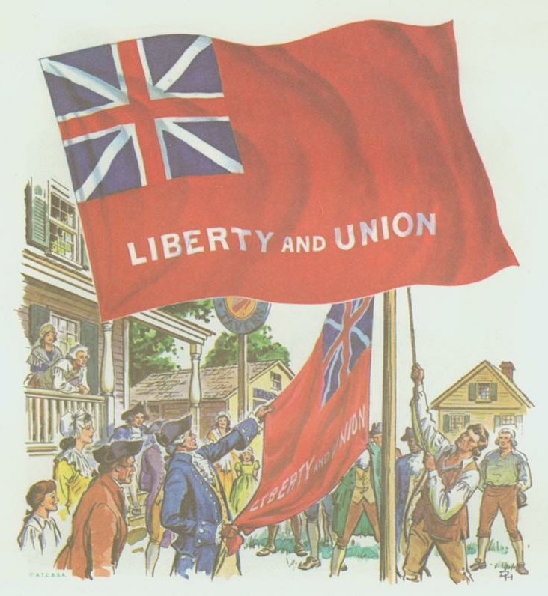
Historically speaking, right now “we” are British.
the Colonies are an extension of Britain, so we share their government, their identity, their pride, and also their enemies.
There is NO United States of America.
Taunton Flag, flown by
colonists to show unity with
the British crown.

Slide 7
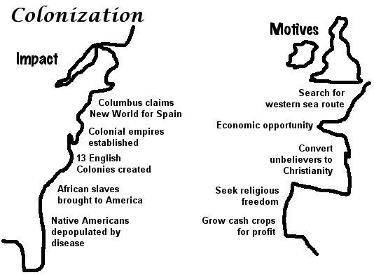

Slide 8
Fun Colonial Facts
Colonial population doubled every 25 years
The largest colony was Virginia, with New York and Massachusetts close behind.
Young boys wore loose fitting dresses until they were the age of five or six.
Female toddlers were often required by their mothers to wear corsets with whalebone “stays” stitched into the fabric.
Families often did not use plates but ate out of the same pot
Breakfast usually consisted of a mug of beer (even children), some bread and cheese, or a bowl of porridge, which was usually made of corn or beans rather than oats
In its early years, the settlers at Jamestown experienced an extremely high mortality rate, the lack of food actually leading some of the settlers to resort to cannibalism during the winter of 1609-1610, this period becoming known as the “starving time.”

Slide 9
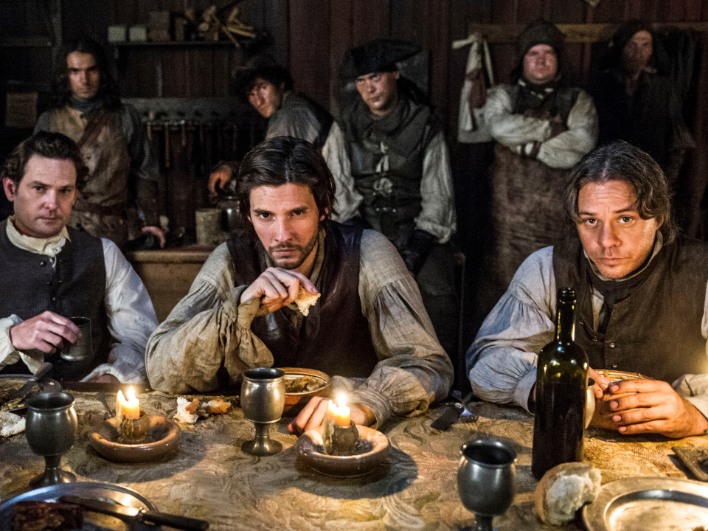
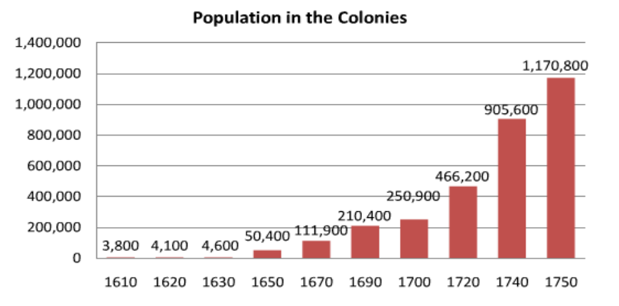
These are some of your buddies

Slide 10
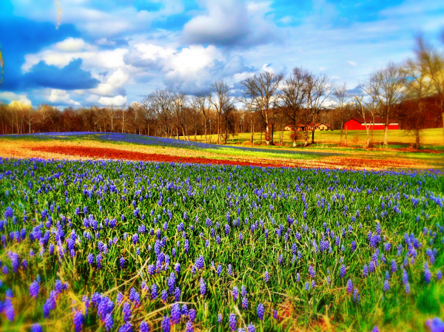
1
Colony Living
Choose one of the #s & write the # on your handout to find out which Colonial area you are from
2
3

Slide 11
1- NEW ENGLAND COLONIES:
You come from a strict-religious-middle class background. Your father was a preacher.
Colony Living
2- MIDDLE COLONIES:
You grew up with not a lot of money but your upbringing raised you to be tolerant of others and have a strong work ethic.
Record your information in your handout
3- SOUTHERN COLONIES:
You come from wealth as you family owns a large sugar plantation. You live a lavish life and are well educated.

Slide 12
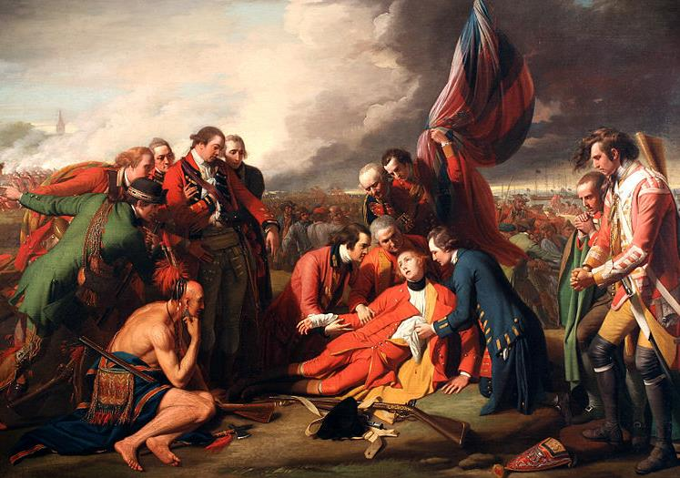
It is 1763 & you, decide to assist Great Britain in its fight against the French & Native Americans. This battle has been raging for 7 years over vast territories in America. You painfully leave your family to take up arms.

Slide 13
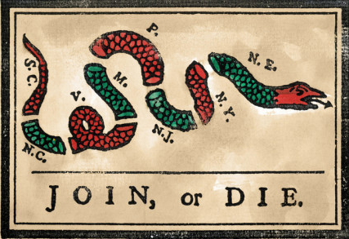
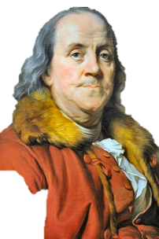
This political cartoon in the newspaper is what inspired you to join
During the French and Indian War, Ben Franklin's "Join or Die" slogan was used as a battle cry, inspiring colonies to unite against the French.
Notes:
What did the various parts of the snake represent?
Questions to ask:
What did the various parts of the snake represent?
What did the snake represent as a whole?
What do you think Franklin was attempting to express through the cartoon?

Slide 14
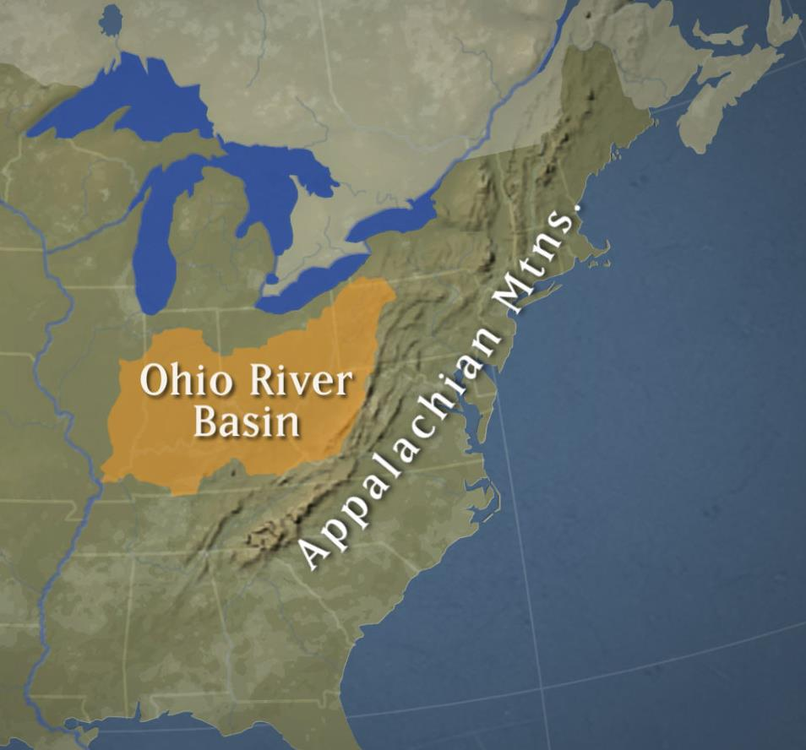
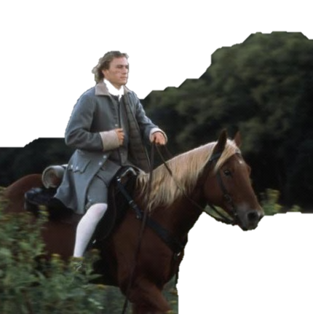
Conflict arose between the French & British over this area of land
I am here to fight!

Slide 15
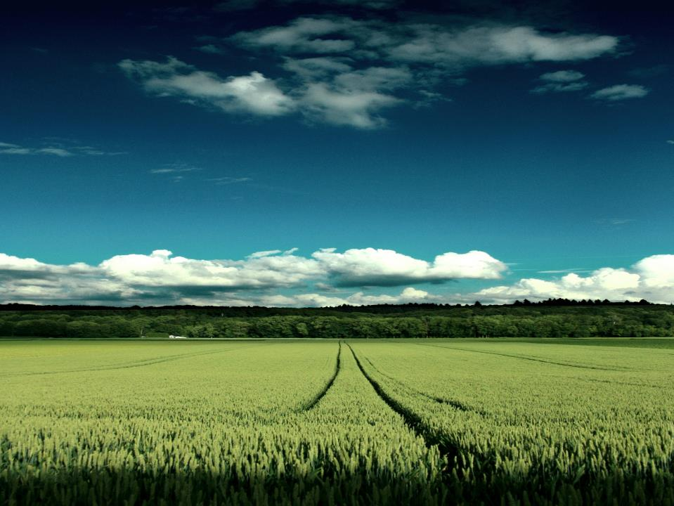
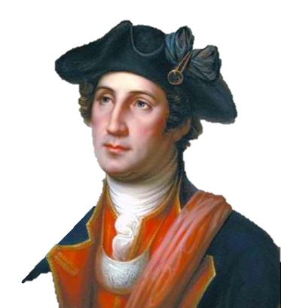
French and Indian War
The French and Indian War was a seven-year war between England and the American colonies, against the French and some of the Indians in North America.
When the war ended, France was no longer in control of Canada.
The Indians that had been threatening the American colonists were defeated.
Great Britain spent a great deal of money fighting the war and colonists fully participated in this war.
George Washington
Notes:
The French and Indian War was a seven-year war between England and the American colonies, against the French and some of the Native Americans in North America. The war ended in 1763 when France finally ceded all of its holdings in North America, west of Mississippi. The most long lasting effect of the war was not negotiated between the parties? Rather, it was the effect the war had on the American colonies. The cost of the war and of controlling the newly acquired territories was high. The British looked to the colonies to help pay those costs. That began the long spiral of events that led to the Revolution.

Slide 16
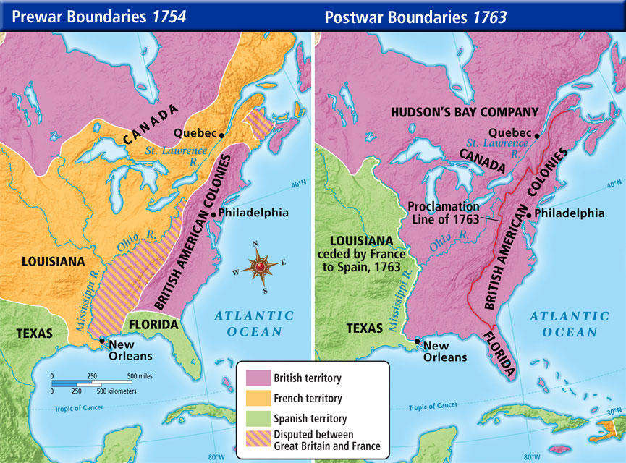

Slide 17
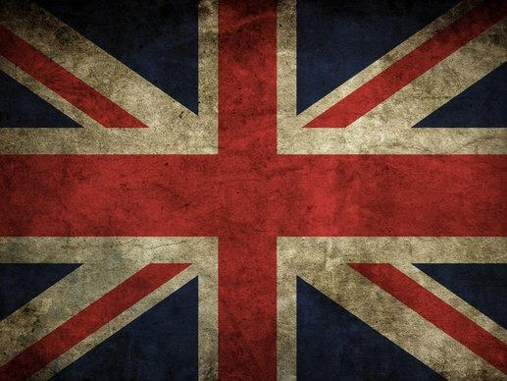
Impact of the War
The cost of the war and of controlling the newly acquired territories was high.
The British looked to the colonies to help pay those costs.
That began the long spiral of events that led to the Revolution.

Slide 18
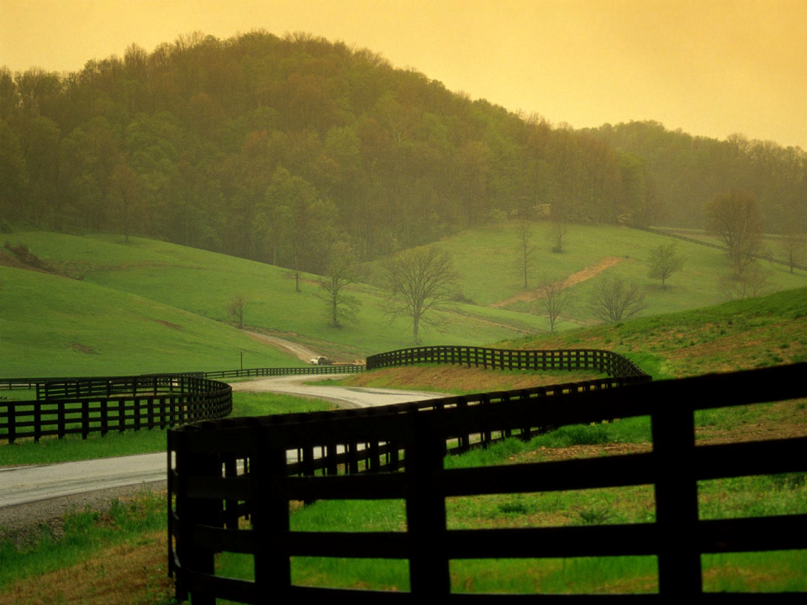
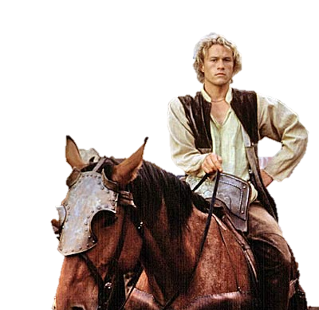
I just spent the last year fighting for Britain and this is how I am repaid!?
The Monarchy is so out of touch! Neigh…

Slide 19
1
2
Post War Frustrations
Choose one of the #s & write the # on your sheet to find out which which Post-French & Indian War-British mandate was the most burdensome to your family
3
4

Slide 20
1- You had been promised land grants West off the Appalachian Mountains for your services in the F&I war but are no longer allowed to claim the land as a result of the Proclamation of 1763.
2- As a result of the Quartering Act of 1765 your family was obligated to house British soldiers. Often soldiers were rude, smelly & would eat up the majority of your family’s food.
Post War Frustrations
Record your experience on your handout
3- To help pay off the debt from the war the British created a bunch of new taxes. It seemed like they were nickel & diming you on everything.
4- You and your neighbor don’t see eye to eye with regards to British distain which makes for a hostile situation. 20% of colonist remained supportive of the British government.

Slide 21
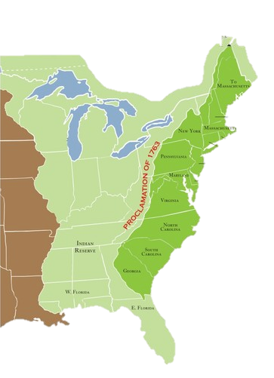
Proclamation of 1763
Forbade American colonists from settling west of the Appalachian Mountains.
In what way did the Proclamation impact settlement of American colonists?
What reason would the King George III have to impose the Proclamation?
Notes:
On October 7, 1763, King George III issued a royal proclamation which forbade American colonists from settling west of the Appalachian Mountains. This was intended to stabilize relations with the Native American population, most of which had sided with France in the recent conflict, as well as reduce the cost of colonial defense. In America, the proclamation was met with outrage as many colonists had either purchased land west of the mountains or had received land grants for services rendered during the war. The colonists felt there was no way any proclamation could stop the natural movement of the Colonists westward.

Slide 22
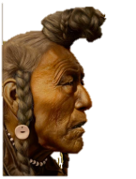
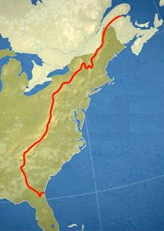
Proclamation of 1763
This was intended to stabilize relations with the Native American population
Colonists were outraged they had either purchased land west of the mountains or had received land grants for services rendered during the war
Notes:
On October 7, 1763, King George III issued a royal proclamation which forbade American colonists from settling west of the Appalachian Mountains. This was intended to stabilize relations with the Native American population, most of which had sided with France in the recent conflict, as well as reduce the cost of colonial defense. In America, the proclamation was met with outrage as many colonists had either purchased land west of the mountains or had received land grants for services rendered during the war. The colonists felt there was no way any proclamation could stop the natural movement of the Colonists westward.

Slide 23
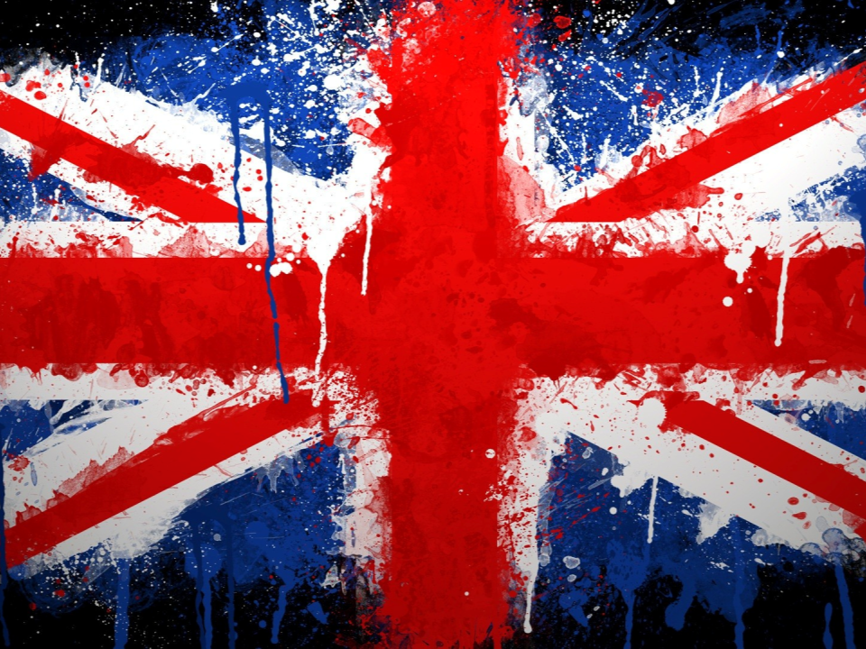
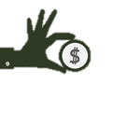
American colonies have to provide the British soldiers with any needed accommodations or housing
Taxation without Representation
It placed a tax on molasses and sugar imported by the colonies.
1764- Sugar Act
American colonist had to provide the British soldiers with: food, beer & wine, bedding, utensils, candles, & firewood
As the British government assessed methods for generating funds, it was decided to implement new taxes on the colonists
Taxed things such as
sugar
Newspapers
molasses
lead
paint
&more
1765, 1774- The Quartering Act
Placed a tax on all printed material, such as newspapers, marriage license, playing cards, and over 40 other documents
1765- The Stamp Act
Placed taxes on glass, paint, oil, lead, paper, and tea
1766- The Townshend Act

Slide 24
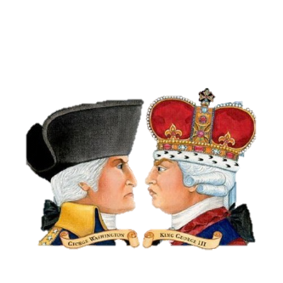
2 Groups Emerged
Patriots
Loyalists
Colonists who challenged British authority and will eventually seek independence
Colonists who remained loyal to the British Monarchy

Slide 25
2 Groups Emerged
Patriots
Loyalists
Who would have supported the following statement?
A strong British Empire is good for all

Slide 26
2 Groups Emerged
Patriots
Loyalists
Who would have supported the following statement?
People have rights the government can’t take them away

Slide 27
2 Groups Emerged
Patriots
Loyalists
Who would have supported the following statement?
Colonies profit from trade with Britain

Slide 28
2 Groups Emerged
Patriots
Loyalists
Who would have supported the following statement?
Colonies would be weak without Britain

Slide 29
2 Groups Emerged
Patriots
Loyalists
Who would have supported the following statement?
Colonies don’t have a voice in Parliament & therefore should not be taxed

Slide 30
2 Groups Emerged
Patriots
Loyalists
Who would have supported the following statement?
Taxes are needed to pay for soldiers to protect the colonists

Slide 31
2 Groups Emerged
Patriots
Loyalists
Who would have supported the following statement?
The King is thousand of miles away and does not understand our life here

Slide 32
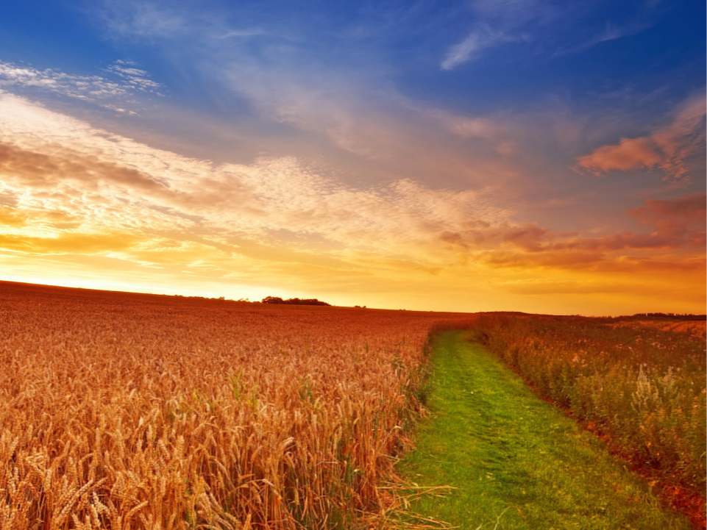
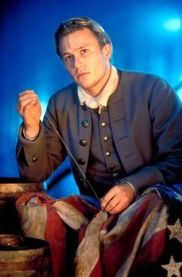
NO TAXATION W/O REPRESENTATION
You are outraged that you have no vote in the British Parliament and complain that this is “taxation without representation.” You help form the group called the “Sons of Liberty.” You meet to find a way to oppose the
taxation acts.

Slide 33
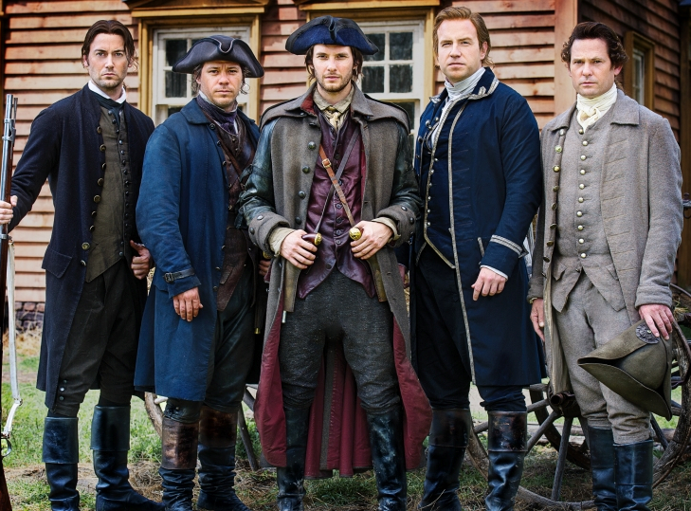
1
2
Choose one of the #s & write the # on your sheet to find out what how you contributed to the Sons of Liberty’s cause
3
4

Slide 34
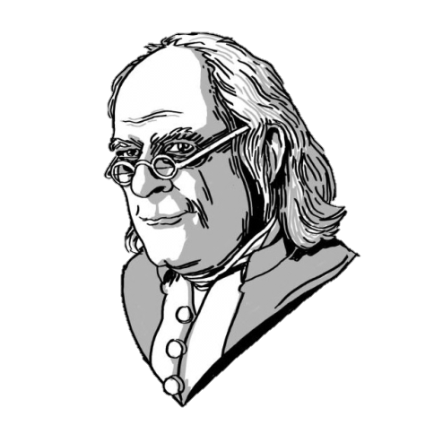
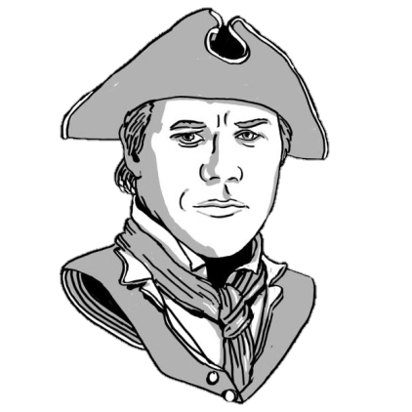
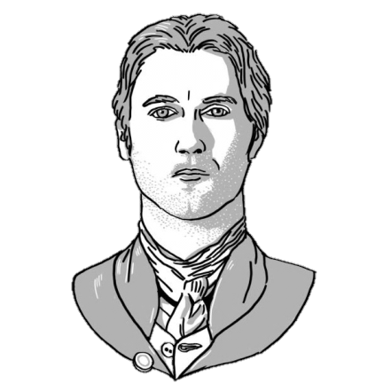
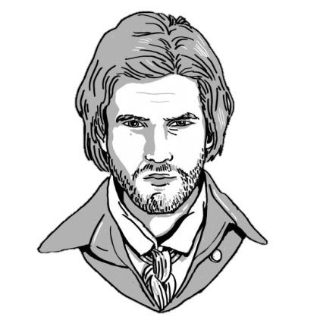
1- Much like Sam Adams you used your organizational and writing skills to fan American rage about unfair British taxes and laws
2- You & your doctor friend Joseph Warren gathered intelligence that sent Paul Revere on the famous midnight ride of April 18-19, 1775 warning of the British invasion of Lexington
Record your contribution on your handout
3- You along similar to the artesian silver & goldsmith Paul Revere became a messenger for the independence movement
4- You worked alongside Ben Franklin to help create & print revolutionary propaganda

Slide 35
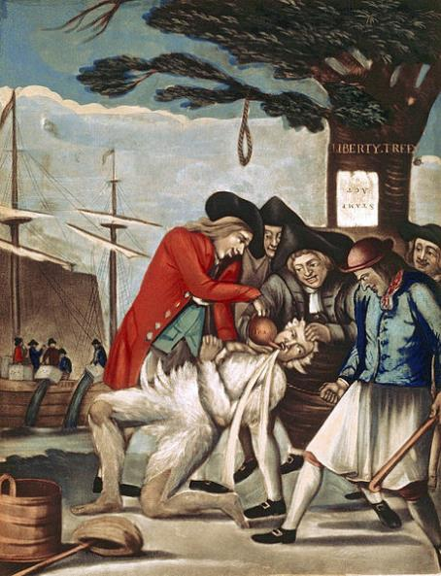
Is this painting for or against the taxes? Find 2 clues to support your answer
Boycott British Goods
Townshend Acts of 1767 had imposed new taxes on lead, paint, paper, glass, and tea imported to the colonies. In protest, the colonists boycotted (refused to buy) these goods.
In addition, they started attacking public officials like the governor and tax
collectors.
Britain responded by sending troops to keep order in 1768.
The Sons of Liberty tarring and feathering, a tax collector underneath the Liberty Tree in 1774

Slide 36
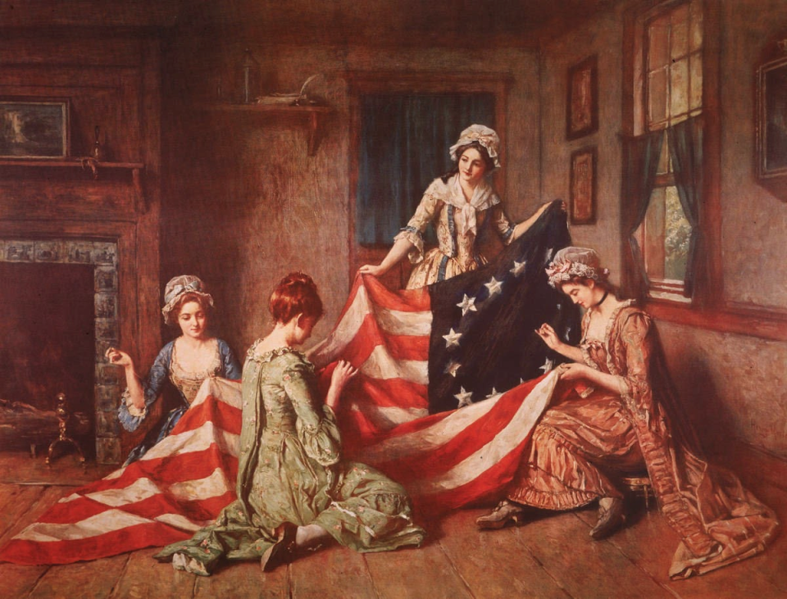
Daughters of Liberty
Women signed pledges against drinking tea,
promised not to buy British-made cloth, and met at
spinning clubs to make their own cloth

Slide 37
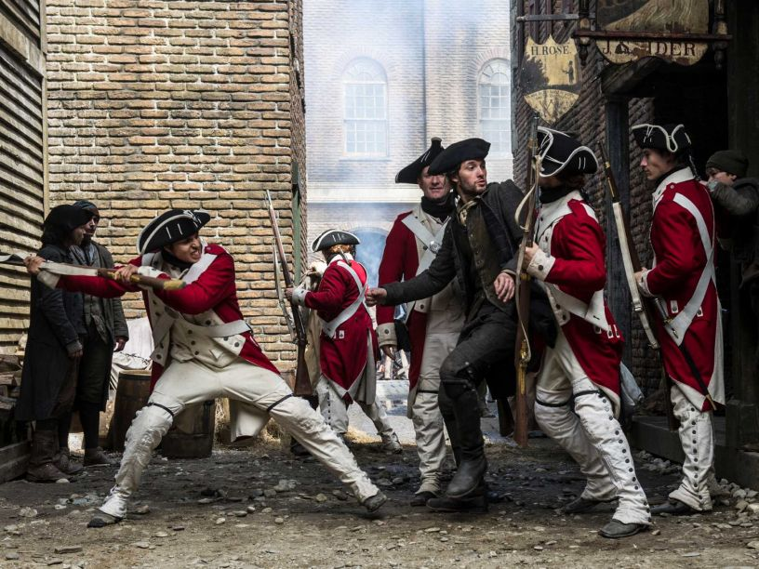
You and your fellow colonists resented the growing number of British soldiers that had been brought in to intimate and keep order. Tensions were rising.

Slide 38
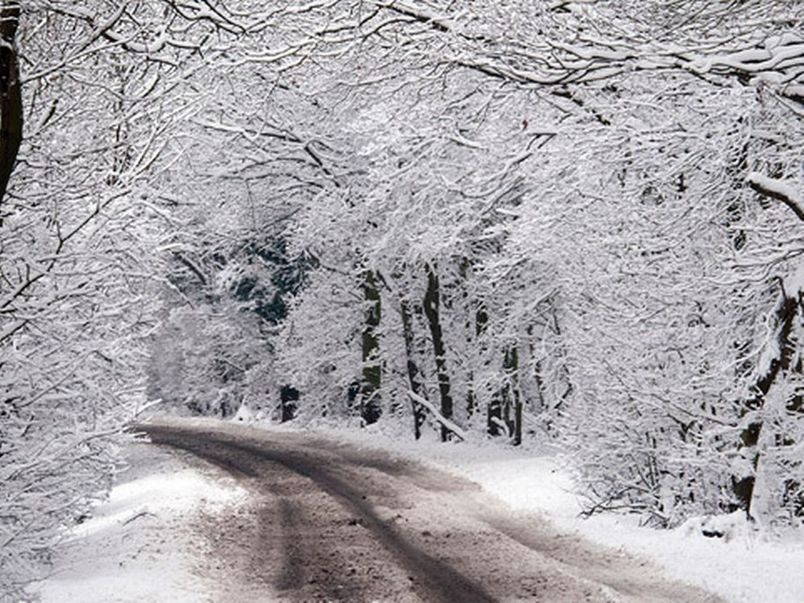
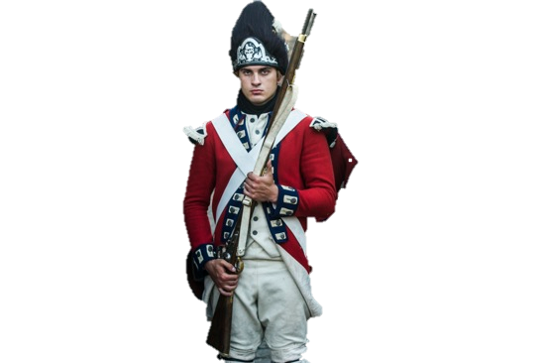
You along with an angry mob of colonists gathered near a customs house that British soldiers were guarding. You began throwing snowballs at the troops. Next thing you know you hear someone yell, “Fire!” and shots rang out. Five died and six were injured as a result of the musket fire.

Slide 39
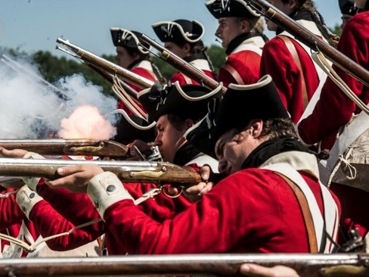
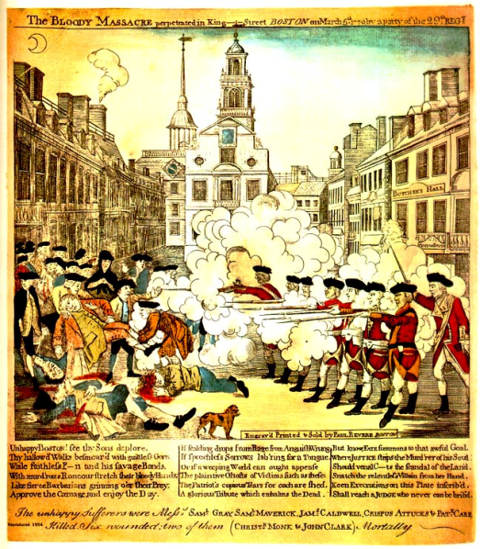
Boston Massacre
This event became known as the Boston Massacre.
5 dead; 6 wounded
Following the Boston Massacre, Townshend Acts were repealed (ended), except for the tax on tea.
Notes:
Paul revere etching

Slide 40
1
2
Boston Massacre
Choose one of the #s & write the # on your sheet to find out what happened to you at the Boston Massacre
3
4

Slide 41
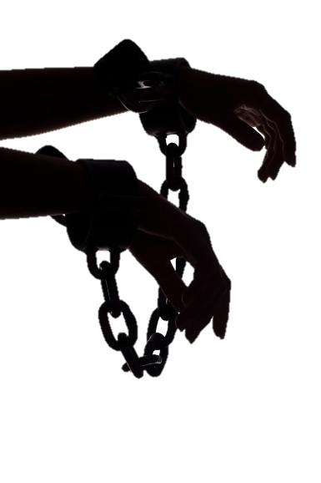
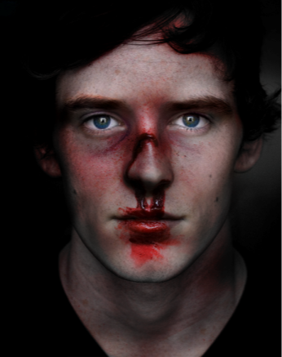
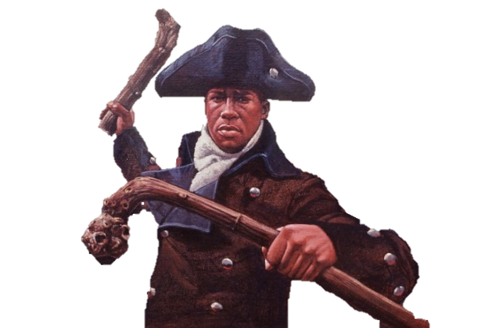
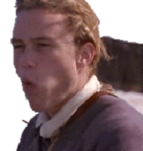
1- You hit a redcoat called Private Montgomery in the face with a stick, he then fired into the crowd killing
your good friend Crispus Attucks, a black colonist. You are outraged by his death.
2- You were wounded by musket fire with a bullet in your leg but you will live.
Boston Massacre
Record your experience on your handout
3- The crowd was eventually dispersed but 13 people were arrested including eight British soldiers, one officer, and four civilians. You were one of the civilians.
4- One of the snowballs you threw at the soldiers had a rock inside. The snowball missed the soldier, the rock then bounced off the building and struck you in your face, breaking your nose.
OUCH!

Slide 42
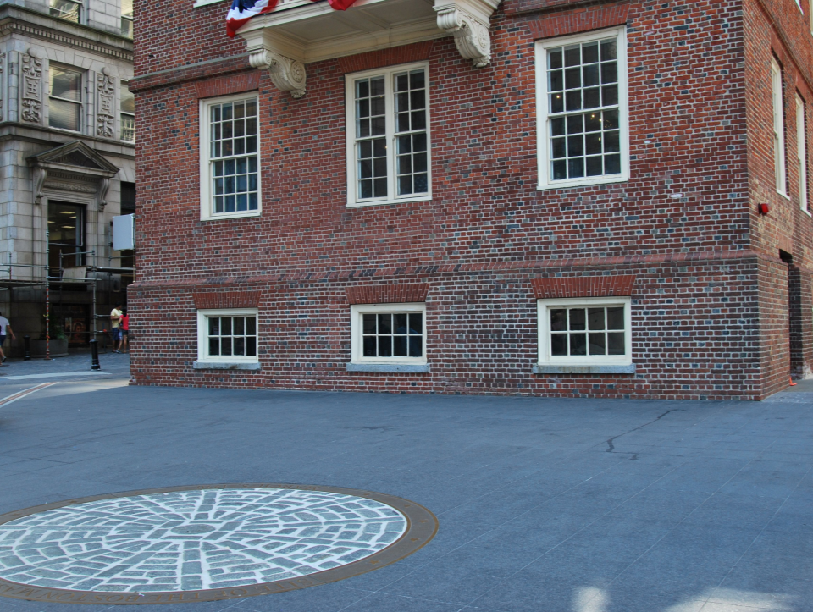
How would you envision a massacre to look?
Why did the soldiers fire into the crowd?
Describe Paul Revere’s use of propaganda in this picture?

Slide 43
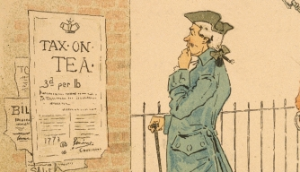
Although the Townshend Act was repealed a new Tea Act was implemented, which didn’t sit well with you and your fellow Sons of Liberty.
Well this isn’t cool!

Slide 44
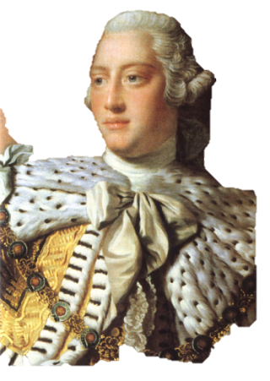
Tea Act 1773
Why you mad though?
The Tea act makes the tea cheaper by ½ then those in England are paying
Allowed the East India Company to become a monopoly, becoming the colonies only source of tea
The company was not taxed to ship the tea to the colonies, but the colonies had to pay a tax to England for the tea.
led to a boycott on tea & eventually the event known as the Boston Tea Party
Haven’t you heard of financial bailout? EIC is too big to fail it needed a boost
The Tea Act, though, left in place the hated three-pence-per-pound duty enacted by the Townshend Acts in 1767, and it irked colonists as another instance of taxation legislation being passed by Parliament without their input and consent.
Notes:
After the Boston Massacre, the colonies stayed calm
• Britain repealed the Townshend Acts—they did keep the tax on tea
• Britain faced a new problem—The East India Company (largest in
England) was losing money—to help it recover, Parliament came up
with The Tea Act.
• The company was not taxed to ship the tea to the colonies, but the
colonies had to pay a tax to England for the tea.
• The Act also let the Company decide which American merchants
could sell the tea
• Colonists were angry that Parliament would give one company total
control over a trade.

Slide 45
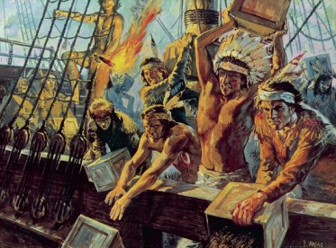
Boston Tea Party
You along with the Sons of Liberty went aboard the ships Beaver, Dartmouth, & Eleanor and dumped boxes of British tea into the Boston Harbor as a form of protest
YOU
Destroyed 340 chests of tea, in today’s money, was worth more than $1,700,000 dollars. The destroyed tea could have brewed 18,523,000 cups of tea!
It is estimated that hundreds took part in the Boston Tea Party. For fear of punishment, many participants of the Boston Tea Party remained anonymous for many years after the event
The British shut down Boston Harbor until all of the 92,000 lbs of British East India Company tea were paid for. This was implemented under the 1774 Intolerable Acts.

Slide 46
1
2
Boston Tea Party
Choose one of the #s & write the # on your sheet to find out what happened to you at the Boston Tea Party
3
4

Slide 47
1- Tea dumping participants didn’t harm any members of the ships crew or damage any property other then the tea. You were the last to flee the scene because you stayed to sweep the deck.
2- You were caught trying to pocket some of the tea on board the Beaver. You were immediately stripped of your coat then tarred & feathered
Boston Tea Party
Record your experience on your handout
3- As you were hacking open one of the crates with your tomahawk a wood splinter flew up and lodged into your eyeball.
4- After the Boston Tea Party you fled Boston and headed to Philadelphia avoid getting arrested

Slide 48
Intolerable Acts

Slide 49
Continental Congress
The Boston Tea Party, as it became known, greatly
angered England’s King George III, and he dispatched even more troops to the colonies in 1774.
The colonists continued with their boycotts and written protests in newspapers and will even create the “Continental Congress” with elected colonial delegates to address the growing concerns between the colonies and England.

Slide 50
Continental Congress
Take a guess. Is the statement true or false in regards to the Continental Congress’ actions?
TRUE
FALSE
The delegates met in Philadelphia

Slide 51
Continental Congress
Take a guess. Is the statement true or false in regards to the Continental Congress’ actions?
TRUE
FALSE
The delegates voted to end all trade with Britain resulting in 98% of British trade ending in the colonies

Slide 52
Continental Congress
Take a guess. Is the statement true or false in regards to the Continental Congress’ actions?
TRUE
FALSE
Representatives from colonies except Georgia made up the 1st Continental Congress

Slide 53
Continental Congress
Take a guess. Is the statement true or false in regards to the Continental Congress’ actions?
TRUE
FALSE
Fighting between British soldiers and colonist didn’t begin until the Continental Congress issued the Declaration of Independence

Slide 54
Continental Congress
Take a guess. Is the statement true or false in regards to the Continental Congress’ actions?
TRUE
FALSE
The Continental Congress created the American Constitution

Slide 55
It is April 1776 and you are sound asleep until you are suddenly waken by your fellow Sons of Liberty member, Paul Revere. Paul was riding horseback, galloping in the streets and shouting in a panic!
The Regulars are coming!

Slide 56
1
2
Midnight
Ride
Choose one of the #s & write the # on your sheet to find how you reacted to Paul Revere’s warning
3
4

Slide 57
1- Being that you are a “Minute Man” (men who could be ready to fight at a minute's notice to assist the militia) you jumped from bed grabbed your gun and join 300 other minute men in Boston
2- You leap out of bed and joined Paul to help warn the others. You both were captured about halfway through the ride.
Midnight Ride
Record your experience on your handout
I’m Ready!
3- You hurry out of bed and take your position in tall tree. There you hide and shoot from high ground at the advancing troops.
.
4- You hear Paul Revere but think he is joking. You roll over & go back to sleep. The Sons of Liberty will not be happy with you when you finally wake up.

Slide 58
The Shot Heard Around the World
Over 200 British Redcoats and 90 American minutemen were wounded or killed during the first engagement of the war.
On April 19, As the redcoats (British soldiers) headed to Concord, Massachusetts Paul Revere and another rider mounted their horses. They then rode as fast as they could toward Lexington and Concord Massachusetts yelling “The regulars are coming! The regulars are coming! Paul Revere was able to wake up enough of the colonial minutemen so they would be prepared to fight. Local militiamen clashed with British soldiers in Lexington and Concord, Massachusetts, marking the first shots fired in the Revolutionary War and by the following summer, the rebels were waging a full-scale war for their independence.
”
.

Slide 59
Americans were literate & read books by leading Enlightenment* thinkers, especially John Locke, & used these ideas to justify their protest
“People are born with natural rights, including life, liberty, property”
“Kings can be overthrown if they violate peoples’ natural rights”
“Government power comes from the consent of the governed”
Enlightenment*- Late 1700s & early 1800s intellectual movement which challenged traditional ways of thinking

Slide 60
Declaration of Independence
Natural Rights
By June 1776, with the Revolutionary War in full swing, a growing majority of the colonists had come to favor independence from Britain.
On July 4, the Continental Congress voted to adopt the Declaration of Independence, drafted by a five-man committee including Franklin and John Adams but written mainly by Jefferson.
Jefferson, uses ideas of Locke (Life, Liberty, and Property→ Life, Liberty, & the Pursuit of Happiness)
Rousseau- Democracy
The Declaration outlined why the colonists should be free of British rule
Second Continental Congress, 1776

Slide 61
Common Sense
6 months prior to the Declaration of Independence, Thomas Paine published his pamphlet title “Common Sense,” setting forth his arguments in favor of American independence.
My pamphlet was widely read
Colonies no longer needed British rule & deserve independence!
I helped gain popular support

Slide 62
Your friend Benjamin Franklin, one of the most famous men the world, was also sent to France to ask for military aid as well as a loan.
And the war was on!

Slide 63
 | AMERICAN | BRITISH
Political Advantages | Fighting to defend independence Democracy Help of France | Well organized, respected gov’t. #1 power in the world
Economic Advantages | Live off the land | Benefits of empire – huge trading network Many industries to create supplies
Social Advantages | Identity as “American” Women help out | Loyalists help out
Military Advantages | Guerilla warfare “Home field” advantage Goal – Independence Good leaders – Washington | #1 military power in world Well-trained, well-disciplined troops
Disadvantages | MONEY!!! (limited) SUPPLIES (low) TRAINING (poor) | DISTANCE (England 3,000 miles away – difficult to communicate and coordinate. FOREIGN MERCENARIES (Fighting for a pay check, not their own homes/freedom)

Slide 64
Your Weapon
As the war rages you are in the thick of the fighting to help America gain its independence. Pick a # to see the weapon you were given to fight with. Record the # on your sheet.
1
2
3

Slide 65
Your Weapon
Record the weapon on your sheet.
1- Musket
2- Canon
3- Flintlock Pistol

Slide 66
British vs Colonists
This side of the room will represent the British Red coats.
Tear a piece of paper out of your notebook and make a paper ball.
Get out of your desk and stand close together to represent the British who walked in organized lines.
This side of the room will represent the American militia men & women.
Tear a piece of paper out of your notebook and make a paper ball.
Get out of your desk and stand where ever you want, you can even stand on your desk.
When the teacher gives the “OK” throw your paper ball at the enemy
Which strategy was more effective?

Slide 68
British Strategy
British walked in lines, extremely organized
Led to difficulty reloading & firing weapons
Easy target for outnumbered 13 colonies

Slide 69
Your Strategy
Pick a # to see if the strategy you used to fight was effective. Record the # on your sheet.
1
2
3

Slide 70
Your Strategy
Record your strategy on your sheet
1-You chose to walk in a group you have been severely wounded
2- You effectively hid in bushes, scattering yourself from the enemy, taking many British soldiers
3- You left the scene crying in terror

Slide 71
American Revolution Facts
There were two main groups of soldiers who fought on the American side during the Revolutionary War- 1. Colonial Militia Men & Continental Army soldiers led by Washington
The average soldier age was 18-24
Soldiers had a poor diet, worn out clothes, damp shelters, and lived in unsanitary conditions. Diseases such as smallpox and typhus killed thousands of soldiers.
Many wives, mothers, and children followed the army. They sewed clothes, cooked meals, tended the sick, and washed the laundry, and some even fought (Molly Pitcher).

Slide 72
The War Ends
1776- Dec. of Independence
1776- Washington crosses the Delaware River
The 13 colonies joined together and fought the British under the guidance of George Washington
Revolutionary War ended in 1783
1777- Battle of Saratoga (turning point in the war)
1778- France signs a treaty to fight along side Americans
1779- American hero Benedict Arnold becomes a traitor
1781- Articles of Confederation ratified
1781- Britain defeated at Yorktown
1783- Treaty of Paris formally ends the war
1787- Adoption of the American Constitution
Continental Congress appointed George Washington commander-in-chief of Continental Army

Slide 74
The Treaty of Paris 1783
Officially ended the war with Britain
Set the geographic boundaries for the new United States
Gave Americans much greater territory than original 13 colonies

Slide 76
The American Revolution Significance
It was the first time a colony overthrew its mother country
It was the first time a gov’t was created using Enlightenment ideas of limited gov’t & individual liberty
The success in America inspired revolutions in Europe & Latin America

Slide 77
End Story
1
2
Choose a number and record it on your handout

Slide 78
End Story
On your handout note how your story ends
1- ☹
After the war you started farming but came into financially difficulty. You couldn’t pay your taxes and were thus jailed.
2- ☺ You were a famous war hero. Statues and songs were created in your honor. You used your fame to be appointed as a state senator.
And that’s how the ledged of Joker came to be. ;)

Slide 79
Looking back at your completed handout & notes do you think the colonist were justified in breaking away from England?

Slide 80
You must also complete the inside of your handout. Use your fill-in notes if you need help.

