Slide 1
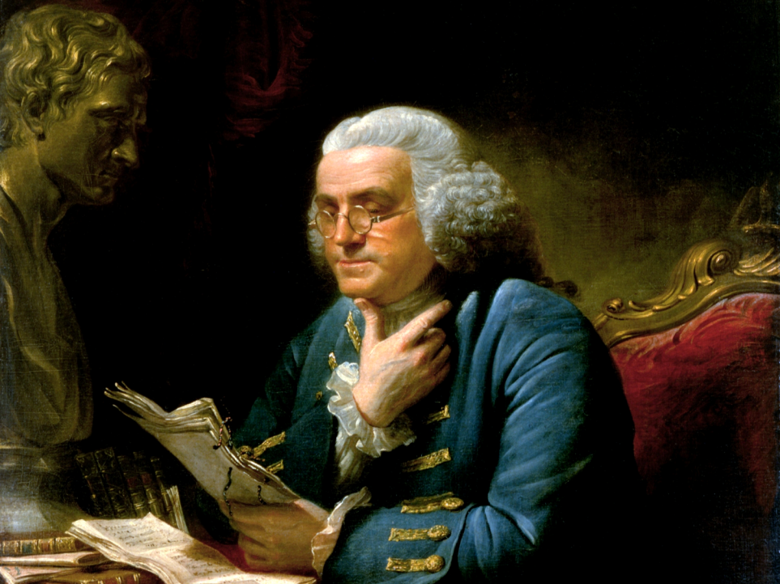
American Enlightenment

Slide 2



Bell Ringer
Do you agree with the statement, “Knowledge is Power?”
Explain

Slide 3
BIG IDEA
Enlightenment ideas influenced the American colonies to shed British rule and create a new nation

Slide 4


Essential Questions
What was the Enlightenment?
Who were Enlightenment philosophers?
How did Enlightenment ideas contribute the the American Revolution & the creation of American democracy?

Slide 5
Terminology
Enlighten- to shed light on truth, free from ignorance
Truth- how things are
Intellect- power of the mind to understand through the use of reason
Reason- to explore the cause and effect of things
Revolution- a dramatic change of practices or beliefs

Slide 6

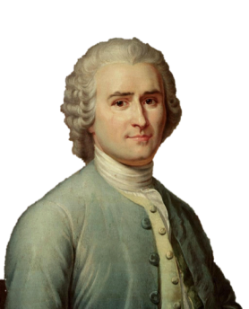
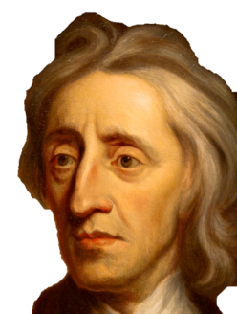
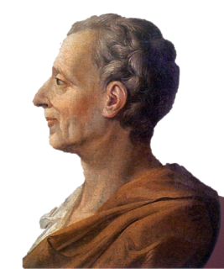
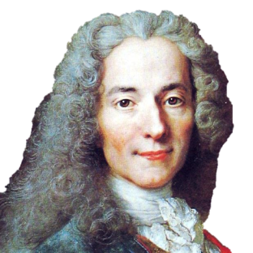
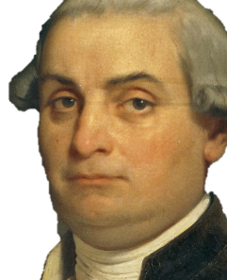
The Enlightenment
The Enlightenment was an intellectual revolution from the late 1700s to early 1800s in Europe & America
Locke
Montesquieu
Rousseau
Voltaire
Beccaria

Slide 7


Why was it an
“Intellectual Revolution”?
  Age of Reason
  It Challenged traditional authority
  Encouraged individualism & the ability to think for yourself
It proved man’s ability to reason & thus discover for himself truths
Peoples liberties should be protected by law

Slide 8
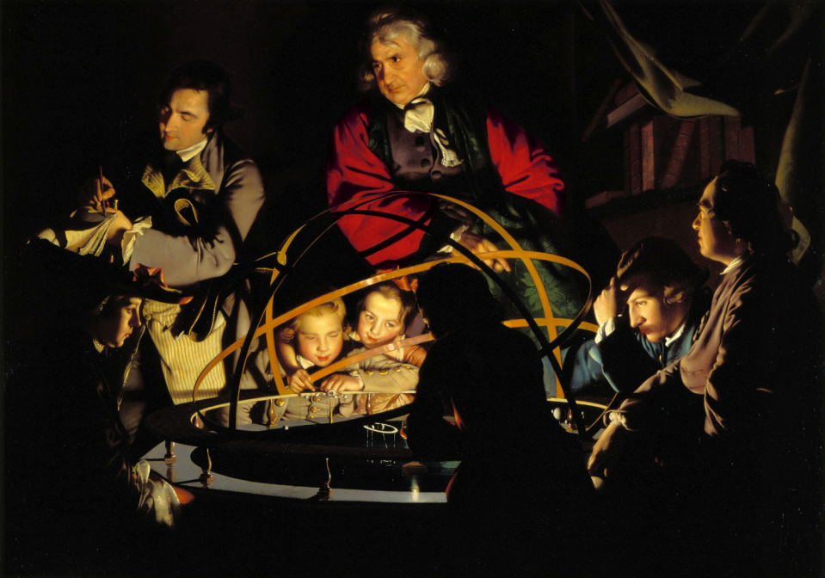
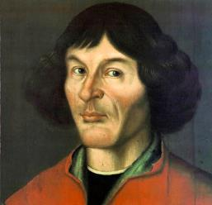
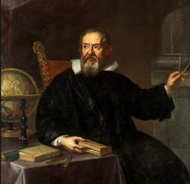
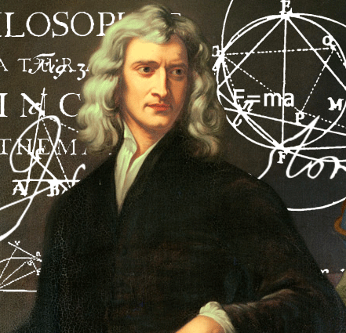
Scientific Revolution
  Nicolaus Copernicus:
Identified the concept of a heliocentric solar system, in which the sun, rather than the earth, is the center of the solar system.
The Enlightenment stemmed from the Scientific Revolution from the 16th & 17th centuries
Natural laws- things could be learned through observation, reason, & logic
  Galileo Galilei:
Italian scientist and scholar Galileo made pioneering observations that laid the foundation for modern physics and astronomy.
  Isaac Newton: English physicist and mathematician Sir Isaac Newton, most famous for his law of gravitation, was instrumental in the scientific revolution of the 17th century.

Slide 9



Founding Fathers will be influenced by Enlightenment ideas
- apply ideas to Revolution
- apply ideas to Constitution

Slide 10
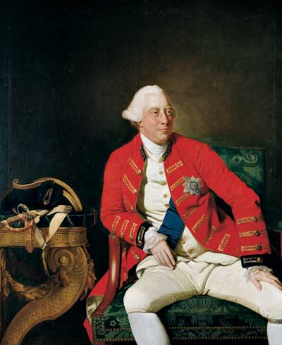
Whose authority will Colonists be challenging?
King George III
of England

Slide 11

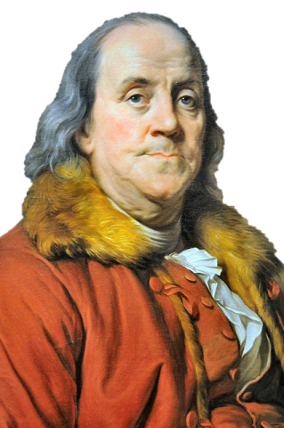
Ben Franklin
Of all the founding fathers Franklin is the most known for his scientific discoveries & inventions
  Proved lightning was electricity
  Member of the Declaration of Independence Committee

Slide 12
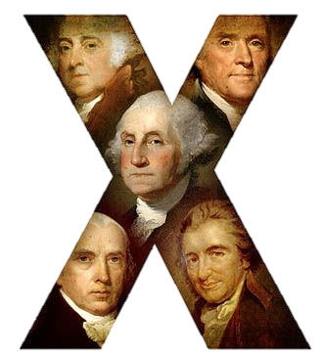
Other Notable Founding Fathers
John Adams- Member of the DOI committee, First VP
Thomas Jefferson- Author of DOI, 3rd President
George Washington- First President of the United States
James Madison- Main Author of the Constitution, 4th President
Thomas Paine- Wrote “Common Sense”

Slide 13


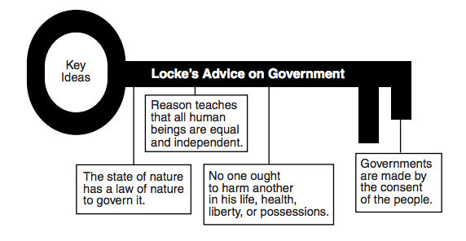
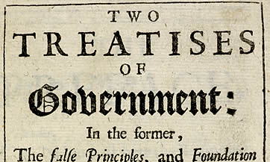
John Locke
English philosopher, expressed the idea that people are born with “natural” rights. These rights include the right to life, liberty, and property.
According to Locke, people have the right to change or overthrow a government that does not protect their “natural” rights.

Slide 14

John Locke
Locke’s key idea was natural rights

Slide 15


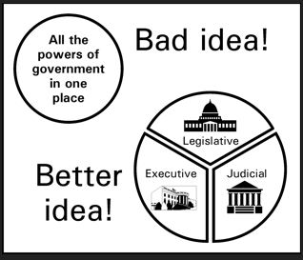
Baron de Montesquieu

Slide 16
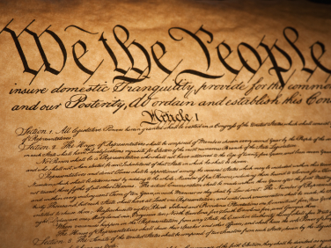


Baron de Montesquieu
Montesquieu=3 claps
  Clap 1- “Mont”
  Clap 2- “e”
  Clap 3- “squieu”
3 claps= 3branches

Slide 17


Jean Rousseau
French philosopher, believed people must give up some
liberty in exchange for the
protection of others by the
government.
In exchange, the government must govern
according to the people.
That’s a democracy

Slide 18




Jean Rousseau
Pronounced very similarly to Jean
The government should be formed by the will of “LES GENS”
les gens= the people
X

Slide 19
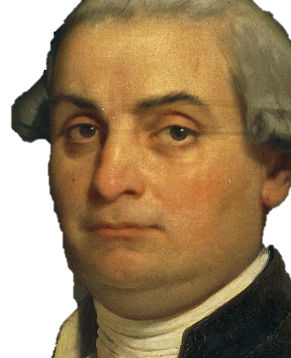
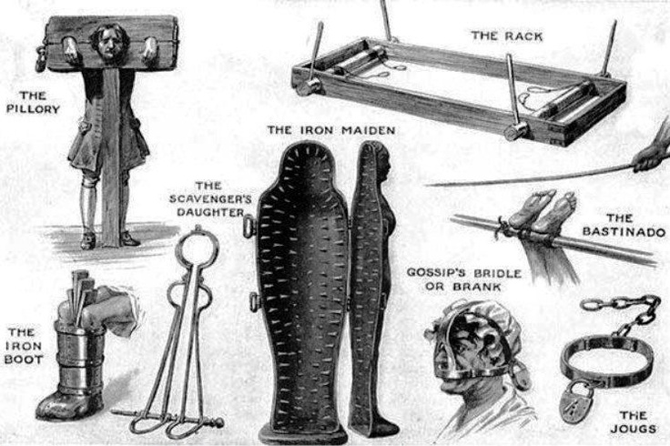
Cesare Beccaria
Italian philosopher, promoted new ideas about the justice system.
He argued that people accused of crimes had certain rights, and he advocated abolishing torture.

Slide 20

Cesare Beccaria
ease
rutality

Slide 21
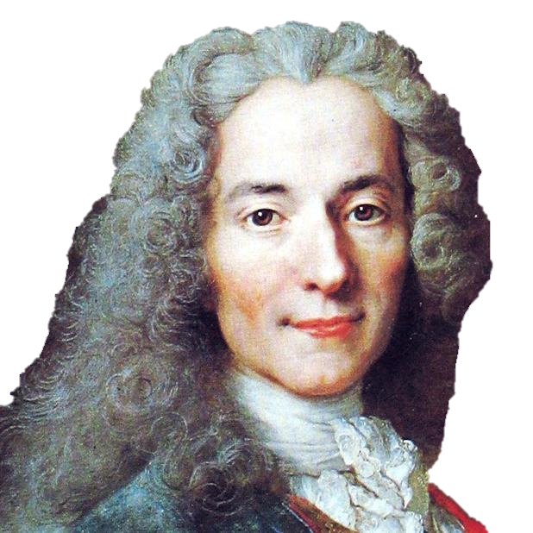

Voltaire
FREEDOM OF SPEECH!

Slide 22

Voltaire
taire-bble
ery
To limit free speech

Slide 23
Review
Philosopher | Mnemonic Device
John Locke
Montesquieu
Jean Rousseau
Cesare Beccaria
Voltaire
Locke’s key ideas was natural rights
3 claps= 3 branches
Les Gens (the people) sounds like Jean
Cease Brutality
Very Taire-bble to limit free speech

Slide 24

Enlightenment in the USA
The constitution is based around the idea of democracy and the idea that the power to make laws should be in the hands of the people
The United States uses the idea of separation of powers when drafting the new constitution (Executive, Legislative, & Judicial Branches).
Guaranteed in U.S. Bill of Rights 1st Amendment people have the right to freedom of speech and press
Guaranteed in U.S. Bill of Rights; torture was outlawed by the 8th amendment
When Thomas Jefferson wrote the Declaration of Independence, he drew on the philosophy of natural rights. The Declaration of Independence states that all men have the right to life, liberty, and the pursuit of happiness.

Slide 25
Summary
Scientific Revolution
Enlightenment Ideas
Founding Fathers are inspired which leads to revolution
American Constitution includes Enlightenment philosophies

