Slide 1
Chapter 1: ​The Nation's Beginnings (Prehistory–1824)
This chapter will cover Native Americans and European colonization, The American Revolution, the creation of a government, and the nation’s early years.
Section 1: Many Cultures Meet
Section 2: Colonization & the American Revolution
Section 3: The Constitution
Section 4: The New Republic

Slide 2
Ch1.2 Part A: A City Upon a Hill Objectives
Describe the European colonial presence in North America.
Compare and contrast the 13 Colonies
Trace the development of democratic ideals in Europe and America.
Explain the significance of the Enlightenment and the Great Awakening.

Slide 3
Terms and People
House of Burgesses − elected Virginia legislature, begun in Jamestown in 1619
Mayflower Compact − provided a framework for self-government at Plymouth in 1620
Magna Carta − 1215 document signed by King John that limited the power of the English monarch
English Bill of Rights − 1688 document signed by King William and Queen Mary that listed freedoms of Englishmen

Slide 4
Terms and People (continued)
Enlightenment − 18th century European intellectual movement; stated that all problems could be solved by human reasoning
Great Awakening − 1740s evangelical movement that led to the birth of new churches in the colonies
Notes:
4

Slide 5
What important ideas and major events led to the American Revolution?
European nations explored and established colonies in the Americas.
England established 13 colonies that later became the United States of America.

Slide 6
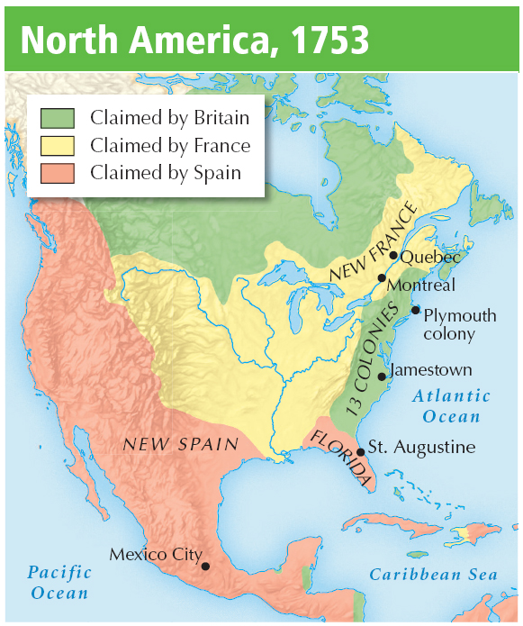
Spain, France, and England all established major colonies in the Americas.
Spain gained wealth from Mexico and South and Central America.
French traders traded for furs in Nova Scotia.
Notes:
6

Slide 7
England established a string of colonies along the east coast of North America.
Despite Indian attacks, disease, and starvation, the colony grew, raising tobacco for export.
Planters established the House of Burgesses as an elected legislature.
In 1607, Jamestown was founded on Chesapeake Bay.

Slide 8
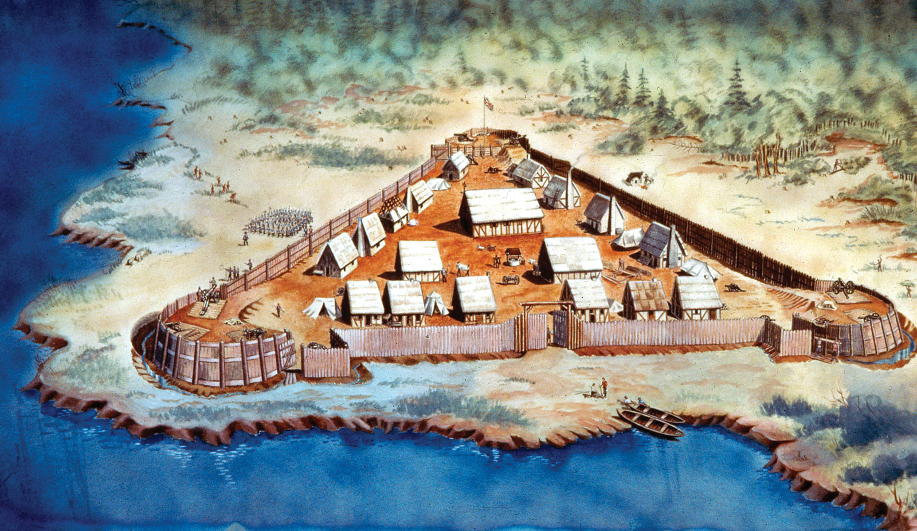

Slide 9
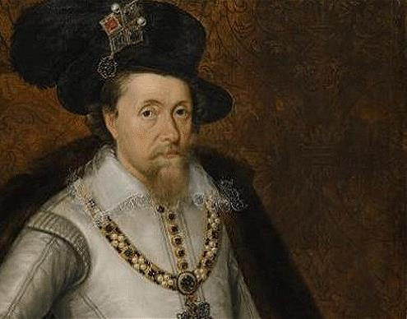
Granted a charter to the Virginia Company in 1606 to settle & “civilize” America
Wanted to prevent Spanish advancements in the New World & find a Northern passage to Asia

Slide 10
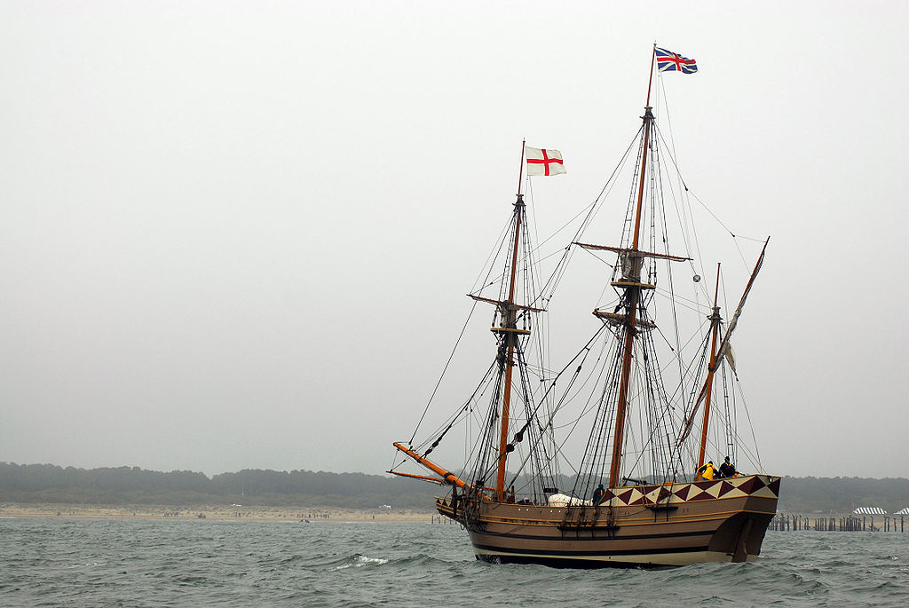
In December 1606, 105 settlers & entrepreneurs set off for America
Arrived in Virginia in April 1607
Edward Winfield elected president of governing council & selects the island location

Slide 11
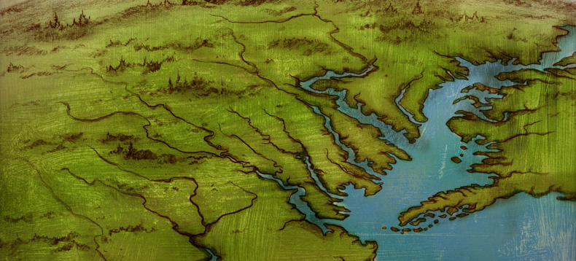
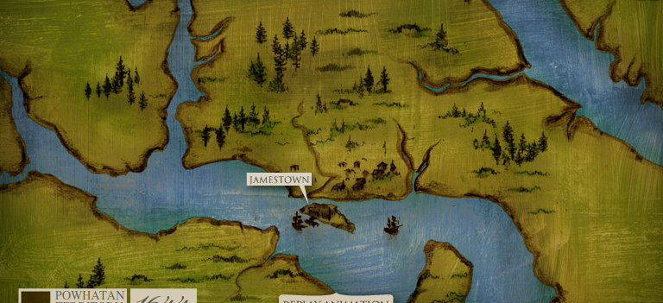
Far enough inland to hide from the Spanish
Deep water anchor for the ships
Swamp and river offered protection from local Native Americans

Slide 12
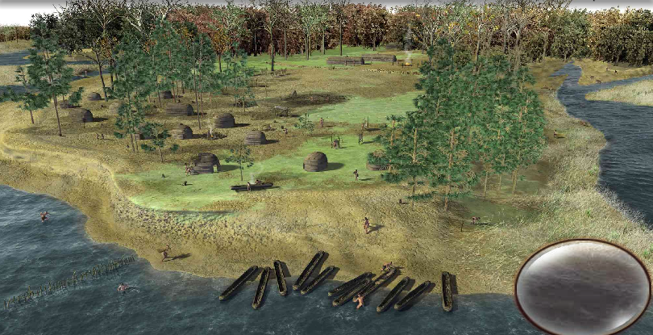
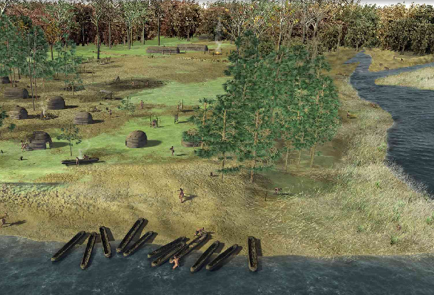
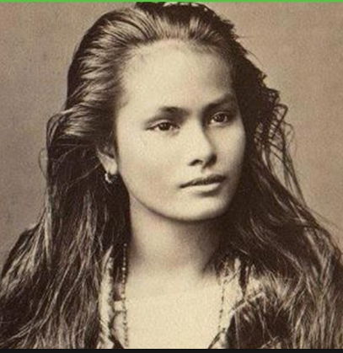
About 14,000 Powhatan Indians lived in the Virginia area
Chief Powhatan’s daughter was the famous Pocahontas- she married John Rolfe, which helped English/Native relations.

Slide 13
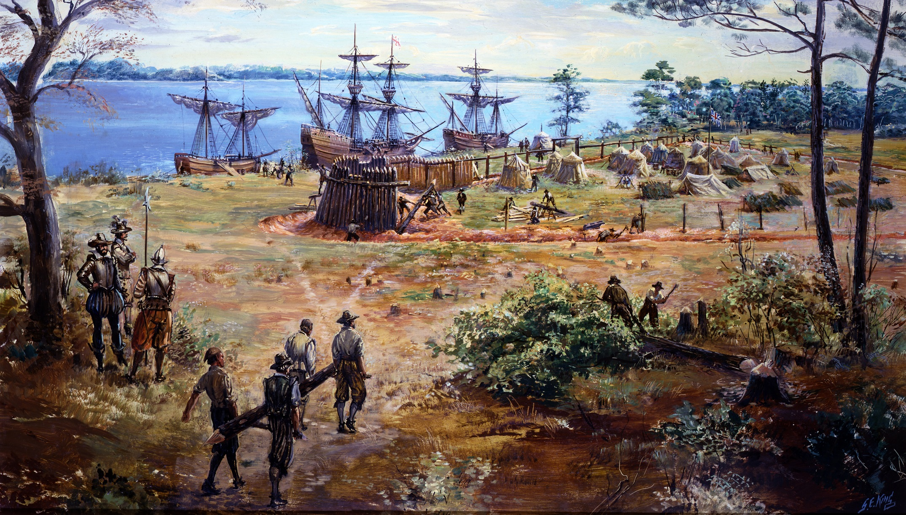

Slide 14
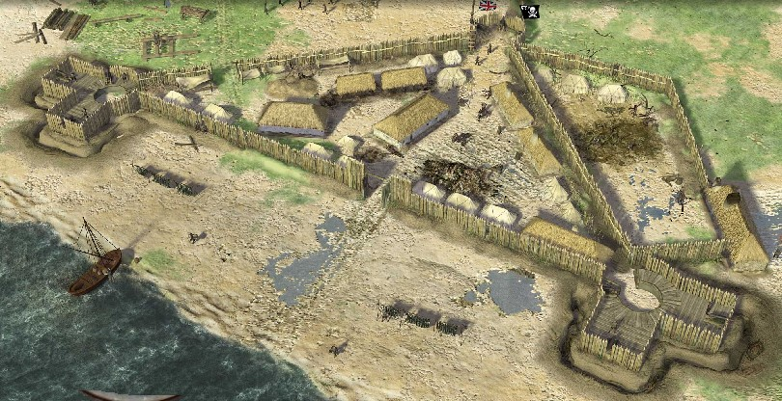

Slide 15
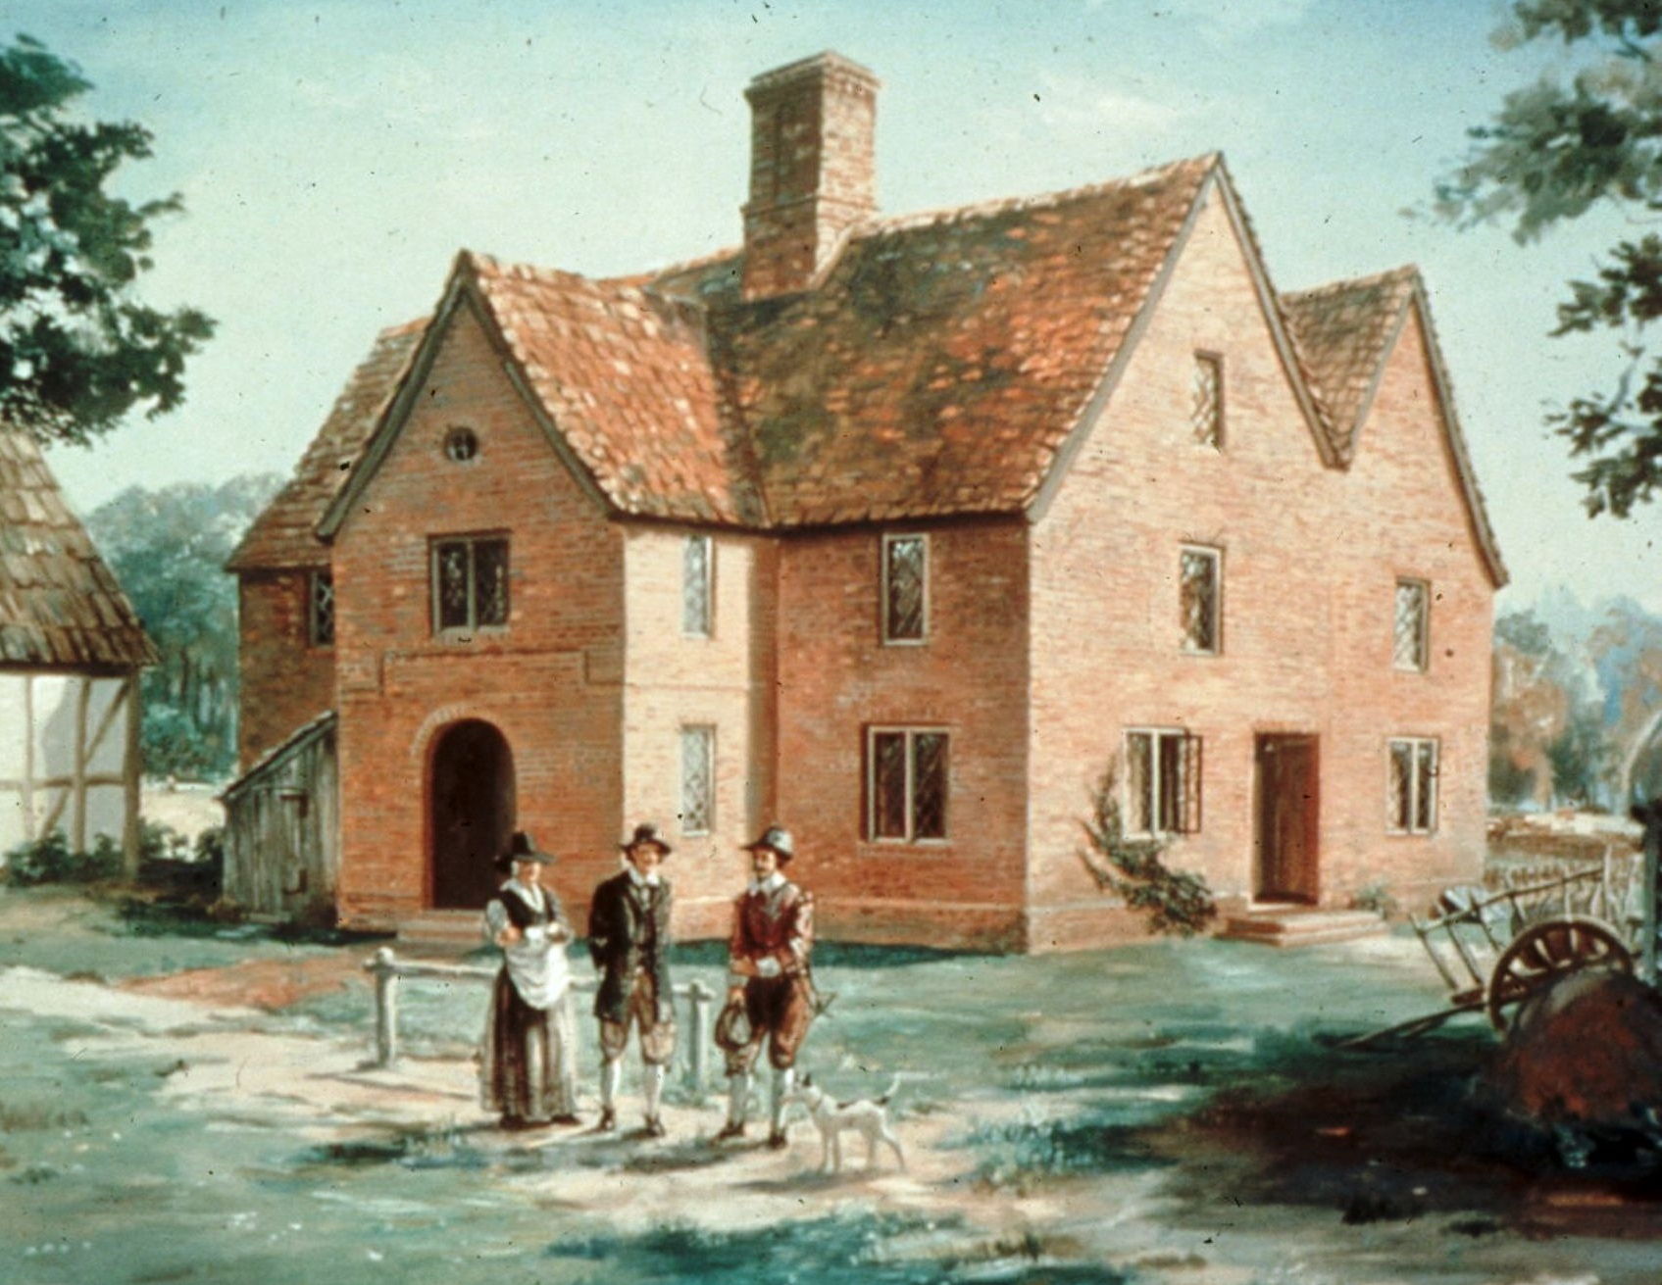
Established in 1619 so colonists could make their own laws
Becomes the first representative government in America
lukerosa@gmail.com

Slide 17
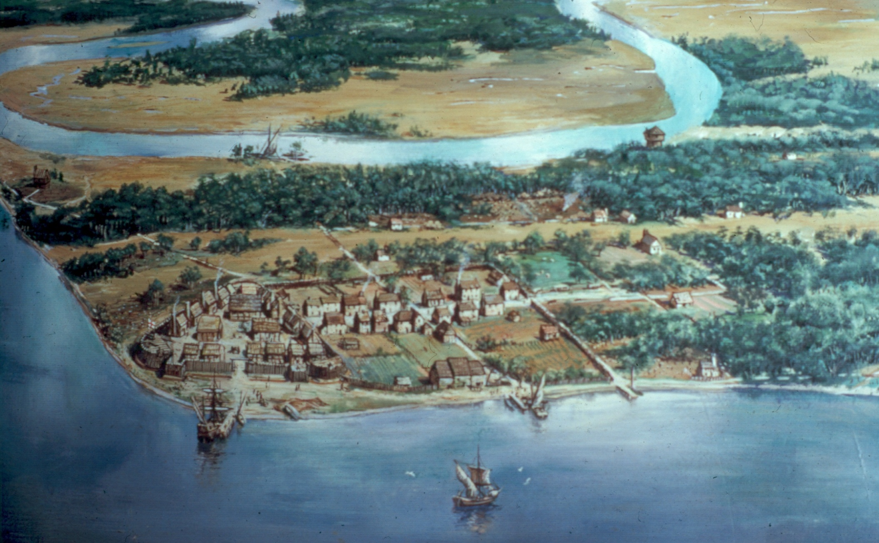
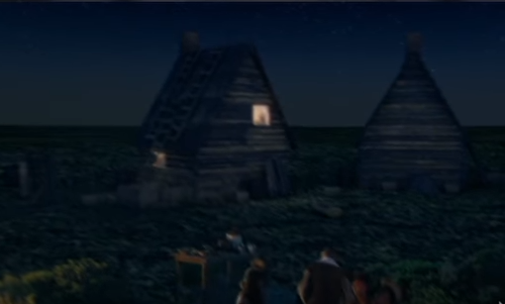

Slide 18
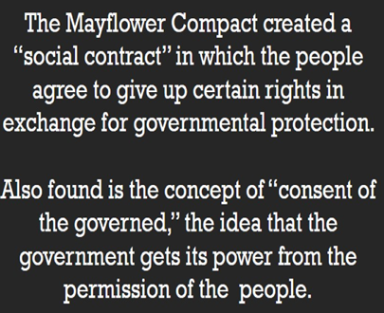
In 1620, Plymouth Colony was established in New England.
Early settlers were devout Puritans who hoped to create model moral communities.
Adult males signed the Mayflower Compact, a framework for self-government.
Notes:
18

Slide 19
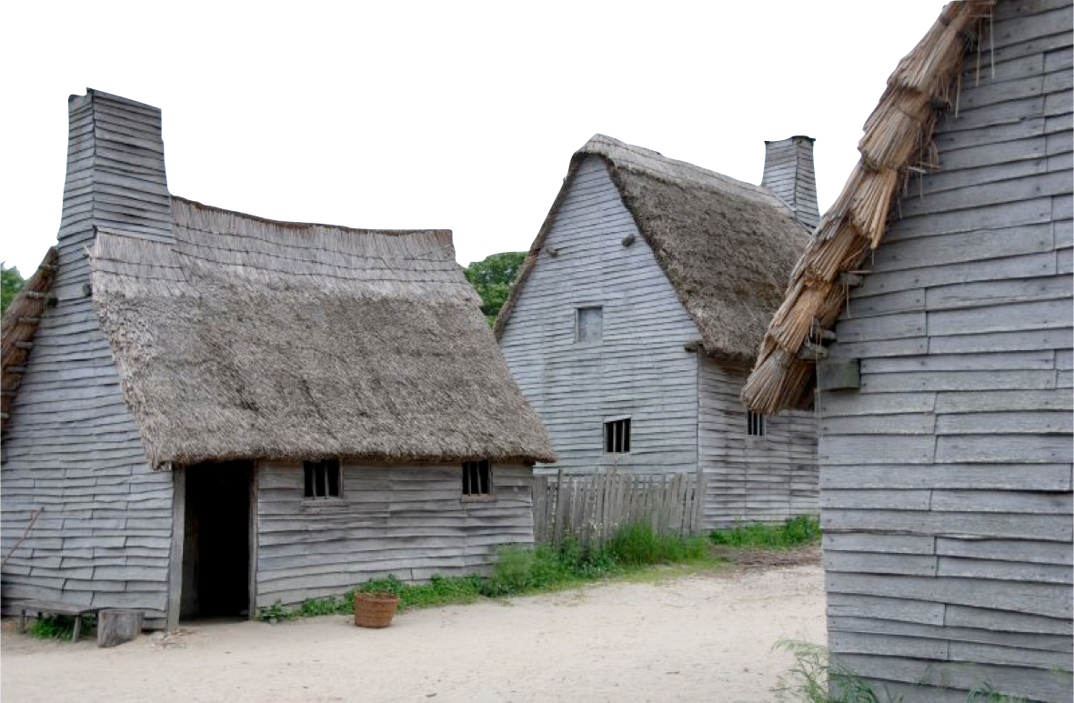
witches!

Slide 20
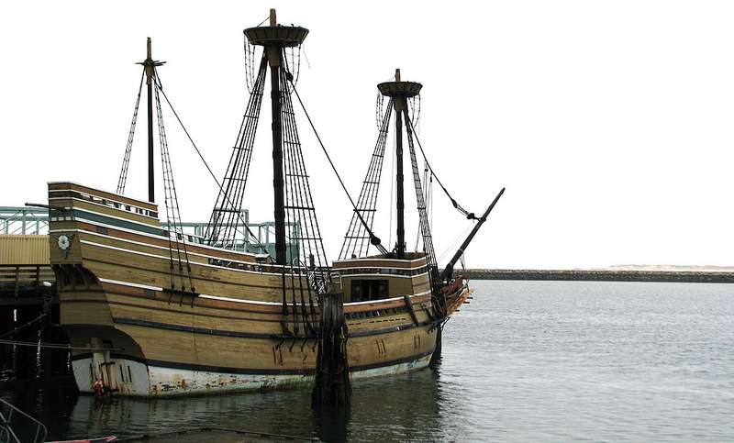
Strict religious separatists first left England for Holland
Secured funding in 1620 for a voyage to America, leaving from Southampton, England.

Slide 21
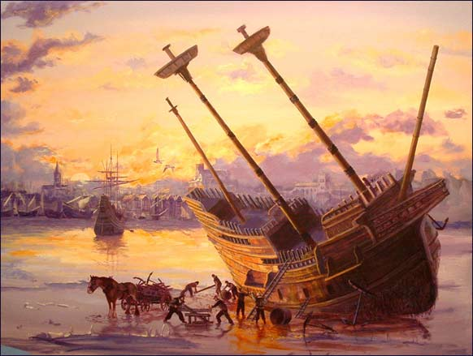
66 Day voyage to America
Landed in Plymouth, blown north of expected destination.
Signed the Mayflower Compact
Helped establish America’s ideas on self-government and majority rule

Slide 22
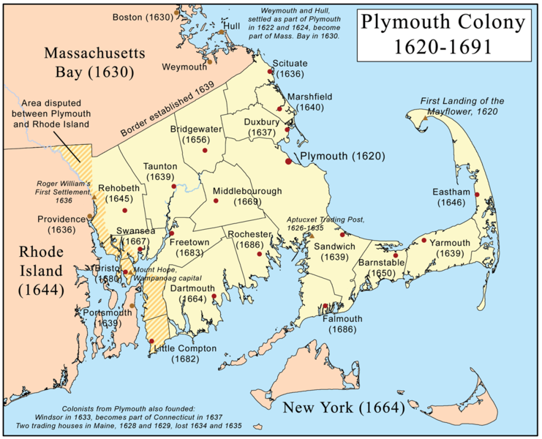

Slide 24
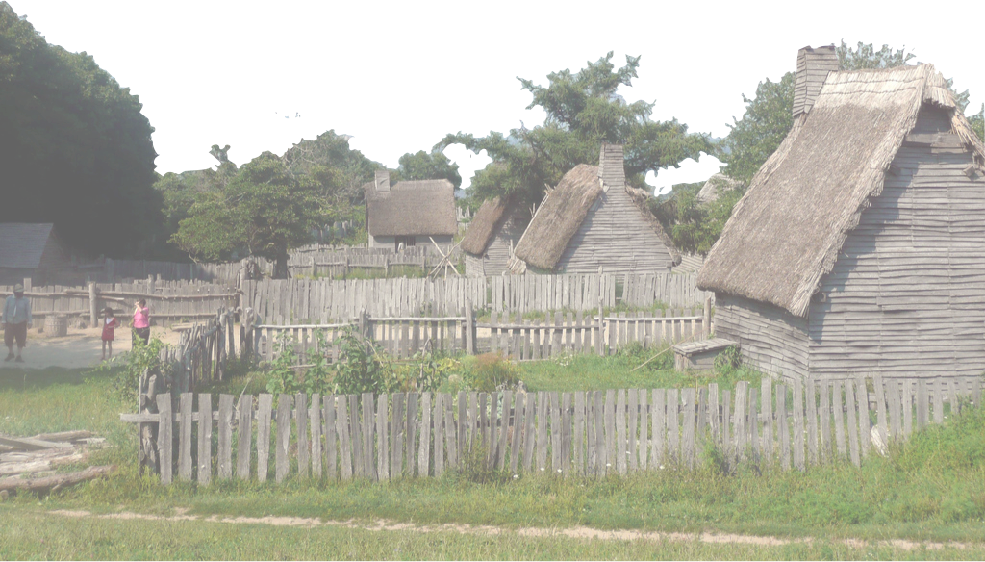
Struggles Endured:
Storm blew Pilgrims off course,
landing far north
Received help from Natives
first winter – Thanksgiving meal.
Created a “covenant community”
Practiced Athenian-style direct democracy in town meetings
Laid the foundation of majority rule in America

Slide 25
The colonists brought democratic
ideals from England.
In 1215 the Magna Carta protected an English citizen’s right to a trial by jury.
In 1688 the English Bill of Rights listed freedoms that the government promised to protect.
Notes:
25

Slide 27
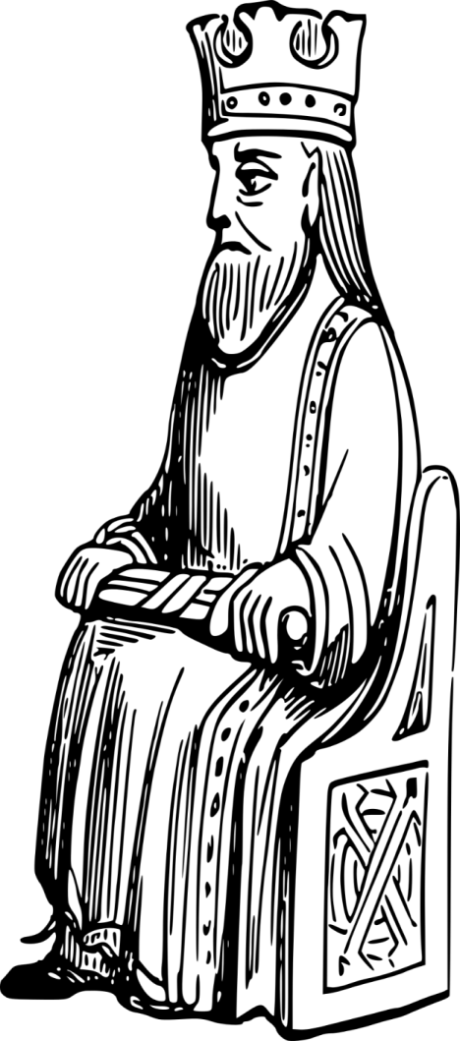
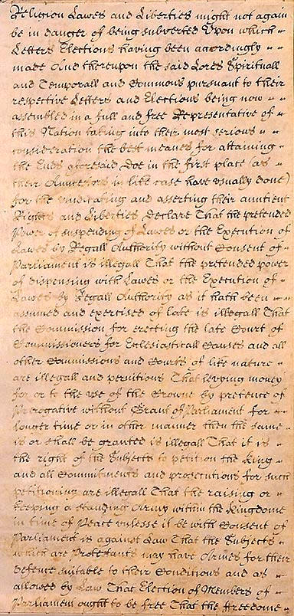
The English Bill of Rights
Signed in 1689, the English Bill of Rights further limited governmental power and protected rights. Included in the document:
No laws could be suspended unless Parliament approved
No taxes without Parliament’s approval
Trial by Jury, Freedom of Speech, No Cruel Punishments
Free Elections
Ugh, my power is totally limited!!

Slide 28
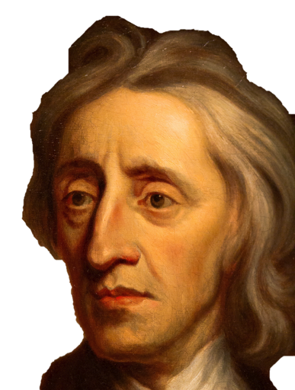
John Locke applied reason to government and politics.
During the 1700s the philosophy of the Enlightenment circulated in the colonies.
Enlightenment philosophers believed all problems could be solved by reasoning.
Notes:
28

Slide 29
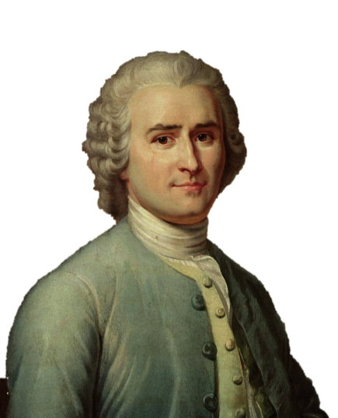
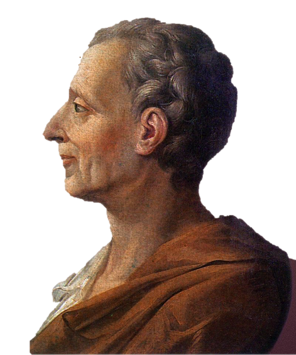
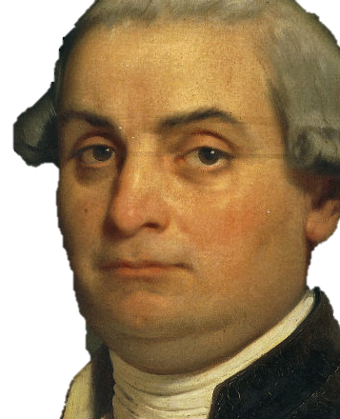
The Enlightenment
The Enlightenment was an intellectual revolution from the late 1700s to early 1800s in Europe & America
Locke
Montesquieu
Rousseau
Voltaire
Beccaria

Slide 30
Why was the Enlightenment an “Intellectual Revolution”?
Age of Reason
It challenged traditional authority
Encouraged individualism & the ability to think for yourself
It proved man’s ability to reason & thus discover for himself truths
Peoples liberties should be protected by law

Slide 33
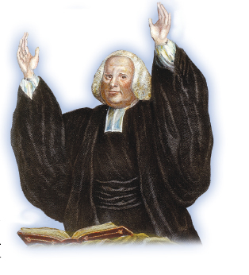
In the 1740s, the Great Awakening, an evangelical movement, began a religious revival in the colonies.
This led to greater tolerance of religious differences.
“Come one, come all!!!”
Notes:
33

Slide 34
The Great Awakening
“Come one, come all!”
Which ideas do this quote call attention to?
Acceptance and tolerance. These ideas will lead to increased colonist unity.

Slide 35
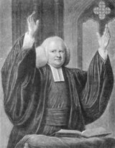
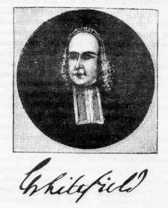
What is the Great Awakening?
Time in the 1730-1740’s of widespread religious passion in the colonies and a time of increased religious toleration and a feeling of community.

Slide 36
What Happened? Big Ideas
Period of intense religious emotions in the colonies from 1730-1740 (a few decades prior to the American Revolution).
Meetings held wherever a group could be gathered, all were welcome showing tolerance and equality.
Created a sense of unification (coming together/community)
Old ideas were challenged and discussed regarding moral choices, and absolute right or absolute wrong. This was an increase in individuality and thinking for oneself.

Slide 37
This section’s Big Takeaway
The Enlightenment and the Great Awakening shaped American culture by opening the minds to the idea of independence which helped lead to Revolutionary ideas against England.
Notes:
37

