Slide 1
Objectives
Identify the causes of the American Revolution.
Guiding Thought: What important ideas and major events led to the American Revolution?

Slide 2
Terms and People
Thomas Jefferson − wrote the Declaration of Independence in 1776
George Washington − General of the Continental Army during the American Revolution
Notes:
2

Slide 3
What important ideas and major events led to the American Revolution?
From Part A: Enlightenment and the Great Awakening.

Slide 4
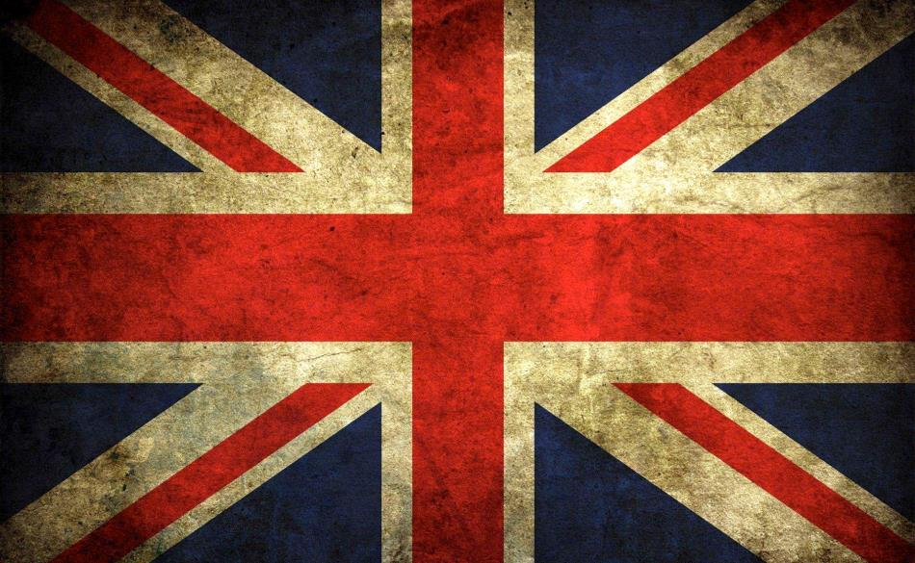
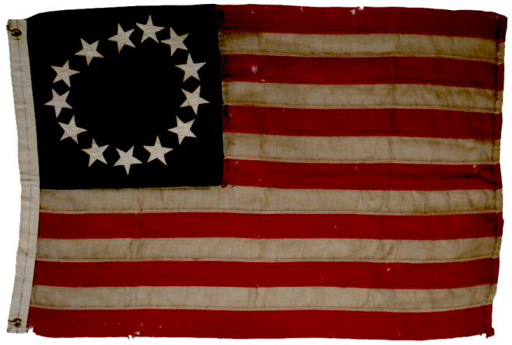
ROAD TO WAR

Slide 5
I. French and Indian War
English Colonies
Salutary Neglect
Policy where Britain gave its colonies more freedom to govern themselves
- rarely enforced trade/tariff acts
England
American
Colonies
Why?
- colonies made England $
- England didn’t have resources for enforcement
Significance:
Colonies grew independent & disliked British interference in their business.
Notes:
England Loosens the Reins
After 1688, England turned its attention away from the colonies. England still expected the colonies to export raw materials and import manufactured goods.(Mercantilism, remember from your world history class). As long as they did this, Parliament was happy. The American colonies was making England rich and thus, England saw little reason to devote large amounts of money and large numbers of soldiers to enforce its colonial laws.
This new policy of England’s became known as Salutary Neglect. Salutary means beneficial, while the neglect meant that England relaxed its enforcement of most regulations on the American colonies. This policy lasted from about 1607 to 1763 and as long as raw materials continued flowing into the homeland(England) and the colonists continued to buy English produced goods, Parliament did not supervise the colonies closely.
Other Reasons: Distance, Indifference, lack of knowledge about what was going on in the colonies.
As the colonies matured, they found that they needed the British government less and less and began to grow resentful of interference
THE SEEDS OF SELF-GOVERNMENT This policy of salutary neglect had an important effect on colonial politics as well as economics. In nearly every colony, a governor appointed by the king served as the highest authority. The governor presided over a political structure that included an advisory council, usually appointed by the governor, and a local assembly, elected by eligible colonists (land-owning white males). The governor held a wide range of powers. He had the authority to call and disband the assembly, appoint and dismiss judges, and over- see all aspects of colonial trade.
However, just as England’s economic policies were stronger in print than in practice, its colonial governors were not as powerful as they might seem. The colonial assembly, not the king, paid the governor’s salary. Using their power of the purse liberally, the colonists influenced the governor in a variety of ways, from the approval of laws to the appointment of judges.
Under England’s less-than-watchful eye, the colonies were developing a taste for self- government that would eventually create the conditions for rebellion. Nehemiah Grew, a British mercantilist, voiced an early concern about the colonies’ growing self-determination. He warned his fellow subjects in 1707.
However, the policy of salutary neglect that characterized British and colonial relations throughout the first half of the 1700s worked in large part because of the colonists’ loyalty to Britain. The men and women of the colonies still considered themselves loyal British subjects, eager to benefit the empire as well as them- selves. Aside from a desire for more economic and political breathing room, the colonies had little in common with one another that would unite them against Britain. In particular, the Northern and Southern colonies were developing dis- tinct societies, based on sharply contrasting economic systems.

Slide 6
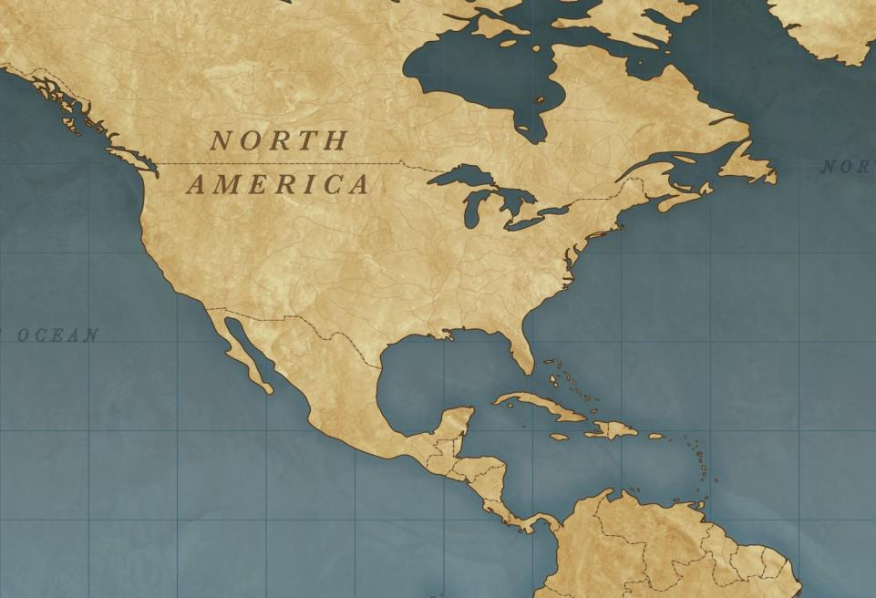
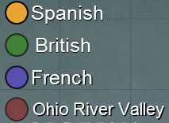
North America before 1754
french and Indian War
(7 Years War) France & Natives vs. Britain 1754 – 1763. Britain wanted French-controlled land: the Ohio River Valley.
Britain wins
Treaty of Paris 1763 - France lost most of its land in Canada and east of the Ohio River in N. America to Britain
Notes:
Rivals for an Empire
In the 1750s, France and Great Britain’s were fighting world domination, an empire across the world. Both had colonies in North America. An area of land that initially the was controlled by the French was now being claimed by the British. It was called the Ohio River Valley.
*Questions 1 - Ask a student to describe where the Ohio River Valley is on the map. Answer: below the great lakes.
*Question 2 - Besides the Native Americans who live on North America, which three European countries control North America? Ans: Spain, Britain, France
The British wanted to settle in the Ohio River Valley and to trade with the Native Americans who lived there. The French built forts to protect their trade with the Indians. In 1754, George Washington led an army against the French. He was quickly defeated.
Britain declared war on France. The war for control of the valley was called the French and Indian War. Most Native Americans in the region were allies of the French. The Native Americans liked the French because they traded but did not settle on the land.
Albany Plan - In 1754, a congress of the British colonies met in Albany, New York. Benjamin Franklin thought the colonies should work together to defeat France. Each colony would still have its own government. They would also create one government together to decide important issues. His idea was called the Albany Plan of Union. The colonists rejected it. They did not want to join together under one government.

Slide 7
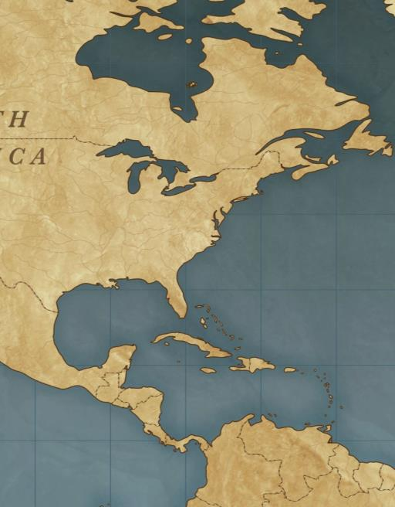
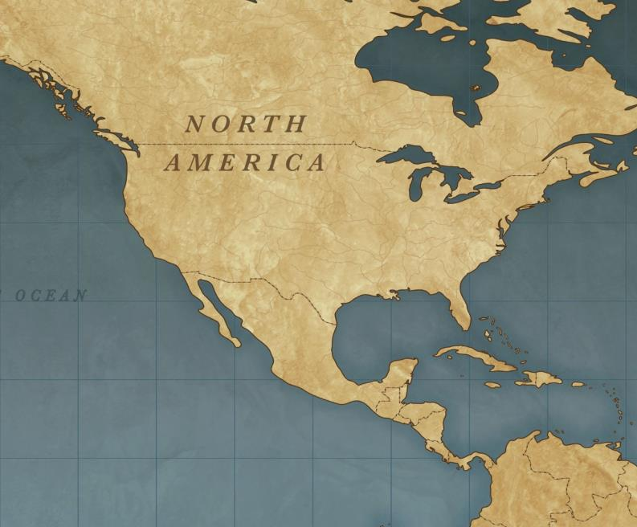
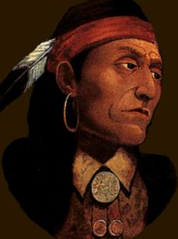
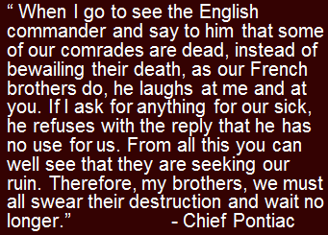
`
North America before 1754
North America I 1763
Proclamation line
Chief Pontiac
Smallpox victim
Pontiac’s Rebellion - war by Native American tribes led by Chief Pontiac against British rule after the French and Indian War
- Natives lose - led to smallpox-infected blankets being given to 2 Delaware chiefs, killing thousands.
Proclamation of 1763 - banned all settlement west of the Appalachians to
avoid conflict w/Native Americans - W. of line for Native Americans
- Colonists ignored proclamation
Notes:
Native Americans feared that the growing number of British settlers crossing the Appalachian mountains would end up driving away the game they depended on for survival. In the spring of 1763, the Ottawa leader, Chief Pontiac recognized that the French loss was a loss for Native Americans He said this: (Press Space Bar for Animation) Read or have student read Pontiac’s words.
Pontiac led various Native American tribes in a war against the British. This was called Pontiac’s Rebellion. Native Americans captured eight British forts in the Ohio Valley and surrounded two others. In response the British pretended they wanted fair settlement for peace. Instead, they commuted germ warfare. They presented smallpox-infected blankets to two Delaware chiefs during peace negotiations, and the virus spread rapidly among the Native Americans, killing thousands. This is small-pox(click for animation). Remember from your World History class, it was small-pox that wiped out entire Native American populations in South America when the Spanish arrived. Small-pox is no longer around thanks to vaccinations. It was finally eradicated in 1979. Weakened by disease and war, most Native American groups negotiated treaties with the British by the end of 1765.
Many colonists felt they were running out of land. They began to move west to farm. As they settled west they were encroaching on Native American land. This encroachment was causing conflict, which could have led to war. To avoid more conflict with American Indians, Britain made the Proclamation of 1763. It recognized the Indians’ right to the land. It did not allow colonists west of the Appalachian Mountains. The colonists were angry. They wanted to settle on the land. They did not want the British soldiers to live among them.

Slide 8
II. Growing Apart
Increase Revenue Strategies After Expensive War
Crack down on colonial exports (avoid taxes)
1761 → writs of assistance → British customs officials to search any ship or building → outraged the merchants of Boston.
Increase in Troops
10,000 troops were stationed in NA to protect the colonies, the colonists viewed it as a standing army that might turn against them. Also expensive.
Notes:
The colonists and Britain were sadly growing apart. In part, the Colonist were mad. They were mad at Britain because the Proclamation of 1763 tried to stop westward expansion. The colonist wanted more land, and it seemed to the colonists that the British government did not care about their needs.
Wars are expensive. Britain had borrowed so much money during the war that it nearly doubled its national debt. So, a second result of the French and Indian War was that Britain was broke. They needed to pay for the war. One way to ensure income into Britain’s bank accounts was to crack down on colonial smuggling. Colonists would illegally import goods from other countries without paying import taxes. This meant that Britain wasn’t making profits from the smuggled goods. Britain felt, if it could just get colonists to purchase legal goods, and pay the tariffs, it could help pay down the war debt. In 1761, the royal governor of Massachusetts authorized the use of the writs of assistance, which allowed British customs officials to search any ship or building. Because many merchants worked out of their homes, the writs enabled officials to search colonial homes. The merchants of Boston were outraged.
After the war, the British government stationed 10,000 troops in its territories to control the Native Americans and former French subjects. Although this army was meant to protect the colonies, the colonists viewed it as a standing army that might turn against them. Maintaining troops in North America was also expensive.
Sugar Act: In 1764 Grenville prompted Parliament to enact a law known as the Sugar Act. The Sugar Act did three things. It halved the duty on foreign-made molasses (in the hopes that colonists would pay a lower tax rather than risk arrest by smuggling). It placed duties on certain imports. Most important, it strengthened the enforcement of the law allowing prosecutors to try smuggling cases in a vice-admiralty court rather than in a more sympathetic colonial court.
By the end of 1764, the colonies and Great Britain were disagreeing more and more about how the colonies should be taxed and governed. They were thirteen years away from all out war.

Slide 9
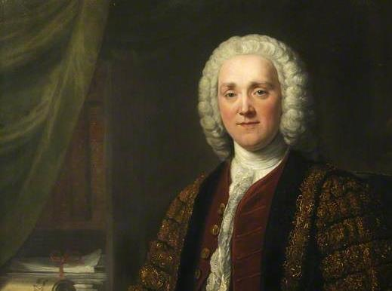
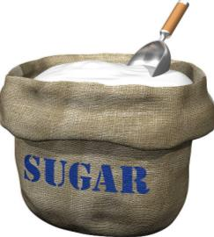
II. Growing Apart
George Grenville
British Prime minister who tried increase revenue (rather than regulating trade) by promoting Sugar Act
Sugar Act 1764 - tried to stop smuggling
- taxed sugar, wine, indigo & coffee
- smuggling trials taken out of sympathetic colonial courts
George Grenville - British Prime Minister
Notes:
The colonists and Britain were sadly growing apart. In part, the Colonist were mad. They were mad at Britain because the Proclamation of 1763 tried to stop westward expansion. The colonist wanted more land, and it seemed to the colonists that the British government did not care about their needs.
Wars are expensive. Britain had borrowed so much money during the war that it nearly doubled its national debt. So, a second result of the French and Indian War was that Britain was broke. They needed to pay for the war. One way to ensure income into Britain’s bank accounts was to crack down on colonial smuggling. Colonists would illegally import goods from other countries without paying import taxes. This meant that Britain wasn’t making profits from the smuggled goods. Britain felt, if it could just get colonists to purchase legal goods, and pay the tariffs, it could help pay down the war debt. In 1761, the royal governor of Massachusetts authorized the use of the writs of assistance, which allowed British customs officials to search any ship or building. Because many merchants worked out of their homes, the writs enabled officials to search colonial homes. The merchants of Boston were outraged.
After the war, the British government stationed 10,000 troops in its territories to control the Native Americans and former French subjects. Although this army was meant to protect the colonies, the colonists viewed it as a standing army that might turn against them. Maintaining troops in North America was also expensive.
Sugar Act: In 1764 Grenville prompted Parliament to enact a law known as the Sugar Act. The Sugar Act did three things. It halved the duty on foreign-made molasses (in the hopes that colonists would pay a lower tax rather than risk arrest by smuggling). It placed duties on certain imports. Most important, it strengthened the enforcement of the law allowing prosecutors to try smuggling cases in a vice-admiralty court rather than in a more sympathetic colonial court.
By the end of 1764, the colonies and Great Britain were disagreeing more and more about how the colonies should be taxed and governed. They were thirteen years away from all out war.

Slide 10
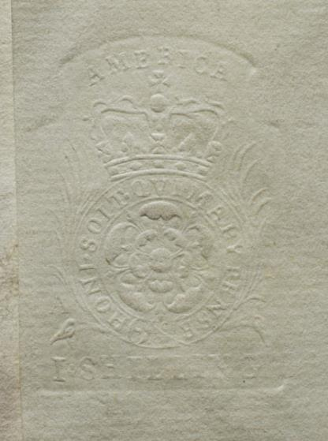
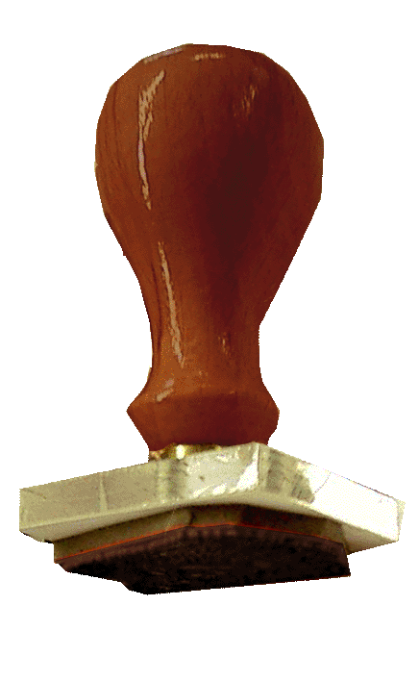
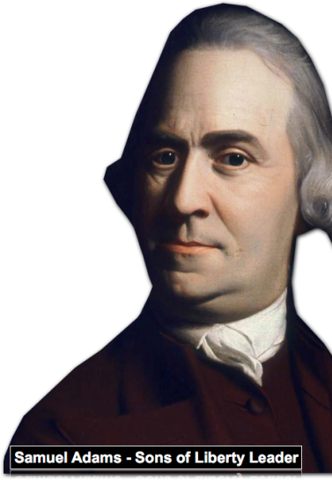
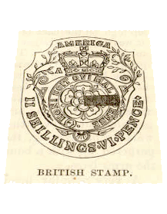
II. Growing Apart
Embossed tax stamp on paper - 1765
Stamp act
Stamp Act of 1765 - tax paid for the right to print (1st Internal Tax)
Sons of Liberty - protest group led by Samuel Adams
Declaratory Act (1766) Parliament ended Stamp Act.
- but also restates Parliament’s power over the colonists
10 Years until War
Notes:
THE STAMP ACT: In March 1765 Parliament, persuaded by Prime Minister George Grenville, passed the Stamp Act. The Stamp Act required colonists to purchase special stamped paper for every legal document, (marriages and birth certificates, licenses, newspaper, pamphlet, and almanac, and imposed special “stamp duties” on packages of playing cards and dice. The tax reached into every colonial pocket. Colonists who disobeyed the law were to be tried in the vice-admiralty courts, where convictions were probable. Colonial lawyers, tavern owners, merchants and printers were the most affected.
STAMP ACT PROTESTS: The colonists were united in their defiance against the new tax. Boston shop-keepers, artisans, and laborers organized a secret resistance group called the Sons of Liberty. One of its founders was Harvard-educated Samuel Adams.
The Sons of Liberty were harassed customs workers, stamp agents, and sometimes royal governors. Facing mob threats and demonstrations, stamp agents all over the began colonies began quitting.
In October 1765, delegates from nine colonies met in New York City. They declared that Parliament lacked the power to impose taxes on the colonies because the colonists were not represented in Parliament. “No taxation without representation!” For the first time, the separate colonies began to act as one. Merchants in New York, Boston, and Philadelphia agreed not to import goods manufactured in Britain until the Stamp Act was repealed. The boycott worked. In March 1766, Parliament repealed the Stamp Act; but on the same day, to make its power clear, Parliament issued the Declaratory Act. This act asserted Parliament’s full right to make laws “to bind the colonies and people of America . . . in all cases whatsoever.”

Slide 11
II. Growing Apart
Townshend Acts
Townshend Acts 1767- indirect taxes, on imported materials
- glass, lead, paint, paper & tea
- “no taxation without representation” led to boycotts under Samuel Adams’ leadership
2,000 Redcoats stationed in Boston.
2 Groups Emerged:
Colonists who challenged British authority and will eventually seek independence (Patriots)
Colonists who remained loyal to the British Monarchy (Loyalists)
Samuel Adams - Massachusetts Patriot Leader
8 Years until War
Notes:
The Townshend Acts: With in a year after Parliament repealed the StampAct, Charles Townshend, the leading government minister at the time, decided on a new method of gaining money from the American colonies. His proposed revenue laws, passed by Parliament in 1767, became known as the Townshend Acts. Unlike the Stamp Act, which was a direct tax, these were indirect taxes, or duties levied on imported materials—glass, lead, paint, and paper— as they came into the colonies from Britain. The acts also imposed a three-penny tax on tea, the most popular drink in the colonies.
The colonists agin resisted. Educated Americans spoke out against the Townshend Acts, protesting “taxation without representation.” Boston’s Samuel Adams called for another boycott of British goods, and American women became involved in the protest. Wealthy women stopped buying British luxuries and joined other women in making their own cloth instead of buying from Britain. Housewives also boycotted British tea and exchanged recipes for tea made from birch bark and sage.
Conflict intensified in June 1768. British agents in Boston seized the Liberty, a ship belonging to local merchant John Hancock. The customs inspector claimed that Hancock had smuggled in a shipment of wine from Madeira and had failed to pay the customs taxes. The seizure triggered riots against customs agents. In response, the British stationed 2,000 “redcoats,” or British soldiers—so named for the red jackets they wore—in Boston.
Boston Massacre -
British troops had been sent to America to protect the people who enforced Britain’s tax laws. One night, a squad of soldiers was harassed by a Boston crow throwing snowballs and rotten eggs at the troops. British Commander, Captain Prescott tried to calm the situation, but one of his soldiers fired, and then followed the rest. Five American colonist lay dead when the smoke cleared.
Instantly, Samuel Adams and other colonial rebels labeled this confrontation the Boston Massacre, thus presenting it as a British attack on defenseless citizens. Paul Revere engraved this picture. It’s been called one of the greatest pieces of propaganda in American history.
Boston Tea Party
Early in 1773, the British East India Company, which held an official monopoly on tea imports, had been hit hard by the colonial boycotts. With its warehouses bulging with 17 million pounds of tea, the company was nearing bankruptcy. To save it, Britain passed the Tea Act, which granted the company the right to sell tea to the colonies free of the taxes that colonial tea sellers had to pay. This action would cut colonial merchants out of the tea trade, because the East India Company could sell its tea directly to consumers for less. North hoped the American colonists would simply buy the cheaper tea; instead, they protested violently.
On the moonlit evening of December 16, 1773, a large group of Boston rebels disguised themselves as Native Americans and proceeded to take action against three British tea ships anchored in the harbor.
In this incident, later known as the Boston Tea Party, the “Indians” dumped 18,000 pounds of the East India Company’s tea into the waters of Boston Harbor.

Slide 12
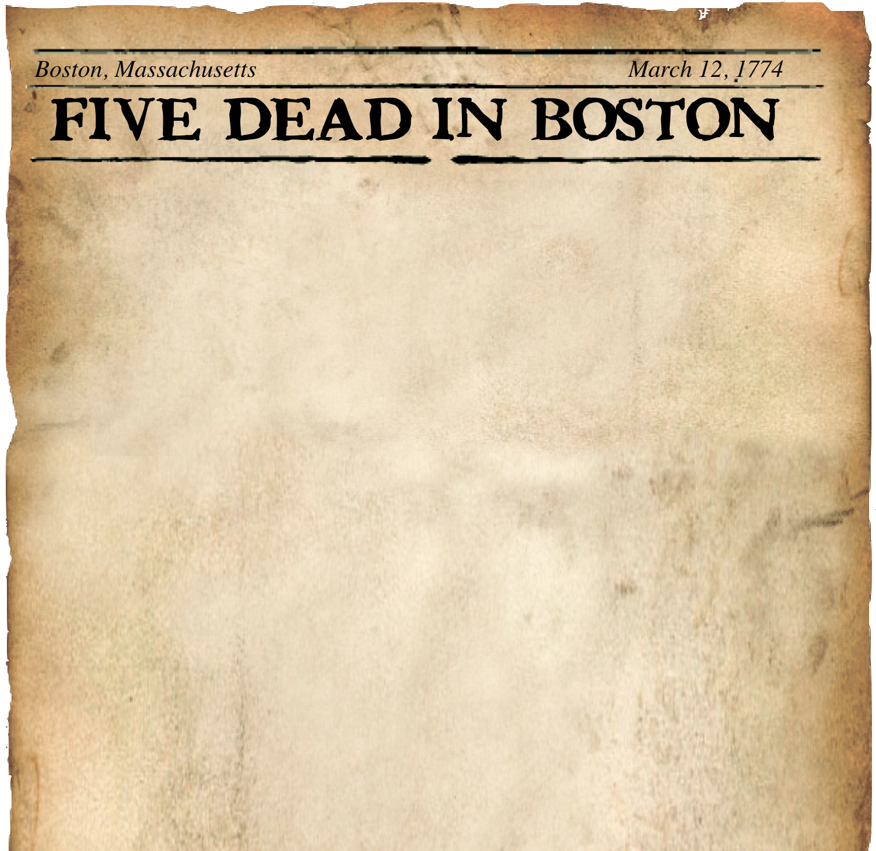
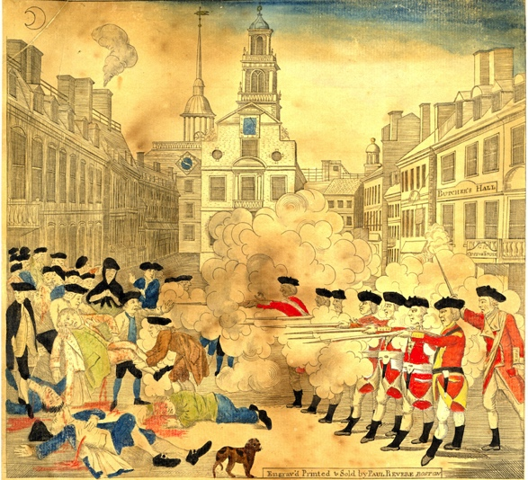
II. Growing Apart
Boston Massacre (1770)
5 Colonist dead
Britain ended taxes except on tea
MASSACRE IN BOSTON
Tea Act 1773
British East India Company, (tea imports) nearing bankruptcy by the colonial boycotts. Allowed to sell tea to the colonies directly.
Cut colonial merchants out of the tea trade (EIC sell its tea directly to consumers for less). Protests.
5 Years until War
Notes:
Boston Massacre -
British troops had been sent to America to protect the people who enforced Britain’s tax laws. One night, a squad of soldiers was harassed by a Boston crow throwing snowballs and rotten eggs at the troops. British Commander, Captain Prescott tried to calm the situation, but one of his soldiers fired, and then followed the rest. Five American colonist lay dead when the smoke cleared.
Instantly, Samuel Adams and other colonial rebels labeled this confrontation the Boston Massacre, thus presenting it as a British attack on defenseless citizens. Paul Revere engraved this picture. It’s been called one of the greatest pieces of propaganda in American history.
Boston Tea Party
Early in 1773, the British East India Company, which held an official monopoly on tea imports, had been hit hard by the colonial boycotts. With its warehouses bulging with 17 million pounds of tea, the company was nearing bankruptcy. To save it, Britain passed the Tea Act, which granted the company the right to sell tea to the colonies free of the taxes that colonial tea sellers had to pay. This action would cut colonial merchants out of the tea trade, because the East India Company could sell its tea directly to consumers for less. North hoped the American colonists would simply buy the cheaper tea; instead, they protested violently.
On the moonlit evening of December 16, 1773, a large group of Boston rebels disguised themselves as Native Americans and proceeded to take action against three British tea ships anchored in the harbor.
In this incident, later known as the Boston Tea Party, the “Indians” dumped 18,000 pounds of the East India Company’s tea into the waters of Boston Harbor.

Slide 13
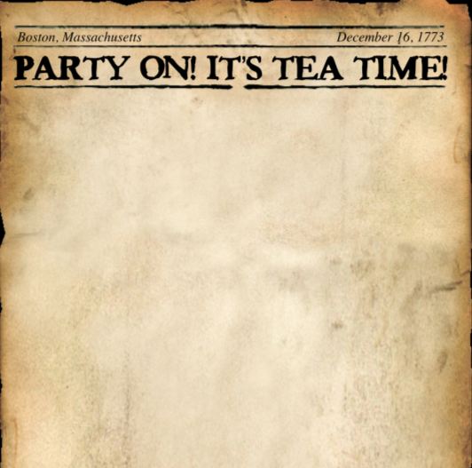
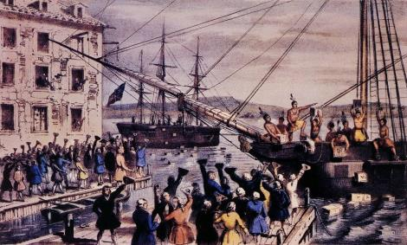
II. Growing Apart
Boston Tea Party (1773)
protested by dumping tea into Boston Harbor
SONS OF LIBERTY PROTESTS
DUMP TEA
Intolerable Acts
punishment for tea party
closed Boston harbor
Quartering Act: colonists to feed and lodge British soldiers.
Boston under Martial Law
Limit the rights of self-government, banned the town meetings and the Committees of Correspondence, (colonial organization against British “oppression”)
2 Years until War
Notes:
Boston Massacre -
British troops had been sent to America to protect the people who enforced Britain’s tax laws. One night, a squad of soldiers was harassed by a Boston crow throwing snowballs and rotten eggs at the troops. British Commander, Captain Prescott tried to calm the situation, but one of his soldiers fired, and then followed the rest. Five American colonist lay dead when the smoke cleared.
Instantly, Samuel Adams and other colonial rebels labeled this confrontation the Boston Massacre, thus presenting it as a British attack on defenseless citizens. Paul Revere engraved this picture. It’s been called one of the greatest pieces of propaganda in American history.
Boston Tea Party
Early in 1773, the British East India Company, which held an official monopoly on tea imports, had been hit hard by the colonial boycotts. With its warehouses bulging with 17 million pounds of tea, the company was nearing bankruptcy. To save it, Britain passed the Tea Act, which granted the company the right to sell tea to the colonies free of the taxes that colonial tea sellers had to pay. This action would cut colonial merchants out of the tea trade, because the East India Company could sell its tea directly to consumers for less. North hoped the American colonists would simply buy the cheaper tea; instead, they protested violently.
After a Town Hall Meeting Sam Adams and a group of about 110 men marched to the docks dressed as Native Americans and dumped all the 18,000 pounds of tea into the harbor. It was worth 10,000 British Pounds (roughly 333,000 dollars today). ** Turned Boston Bay brown for five months and killed every fish in the water at that time. This incident would become known as the Boston Tea Party and would lead to the Intolerable Acts.
Intolerable Acts:
The British would punish the colonists for the Boston Tea Party by passing what the colonists called the Intolerable Acts.
The Intolerable Acts:
first closed Boston Harbor
two, required colonists to feed and house British soldiers (Quartering Act)
three, limit the rights of self government - banned the town meetings and the Committees of Correspondence, which was a organization that established a union among the 13 colonies against British “oppression.”

Slide 14
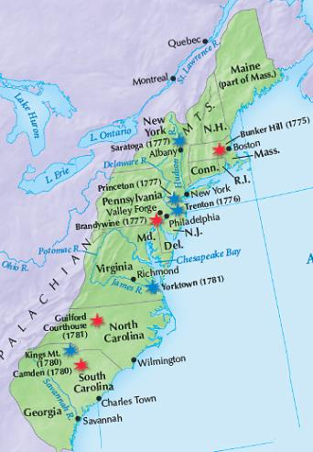
The Americans won the war after trapping a British army in Yorktown, Virginia.
The Americans benefited from the leadership of George Washington and assistance from France.
The Treaty of Paris was signed in 1783.
Notes:
14

