Slide 1
13 Colonies
Great Britain

Slide 2
1776-1781

Slide 3
The war was fought in the 13 colonies.
Color in the territory of the 13 colonies.

Slide 4
*British debt after the French and Indian War
*Tax acts passed by Great Britain angered many colonists and “no taxation without representation” became a rallying cry.
*Boston Massacre
*Boston Tea Party
*Battles of Lexington and Concord
*Battle of Bunker Hill
*Declaration of Independence
Boston Massacre Video
Boston Tea Party
Lexington and Concord
Battle of Bunker Hill Video
Declaration of Independence Song

Slide 5
The war is also called the

Slide 6
Tories like me are sometimes called Loyalists because we remain loyal to Great Britain and don’t support independence.
Patriots like me want independence from Great Britain!

Slide 7
*The Congress met in Philadelphia during the war as the acting national government
*relied on states to send contributions to pay for military supplies and
soldiers’ wages
*issued paper
money, but it
was worthless
*In 1778, it
formalized an
alliance with
France
I am honored to be chosen as the commander of the colonial army. May I have some money to pay my men and buy supplies?
George Washington Becomes Army Commander Video

Slide 8
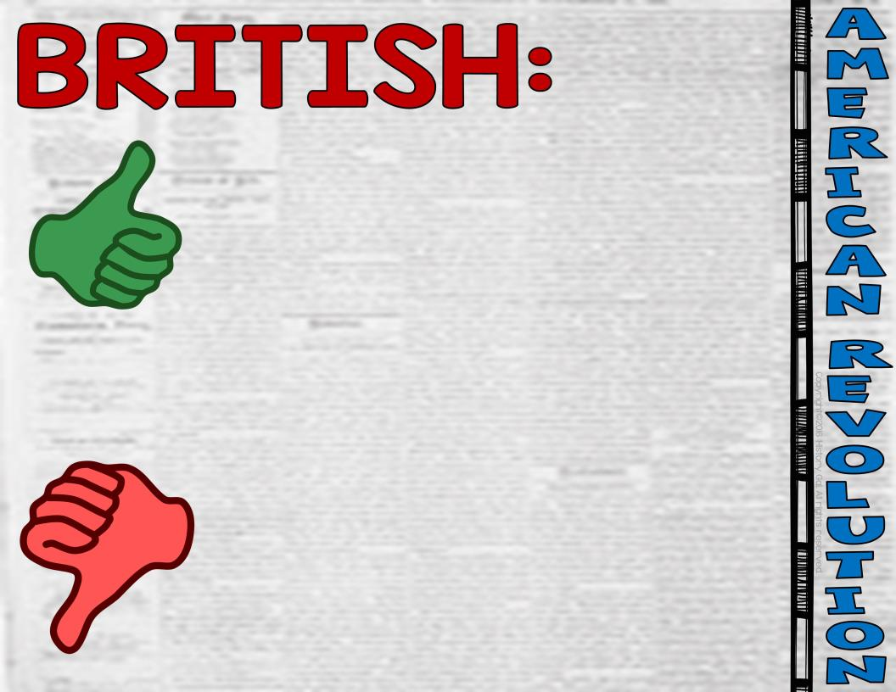
*largest navy in the world
*professional soldiers
*had the infrastructure to produce weapons and supplies
*fighting a war across the Atlantic Ocean
*common for soldiers to desert
*fighting in unfamiliar territory

Slide 9
*determination to win
*knew the land (home field advantage)
*inexperienced military
*politically disorganized

Slide 10
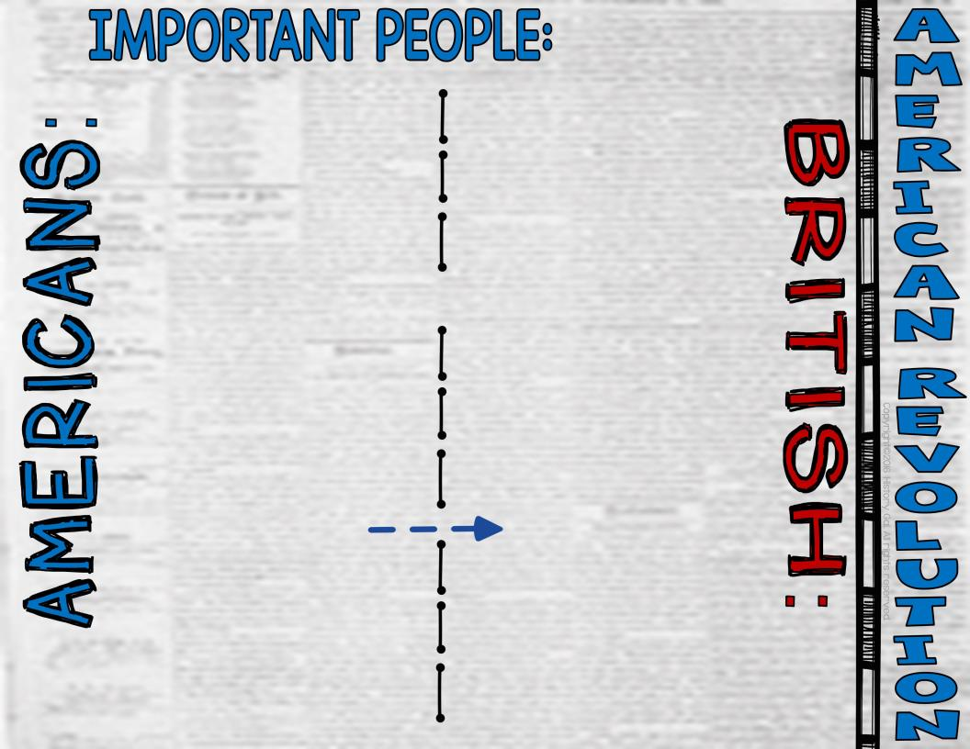
*George Washington
*Baron von Steuben
*Marquis de Layfette
*Horatio Gates
*Nathanel Green
*Benedict Arnold
*Ethan Allen
*Nathan Hale
*King George III
*Charles Cornwallis
*William Howe
*John Burgoyne
*Thomas Gage
Layfette Video
Benedict Arnold Video
Baron von Steuben Video

Slide 11
*Battle of Trenton (Dec. 26, 1776) - Washington’s surprise attack on the British hired Hessian soldiers was an American victory that boosted morale, the Americans then wintered in Valley Forge, Pennsylvania
*Battles of Saratoga (Sept. 19 - Oct. 7, 1777) - An American victory that resulted in the French openly supporting the Americans in the war
*Battle of Yorktown (Sept. 28 - Oct. 19, 1781) - British General Cornwallis surrendered to the Americans basically ending the war
Battle of Trenton Video
Battle of Saratoga Video
Yorktown Video

Slide 12
*British recognized the sovereignty and independence of the United States with generous boundaries from the Great Lakes to the Mississippi River to Spanish Florida
American Revolution in 9 Minutes

