Slide 1
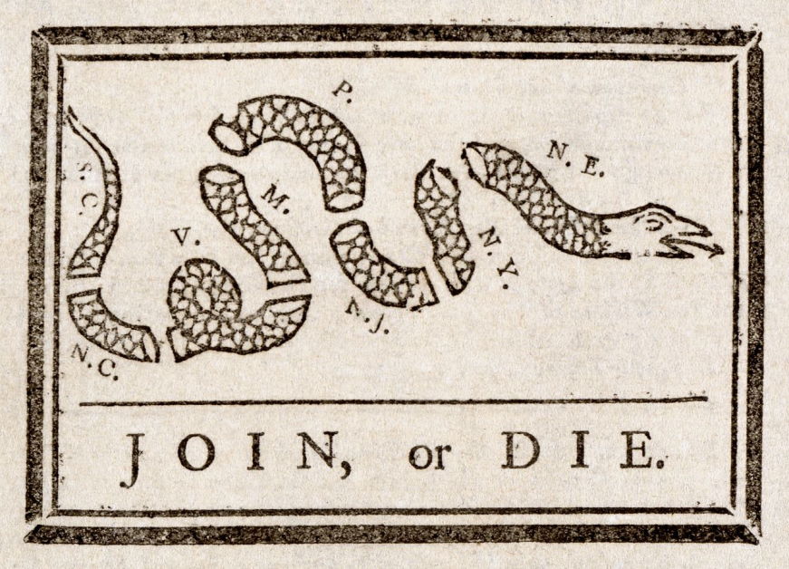
*Albany Plan of Union (1754)- Colonists from 7 colonies met in Albany to discuss many issues including the war, Benjamin Franklin proposed a Plan of Union - a loose confederation of the 13 colonies and while the plan was never carried out, the idea of uniting together remained.
* After the war, Great Britain had a large war debt and needed money
Political cartoon drawn by Benjamin Franklin, 1754
#FAIL Albany Plan of Union Video

Slide 2
*1763 - Chief Pontiac led an attack against colonial settlements on the western frontier
*British sent over troops to fight instead of using colonial militias
Pontiac’s Rebellion

Slide 3
*1763 - Colonists were not allowed to settle west of the Appalachian Mountains
Proclamation of 1763

Slide 4
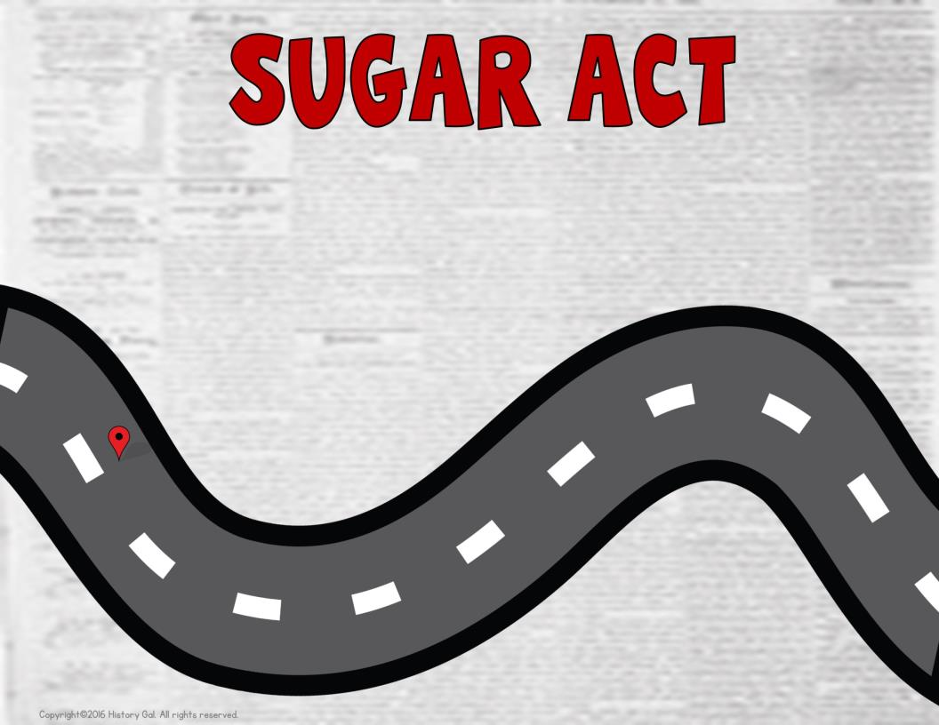
*April 1764 - Placed a tax on foreign (non-British) sugar and certain luxuries
Sugar Act
Sugar Act Song #1
Sugar Act Song #2

Slide 5
*March 1765 – Colonists had to provide shelter and food for the British soldiers
The Quartering Act
Proclamation from King George III

Slide 6
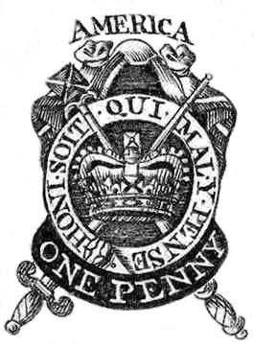
*March 1765 - placed a tax on all printed materials
*The Sons of Liberty group was created in opposition to the act -“no taxation without
representation!”
1765 Stamp Act
Sons of Liberty

Slide 7
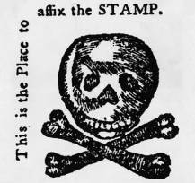
*October 1765 - representatives from 9 colonies resolved that only their elected officials could approve taxes

Slide 8
*March1766

Slide 9
*March 1766 - reminded the colonists that Great Britain made the laws
You may make the laws, but tax officials better watch out for angry mobs with tar and feathers!
I know thousands of miles separate us and I did neglect you for a while, but
I AM YOUR KING!
No More Kings Song

Slide 10
*1767 - placed a tax on imported tea, glass, and paper
*suspended the New York Assembly for refusing to
follow the Quartering Act
*gave customs officials a general license or writ of assistance to search private homes
and businesses for
smuggled goods

Slide 11
*1767-1768
Taxes cannot be levied without the consent of colonial representatives.
JOHN DICKINSON

Slide 12
*Feb. 1768 - letter was sent to every colonial legislature urging them to petition Parliament to repeal the Townshend Acts

Slide 13
March 1770-
except for a tax on tea

Slide 14
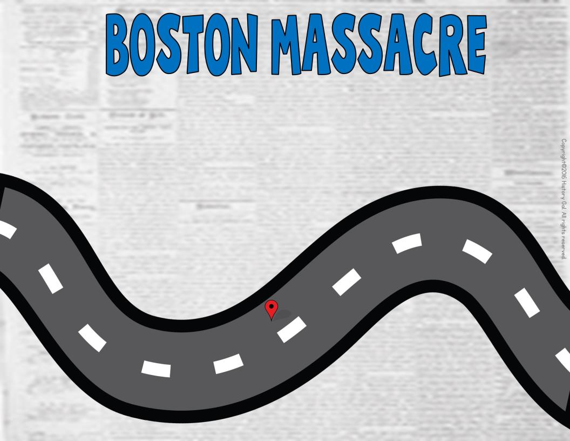
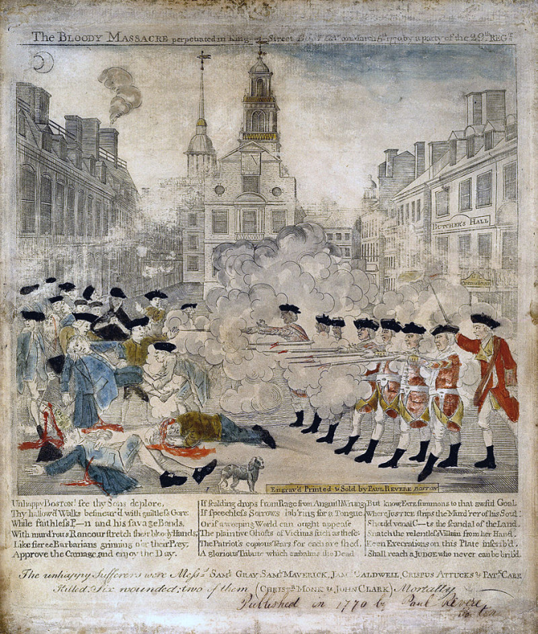
Paul Revere’s Print
*On March 5, 1770 - a crowd of colonists harassed British guards near a customs house
*soldiers fired into the unruly crowd and killed 5
Boston Massacre Explained
Boston Massacre

Slide 15
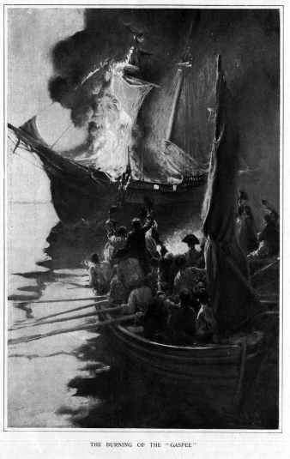
*June 1772 - Rhode Island colonists burned the British patrol ship, the Gaspee

Slide 16
*Between 1772- 1774, each colony established a Patriot led government that opposed British policies and became a communication network between the colonies
Committees of Correspondence

Slide 17
*April 1773 -placed a tax on tea
Even if it is cheaper than my smuggled Dutch tea. I will never drink
British tea!

Slide 18
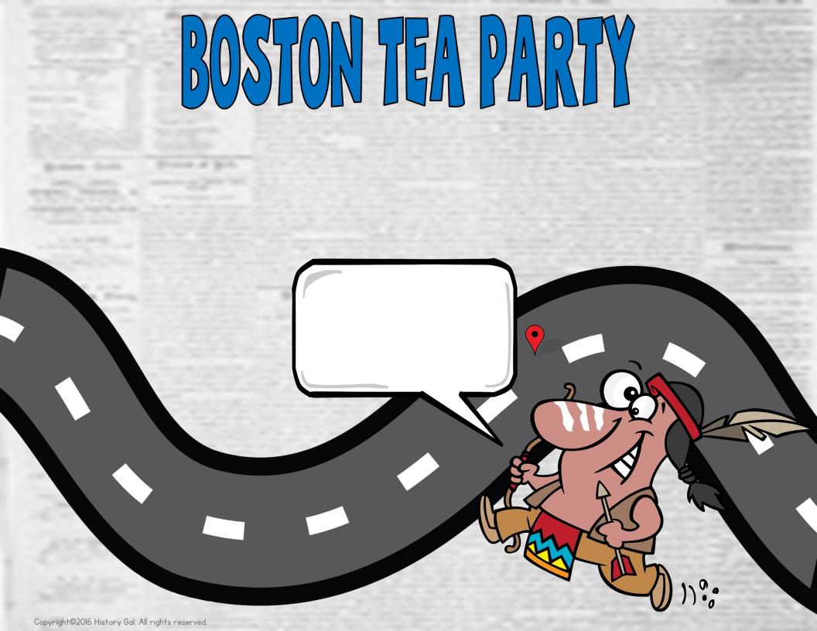
*Dec. 1773 - Boston patriots dressed as Indians
boarded ships and dumped 342 chests of tea
worth about $1 million today into the harbor
Shh. . . I’m really a Patriot is disguise! They British won’t be able to identify me as I dump chests of tea overboard!
Boston Tea Party Song
History Channel Video

Slide 19
*1774 - also known as the Coercive Acts
*passed to punish the people of Boston and Massachusetts for the Tea Party
*closed the port of Boston until the tea was paid for
*gave more power to the royal governor
*allowed royal officials accused of crimes to be tried in England instead of the colonies
*expanded the Quartering Act to force colonists to house British soldiers in private homes
Colonists, now is the time to gather. These acts are truly intolerable. We must work together towards a common solution.
Intolerable Acts Video

Slide 20
*Sept. -Oct. 1774 - met in Philadelphia in response to the Intolerable Acts
*Georgia was the only colony that did not send a representative

Slide 21
*April 19, 1775 - British troops on their way to destroy
weapons being stored
by the colonists were
met by colonial militia at
Lexington, Massachusetts
*Someone, no one
knows who, fired the first
shot and the war began
The British are coming! The British are coming!
*Colonial militia and British troops fought
again in Concord, Massachusetts
Lexington and Concord Video
Shot Heard Around the World Song

Slide 22
*1775-1781 - met in Philadelphia and began to act as an independent government
*appointed George Washington as head of the
colonial army

Slide 23
*June 1775 - Massachusetts militia and British troops fought outside of Boston
*While the battle was a British victory, it helped improve colonial forces’ morale
Battle of Bunker Hill

Slide 24
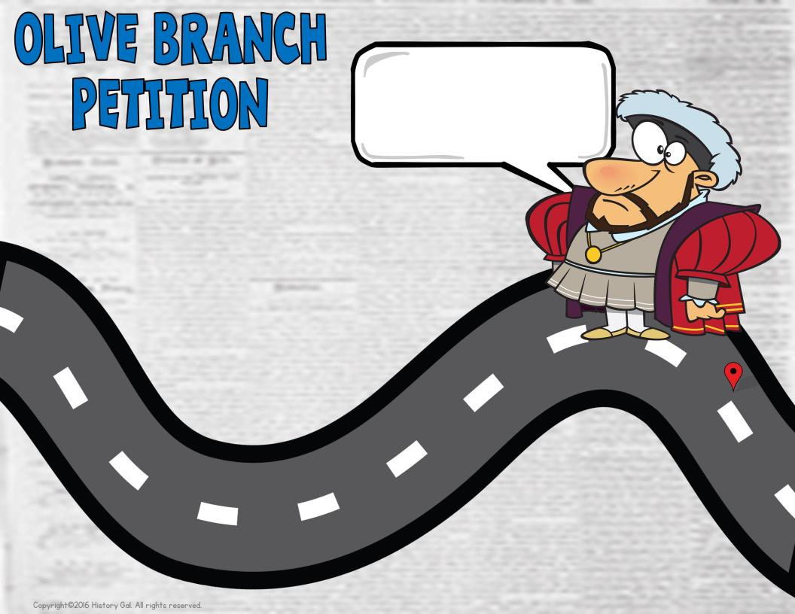
I don’t think you understand who you are talking to. I am the king of the most powerful nation in the world. My army and my navy make my enemies shake in the boots and you think you can negotiate with ME?! Prepare for annihilation!
*July - 2nd Continental Congress sent King George III a petition offering a chance for peace
*the king doesn’t read it
Olive Branch Petition
King’s Response

Slide 25
*Jan. 1776 - Written by Thomas Paine, Common Sense, clearly explained the problems between the colonies and that it was common sense for the colonies to separate from England
Thomas Paine
Common Sense

Slide 26
*July 4, 1776 -Written by Thomas Jefferson, the Declaration of Independence explained the reasons for the colonies’ actions
*Jefferson used ideas from Enlightenment philosophers like John Locke
I believe we have natural rights of life, liberty, and property and I believe government exists for the benefit of the governed.
Too Late to Apologize Song
Locke
Thomas Jefferson Writes the Declaration of Independence
Copyright©2016 History Gal. All rights reserved.

Slide 27
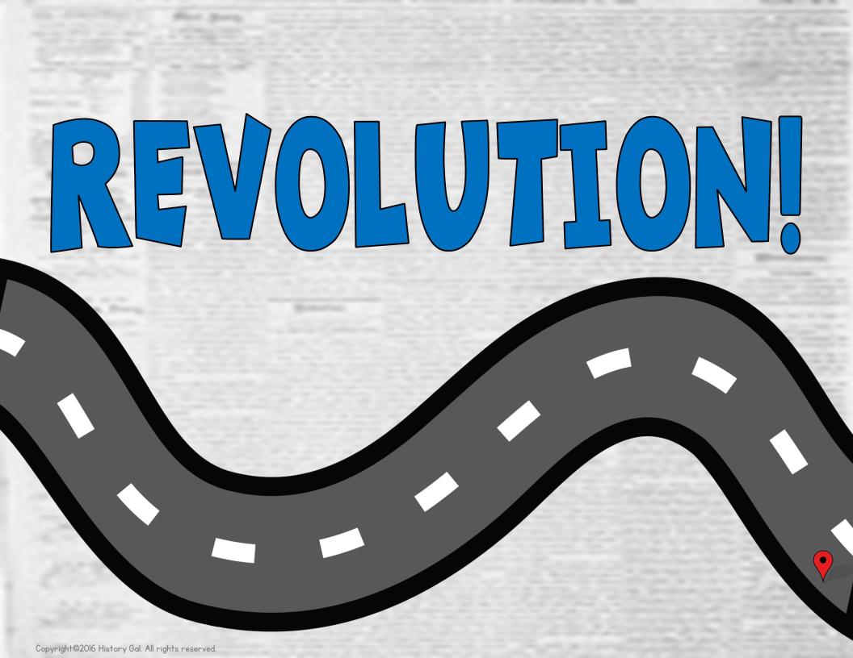
Revolution!
4th of July Zombies

