Slide 1
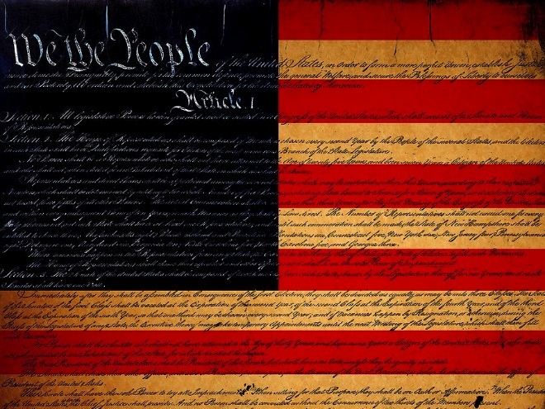
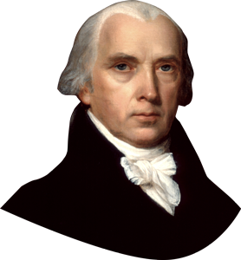
Notes:
James Madison

Slide 2
Why did our founding fathers create the US Constitution, thus replacing the Articles of Confederation?
What is the Constitution?
What are the basic principles of the Constitution?
How are citizens freedoms guaranteed under the constitution?

Slide 3
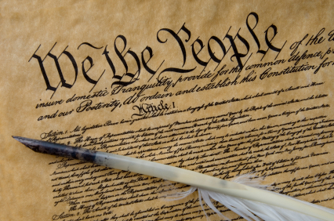
Why did our founding fathers create the US Constitution, thus replacing the Articles of Confederation?

Slide 4
The Continental Congress adopted the Articles of Confederation (1777), and were ratified by the states in 1781.
At this point in history America was still fighting for its independence.

Slide 5
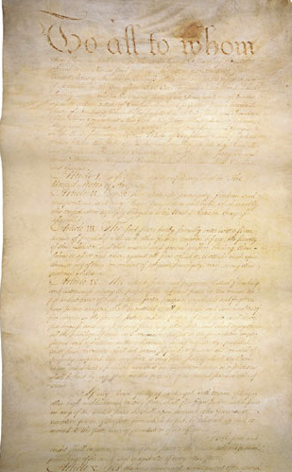
In 1781 the Articles of Confederation became law of the land
The Articles created a loose confederation (union) of independent states and a weak central government, leaving most of the power with the state governments
It was a start but was too weak to be effective
Will eventually be replaced in 1788 by the Constitution

Slide 6
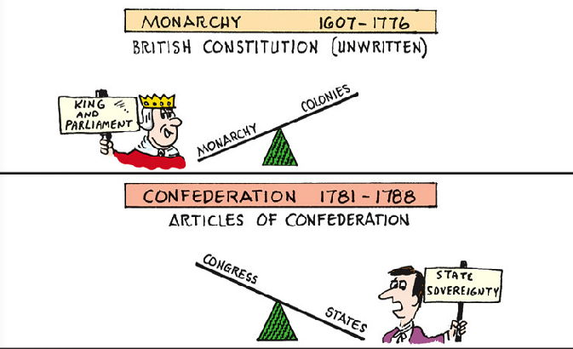
Why would giving the states more over the federal (national) government be problematic?

Slide 7
Congress had no power to tax
Weak currency & increased debt lead to inability to pay army—threats of mutiny
Congress had no power to enforce treaties
Foreign countries angry when treaties are not honored
Every state, despite size has one vote
Populous states not equally represented
Congress has no power to regulate commerce
Trade hindered by states, high tariffs (taxes) o n each other
\
Amendments requires unanimous vote of states
\
Difficult to adapt articles to changing needs

Slide 8
Shays’ Rebellion is the name given to a series of protests in 1786 and 1787 by American farmers against state and local enforcement of tax collections and judgments for debt.
Many of these men who had fought for America’s independence were jailed for being unable to pay their taxes due to bad harvests & economic difficulties
The rebellion took its name from its symbolic leader, Daniel Shays a former captain in the Continental army.

Slide 9
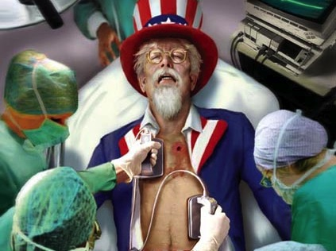

Slide 10
How did the Articles of Confederation shift Power from who was running the government before?
Before the King had all the power and with the AOC the states have most of the power

Slide 11
How strong was the central government under the Articles of Confederation?
Weak central government
Couldn’t enforce laws, tax, regulate trade state to state

Slide 12
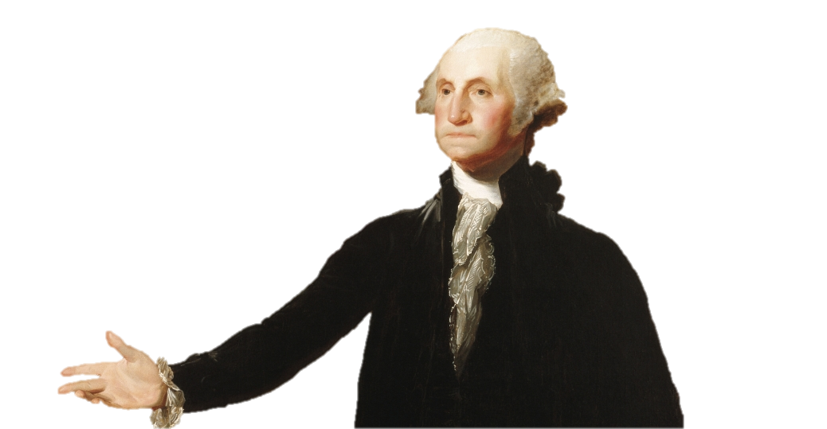
A strong national government is need to save the country from financial & political ruin.

Slide 13
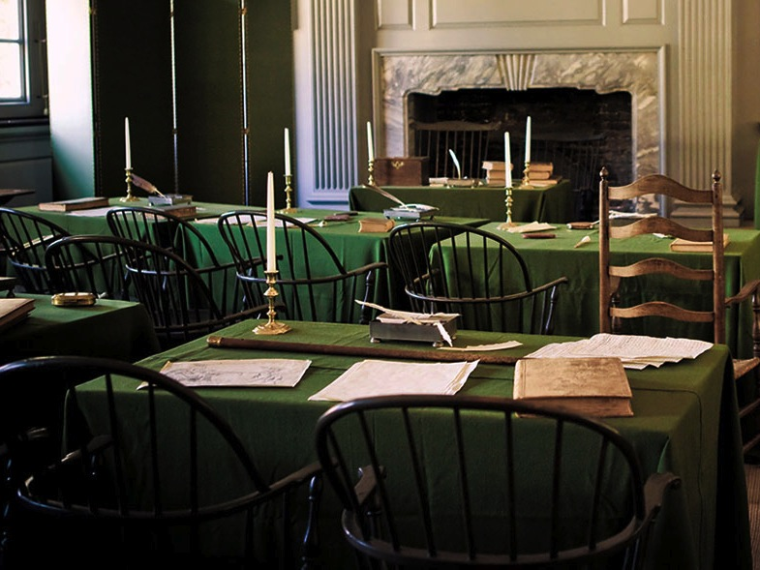
And so…
12 states sent 55 delegates to meet in Philadelphia
Independence Hall the same place 11 years earlier the Dec. of Indp. Was adopted
They disregarded Congress’ mandate to revise the Articles of Confederation based on state sovereignty
instead 4 months later with a completely new governing document → THE CONSTITUTION

Slide 14
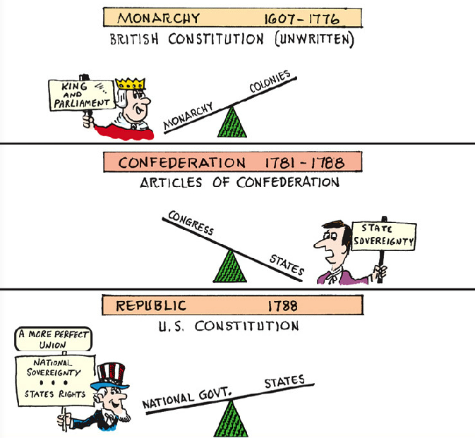
The new Constitution was based on national sovereignty
Federal republic

Slide 15
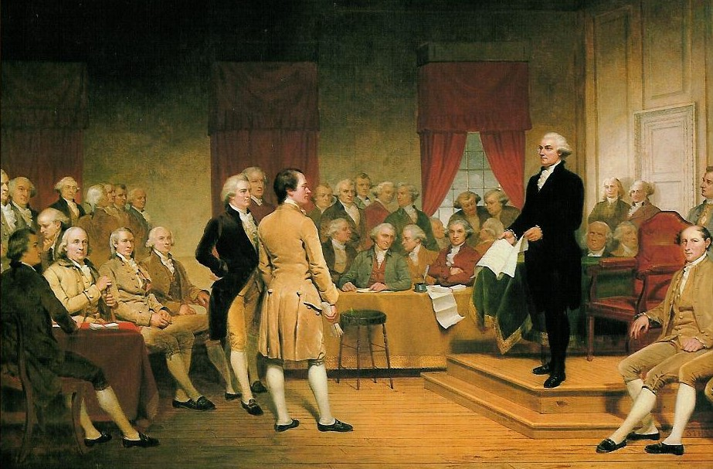
The supreme law of the United States.
It is the foundation and source of the legal authority underlying the existence of the United States of America and the Federal Government of the United States.
It provides the framework for the organization of the United States
Instruction manual to run our country

Slide 16
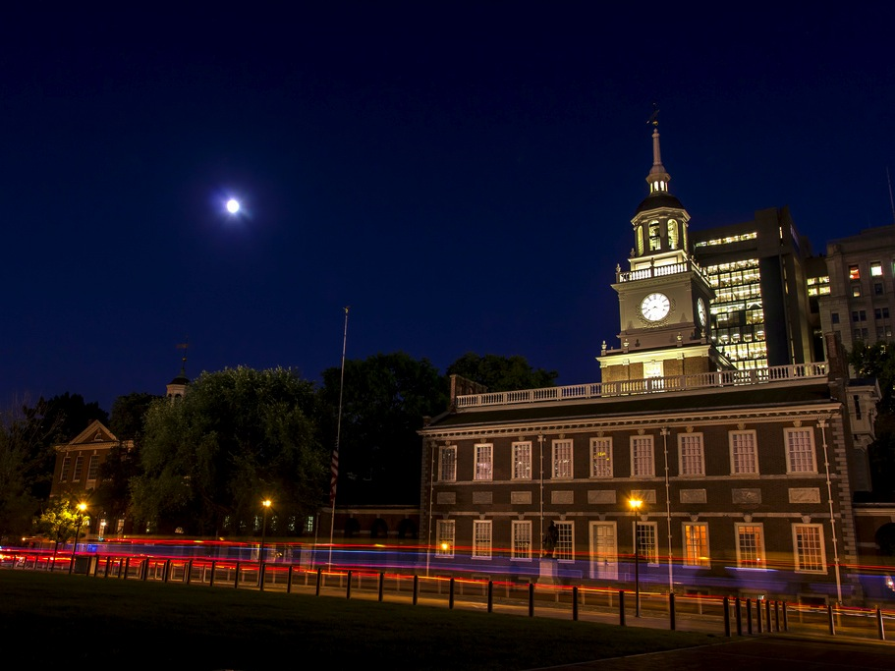
How can we create a strong national government without taking rights away from the people?
James Madison was the main author of the constitution
Spend a year prior studying democratic philosophies
Read more than 200 books
During the 4 month convention he took notes on every word spoken

Slide 17
What is the Constitution?
Blueprint on how to run our country

Slide 18
Who was the main author of the Constitution?
James Madison

Slide 19
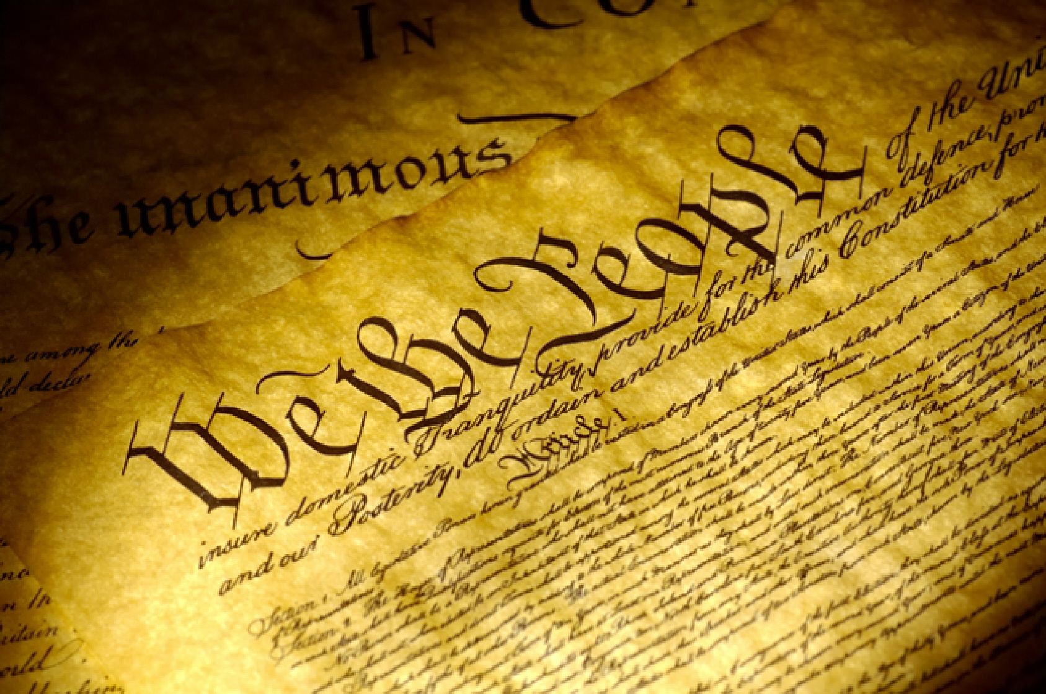

Slide 20
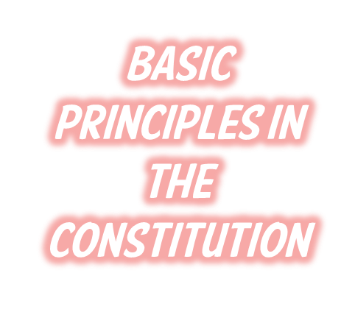
Popular Sovereignty
Limited Gov’t
Federalism
Checks & Balances
Separation of Powers
Republic

Slide 21
When American leaders created the USA, they made the deliberate choice to replace royal rule with a republic.
Republic- AKA Representative Democracy: Power rests with the citizens who elect leaders. These leaders will then make government decisions on their behalf.

Slide 22
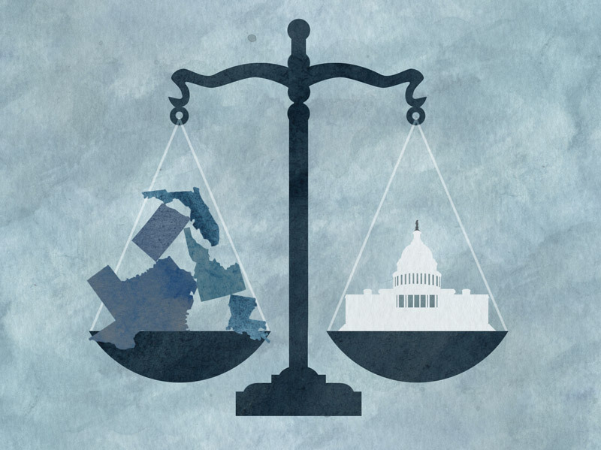
To strengthen the central government but still preserve the rights of the states, the constitution created a system known as federalism- power divided between federal (national) government and state government.

Slide 23
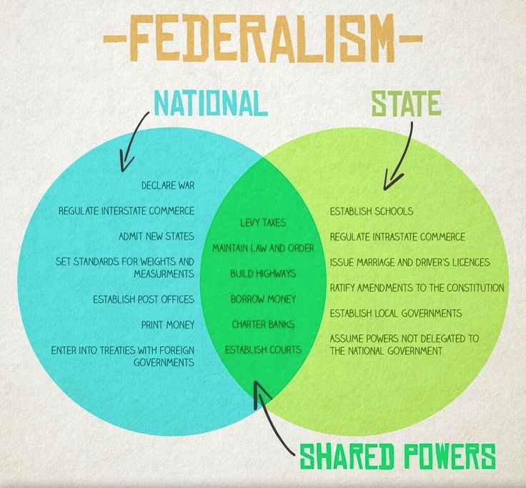

Slide 24
Popular Sovereignty – Government power resides from the consent of the people
Limited government – Government is not all powerful, can only do what the people let it.

Slide 25
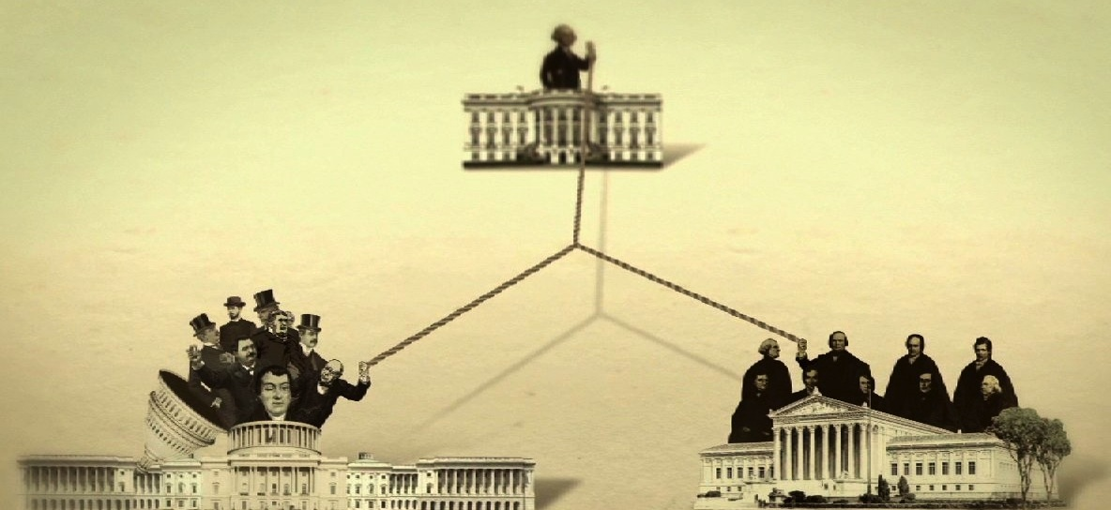
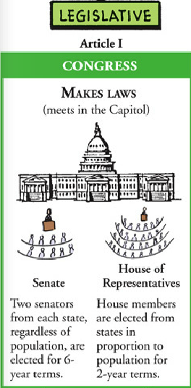
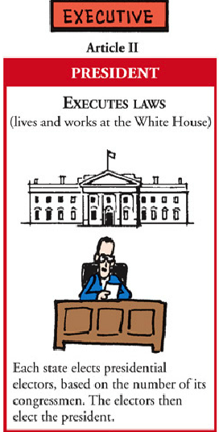
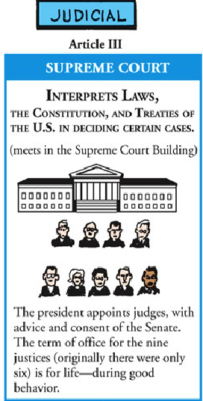
Constitution also provided separation of powers.
Separation of Powers – Helps prevent one branch from becoming too powerful – Checks and Balances
3 Branches:
Legislative- makes laws
Executive- enforces laws
Judicial- courts, interpret the laws

Slide 26
Each branch of the government has some measure of influence over the other branches and may choose to block procedures of the other branches.
Prevent any one branch from accumulating too much power and encourage cooperation between branches as well as debate on controversial policies.

Slide 27
What type of democracy is the United States?
Representative Democracy
AKA Republic

Slide 28
What is Federalism?
Power is divided between state and federal authority

Slide 29
What is it called when the government’s power comes from the consent of its people?
Popular Sovereignty

Slide 30
What principle is founded on the idea that a country’s constitution requires the branches of government to remain independent of each other?
separation of powers

Slide 31
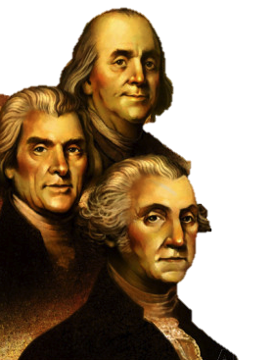

Slide 32
When creating the constitution many items all states agreed on, but the delegates were split on whether each state should have an equal vote in congress.
New Jersey Plan- Small states favored such a plan
Virginia Plan- Big states insisted on representation reflective of population
VIRGINIA PLAN! Based on population
NEW JERSEY PLAN! Equal Representation

Slide 33
Congress would be split in 2 houses
House of Reps- the # of a states representative would depend on population
Senate- each state would have equal representation
Voters choose who to elect for House of Representative
State Legislatures choose senators

Slide 34
New Jersey Plan
Equal Representation for all states
Virginia Plan
Representation based on population
US Congress- Split into 2 houses
1-based on population
1-based on equal representation

Slide 35
Should there be a religious requirement to hold public office? NO
Who should declare war? Congress
Should there be a standing army? Yes
Do slaves count toward state population?
3/5 Compromise
Who should elect legislators? HR people elect; Senate would then be appointed by State legislators (In 1913 they will be elected by the people )
Who would elect the president? People through the electoral college system

Slide 36
What was the result of the Great Compromise?
2 House Congress
SENATE- equal representation per state
HOUSE OF REPS- based of population

Slide 37
What branch has the power to declare war?
Legislative

Slide 38
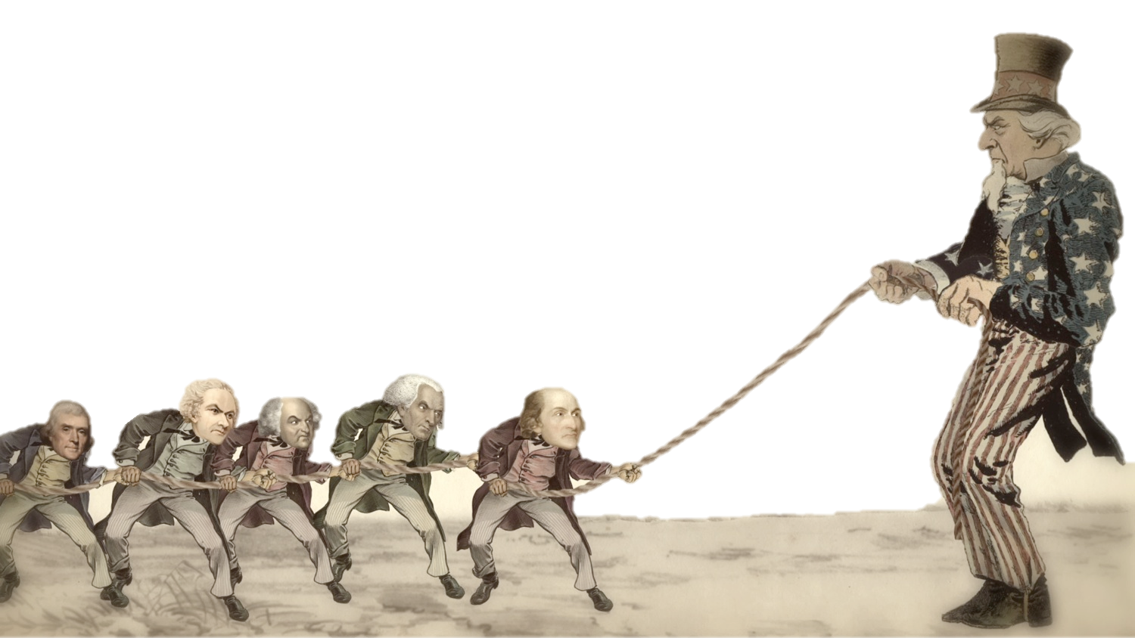
• Needed 9 of 13 states to ratify or official approve of the Constitution before it went into effect.
• A huge debate emerged between two sides: – Federalists – Antifederalists

Slide 39
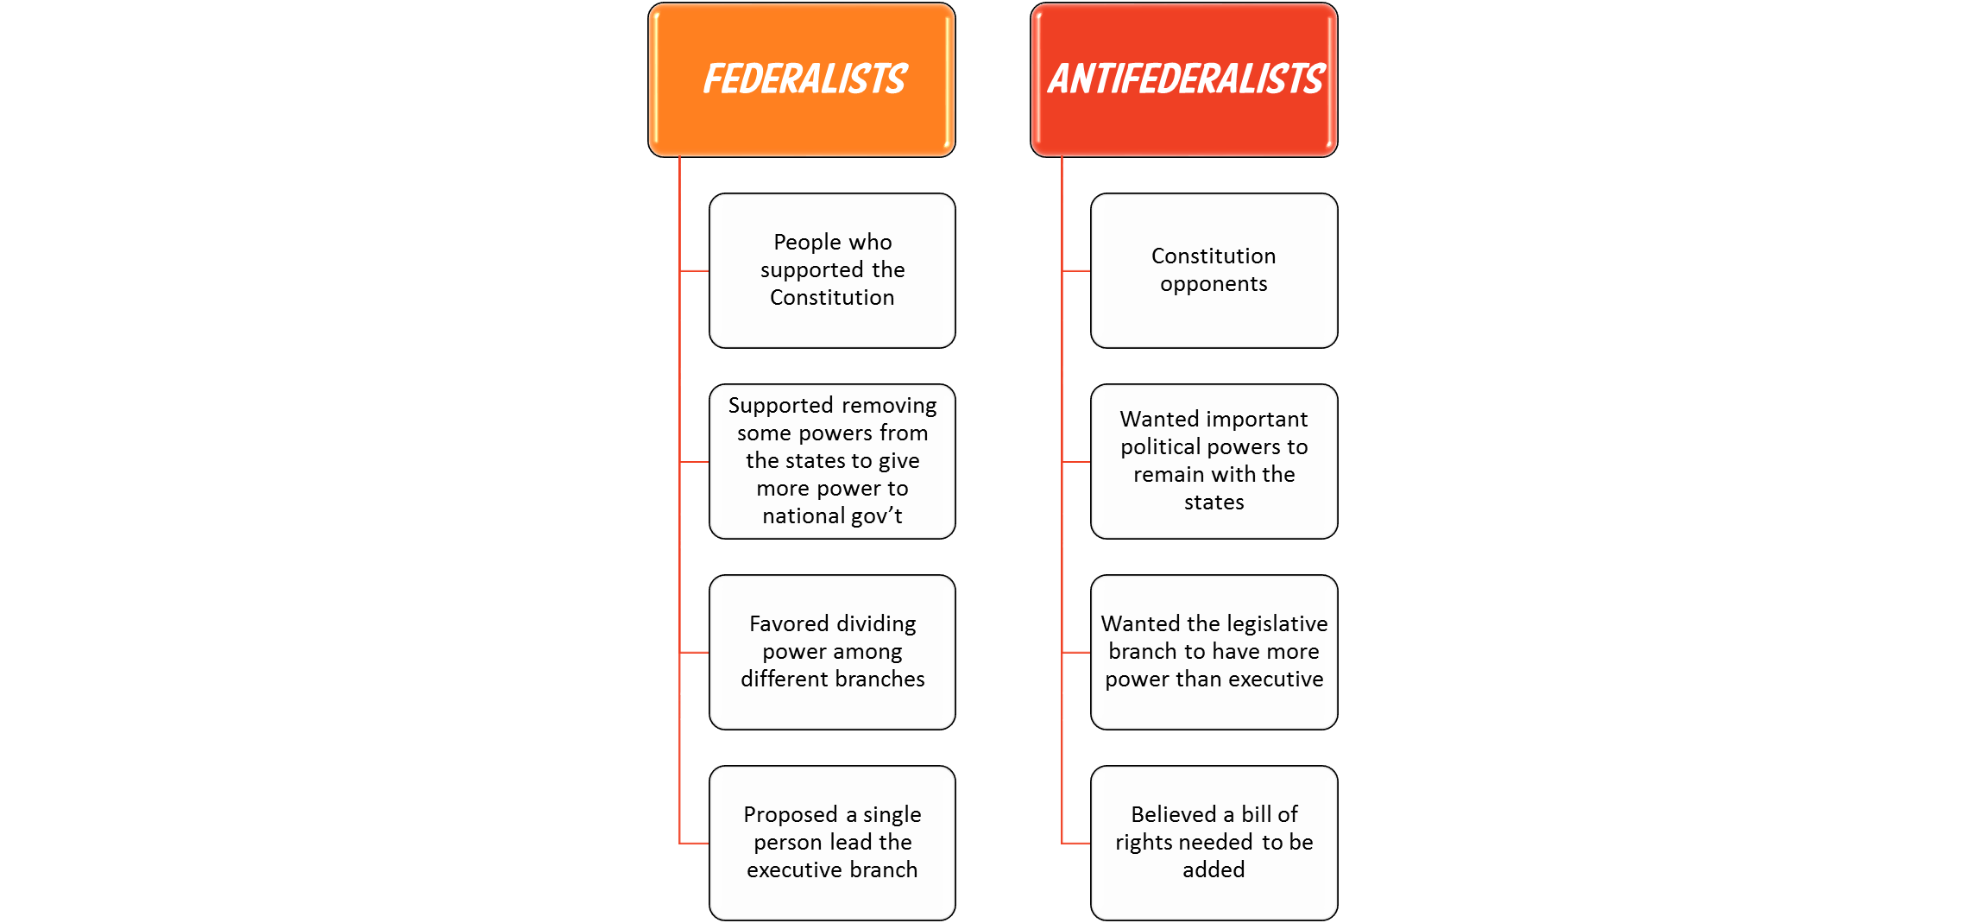
Federalists
People who supported the Constitution
Supported removing some powers from the states to give more power to national gov’t
Antifederalists
Constitution opponents
Wanted important political powers to remain with the states
Favored dividing power among different branches
Proposed a single person lead the executive branch
Wanted the legislative branch to have more power than executive
Believed a bill of rights needed to be added

Slide 40
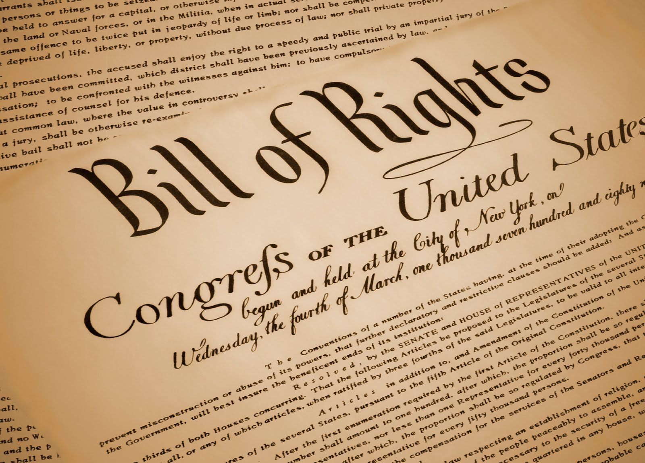
1791- Bill of Rights was added to satisfy those weary of a strong central government and to protect basic freedoms.
The Bill of Rights, or the first ten amendments to the Constitution, guaranteed the freedoms of speech, press, and religion; protection from unreasonable searches and seizures; and the right to a trial by jury.

Slide 41
What was added to the Constitution that resulted in its ratification?
The addition of the bill of rights

Slide 42
What does the Bill of Rights do?
Protect personal freedoms

Slide 43
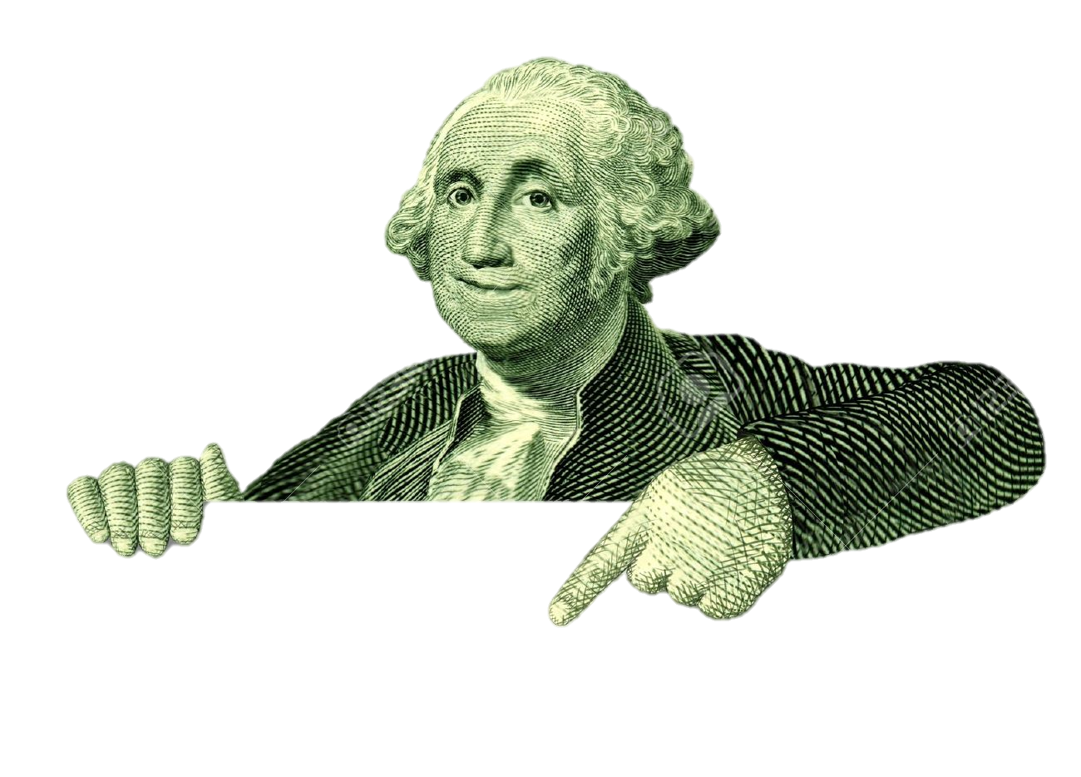
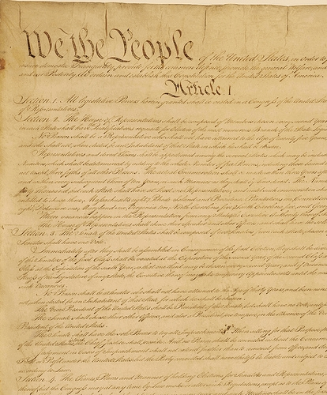
George Washington was chosen as the first president under the new Constitution.
The only president to ever get 100% of the electoral vote (and he did it twice!)

Slide 44
• Preamble: – Statement of purpose
• Articles: – I: Legislative Branch
– II: Executive Branch
– III: Judicial Branch
– IV: Relations Among the States
– V: Amendment Process
– VI: Federal Power
– VII: Ratification
• Amendments: – 27 Total – 1st ten are the Bill of Rights

Slide 45
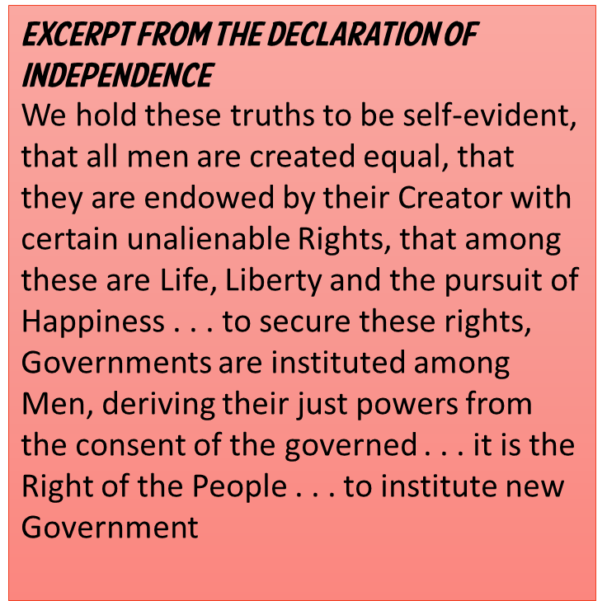
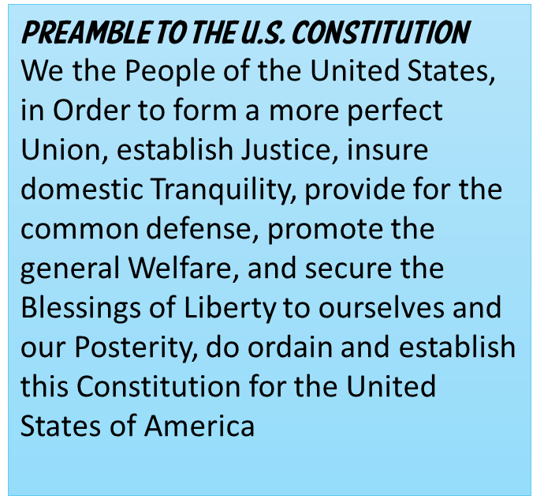

Slide 46
