Slide 1
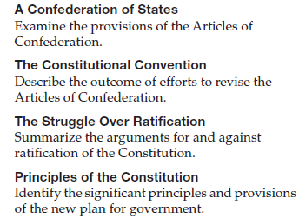
Objectives
Identify the weaknesses of the Articles of Confederation.
Describe the role compromise played in the creation of the Constitution and the struggle for its ratification.
Define the principles expressed in the Constitution and Bill of Rights.

Slide 2
Terms and People
bill of rights – guarantee of basic freedoms
Shays’ Rebellion – 1786 armed revolt by Massachusetts farmers led by Daniel Shays
James Madison – Virginia delegate to the Constitutional Convention who was a key figure in the writing and ratification of the Constitution
ratify – officially approve

Slide 3
Terms and People (continued)
federalism – division of sovereignty between states and the federal government
separation of powers – government functions are divided between three branches: legislative, executive, and judicial
checks and balances – each branch can check, or limit, the power of the others, preventing a concentration of power
Notes:
3

Slide 4
What ideas and debates led to the Constitution and Bill of Rights?
Dissatisfied with British rule, the American colonists rebelled and created the United States of America with a new system of government.
The enduring document they created−the Constitution−has guided the nation for over 200 years.

Slide 5
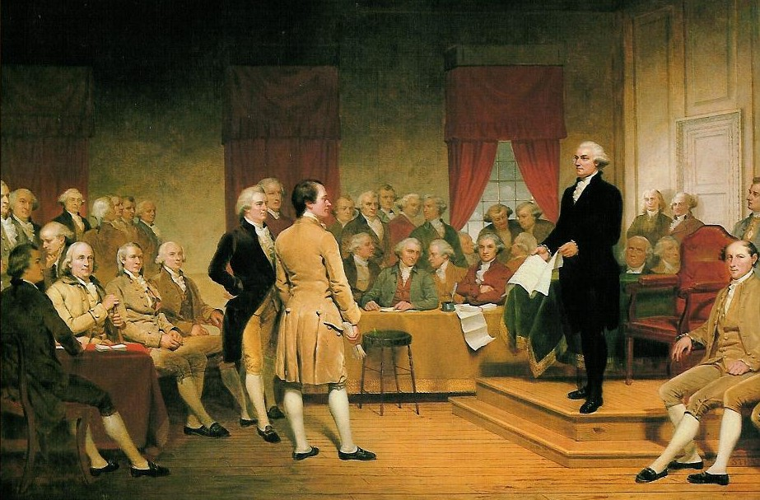
“The Crisis Period”: from the Articles of Confederation to the Constitution.
US History, 1781- 1791

Slide 6
Problems that the New America Faced
War Debt
Who collects taxes?
Who creates money?
Deciding on a government
Strong Central Government, or Give powers to States?

Slide 7
They created governments with representatives elected by the people.
Most contained a bill of rights listing freedoms guaranteed to citizens.
After declaring independence in 1776, each state wrote its own constitution.
Notes:
7

Slide 8
The Articles of Confederation was the new nation’s first constitution.
Congress could declare and conduct war and could regulate trade with foreign countries and Indian nations.
BUT
Congress had no real power to enforce laws, collect taxes, or form a national military.
Fearing the abuse of power, the states gave the new federal government only limited authority.

Slide 9
The Articles of Confederation - 1781
Proposed in 1777, it took four years for the Articles of Confederation to receive unanimous ratification.
In 1781, it became the law of the land.
Among its most important accomplishments:
1. The Revolutionary War was won against England.
2. Treaties of alliance were signed with France, Spain, and Holland.
3. The Treaty of Paris of 1783 was signed.
4. The Northwest Ordinance was made law.

Slide 10
Congress had no power to tax
Weak currency & increased debt lead to inability to pay army—threats of mutiny
Congress had no power to enforce treaties
Foreign countries angry when treaties are not honored
Every state, despite size has one vote
Populous states not equally represented
Congress has no power to regulate commerce
Trade hindered by states, high tariffs (taxes) o n each other
\
Amendments requires unanimous vote of states
\
Difficult to adapt articles to changing needs

Slide 11
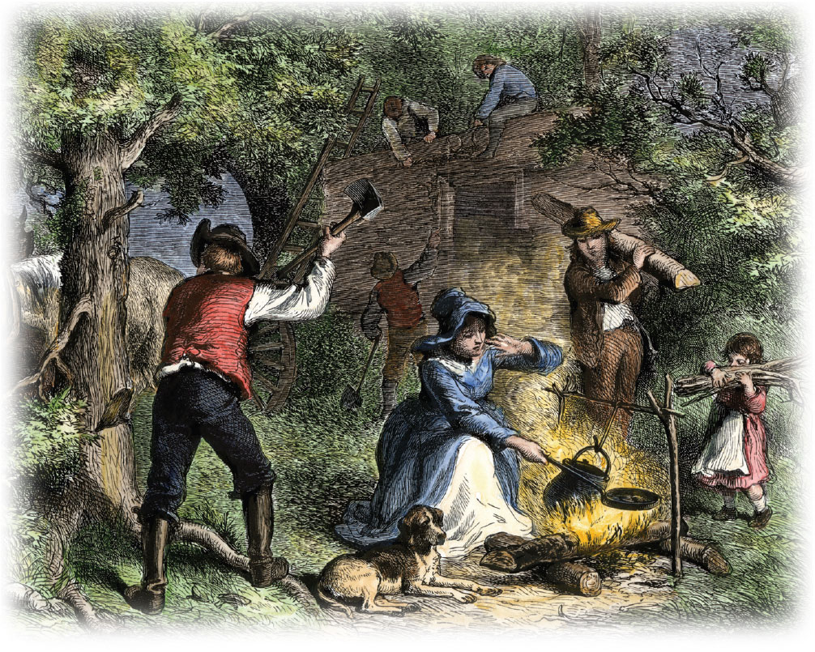
Under the Articles, Congress had authority over the Northwest Territory. It passed two laws to organize and govern this land.

Slide 12
II. Governing New land
II. Plan for the west
How do we manage new land west of the
Appalachians and north of the Ohio River?
A. Land Ordinance of 1785
established a plan for surveying, selling & settling land
U.S.
Spanish
British
B. Northwest Ordinance of 1787
- est. a plan for dividing new territories & admission of new states.
established a blueprint for future growth of the nation.
Banned slavery north of the Ohio River, setting the stage for future conflict over slavery
Notes:
Governing the West Lands: Confederation Congress then faced the question of how to govern the public lands west of the Appalachians and north of the Ohio River that offered rich land for settlers. Congress passed the Land Ordinance of 1785, which established a plan for surveying the land. In the Northwest Ordinance of 1787, Congress provided a procedure for dividing the land into territories. The Northwest Ordinance also set requirements for the admission of new states, which, however, seemed to overlook Native American land claims. There were three basic stages for becoming a state:
1. Congress would appoint a territorial governor and judges.
2. When a territory had 5,000 voting residents, the settlers could write a temporary constitution and elect their own government.
3. When the total population of a territory reached 60,000 free inhabitants, the settlers could write a state constitution, which had to be approved by Congress before it granted statehood.
The Land Ordinance of 1785 and the Northwest Ordinance of 1787 became the Confederation’s greatest achievements. These laws established a blueprint for future growth of the nation.

Slide 13
States taxed goods from other states, which hurt interstate commerce.
The nation could not pay its war debt.
With no national army, the states could not defend the nation’s borders or gain respect abroad.
Problems emerged under the Articles of Confederation.
Notes:
13

Slide 14
In Massachusetts, farmers faced losing their farms when they couldn’t pay their debts.
In 1786, Daniel Shays led a mob of angry farmers on a federal arsenal.
Known as Shays’ Rebellion, the incident highlighted the weakness of the federal government under the Articles.
Notes:
14

Slide 15
The Whiskey Rebellion of 1794
When farmers in the Western part of Pennsylvania refused to pay their federal taxes in 1794, George Washington personally led an army of over 13,000 soldiers to coerce the people into paying their taxes – affirming the power of the federal government in the process.

Slide 16
In May 1787, state delegates met in Philadelphia to amend the Articles of Confederation.
Delegates restructured the national government in what became known as the Constitutional Convention.
Delegates disputed the amount of power to be retained by states or given to Congress.
Notes:
16

Slide 17
Constitutional
Convention

Slide 18
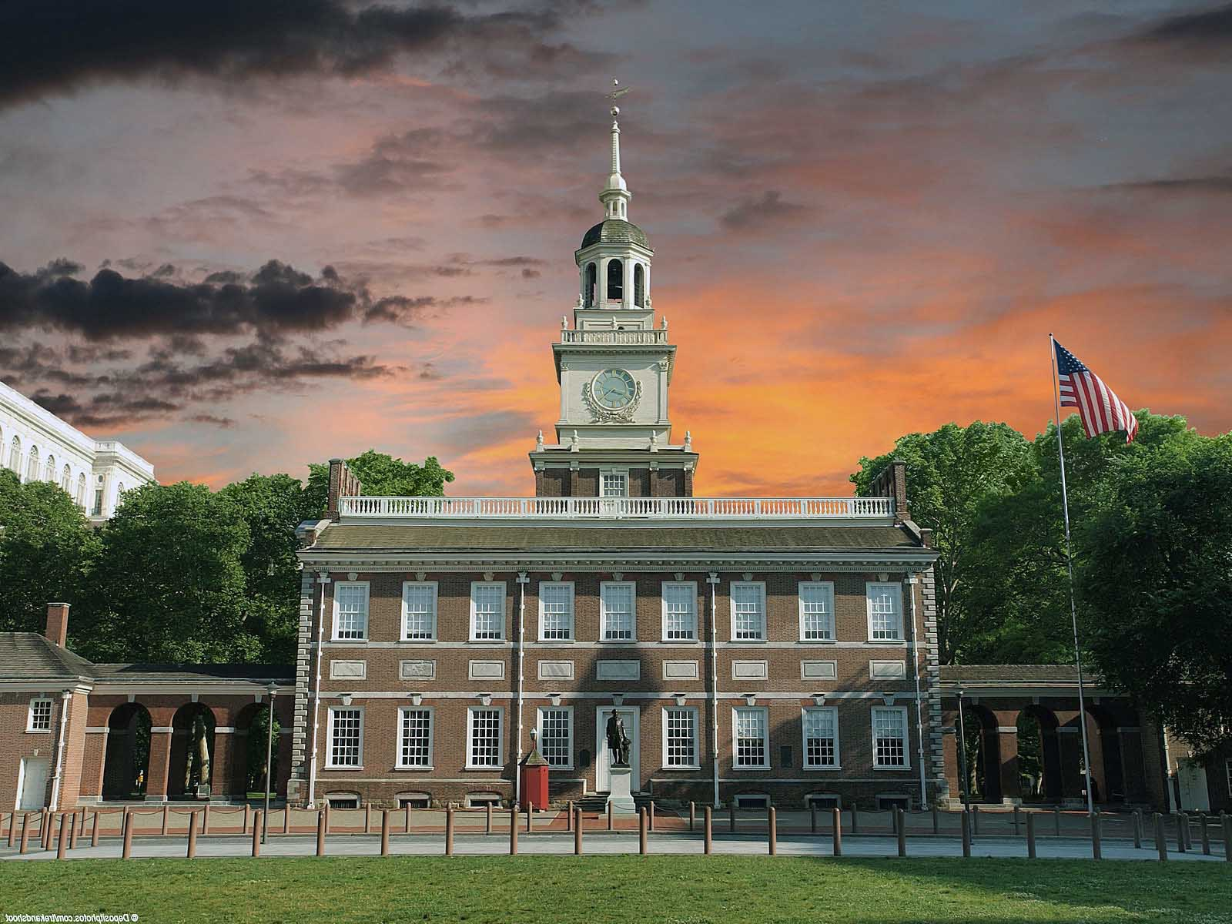
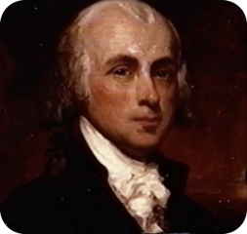
IV. Constitutional convention
May of 1787
Independence Hall, Philadelphia
James Madison - Father of the Constitution
Notes:
The first act of the Constitutional Convention in 1787 was to unanimously elect George Washington as its president. There rose a major division between those who wanted to amend the Articles of Confederation and those who wanted to abandon it all together. Almost everyone wanted a strong national government, but not everyone agreed to start from scratch.
In fact, the delegation was only sent by the states to amend the Articles of Confederation. The Delegates who chose to start from scratch were OVERSTEPPING their authority.
And thus two plans arose. The only man to come with a real plan was young intellectual named James Madison. 36 yrs old. The Plan was the VIRGINIA PLAN and became the focus of the convention. Madison would be called the father of the Constitution.
The second was the THE NEW JERSEY PLAN. This was a challenge to the Virginia Plan.

Slide 19
Small states favored the New Jersey Plan.
There would be a one-house Congress.
States would be represented as equals, no matter their size.
The U.S. would remain a confederation of sovereign states with few powers granted to the national government.
Large states favored James Madison’s Virginia Plan.
Congress would be a bicameral legislature.
In both houses, states with larger populations would have more members.
A President would command the armed forces.

Slide 20
The Great Compromise proposed by Roger Sherman included:
a House of Representatives based on the Virginia Plan. More populous states would have more members.
a Senate based on the New Jersey Plan. Each state would have two senators.
the Three-Fifths Compromise counted each slave as three-fifths of a person for a state’s representation in the House. Enslaved people could not vote.
Notes:
20

Slide 21
IV. Constitutional convention
A. VIRGINIA PLAN
B. NEW JERSEY PLAN
1. bicameral congress - votes based on state pop.
2. Congress -power to tax, & regulate foreign & interstate trade
3. National Gov. - power to VETO any state law
4. Executive Branch & Judicial Branch
1. unicameral congress -
1 state, 1 vote
2. Congress -power to tax, & regulate foreign & interstate trade
3. Executive Branch & Judicial Branch
Notes:
And thus two plans arose. The only man to come with a real plan was young intellectual named James Madison, just 36 years old. The Plan was called the VIRGINIA PLAN and became the focus of the convention. Madison would be called the father of the Constitution.
The second was the THE NEW JERSEY PLAN. This was a challenge to the Virginia Plan.
The Virginia plan proposed a government based on three principles: (1) a strong national legislature with bicameral congress, meaning two chambers, the lower one to be chosen by the people and the upper chamber to be chosen by the lower. The legislature would have the power to bar any state laws it found unconstitutional; (2) a strong national executive to be chosen by the national legislature; and (3) a national judiciary to be appointed by the legislature. In the lower chamber of congress, votes would be based on state populations, the more people in a state, the more legislatures they received. Thus the larger states championed the Virginia Plan.
Questions - Which plan benefits big states? Why?
New Jersey Plan was a response to the Virginia Plan. In the Jersey Plan, each state received one vote. Like the Articles of Confederation, the New Jersey Plan aimed to keep state governments more powerful than the national government. The plan also ensured that heavily populated states would not overpower the others.
Which plan strengthens the National government?
As the summer grew hotter, so did the delegates’ tempers. Soon the convention was deadlocked over the question of the representation of states in Congress. Should the states be represented on the basis of population (favored by the large-state delegations), or should they be represented equally, regardless of population (favored by the small- state delegations)? The debate was bitter, and the convention was in danger of dissolving.
Has there ever been a time when you had to compromise?

Slide 22
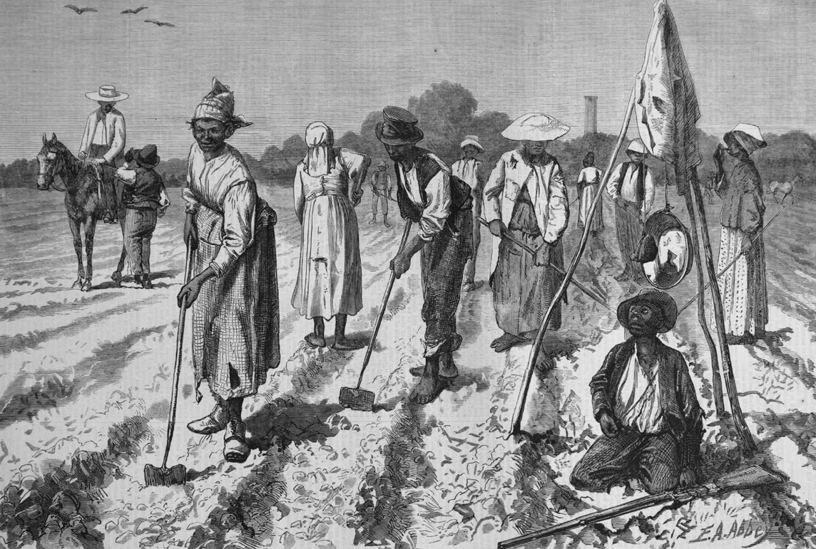
8. with Three-Fifths Compromise slaves counted as 3/5ths a person in census counts (though the word “slave” does not appear in the Constitution)

Slide 23
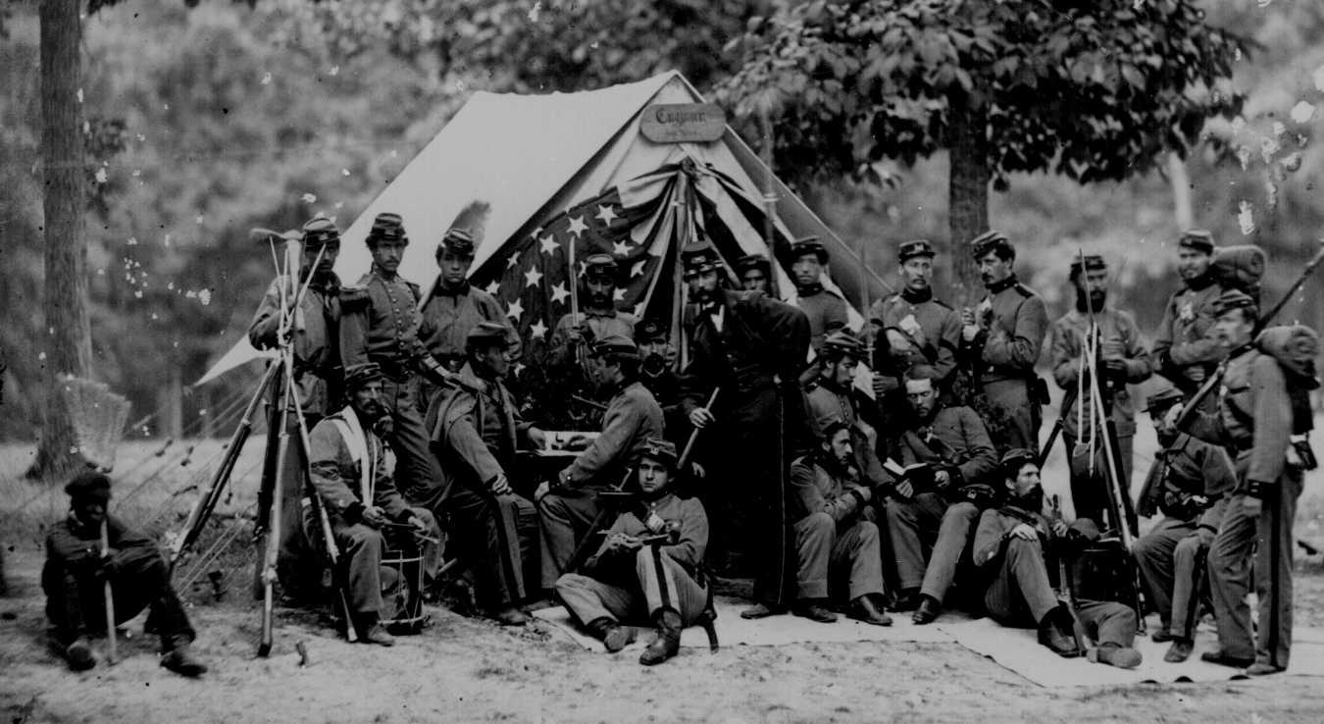
9. the constitutional framers postponed a solution to the problems of slavery, setting the stage for recurring conflicts in later years

Slide 24
Before the Constitution could go into effect, it had to be ratified by 9 of the 13 states.
Those in favor were called Federalists.
Opponents were called Antifederalists
With New Hampshire’s ratification in 1788, the Constitution was the new law of the land.
Notes:
24

Slide 25
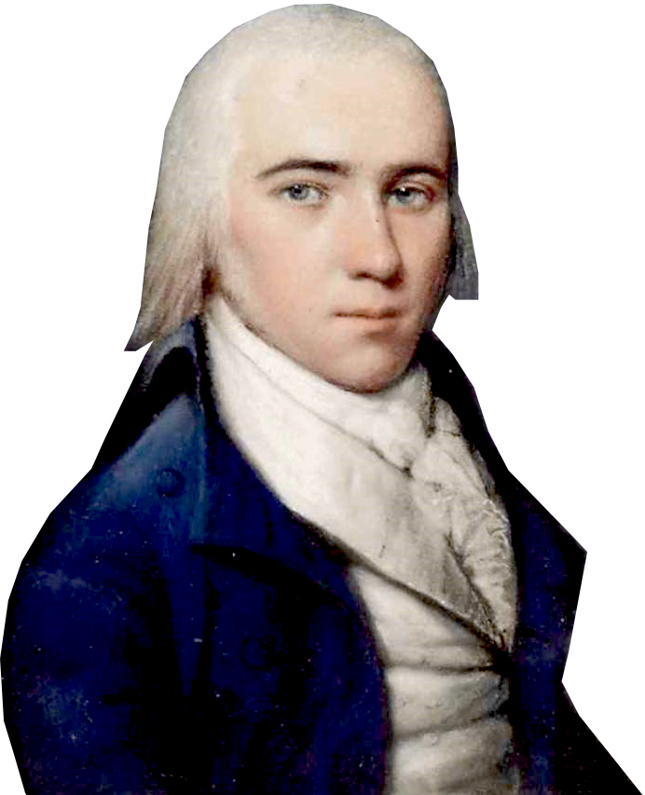
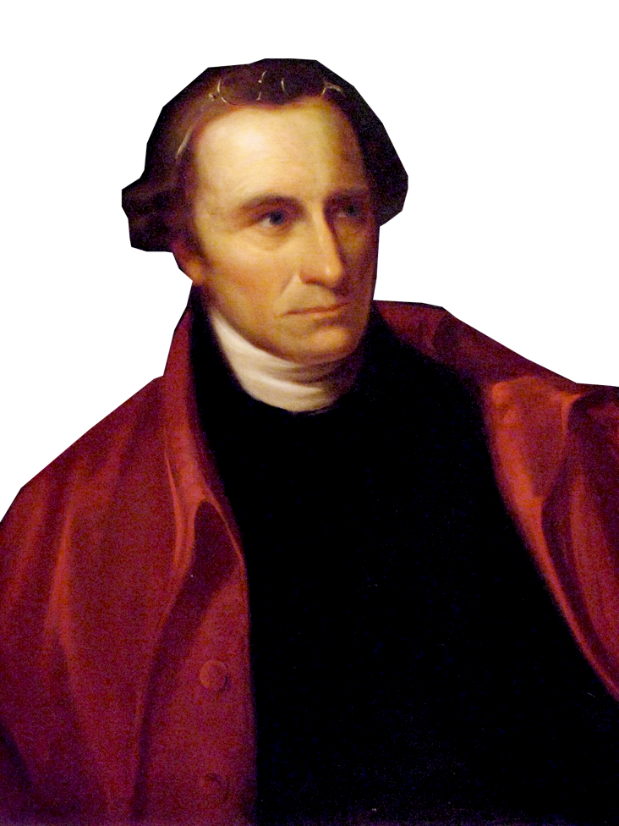
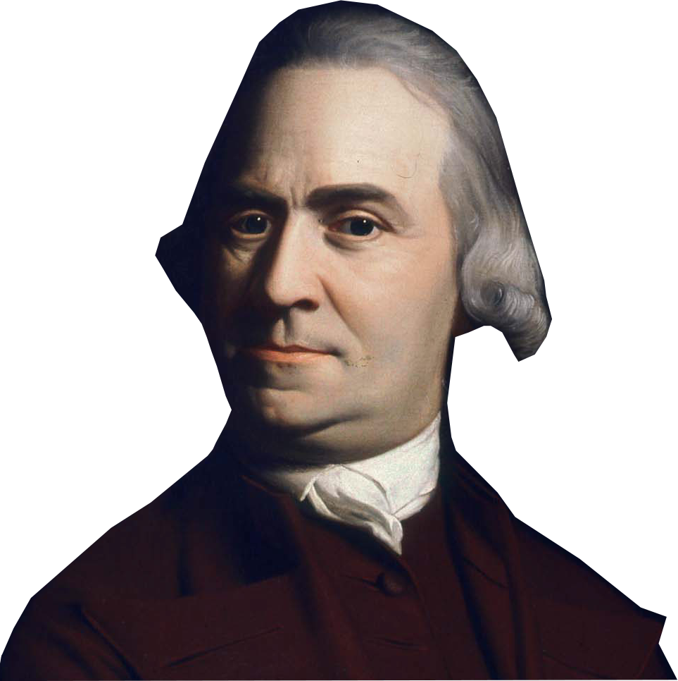
VI. ratifying the Constitution
James Madison • Alexander Hamilton
Samuel Adams • Patrick Henry
A. Federalists
- delegates pro Constitution
- Strong National Govt.
B. Antifederalists
- Against the Constitution
- Fought for a Bill of Rights
C. Federalists Papers- Essays written to urge delegates to ratify the Constitution. Written secretly by Alexander Hamilton, John Jay, James Madison
Notes:
Not everyone was for the Constitution and for the new Constitution to become law, 9 of the 13 states had to ratify it. There evolves two factions, the Federalists and the Antifederalists.
Those who favored the Constitution were called the Federalists. They included James Madison (shown), George Washington, and Alexander Hamilton. Their support came mainly from merchants and others in the cities and coastal regions.
Antifederalists thought that the Constitution made the National Government too powerful. They didn’t want the states to be under control of this new government. They drew support mostly from the inland farmers and laborers, who feared a strong national government. They fought against the Constitution. There biggest supporter was Patrick Henry (shown here).
The Anti-Federalists criticized the Constitution for having been drafted in secret. They claimed the document was extralegal, not sanctioned by law, because Congress authorized the Convention only to revise the old Articles. They also argued that the Constitution took important powers from the states.
The Anti-Federalists’ strongest argument, however, was that the Constitution lacked a Bill of Rights. The Convention had, in fact, considered adding this kind of bill. But in their discussions, they concluded that it was not necessary to have a bill of rights because the Constitution did not authorize the government to violate the rights of the people.
The Federalists, argued that without a strong national government, anarchy, or political disorder, would win. They claimed that only a strong national government could protect the nation from enemies abroad and solve the country’s internal problems. The Federalists argued that eight states already had such bills in their state constitutions. Eventually, however, the Federalists promised to add a bill of rights as the first order of business when the new government met.
Federalist Papers - The Federalist had a secret weapon, that the antifederalists didn’t have. They had a Powerful Propaganda writer by the name of Publius -(latin for public)who wrote a a series of articles written for the Newspapers of New York, that set out to convince the delegates that a strong Federal government was needed.
Federalist Papers - 85 separate articles were written. It was later found out that Alexander Hamilton, James Madison, and and man by the name of John Jay actually wrote the articles.
--The Federalist essays are important for a couple different reasons - They not only set out to influence the members of the convention to vote for this new constitution, but also to shape future interpretations of the Constitution, thus they are our only real primary source documents that reveal the motivation behind many parts of the Constitution.

Slide 26
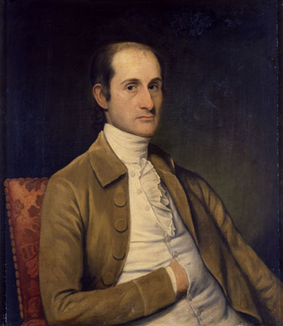
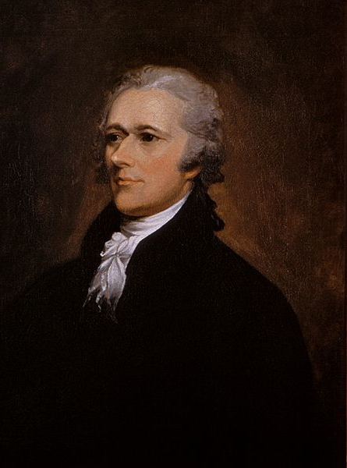
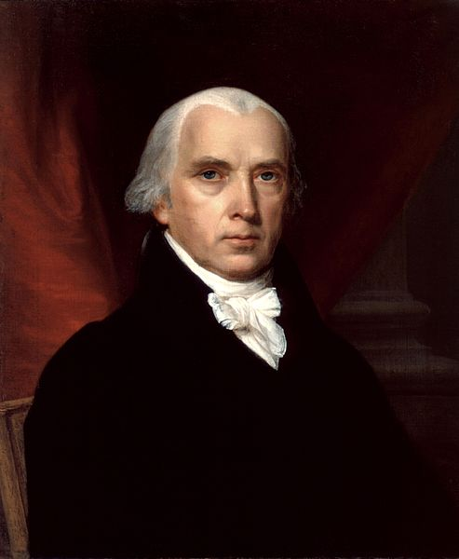
The Federalist Papers
The Federalist Papers were a series of pro-ratification essays intended to persuade New York to accept the Constitution.
The Federalist Papers remains one of the finest statements on government and the Constitution ever written.
John Jay
Alexander Hamilton
“Ambition must be made to counteract ambition . . . If men were angels, no government would be necessary. If angels were to govern men, neither external nor internal controls would be necessary. In framing a government which is to be administered by men over men, the great difficulty lies in this: you must first enable the government to control the governed; and in the next place oblige it to control itself.”
James Madison

Slide 27
The Federalists
Federalists were in favor of the immediate ratification of the Constitution. Most of the men present at the Constitutional Convention fell into this category. They believed that it was essential to grant the central government more power quickly, and that the Constitution be ratified, without a Bill of Rights.
George Washington, Alexander Hamilton, James Madison, and Ben Franklin were all Federalists, encouraging the immediate ratification of the Constitution in 1787 – 1788.

Slide 28
The Antifederalists
Men and women who opposed the ratification of the Constitution were known as Antifederalists. Patrick Henry, Elbridge Gerry, George Mason, and Mercy Otis Warren were some of the most outspoken opponents of the Constitution. Most sought to have a Bill of Rights added to the document.

Slide 29
The Bill of Rights
Antifederalists generally opposed the Constitution because they feared it would not guarantee individual rights. James Madison proposed the Bill of Rights in 1789, at the first Congress. Twelve amendments were proposed, and ten would be immediately ratified by the states two years later in 1791. Another, the twenty-seventh amendment to the Constitution, was passed 202 years later, in 1993.

Slide 30
VI. ratifying the Constitution
I may disagree with what you say, but I will defend to the death your right to say it.
—Voltaire
Bill of Rights
Formal summary of citizen’s rights & freedoms
Antifederalists feared strong Nat’l Govt would suppress speech, press, religion, trials
many delegates would not vote for ratification w/o a Bill of Rights
Notes:
Pushing for a Bill of Rights
The proposed U.S. Constitution contained no guarantee that the government would protect the rights of the people or of the states. Some supporters of the Constitution, such as Thomas Jefferson, viewed the Constitution’s lack of a bill of rights—a formal summary of citizens’ rights and freedoms, as a serious drawback to ratification.
Antifederalists argued that since the Constitution weakened the states, the people needed a national bill of rights. They wanted written guarantees that the people would have freedom of speech, of the press, and of religion. They demanded assurance of the right to trial by jury and the right to bear arms.
Federalists argued that the Constitution granted only limited powers to the national government so that it could not violate the rights of the states or of the people. They also pointed out that the Constitution gave the people the power to protect their rights through the election of trustworthy leaders. In the end, though, the Federalists yielded to people’s overwhelming desire and promised to add a bill of rights if the states would ratify the Constitution

Slide 31
Under federalism, power was divided between the states and the federal government.
The Constitution promoted a separation of powers into distinct executive, legislative, and judicial branches. Each branch has checks and balances on the others.
This prevented the concentration of power in any one branch of the federal government.
Notes:
31

Slide 32
The Checks & Balances System
Executive
Congress has power to:
Override Presidential veto
Reject treaties and presidential appointments
Impeach and remove
Supreme Court has power to:
Decide actions unconstitutional
Interpret treaties
Checks the Congress
President has power to:
Grant pardons
Appoint judges
Checks the President
Checks the President
President has power to:
Veto laws
Make treaties and foreign policy
Appoint federal officials
Propose laws
Checks the Supreme Court
Supreme Court has power to:
Decide laws unconstitutional
Legislative
Checks the Congress
Judicial
Checks the Supreme Court
Congress has power to:
Propose amendments to overturn court decisions
Create lower courts
Impeach and remove
Reject appointments

Slide 33
System of Federalism
National Government
State Government
Delegated Powers:
Maintain army and navy
Declare war
Coin money
Regulate trade between states and with foreign nations
Make all laws necessary for carrying out delegated powers
Concurrent Powers:
Enforce laws
Establish courts
Borrow money
Protect the safety of the people
Build roads
Collect taxes
Reserved Powers:
Conduct elections
Establish schools
Regulate business within a state
Establish local governments
Regulate marriages
Assume other powers not given to the national government or denied to the states

Slide 34
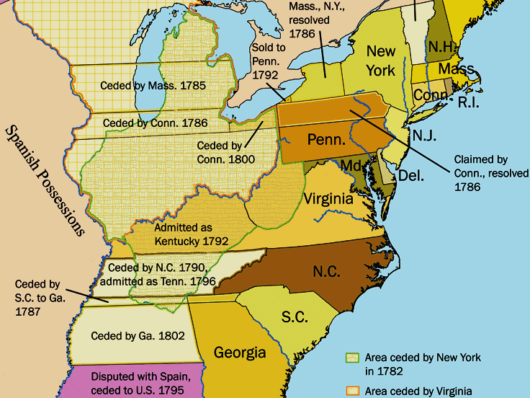
5. (June 1788) Constitution was officially adopted after nine states had ratified

Slide 35
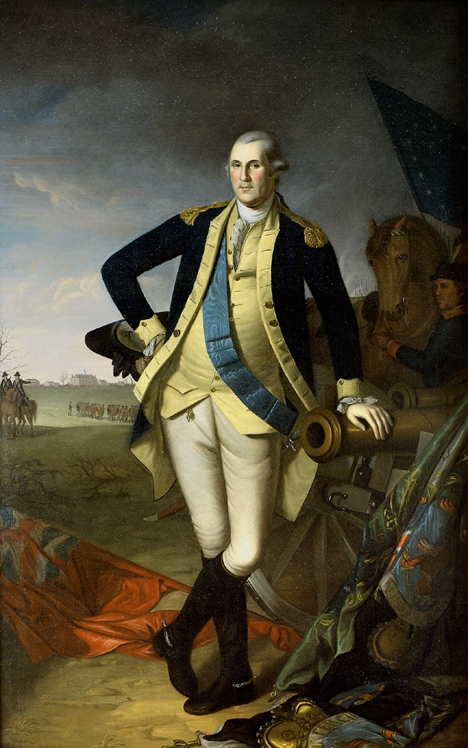
VI. ratifying the Constitution
Ratification of the
Constitution
State Date Vote
Delaware Dec. 7, 1787 30-0
New Jersey Dec. 19, 1787 38-0
Connecticut Jan. 9, 1788 128-40
Why the Feds Won -
1. the Articles had serious probs.
2. Feds had a specific plan - the Constitution
3. Feds were well organized
4. Compromised w/the Bill of Rights
5. Feds had . . .
Delaware Dec. 7, 1787 30-0
New Jersey Dec. 19, 1787 38-0
Connecticut Jan. 9, 1788 128-40
Georgia Jan. 2, 1788 26-0
Pennsylvania Dec. 12, 1787 46-23
Massachusetts Feb. 6, 1788 187-168
Maryland April 28, 1788 63-11
South Carolina May 23, 1788 149-73
New Hampshire June 21, 1788 57-46
Virginia June 25, 1788 89-79
New York July 26, 1788 30-27
North Carolina Nov. 9, 1789 184-77
Rhode Island May 29, 1790 34-32
George Washington
Notes:
Guess who wins??
Who ratified first?
Delaware, New Jersey & Connecticut ratify quickly. They are small states who can benefit from being apart of a bigger country.
Georgia ratified quickly because they feared war with Native Americans and they could use the backing of giant national government.
Pennsylvania.
Massachusetts narrowly voted to ratify. Maryland and South Carolina followed.
New Hampshire delayed a vote until the Federalists new they had a victory. In June 1788, they became that magic number 9. 9 of the 13 states ratified the constitution.
--Everyone knew the nation would not succeed without the backing of the most populated states of Virginia and New York so real celebrations didn’t begin until they were in.
North Carolina and Rhode Island first rejected the Constitution but reversed itself and voted in favor.
--Why Rhode island? RI was always paranoid that a strong national government would destroy their independence, plus they issued a lot of paper money - they didn’t want their currency to be nullified by federal gov. money. They didn’t even send delegates. But when the rest of the nation voted in, they didn’t think a small sovereign nation would last surrounded by a large United States.
WHY THE FEDERALIST WON!
1. Shay’s Rebellion and the States’ financial debt. showed proof.
2. Madison came to the convention with a plan and the antifederalists had nothing else to offer.
3. Antifederalists were local and state officials who couldn’t coordinate on a national level - the Feds also had the Federalist papers
The Feds had (Click for animation)
4. George Washington was a national hero. He was bigger than Bush, Clinton, Martin Luther King and the Pope put together. One of the antifederalists biggest fears was that the next president would turn into a king or dictator. When General George Washington resigned from the army, and went back to his farm at Mount Vernon, the nation looked at it him in awe. He was a war hero - but not a warrior - He was a farmer, a leader and an American.

Slide 36
The Chronology of Events
1781 – The Articles of Confederation are ratified.
1786 – Shays’ Rebellion in Western Massachusetts.
1787 – The Northwest Ordinance is passed.
1787 – The Constitutional Convention begins.
1787 – The Great Compromise - Bicameral Congress.
1787 – The Three-Fifths Compromise – Slavery in America.

Slide 37
The Chronology of Events
1787 – 1788 – The Federalist Papers are written.
1788 – The Constitution is ratified and becomes the
law of the land.
1789 – 1791 – The Bill of Rights are proposed and
then ratified by the states.
1794 – The Whiskey Rebellion is put down by President
George Washington.

