Slide 1
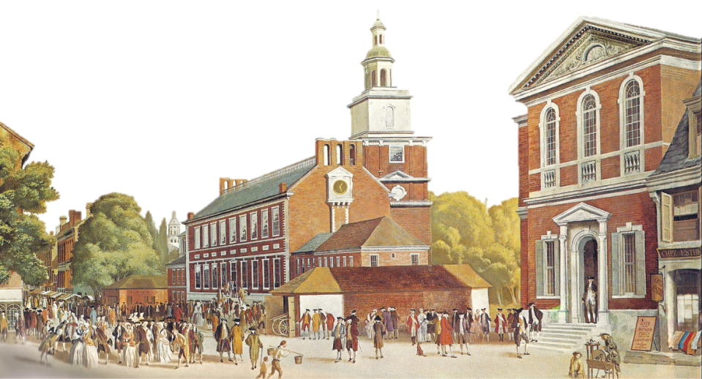
© Students of History - https://www.teacherspayteachers.com/Store/Students-Of-History

Slide 2
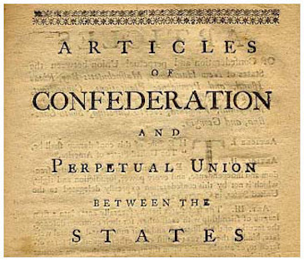
Congress- sole body (unicameral)
No judicial branch
A “presiding officer” would be chosen from within as a leader
Civil officers appointed by Congress

Slide 3
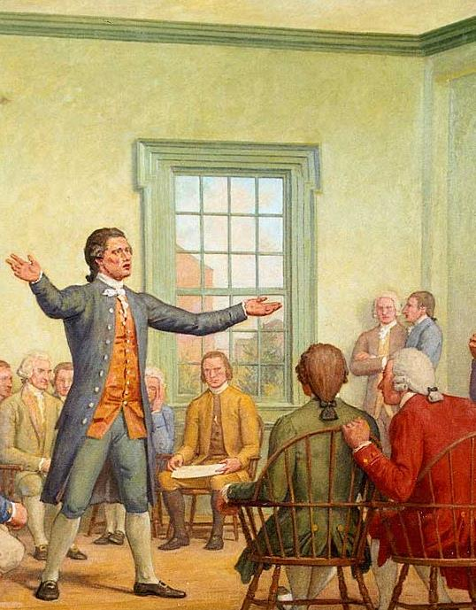
Make war and peace
Send and receive ambassadors
Make treaties
Borrow money & set up money system
Build navy
Raise an army by asking STATES for troops

Slide 4
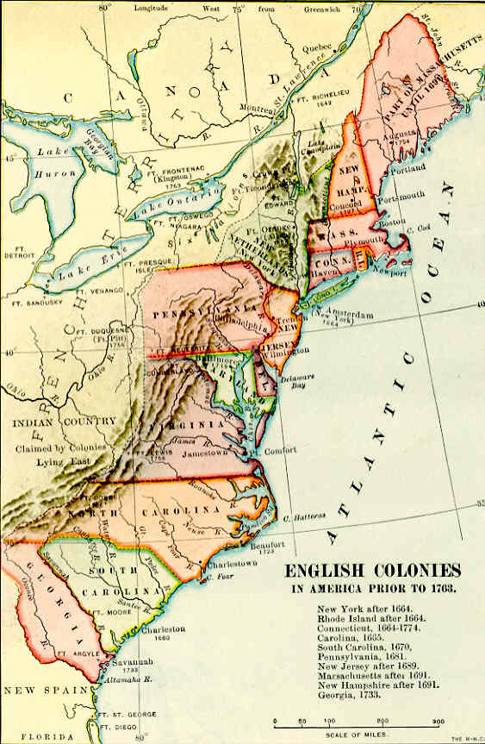
© Students of History - https://www.teacherspayteachers.com/Store/Students-Of-History
By agreeing to the Articles states had to:
Provide funds
Send troops when requested
Comply with acts of Congress
Treat citizens of other states fairly
Surrender fugitives from justice
Open travel and trade between states

Slide 5
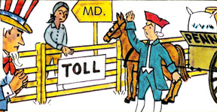
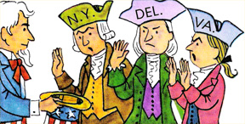
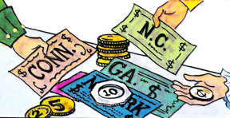
Congress did not have power to tax
Congress could not regulate trade
No executive branch
States could print their own currency
Could not make the states follow the Articles
ALL 13 states had to agree to change the document

Slide 6
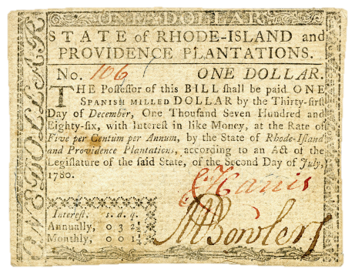
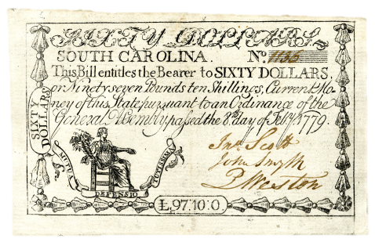
Each state was eager to run its own affairs
Foreign countries hesitant to deal with a government with so little power
US owed over $10 million to foreign countries for the war
The Confederation Congress had no power to raise money to pay debts
Different state money limits trade

Slide 7
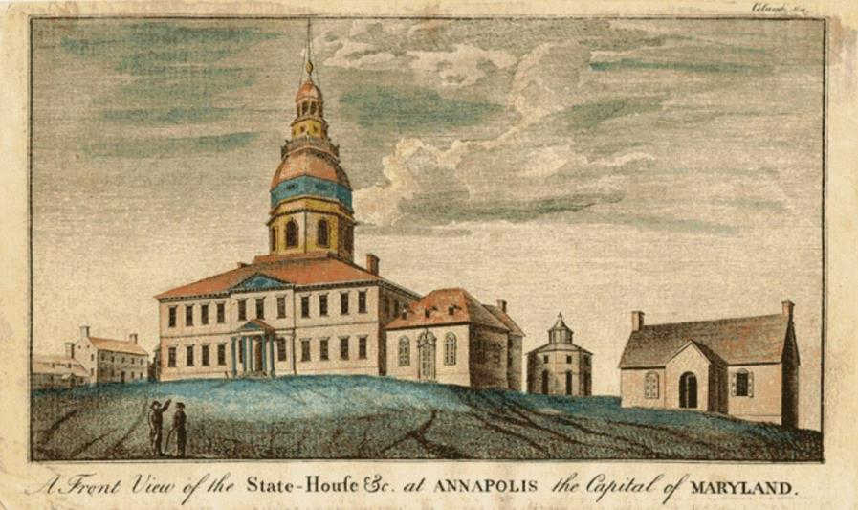
Leaders demand that something be done to make the central government stronger
Joint meeting of all states called in Annapolis in 1786
Only 5 of 13 states attended
Conference calls for a convention of ALL states in Philadelphia the next summer

