Slide 1
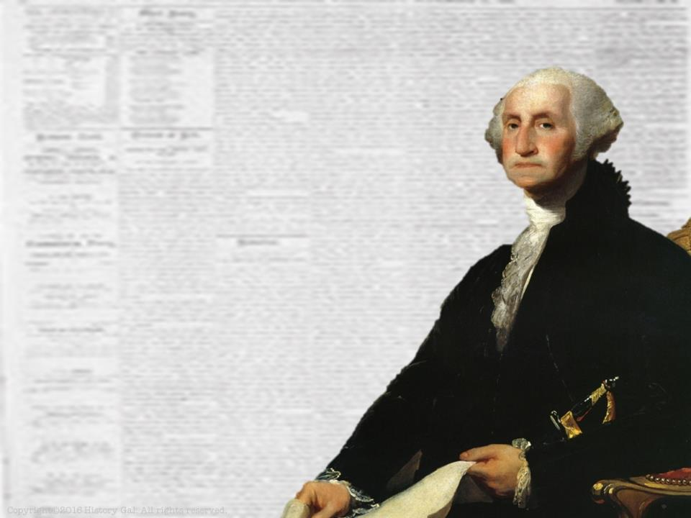
PRESIDENCY OF
GEORGE
WASHINGTON
1789-1797
George Washington in 60 Seconds

Slide 2
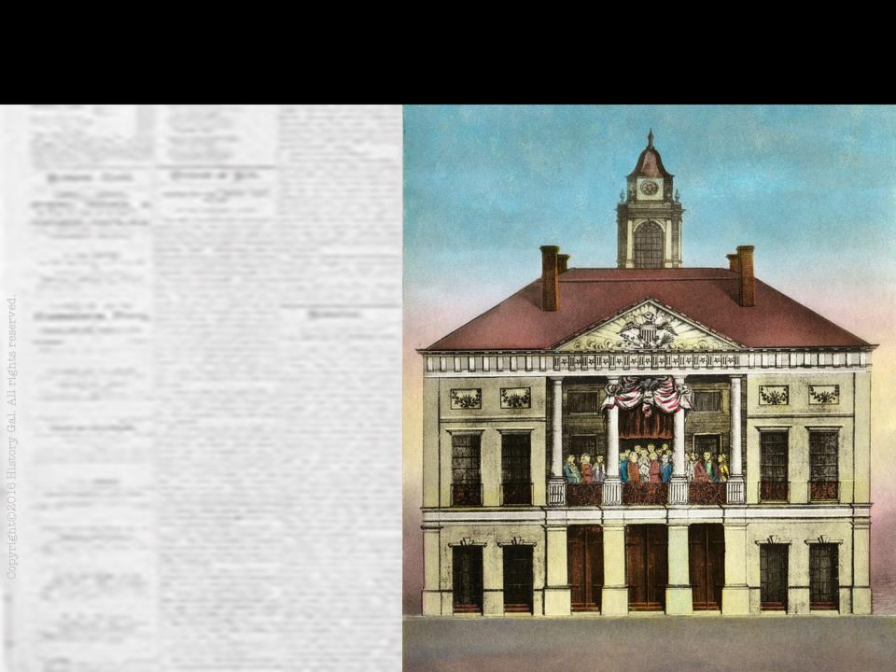
A NEW GOVERNMENT
First Congress under the Constitution was elected in 1788 and began their first session in March 1789 in New York City (the nation’s temporary capital)
Where Was the First U.S. Capital?

Slide 3
A NEW GOVERNMENT
George Washington was the electoral college’s unanimous choice for President and he took his oath of office on April 30, 1789
John Adams became the 1st Vice President

Slide 4
A NEW GOVERNMENT
At the time of Washington’s election, 11 out of the 13 states had ratified the Constitution (North Carolina and Rhode Island had not ratified it yet)

Slide 5
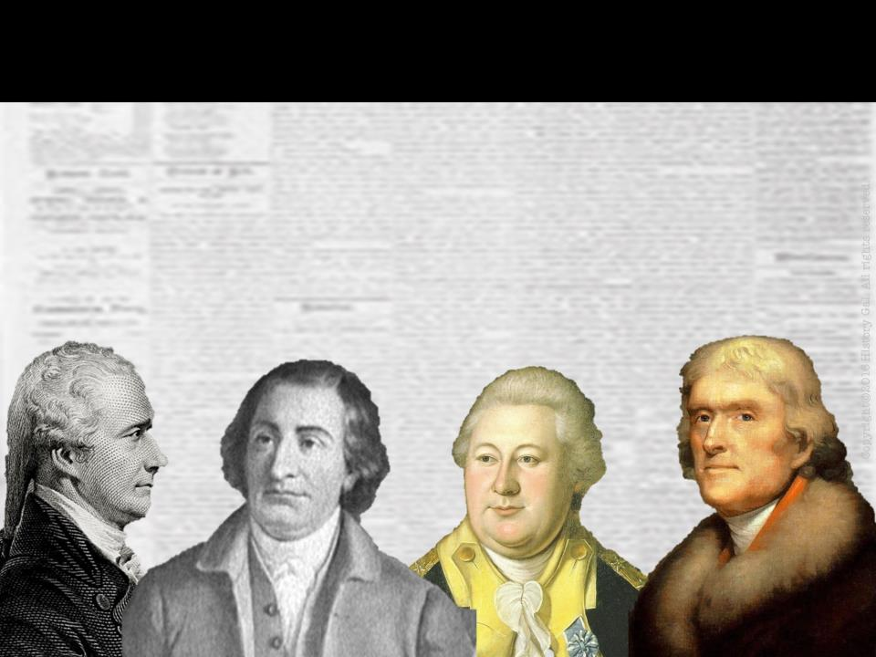
ORGANIZING THE NEW FEDERAL GOVERNMENT
Washington appointed 4 department heads and created a CABINET of advisors that he met with regularly to discuss issues (this practice continues today)
How Presidents Govern

Slide 6
ORGANIZING THE NEW FEDERAL GOVERNMENT
Thomas Jefferson - Secretary of State
Alexander Hamilton - Secretary of Treasury
Henry Knox - Secretary of War
Edmund Randolph - Attorney General
Alexander Hamilton

Slide 7
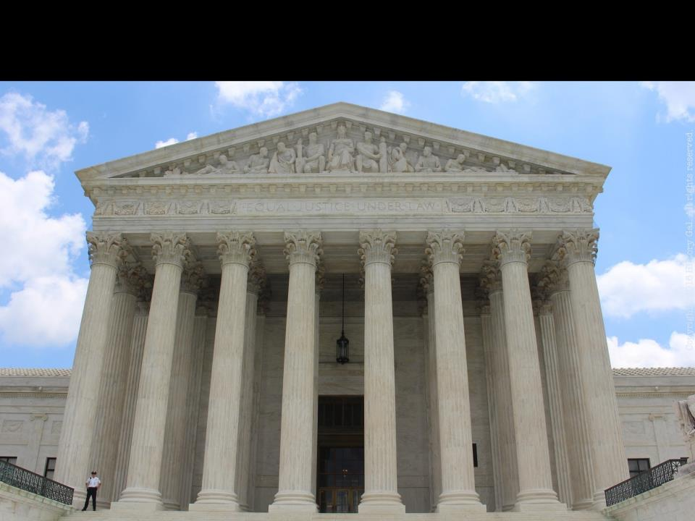
JUDICIARY ACT OF 1789
Established the Supreme Court with one Chief Justice and 5 Associate Justices, created 13 district courts and 3 circuit courts of appeal

Slide 8
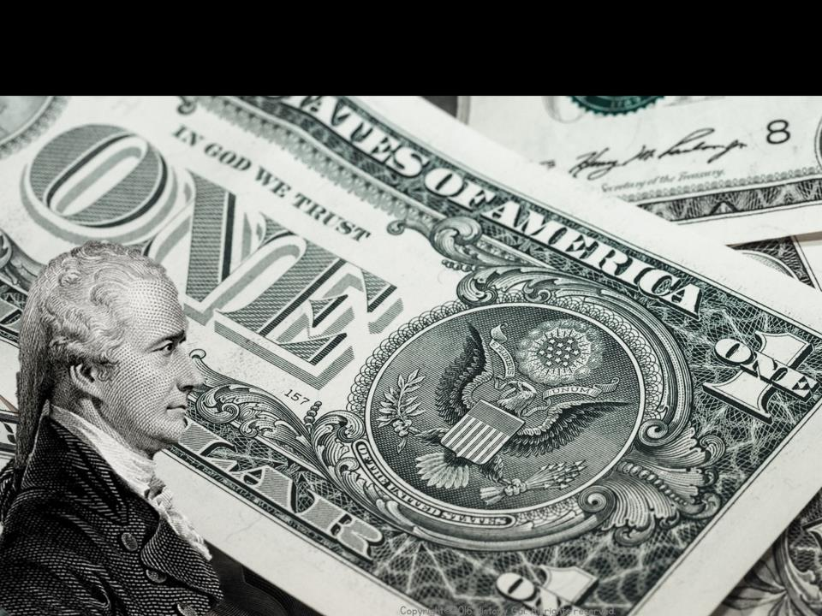
HAMILTON’S FINANCIAL PROGRAM
Assume the debts of the states and the federal government
Create protective tariffs
Create a Bank of the United States
Hamilton for Dummies

Slide 9
HAMILTON’S FINANCIAL PROGRAM
SUPPORTERS: Northern merchants who would gain from high tariffs and a stable U.S. currency
OPPONENTS: Anti-federalists and Thomas Jefferson believed it only benefited the rich

Slide 10
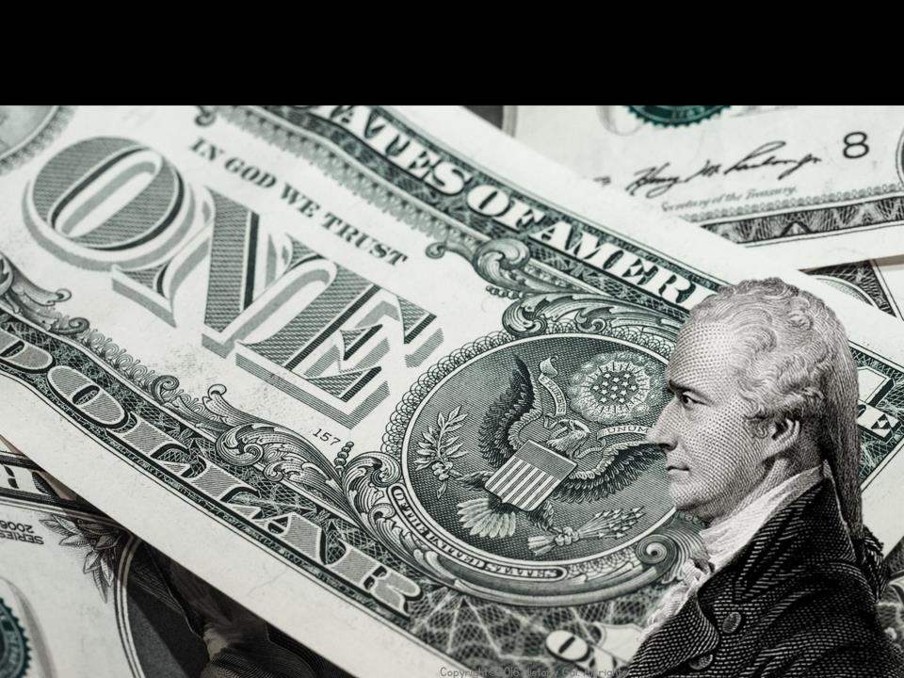
HAMILTON’S FINANCIAL PROGRAM
WHAT PASSED THROUGH CONGRESS:
Pay off national debt
Assume the debts of the states
A compromise with Jefferson established the nation’s capital in the South along the Potomac River (will be named Washington after his death)

Slide 11
HAMILTON’S FINANCIAL PROGRAM
WHAT PASSED THROUGH CONGRESS:
Tariff rates were lower than what Hamilton wanted, but he persuaded Congress to pass excise taxes, particularly one on whiskey
Established a National Bank (argument whether or not this was constitutional)

Slide 12
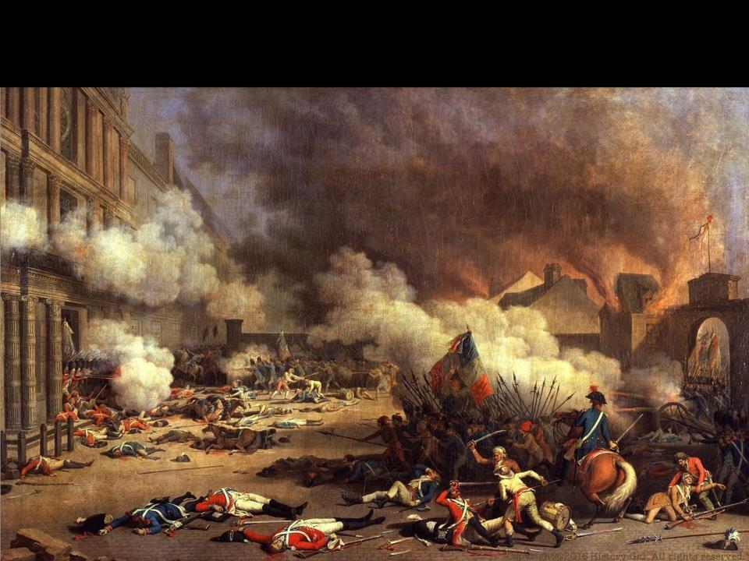
FRENCH REVOLUTION
Americans generally supported the cause of the French people, but were horrified by the mass executions and mob hysteria
PROCLAMATION OF NEUTRALITY 1793 – proclaimed U.S. neutrality in the French Revolution and the European wars (Thomas Jefferson resigned over this proclamation)
French Revolution in 9 Minutes
Proclamation of Neutrality

Slide 13
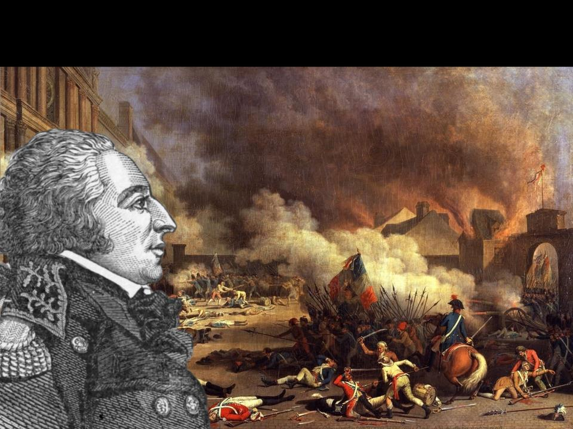
FRENCH REVOLUTION
CITIZEN GENET
French minister to the U.S. appealed directly to the American people to support the French cause
Washington requested that France remove the diplomat
France recalled him but Genet chose to stay in the U.S. (later married and became U.S. citizen)

Slide 14
JAY TREATY 1794
Chief Justice John Jay was sent to England to stop the British from searching and seizing American ships and impressing American seamen into the British navy
Britain agreed to evacuate military posts on the U.S. western frontier and pay damages to American shipping
SIGNIFICANCE – kept U.S. and Britain at peace
Jay’s Treaty Explained

Slide 15
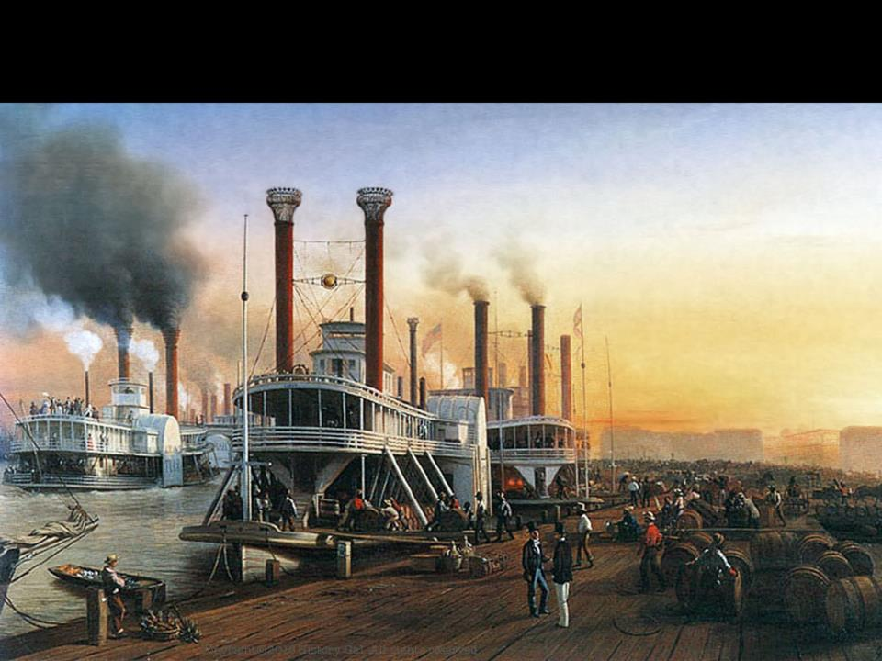
PINCKNEY TREATY 1795
Between U.S. and Spain
Spain agreed to open the lower Mississippi River and New Orleans to U.S. trade
U.S. could transfer cargo in New Orleans without paying duties to the Spanish government
Set the northern border of Spanish Florida at the 31st parallel
Pinckney’s Treaty

Slide 16
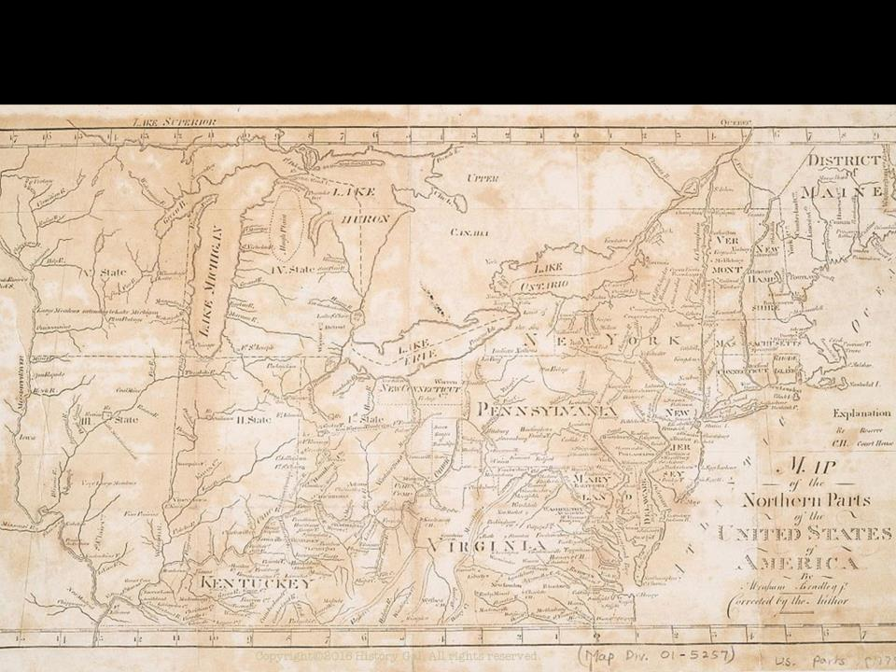
NATIVE AMERICANS
American settlers moved steadily westward into Ohio and beyond
Settlers encroached on Native American lands
The British supplied weapons to the Native Americans and encouraged them to attack the settlers
U.S. army and Native Americans fought for control of the Northwest Territory

Slide 17
NATIVE AMERICANS
1794 TREATY OF GREENVILLE – the Native Americans who lost to the U.S. Army surrendered claims in the Ohio territory and promised to open it up to settlement

Slide 18
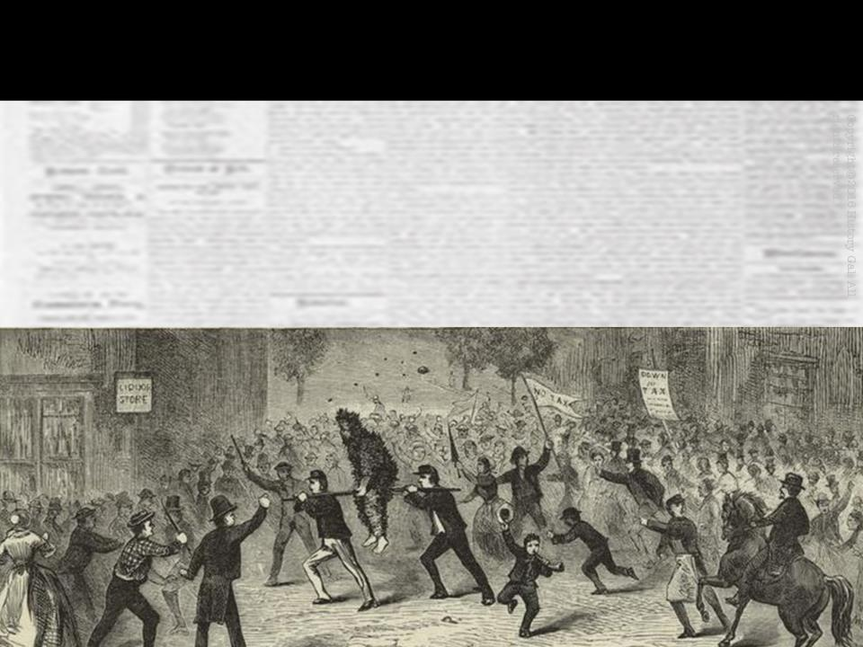
WHISKEY REBELLION 1794
Farmers in western Pennsylvania refused to pay the federal excise tax on whiskey because they could not afford to pay it
They defended their “liberties” by attacking the revenue (tax) collectors
Illustrated Whiskey Rebellion

Slide 19
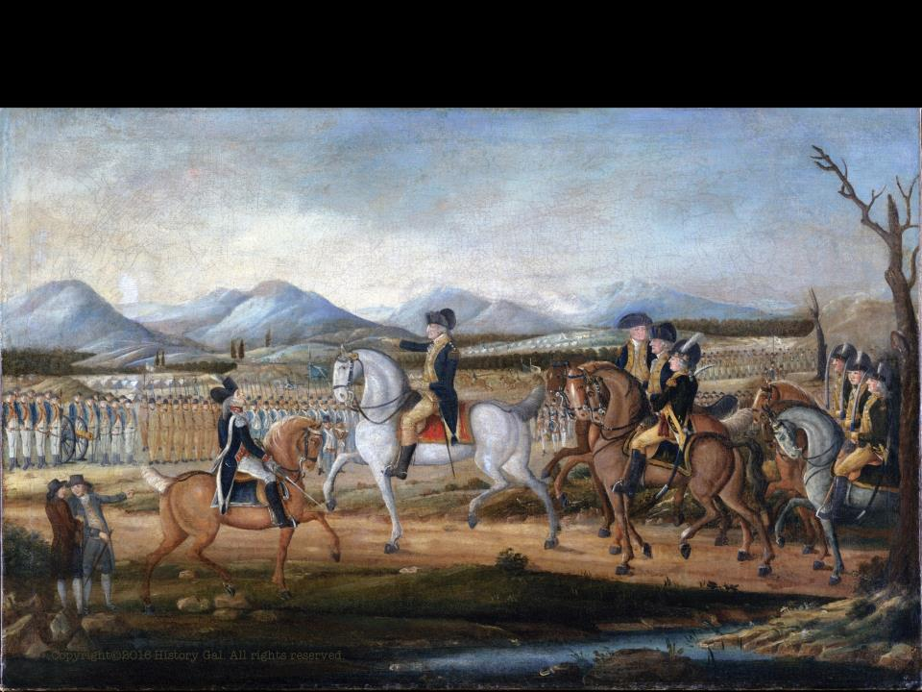
WHISKEY REBELLION 1794
Washington federalized 15,000 state militiamen
the show of force caused the Whiskey Rebellion to collapse without bloodshed
SIGNIFICANCE – demonstrated that the new Federal government was strong enough to deal successfully with rebellion against its laws
Whiskey Rebellion in One Minute

Slide 20
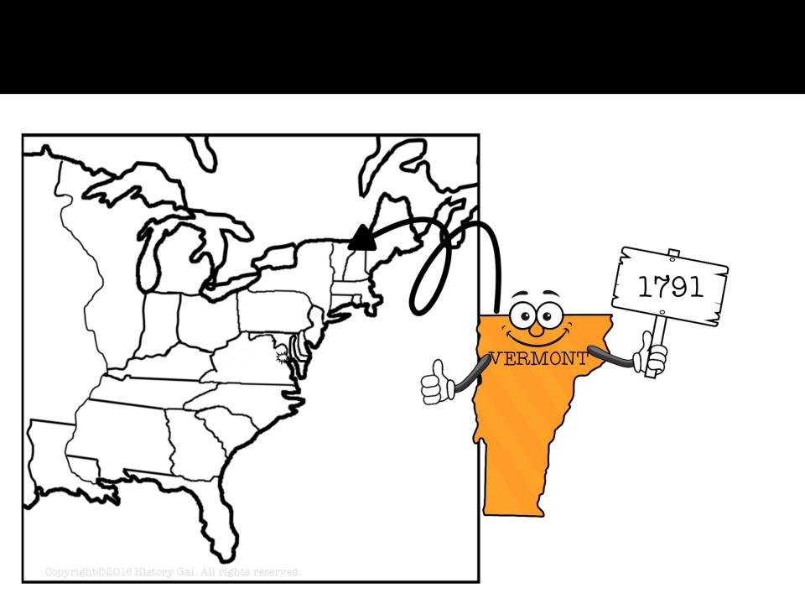
NEW STATES

Slide 21
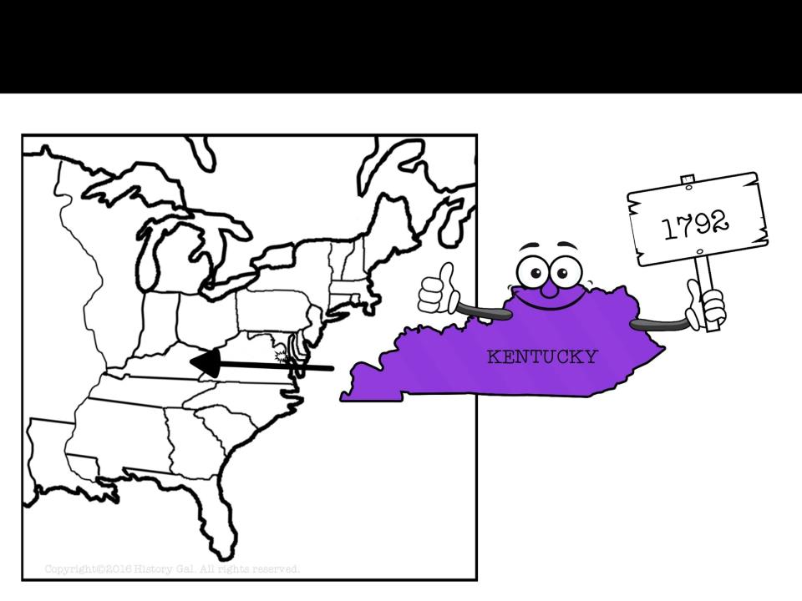
NEW STATES

Slide 22
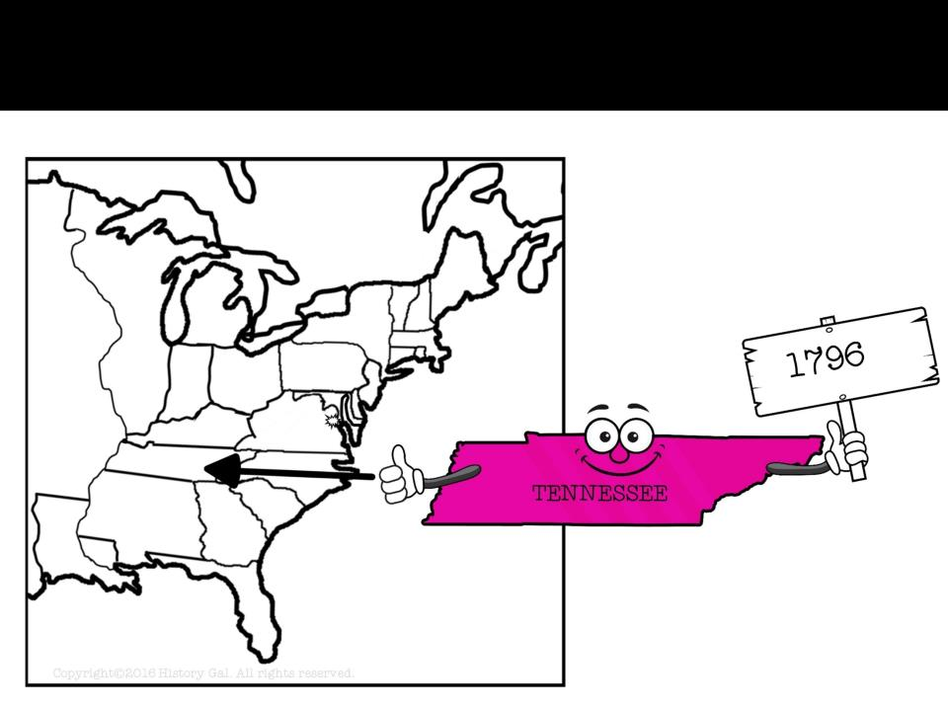
NEW STATES

Slide 23
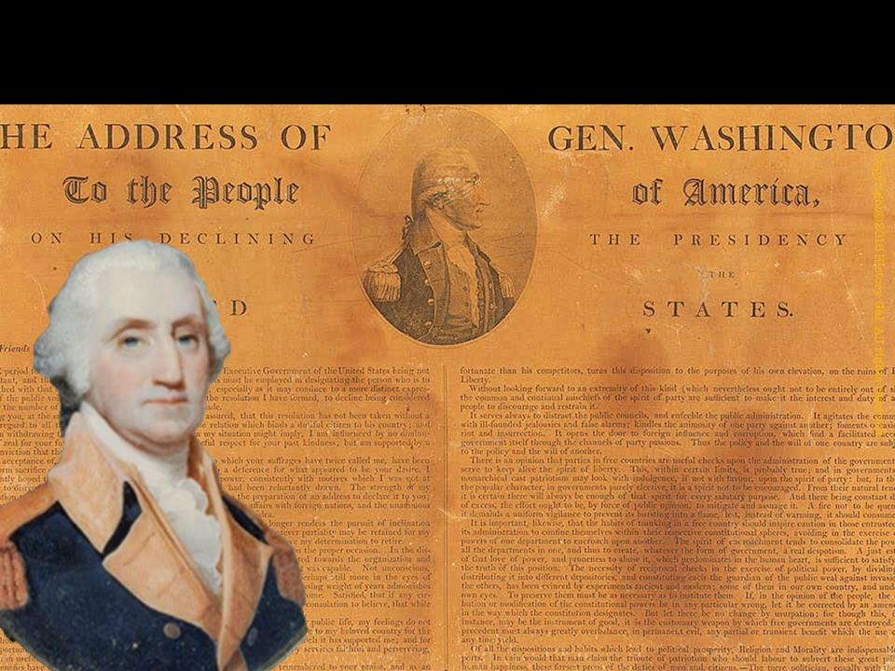
A TWO TERM PRECEDENT
1796 – Washington announced he would not run for a 3rd term (set a precedent, or example)

Slide 24
WASHINGTON’S FAREWELL ADDRESS
WASHINGTON’S FAREWELL ADDRESS:
Avoid sectionalism
Do not get involved in European affairs
Avoid permanent military alliances
Do not form political parties
George Washington’s Farewell Address

Slide 25
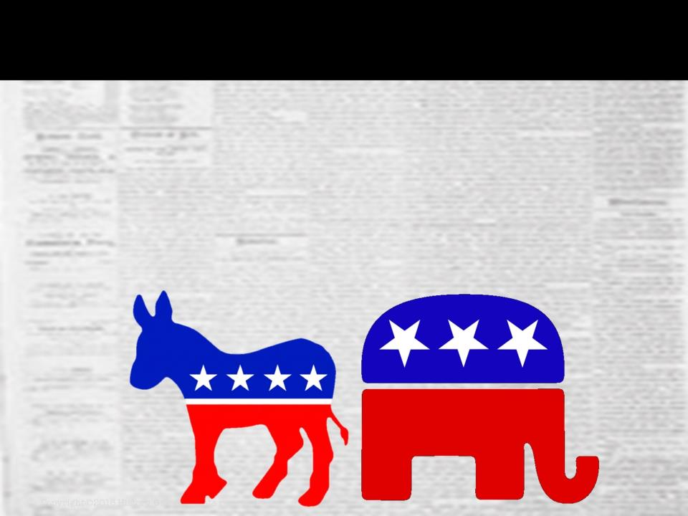
POLITICAL PARTIES
Washington’s election by unanimous vote of the Electoral College led people to believe that political parties were not needed and therefore would not arise.
THEY WERE WRONG

Slide 26
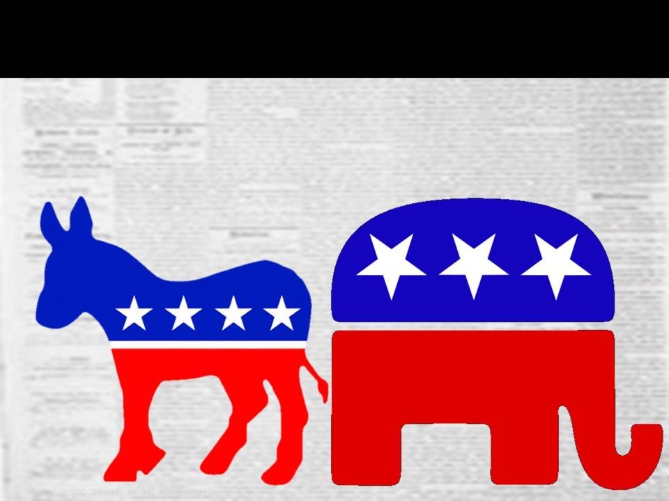
POLITICAL PARTIES
FEDERALISTS
supported Hamilton’s financial reform
favored growth of Federal power
mostly from Northern states
favored loose interpretation of the Constitution

Slide 27
POLITICAL PARTIES
DEMOCRATIC-REPUBLICANS (D-R)
supported Thomas Jefferson
favored states’ rights and containment of Federal power
mostly from Southern and western states
favored strict interpretation of the Constitution
History of Political Parties in the U.S.

Slide 28
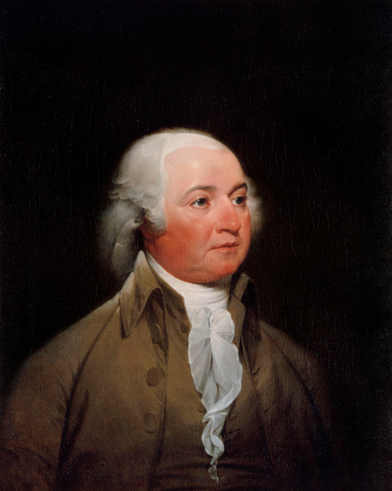
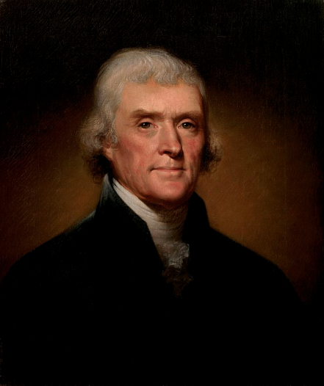
ELECTION OF 1796
Federalist
John Adams
VS.
WINNER!
Thomas Jefferson became Vice-President (method will be changed in 1804 with the 12th Amendment)
Adams won by 3 electoral votes
Democratic-Republican
Thomas Jefferson
Election of 1796 Explained

Slide 29
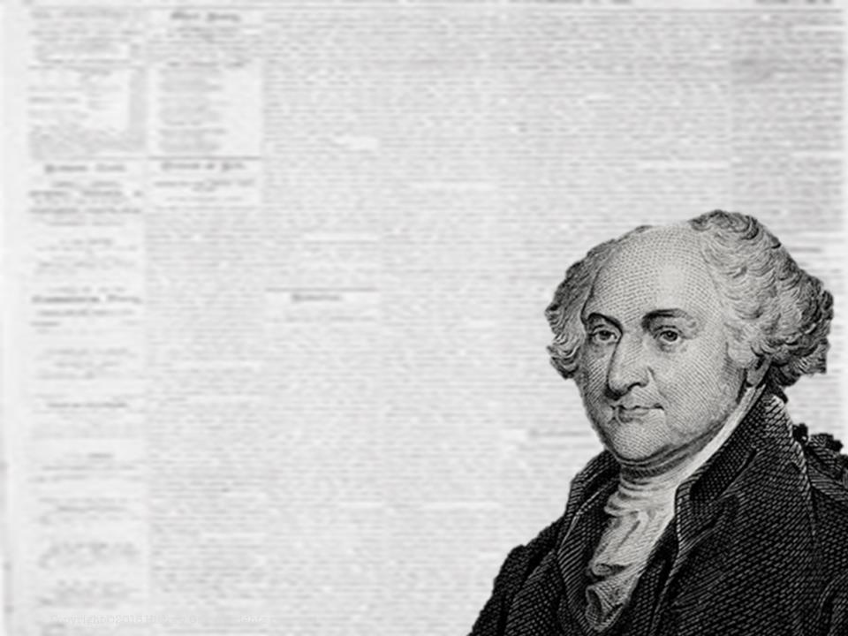
PRESIDENCY OF
JOHN
ADAMS
1797-1801
John Adams in 60 Seconds

Slide 30
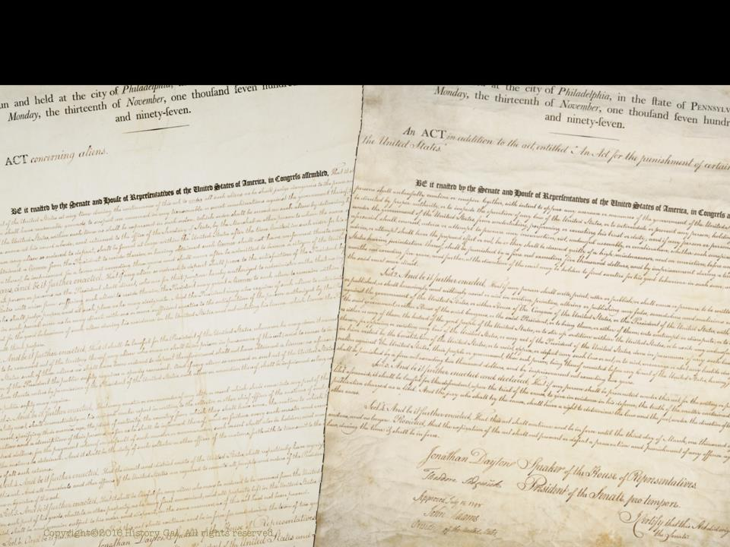
IMPORTANT ACTS
NATURALIZATION ACT – increased number of years to qualify for U.S. citizenship from 5 to 14 (this act hurt the D-R because immigrants tended to vote for D-R candidates)

Slide 31
IMPORTANT ACTS
ALIEN ACT – authorized the President to deport any aliens considered dangerous and to detain enemy citizens in time of war
SEDITION ACT – made it illegal for newspaper editors to criticize either the President or Congress and imposed heavy penalties (fined or imprisoned) for editors who violated the laws
Alien and Sedition Acts

Slide 32
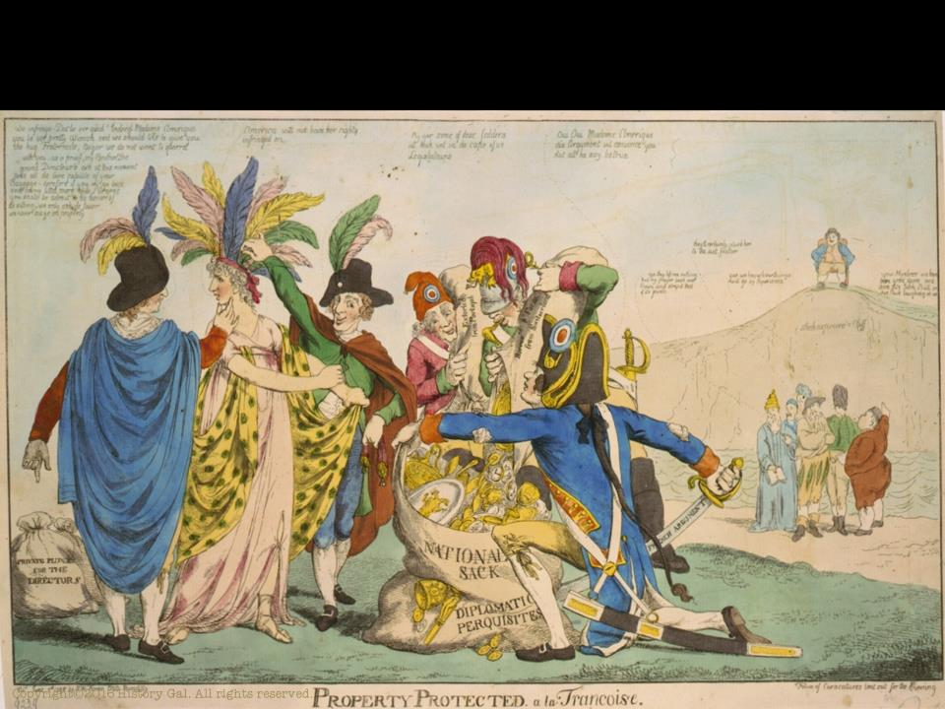
XYZ AFFAIR
U.S. merchant ships were being seized by French warships and privateers
Seeking peace, Adams sent a delegation to Paris to negotiate a treaty
French ministers known only as X, Y, Z (their names were never revealed) requested bribes before they would enter into negotiations

Slide 33
XYZ AFFAIR
U.S. delegates refused and went home
Americans wanted to go to war with France because of this insult
Adams opposed going to war with France and kept the U.S. out of the European wars
XYZ Affair

Slide 34
KENTUCKY & VIRGINIA RESOLUTIONS
Written by Thomas Jefferson and James Madison
States had entered into a compact and if any act of the Federal government broke this compact, a state could nullify the Federal law

Slide 35
KENTUCKY & VIRGINIA RESOLUTIONS
Written because D-R believed the Alien and Sedition Acts violated rights guaranteed by the 1st Amendment
At this time, the Supreme Court did not have power to declare laws unconstitutional
Crisis will soon fade because Federalists lose majority in Congress and the Supreme Court will gain the power to declare a law unconstitutional

Slide 36
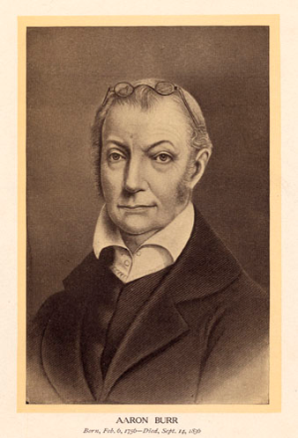
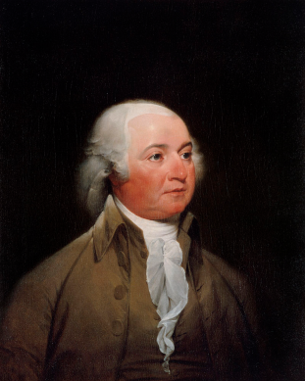
ELECTION OF 1800
Democratic-Republican
Aaron Burr
Federalist
John Adams
VS.
Democratic-Republican
Thomas Jefferson

Slide 37
ELECTION OF 1800
Electoral College split between Jefferson and Burr so the vote went to the House of Representatives
Aaron Burr
Thomas Jefferson

Slide 38
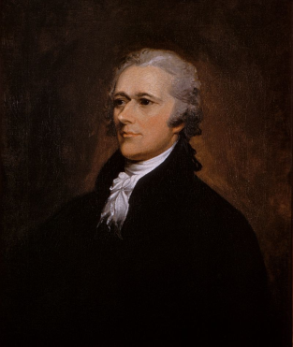
ELECTION OF 1800
Thomas Jefferson
Alexander Hamilton convinced his supporters in the House to vote for Jefferson not Burr
Aaron Burr
WINNER!
VICE PRESIDENT
Alexander
Hamilton

Slide 39
REVOLUTION OF 1800
The Election of 1800 is called the REVOLUTION OF 1800 because it was a peaceful transfer of power from the Federalists to the Democratic-Republicans
Indicated the U.S. Constitutional system would endure
Election of 1800

