Slide 1
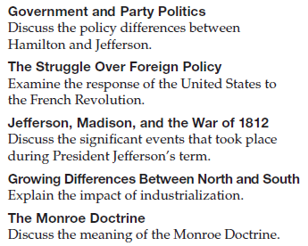
Objectives
Discuss the structure of the federal government and the emergence of political parties.
Explore the major foreign-policy issues that confronted the United States.
Describe the growing differences between the North and the South.

Slide 2
Terms and People
Alien Act − Federalist law meant to make it more difficult for immigrants to become citizens
Sedition Act − Federalist law meant to stop criticism of President Adams’s policies by Democratic Republicans
judicial review − power of the court to declare an act of Congress or the President unconstitutional
Louisiana Purchase − large territory purchased from France in 1803, doubling the size of the U.S.

Slide 3
Terms and People (Continued)
impressment − British practice of “pressing” or forcing American sailors into the British navy
embargo − suspension of trade
cotton gin − invention by Eli Whitney to separate cotton fibers from shells, made slavery more profitable in the South
Monroe Doctrine − U.S. policy barring European interference in the Americas
Notes:
3

Slide 4
How did the United States and its government change in the late 1700s and early 1800s?
Both internal political issues and international affairs tested the new nation. Despite these challenges, the United States grew.
But with growth came economic, political, and social issues that began to divide the North and the South.

Slide 5
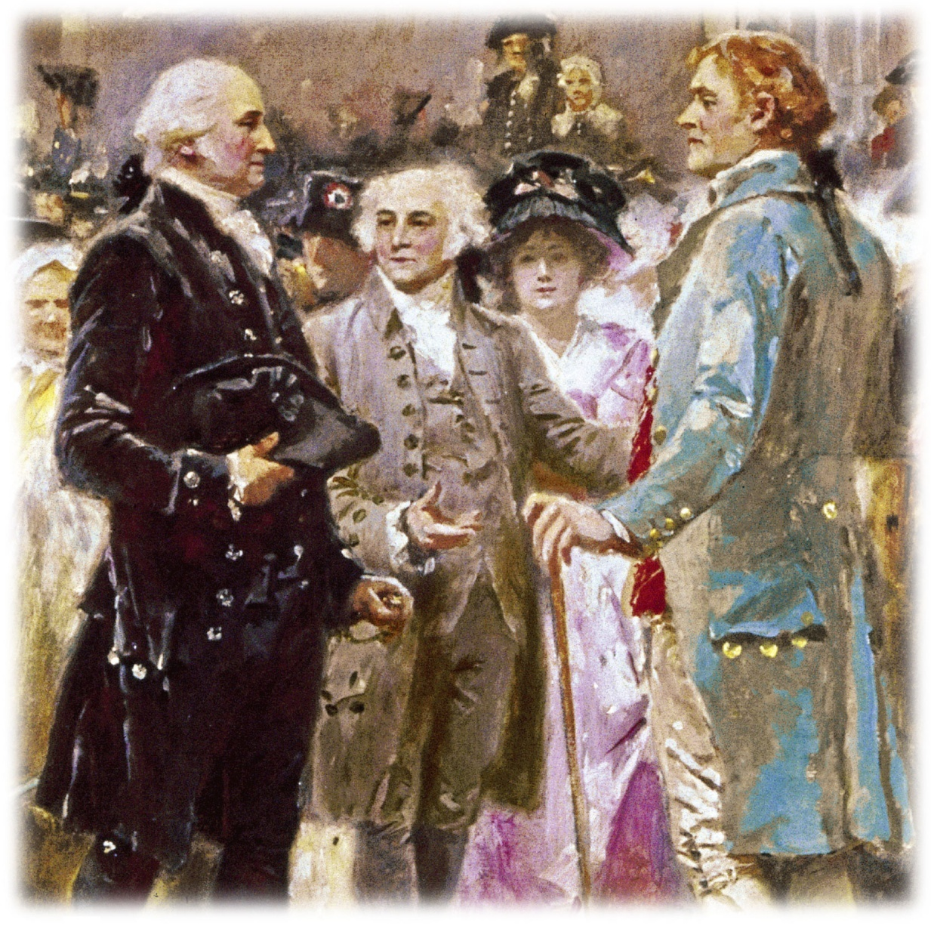
In 1789, George Washington took office as the first President of the United States.
Left to right: Washington, Adams, and Jefferson
Notes:
5

Slide 6
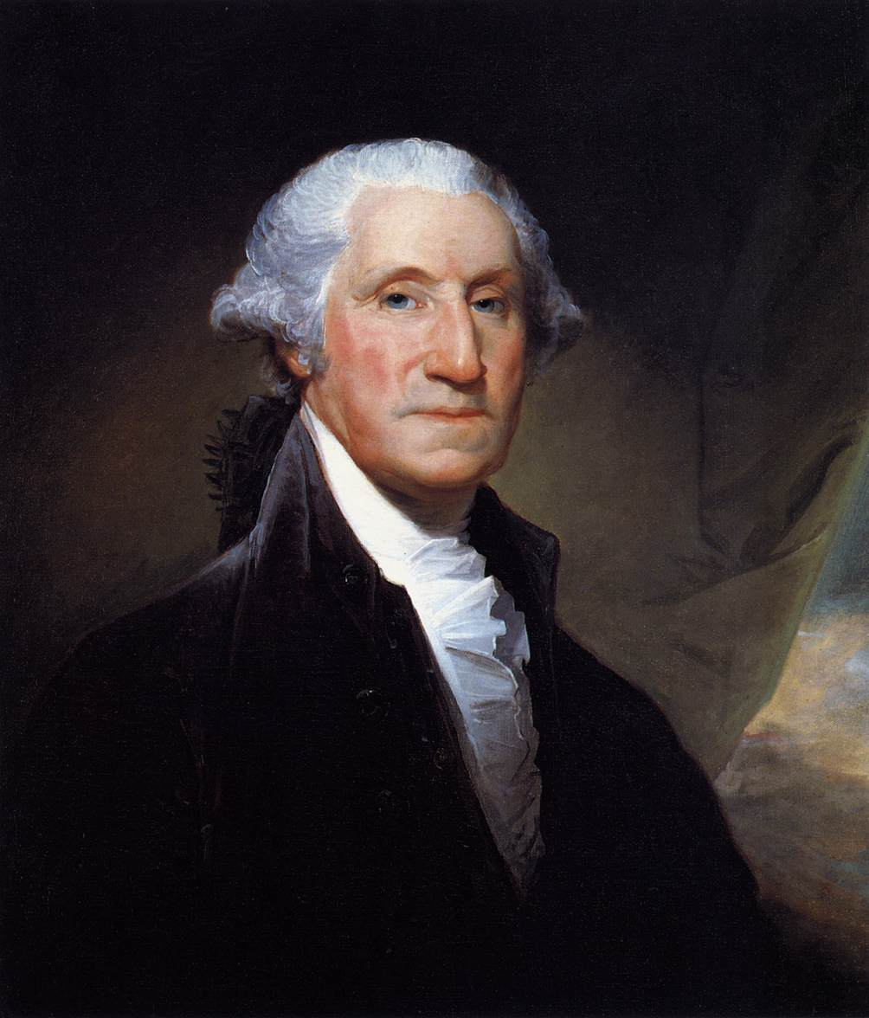
The Big Picture
George Washington was an obvious choice to be our nation’s first president and established important precedents and traditions that future holders of the office would honor.
The First President

Slide 7
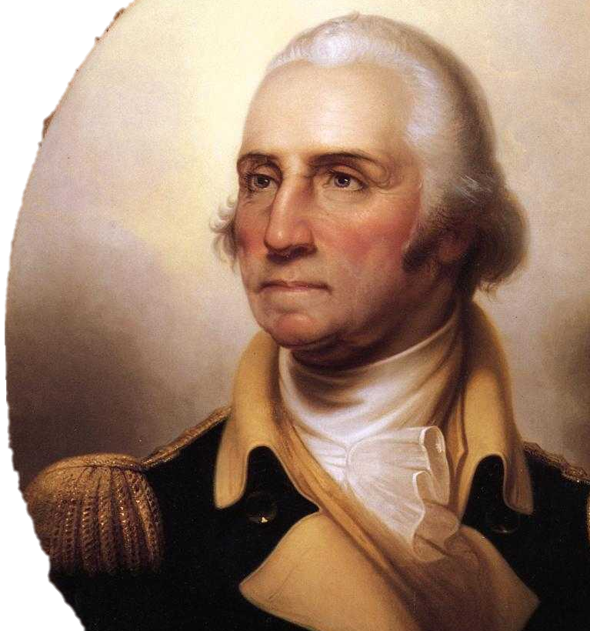
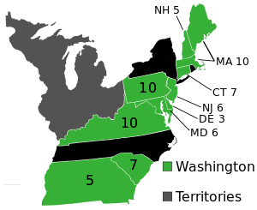
1. (1789) Washington was unanimously chosen president by the Electoral College

Slide 8
RANK—#2
George Washington
Presidency: 1789—1797
Birthplace: Virginia
Education: Elementary School
Party: Federalist
Age Upon Taking Office: 57
Vice-President: John Adams
Height: 6’2”
Nicknames: “Father of Our Country” “The Old Fox”
Sound Bite:
“My movements to the chair of government will be accompanied by feelings not unlike those of a culprit who is going to the place of his execution.”
Fun Fact:
The “Father of Our Country” was sterile. Likely the effects of suffering both malaria and smallpox at age 17.

Slide 9
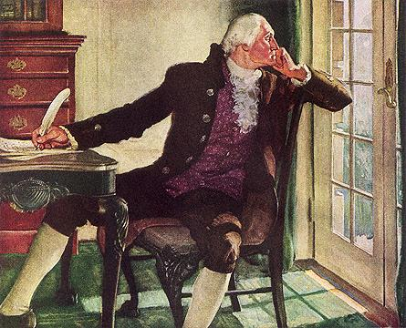
4. Washington established a diverse cabinet

Slide 12
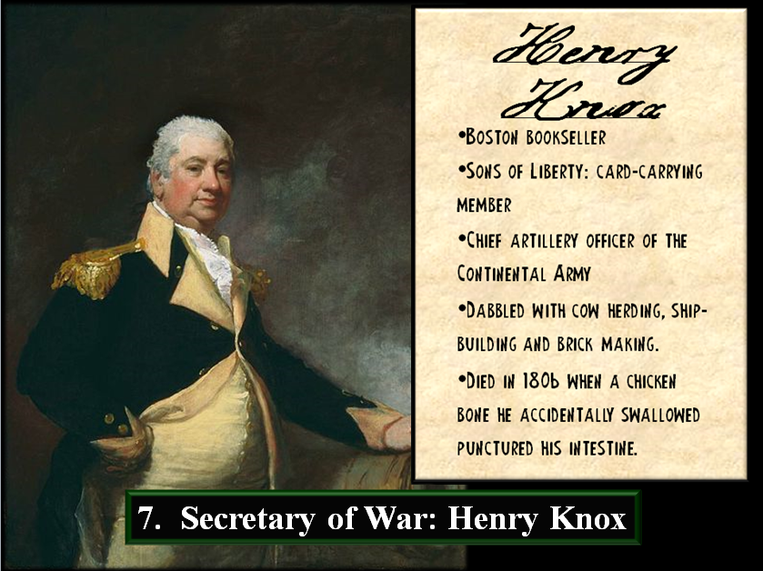

Slide 13
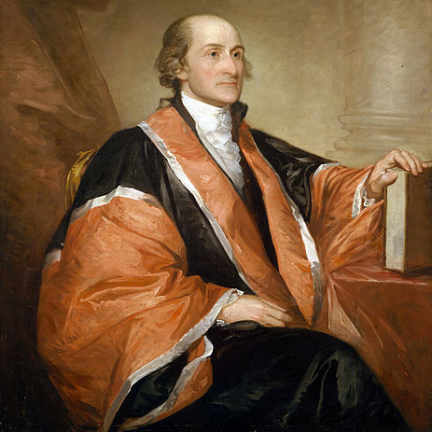
9. John Jay became first chief justice of the US

Slide 14
The future of the nation depended on his ability to lead.
Washington proved an excellent choice. He selected a skilled Cabinet, including Alexander Hamilton and Thomas Jefferson.
Hamilton proposed an economic plan that included a national bank.

Slide 15
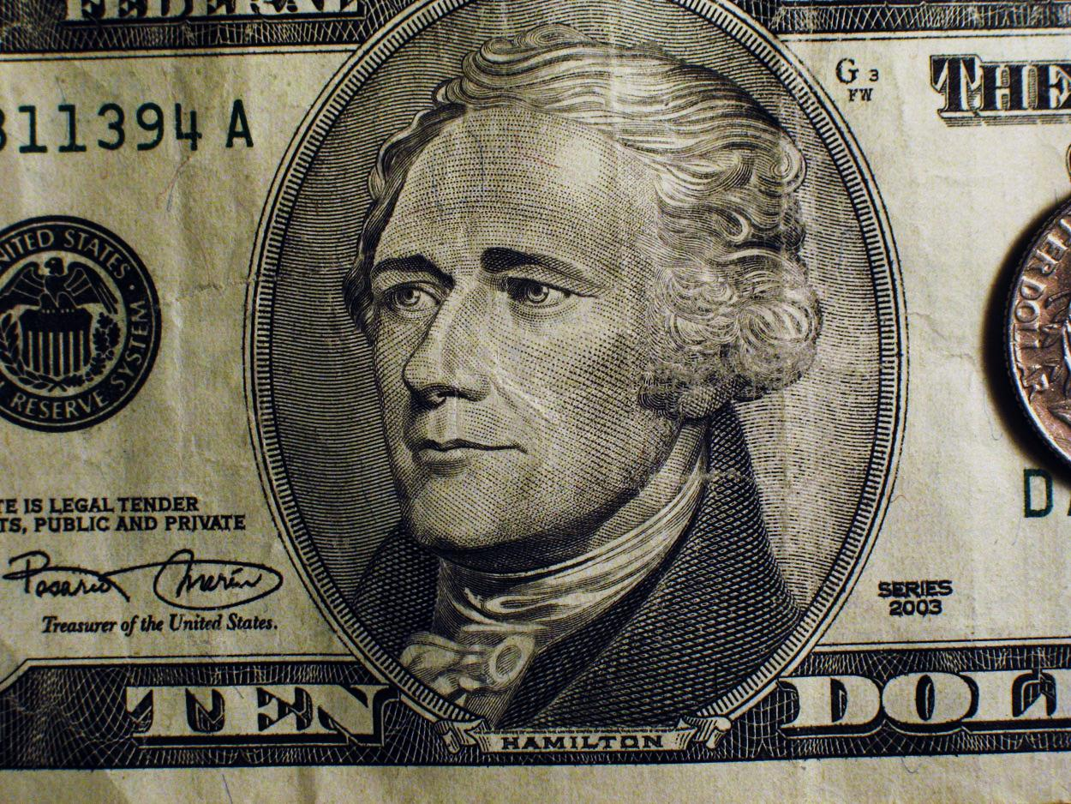
1. Hamilton urged the federal government to assume its debts ($54 million) as well as assume the debts of the states ($21.5 million)

Slide 17
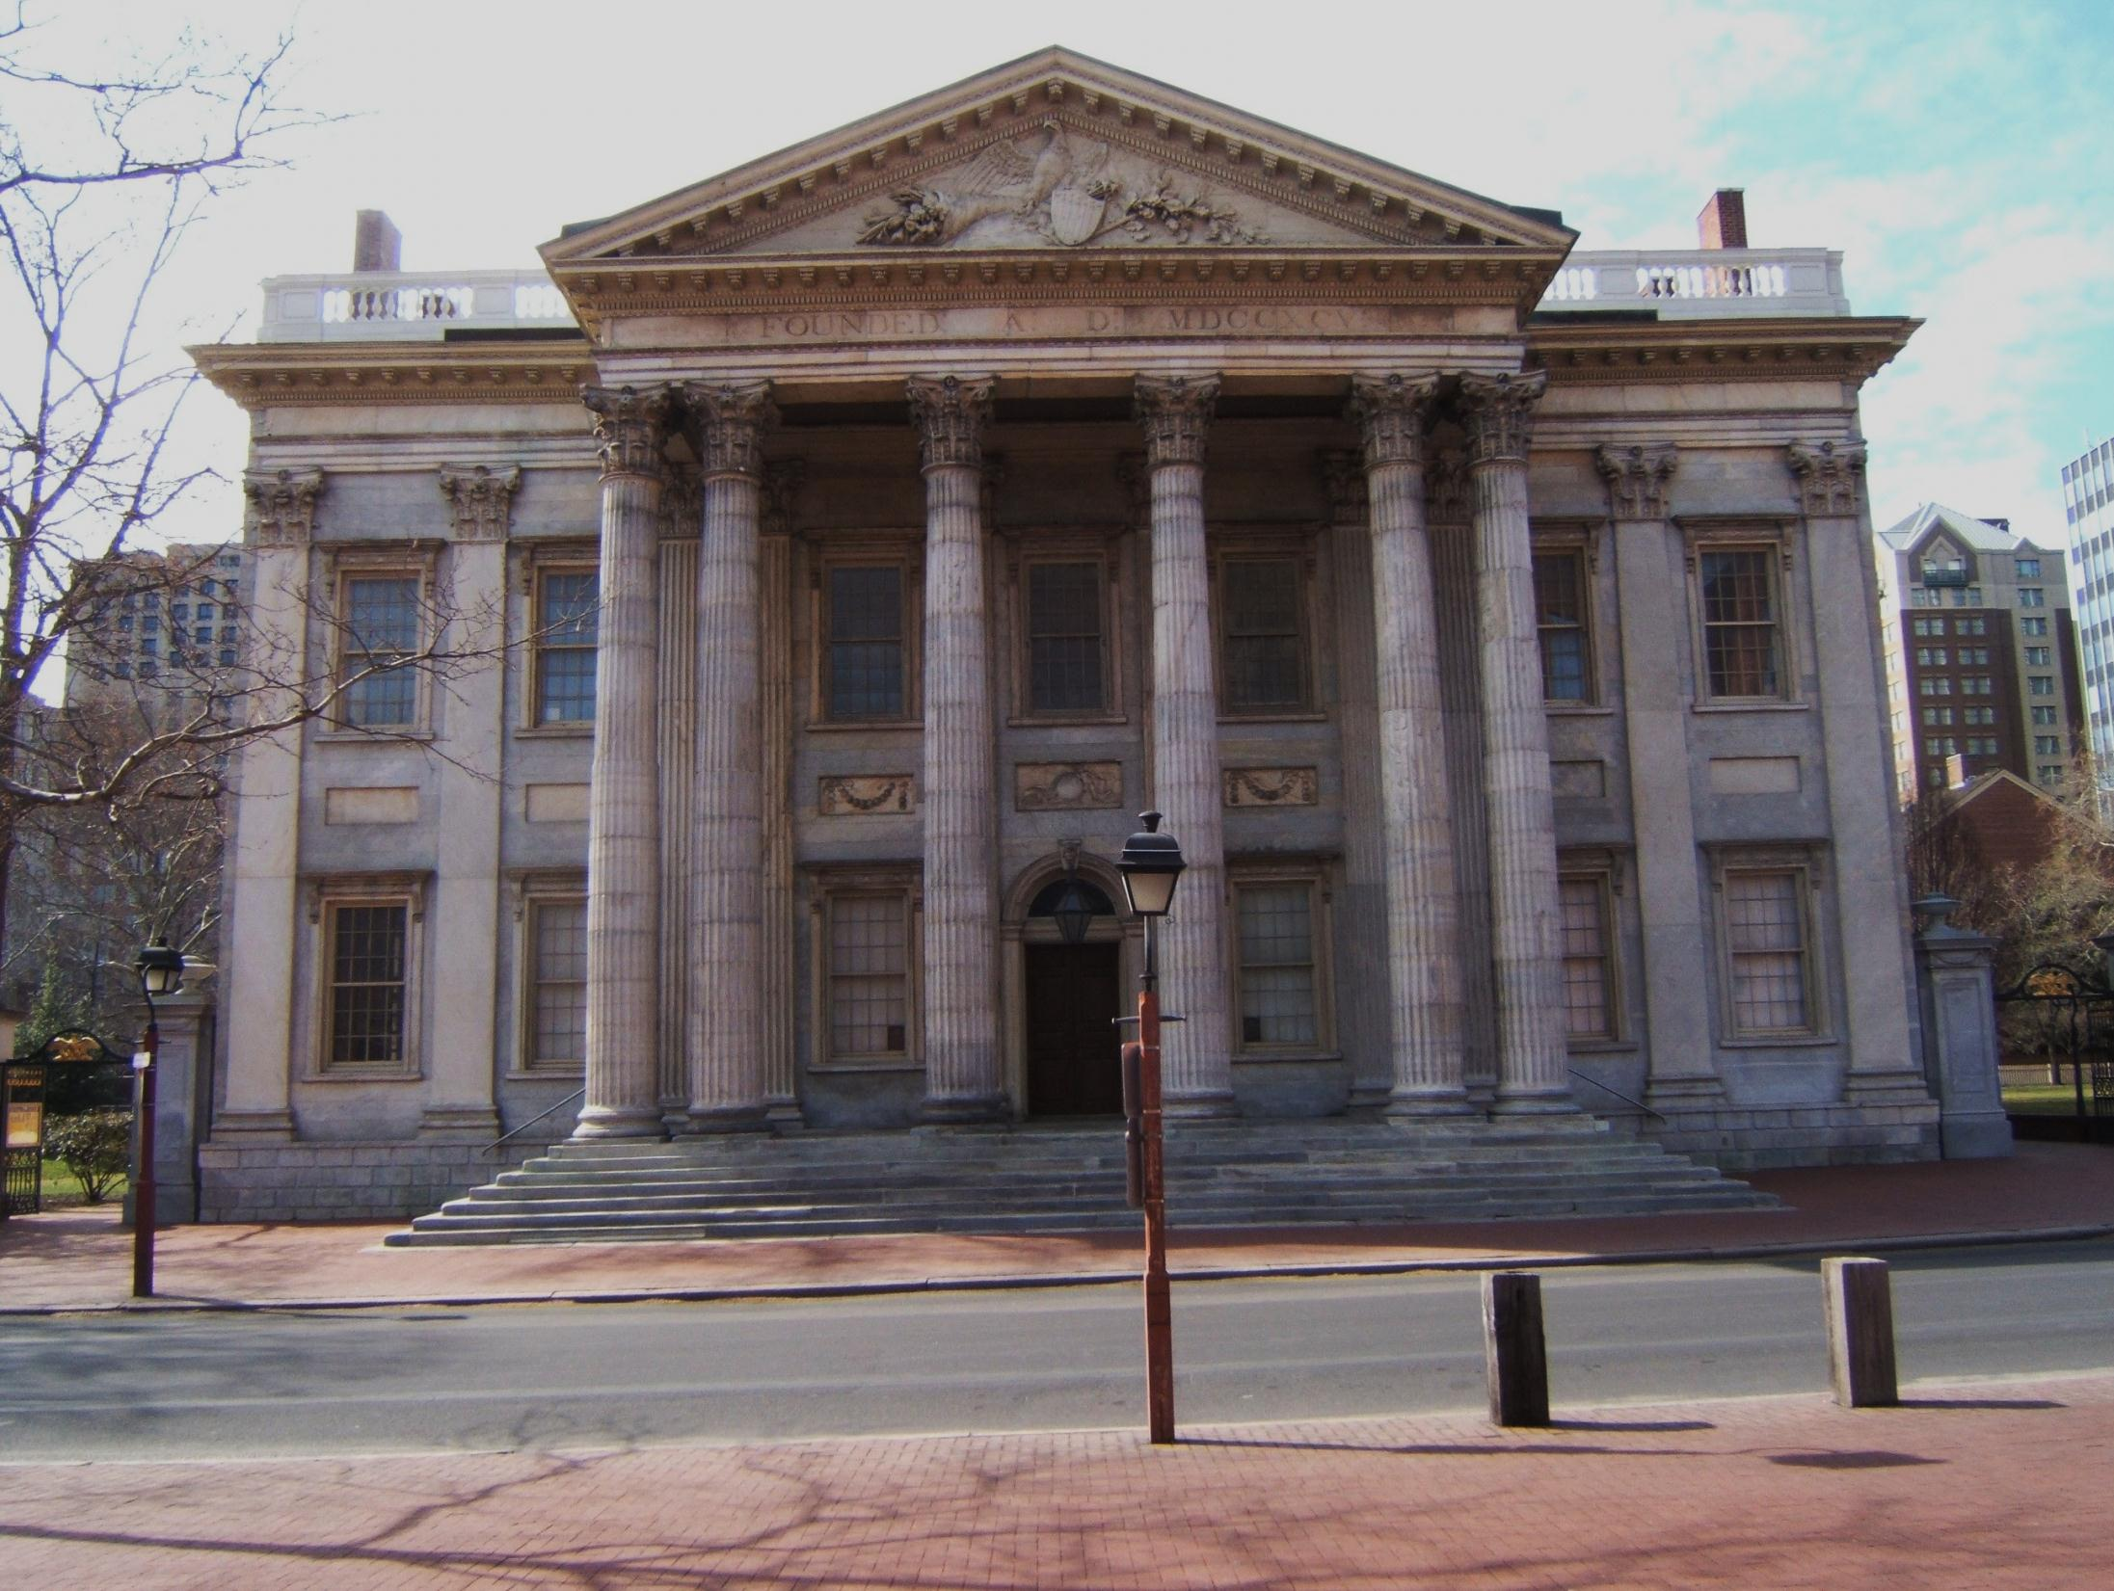
11. Hamilton proposed a national bank (a private institution with the federal government as a major stockholder)

Slide 18
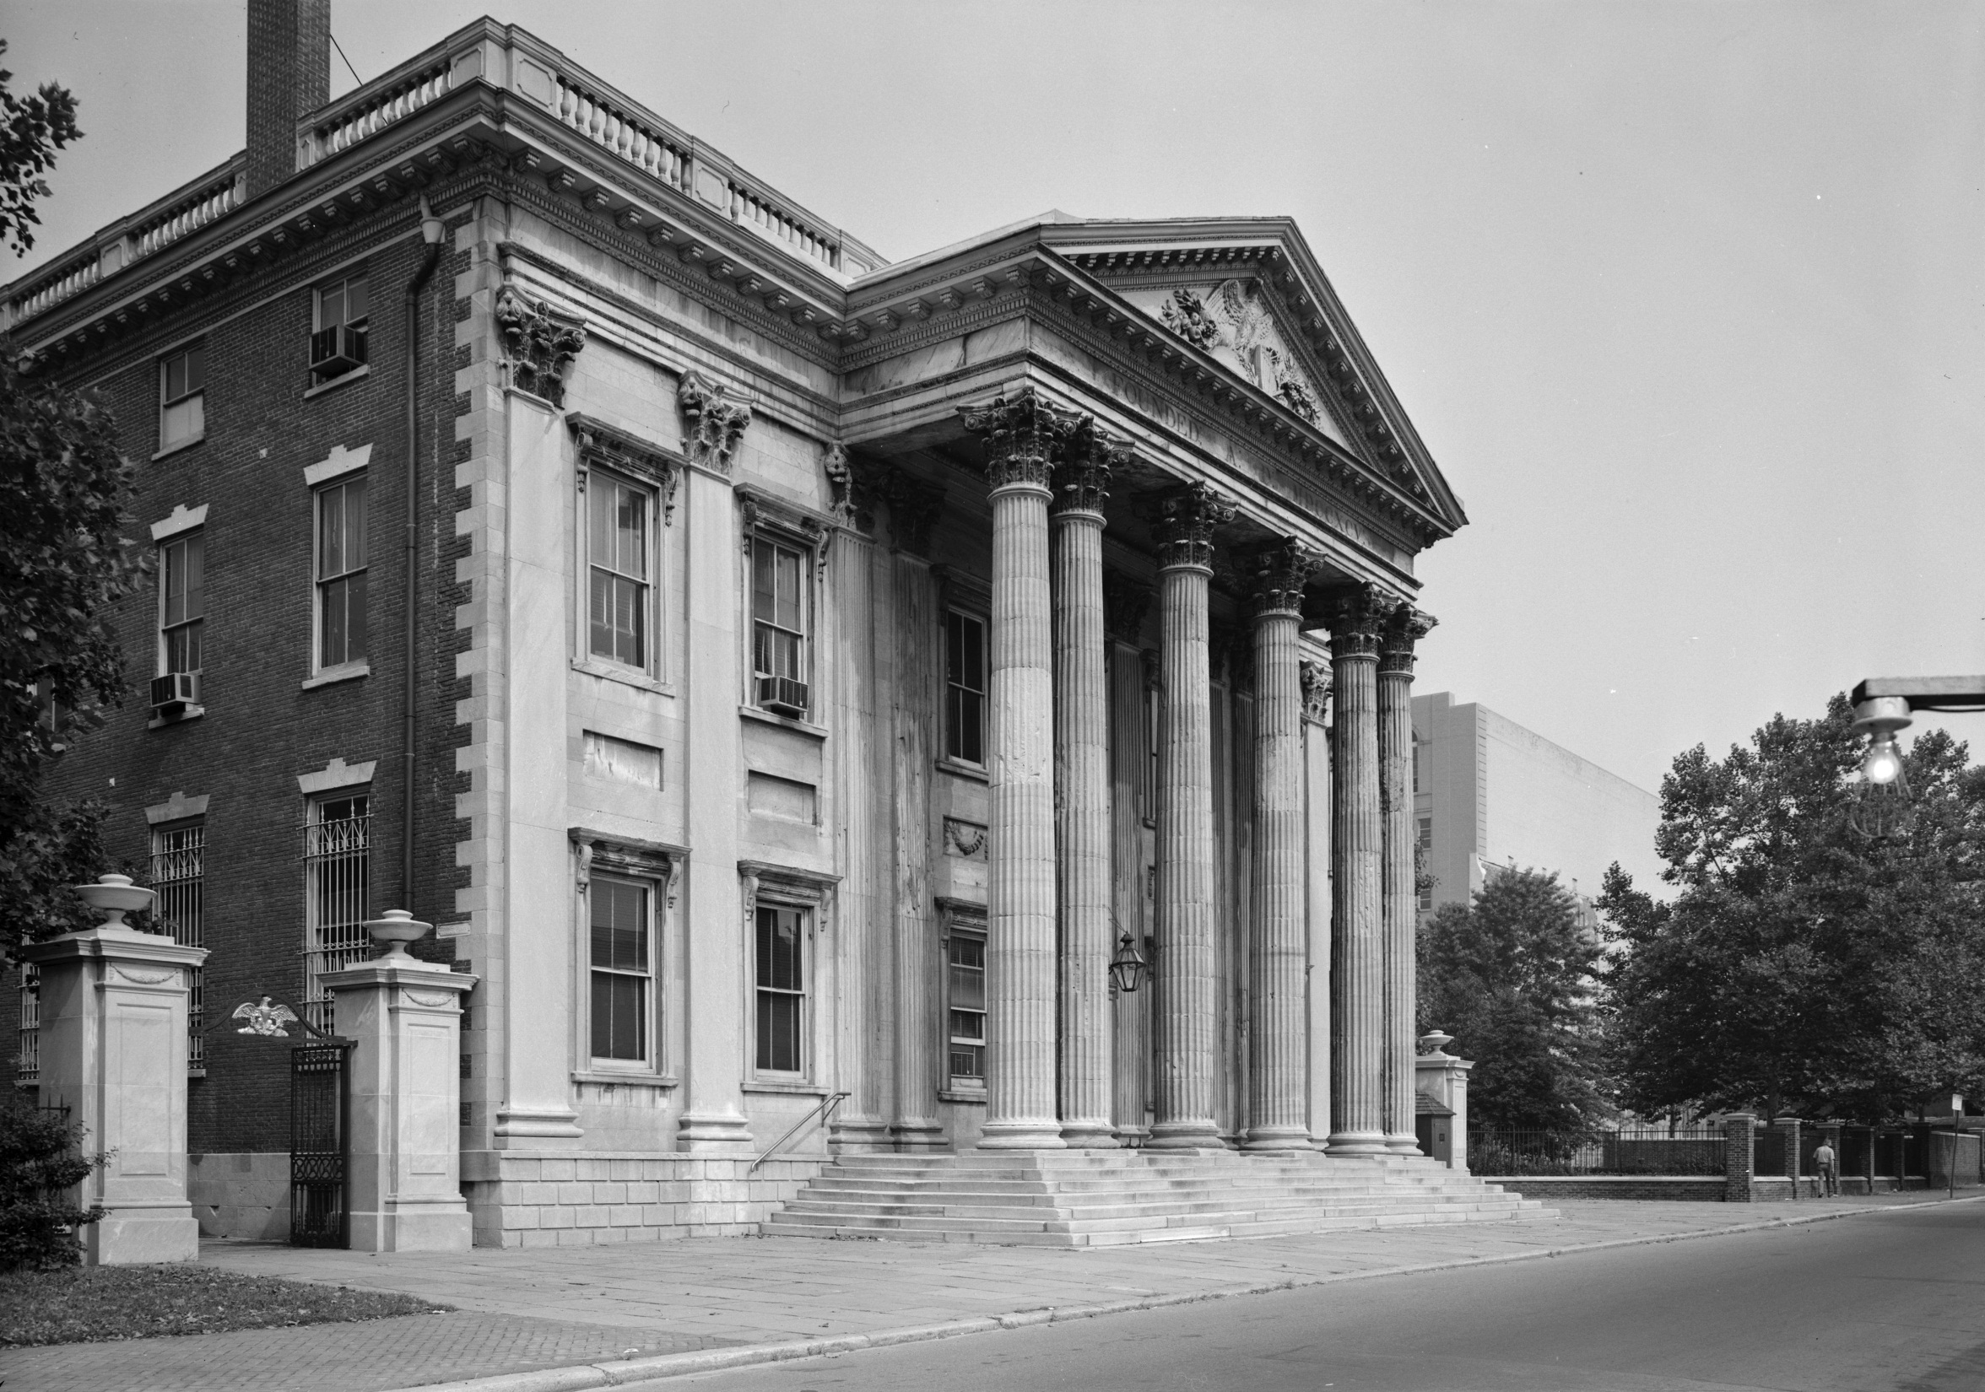
12. the national bank could circulate cash to stimulate business, store excess money, and print money with actual value

Slide 19
19. Hamilton’s successful financial plan allowed US to establish sound credit and expedited the transition away from a colonial economy

Slide 20
Opponents criticized Hamilton’s broad interpretation of the Constitution.
Federalists believed the Constitution empowered Congress to enact laws for the “general welfare.” They were loose constructionists.
Democratic Republicans wanted to limit the federal government only to powers stated in the Constitution. They were strict constructionists.
Notes:
20

Slide 21
American loyalties were split by the French Revolution and the resulting war between France and Britain.
Democratic Republicans sympathized with the French, while Federalists favored Britain.
Despite U.S. neutrality, American ships were seized by the British for trading with the French.
In 1794 Washington sent John Jay to negotiate with Britain.
Jay’s Treaty avoided war but the Democratic Republicans cried foul.
Notes:
21

Slide 22
In 1796 John (“Bonnie Johnny”) Adams was elected the second President. He faced challenges from France.
American ships were seized.
French officials demanded bribes.
Full-scale naval war erupted.
Notes:
22

Slide 24
The Big Picture
France was irked by the Neutrality Proclamation stressing the relationship with our one-time ally to the point where war looked likely.
I. Unofficial Fighting With France

Slide 25
France ordered U.S. ships carrying “so much as a handkerchief” from Britain seized.
1. France considered Jay’s Treaty a violation of the 1778 Franco-American alliance (France began seizing US merchant ships)

Slide 26
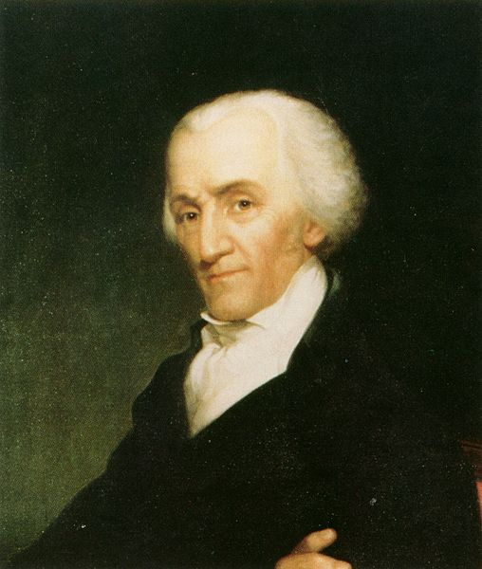
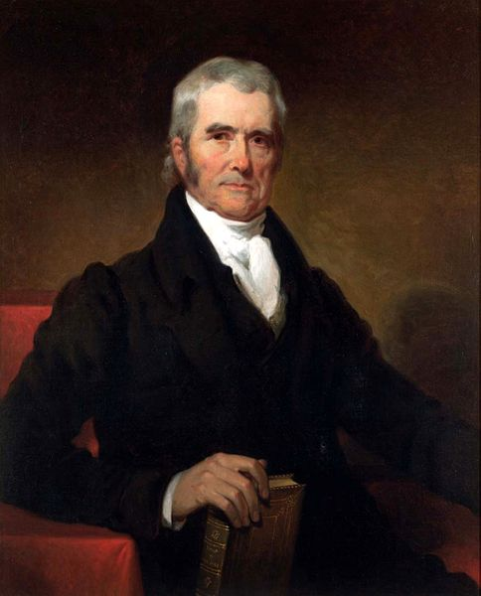
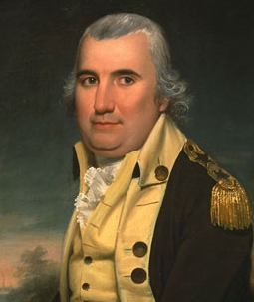
Elbridge Gerry
John Marshall
Charles Pinckney
2. XYZ Affair—John Adams sent 3 diplomats to France where they were met by 3 French agents “X”, “Y” and “Z”

Slide 27
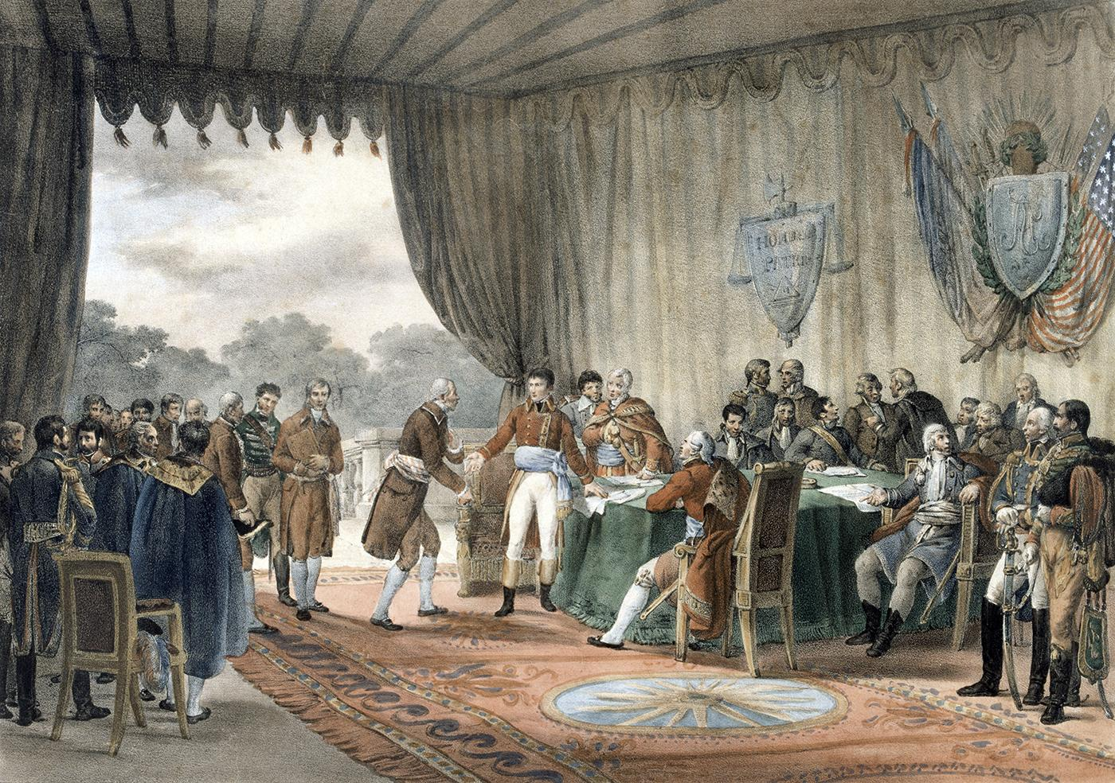
3. XYZ agents demanded $250,000 bribe to begin negotiating plus France demanded a $12 million loan from US

Slide 28
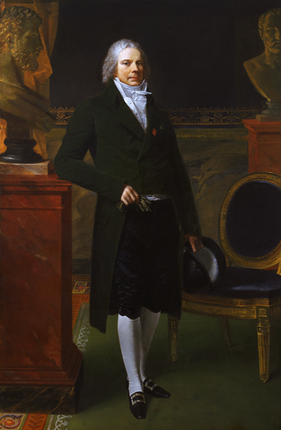
Charles Maurice de Talleyrand
4. bribes were routine in diplomacy but not this high just to talk, with no guaranteed agreement

Slide 29
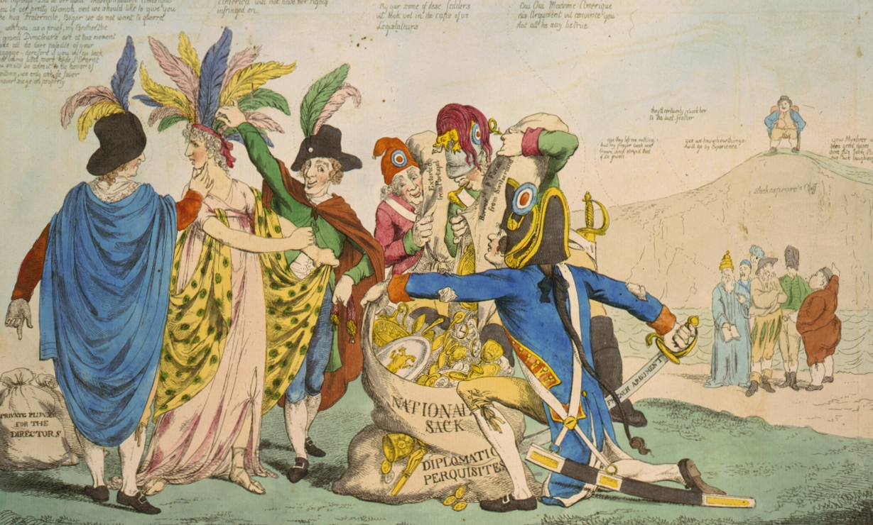
Maiden America Ravaged By The French
“Millions for defense, but not one cent for tribute.”
5. the Americans returned home and were cheered by people for doing the right thing

Slide 30
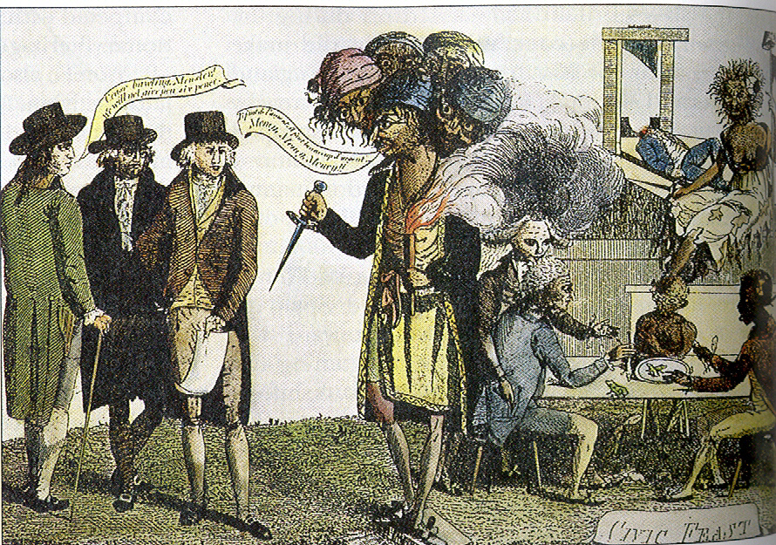
Refusing The Paris Monster
6. some called for war with France but Adams (like Washington) knew war might be disastrous

Slide 31
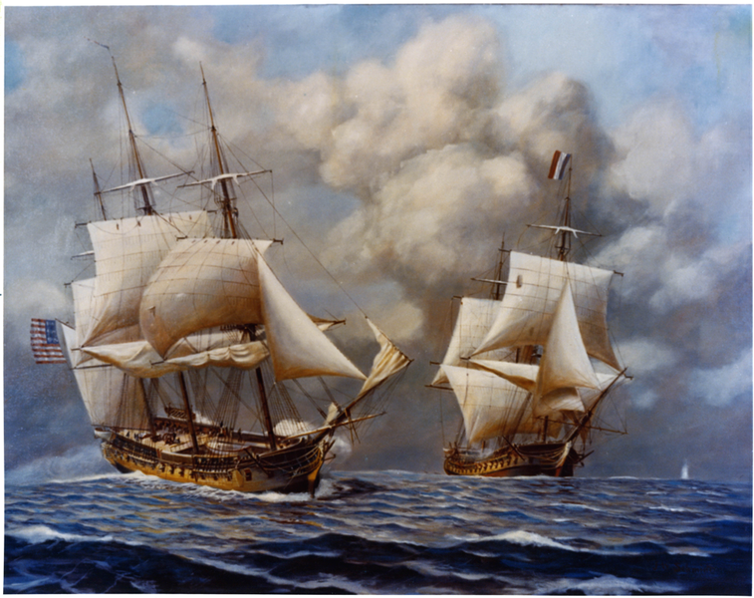
"To me there appears no means of averting a storm, and, in my opinion, we must all be ready to dedicate ourselves to fatigues and dangers."
-John Adams
7. a “Quasi War” with France at sea raged for 2 ½ years (Americans captured 80+ French ships)

Slide 32
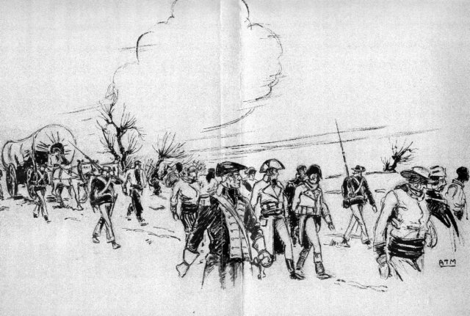
French prisoners being escorted by US Marines
8. France (hoping to avoid war with U.S.) promised that the next diplomats would be received with respect

Slide 33
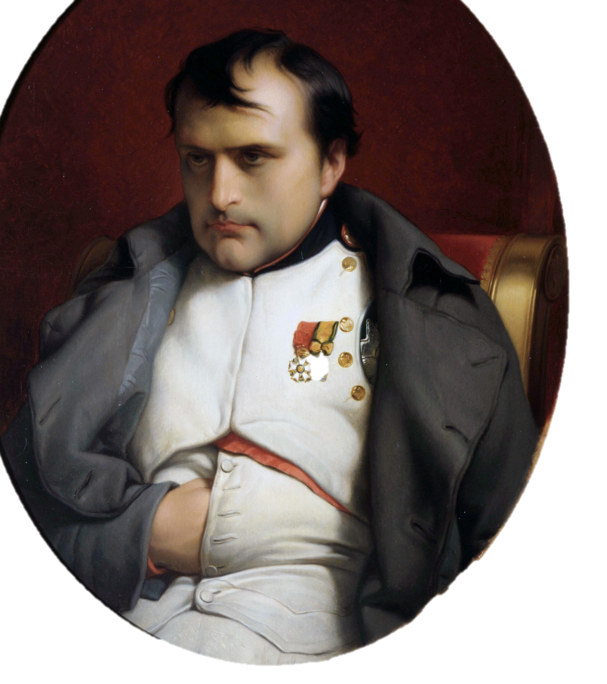
9. (1800) 3 American diplomats met Napoleon who was eager to work with the U.S.

Slide 34
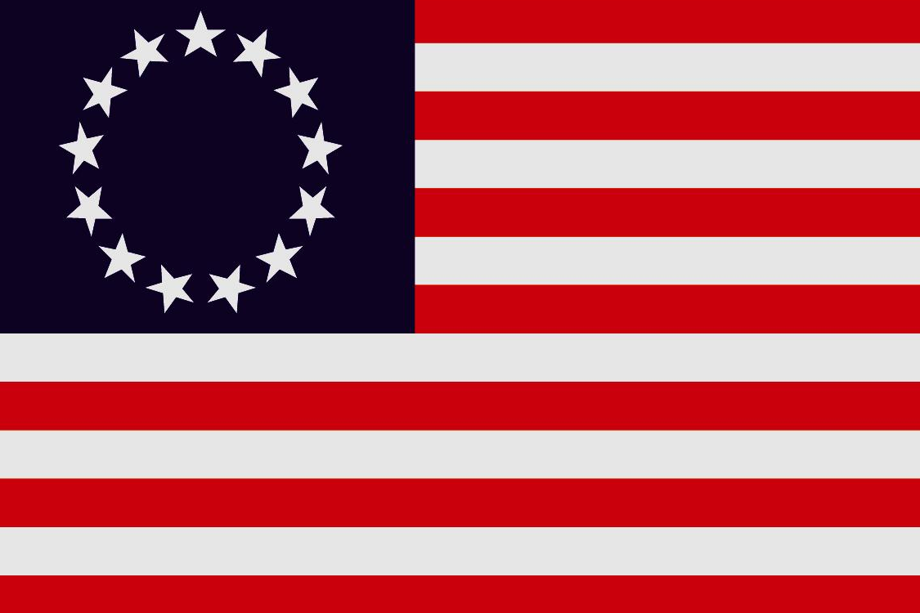
Treaty of Mortefontaine
10. Treaty of 1800 ended 1778 alliance and US dropped its demand for repayment of lost shipping money

Slide 35
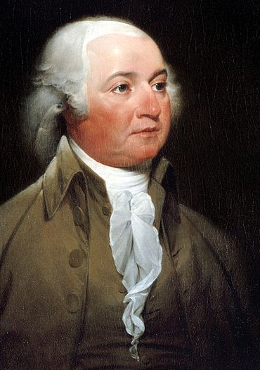
“There never was perhaps a greater contrast between two characters than between those of the present President and of his predecessor. The one cold considerate and cautious, the other headlong and kindled into flame by every spark that lights on his passions. The one ever scrutinizing into the public opinion, and ready to follow where he could not lead it; the other insulting it by the most adverse sentiments and pursuits. W. a hero in the field, yet over-weighing every danger in the Cabinet. A. without a single pretension to the character of a soldier, a perfect Quixote as a statesman. The latter taking as much pains to get into war, as the former took to keep out of it.”
-James Madison
11. Adams helped US avoid war (an unpopular decision but it protected the still weak country)

Slide 36
The Federalists exploited the crisis by passing two laws aimed at their opponents.
The Alien Act allowed the deportation of pro-French immigrants who criticized the government.
The Sedition Act made it a crime to publicly discredit Federal leaders.
Unpopular laws led to the decline of the Federalists.
Notes:
36

Slide 37
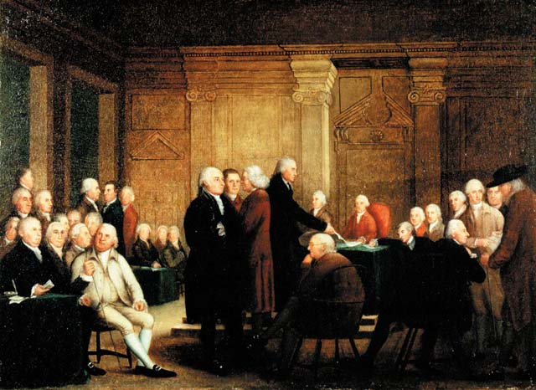
J. The Federalist Witch Hunt
The Big Picture
Federalists feared the influence of immigrants so much they beefed up naturalization laws and banned many forms of free speech directed against our federal government.

Slide 38
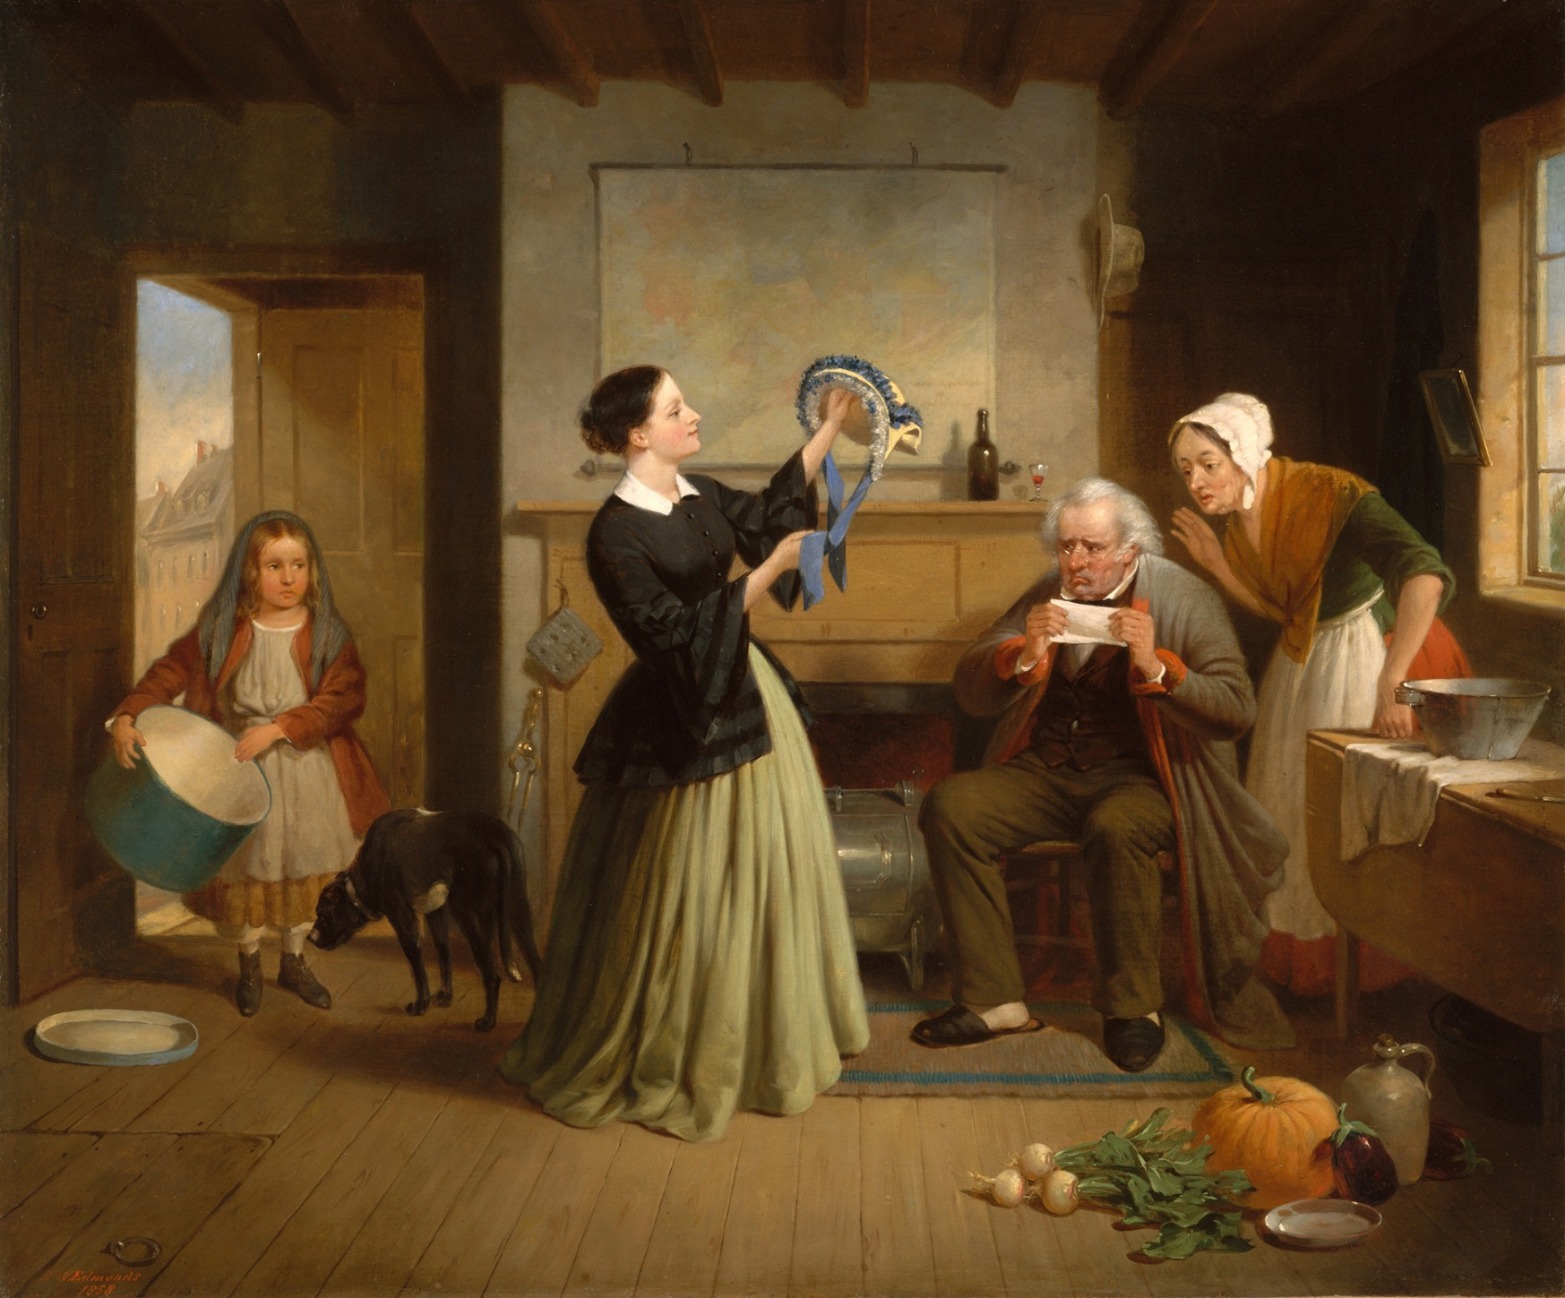
1. Federalists scorned poor people (especially immigrants) who were welcomed by the D-Rs

Slide 39
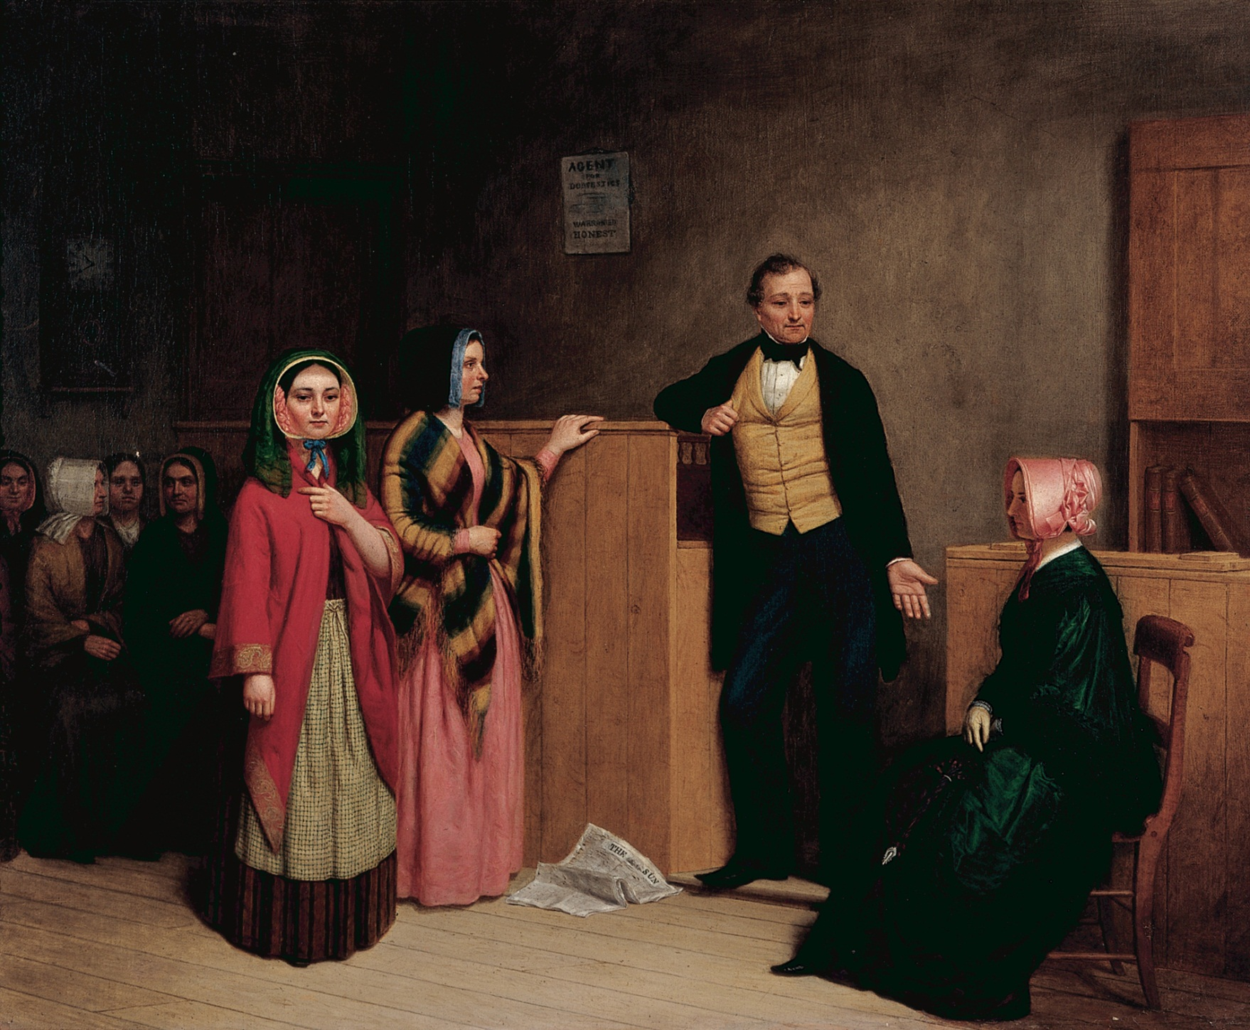
2. Alien Act—Federalists raised residency requirements for citizenship from 5 to 14 years (a law violating the traditional US policy of open-door hospitality and speedy assimilation)

Slide 40
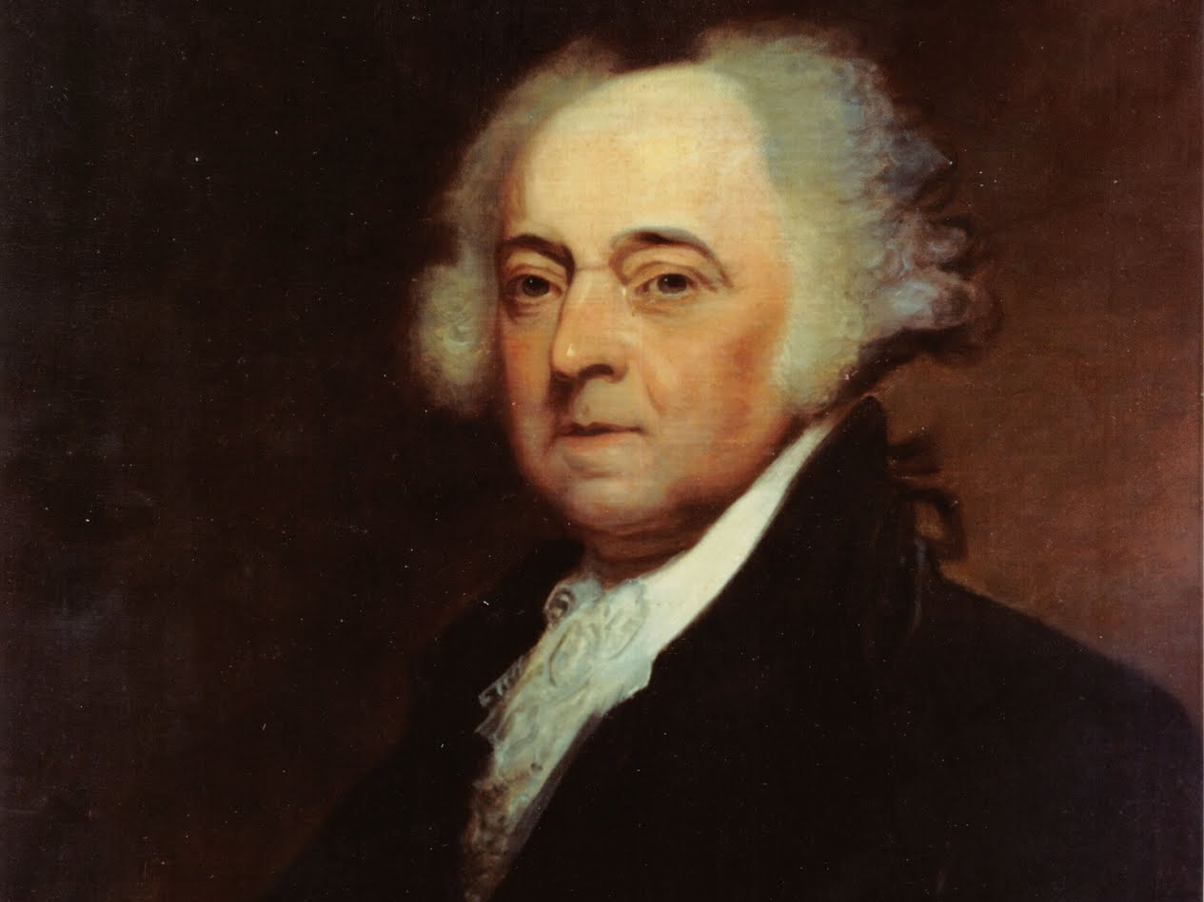
3. Espionage Act allowed president to deport aliens during peacetime and jail them during war

Slide 41
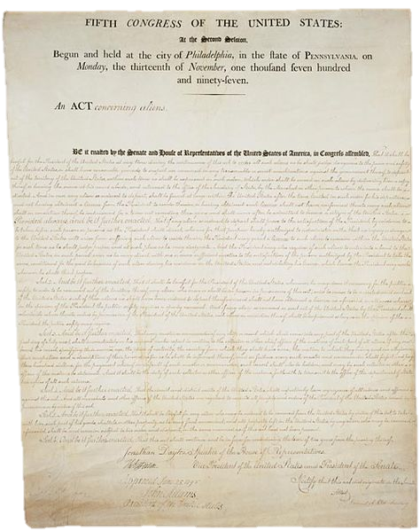
“Anyone who wrote, printed, or spoke “false, scandalous, and malicious statements “against the government of the United States, or the President of the United States, with intent to defame...Or to bring them or either of them, into contempt or disrepute.”
4. Sedition Act→ anyone critical of government policies or elected officials could be fined or imprisoned (aimed at newspapers and D-Rs)

Slide 42
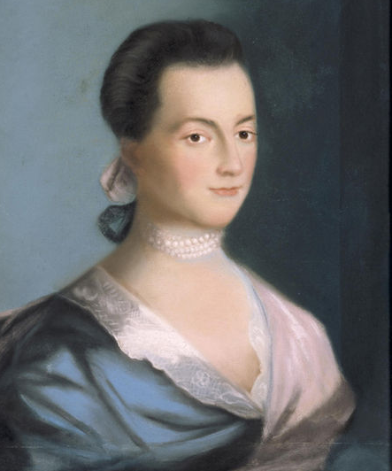
“Nothing will have an effect until the Congress passes a sedition bill” permitting “the wrath of the public to fall upon their [the Republican editors’] devoted heads. In any other country Bache [a ‘seditious’ editor] and all his papers would have been seized long ago.” -Abigail Adams
The Alien & Sedition Acts

Slide 43
“This act seemed to directly violate the First Amendment. Yet, it was enforced. Ten Americans were put in prison for utterances against the government, and every member of the Supreme Court in 1798-1800…held it constitutional.”
-Howard Zinn, A People’s History of the United States
5. Sedition Act was unconstitutional but it was passed by Federalists in Congress and upheld by Federalists in the courts

Slide 44
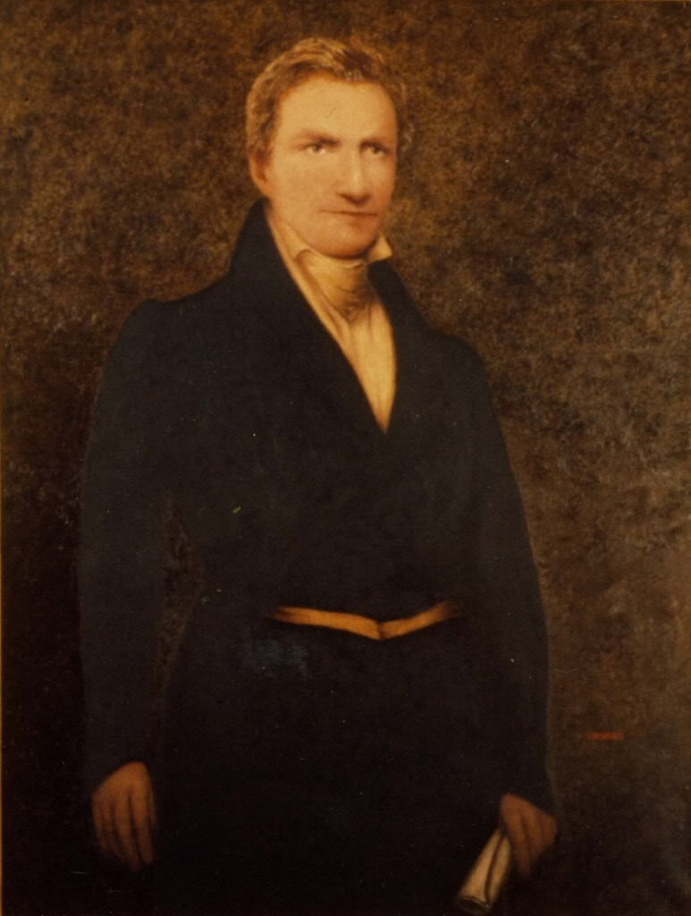
Fact: Matthew Lyon is the only man ever elected into Congress while in jail.
7. Mathew Lyon spent 4 months in jail for writing negatively about President Adams

Slide 45
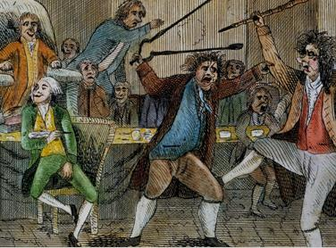
Matthew Lyon fighting Federalist Roger Griswold with fire tongs—he was cited for an ethics violation for “gross indecency” for spitting on Griswold.
Rep. Matthew Lyon

Slide 46
8. Federalists did well in elections of 1798 (Americans supported Alien & Sedition Acts?)

Slide 47
9. resentful D-Rs feared Federalists were going to wipe out free speech/press (might go further)

Slide 48
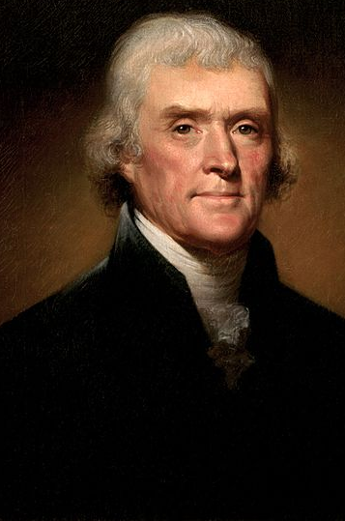
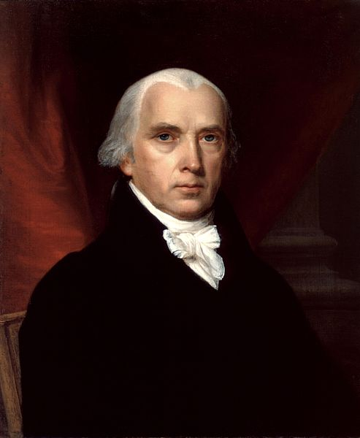
10. (1798) Jefferson wrote laws for Kentucky and Madison for Virginia that nullified the Alien & Sedition Acts

Slide 49
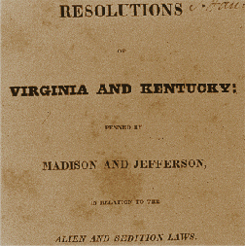
Doctrines Presented in the KY & VA Resolutions
States have fundamental rights that the Federal Government cannot deny.
The US Constitution exists as a compact (agreement) between the Federal and State Governments.
States can nullify federal laws that they judge to be unconstitutional
11. the Kentucky and Virginia Resolutions stressed the compact theory arguing the 13 states created the government so states could choose what federal laws to follow

Slide 50
Thomas Jefferson defeated Adams in the election of 1800.
The election set a precedent for the peaceful transfer of power based on voting.
Jefferson and the Democratic Republicans eliminated unpopular taxes, cut expenses, and reduced the national debt.
Notes:
50

Slide 51
Jefferson’s policies to limit federal power, however, were checked by Chief Justice John Marshall.
In Marbury v. Madison the Supreme Court asserted judicial review, the power to decide the constitutionality of acts of Congress or the President.
Notes:
51

Slide 52
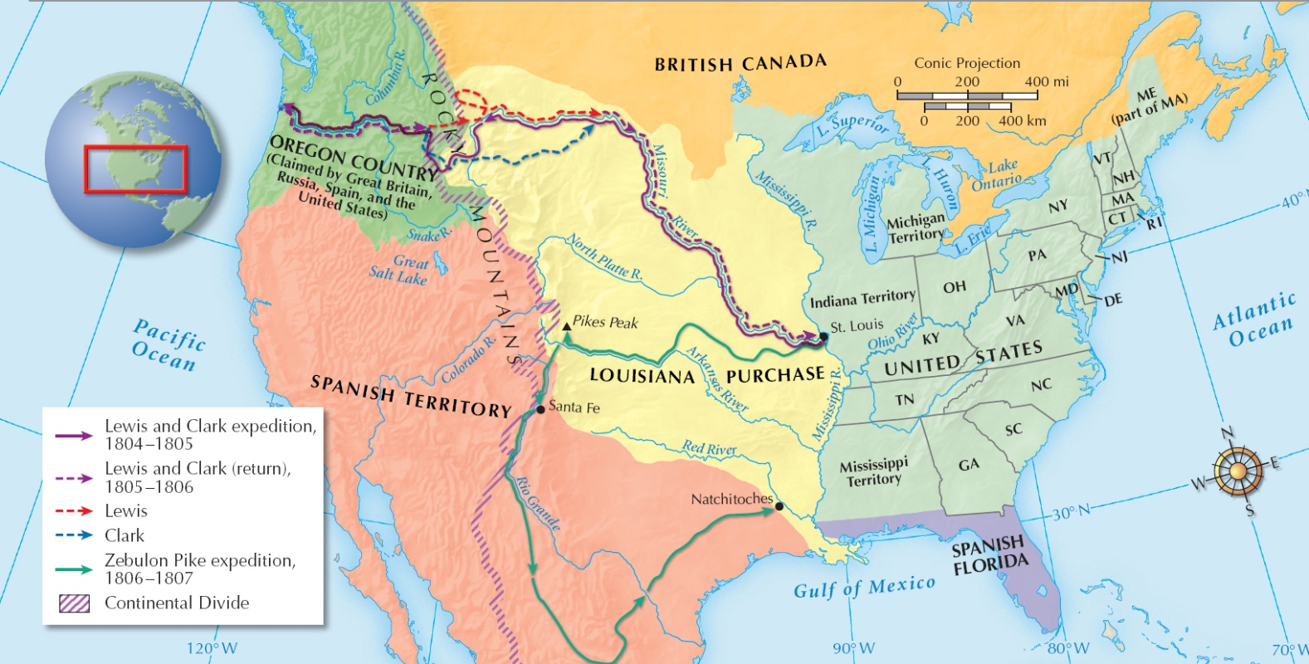
In 1803 Jefferson obtained the huge Louisiana Purchase from French ruler Napoleon Bonaparte.
Meriwether Lewis and William Clark explored the new territory.
Notes:
52

Slide 53
Jefferson persuaded Congress to declare a trade embargo.
He hoped the lack of trade would hurt Britain. It hurt Americans more.
The unsuccessful embargo was lifted in 1809.
Britain resumed seizing U.S. ships trading with France and allowed for the impressment of U.S. sailors.

Slide 54
In 1809, Democratic Republican James Madison succeeded Jefferson as President.
In 1812 the United States went to war with Britain.
The Americans failed to take Canada and the British burned Washington, D.C.
The war ended with an 1814 peace treaty.

Slide 55
Northerners built factories during the War of 1812.
These attracted European immigrants and promoted urban growth.
War set the North on a different path from the South

Slide 56
Southern states remained agricultural and dependent on enslaved labor.
Eli Whitney’s invention of the cotton gin made slavery more profitable for southern planters.
Plantations expanded−and forced more slaves to work−to provide cotton for northern textile mills.

Slide 57
It stated that European monarchies had no business meddling with American republics.
The United States, similarly, would stay out of European affairs.
In 1823, President James Monroe issued the Monroe Doctrine.

Slide 58
United States government change in the late 1700s and early 1800s?
Washington 1st President
Cabinet
Hamilton’s Financial Plan
Federalists Support
Republic Dems Oppose
French Revolution
Jay’s Treaty
John Adams 2nd President 1796
French Challenges
XYZ Affair
Alien and Sedition Acts
Thomas Jefferson 3rd President 1800
John Marshall’s Court
Marbury v Madison
Judicial Review
Louisiana Purchase 1803
Lewis and Clark
British Problems
Impressment
Embargo
James Madison, 4th President 1809
War of 1812
North Industrialization
Factories & Growth
South Plantations
Cotton Gin
Slavery
John Monroe, 5th President
Monroe Doctrine 1823
American Isolationism

