Slide 1
Chapter Introduction
This chapter will cover the emergence of totalitarian states following World War I as well as some of the key factors leading to World War II and how the United States became involved in it.
Section 1: Dictators and Wars
Section 2: From Isolation to Involvement
Section 3: America Enters the War

Slide 2
Objectives
Explain how dictators and militarist regimes arose in several countries in the 1930s.
Summarize the actions taken by aggressive regimes in Europe and Asia.
Analyze the responses of Britain, France, and the United States to the aggressive regimes.

Slide 3
Terms and People
totalitarianism − theory of government in which a single party or leader controls the economic, social, and cultural lives of its people
Joseph Stalin − dictator and head of the Communist Party in Russia
Benito Mussolini − founder of the Fascist Party and Italian dictator
Adolf Hitler − leader of the Nazi Party in Germany who seized power and attempted world domination
anti-Semitic − prejudiced against Jewish people

Slide 4
Terms and People (continued)
Spanish Civil War − Spanish conflict fought from 1936 to 1939
appeasement − policy of granting concessions to a potential enemy in the hope that it will maintain peace
Anschluss − union in which Hitler forced Austria to become part of Germany’s territory
Munich Pact − agreement in which Britain and France attempted to preserve peace by allowing Hitler to take more territory

Slide 5
Why did totalitarian states rise after World War I, and what did they do?
World War I and the Great Depression had devastating effects throughout the world.
In some countries, people turned to new leaders who would be responsible for creating an even deadlier global conflict.

Slide 6
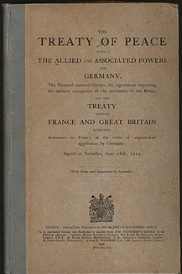
World War I ended in 1918 when Germany surrendered to the Allies. An uneasy peace followed.
• Germans resented the terms of the Treaty of Versailles, feeling humiliated in defeat.
Italy and Japan were angered by the treaty, expecting to receive more land as Allied victors.
• Worldwide depression brought despair to many already suffering from war.
Notes:
It was signed on 28 June 1919 in Versailles, exactly five years after the assassination of Archduke Franz Ferdinand, which had directly led to World War I. The other Central Powers on the German side of World War I signed separate treaties.^{[6]} Although the armistice, signed on 11 November 1918, ended the actual fighting, it took six months of Allied negotiations at the Paris Peace Conference to conclude the peace treaty. Article 231, later became known as the War Guilt clause. The treaty required Germany to disarm, make ample territorial concessions, and pay reparations to certain countries that had formed the Entente powers. In 1921 the total cost of these reparations was assessed at 132 billion marks (then $31.4 billion or £6.6 billion, roughly equivalent to US$442 billion or UK£284 billion in 2019). At the time economists, notably John Maynard Keynes (a British delegate to the Paris Peace Conference), predicted that the treaty was too harsh—a "Carthaginian peace"—and said the reparations figure was excessive and counter-productive, views that, since then, have been the subject of ongoing debate by historians and economists from several countries. On the other hand, prominent figures on the Allied side such as French Marshal Ferdinand Foch criticized the treaty for treating Germany too leniently.

Slide 7
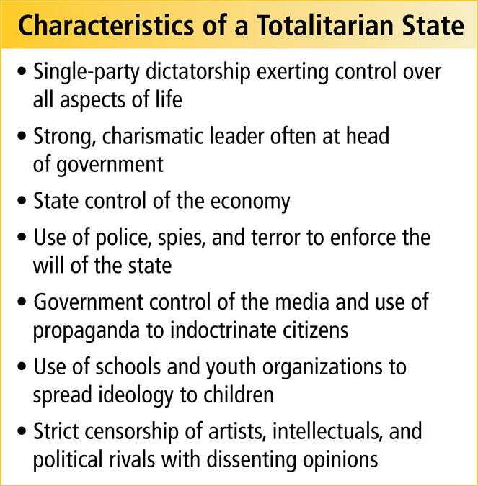
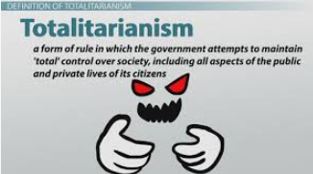
Overwhelming problems led some to turn to a new form of government called totalitarianism.
Notes:
7

Slide 8
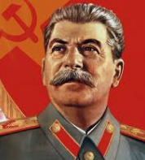
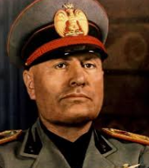
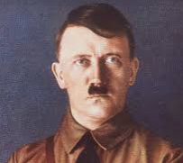
Totalitarian governments developed in several countries during the 1930s.
Country | Leader
Soviet Union | Joseph Stalin
Italy | Benito Mussolini
Germany | Adolf Hitler
Stalin
Mussolini
Each of these countries faced crushing problems. Unemployment, hunger, and homelessness were rampant.
Hitler

Slide 9
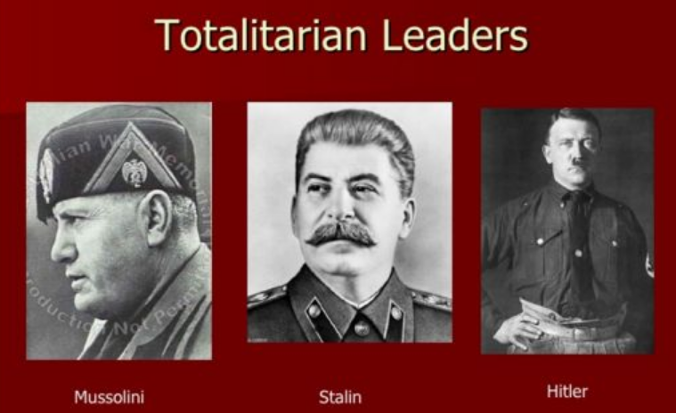
Totalitarian leaders promised to bring jobs, food, & prosperity.
They promised to make their countries great again.
In reality, however, the brutal tactics used by totalitarian leaders resulted in the deaths of millions of people.
Notes:
9

Slide 10
Attempted to turn the Soviet Union into an industrial power
Forced people to work in factories and on state-run farms
Killed or imprisoned suspected traitors during the Great Terror
Ruled through fear and massive propaganda
Joseph Stalin took control of the Soviet Union following the death of Vladimir Lenin.
Notes:
10
Stalin began to become paranoid. He feared being overthrown or the threat of a counter revolution. He formed a secret police called the NKVD to remove any and all possible threats. The secret police later became known as the KGB. All of the old heroes of the revolution or basically anybody with popular support was charged with treason. They were either killed or sent to gulags in Siberia. They would die either way. 1 in 5 officers of the army ended up being executed. This caused many problems when WWII started. They were also often put on trial called "Show Trials." Here the people were forced to admit that they had done what they were charged with, even if they were innocent. If somebody did not plead guilty, they would bring in family member's and close friends, and threaten to kill them on the spot if they did not plea guilty.

Slide 11
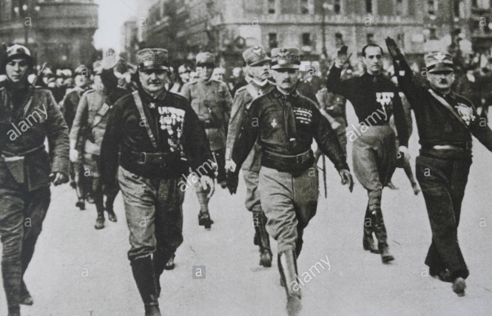
Another totalitarian regime formed in Italy.
The government seemed unable to deal with the country’s many problems.
Benito Mussolini formed the Fascist Party.
Mussolini and his followers, the Black Shirts, fought to gain power.
Mussolini, called Il Duce, took control of the government, using secret police to maintain control.
Notes:
11
Italian dictator who created the Fascist Party in 1919 and eventually held all the power in Italy as the country’s prime minister from 1922 until 1943. An ardent socialist as a youth, Mussolini followed in his father's political footsteps but was expelled by the party for his support of World War I. As dictator during World War II, he overextended his forces and was eventually killed by his own people in Mezzegra, Italy.

Slide 12
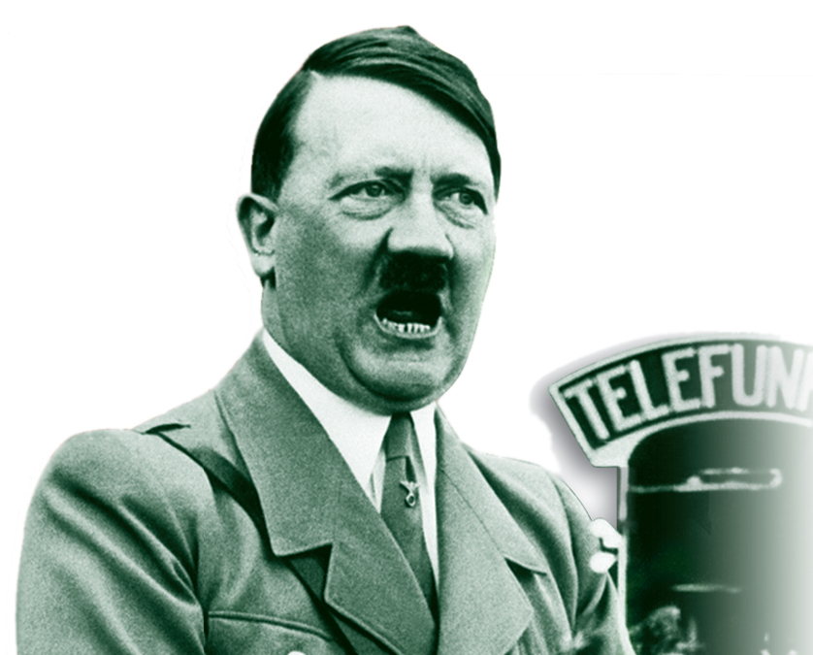
In Germany, the Weimar Republic struggled with overwhelming economic and social problems.
Adolf Hitler, the leader of the Nazi Party, was appointed chancellor.
Hitler seized power and created a totalitarian state.
Notes:
12
Adolf Hitler's rise to power began in Germany in September 1919 when Hitler joined the political party then known as the Deutsche Arbeiterpartei – DAP (German Workers' Party). The name was changed in 1920 to the Nationalsozialistische Deutsche Arbeiterpartei – NSDAP (National Socialist German Workers' Party, commonly known as the Nazi Party). It was anti-Marxist and opposed to the democratic post-war government of the Weimar Republic and the Treaty of Versailles, advocating extreme nationalism and Pan-Germanism as well as virulent anti-Semitism. Hitler's "rise" can be considered to have ended in March 1933, after the Reichstag adopted the Enabling Act of 1933 in that month. President Paul von Hindenburg had already appointed Hitler as Chancellor on 30 January 1933 after a series of parliamentary elections and associated backroom intrigues. The Enabling Act—when used ruthlessly and with authority—virtually assured that Hitler could thereafter constitutionally exercise dictatorial power without legal objection.
Adolf Hitler rose to a place of prominence in the early years of the party. Being one of its best speakers, he told the other members to either make him leader of the party or he would never return. He was aided in part by his willingness to use violence in advancing his political objectives and to recruit party members who were willing to do the same. The Beer Hall Putsch in November 1923 and the later release of his book Mein Kampf (Translation: My Struggle) expanded Hitler's audience. In the mid-1920s, the party engaged in electoral battles in which Hitler participated as a speaker and organizer,^{[a]} as well as in street battles and violence between the Rotfrontkämpferbund and the Nazis' Sturmabteilung (SA). Through the late 1920s and early 1930s, the Nazis gathered enough electoral support to become the largest political party in the Reichstag, and Hitler's blend of political acuity, deceptiveness and cunning converted the party's non-majority but plurality status into effective governing power in the ailing Weimar Republic of 1933.
Once in power, the Nazis created a mythology surrounding the rise to power, and they described the period that roughly corresponds to the scope of this article as either the Kampfzeit (the time of struggle) or the Kampfjahre (years of struggle).

Slide 13
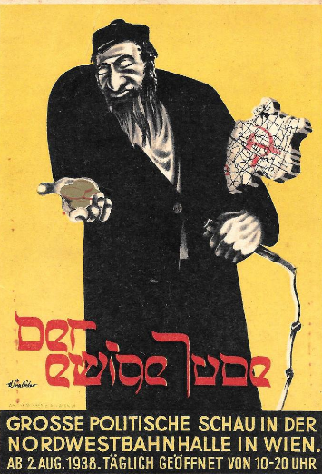
Hitler rebuilt the nation’s army. His economic policies put people back to work. Many cheered his success.
Controlled the press and education system
Used propaganda to boost his popularity
Used the secret police to silence opposition
Yet Hitler ruled with unlimited power.
Violently anti-Semitic, Hitler openly attacked Jews, blaming them for all of the country’s problems.
Notes:
13

Slide 14
Japan did not become a totalitarian dictatorship, but it did come under the influence of strong military leaders.
These leaders attempted to solve their country’s economic problems through aggressive military conquests.

Slide 15
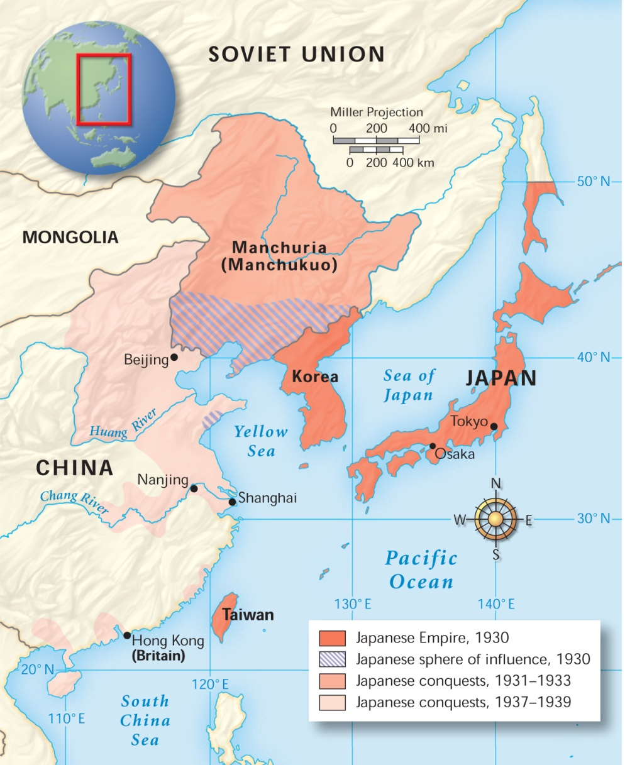
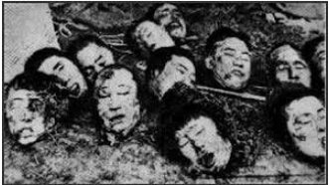
Japanese Expansion, 1931-1939
Japan invaded Manchuria, then China.
The attack on Nanjing was especially brutal.
Notes:
15
The Nanjing Massacre, or Rape of Nanjing, was an episode of mass murder and mass rape ...... Other sources, including Iris Chang's The Rape of Nanking, also conclude that the death toll reached 300,000.
The massacre occurred over a period of six weeks starting on December 13, 1937, the day that the Japanese captured Nanjing. During this period, soldiers of the Imperial Japanese Army murdered Chinese civilians and disarmed combatants who numbered an estimated 40,000 to over 300,000,^{[7][8]} and perpetrated widespread rape and looting.^{[9][10]}

Slide 16
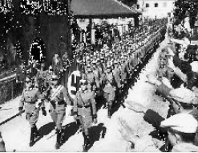
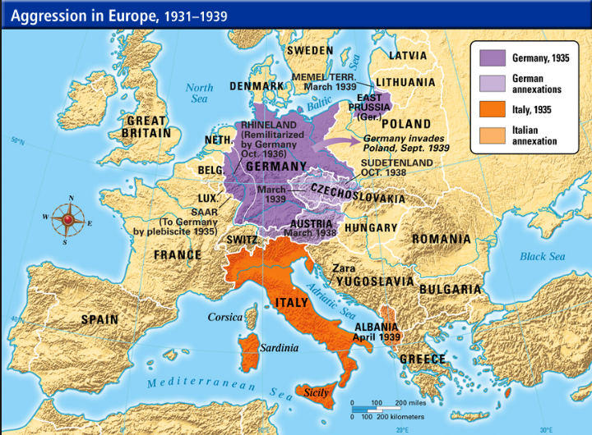
Acts of Aggression in Europe and Asia
Germany | • rebuilt military • reclaimed Saar region from France • invaded the Rhineland • Anschluss • invaded the Sudetenland
Italy | • invaded Ethiopia
Spain | • Fascists rebel against the government
Japan | • conquered Manchuria and parts of China
Notes:
(German: [ˈʔanʃlʊs] ( listen) "joining") refers to the annexation of Austria into Nazi Germany on 12 March 1938.
The Sudetenland is the historical German name for the northern, southern, and western areas of former Czechoslovakia which were inhabited primarily by Sudeten Germans.

Slide 17
A weak League of Nations did little to stop the aggression of the totalitarian states or of Japan.
Many feared involvement in another war.
Some believed the Soviet Union posed a greater threat than Nazi Germany.
Others questioned the resolve of their own country and their allies, and embraced a policy of isolationism.
Notes:
17

Slide 18
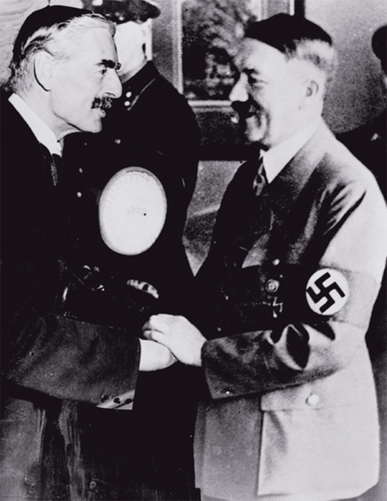
The appeasement of Hitler continued with the Munich Pact.
Britain and France sacrificed the Sudetenland to Germany in return for peace.
But peace was not to come.
Notes:
18

Slide 19
Notes:
19

