Slide 1
Chapter Introduction
This chapter will cover the emergence of totalitarian states following World War I as well as some of the key factors leading to World War II and how the United States became involved in it.
Section 1: Dictators and Wars
Section 2: From Isolation to Involvement
Section 3: America Enters the War

Slide 2
Objectives
Understand the course of the early years of World War II in Europe.
Describe Franklin Roosevelt’s foreign policy in the mid-1930s and the great debate between interventionists and isolationists.
Explain how the United States became more involved in the conflict.

Slide 3
Terms and People
blitzkrieg − lightning war
Axis Powers − Germany, Italy, Japan, and other nations that fought together during World War II
Allies − Britain, France, the Soviet Union, the United States, China, and other nations that fought against the Axis Powers during World War II
Winston Churchill − British prime minister during World War II

Slide 4
Terms and People (continued)
Neutrality Act of 1939 − American law that allowed nations at war to buy U.S. arms if they paid cash and carried them away on their own ships
Tripartite Pact − three-party agreement establishing an alliance between Germany, Italy, and Japan
Lend-Lease Act − American law that allowed the U.S. to lend, lease, sell, or otherwise provide aid to other nations if doing so helped in the defense of the United States

Slide 5
Terms and People (continued)
Atlantic Charter − document signed by Roosevelt and Churchill that endorsed national self-determination and an international system of general security

Slide 6
How did Americans react to events in Europe and Asia in the early years of World War II?
Americans were shocked by Japanese and German aggression.
Yet they remained deeply divided over American involvement in another war—especially as they fought the despair of the Great Depression.

Slide 7
Hopes for peace in Europe faded as it became clear that efforts to appease Hitler had failed.
Hitler violated the Munich Pact, taking over the remainder of Czechoslovakia
Germany launched a series of attacks on its neighbors marked by speed and massive firepower—a blitzkrieg, or “lightning war.”
Notes:
Tank photo pg. 780
Woman crying photo p g. 781

Slide 8
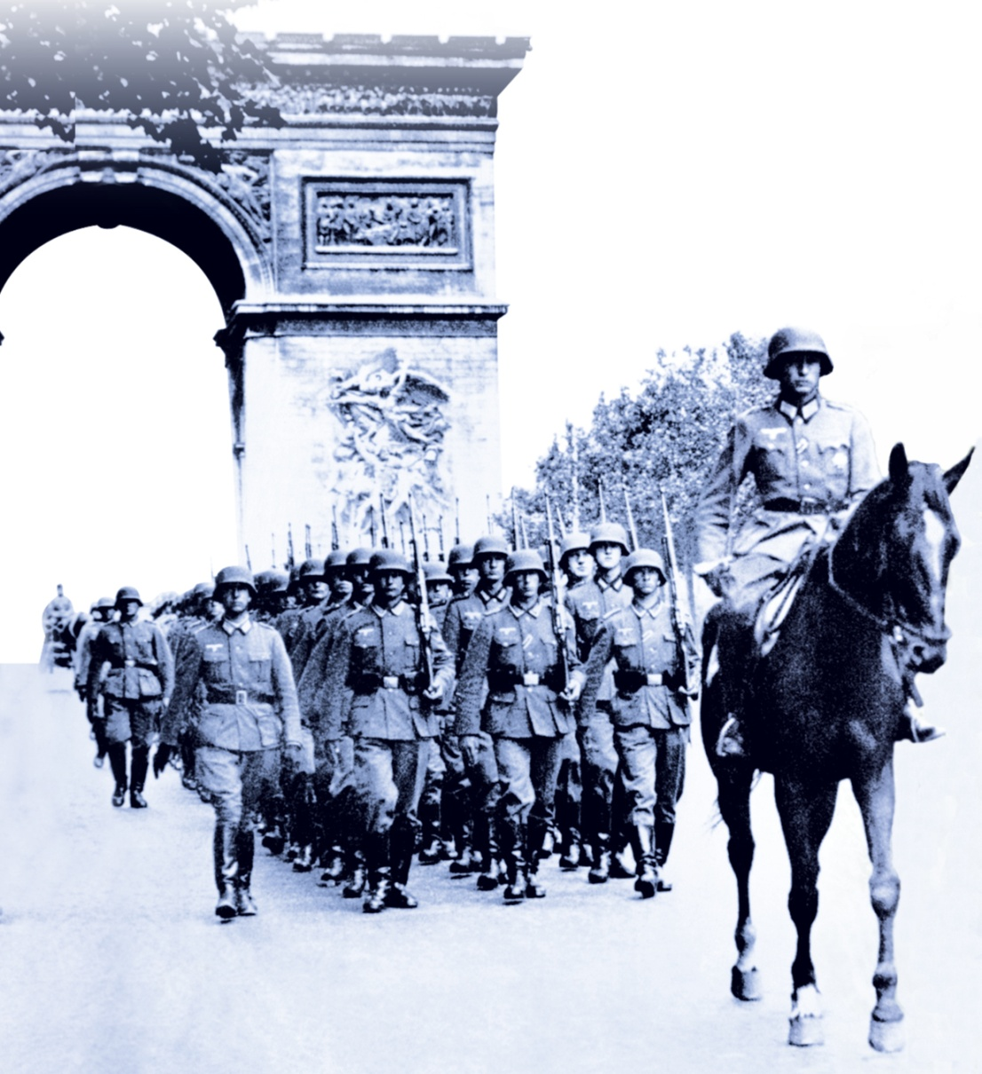
Poland, Denmark, Norway, and the Netherlands fell.
So, too, did France.
Notes:
8
Tank photo pg. 780
Woman crying photo p g. 781

Slide 9
Hitler then turned his fury on Britain.
The Battle of Britain was waged in the air as pilots fought for control of the skies.
The British hid in shelters and darkened homes as bombs rained down.
Despite terrible destruction, the British held on.
Notes:
People in train station photo pg. 783
Milkman photo pg. 783

Slide 10
Europe was again at war. In time, major powers around the world joined in alliances.
Axis Powers
Germany
Italy
Japan
Allies
Britain
France
Soviet Union
United States
China
Notes:
10
People in train station photo pg. 783
Milkman photo pg. 783

Slide 11
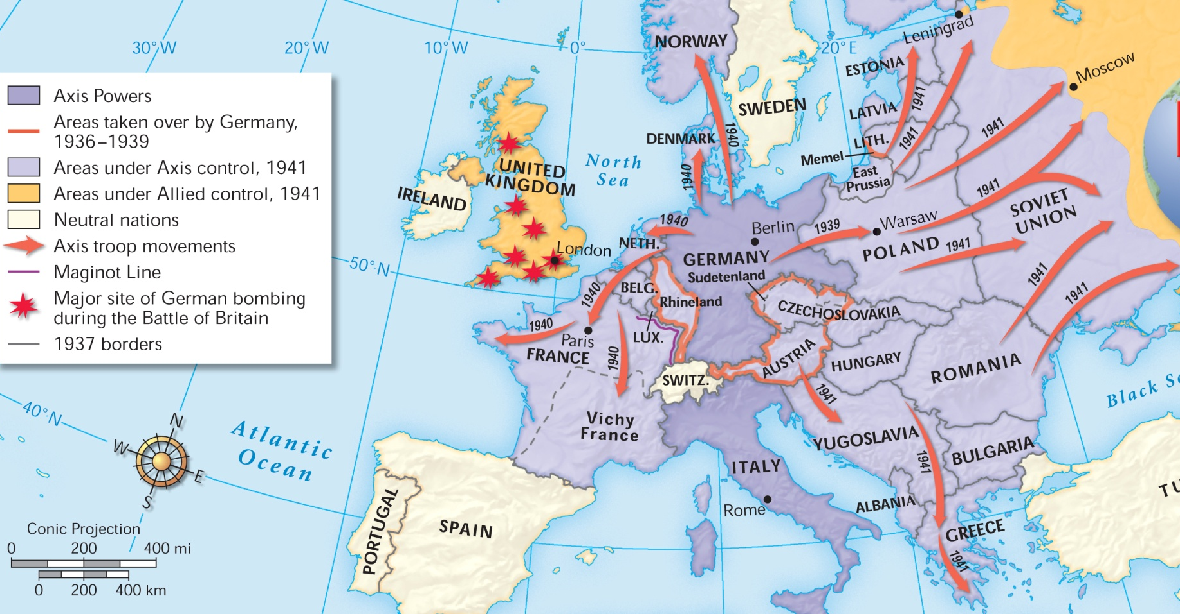
German Aggression, 1936-1941
Many feared that Hitler was unstoppable.

Slide 12
In the early days of the war, Congress declared neutrality. But as the war raged on in Europe, the United States began to take steps to support Europe’s democracies.
The Neutrality Act of 1939 contained a cash-and-carry provision favoring the Allies.
The Selective Service Act provided for a military draft.
FDR agreed to give Britain battleships in exchange for defense bases.
Notes:
Photo of Edward R. Murrow pg. 783

Slide 13
Not everyone agreed with FDR’s pro-Allies position. A loud debate soon raged between isolationists and interventionists.
Notes:
13
Photo of Edward R. Murrow pg. 783

Slide 14
As conditions worsened overseas, Roosevelt described what was at stake in an address to Congress.
He highlighted four freedoms precious to Americans.
freedom of speech
freedom of worship
freedom from want
freedom from fear
All of these freedoms, he argued, were threatened by German and Japanese militarism.
Notes:
Poster photo pg. 787

Slide 15
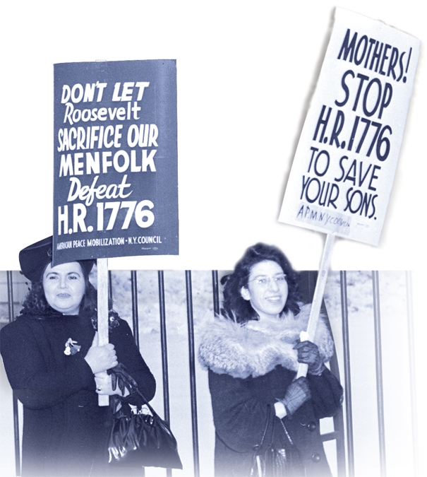
Congress then took another step to aid the British.
The Lend-Lease Act, symbolically numbered 1776, amounted to an economic declaration of war.
Many people, however, remained divided over American involvement in the war.

Slide 16
In 1941, Roosevelt and British Prime Minister Winston Churchill signed the Atlantic Charter, deepening the alliance between the two nations.
German submarines began to fire on American ships supporting the Allies.
Roosevelt ordered the navy to attack the U-boats on sight.
War seemed inevitable.
Notes:
FDR and Churchill photo pg. 786

