Slide 1
Chapter Introduction
This chapter will cover the emergence of totalitarian states following World War I as well as some of the key factors leading to World War II and how the United States became involved in it.
Section 1: Dictators and Wars
Section 2: From Isolation to Involvement
Section 3: America Enters the War

Slide 2
Objectives
Explain why Japan decided to attack Pearl Harbor, and describe the attack itself.
Outline how the United States mobilized for war after the attack on Pearl Harbor.
Summarize the course of the war in the Pacific through the summer of 1942.

Slide 3
Terms and People
Hideki Tojo − Japanese general and prime minister during World War II
Pearl Harbor − site in Hawaii of the United States Navy’s main Pacific base
WAC − Women’s Army Corps; volunteer organization that provided clerical workers, truck drivers, instructors, and lab technicians for the army
Douglas MacArthur − general who served as commander of United States Army forces in Asia

Slide 4
Terms and People (continued)
Bataan Death March − grueling march in which Japanese troops forced sick and malnourished prisoners of war to walk more than 60 miles to prison camps
Battle of Coral Sea − battle that provided a strategic American victory and marked the key role of aircraft carriers and fighter planes in the war in the Pacific

Slide 5
How did the United States react to the Japanese attack on Pearl Harbor?
A surprise attack on the American naval base at Pearl Harbor, Hawaii, ended the debate between isolationists and interventionists.
The United States was going to war.

Slide 6
Tensions mounted as Japan continued its march into new lands, gaining territory and valuable natural resources.
Angered by American interference, Prime Minister Hideki Tojo decided it was time to eliminate the U.S. presence in the Pacific.
Roosevelt condemned Japanese aggression.
He worked to slow Japan’s expansion with an embargo.
Notes:
Tank photo pg. 780
Woman crying photo p g. 781

Slide 7
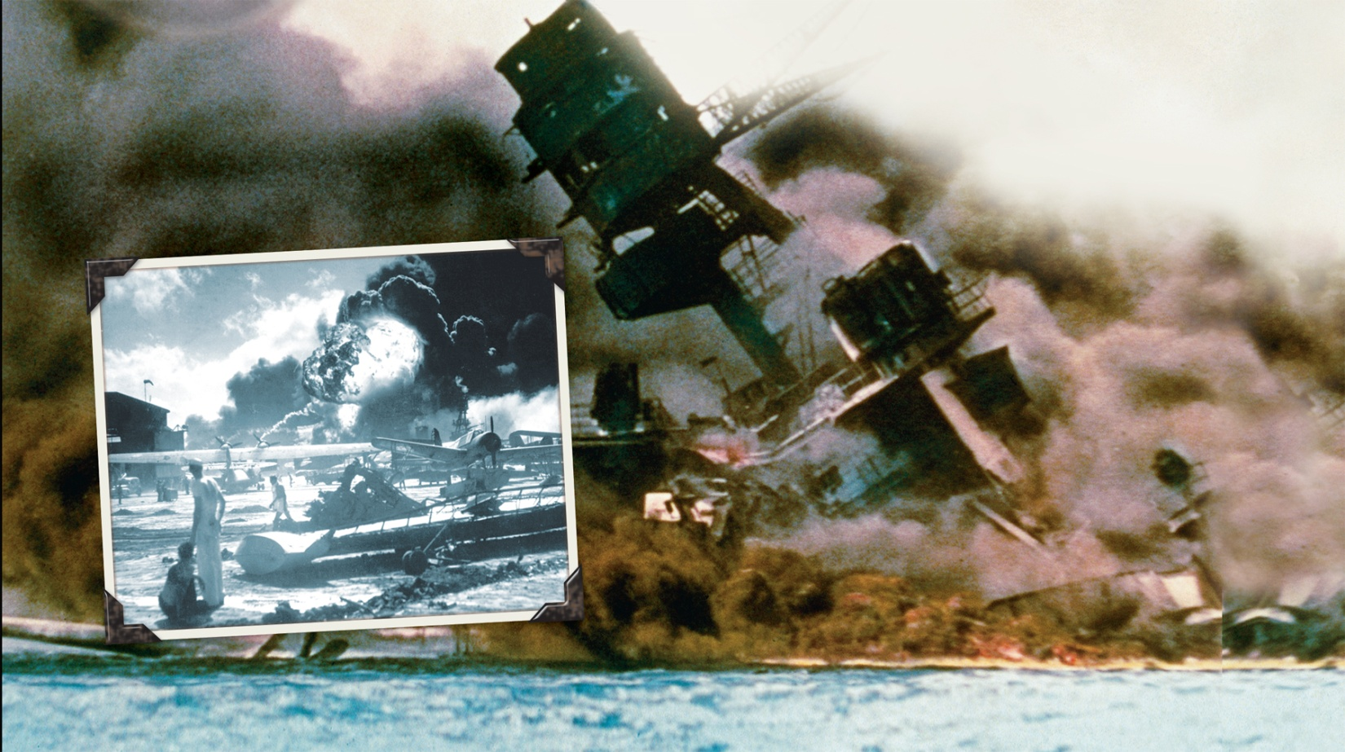
On December 7, 1941, Japanese fighter pilots attacked the American naval base at Pearl Harbor, Hawaii.

Slide 8
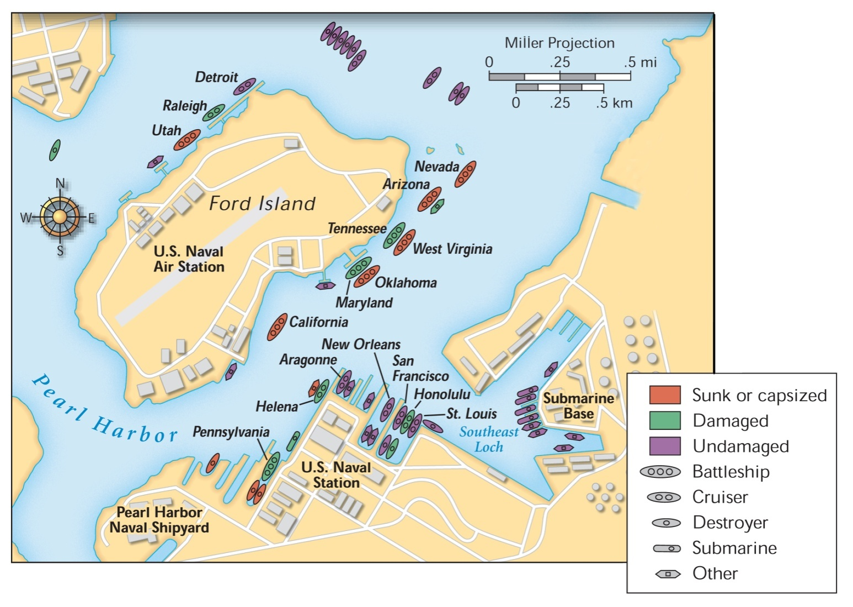
Damage at Pearl Harbor
The United States suffered terrible losses.

Slide 9
After the attack, the United States declared war on Japan.
Japan’s allies, Germany and Italy, then declared war on the United States.

Slide 10
A wave of patriotism swept the United States following the attack.
Americans joined the military, the Red Cross, and other organizations.
Women responded by joining the Women’s Army Corps, Army Nurse Corps, and other military auxiliaries.
Americans took new jobs making weapons and supplies that supported the war effort.
Notes:
10

Slide 11
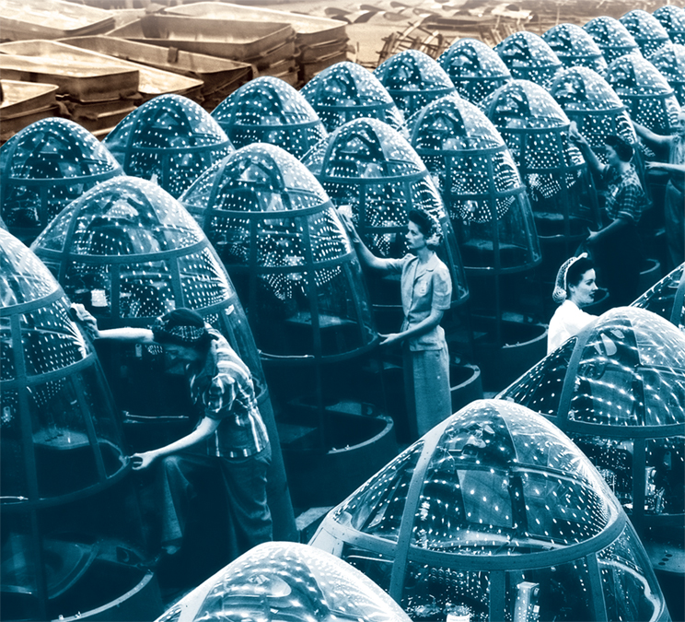
The peacetime economy soon shifted to a wartime economy.
Companies that once produced consumer goods mobilized to build ships, planes, and tanks.

Slide 12
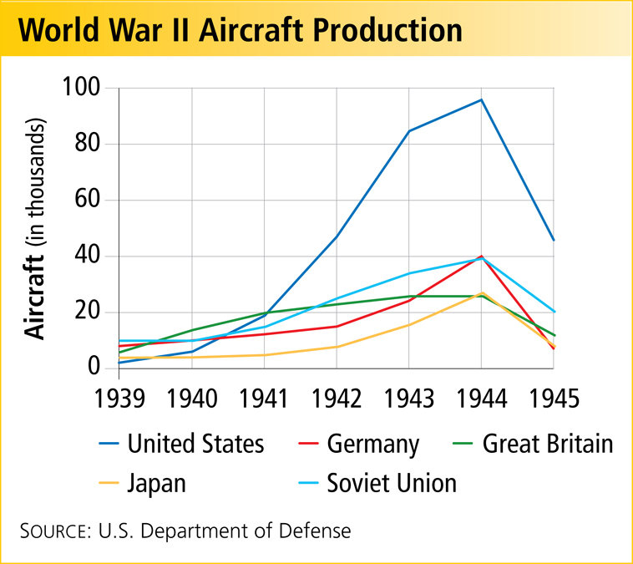
The money poured into defense spending finally ended the Great Depression.
American workers could once again find jobs.

Slide 13
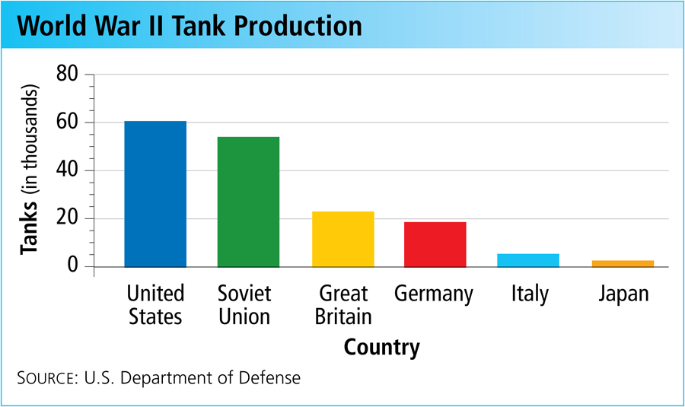
In 1944, American production levels were double those of all the Axis nations combined.
This “production miracle” gave the Allies a crucial advantage.

Slide 14
In the early years of the war, the outlook for the Allies was grim.
Japan’s Advantages
Dominance of the Pacific
Technologically advanced weapons
Highly motivated and well-trained military
Notes:
14

Slide 15
Japanese armies quickly took Guam, Wake Island, and Hong Kong.
Then they moved into the Philippines, forcing American General Douglas MacArthur to retreat.
The troops were surrounded, trapped.
After a terrible siege, thousands died when they were forced to walk to prison camps during the Bataan Death March.

Slide 16
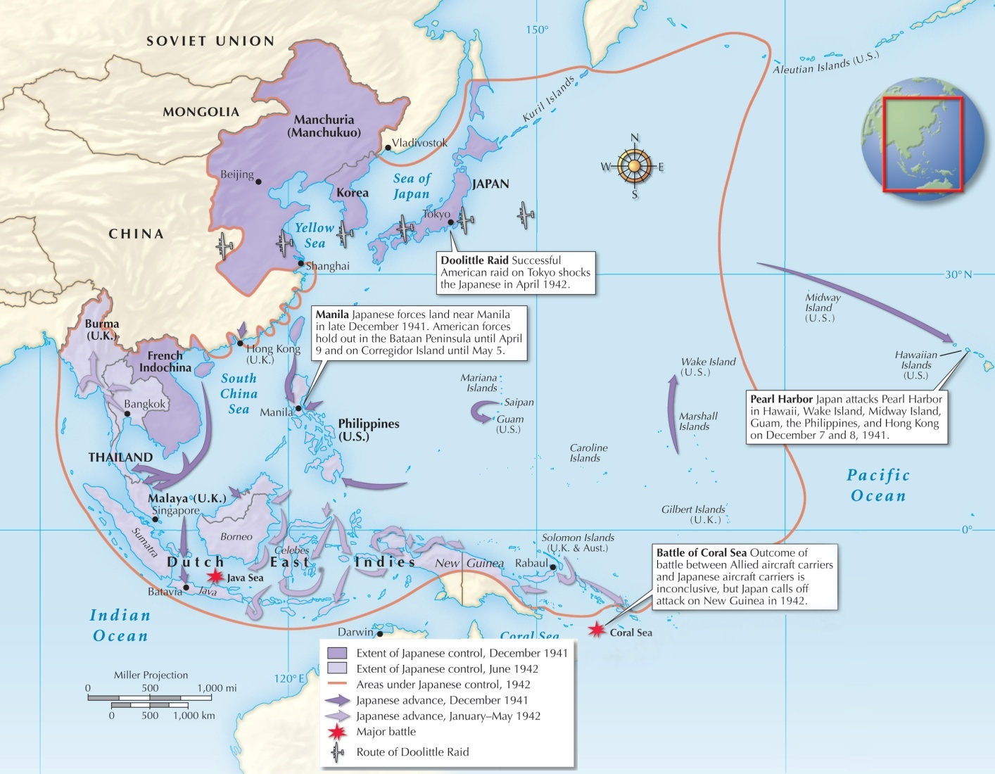
Japanese Aggression, December 1941–June 1942
Notes:
16

Slide 17
With hopes for a quick victory fading, Americans finally got some good news.
A long fight lay ahead, but the darkest days of 1942 seemed to be over.
Colonel James Doolittle’s surprise raid on Tokyo
The American victory at the Battle of Coral Sea

