Slide 1
Objectives
Analyze the reasons for and impact of the Allies’ “Europe First” strategy.
Explain why the battles of Stalingrad and Midway were major turning points in the war.
Discuss how the Allies put increasing pressure on the Axis in North Africa and Europe.

Slide 2
Terms and People
Dwight Eisenhower − American general and commander of Allied forces
George S. Patton, Jr. − American general and tank commander
unconditional surrender − giving up completely without any concessions
saturation bombing − dropping massive amounts of bombs to inflict maximum damage

Slide 3
Terms and People (continued)
strategic bombing − dropping bombs on key targets to destroy the enemy’s capacity to make war
Tuskegee Airmen − African American fighter squadron
Chester Nimitz − Commander of the U.S. Navy in the Pacific
Battle of Midway − American victory and turning point of the war in the Pacific

Slide 4
How did the Allies turn the tide against the Axis?
After the dark days of 1942, the Allies began to make important advances.
Tough years of fighting lay ahead, but many began to see a glimmer of hope.

Slide 5
The Allies viewed Germany as the most dangerous Axis Power.
The German military could:
bomb Britain
• fight both the U.S. and British navies
• invade the Soviet Union
For these reasons, the Allies agreed to a “Europe First” strategy to defeat Hitler.

Slide 6
The U.S. moved quickly to produce military supplies and send them to Europe.
Hitler was determined to prevent the supplies from reaching Europe.
German
U-boats sank thousands of supply ships in the North Atlantic.
New technology such as radar helped the Allies target the U-boats and restore the supply lines.
Notes:
6

Slide 7
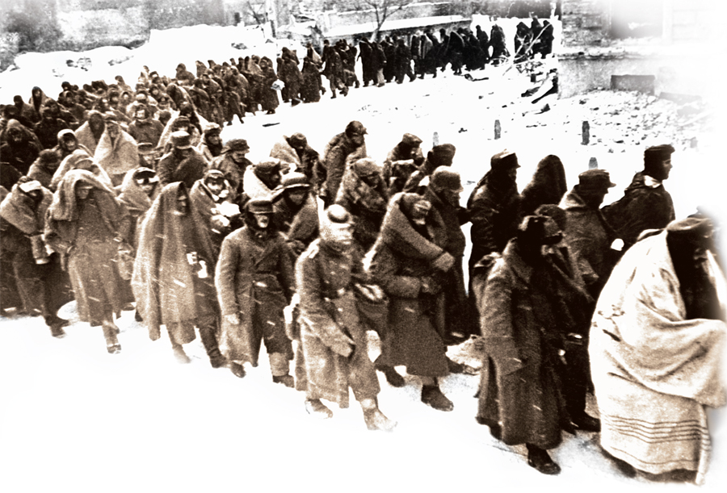
Germany invaded the Soviet Union in June 1941. Millions of soldiers and civilians died in fierce fighting.
After a long struggle, the Soviets defeated the Germans at Stalingrad.
Thousands of Germans surrendered.
Notes:
7

Slide 8
Nazi armies were forced to retreat westward, back toward Germany.
The Soviet Union was now on the offensive.
Hitler’s dream of dominating Europe was crushed.
The Battle of Stalingrad proved to be a major turning point of the war in Europe.

Slide 9
Meanwhile, Allied forces pressured the Axis on another front—the deserts of North Africa.
General Dwight Eisenhower commanded the Allied invasion.
Heat, sandstorms, and scorpions made conditions difficult.

Slide 10
Tank battles dominated the fighting, pitting two brilliant tank strategists against each other.
American General George S. Patton, Jr.
German General Erwin Rommel, the “Desert Fox”
Patton eventually defeated Rommel’s Afrika Korps, forcing a German surrender.
Notes:
10

Slide 11
The Allied victory in North Africa paved the way for an invasion of Italy, with forces capturing Sicily.
The campaign ended the rule of Benito Mussolini.
In 1943, Italy surrendered to the Allies.

Slide 12
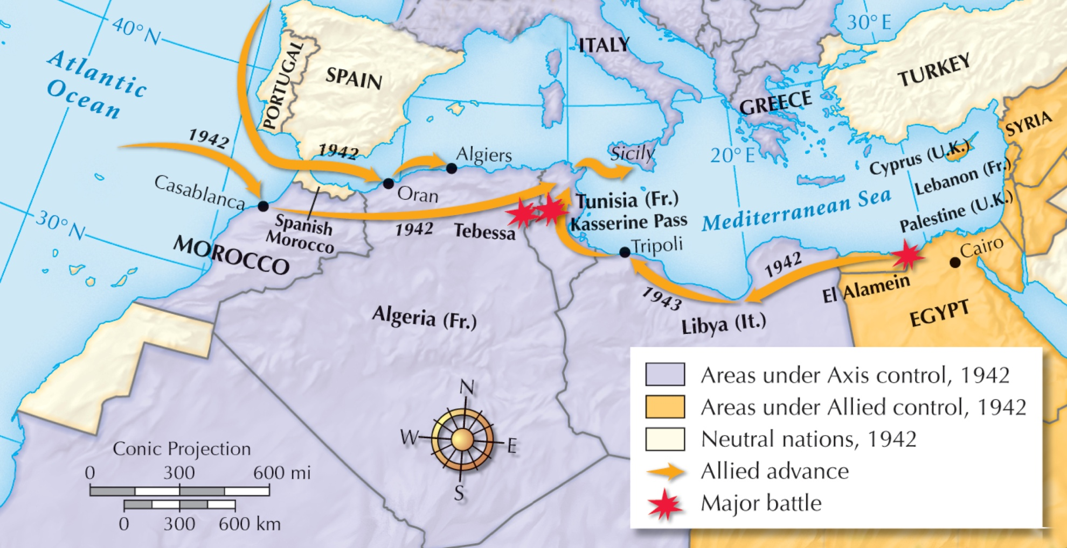
Allied Advances

Slide 13
The Allies next took the fight to the air.
Bombers launched nonstop attacks against Germany.
The goal was unconditional surrender.
massive saturation bombing
pinpoint strategic bombing
Notes:
13

Slide 14
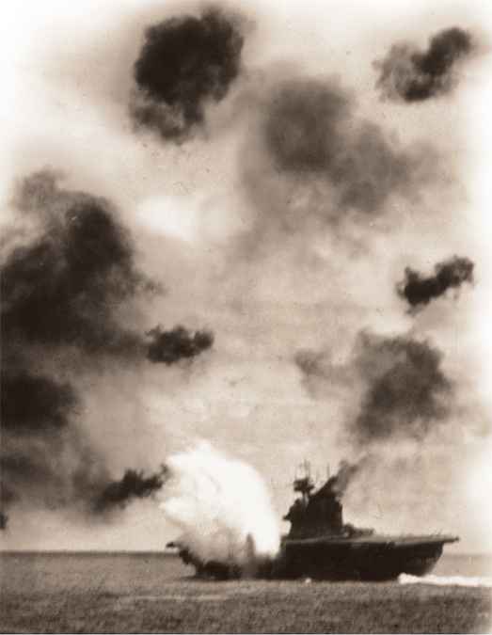
While battles raged in Europe, the Allies continued to fight Japanese advances in the Pacific.
At Midway, Allied aircraft carriers and fighter planes were victorious in fierce fighting.

Slide 15
The Battle of Midway proved to be a major turning point of the war in the Pacific.
Japan’s momentum was finally halted.
Americans took the offensive, moving on to defeat the Japanese at Guadalcanal.
Now the Allies began advancing—toward Japan.

