Slide 1
Objectives
Explain how World War II increased opportunities for women and minorities.
Analyze the effects of the war on civil liberties for Japanese Americans and others.
Examine how the need to support the war effort changed American lives.

Slide 2
Terms and People
A. Philip Randolph − African American labor leader
Executive Order 8802 − measure that assured fair hiring practices in jobs funded with government money
bracero program − program in which laborers were brought from Mexico to work on American farms
internment − temporary imprisonment

Slide 3
Terms and People (continued)
Korematsu v. United States − Supreme Court case that upheld the government’s wartime internment policy
442nd Regimental Combat Team − Japanese American combat team that became the most decorated military unit in American history
rationing − system that limits the amount of certain goods people can buy
OWI − Office of War Information, encouraged support of the war effort

Slide 4
How did the war change America at home?
The war stirred patriotism even as it brought out long-simmering fears and tensions.
Americans from different backgrounds living in different places across the country made huge sacrifices to support the war effort.

Slide 5
Wartime America saw industries gearing up to produce military goods.
With men joining the army in huge numbers, women stepped into jobs in businesses and factories.
Unlike the past,
Women worked in both light and heavy industries.
Married and older women worked.

Slide 6
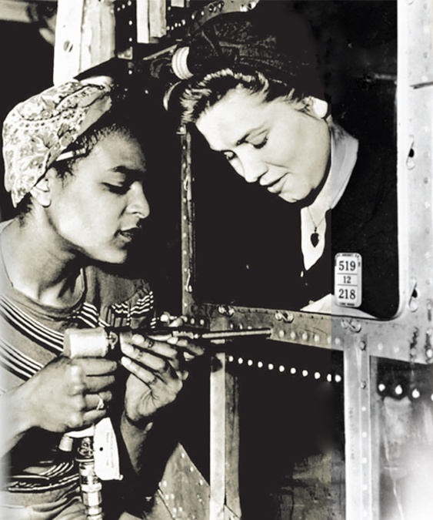
Wartime changes to the workforce had long-lasting effects.
Women earned paychecks and gained knowledge and experience.
Future generations benefited from new opportunities.
Day-care options for children expanded.

Slide 7
African Americans hoped for similar job opportunities, but were disappointed.
Victory against fascism abroad
Victory against discrimination at home
Leaders called for a “Double V” campaign.
Yet many jobs, including those in the government and the military, remained segregated.
Notes:
7

Slide 8
Labor leader A. Phillip Randolph urged Roosevelt to end discrimination in government-funded training, employment, and military service.
Under pressure, FDR issued Executive Order 8802.
Assured fair hiring practices in government jobs
Such victories set the stage for the civil rights struggles to come.

Slide 9
Migration patterns changed as people moved across the country—especially to cities—seeking jobs in wartime industries.
Bracero program
To alleviate the loss of workers in rural areas, Mexican laborers were brought in to work on American farms.
Agricultural industries would continue to hire migratory labor in the West for years to come.

Slide 10
Population changes and racial tensions at times triggered violence.
Urban riots
Zoot suit attacks
Despite this, African Americans and Mexican Americans continued to contribute to the war effort.

Slide 11
Wartime fears also led to discrimination against Americans from Germany, Italy, and Japan.
In time, suspicion focused on Japanese Americans.
They were targeted for a combination of reasons.
Racism
Lack of political clout
Their fewer numbers and relative isolation

Slide 12
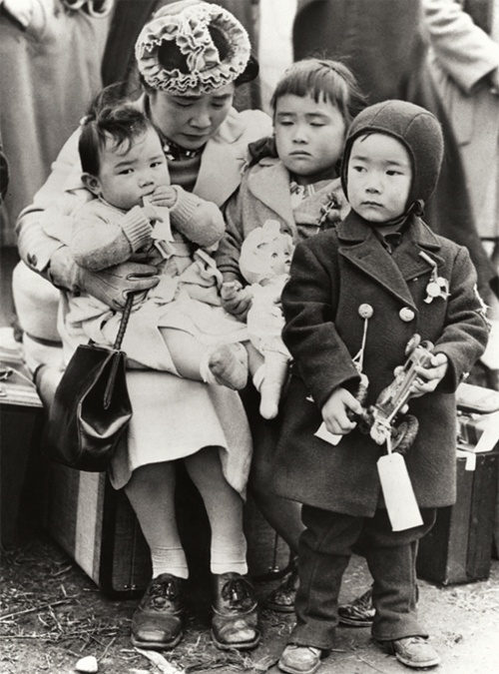
By executive order, more than 100,000 Japanese Americans were forced to sell their homes and belongings.
They were then sent to isolated internment camps.

Slide 13
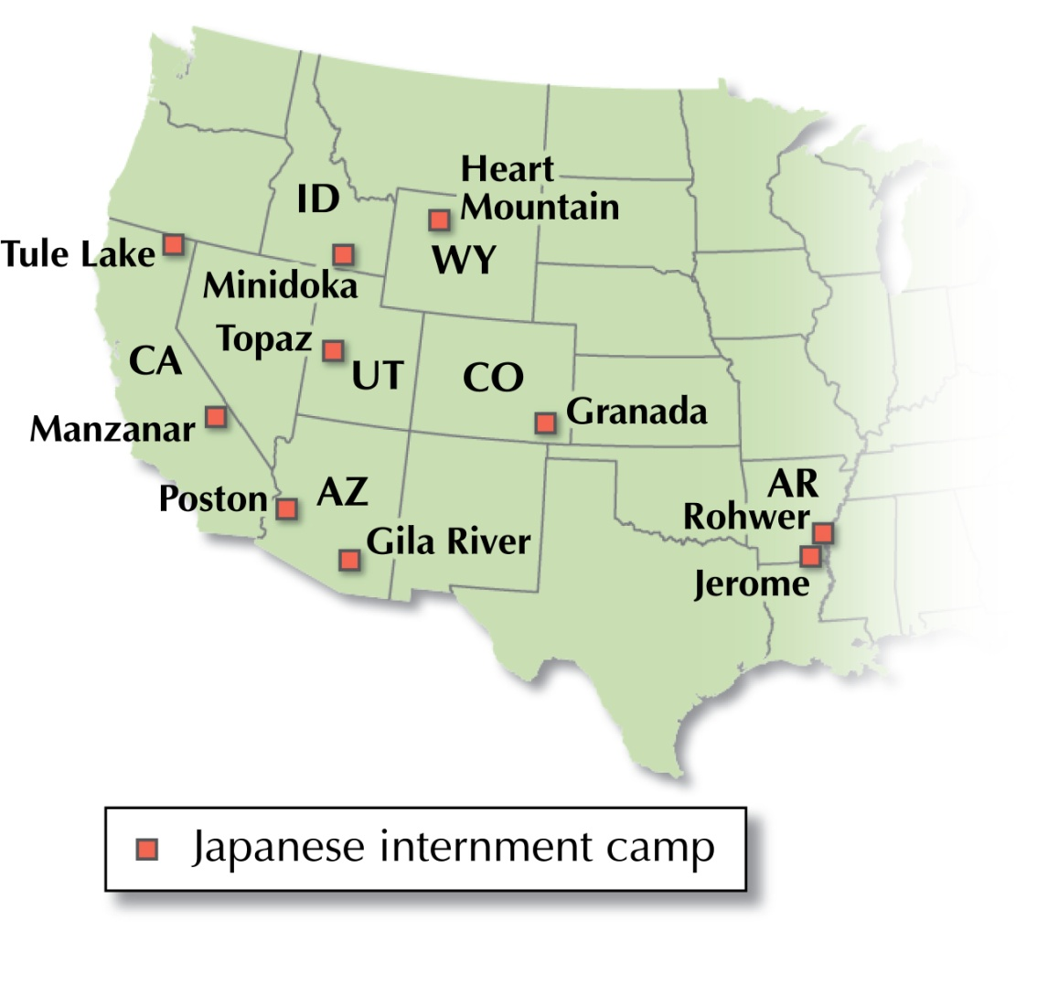
They remained in the camps for the rest of the war.
Some Japanese Americans went to court to fight for their civil liberties.
Their efforts failed.

Slide 14
Korematsu v. United States (1944)
The Facts | The Issue | The Decision
• In 1942, FDR ordered that select people could be banned from war zones. • The army relocated Japanese Americans on the West Coast to internment camps. • Fred Korematsu was arrested for resisting the army’s orders. | Korematsu argued that he was denied equal protection under the law because he was a Japanese American. | The court held that the military order was justified for security reasons.

Slide 15
The war effort had a huge effect on the economy.
The national debt skyrocketed.
Taxes increased.
Wages and prices were controlled.

Slide 16
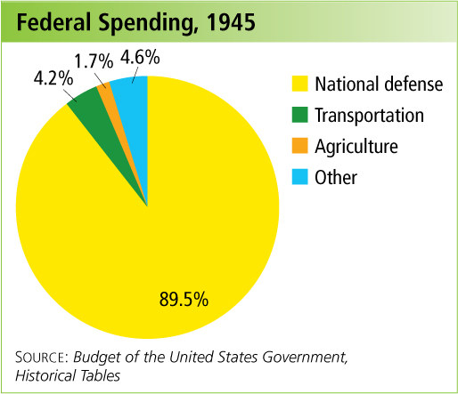
As industries cranked out military goods, consumer goods became scarce.

Slide 17
Americans made many sacrifices, looking toward victory.
Americans were urged to do all they could to support the war effort, and they responded to the call.
• Shopped with ration books
• Bought war bonds
• Planted victory gardens
• Collected scrap metal and other materials

