Slide 1
Objectives
Analyze the planning and impact of the D-Day invasion of France.
Understand how the Allies achieved final victory in Europe.
Explore the reasons that President Truman decided to use the atomic bomb against Japan.

Slide 2
Terms and People
D-Day − June 6, 1944, the day Allied forces invaded France
Battle of the Bulge − German counterattack that failed, resulting in an Allied victory
Harry S. Truman − President during the end of World War II
island hopping − American strategy of capturing selected islands in the Pacific in a steady path to Japan

Slide 3
Terms and People (continued)
kamikaze − Japanese pilots who deliberately crashed their planes into American ships
Albert Einstein − world-famous scientist who alerted Roosevelt of the need to develop atomic weapons
Manhattan Project − code name for the program to develop an atomic bomb
J. Robert Oppenheimer − key leader of the Manhattan Project

Slide 4
How did the Allies defeat the Axis Powers?
It took years of hard fighting to reverse Axis advances and move toward victory.
A new weapon finally ended the war, changing both warfare and global politics forever.

Slide 5
In 1943, Allied leaders agreed to open a second front in the war in Europe.
American and British troops would cross the English Channel and invade France.
The secret operation was code-named Operation Overlord.
General Dwight Eisenhower was the mission’s commander.

Slide 6
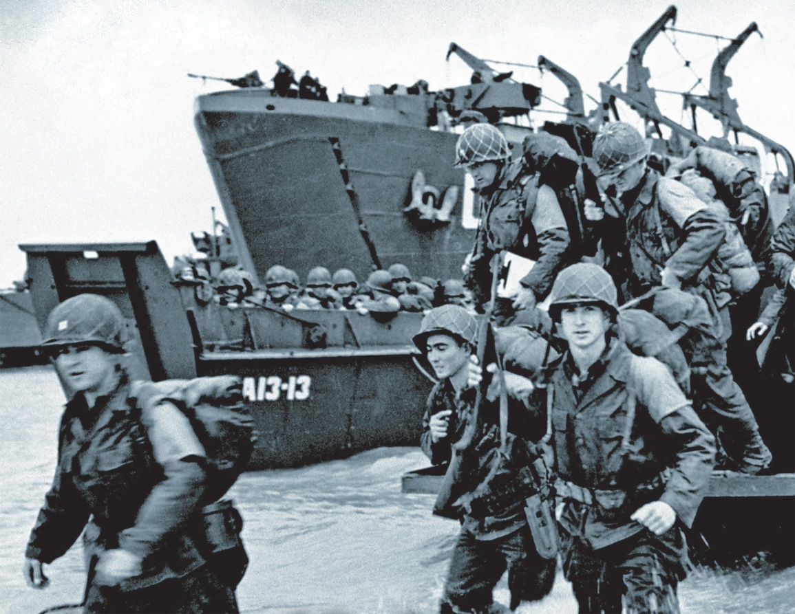
Operation Overlord was a massive operation.
It required careful planning and involved an elaborate hoax to fool the enemy about where troops would land.
On D-Day, June 6, 1944, the Allies landed at Normandy.

Slide 7
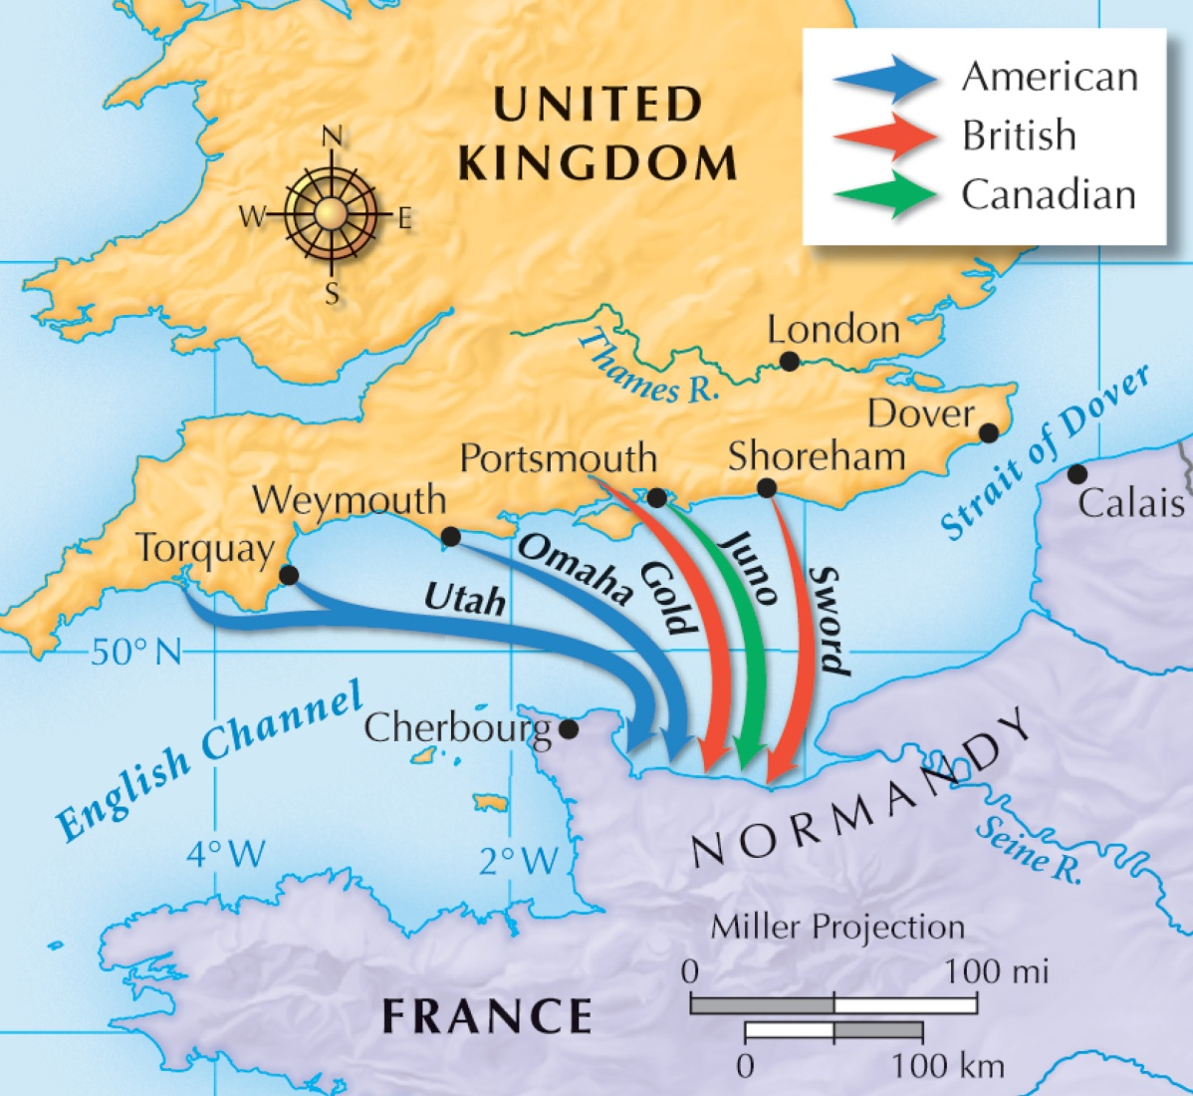
Amid intense fighting, the Allies captured the beaches.
Within a month, more than one million troops landed in France.

Slide 8
The Allies seized the momentum.
The Americans and British advanced from the west, liberating Paris.
The Soviets advanced from the east, liberating Latvia, Romania, Slovakia, and Hungary.

Slide 9
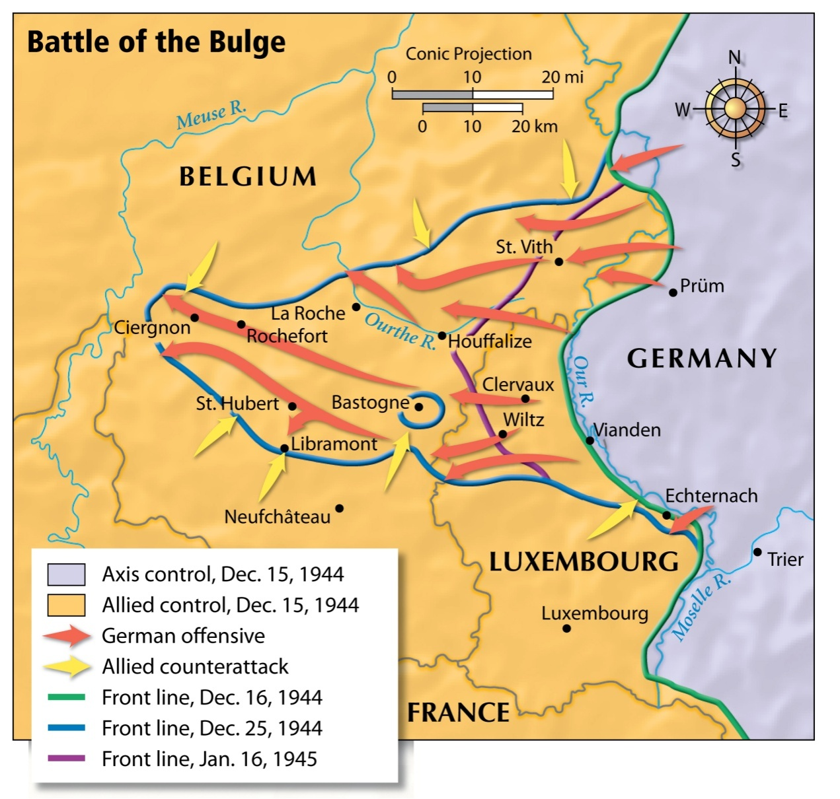
Hitler launched a counterattack, creating a bulge in the American lines.
The Americans pushed back, forcing a German retreat.

Slide 10
The Allies soon surrounded Berlin, preparing for an all-out assault on Hitler’s capital
Hitler had fallen into madness, giving orders that were not obeyed and planning attacks that were not carried out.
In April 1945, Hitler committed suicide. Germany surrendered.

Slide 11
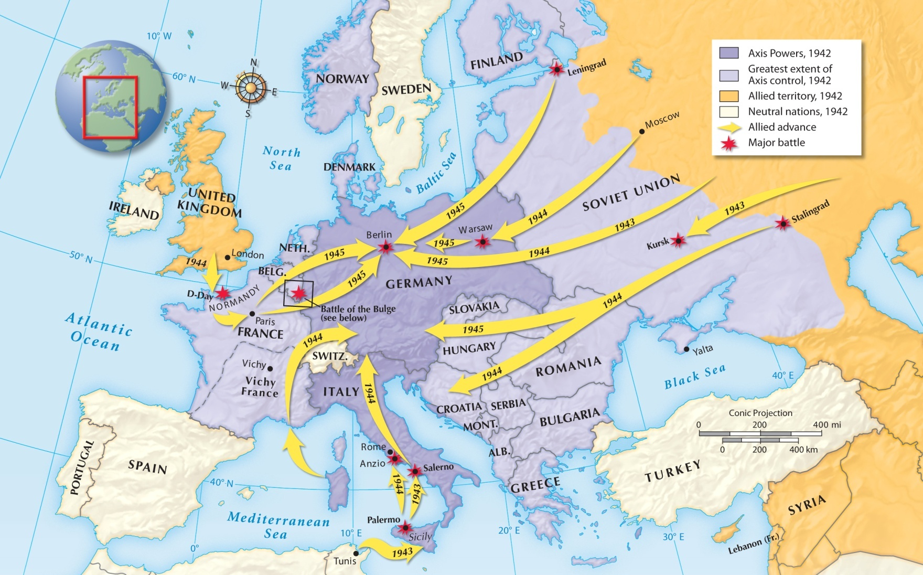
World War II in Europe, 1942–1945

Slide 12
With the German surrender, the Allies celebrated V-E Day, hailing their hard-fought victory in Europe.
FDR did not live to join the celebrations. He died a few weeks earlier.
The new President was Harry S. Truman.

Slide 13
War still raged in the Pacific, where the Allies were fighting their way toward Japan.
Battles during the island-hopping campaign were fierce, with high casualties on both sides.
Kamikazes crashed into American ships. Japanese troops fought to the death.
An intense bombing campaign leveled much of Tokyo. Still, Japan refused to surrender.

Slide 14
Early in the war, FDR had authorized scientists to develop an atomic bomb.
The top secret program was code-named the Manhattan Project.
The bomb was successfully tested in July 1945.
Now it was up to Truman to decide if and when to use it.
Notes:
14

Slide 15
The Japanese refused to surrender.
An invasion of Japan could cost up to 1,000,000 American lives.
Truman’s chief priority was to save American lives.

Slide 16
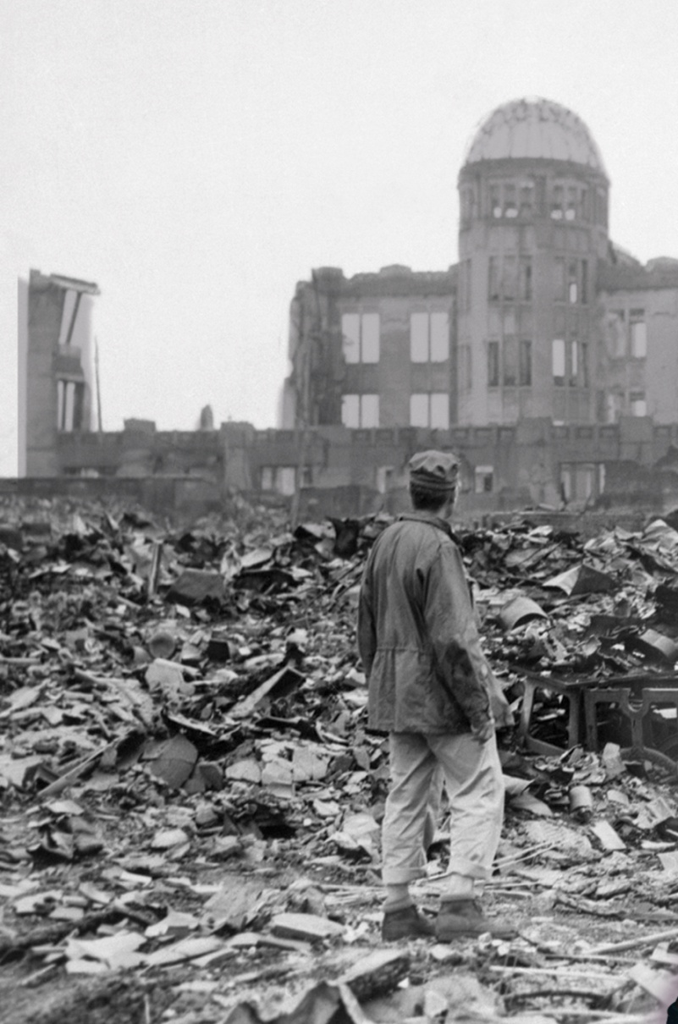
On August 6, 1945, U.S. pilots dropped an atomic bomb on Hiroshima.
Three days later, they dropped a second bomb on Nagasaki.
On August 15, Emperor Hirohito surrendered.
Notes:
16

Slide 17
The Allies celebrated V-J Day, marking victory in Japan.
The most costly war in history was finally over.

Slide 18
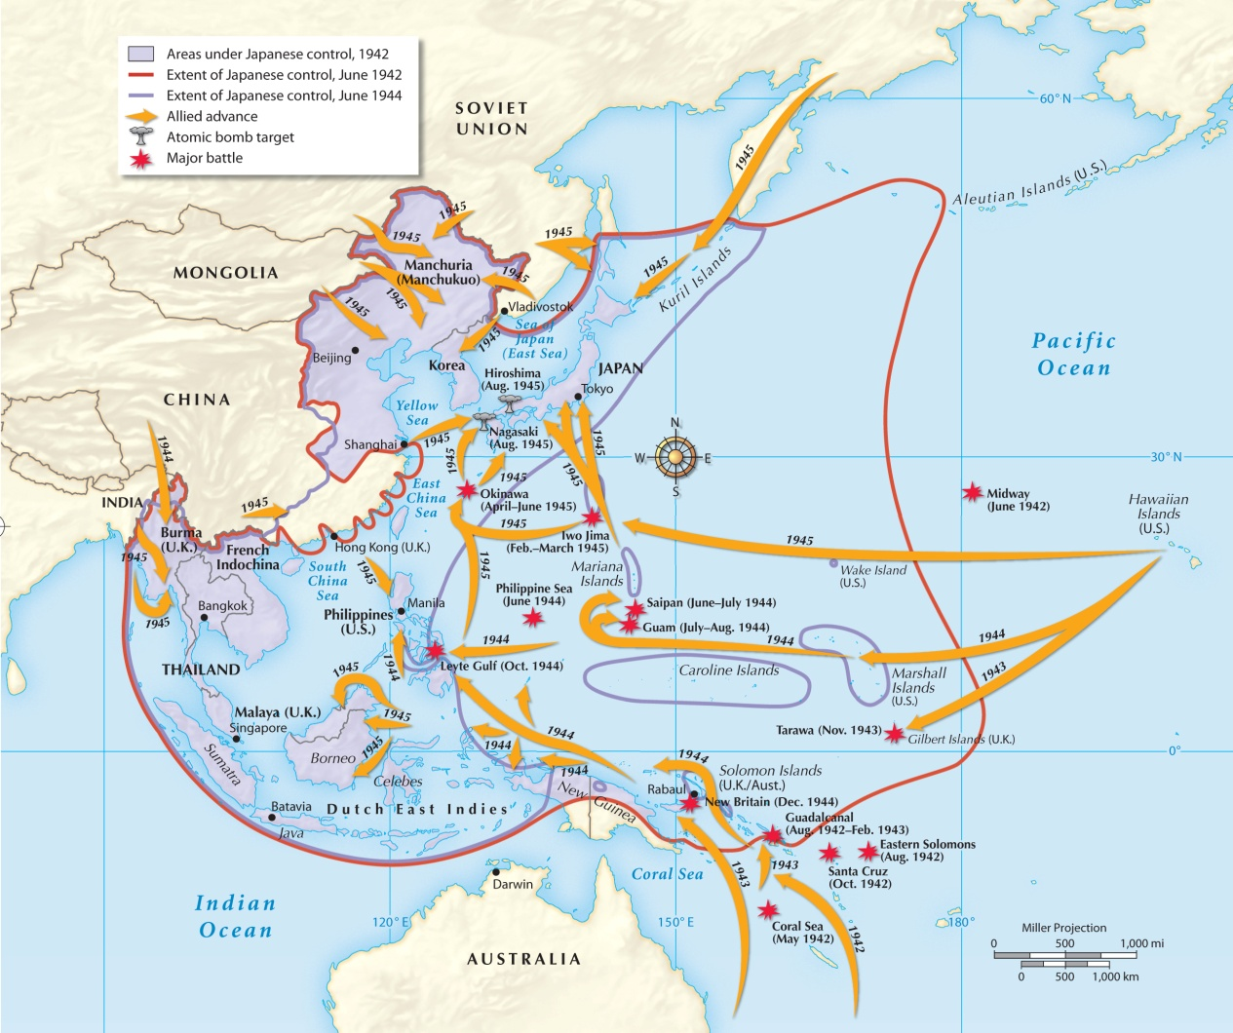
World War II in the Pacific, 1942−1945

