Slide 1
Objectives
Trace the roots and progress of Hitler’s campaign against the Jews.
Explore the goals of Hitler’s “final solution” and the nature of the Nazi death camps.
Examine how the United States responded to the Holocaust.

Slide 2
Terms and People
Holocaust − Nazi attempt to kill Jews and others considered “undesirable”
Nuremberg Laws − German laws discriminating against Jews
Kristallnacht − night of organized violence in which Jews were arrested and killed and synagogues and Jewish businesses destroyed
genocide − willful annihilation of a racial, political, or cultural group

Slide 3
Terms and People (continued)
concentration camp − camp where members of specially designated groups were confined
death camp − concentration camp where prisoners were systematically exterminated
War Refugee Board − U.S. board that worked with the Red Cross to save Jews

Slide 4
How did the Holocaust develop and what were its results?
Hitler found a target for his anger and hatred in Jews and other “undesirables.”
Nazi persecution resulted in the deaths of millions of people.

Slide 5
Roots of the Holocaust:
Racist belief that proclaimed Aryans superior to other people
Desire by Hitler and others to blame someone for Germany’s problems following World War I
Hitler found someone to blame: the Jews.

Slide 6
At first, the focus of persecution was economic.
Jewish businesses were boycotted.
Jews were fired from their jobs.
Jews were barred from working in fields such as banking, law, and medicine.

Slide 7
In time, laws were passed that broadened the persecution.
Nuremberg Laws
Denied Jews German citizenship
Banned marriage between Jews and non-Jews
Segregated Jews at every level of society

Slide 8
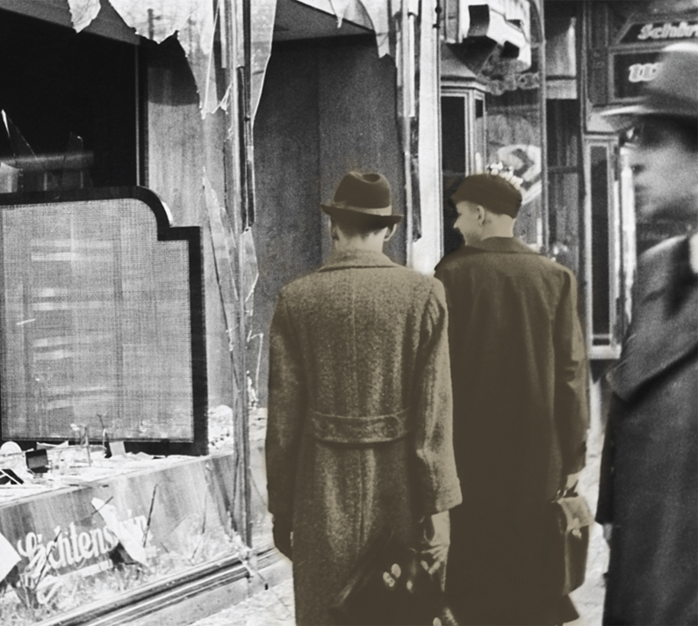
The hatred directed against Jews soon turned violent.
Hitler’s secret police carried out vicious attacks.
During Kristallnacht, hundreds of Jews were killed and Jewish businesses and synagogues burned.

Slide 9
Beginning in the 1930s, Jews were forced from their homes, put onto trains, and taken to concentration camps.
Hitler’s “final solution to the Jewish question” was genocide— extermination of all Jews.
Political opponents and anyone labeled “undesirable” also were imprisoned.

Slide 10
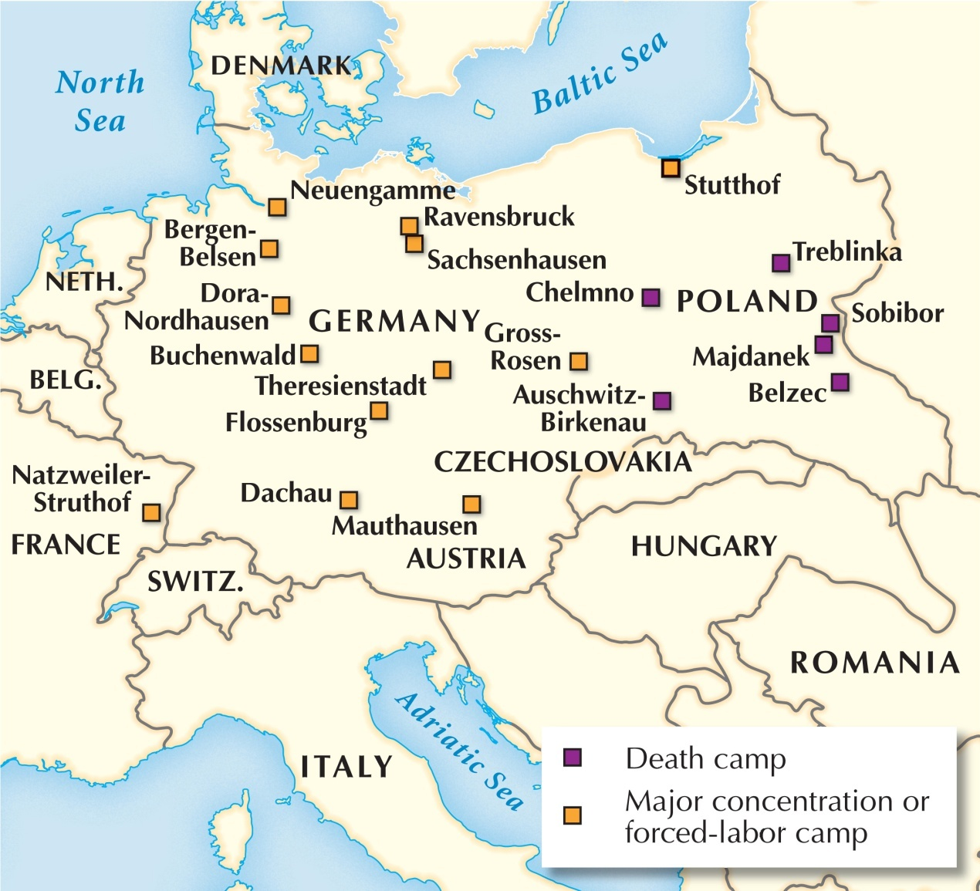
Some concentration camps were death camps.
There, prisoners were killed in gas chambers or shot, and their bodies burned.

Slide 11
Prisoners in other camps were forced to perform heavy labor, often brutalized by the guards.
Some were tortured or subjected to horrible medical experiments.
Death by starvation and disease was common.
Millions of people died in concentration camps.

Slide 12
For years, the Allies had received reports of Jews being killed in Nazi camps.
Yet little was done to stop it.
A 1943 conference to discuss possible rescue plans ended with no concrete action being taken.
The U.S. and other countries blocked Jews fleeing Germany from immigrating.

Slide 13
Some suggested they bomb the rail lines leading to the camps.
But the military hesitated to divert resources needed in battle.
Though they expressed concern, American leaders remained focused on their war plans.
In 1944, Roosevelt created the War Refugee Board in an attempt to help Jews in Eastern Europe. Sadly, too few were saved.

Slide 14
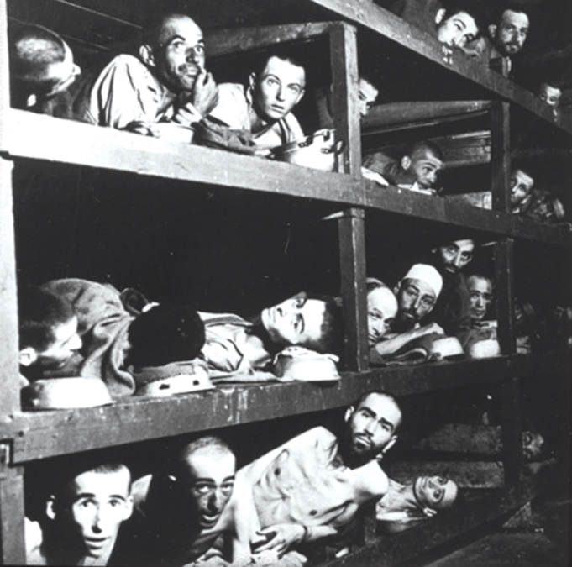
When Allied soldiers liberated the camps at war’s end, they were stunned by the horror before them.
Americans reacted with an outpouring of sympathy and a desire to help.
Many survivors eventually found homes in the U.S.

Slide 15
The enormity of the Nazi crime led to renewed calls for an independent Jewish state.
The state of Israel was founded in 1948.
Truman immediately recognized the new nation, and the U.S. became a staunch ally.

