Slide 1
Objectives
Evaluate the goals that Allied leaders set for the postwar world.
Describe the steps that the United States and other nations took toward international cooperation.
Explain the impact of World War II on the postwar United States.

Slide 2
Terms and People
Yalta Conference − meeting at which Roosevelt, Churchill, and Stalin discussed plans for the postwar world
superpower − strong country that dominated the postwar world
GATT − General Agreement on Tariffs and Trade; treaty designed to expand world trade by reducing tariffs
United Nations − organization of nations formed after World War II

Slide 3
Terms and People (continued)
Universal Declaration of Human Rights − UN document affirming basic human rights
Geneva Convention − international agreement governing the humane treatment of wounded soldiers and prisoners of war
Nuremberg Trials − trials in which the Allies prosecuted Nazis for war crimes

Slide 4
What were the major immediate and long-term effects of World War II?
World War II changed the United States in profound ways.
The nation emerged from the war as a superpower, prepared to take an active role in world affairs.

Slide 5
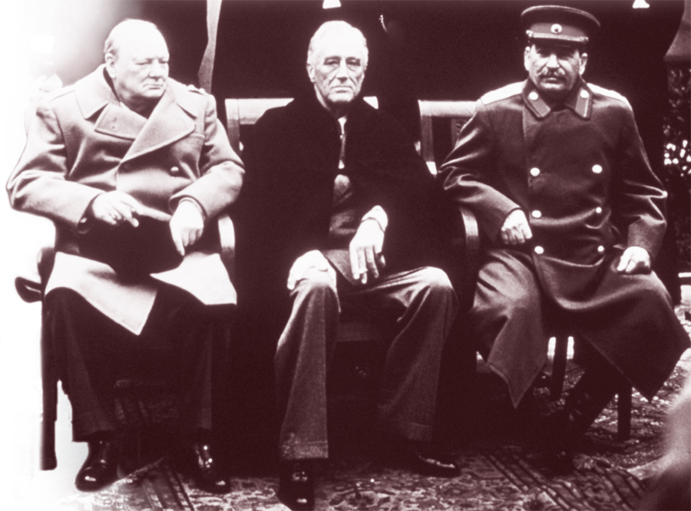
Even before the war ended, Allied leaders were making plans for the peace.

Slide 6
Big Three Meetings, 1945
Location | Participants | Agreements
Yalta | Roosevelt, Churchill, Stalin | • Free elections for Poland, Bulgaria, Romania
Potsdam | Truman, Atlee, Stalin | • Divide Germany into four zones of occupation • New borders and free elections for Poland • Allow Soviets to claim war reparations

Slide 7
Stalin, however, eventually reneged on the promises made at Yalta and Potsdam.
Nearly all of the Eastern European countries occupied by Soviet troops at war’s end came under communist control.
Free elections were never held.

Slide 8
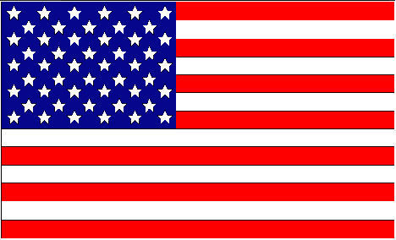
These developments pitted the United States against the Soviet Union.
United
States
Soviet
Union
Both had emerged from the war strong and confident.
Both were world superpowers.
But they were no longer allies.

Slide 9
The end of the war saw other changes in global politics.
In Japan, American occupation forces supervised the writing of a new constitution.
In China, the civil war between Nationalist and communist forces resumed.
In Africa, Asia, and Latin America, former European colonies gained independence.

Slide 10
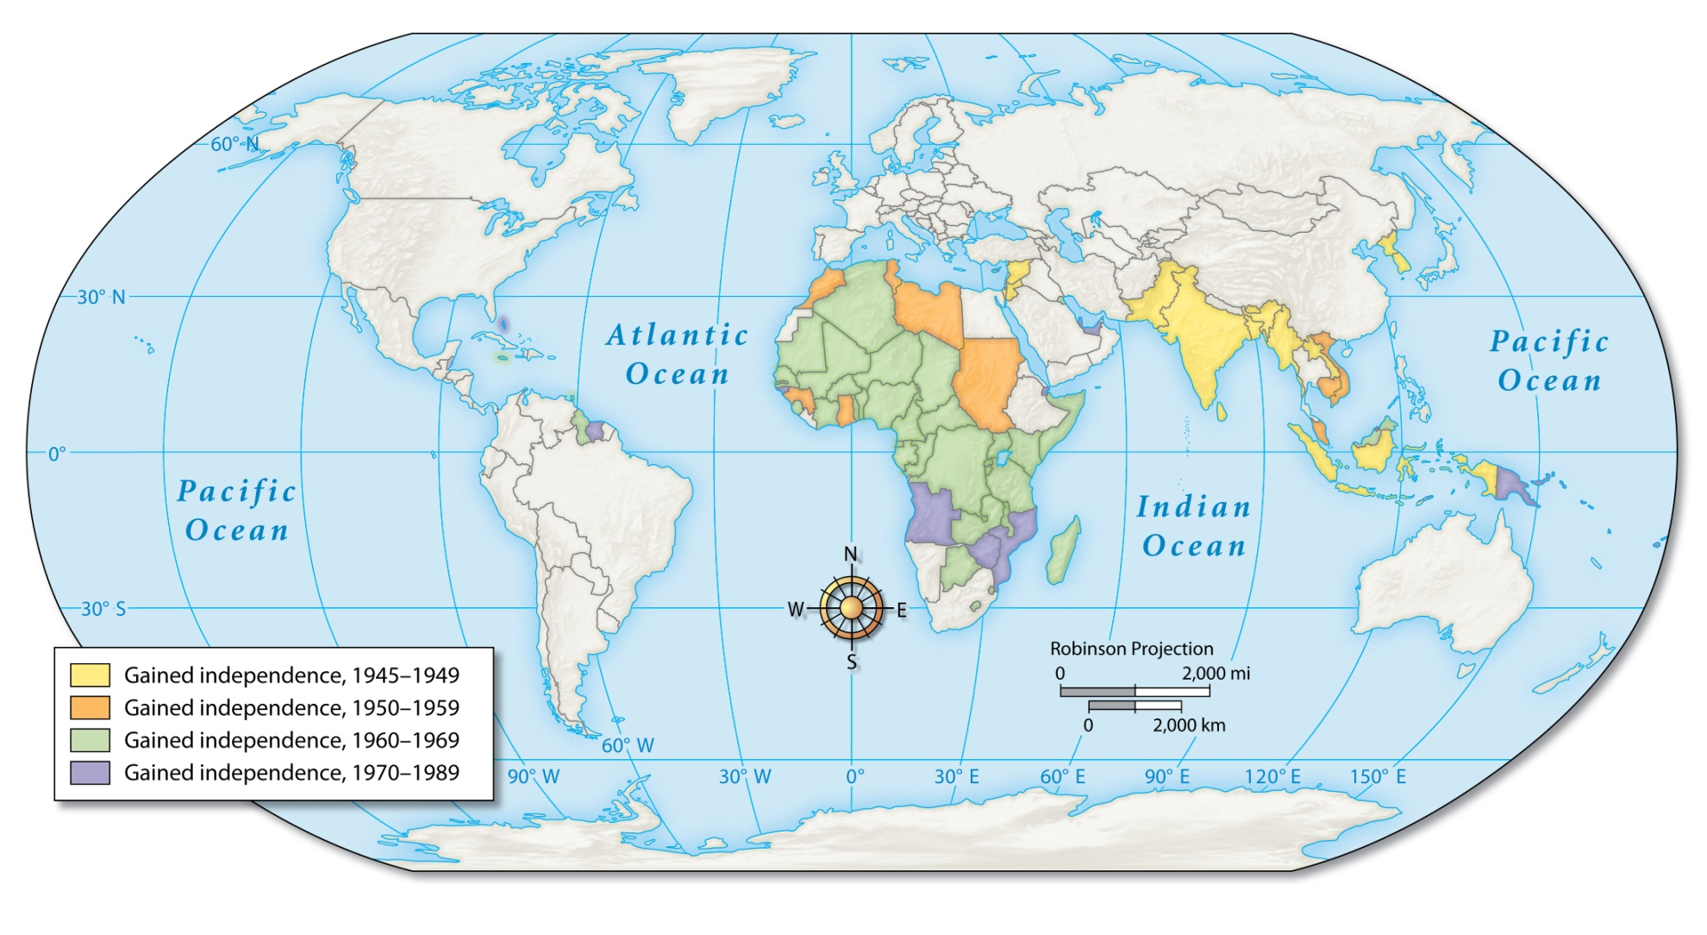
The Decline of Imperialism, 1945–1989

Slide 11
Japanese war criminals were tried for committing atrocities and mistreating POWs.
Nazi war criminals were prosecuted at the Nuremberg Trials, which revealed the depth and horror of their crimes.
As the postwar world took shape, the Allies turned to those responsible for the war’s death and destruction.
Notes:
11

Slide 12
To prevent future conflicts, many called for increased international cooperation.
Americans took the lead, embracing their new role as citizens of a global superpower. They helped establish:
The International Monetary Fund
The World Bank
The GATT treaties

Slide 13
The U.S. also led the charge for the creation of the United Nations.
Aided the move away from colonialism
Helped create the state of Israel
Mediated regional conflicts
Provided aid to needy nations
Issued the Universal Declaration of Human Rights
Since it was founded in 1945, the UN worked to make a difference throughout the world.
Notes:
13

Slide 14
The war changed Americans in other ways, too.
In the fight against totalitarianism, Americans turned with renewed pride to the nation’s ideals of freedom and democracy.
Yet many still faced racism at home.
This led to an increased commitment to the fight for civil rights.

Slide 15
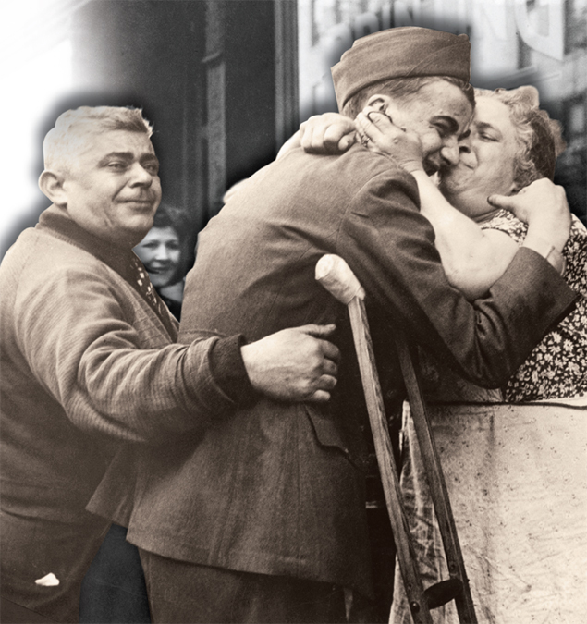
The war also brought lasting changes to the nation’s economy.
Ended the Great Depression
Ushered in decades of growth and prosperity
Led to an expanded role for government in the economy
Notes:
15

