Slide 1
Objectives
Explain how Mao Zedong and the communists gained power in China.
Describe the causes and progress of the war in Korea.
Identify the long-term effects of the Korean War.

Slide 2
Terms and People
Jiang Jieshi − Nationalist leader in China
Mao Zedong − communist leader in China
38th parallel − dividing line between North Korea and South Korea
Douglas MacArthur − World War II hero who commanded American troops in South Korea
limited war − war fought to achieve only specific goals

Slide 3
Terms and People (continued)
SEATO − Southeast Asia Treaty Organization; defensive alliance aimed at preventing the spread of communism in Southeast Asia

Slide 4
How did President Truman use the power of the presidency to limit the spread of communism in East Asia?
In the early 1950s, Cold War tensions erupted in East Asia, where communist and non-communist forces struggled for control of Korea.

Slide 5
Before World War II, China had been torn apart by a brutal civil war.
Pro-government Nationalists
Communist revolutionaries
Led by Jiang Jieshi
Supported by the United States
Led by Mao Zedong
Supported by the Soviet Union

Slide 6
Once the war ended, however, civil war broke out once again, with renewed fury.
During WWII, the two sides formed an uneasy alliance to fight Japan.
Despite U.S. aid, Jiang’s government faltered.
Nationalist generals were reluctant to fight.
Corruption was rampant.

Slide 7
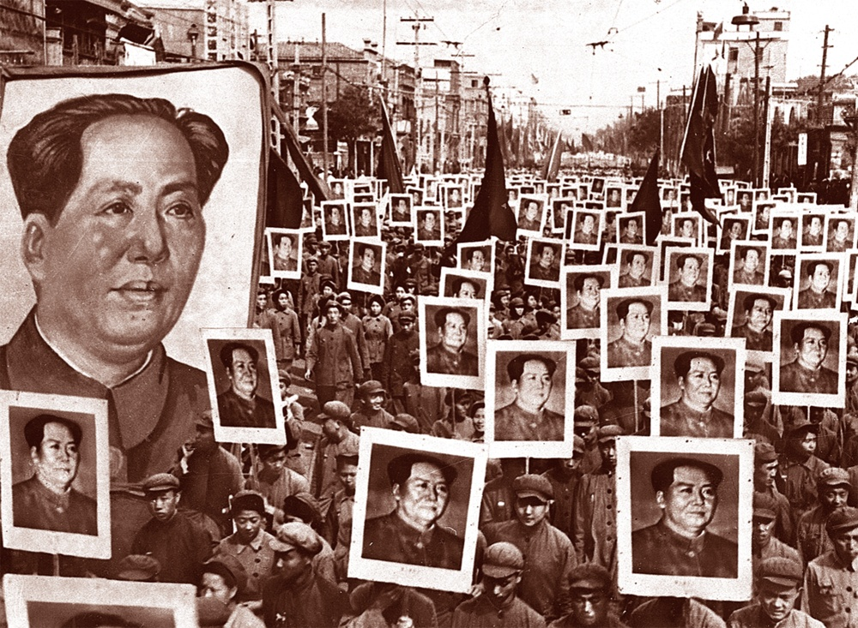
Mao built support by promising food to the starving population. Communist forces soon dominated.
Jiang fled to Taiwan.
Mao took control of the mainland, renaming it the People’s Republic of China.

Slide 8
Mao’s victory deeply shocked Americans.
Communists seemed to be winning everywhere, extending their reach throughout the world.
Communist regimes now controlled:
one fourth of the world’s landmass
one third of the world’s population

Slide 9
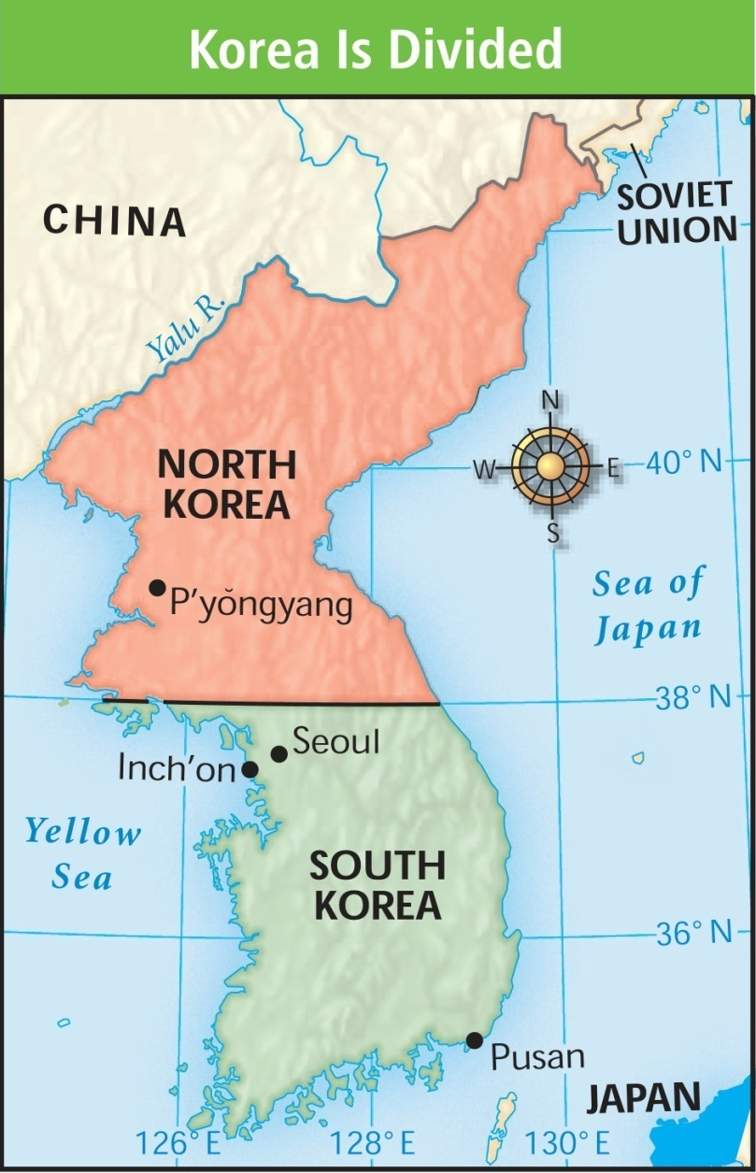
The next battleground was on the Korean peninsula.
After World War II, Korea was divided into two countries along the 38th parallel.

Slide 10
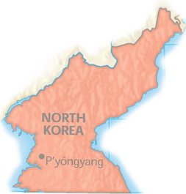
The Soviet Union supported North Korea and established a communist government there.
North Korea
The United States provided aid to noncommunist South Korea.
South Korea
Notes:
10

Slide 11
The crisis began in June, 1950.
Communist forces advanced far into the South, taking over much of the peninsula.
North Korean troops, armed with Soviet equipment, crossed the 38th parallel and attacked South Korea.

Slide 12
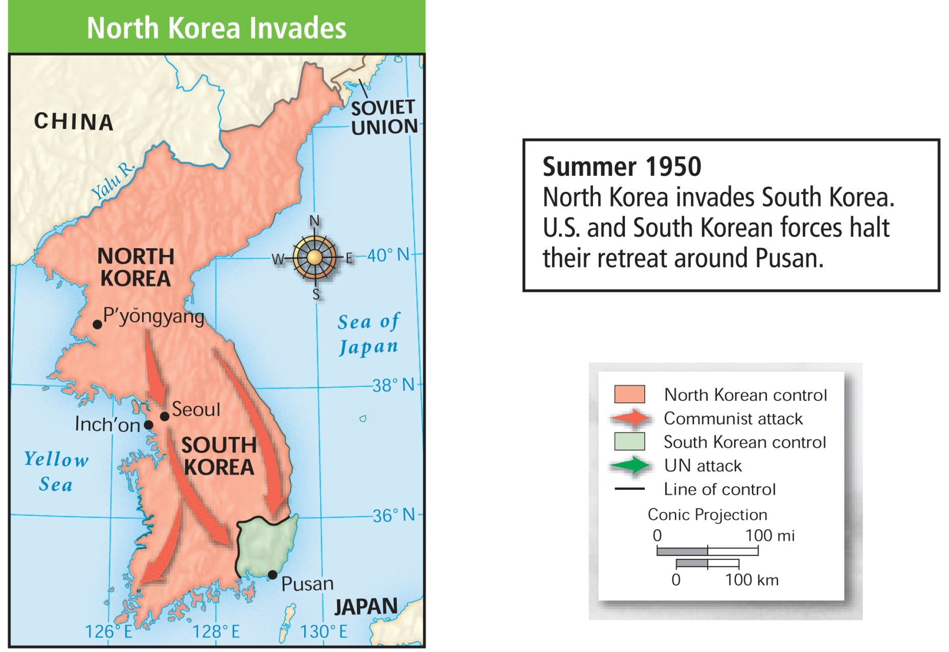
Forces from the U.S. and other UN countries arrived to help their South Korean allies.
They halted their retreat near Pusan.

Slide 13
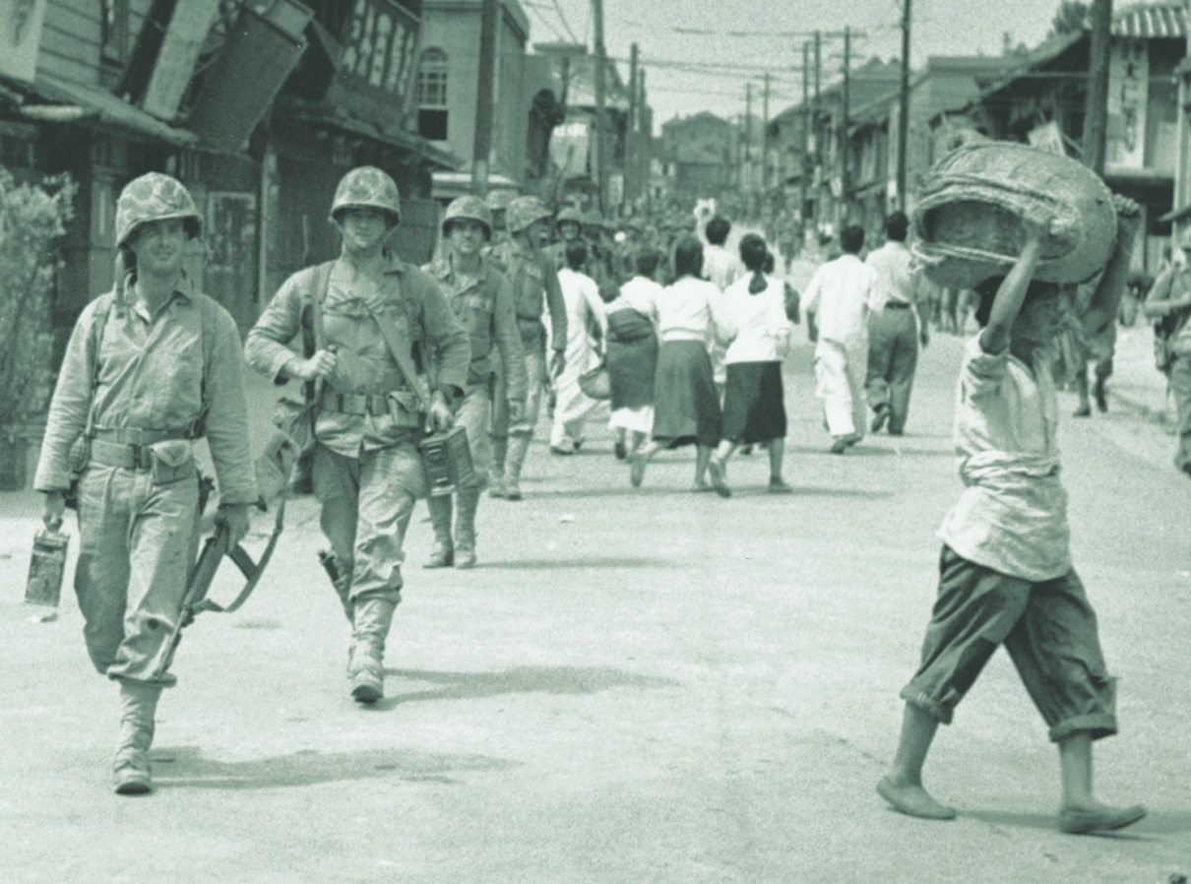
American troops in South Korea were led by WWII hero Douglas MacArthur.
MacArthur devised a bold counterattack designed to drive the invaders from South Korea.
Notes:
13

Slide 14
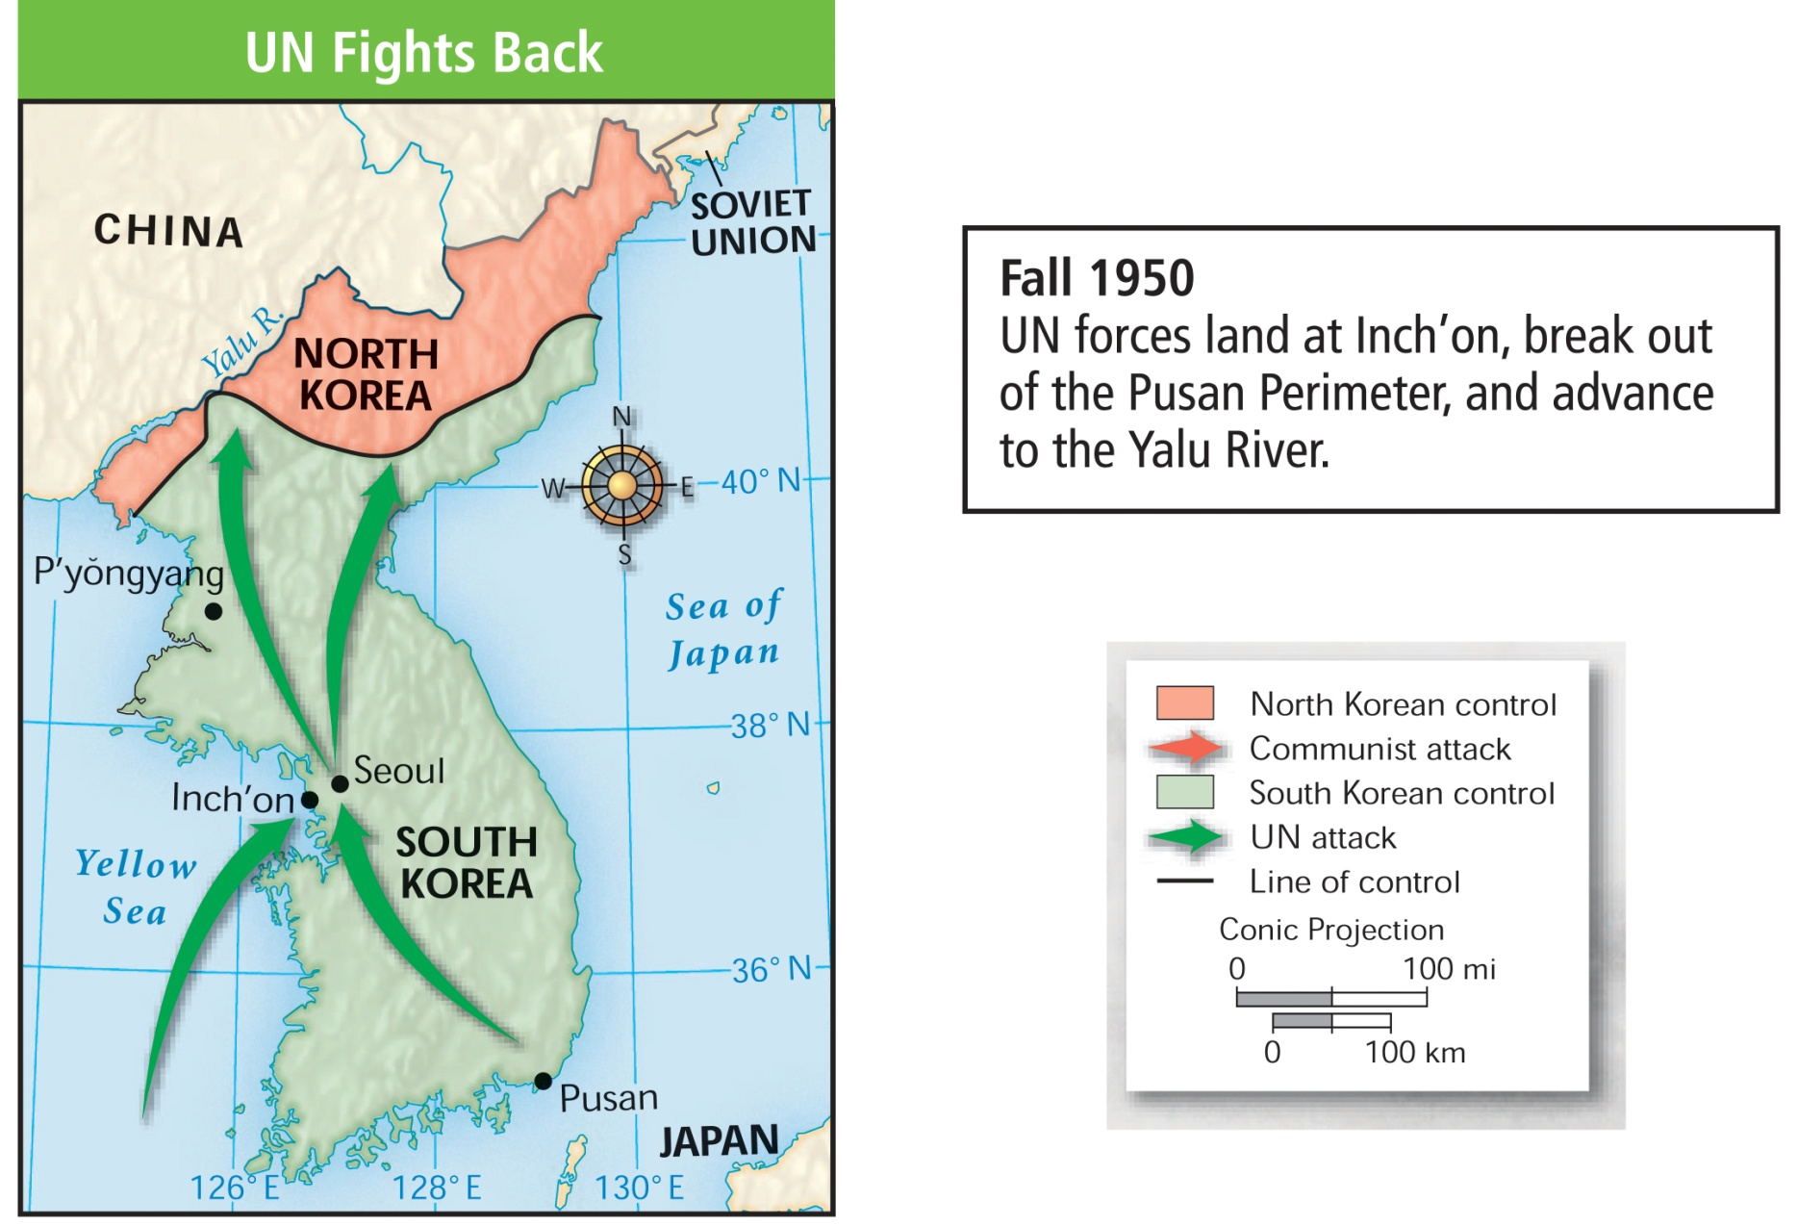
MacArthur’s plan worked.
In the fall of 1950, a surprise landing at Inchon helped UN forces push the North Koreans to the Chinese border.

Slide 15
The situation worsened when China entered the war, sending 300,000 troops across the border into North Korea.
The Chinese attacked U.S. and South Korean positions.
Badly outnumbered, UN troops were forced to retreat.

Slide 16
During the winter of 1950 and 1951, communist forces pushed UN troops to the 37th parallel.

Slide 17
The U.S. now faced the possibility of all-out war against the world’s most populous nation.
Truman refused. He favored a limited war to help stabilize South Korea.
MacArthur favored invading China to win a total victory.
Notes:
17

Slide 18
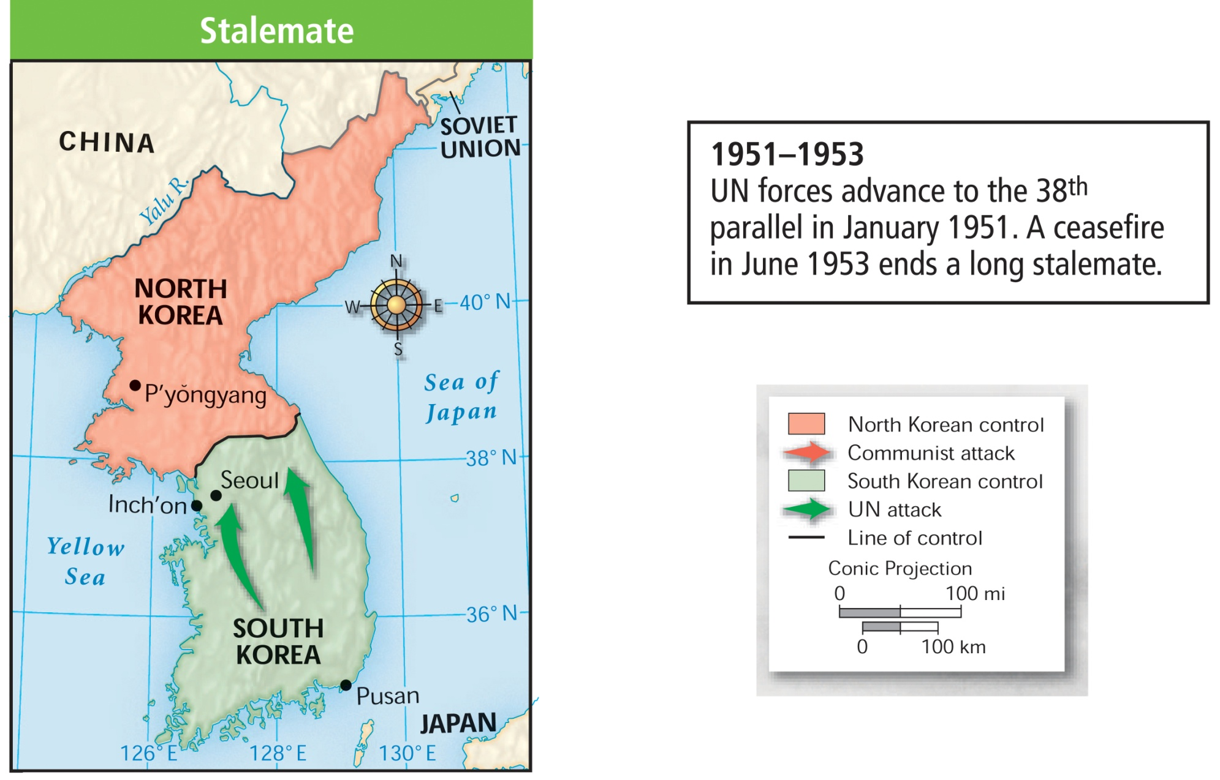
By the spring of 1951, UN forces secured their position near the 38th parallel, and a tense stalemate began.

Slide 19
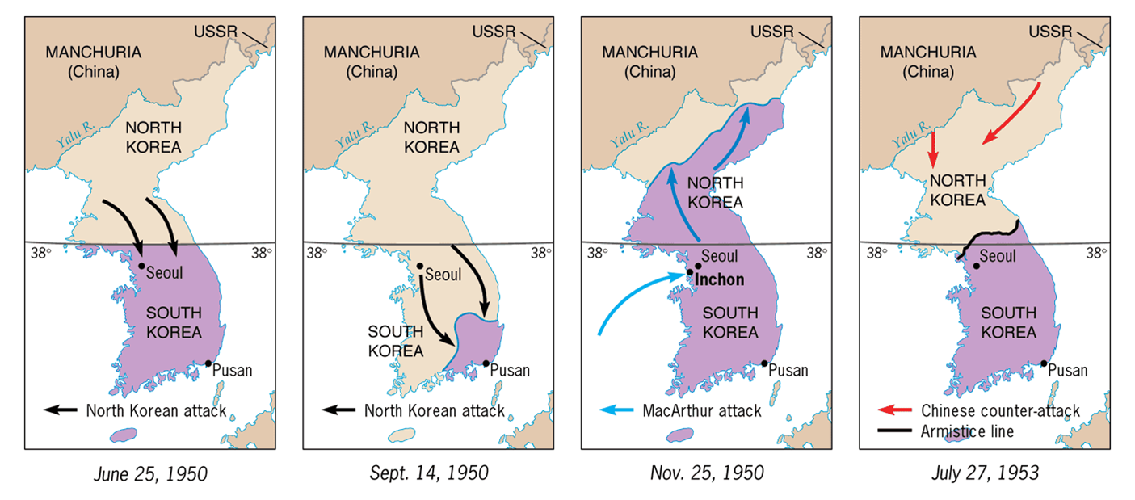
The Shifting Map of Korea [1950-1953]

Slide 20
In 1953, the two sides agreed to a cease-fire. This agreement remains in effect today.
Military spending increases.
Military commitments increase worldwide.
SEATO contains communism in Asia.
Future Presidents send the military into combat without Congressional approval.
There was no clear winner in the Korean War, but the conflict had lasting effects in the U.S.
Notes:
The Southeast Asia Treaty Organization (SEATO) was an international organization for collective defense in Southeast Asia created by the Southeast Asia Collective Defense Treaty, or Manila Pact, signed in September 1954 in Manila, Philippines.

