Slide 1
Objectives
Describe the causes and results of the arms race between the United States and Soviet Union.
Explain how Eisenhower’s response to communism differed from that of Truman.
Analyze worldwide Cold War conflicts that erupted in Eastern Europe, the Middle East, and other places.
Discuss the effects of Soviet efforts in space exploration.

Slide 2
Terms and People
arms race − race in which countries compete to build more powerful weapons
mutually assured destruction − policy in which the U.S. and Soviet Union hoped to deter nuclear war by building up enough weapons to destroy each other
John Foster Dulles − diplomat and secretary of state under President Eisenhower
massive retaliation − policy of threatening to use massive force in response to aggression

Slide 3
Terms and People (continued)
brinkmanship – belief that only by going to the brink of war could the U.S. prevent war
Nikita Khrushchev − leader of the Soviet Union after Stalin’s death
nationalize − to place under government control
Suez crisis − crisis in which Britain and France attempted to seize control of the Suez canal from Egypt

Slide 4
Terms and People (continued)
Eisenhower Doctrine − President Eisenhower’s policy that stated the U.S. would use force to help nations threatened by communism
CIA − Central Intelligence Agency; American intelligence-gathering organization
NASA − National Aeronautics and Space Administration; American organization that coordinates the space-related efforts of scientists and the military

Slide 5
What methods did the United States use in its global struggle against the Soviet Union?
By 1950, the United States and the Soviet Union were world superpowers.
Tensions ran high as each stockpiled weapons and struggled for influence around the globe.

Slide 6
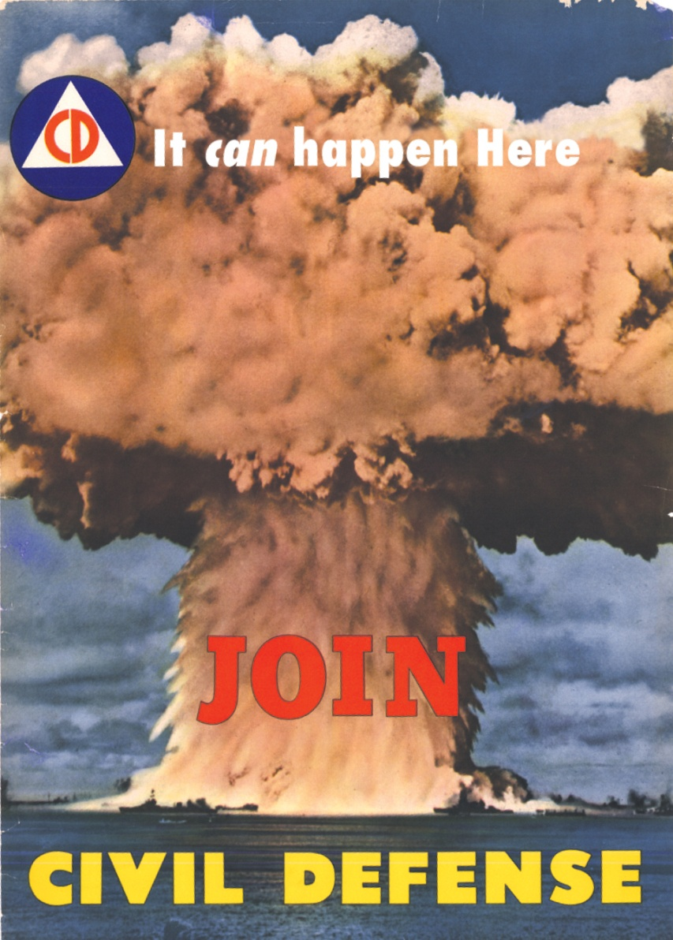
On September 2, 1949, the balance of power between the U.S. and the Soviet Union changed forever.
That day, the Soviet Union tested an atomic bomb.
The threat of nuclear war suddenly became very real.

Slide 7
In response, Truman ordered scientists to produce a hydrogen bomb—a bomb 1,000 times more powerful than the atomic bomb.
In 1952, the U.S. tested the first
H-bomb.
The next year, the Soviets tested their own H-bomb.
The arms race had begun.

Slide 8
In time, the United States and the Soviet Union would build enough nuclear weapons to destroy each other many times over.
Both sides hoped that this program of mutually assured destruction would serve as a deterrent.

Slide 9
For many, however, the existence of so many weapons was a further threat to peace.
Nuclear Warhead Proliferation
Year | U.S. | USSR | Britain | France | China
1945 | 6 | 0 | 0 | 0 | 0
1950 | 369 | 5 | 0 | 0 | 0
1955 | 3,057 | 200 | 10 | 0 | 0
1960 | 20,434 | 1,605 | 30 | 0 | 0
1965 | 31,642 | 6,129 | 310 | 4 | 1

Slide 10
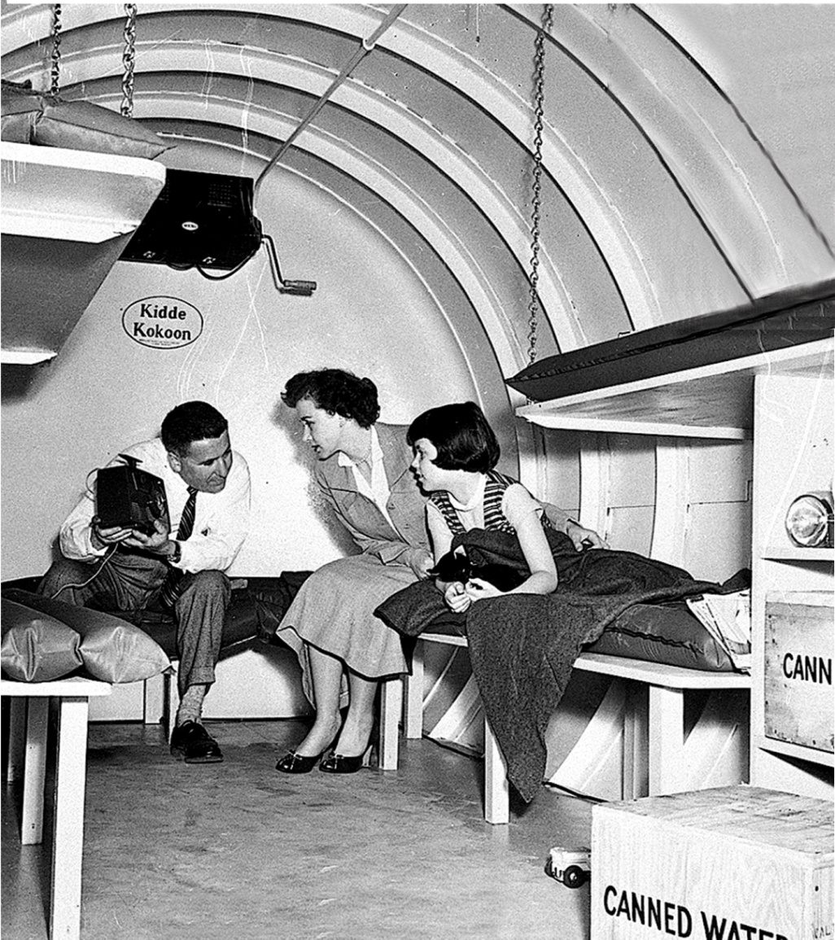
Americans reacted to the nuclear threat by following civil defense guidelines.
Families built bomb shelters in backyards.
Students practiced “duck and cover” drills at school.

Slide 11
President Eisenhower encouraged such efforts, believing that if there was another major war, it would be nuclear.
Unlike Truman, Eisenhower was not interested in fighting communism by building conventional forces.
Instead, he focused on stockpiling nuclear weapons.

Slide 12
Joseph Stalin died in 1953.
After a brief power struggle, he was succeeded by Nikita Khrushchev.
Cold War hostilities eased for a time, with the new leader speaking of “peaceful coexistence.”

Slide 13
The Soviets crushed protests against communist rule in Hungary.
The Suez crisis added to the tensions.
Yet hopes for peace faded quickly.
As Americans watched events unfold, the threat of massive retaliation suddenly seemed useless in the fight against communism.
Notes:
13

Slide 14
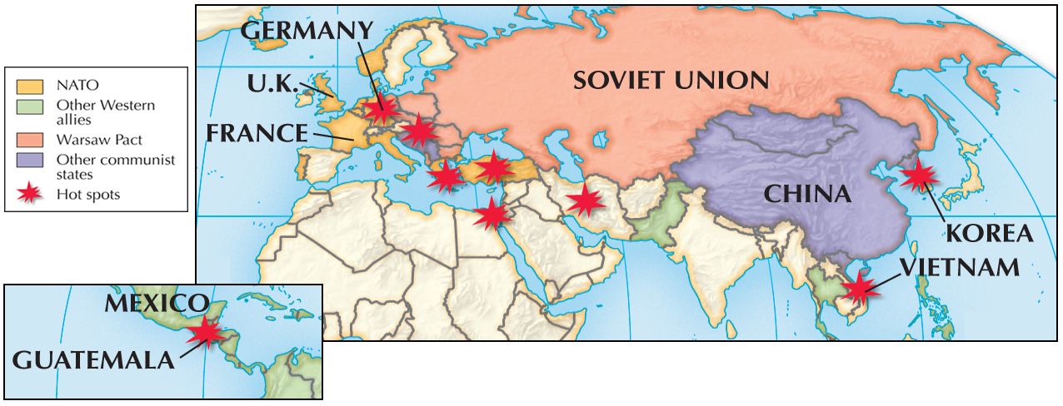
Nuclear weapons would not be used in the world’s “hot spots.”
Global Cold War, 1946−1956

Slide 15
Other methods, however, would be used to help nations threatened by communism.
Eisenhower sent troops to quell conflicts.
He also approved secret CIA operations to promote American interests abroad.

Slide 16
While the U.S. worked to contain communism on the ground, they suffered a serious setback in space.
In 1957, the Soviets launched the Sputnik I satellite into orbit around the earth.
Fearing Soviet dominance of space, Congress approved funding to create NASA.
The arms race was now joined by a space race.
Notes:
16

