Slide 1
Objectives
Describe the efforts of President Truman and the House of Representatives to fight communism at home.
Explain how domestic spy cases increased fears of communist influence in the U.S. government.
Analyze the rise and fall of Senator Joseph McCarthy and the methods of McCarthyism.

Slide 2
Terms and People
Red Scare − American reaction to the fear that communists were working to destroy American life
Smith Act − law making it illegal to teach about or advocate the violent overthrow of the U.S. government
HUAC − House Un-American Activities Committee; congressional committee that investigated possible subversive activities within the United States

Slide 3
Terms and People (continued)
Hollywood Ten − group of writers, directors, and producers who refused to answer HUAC questions about possible communist ties
blacklist − list of people banned from certain jobs because of suspected communist ties
Alger Hiss − U.S. government official accused of being a communist spy and convicted of perjury
Julius and Ethel Rosenberg − American couple executed for passing atomic secrets to Soviet agents

Slide 4
Terms and People (continued)
Joseph R. McCarthy − U.S. Senator who falsely accused Americans of having communist ties
McCarthyism − negative catchword for extreme, reckless charges of disloyalty

Slide 5
How did fear of domestic communism affect American society during the Cold War?
As Cold War tensions mounted, the United States became gripped by a Red Scare.
Many feared that communists were infiltrating the country, attempting to destroy the American way of life.

Slide 6
During the Cold War, it seemed to many Americans that communism was spreading everywhere— in Europe, in Asia, even into outer space.
Some suspected that communists were already in the country, plotting revolution.
Many feared the United States was next.
Red Scare fears led President Truman to take action.

Slide 7
Fighting Communism at Home
Act | Date | Provisions
Smith Act | 1940 | Made it unlawful to teach about or advocate the violent overthrow of the U.S. government
Federal Employee Loyalty Program | 1947 | Allowed the FBI to screen federal employees for signs of disloyalty Allowed the Attorney General to compile a list of subversive organizations in the U.S.

Slide 8
Congress joined in the search for communists.
The House Un-American Activities Committee held hearings to investigate communist influence in American society, including:
the government
the armed forces
labor unions
education
newspapers
the movie industry

Slide 9
HUAC hearings were highly charged and widely publicized.
The Hollywood Ten refused to testify and eventually were jailed.
People from all walks of life were accused of being disloyal.
Blacklists were created.
Careers were shattered.

Slide 10
As fears of disloyalty rose, Americans became riveted to two spy trials.
Defendant | Year | Charges | Outcome
Alger Hiss | 1948 | Accused by a former Soviet spy of being a communist agent | Convicted of perjury and jailed
Julius Rosenberg Ethel Rosenberg | 1950 | Accused of passing atomic secrets to Soviet agents | Found guilty and executed

Slide 11
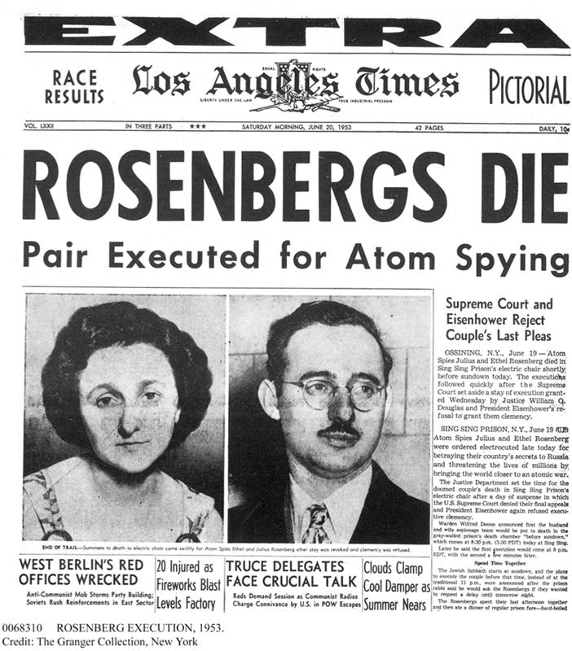
The Rosenberg case, which focused on atomic secrets, heightened fears of a nuclear disaster.

Slide 12
As Americans worried about the nation’s security, a little-known leader burst onto the national scene.
Senator Joseph McCarthy charged that communist agents had infiltrated the highest levels of government.
He claimed to have lists of Americans who were secretly communists and had betrayed their country.

Slide 13
McCarthy could not prove his charges, but they grabbed the public’s attention.
He consolidated power by making baseless allegations and opening endless investigations.
Few protested, for fear they would be accused.
Those branded as communist sympathizers lost their jobs, their reputations ruined.

Slide 14
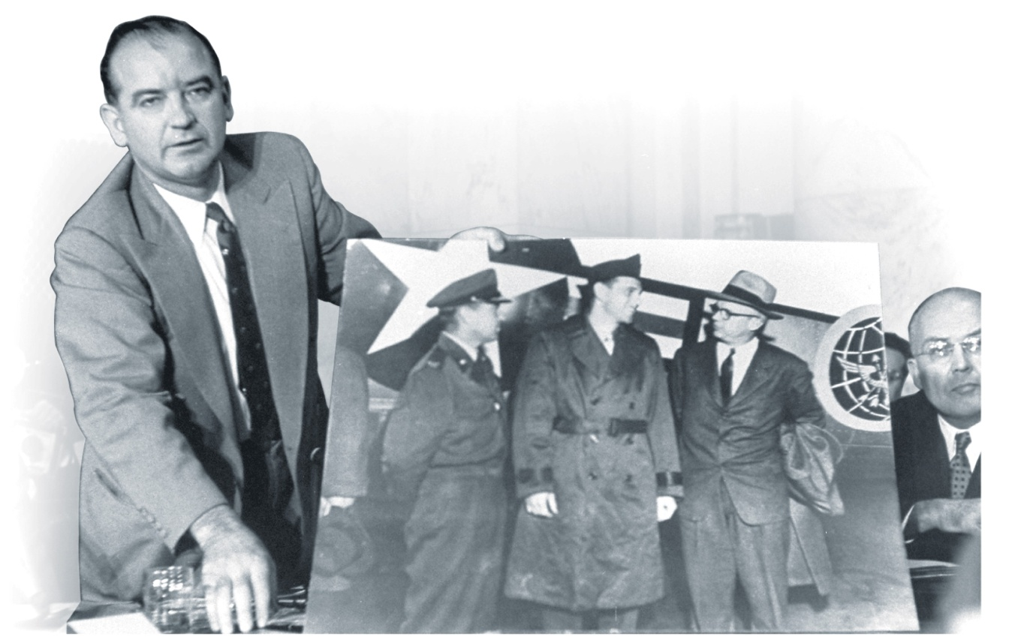
In 1954, McCarthy claimed that the army, too, was filled with communists.
The Army-McCarthy hearings were televised, and Americans saw McCarthy’s tactics firsthand.

Slide 15
The public was horrified to see McCarthy bullying witnesses, making reckless accusations, and twisting the truth.
Today, such irresponsible actions are known as McCarthyism.
By the time the hearings ended, McCarthy had lost much of his support.
He was formally censured by the Senate.

Slide 16
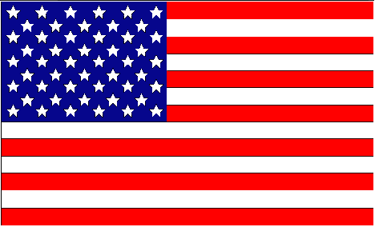
McCarthy’s downfall marked the decline of the Red Scare.
In an attempt to protect the nation from communism, free speech had been threatened.
In the end, both the nation and free speech survived.
Today, the U.S. still struggles with balancing the nation’s security with the civil liberties of its citizens.

