Slide 1
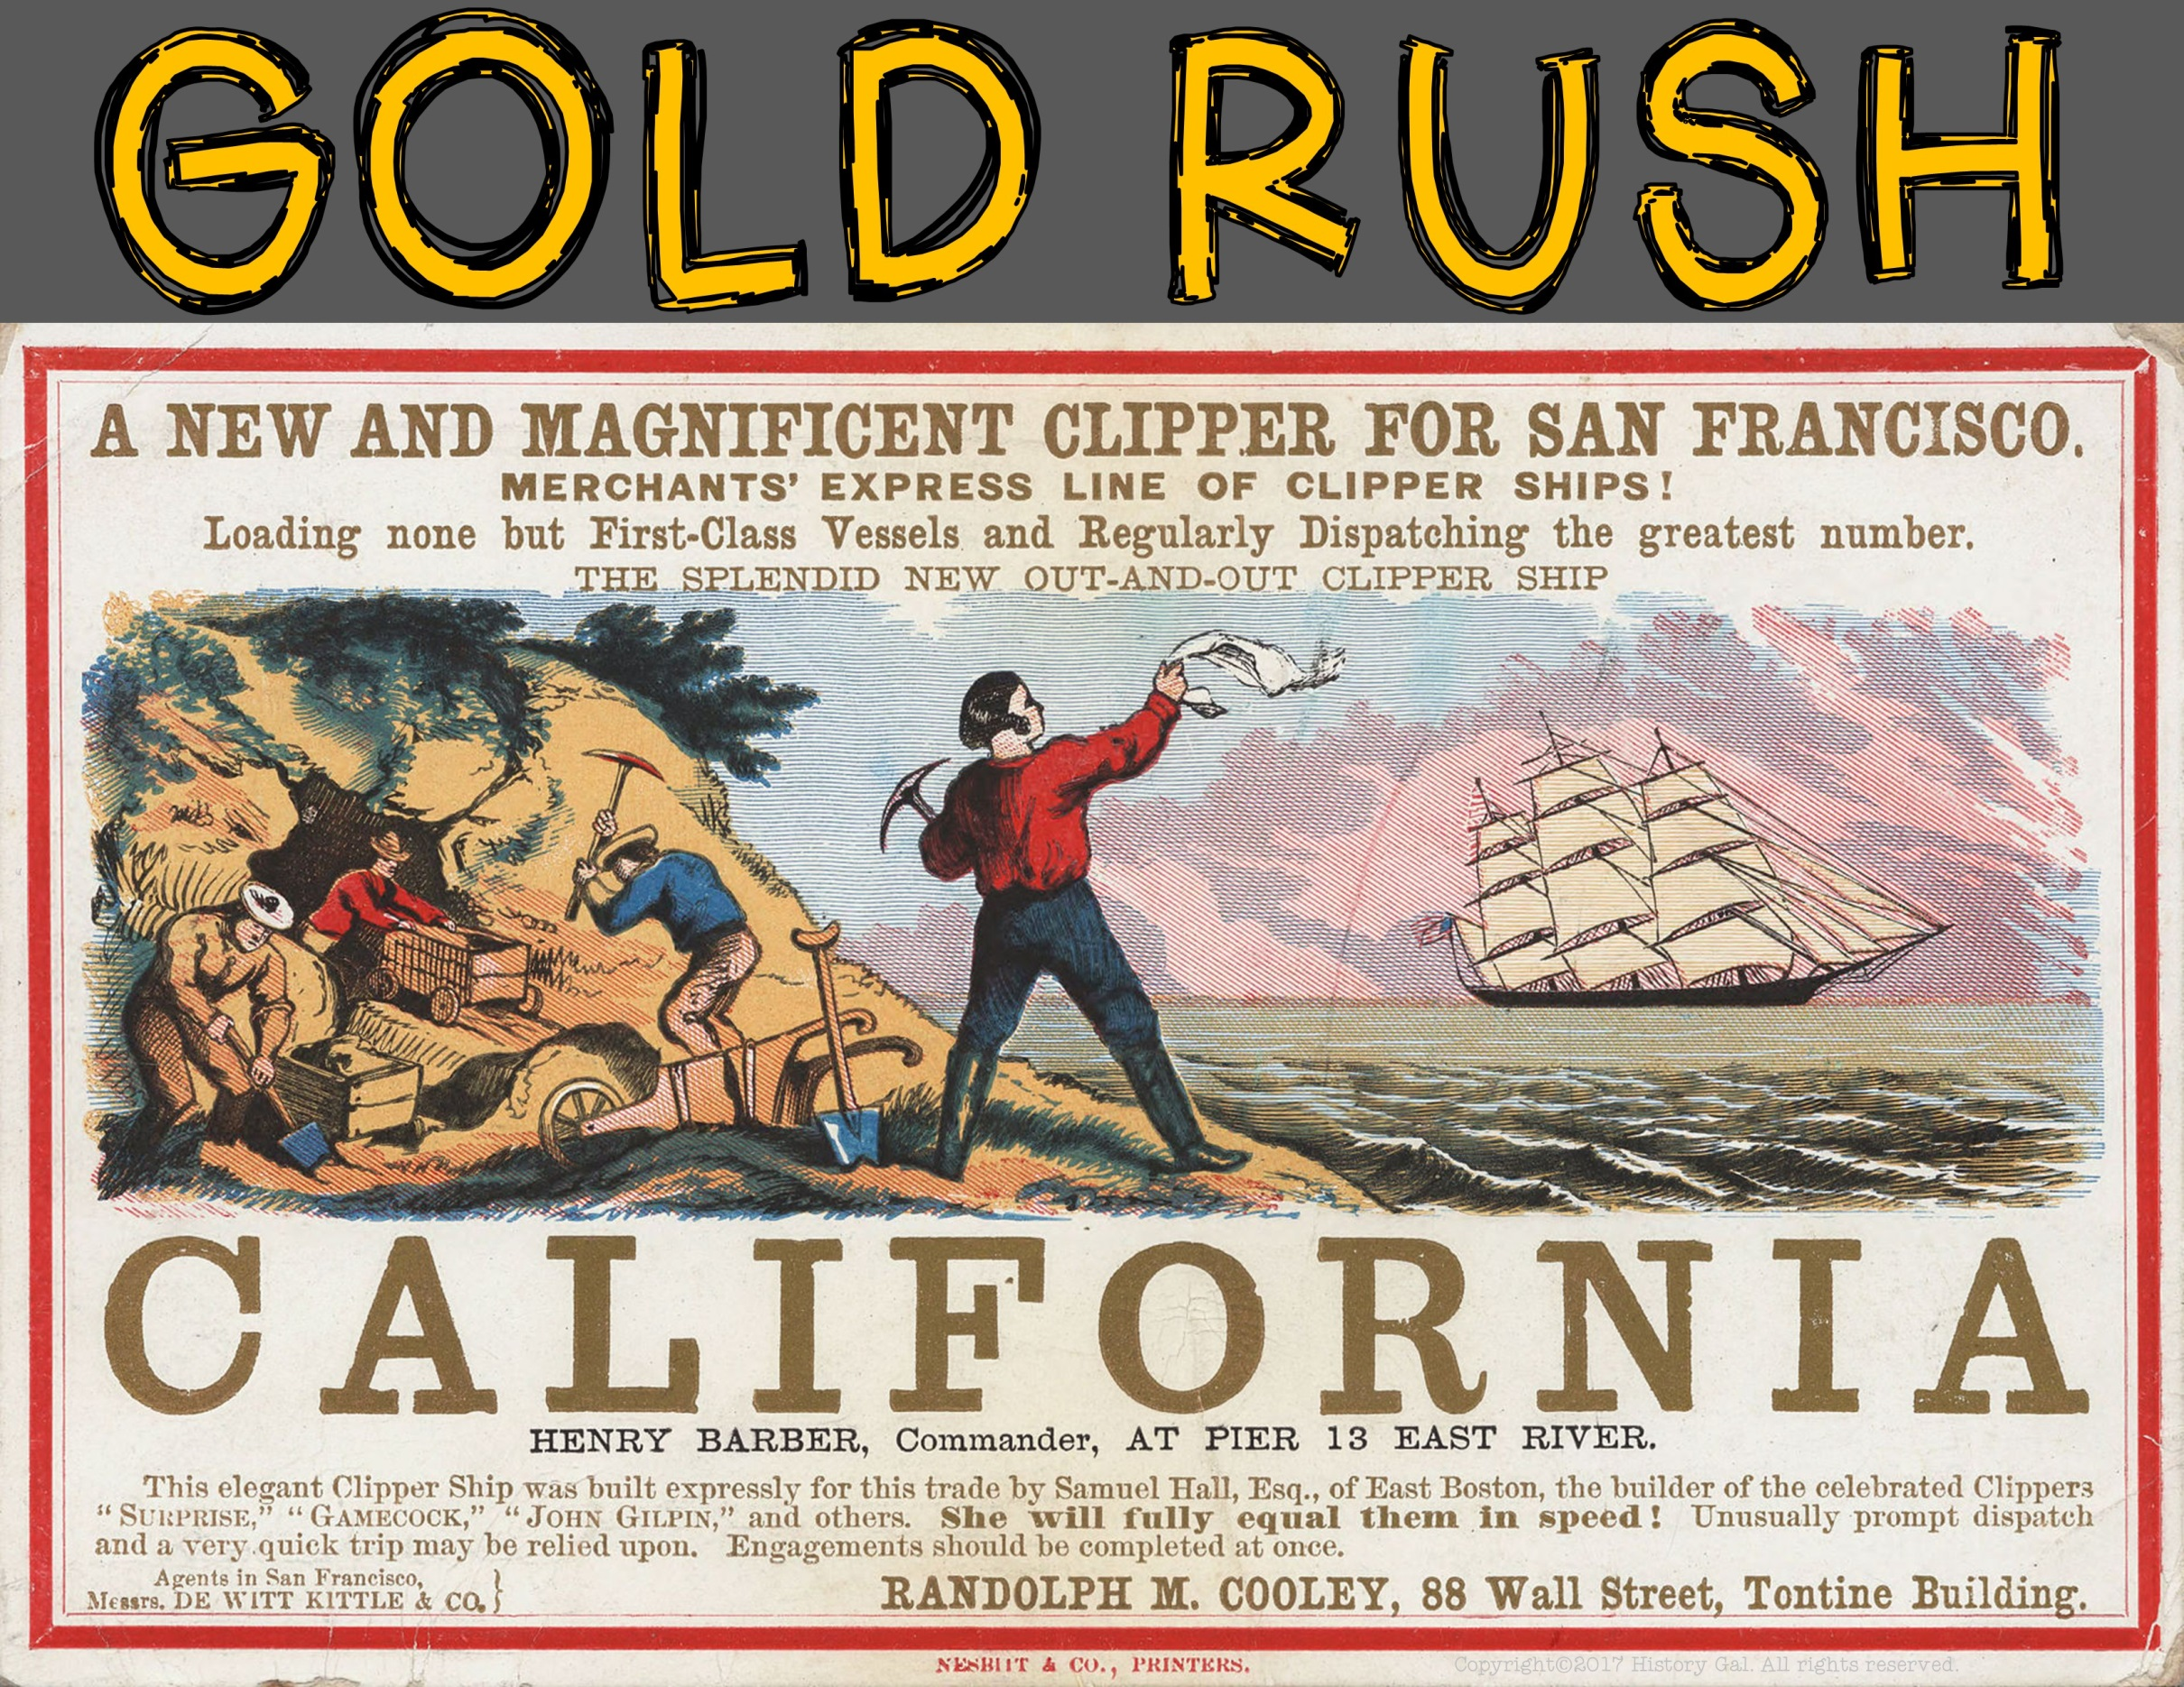

Slide 2
January 1848, James W. Marshall discovered gold at Sutter’s Saw Mill along the American River in Coloma, California
He tried to keep the discovery a secret, but the news quickly spread to the surrounding areas and soon people from all over the United States and the world flocked to California
How the Gold Rush Began
Gold Rush Cartoon
President Polk Confirms Gold in California

Slide 3
When gold was discovered in 1848, the United States and Mexico were at war and California was technically still part of Mexico
The Treaty of Guadalupe Hidalgo ceded the territory of California to the United States (Feb. 1848)
PROPERTY OF
MEXICO
UNITED STATES

Slide 4
Marshall’s discovery was just one small area of the mother lode (the main vein of gold ore) that would soon be uncovered
Ultimately, $2 billion in gold would be uncovered by prospectors (worth over $20 billion today)
Over the next 8 years, 300,000 people and their money poured into California’s boom towns
The population explosion resulted in California quickly becoming a state in 1850
Chinese Prospectors
Gold Rush – PBS
Story of Us
California Video
Connecting the Country – Transcontinental Road

Slide 5
The people rushing to California were called 49ners because they arrived in 1849
They came overland along the California Trail or by sea via Cape Horn or Panama
Native Americans and the 49ners

Slide 6
One of the most common methods used to find gold is called panning
Prospectors placed a shovel of dirt from an area suspected to contain gold into a pan or a sieve along with some water and vigorously shook the pan back and forth
The shaking caused the heavier gold to settle on the bottom while the worthless silt rose to the top
As gold became harder and more expensive to find, more prospectors turned to underground and hydraulic mining in search for gold
Panning for Gold
Sluicing for Gold
Explosive Technology
Aftermath of the Gold Rush

Slide 7
Mining pan, sieve, pick, and shovel
Food and living supplies like a tent, lamp, and kettle
As demand for supplies increased, so did the prices
People who sold mining supplies often made more money than the prospectors
Online Exhibit
Sam Brannan’s Master Plan

Slide 8
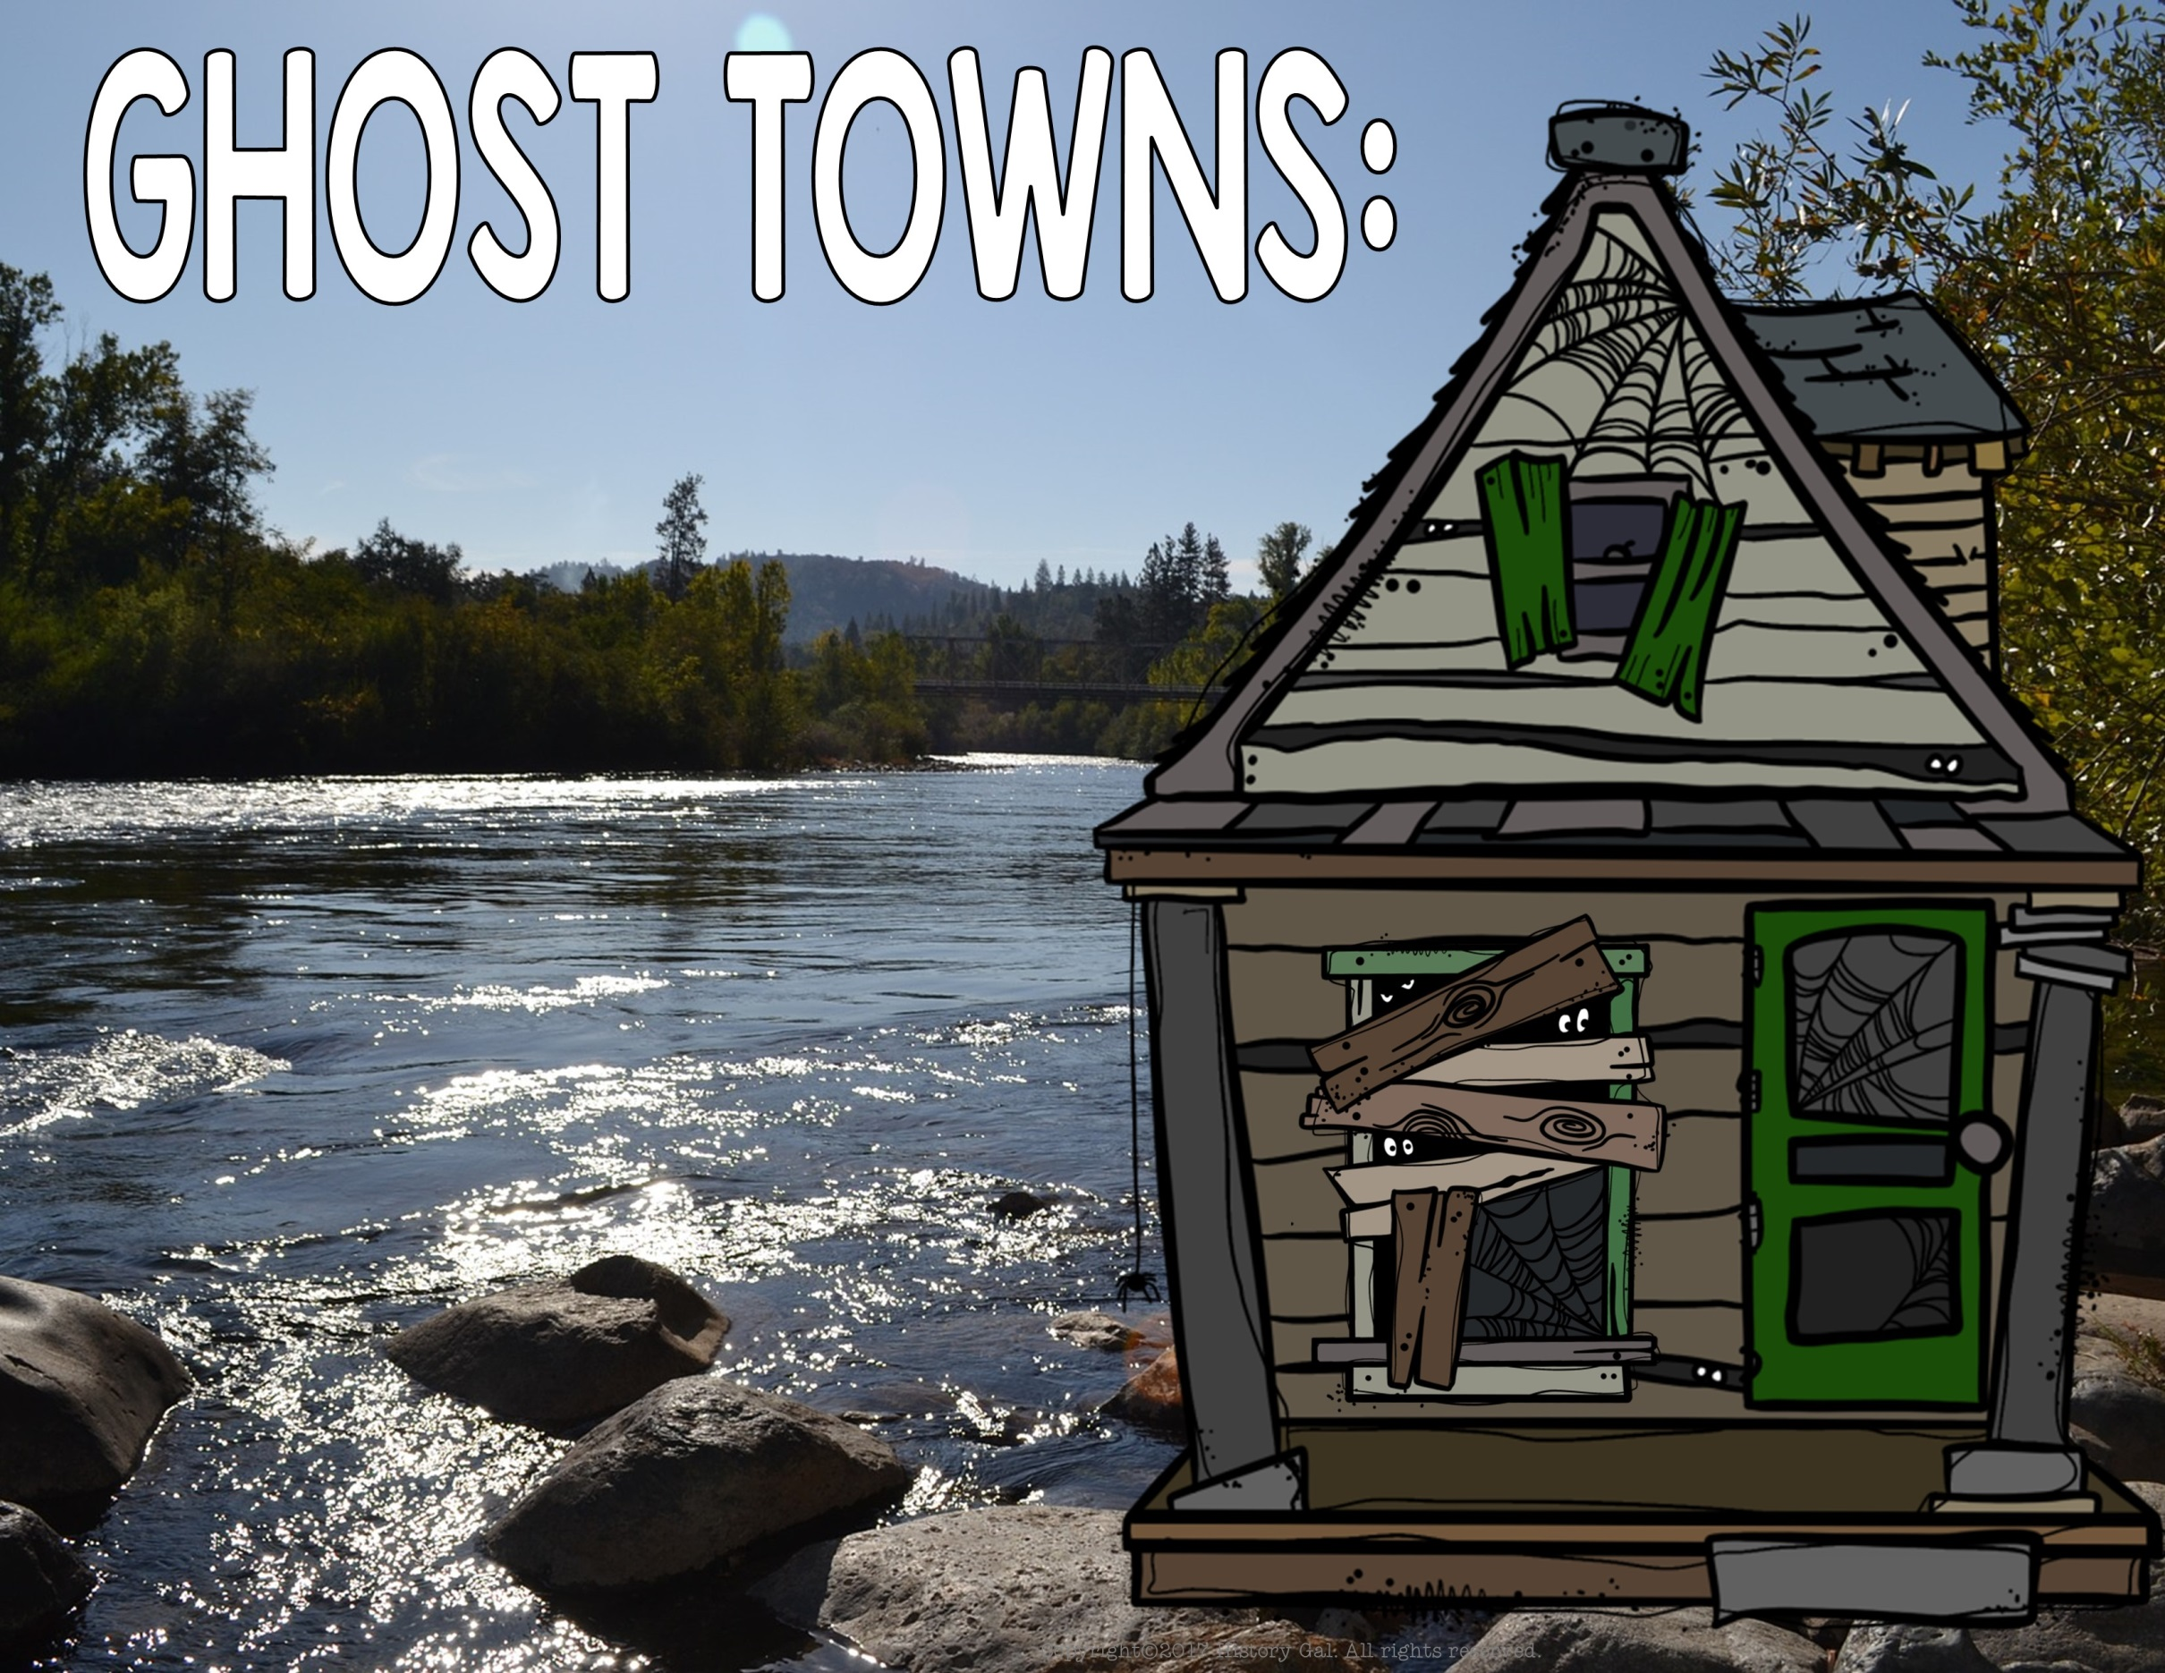
As gold ran out, prospectors left the boom towns
Without customers, businesses shut down and the towns became abandoned ghost towns

Slide 9
While the California Gold Rush is probably the most well known gold rush, it was not the nation’s first
The first gold rush started in 1802 at Reed’s Farm in North Carolina after the family discovered that a rock their son brought home was actually a gold nugget
Between 1804-1828 all gold coins minted by the United States were cast from North Carolina gold
North Carolina Gold Rush
History of Gold in North Carolina

Slide 10
After the California Gold Rush, gold, silver, copper, zinc, and lead deposits were discovered throughout the west resulting in more rushes as people hoped to strike it rich
Comstock Lode
Gold in Black Hills
Modern 49ners
There’s Still Gold In California

