Slide 1
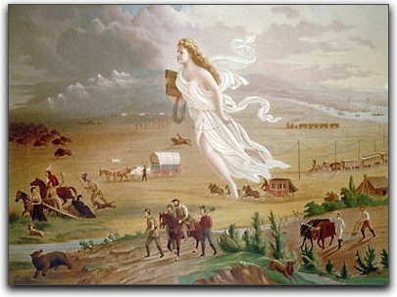
1. List 10 things that you see. 2. Do you think this was painted by a native American or a settler? Why or why not.

Slide 2
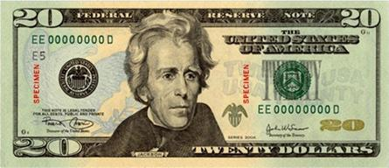
Andrew Jackson
Spoiled Banks, raised tariffs and Removed Indians

Slide 3
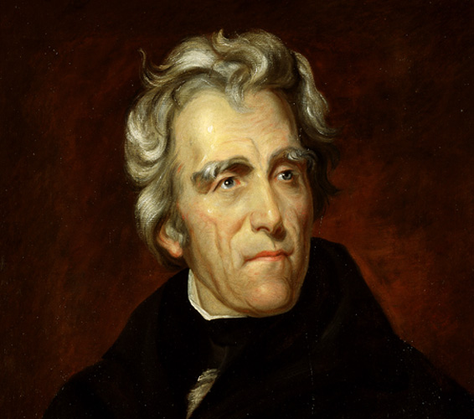
I. Andrew Jackson, “Old Hickory” 1828-1837
Democrat, first president for the ordinary people. He had no formal education, but he taught himself law and became a successful lawyer.
In 1828 election voting rights extended to non–land owning males. A turn from aristocrats to common people participating in elections.
President Jacksons inauguration – throngs of common people attended
He was considered a commoner and hero (a war hero – his forces defeated the Seminole Indians and he battled the British in the War of 1812)

Slide 4
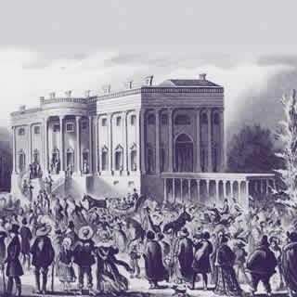
President Jackson’s Inauguration

Slide 5
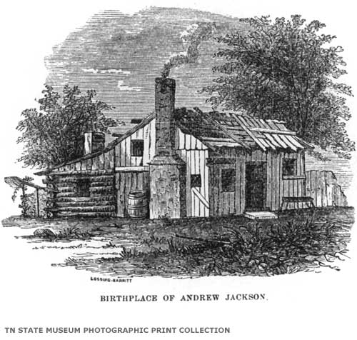
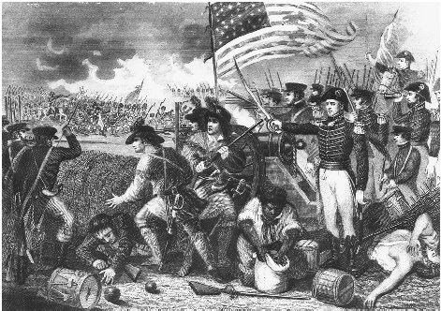
Commoner and Hero
War of 1812

Slide 6
II. Spoiled System
Practice of rewarding supporters with govt. jobs.
He fired and replaced cabinet
Martin Van Buren, was one of Jacksons strongest allies in his official cabinet
He also created a “Kitchen Cabinet” which was an informal group of his most trusted advisors, that would sometimes meet in the white house kitchen

Slide 7
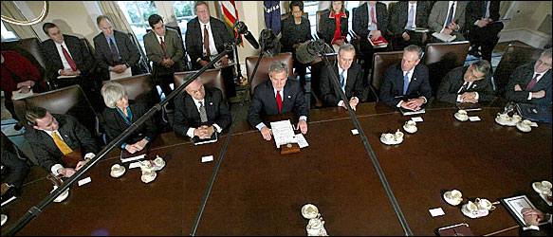
President’s Cabinet (no need to copy)
The Cabinet includes the Vice President and the heads of 15 executive departments-the Secretaries of Agriculture, Commerce, Defense, Education, Energy, Health and Human Services, Homeland Security, Housing and Urban Development, Interior, Labor, State, Transportation, Treasury, and Veterans Affairs, and the Attorney General.

Slide 8
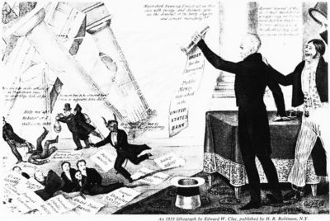
III. Banks-Jackson Refused Bank Charter
Political party-Whigs wanted to renew National Bank Charter (20 years)
Jackson said The Bank was too powerful because it had been the federal govt. chief financial agents (80% was privately owned)
The President of the Bank was growing rich from public funds
Controlled loans made by state banks limited amount of states could lend. It also printed money.
Small farmers believed the bank only helped wealthy business men
Jackson questions its constitutionality, as it was run by Congress
He made it so state funds are deposited into State Banks

Slide 9
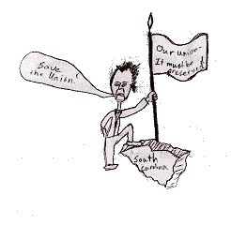
IV. Tariffs-Another High Tariff (tax on imported goods)
Called “Tariff of Abominations”
South hates it, North likes it. Intended to protect manufacturers
Nullification Crisis- South Carolina tries to nullify (cancel) tariff and threatens to secede (leave) the union
Vice President Calhoun (from S.C.) said that states had the right to nullity or cancel federal laws.
Jackson agreed with Daniel Webster who said …”Liberty and Union, now and forever.”

Slide 10
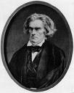
The Nullification Crisis V.P. Calhoun vs. Webster

Slide 11
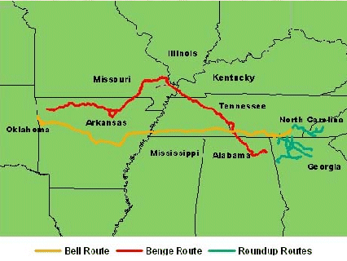
Indian Removal
Cherokees claim they have rights to make their own laws… Supreme court agreed
Indian Removal Act – in 1830 Cherokees negotiate and sign treaties with President Jackson. They think they can stay.
15,000 Cherokees are forced to relocate into Louisiana territory. ¼ died because of winter conditions, starvation, and sickness
Seminole Indians resist- Seminole war

Slide 12
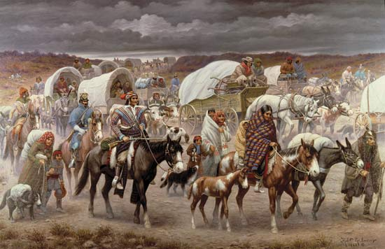
Trail of Tears

Slide 13
Why would some people feel this way? Are they justified?

Slide 14
Youtube Links
Jackson Biography
http://www.youtube.com/watch?v=Z-Nzn40b_n8
Indian Removal Act
http://www.youtube.com/watch?v=Nfo_LnuDJ1c

