Slide 1
Chapter Introduction
This chapter will cover the growth of the U.S. in the early 19th century, how slavery split the nation, the Civil War, and the Reconstruction that followed.
Section 1: Reform and Westward Expansion
Section 2: The Union in Crisis
Section 3: The Civil War
Section 4: The Reconstruction Era

Slide 2
Objectives
Analyze growing democratization, as well as limits on democracy, in the 1800s.
Discuss the importance of the Second Great Awakening and the rise of various reform movements.
Explain how the nation expanded westward.
Focus Question: What trends in democratization and reform were taking shape in the United States by 1850?

Slide 3
Terms and People
Andrew Jackson – elected President in 1828; seen as representing the “common man”; restricted the rights of Native Americans
tariff – a tax on imported products
Second Great Awakening – a religious revival movement that spread across the U.S. during the first half of the 1800s
civil disobedience – the idea that people should peacefully refuse to obey laws they considered to be immoral

Slide 4
Terms and People (continued)
abolitionist – a reformer who sought a gradual or immediate end to slavery
Missouri Compromise – 1820 agreement that admitted Missouri as a slave state and Maine as a free state and banned slavery in the Louisiana Purchase territory north of the 36°30'N latitude
Frederick Douglass – a runaway slave who started an abolitionist newspaper and spoke at abolitionist meetings
Notes:
4

Slide 5
Terms and People (continued)
Underground Railroad – network of black and white abolitionists who aided slaves running away to the North or to Canada
Elizabeth Cady Stanton – suffrage advocate; organized the 1848 Seneca Falls Convention on women’s rights with Lucretia Mott
Susan B. Anthony – suffrage and women’s rights advocate and activist
Manifest Destiny – 19th century doctrine that westward expansion of the U.S. was not only inevitable but a God-given right

Slide 6

What trends in democratization and reform were taking shape in the United States by 1850?
In the mid-1800s, as the nation expanded westward, some Americans called for an expansion of democratic rights as well.
Issues raised by reformers, such as women’s rights, continue to stir debate today.

Slide 7
By 1828, most states had ended property requirements for voting, and more white men over the age of 21 could vote than ever before.
However, women and Native Americans could not vote at all, and free African American men could vote in only a few states.
Notes:
7

Slide 8
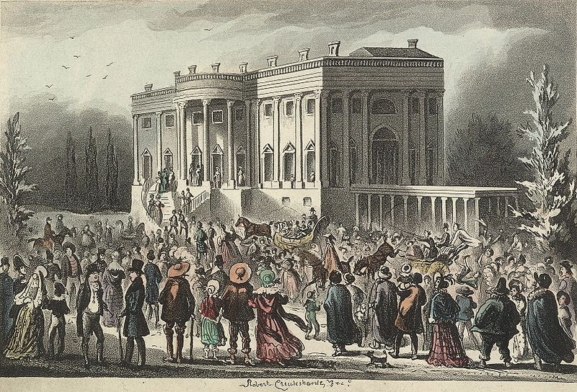

The Big Picture
In the early 1800s, states began extending the right to vote to all white men forcing politicians to heed the demands of the people.
A. Politics for the People

Slide 9
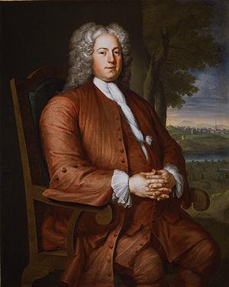
European society is composed “of great lords who possess everything, and of a herd of people who have nothing.” In the United States, there are “no aristocratic families, no courts, no kings, no bishops.”
-French essayist, J. Hector St. Jean de Crèvecoeur
1. Federalists didn’t respect democracy but by 1820s the US becoming more democratic

Slide 10
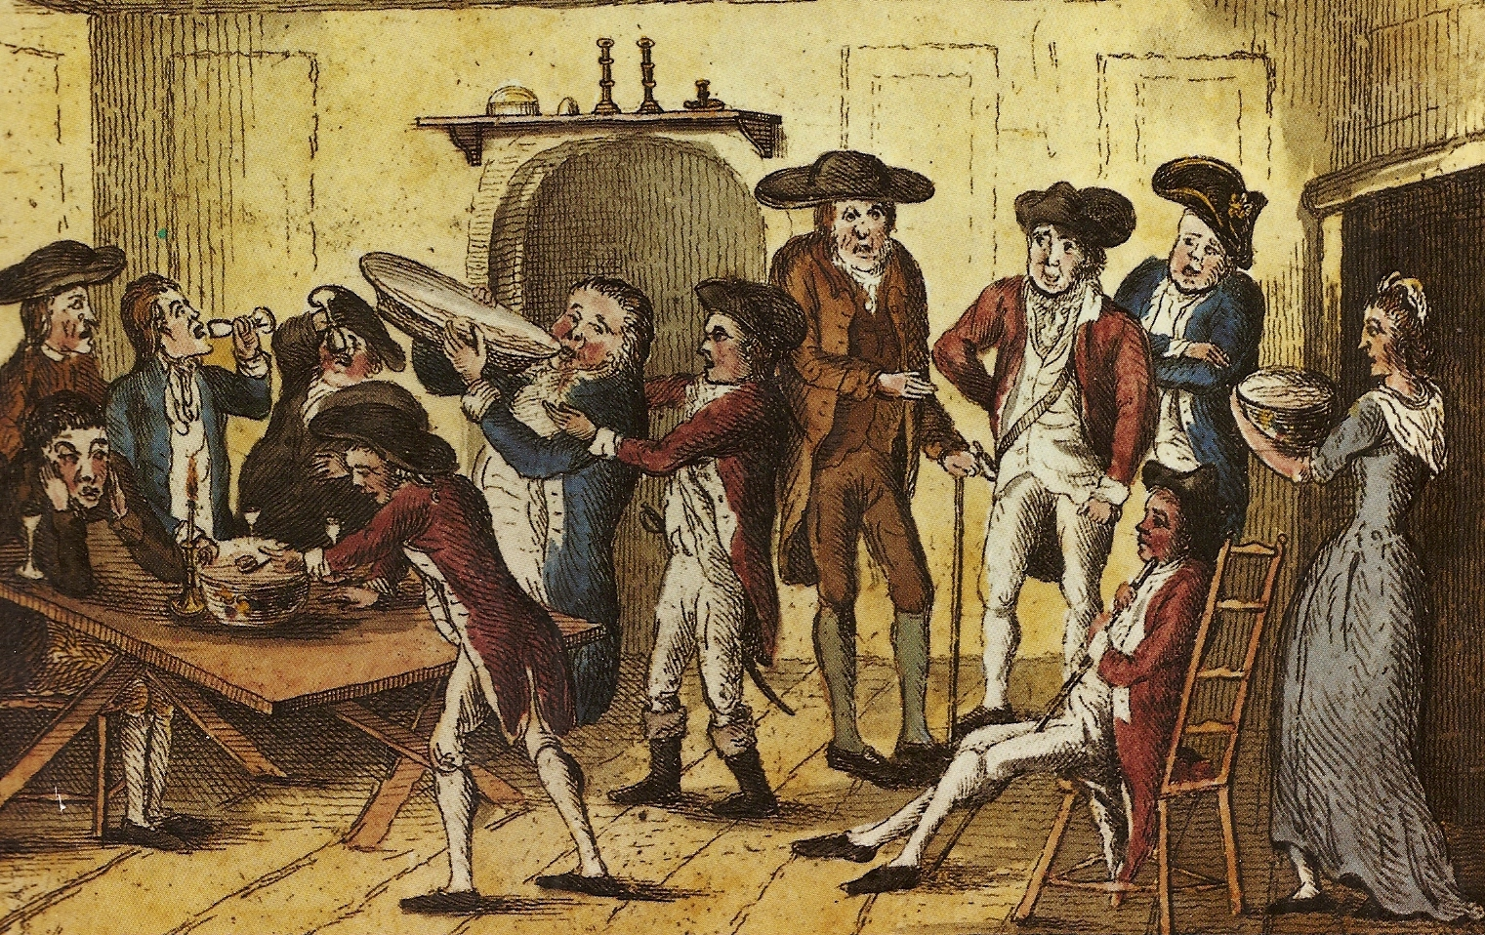
2. US developed world’s first modern democracy and celebrated a new national culture, while seeking to define nation’s democratic ideals and reform its institutions to match them

Slide 11
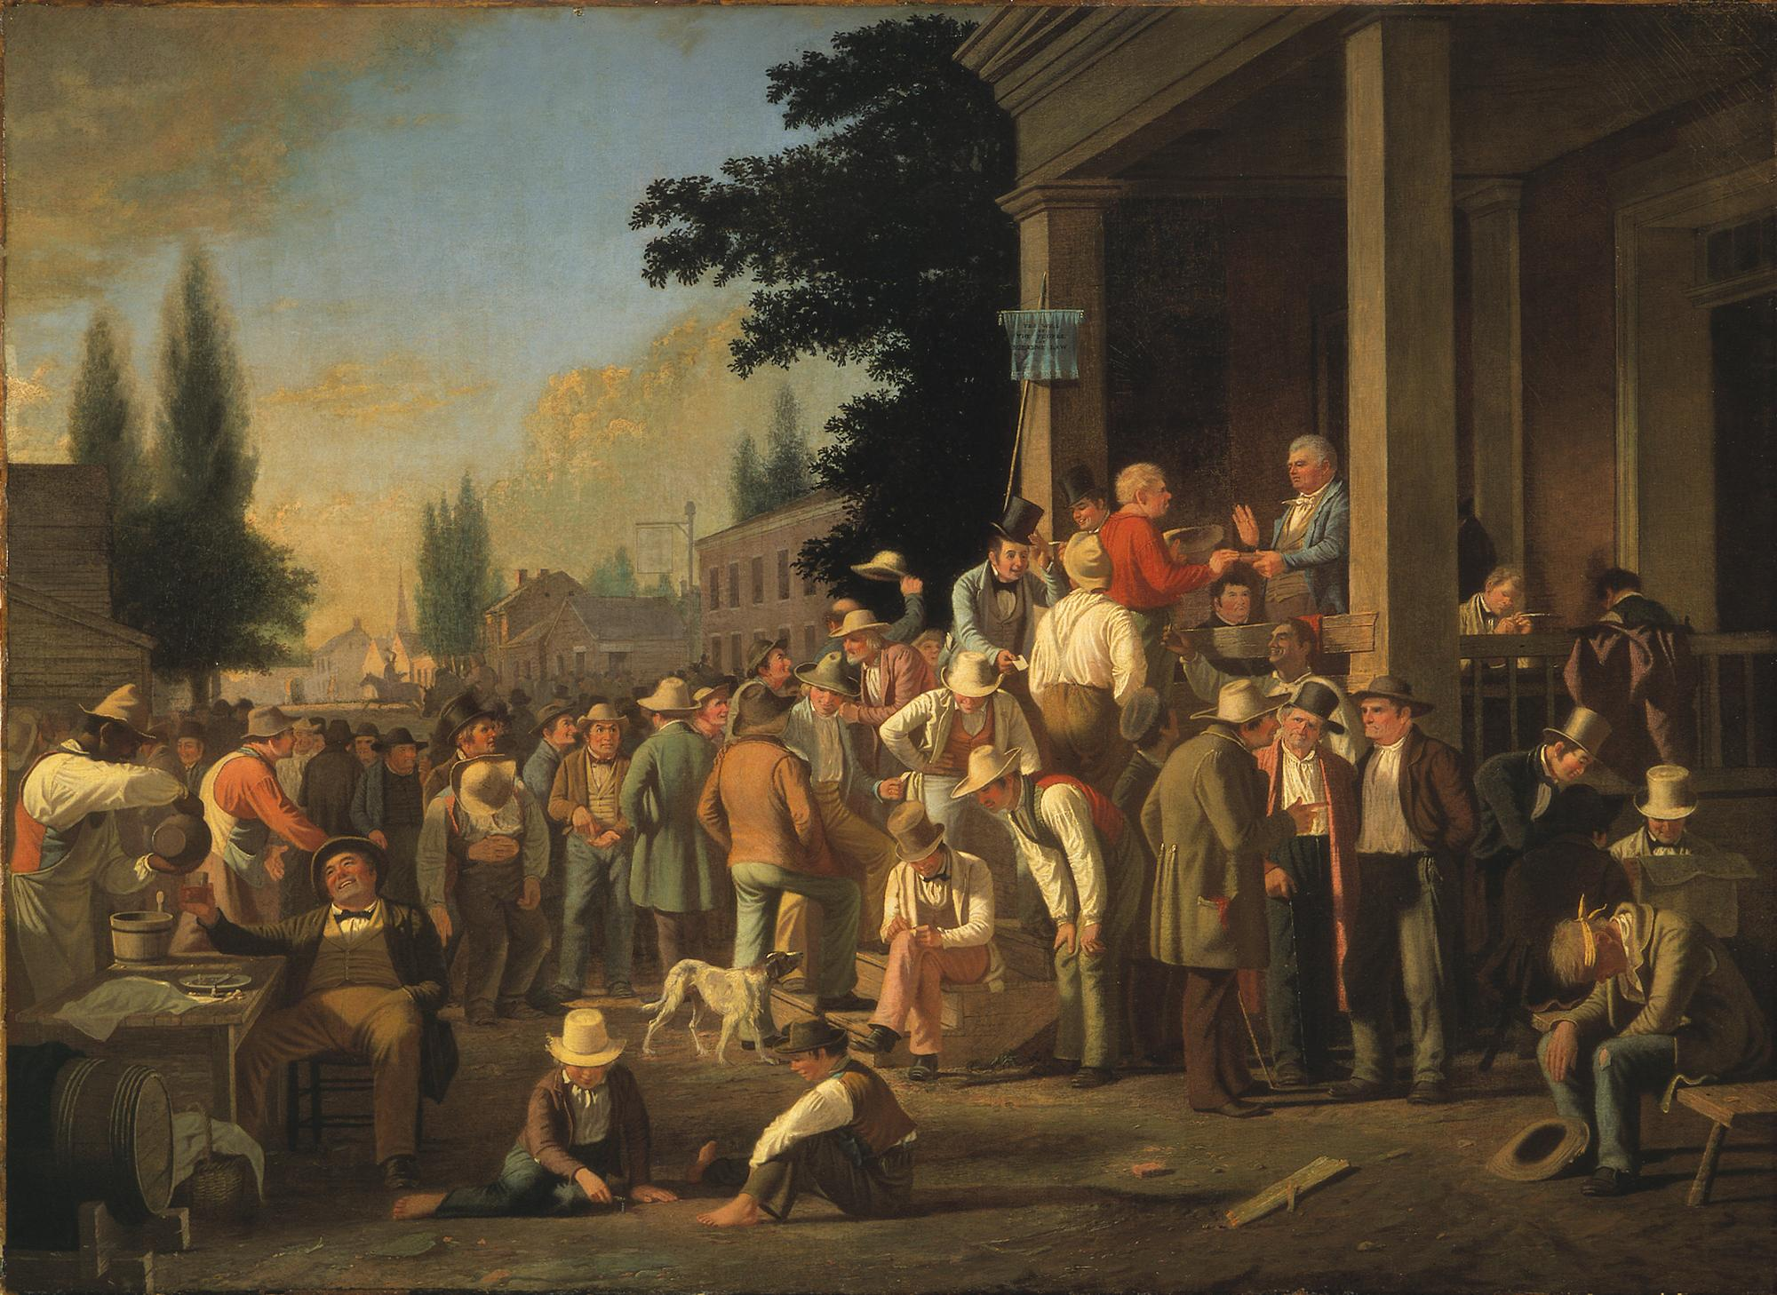
3. as more people earned right to vote politicians were forced to appease and appeal to the masses

Slide 12
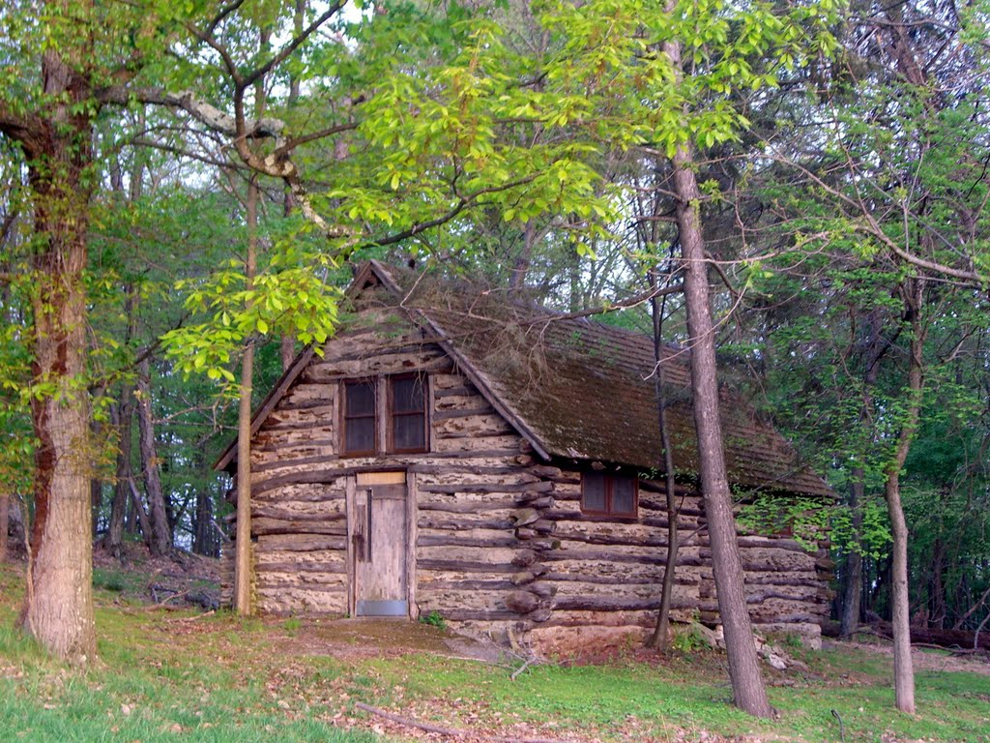
4. popular politicians claimed to be born in log cabins from a humble background

Slide 13
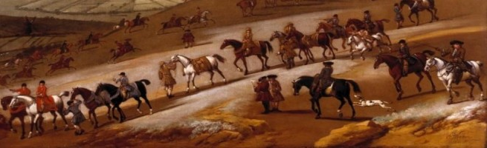
The most successful politicians smelled like “whiskey and onions.”
5. politicians who were aristocratic (too clean, too well dressed, too intellectual) were scorned

Slide 14
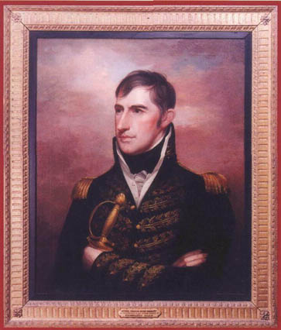
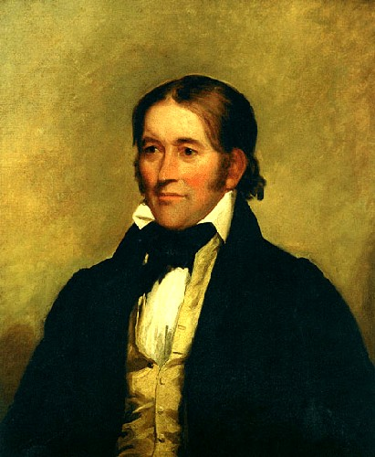
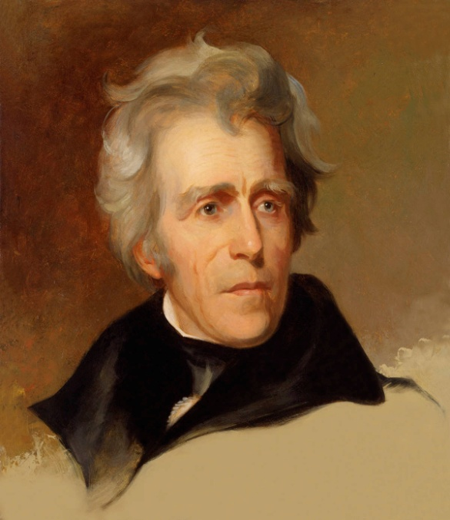
6. western Indian fighters and/or militia commanders were popular (Andrew Jackson, Davy Crocket, William Henry Harrison)

Slide 15
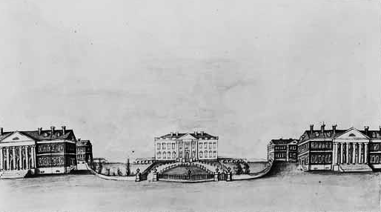
7. Jacksonian democracy characterized by the people directly governing

Slide 16
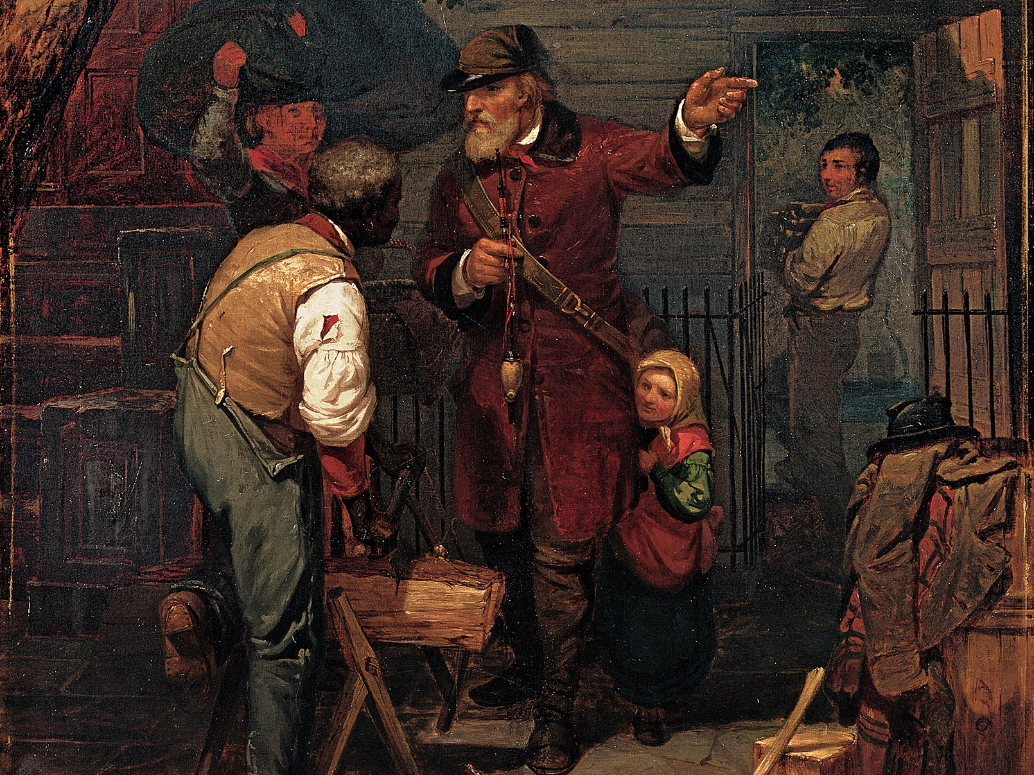
8. called the “New Democracy” based on universal male suffrage

Slide 17
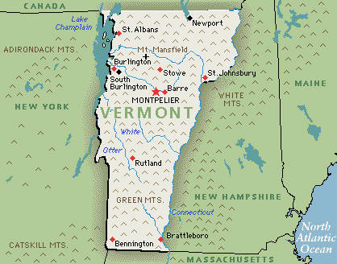
9. (1791) VT was 1st state admitted to union that allowed all white males to vote in elections

Slide 18
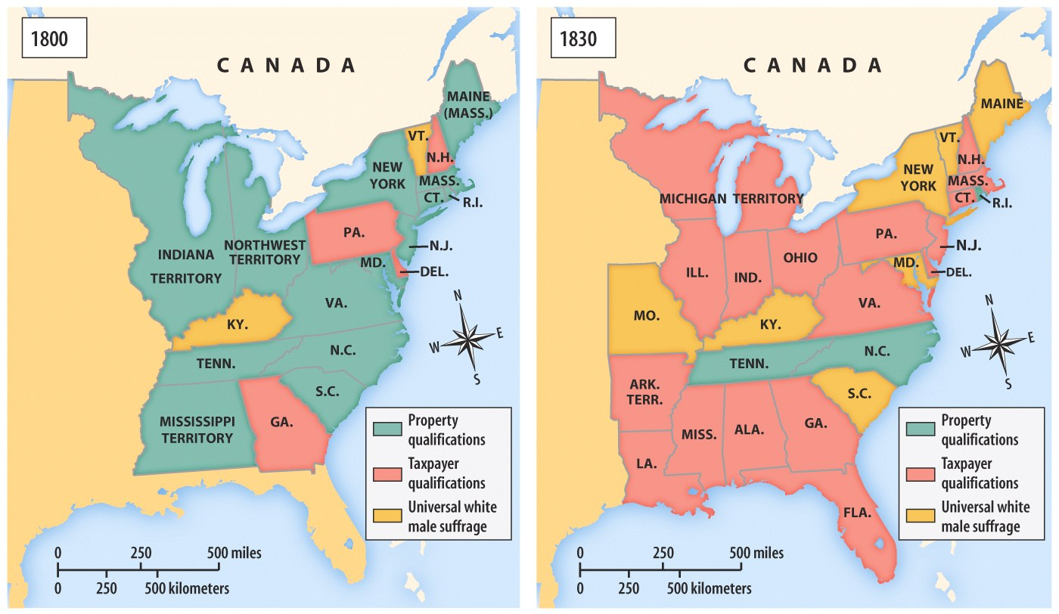
Extension of The Vote In
Early 19th Century America
Property qualifications to vote is “tyranny” because there was “one class of men with privileges which are denied to another.”
-Maryland reformers

Slide 19
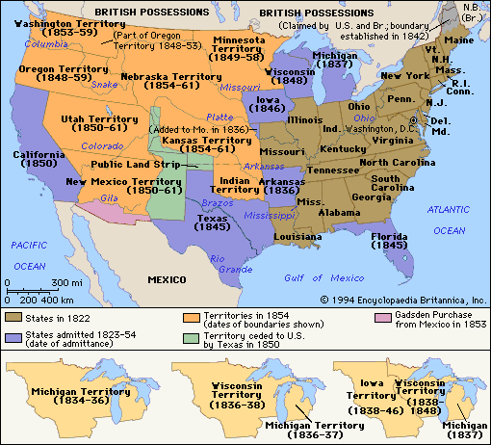
The Big Picture
Americans quickly understood that the right to vote had profound political and economic consequences for the people.
B. Nourishing the New Democracy

Slide 20
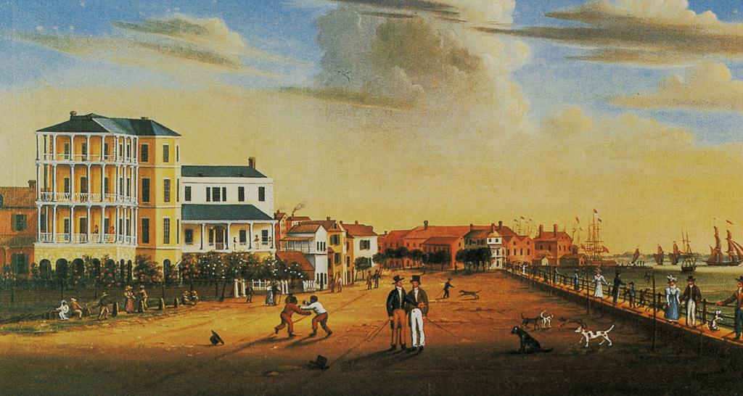
1. several factors led to expanding political democracy in US

Slide 21
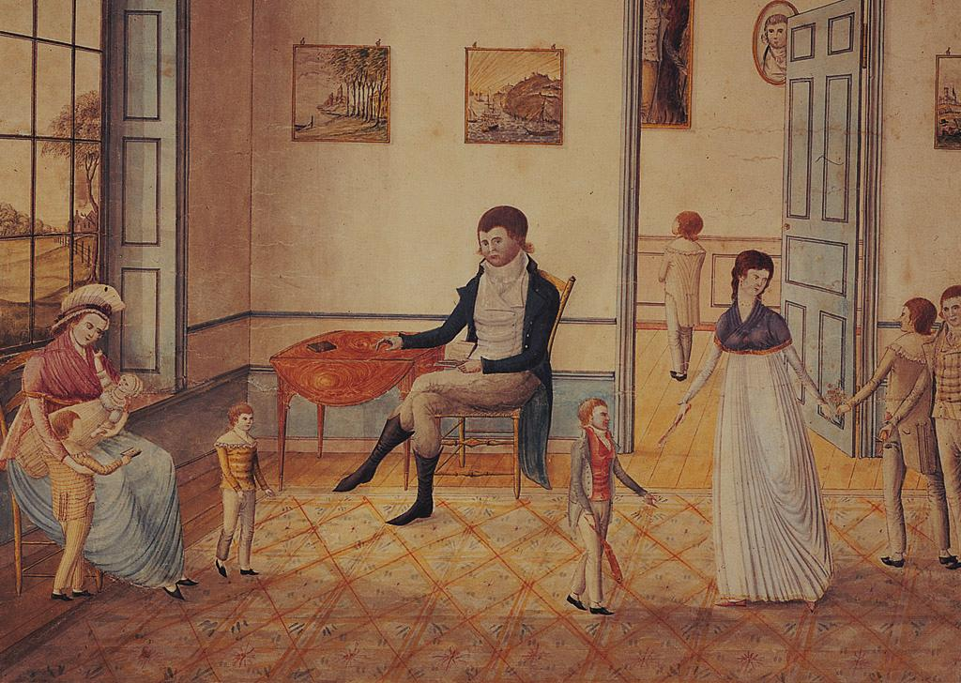
2. egalitarian ideas of the colonial period

Slide 22
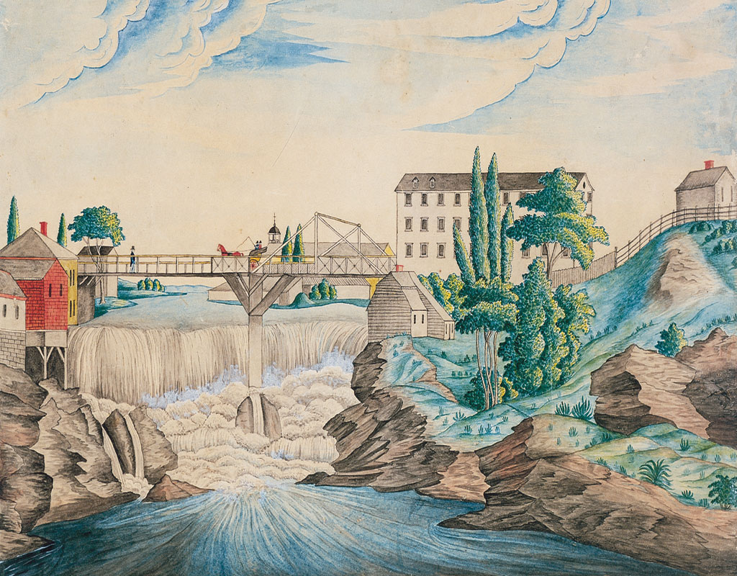
3. the steady growth of the market economy

Slide 23
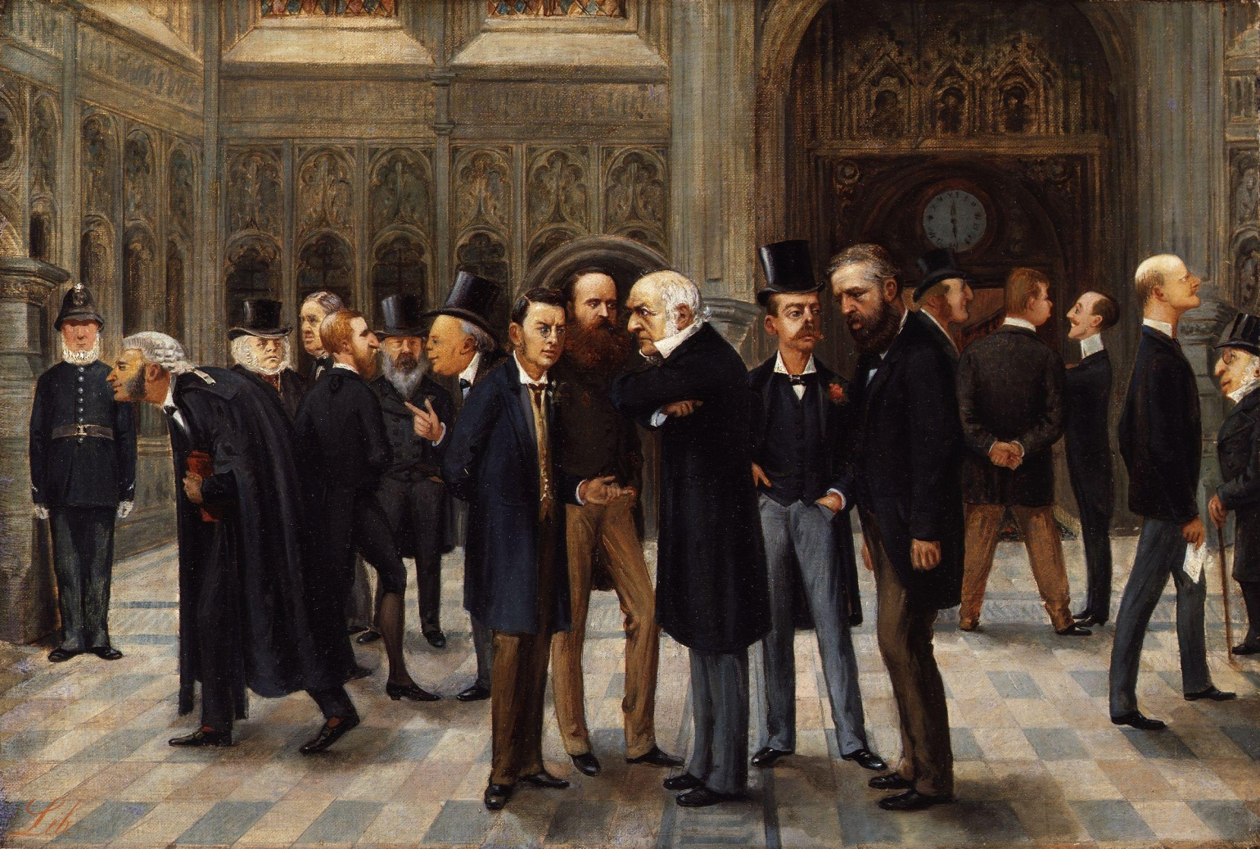
“The (men) spit, talk of elections and the price of produce, and spit again.”
-Frances Trollope, French
4. more people understood how banks, tariffs, & internal improvements affected quality of lives

Slide 24
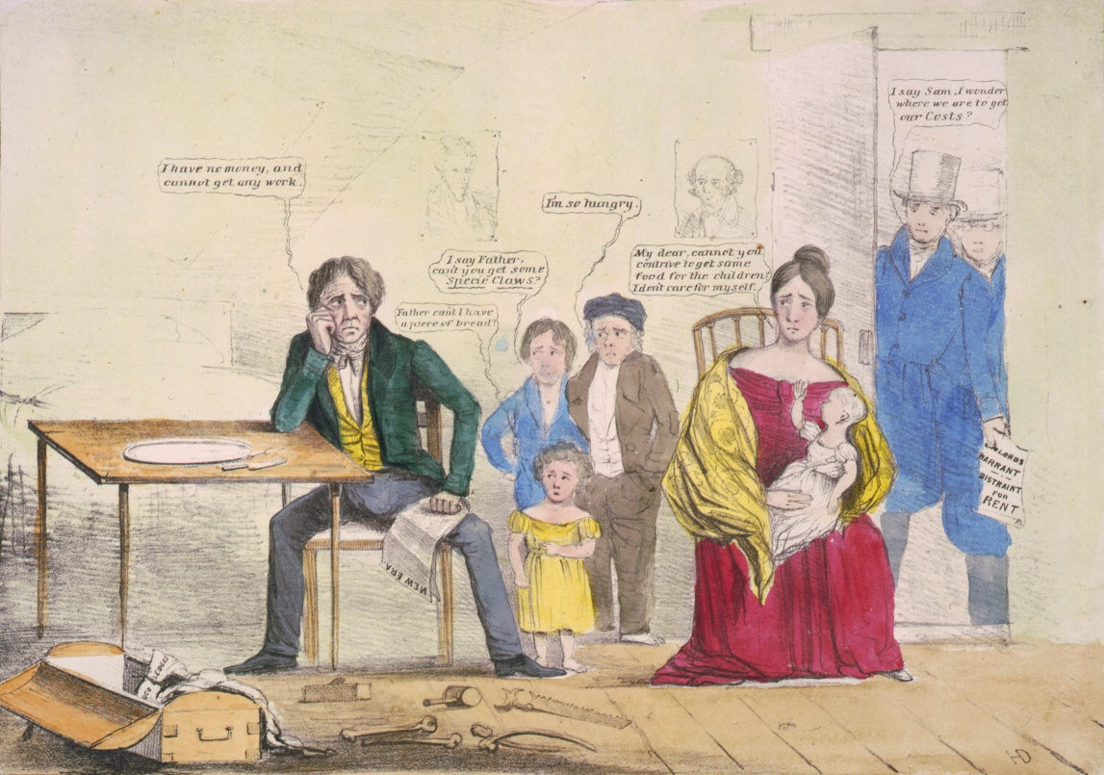
5. Panic of 1819 spurred resentment of rich when banks called in debts (farmers lost lands while bankers recovered)

Slide 25
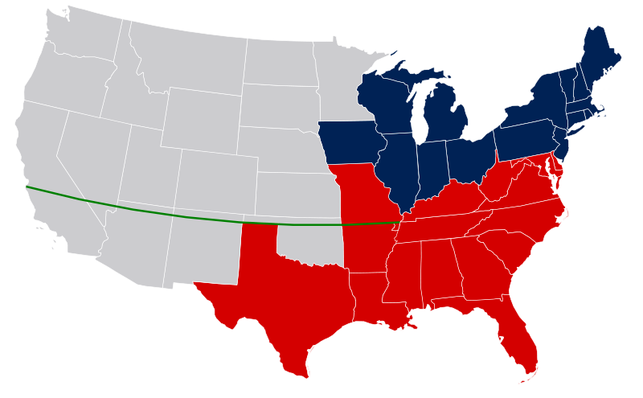
6. Missouri Compromise aroused Southern awareness that North may try ending slavery

Slide 26
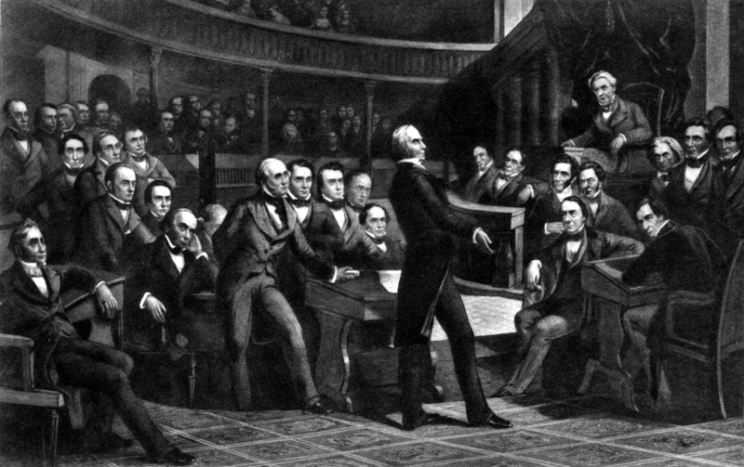
7. voter turnout rose dramatically as political parties developed and new styles of politicking emerged

Slide 27
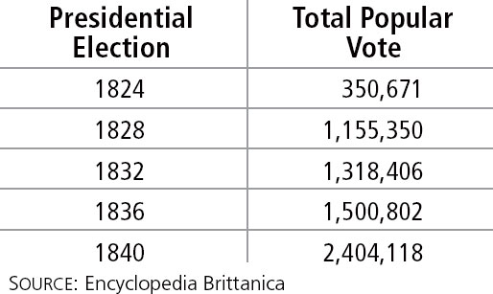
The Growing Electorate, 1824-1840
The number of white male voters grew
as democracy expanded.
Notes:
27

Slide 28
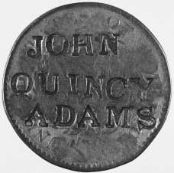
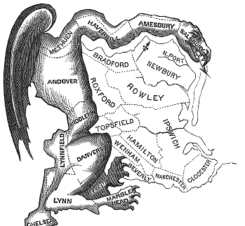
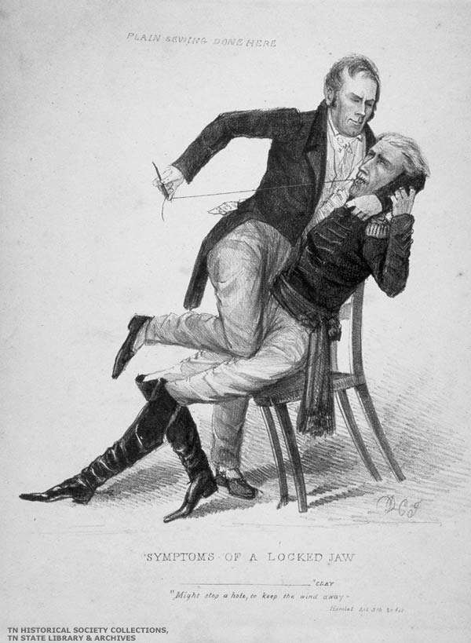
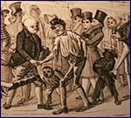
9. candidates used banners, badges, parades, barbeques, free drinks, and baby kissing in order to get the vote

Slide 29
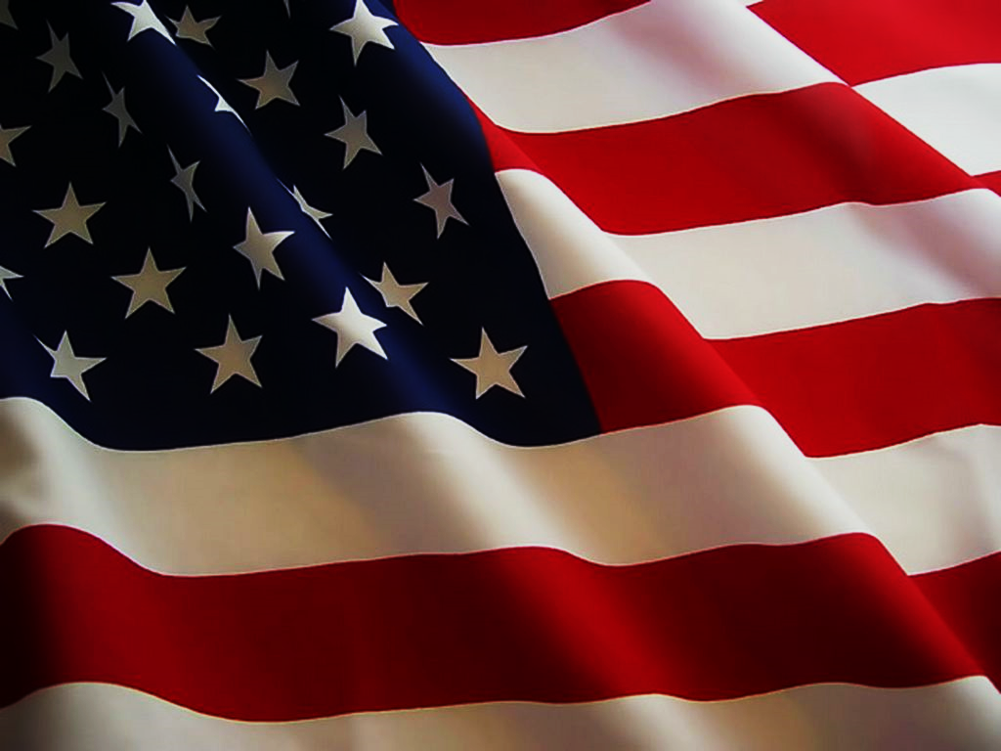
10. parties no longer chose their presidential candidates (replaced by conventions where people nominated candidates)

Slide 30
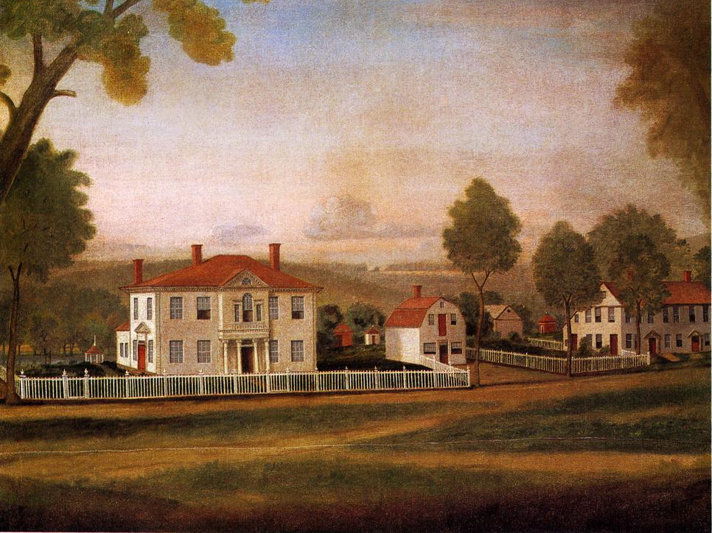
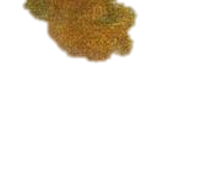
11. resistance to initiatives for democracy and inclusion included proslavery arguments, rising xenophobia, and restrictive anti-Indian policies

Slide 31
Partly as a consequence of expanded voting rights, Andrew Jackson was elected
president in 1828.
  Born to poor Irish immigrant parents, he had little early education, but he later acquired wealth and a plantation.
  He was a hero of the War of 1812 and was seen as a representative of the “common man.”
Notes:
31

Slide 32
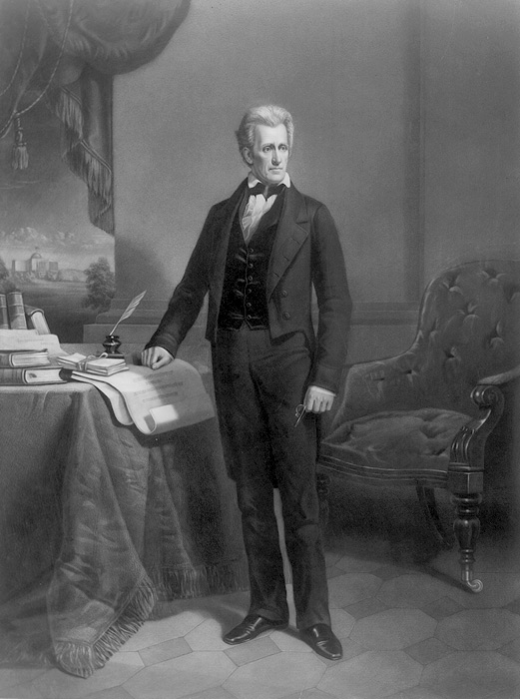
The Big Picture
Andrew Jackson’s presidency marks the first time in US history that the clear choice among the common people won the election.
E. The Jacksonian “Revolution of 1828”

Slide 33
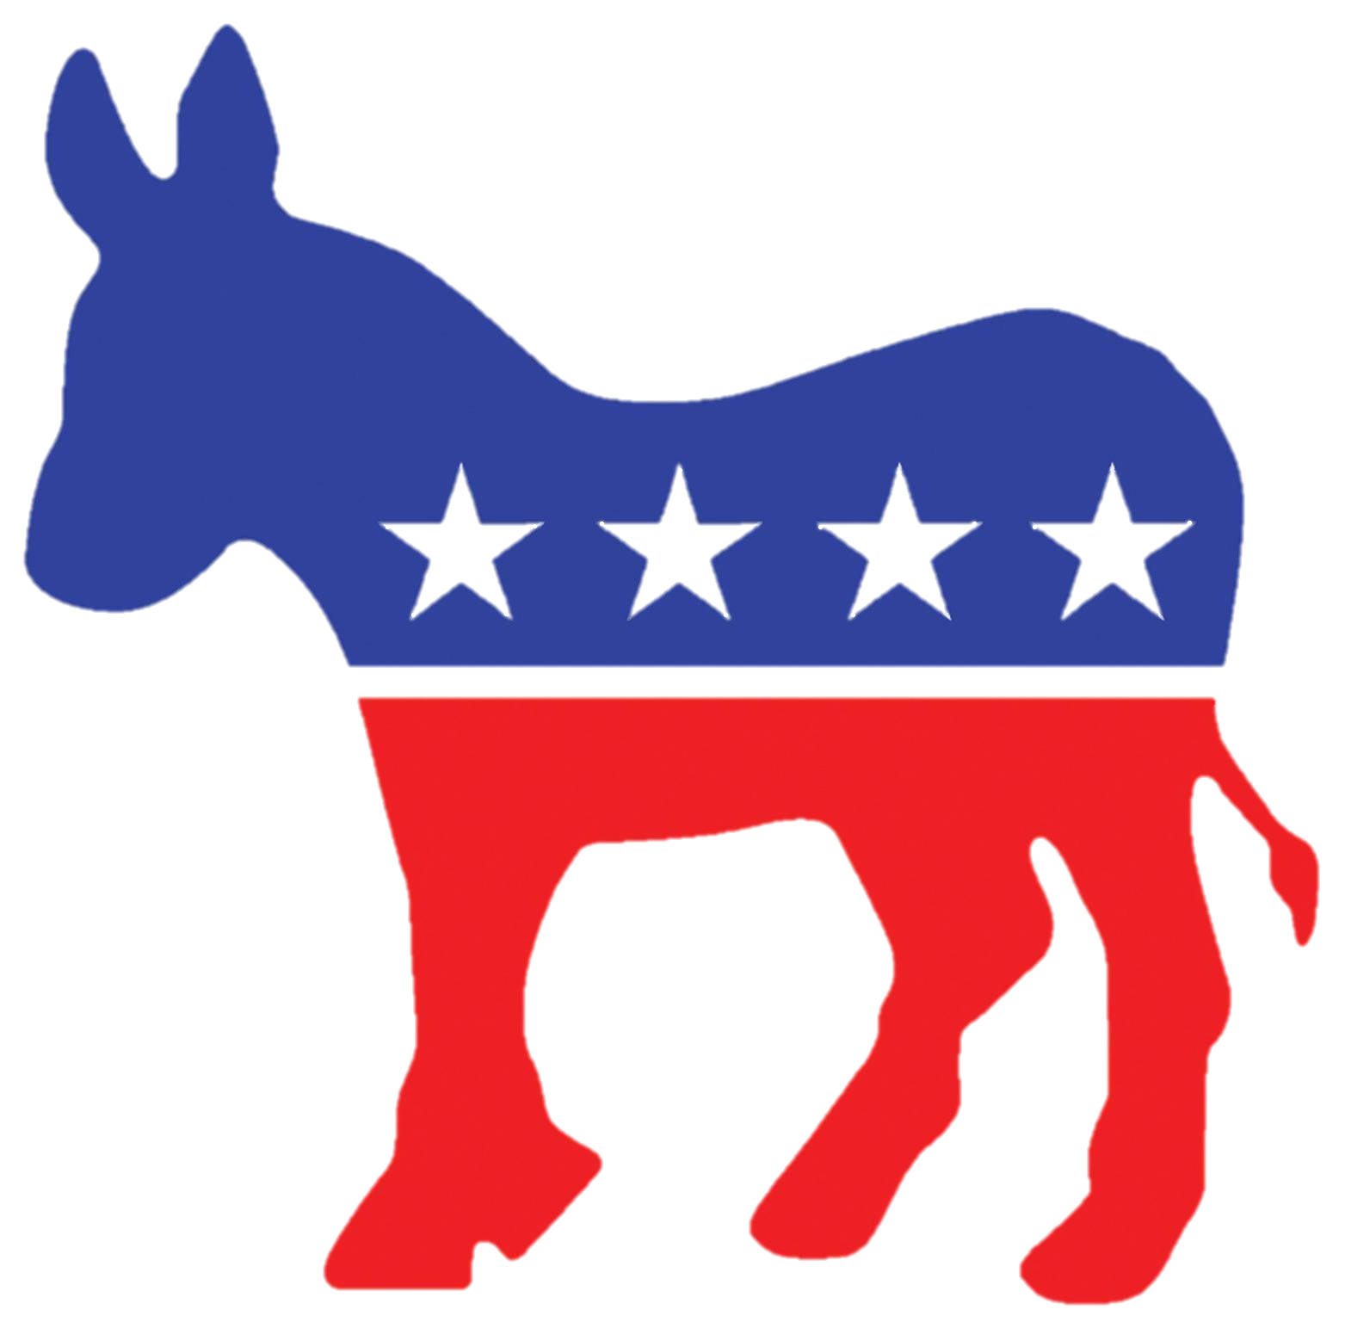
Jackson’s opponents referred to him as a “Jackass.” It later became the symbol of the Democratic Party of which Jackson belonged.

Slide 34
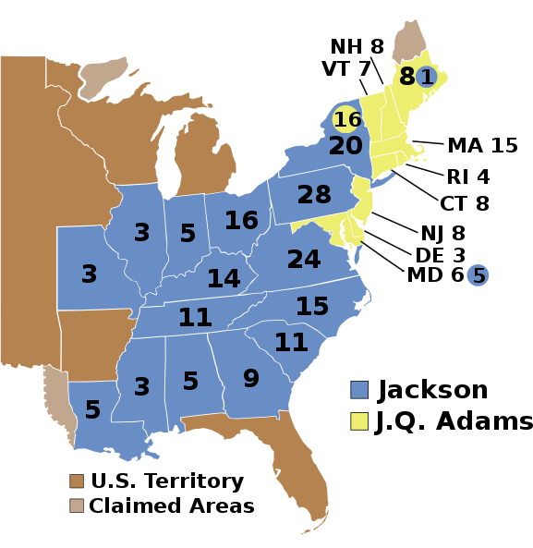
3. Jackson won both the popular and electoral vote in election of 1828

Slide 35
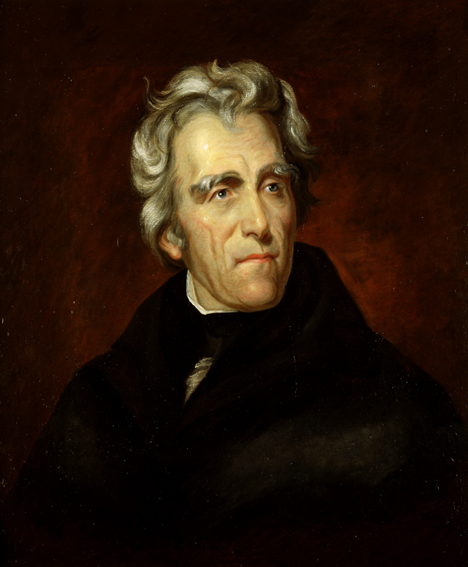
5. as the “People’s President” Jackson helped transfer national power to the poor (not elites)

Slide 36
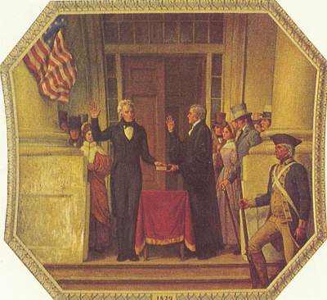
6. Jackson would become a powerful president who ignored the Supreme Court and used the veto power to control Congress

Slide 37
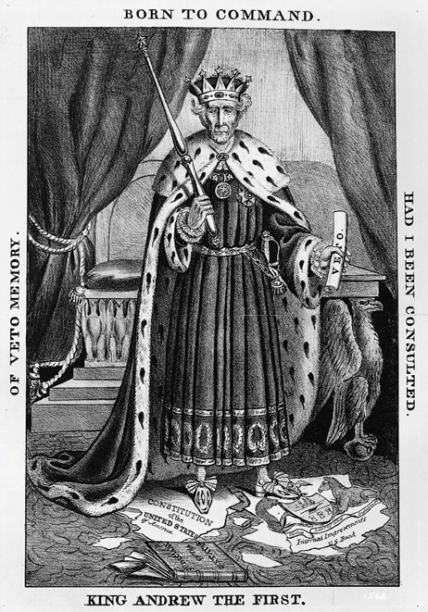
The new president (Jackson) would “bring a breeze with him. Which way it will blow, I cannot tell but…my fear is stronger than my hope.”
-Sen. Daniel Webster
7. conservatives condemned Jackson as “King Mob” and harshly criticized his power

Slide 38

RANK—#13
Andrew Jackson
Presidency: 1829—1837
Birthplace: North Carolina
Education: Elementary School
Party: Democratic
Age Upon Taking Office: 61
Vice-President: John C. Calhoun, Martin Van Buren
Height: 6’
Nicknames: “Old Hickory” “Sharp Knife” “King Andrew I”
Fun Fact:
Jackson was involved in over 100 duels in his life and survived malaria, dysentery and tuberculosis.
Sound Bite: “If you have a job in your department that can’t be done by a Democrat, then abolish the job.”

Slide 39
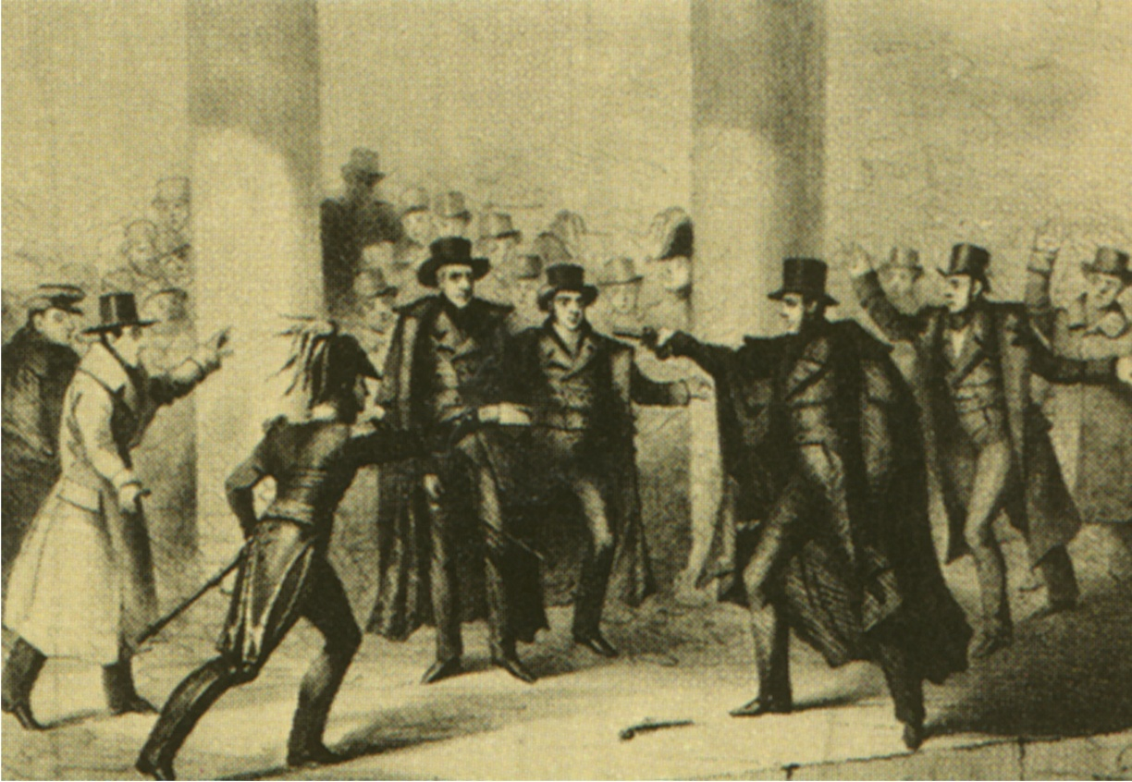
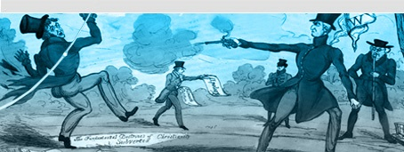
Jackson had been wounded so frequently in duels that it was said he "rattled like a bag of marbles".
Fought 13 duels—killed Charles Dickinson over a horse-racing debt—he broke the rules by firing twice.
Had bullets lodged in his arm and lung for the remainder of his life—causing him to occasionally spit up blood.

Slide 40
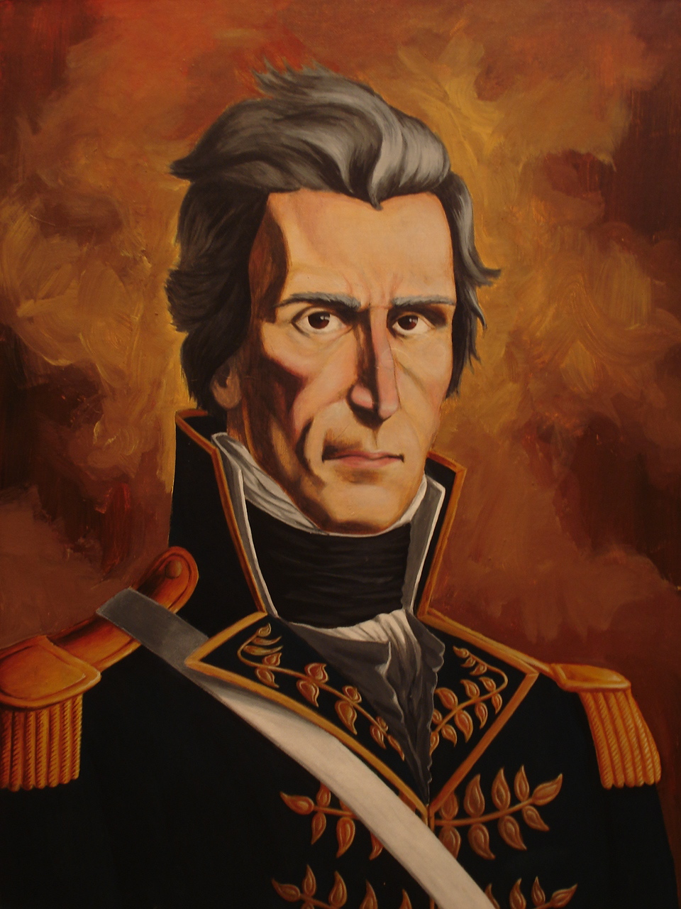
The Big Picture
Jackson believed that to the victor goes the spoils, and as such, replaced many employees within the executive branch with men loyal to him, regardless of their individual merit.
F. Jackson & The Spoils System

Slide 41
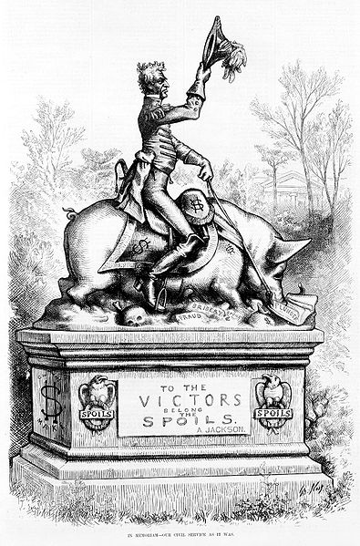
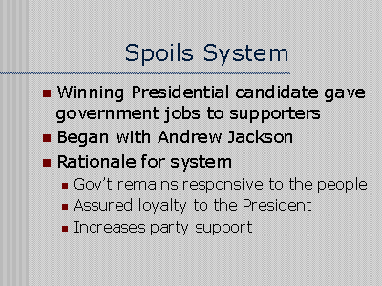
1. the spoils system involved presidents rewarding supporters with government jobs

Slide 42
The Spoils System is fair because it “would operate sometimes in favour of one party, and sometimes of another.”
-Martin Van Buren
2. Jackson believed that loyalty and new blood outweighed experience

Slide 43
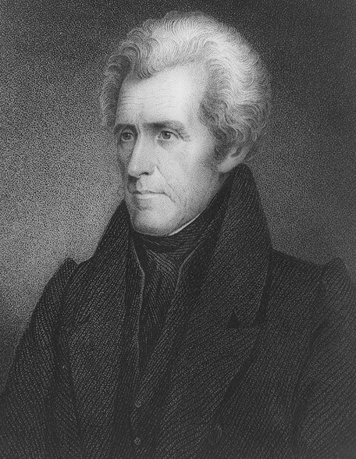
3. by rewarding loyalty over ability the spoils system sacrificed the effectiveness of government

Slide 44
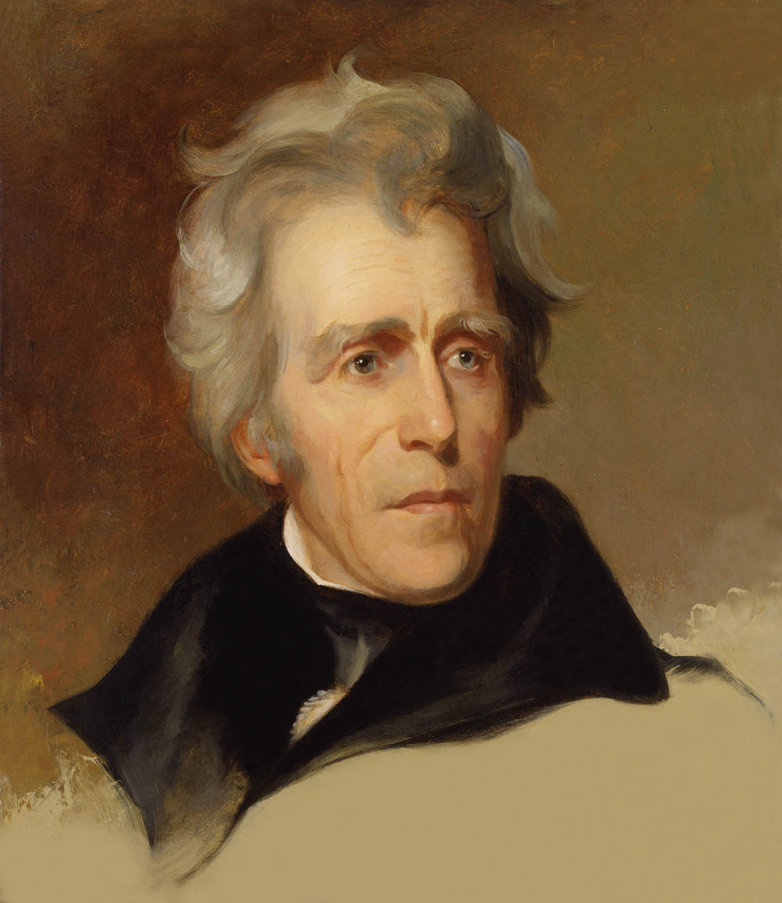
Public duties are “so plain and simple that men of intelligence may readily qualify themselves for their performance.”
-Andrew Jackson
4. Jackson threatened to “wipe the slate clean” but only 20% of federal employees were fired

Slide 45
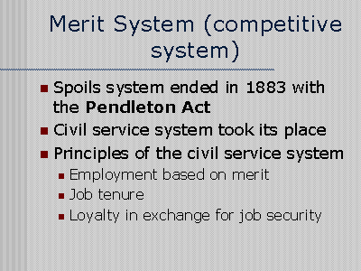
5. spoils system remained until 1883 when Pendleton Act introduced civil service exams

Slide 46

The Big Picture
Jackson filled his Cabinet with men to whom he owed political debts, and as a result the executive department was riddled with petty in fighting and was largely inept.
G. The Cabinet Crisis

Slide 47
2. Jackson preferred advice of friends (“The Kitchen Cabinet”) and often discussed public opinion with newspaper editors

Slide 48
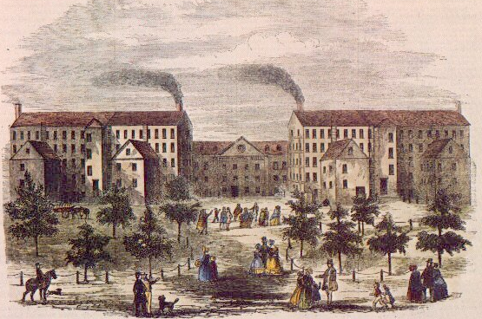
The Big Picture
Tariffs were beloved in the burgeoning industrial centers of the North and despised in the South.
H. The “Tariff of Abominations”

Slide 49
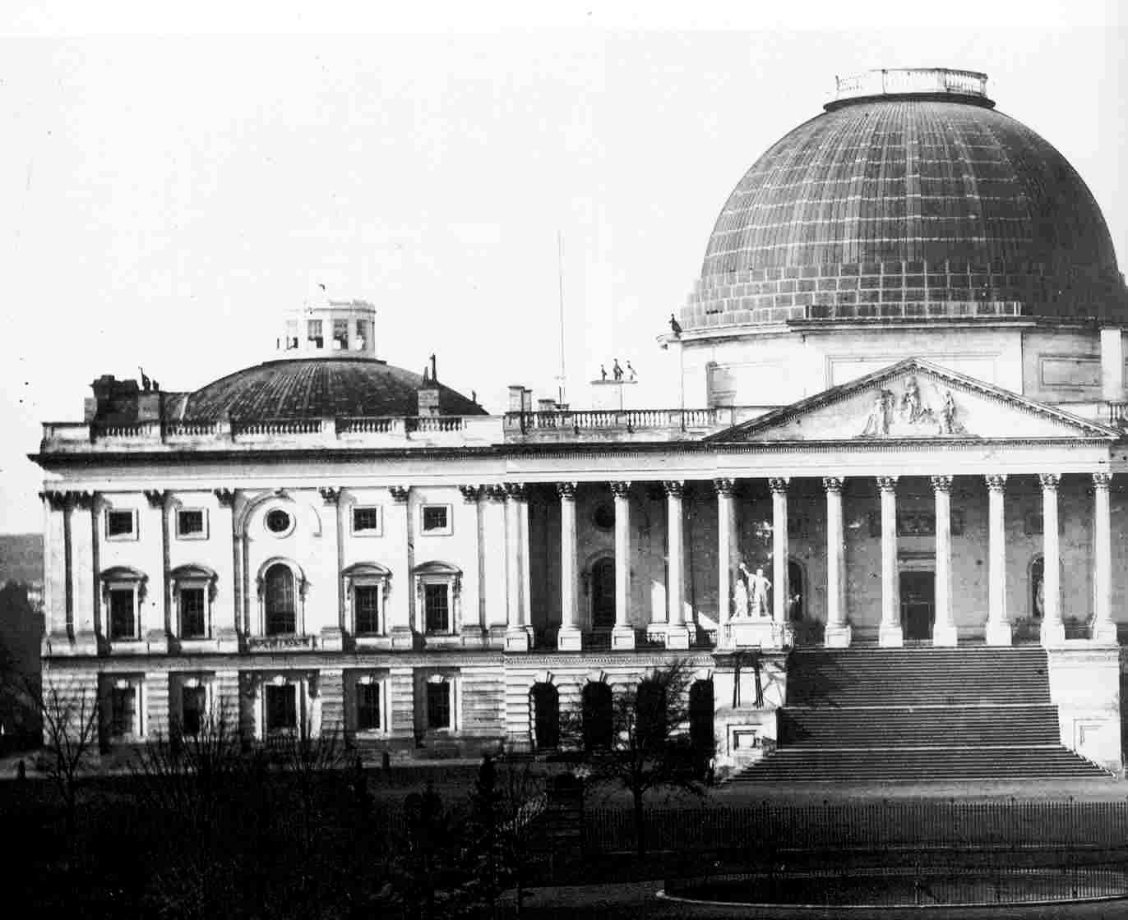
1. (1824) Congress increased tariff from 23% to 37% (some wanted it even higher)

Slide 50
The highest tariff in U.S. peacetime history!
2. with Tariff of 1828 Jackson’s supporters in Congress tried to raise tariffs to 45%

Slide 51
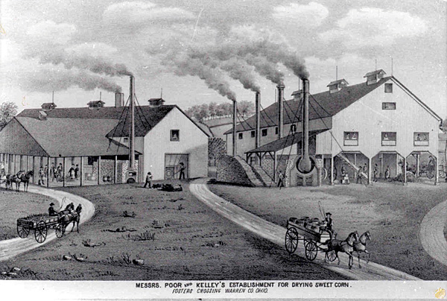
4. New Englanders actually embraced higher tariff and passed the bill

Slide 52
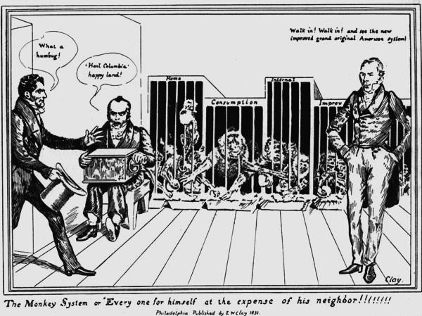
It is “unconstitutional, unwise, unjust, unequal, and oppressive.”
5. Southerners called the law the “Tariff of Abominations”

Slide 53
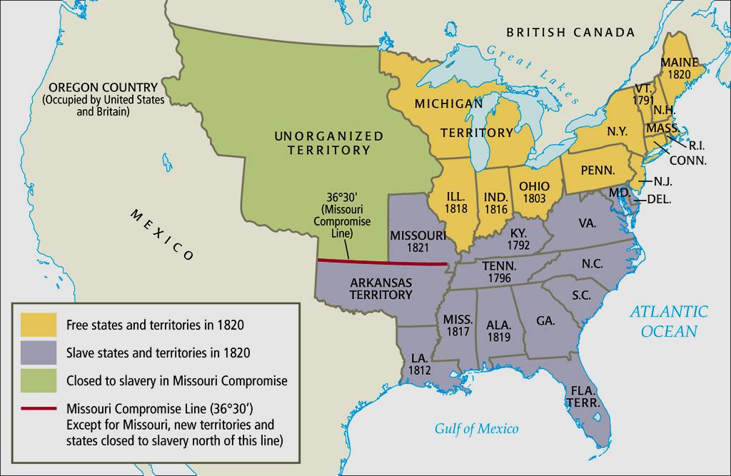
6. the South felt government favored the North (first the tariff…then slavery?)

Slide 54
  In the “Nullification Crisis,” South Carolina passed a law cancelling a federal tariff.
Congress granted Jackson the authority to use troops to put down this challenge to federal authority.
However, Congress also lowered the tariff.
Notes:
54

Slide 55
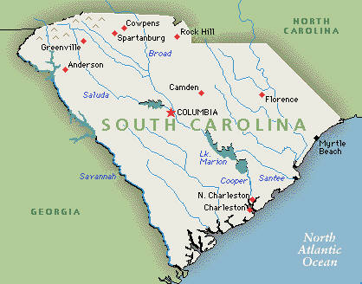
The Big Picture
South Carolina took a stand on the tariff by nullifying the Tariff of 1832 and threatened secession if the federal government attempted to enforce the law.
K. The Nullification Crisis

Slide 56
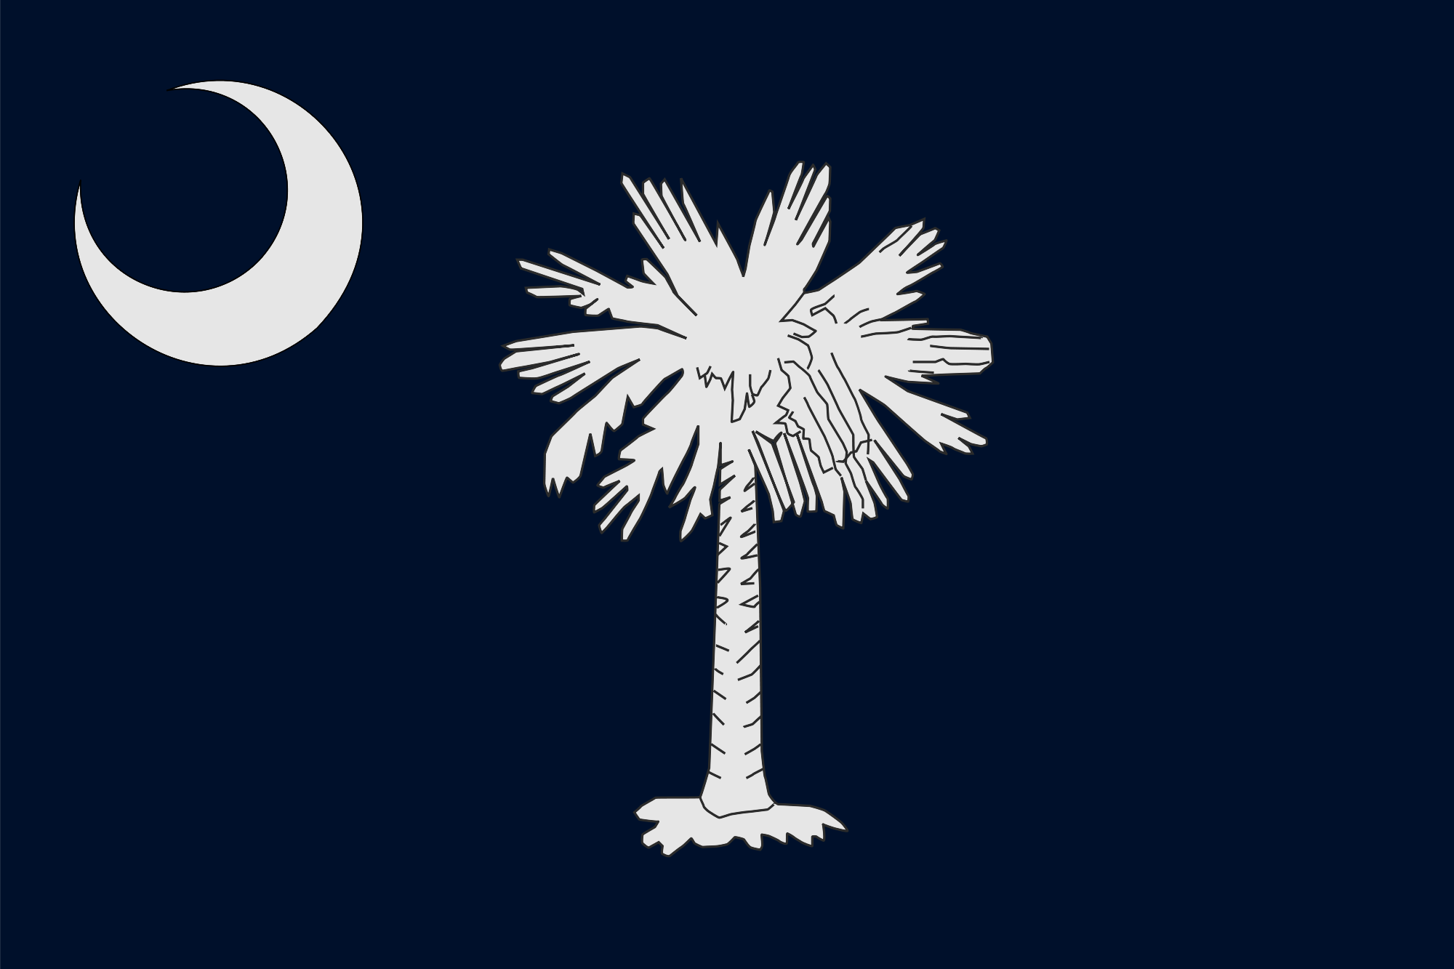
1. SC hated the Tariff of Abominations (decided if 2/3rds of their state legislature agreed they would nullify it)

Slide 57
2. Congress passed Tariff of 1832 lowering tariffs by 10% (hoped to ease tensions but southerners still hated it)

Slide 58

3. (1832) SC nullified the Tariff of 1832 and threatened to secede from Union if challenged

Slide 59
The use of nullification is “unauthorized” by the Constitution’s “spirit…and destructive of the great object for which it was formed. Disunion (secession) by armed force is treason.”
-Andrew Jackson
4. Jackson denounced SC’s actions and the Nullification Crisis threatened to tear US apart

Slide 60


Henry Clay proposed a compromise bill that would gradually reduce the Tariff of 1832 by 10% over 8 years prevent Jackson from crushing SC and gaining popularity)
The Nullification Crisis

Slide 61

5. Congress passed the Force Bill (or “Bloody Bill”) authorizing the president to use the army or navy to collect tariffs if necessary

Slide 62
6. no other state joined SC’s threat to secede (VA and GA considered it) and eventually SC ended its nullification

Slide 63
7. Unionists felt they won (nullification ended, war was avoided and the Union was preserved)

Slide 64

Essay
Essential Question
Although the power of the national government increased during the early republic, this development often faced serious opposition. Compare the motives of those opposed to the growing power of the national government in the following: Whiskey Rebellion (1794), Virginia and Kentucky Resolutions (1798-1799), Hartford Convention (1814-1815), Nullification Crisis (1832-1833).
8. Nullies felt they won (tariff was lowered and the threat of secession remained a powerful tool)

Slide 65
Jackson Restricted Native American Rights
The Cherokees and the Supreme Court | The Supreme Court upheld the Cherokees’ rights to land in Georgia. Jackson ignored the Court’s decision and ordered Native Americans to move West.
The Trail of Tears | Tens of thousands of Native Americans were forced to march from the South to Oklahoma. The 1838 forced march of the Cherokees, now known as the Trail of Tears, caused much suffering and death.
Notes:
65

Slide 66

The Big Picture
In the 1830s, US policy shifted regarding Native Americans away from marginalizing them on reservations to having them removed west of the Mississippi.
N. Transplanting The Tribes

Slide 67

“If women, of all the subordinate groups in a society dominated by rich white males, were closest to home (indeed, in the home), the most interior, then the Indians were the most foreign, the most exterior. Women, because they were so near and so needed, were dealt with more by patronization than by force. The Indian, not needed-indeed, an obstacle-could be dealt with by sheer force, except that sometimes the language of paternalism preceded the burning of villages.”
-Howard Zinn, A People’s History of the United States
1. whites living on the frontier tended to champion expansion efforts (resistance by Indians led to a sequence of wars and federal efforts to control Indian populations)

Slide 68


2. (1830) the U.S. population was 13 million and as states emerged Indians were left stranded

Slide 69

Andrew Jackson’s “Love” for the Indians
“Those tribes cannot exist surrounded by our settlements. They have neither the intelligence nor the moral habits. Established in the midst of a superior race, they must disappear.”

Slide 70

3. federal policy = acquire Indian lands through treaties (often Indians were tricked)

Slide 71

4. some people respected Indians and tried to Christianize them (assimilation)

Slide 72

The Society for Propagating the Gospel Among Indians (est. 1787)

Slide 73

system of settled agriculture, devised an alphabet, legislated a legal code (1808) and a written constitution (1827)
5. some Indians violently resisted but tribes like the Cherokees tried to adopt American ways

Slide 74


“You asked us to throw off the hunter and warrior state: we did so. You asked us to form a republican government: we did so. You asked us to learn to read: we did so. You asked us to cast away our idols, and worship your God: we did so.
-John Ridge, Cherokee Indian
6. the Cherokees, Creeks, Chickasaw, Choctaws, and Seminoles called the “Five Civilized Tribes”

Slide 75

7. (1828) Georgia declared the Cherokee tribal council illegal asserting jurisdiction over Indian lands and affairs

Slide 76


Cherokee Chief
John Ross
“John Marshall has made his decision: now let him enforce it!”
-Jackson
the court ruled that the Cherokee nation was a "distinct community" with self-government "in which the laws of Georgia can have no force."
8. in Worcester v. Georgia the Cherokees appealed to and won in the Supreme Court but Jackson refused to recognize the decision

Slide 77
9. Jackson proposed that the Indians be resettled west of the Mississippi where they could preserve their culture

Slide 78
“They and all their children” could live in Oklahoma “as long as grass grows and water runs. “
-government officials
10. (1830) Congress passed the Indian Removal Act (Indians were moved to Oklahoma)

Slide 79

Nunna daul Isunyi “The Trail Where We Cried”
“In the long record of man’s inhumanity, exile has wrung the moans of anguish from many different peoples. Upon no people could it have fallen with a more shattering impact than upon the eastern Indians. The Indian was peculiarly susceptible to every sensory attribute of every natural feature of his surroundings. He lived in the open. He knew every marsh, glade, hill top, spring, creek, as only the hunter can know them. He had never fully grasped the principle establishing private ownership of land as any more rational than private ownership of air but he loved the land with a deeper emotion than could any proprietor. He felt himself as much a part of it as the rocks and trees, the animals and birds. His homeland was holy ground, sanctified for him as the resting place of the bones of his ancestors and the natural shrine of his religion. He conceived its waterfalls and ridges, its clouds and mists, its glens and meadows, to be inhabited by the myriad of spirits with whom he held daily communion. It was from this rain-washed land of forests, streams and lakes, …that he had to be driven to the arid, treeless plains of the far west, a desolate region then universally known as the Great American Desert.”
-Dale Van Every, The Disinherited
11. 1000s of Indians died on the “Trail of Tears”

Slide 80


12. (1836) The Bureau of Indian Affairs was established to deal with the Indians

Slide 81
“The United States will never ask for your land there (west of the Mississippi River). This I promise you in the name of your great father, the President. That country he assigns to his red people, (is) to be held by them and their children’s children forever.”
-Lewis Cass, Secretary of War
The Indian Removal Act “only defers the fate of the Indians. In half a century their conditions beyond the Mississippi will be just what it is now on this side. Their extinction is inevitable.”
-editor of the North American Review

Slide 82

Religious and social reform also grew.
Baptists, Methodists, African Methodist Episcopals, and new religious groups, such as the Mormons, expanded membership.
A Second Great Awakening called for moral perfection. Thousands attended outdoor camp meetings.
Notes:
82

Slide 83
Social reform grew out of religious fervor.
The temperance movement sought to end alcohol abuse.
Dorothea Dix advocated reforms to aid prisoners and the mentally ill.
Horace Mann worked to improve public schools.

Slide 84
A Transcendentalist named Henry David Thoreau called for civil disobedience.
Thoreau was one of a small number of reformers called abolitionists, who sought to end slavery as a moral wrong harming both slave and owner.

Slide 85
The westward expansion of slavery
became a political issue.
The Missouri Compromise of 1820 drew a line across the Louisiana Territory that separated free and slave territories.
Many Americans supported slavery because they believed their prosperity rested on the institution of slavery.
Notes:
85

Slide 86


Known as “Black Moses” for leading slaves to freedom, Harriet Tubman was
a conductor on the Underground Railroad.
William Lloyd Garrison risked his life to publish the abolitionist newspaper,
The Liberator.

Slide 87
Supporters of slavery were sometimes violent. Abolitionist newspaper editor Elijah Lovejoy was murdered by an angry mob.
Some abolitionists, such as Frederick Douglass, demanded freedom and full rights for African Americans.
Notes:
87

Slide 88
Women began to fight for their rights as well.
In the 1830s and 1840s, some women joined anti-slavery organizations and labor unions.
In 1848, Elizabeth Cady Stanton and
Lucretia Mott organized a women’s rights convention in Seneca Falls, New York.
Susan B. Anthony led the fight
for women’s suffrage.

Slide 89
In 1845, the U.S annexed Texas. In 1846, a dispute over the border between Texas and Mexico Sparked the Mexican-American War.
The Treaty of Guadalupe Hidalgo resulted in a huge land sale to the United States. The Rio Grande River became the southern border of Texas.
Notes:
89

Slide 90

The discovery of gold in 1848 spurred a tremendous migration to California.
In 1850, California applied for statehood as a free state, raising a new conflict over slavery.

Slide 91
Section Review
Reform & Westward Expansion
Growing Democratiz-ation
The Age of Jackson
Trail of Tears
Nullification Crisis
Religion and Social Reform
2nd Great Awakening
Social Reform
Alcohol Abuse
Prisoners
Education
Civil Disobedience
The Antislavery Movement
Missouri Compromise
Underground Railroad
Frederick Douglass
The Women’s Rights Movement
Antislavery
Labor
Manifest Destiny
Mexican-American War
The Gold Rush
Notes:
91

