Slide 1
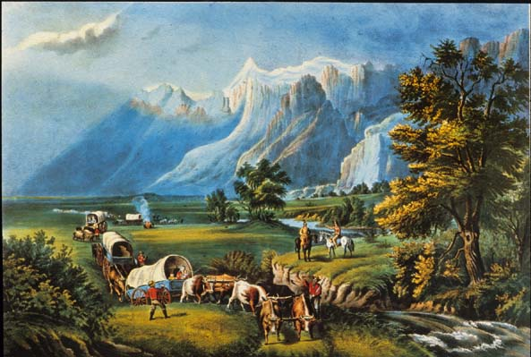
“Our manifest destiny is to overspread the continent allotted by Providence for the free development of our yearly multiplying millions.”
-John O’Sullivan, Democratic Review
The Big Picture
James K. Polk made aggressive territorial expansion the centerpiece of his 1844 Presidential bid and his victory arguably provided the mandate for this to occur.
A Mandate(?) for Manifest Destiny

Slide 2
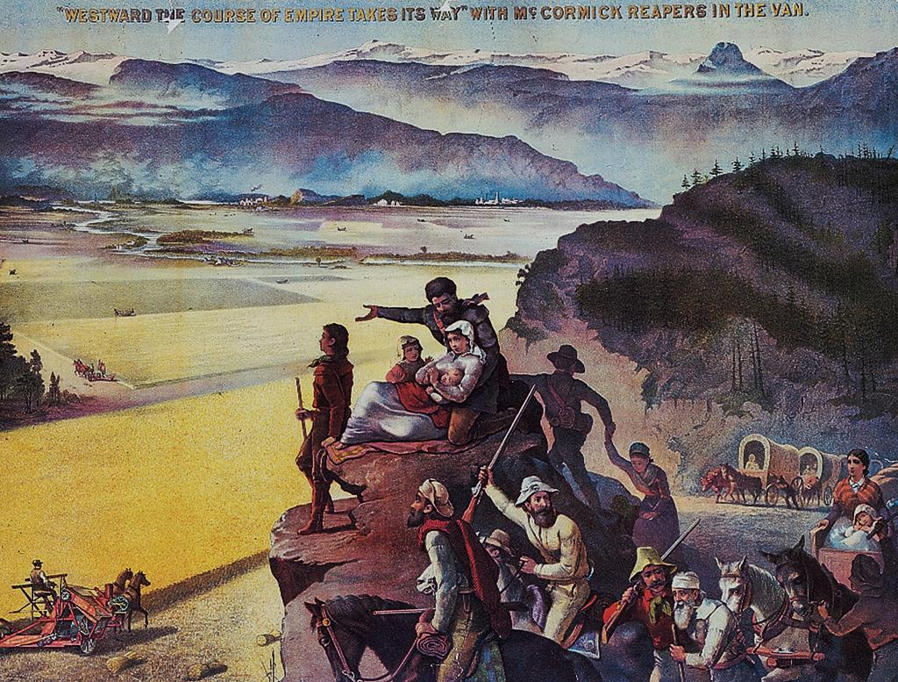
Manifest Destiny and Its Legacy

Slide 3
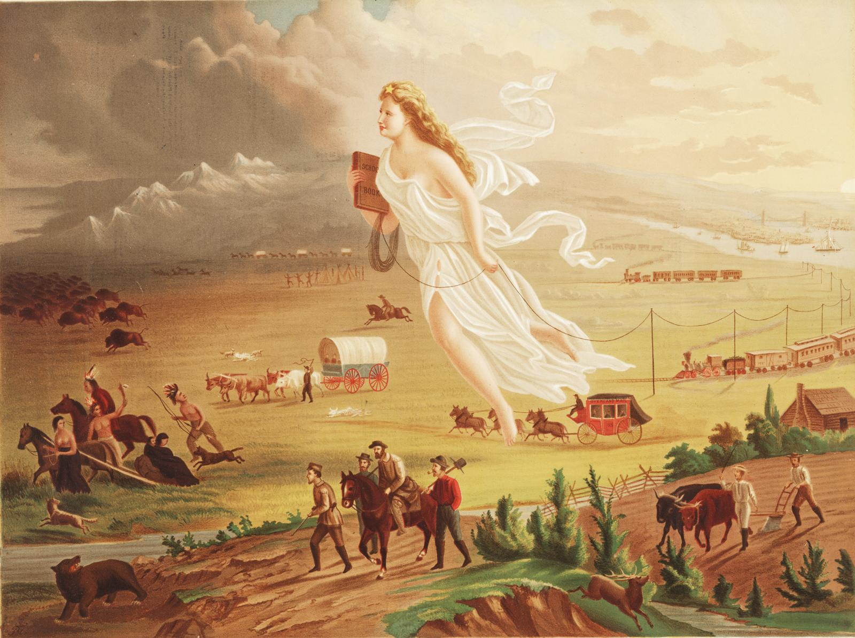
John Gast’s American Progress, 1872
Columbia, the female figure of America, leads Americans into the West and into the future by carrying the values of republicanism (as seen through her Roman garb) and progress (shown through the inclusion of technological innovations like the telegraph) and clearing native peoples and animals, seen being pushed into the darkness.

Slide 4
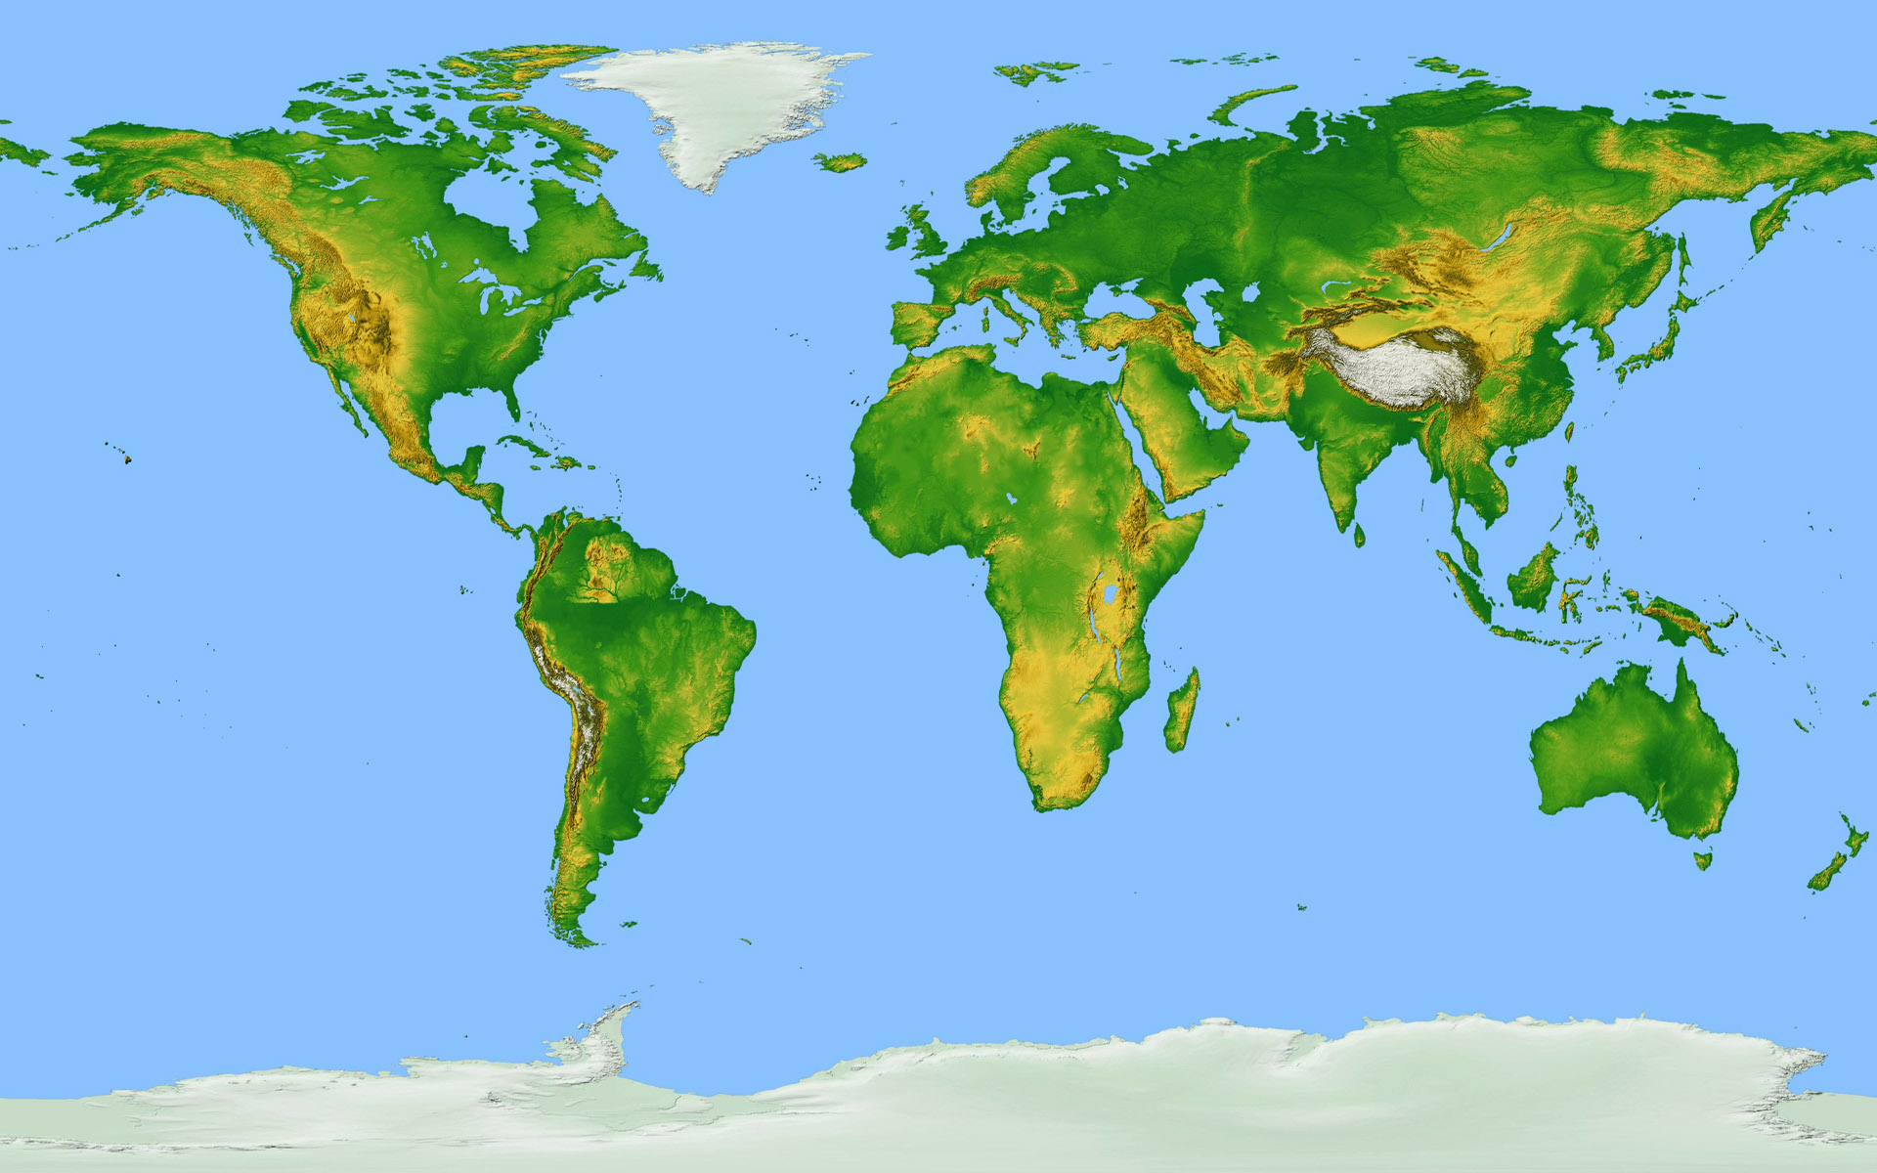
“The whole continent of North America appears to be destined by Divine Providence to be peopled by one nation, speaking one language, professing one general system of religious and political principles, and accustomed to one general tenor of social usages and customs. For the common happiness of them all, for their peace and prosperity, I believe it is indispensable that they should be associated in one federal Union”
-John Quincy Adams, 1811
Struggling to create a stronger global presence, US policymakers (expansionists) sought to dominate North America

Slide 5
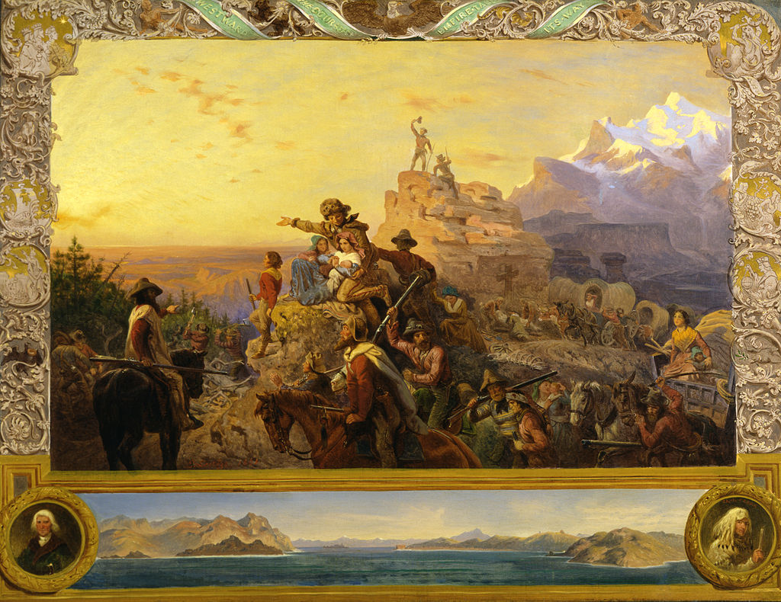
Manifest Destiny (US expansion in North America) built on belief of white racial superiority and sense of American cultural superiority

Slide 6
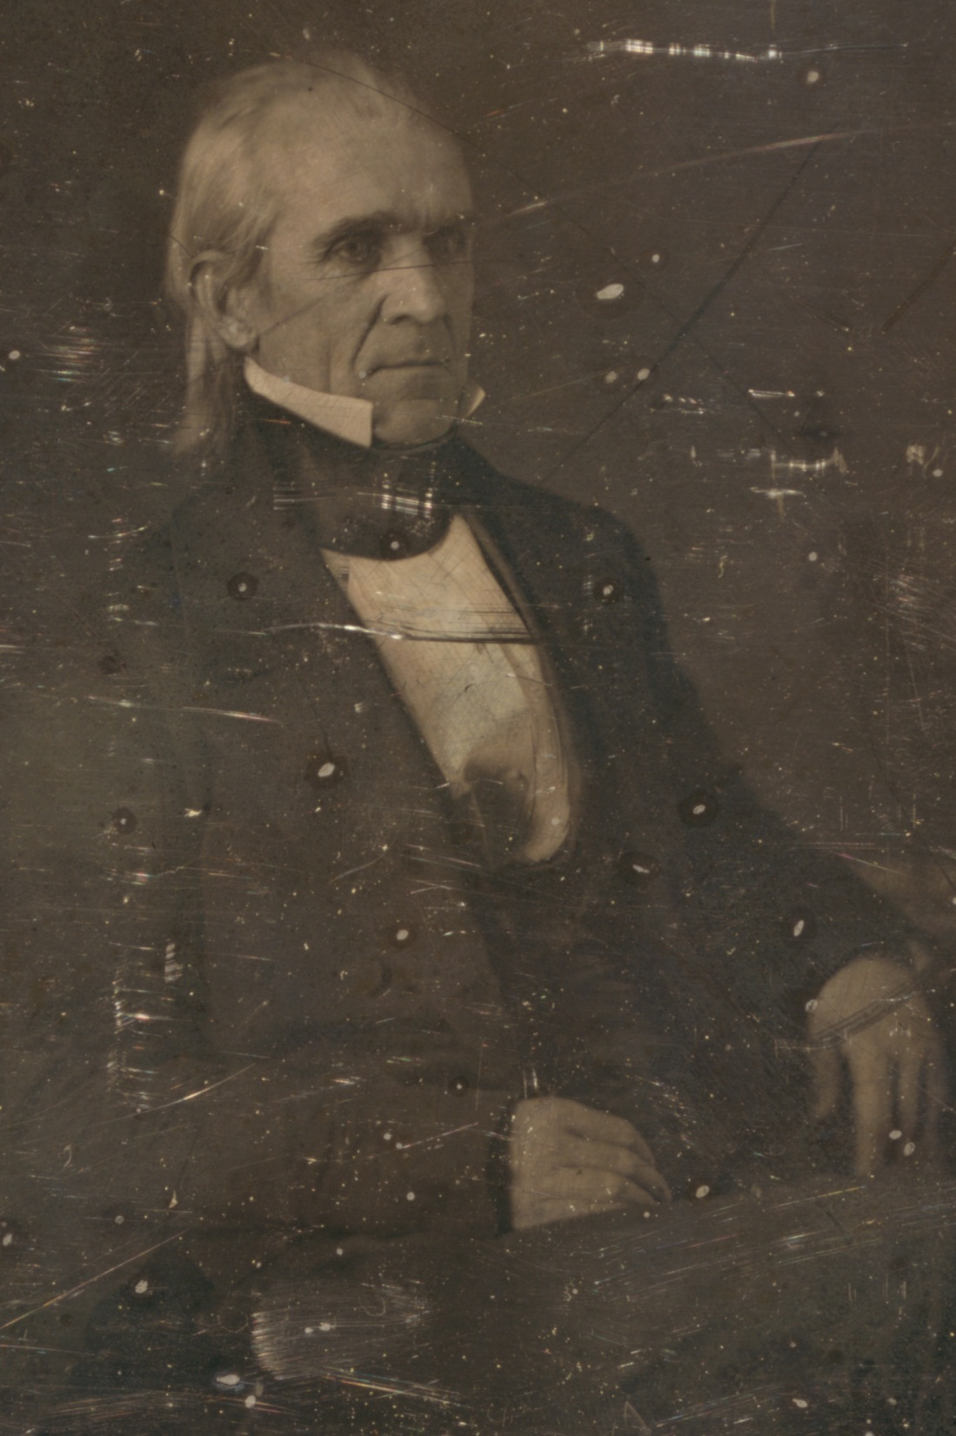
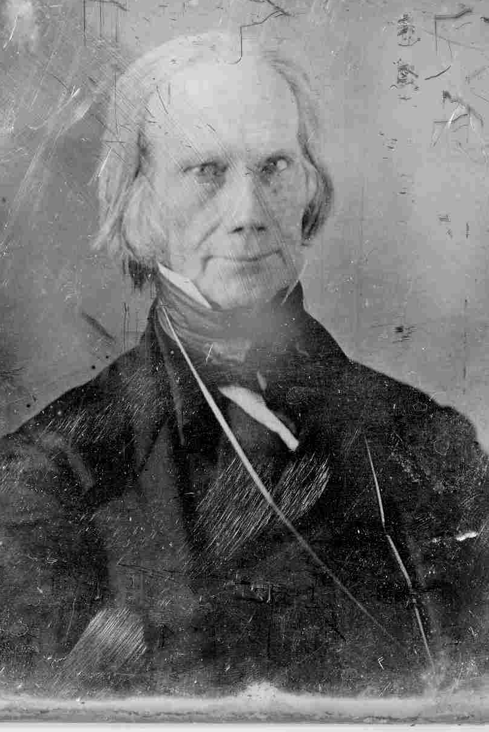
(1844) Henry Clay (Whig) ran against a long-shot candidate James K. Polk (Democrat)

Slide 7
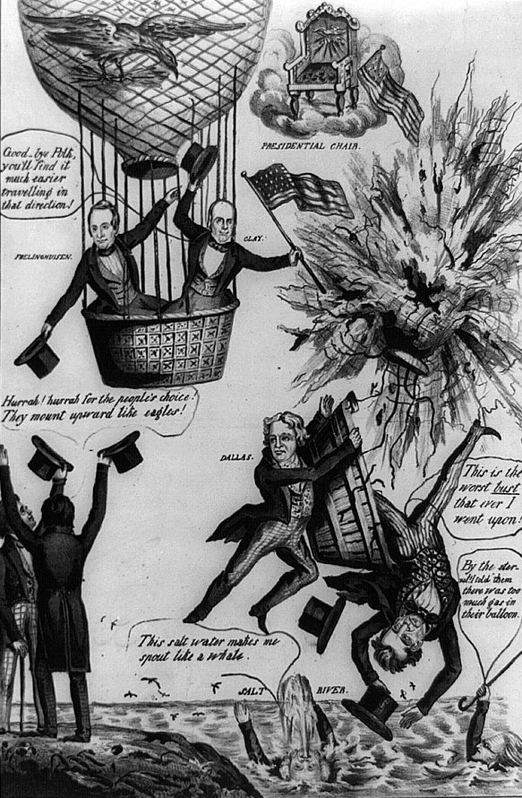
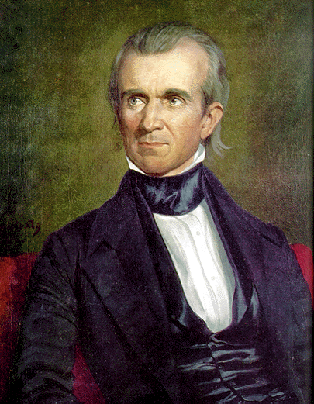
Polk Bursting
Clay’s Balloon
Polk had been Speaker of the House, governor of Tennessee and “Young Hickory” was sponsored by Jackson

Slide 8
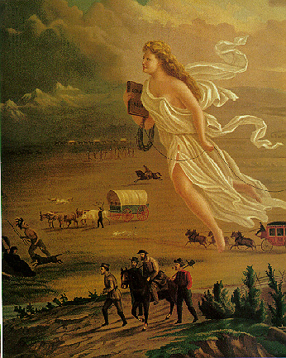
Polk and Democrats advocated “Manifest Destiny” (God-supported US expansion)

Slide 9
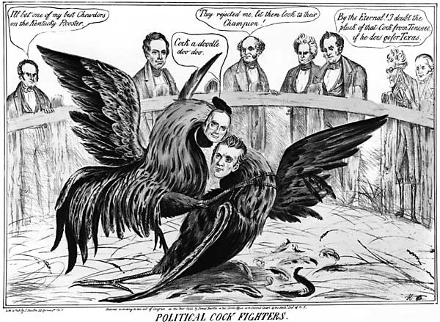
The possible annexation of Texas was major campaign issue (Clay was inconsistent on the issue and he lost election)

Slide 10
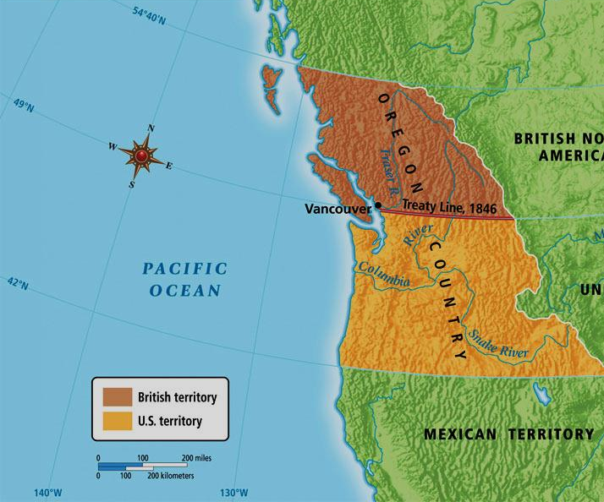
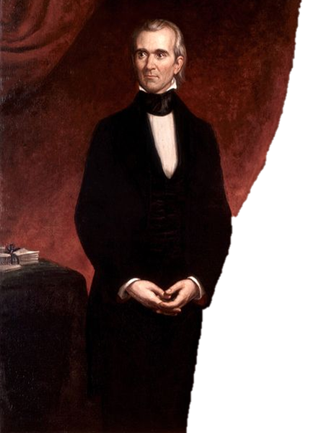
“54º 40’, or Fight!”
(1844) James K. Polk and his expansionist ideas won the election

Slide 11
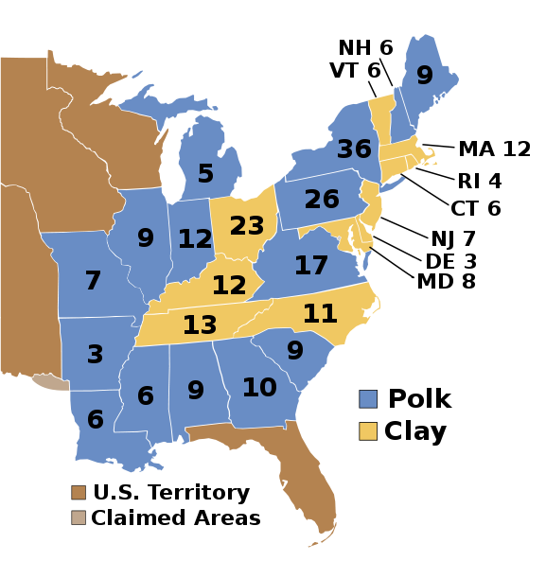
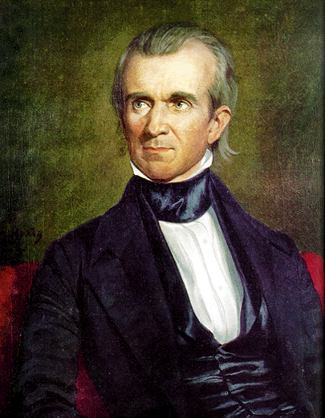
Election of 1844

Slide 12
RANK—#12
James K. Polk
Presidency: 1845-1849
Birthplace: North Carolina
Education: UNC
Party: Democrat
Age Upon Taking Office: 49
Vice-President: George Dallas
Height: 5’8”
Nicknames: “Young Hickory” “Napoleon of the Stump”
Fun Fact:
Polk suffered with an intestinal order that resulted in chronic diarrhea
Sound Bite: “No President who performs his duties faithfully and conscientiously can have any leisure.”

Slide 13
The Big Picture
Polk had a clear agenda for his presidency, meticulously achieved these goals and has enjoyed growing respect for his legacy among modern historians.
Polk and Manifest Destiny

Slide 14
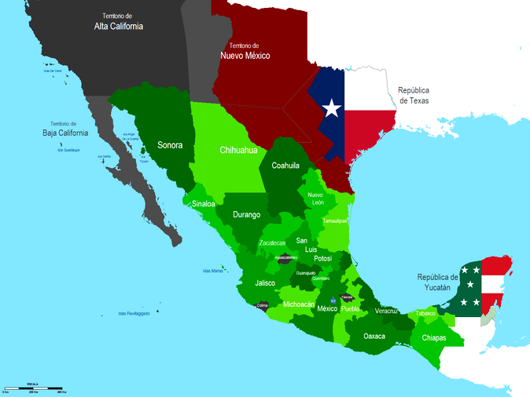
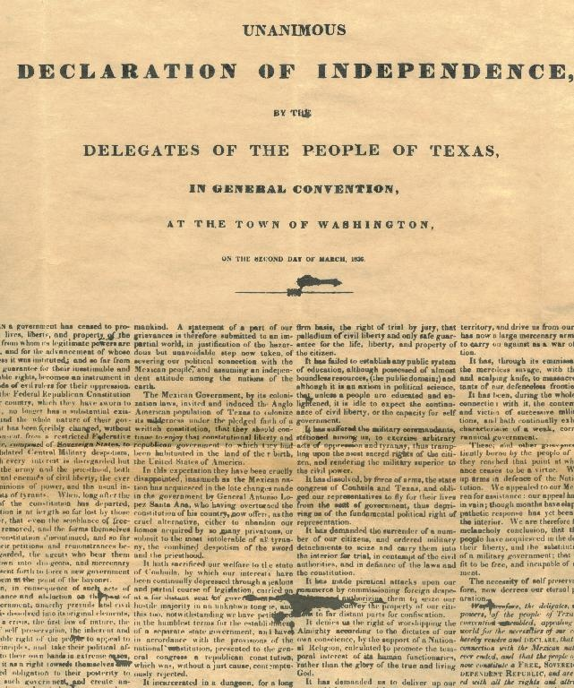
Polk wanted to annex Texas and knew it might cause war with Mexico

Slide 15
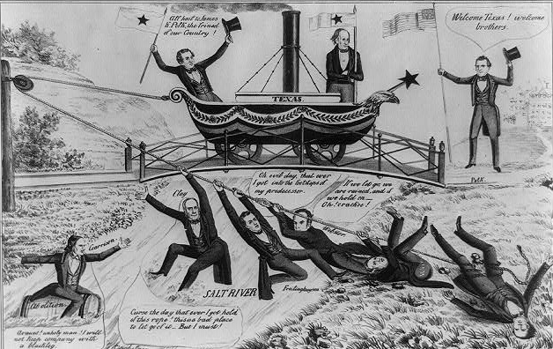
“We have heretofore held our peace in regard to the annexation of Texas, for the purpose of seeing whether our Nation would attempt so base (evil) an action. We call it base, because it would be giving men that live upon the blood of others, an opportunity of dipping their hand still deeper in the sin of slavery. …Have we not slaves enough already?”
-newspaper from Manchester, New Hampshire
(1845) Polk invited Texas to be 28th state

Slide 16
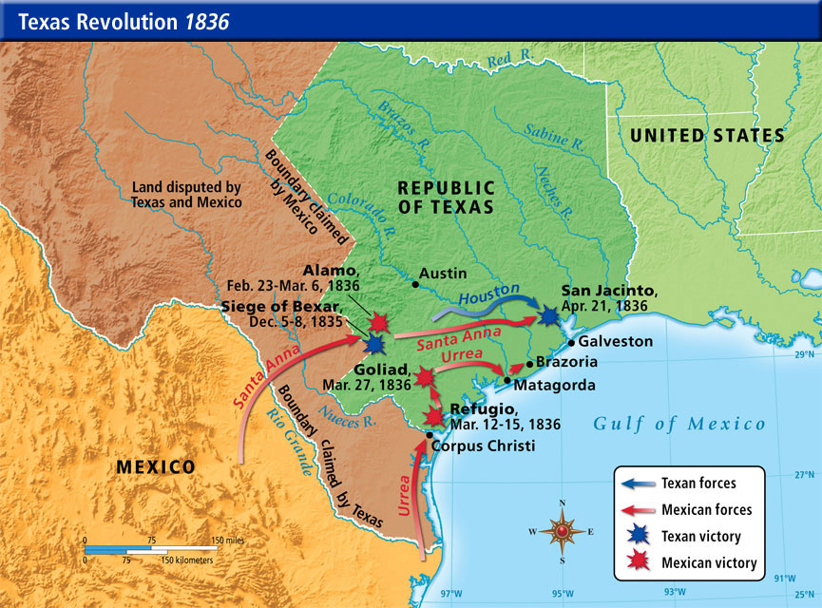
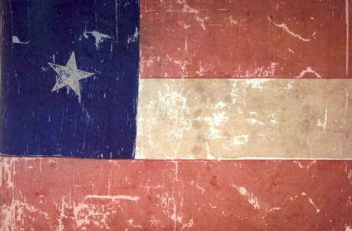
Once Texas was acquired few southern Democrats cared about further expansion

Slide 17
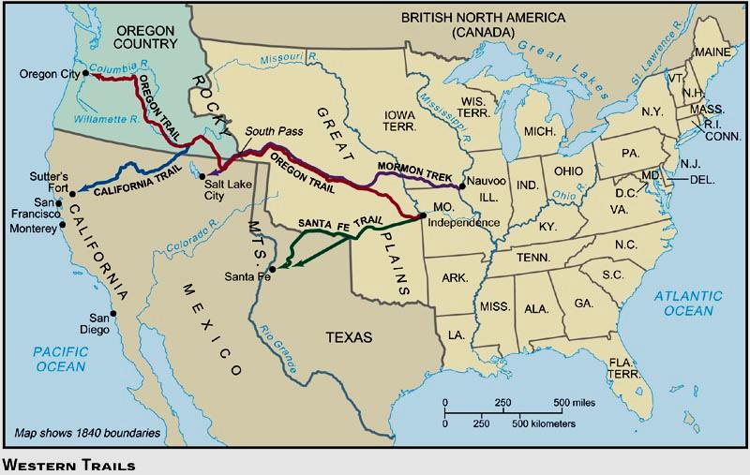
Polk wanted to acquire California and settle the Oregon dispute

Slide 18
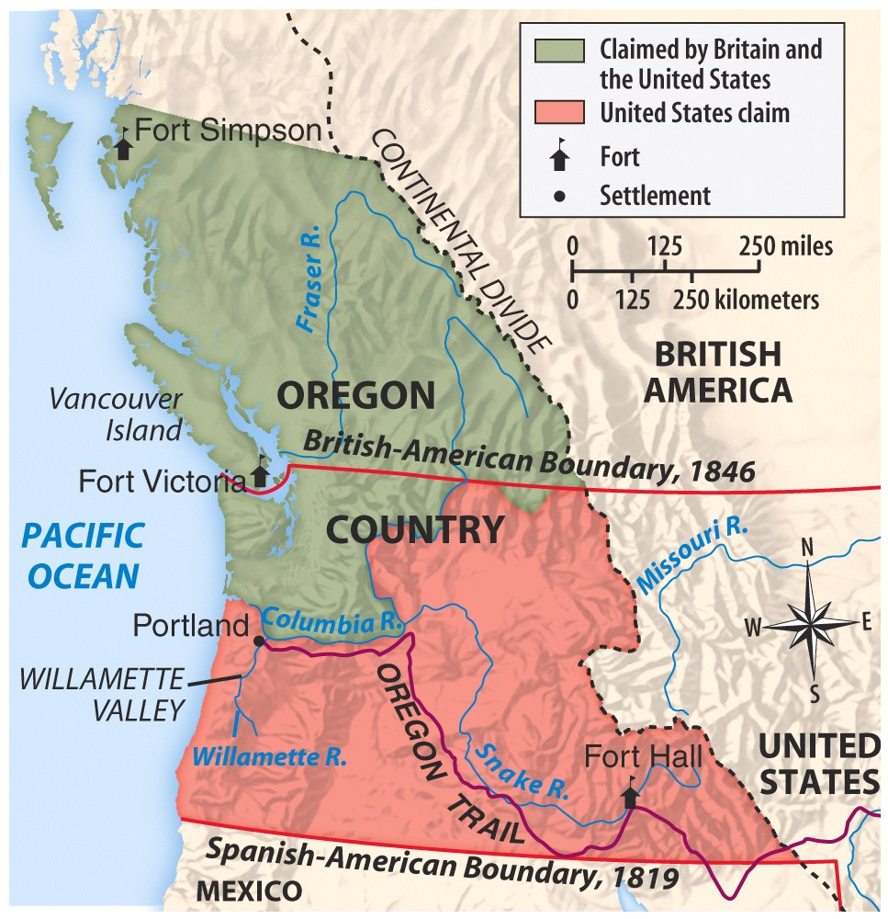
Oregon was huge (stretching from northern CA to the 54°40’ line)

Slide 19
British claims were strong north of the Columbia River (populated by Brits and claimed by Hudson’s Bay Company)

Slide 20
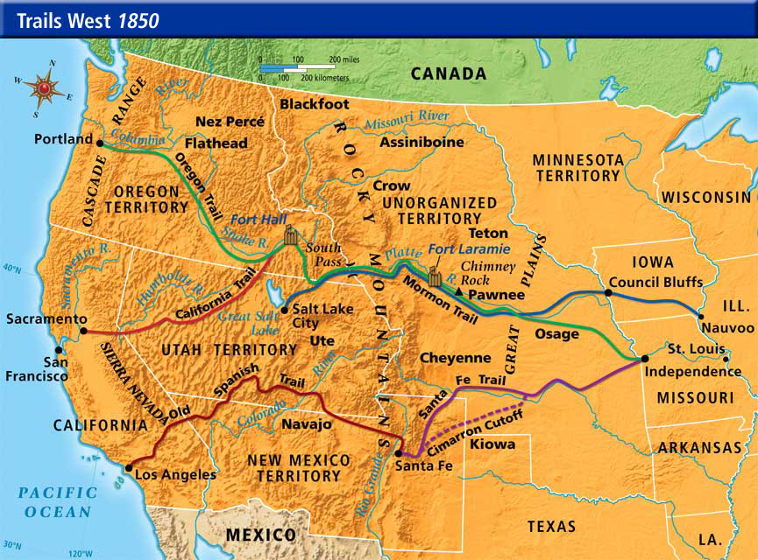
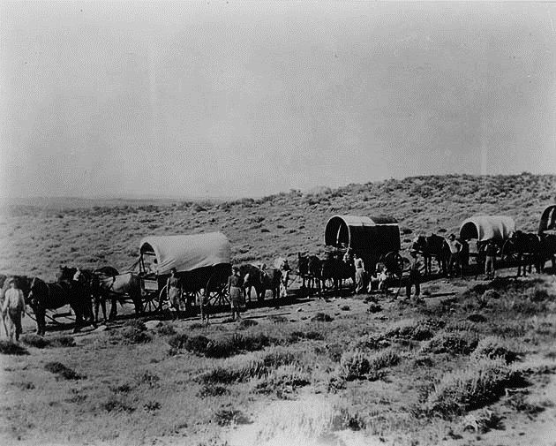
US had strong claims south of Columbia River (lots of Americans lived there thinks to Oregon Trail)

Slide 21
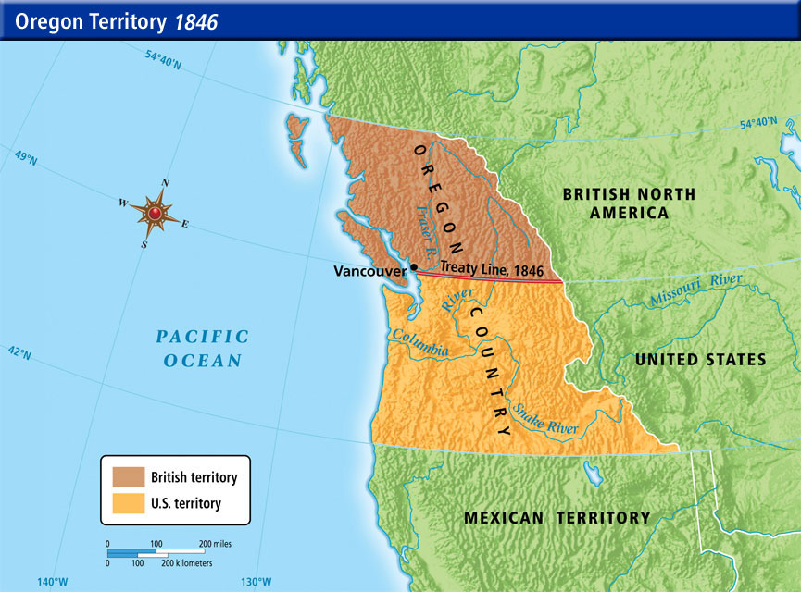
Britain proposed treaty separating British and American claims at 49th parallel (excluding Vancouver) and Polk accepted it

Slide 22
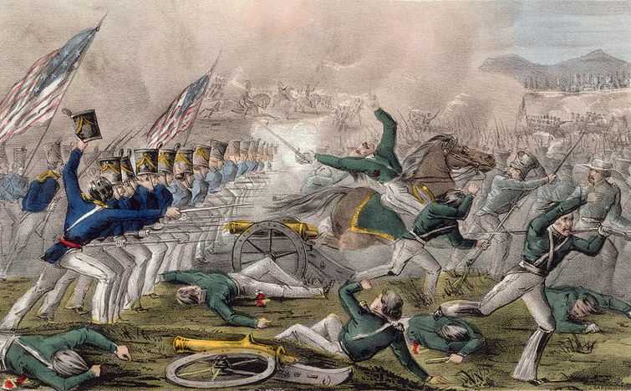
The Big Picture
The motivation for the Mexican-American War ranks among the most underhanded in US history, but the war was executed efficiently and US victory was virtually a sure thing.
The Mexican—American War

Slide 23
“Shall this garden of beauty be suffered to lie dormant in its wild and useless luxuriance? …Myriads of enterprising Americans would flock to its rich and inviting prairies; the hum of Anglo-American industry would be heard in its valleys; cities would rise upon its plains and sea-coast, and the resources and wealth of the nation be increased in an incalculable degree.”
-Illinois State Register
"As to Texas I regard it as of very little value compared with California, the richest, the most beautiful and the healthiest country in the world ... with the acquisition of Upper California we should have the same ascendency on the Pacific ... France and England both have had their eyes upon it.“
-Waddy Thompson, US minister to Mexico
Mexicans must yield to “a superior population, insensibly oozing into her territories, changing her customs, and out-living, out-trading, exterminating her weaker blood.”
-American Review
Polk wanted Mexican-owned California (a diplomatic solution less likely given annexation of Texas)

Slide 24
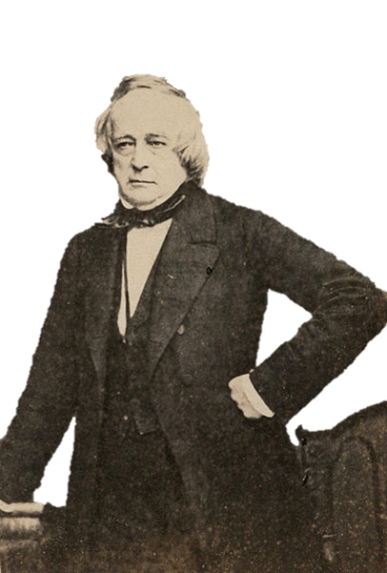
US sent John Slidell to Mexico City prepared to offer up to $25 million for CA (he was ignored)

Slide 25
Border between Mexico and US undefined (Texas claimed its border at the Rio Grande and not the Nueces River like Mexico)

Slide 26
“We were sent to provoke a fight but it was essential that Mexico should commence it.”
-Ulysses S. Grant, officer under Taylor
(Jan, 1846) Polk sent 4000 men under Zachary Taylor to march from the Nueces River to the Rio Grande (near Mexican troops)

Slide 27
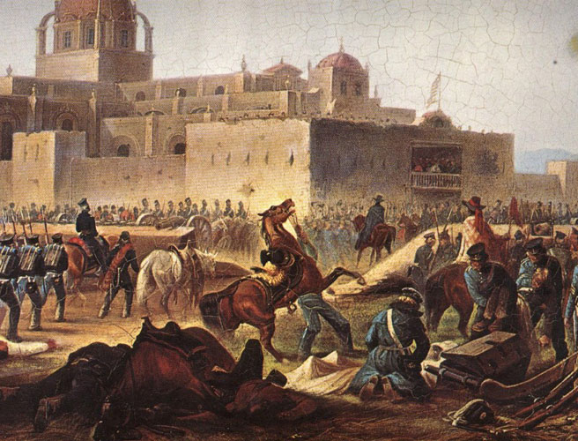
“I have said from the first that the United States are the aggressors. …We have not one particle of right to be here. …It looks as if the government sent a small force on purpose to bring on a war, so as to have a pretext for taking California and as much of this country (Mexico) as it chooses, for, whatever becomes of this army, there is no doubt of a war between the United States and Mexico. …My heart is not in this business…but, as a military man, I am bound to execute orders.”
-Colonel Ethan Hitchcock
(April, 1846) news of Mexican troops crossing Rio Grande and killing or wounding 16 Americans reached Polk

Slide 28
Mexico “has passed the boundary of the United States, has invaded our territory, and shed American blood upon the American soil.”
-James K. Polk
Polk called for a declaration of war on Mexico

Slide 29
Some politicians wanted to know the exact spot of the fighting (including Abraham “Spotty” Lincoln)

Slide 30
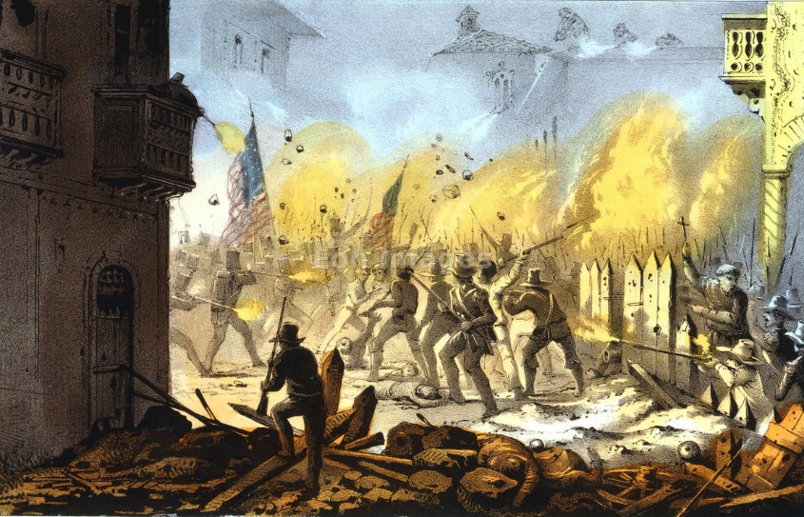
Congress declared war (the Mexican-American War began)

Slide 31
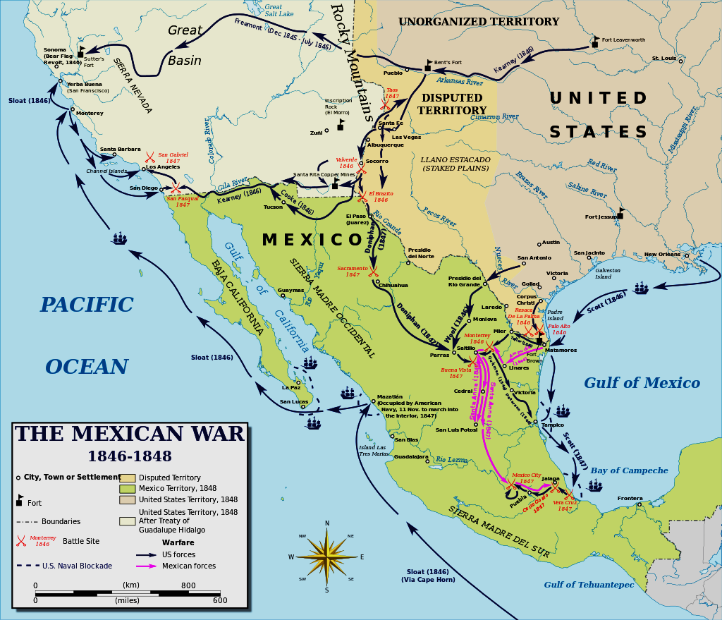
Polk hoped to beat Mexico enough so they would sell CA

Slide 32
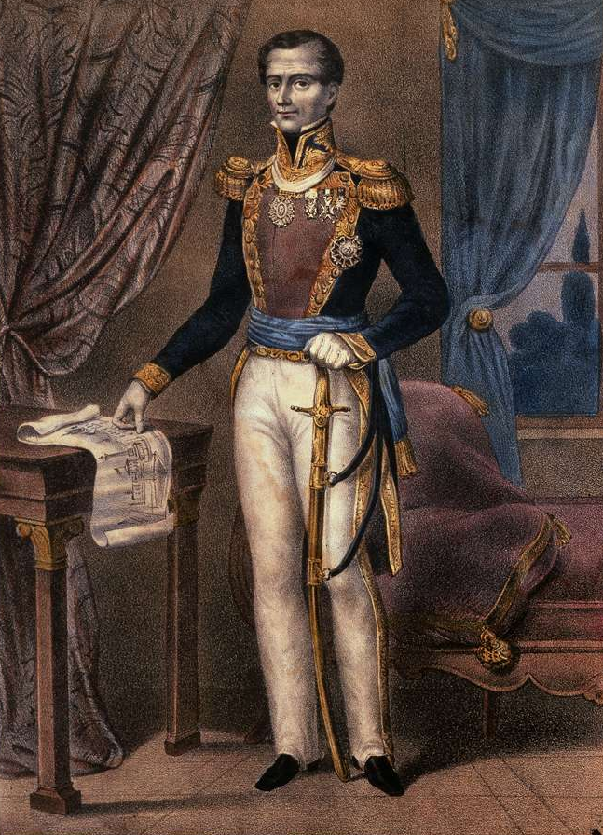
The recently dethroned Santa Anna promised the US if he returned to power he would end war and give US CA (he lied)

Slide 33
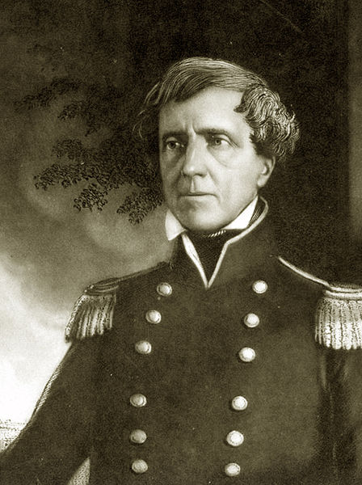
Operations under Stephen Kearny captured Santa Fe

Slide 34
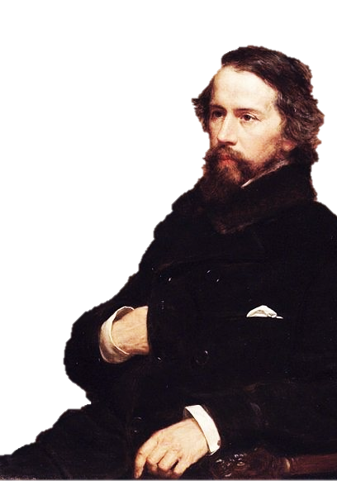
John Fremont successfully led the Bear Flag Revolt in CA in 1846

Slide 35
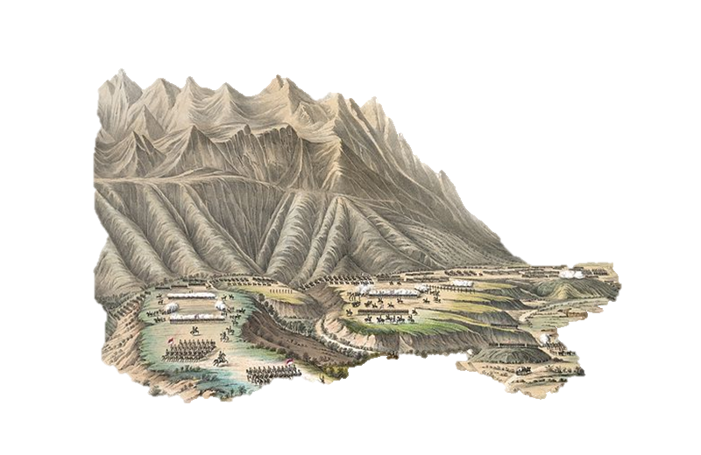
General Zachary Taylor pushed into Mexico with 5,000 men and defeated 20,000 Mexican troops at Buena Vista

Slide 36
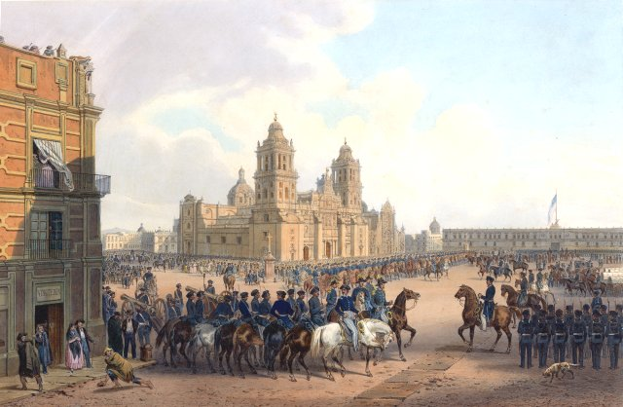
General Winfield Scott led US troops into Mexico City

Slide 37
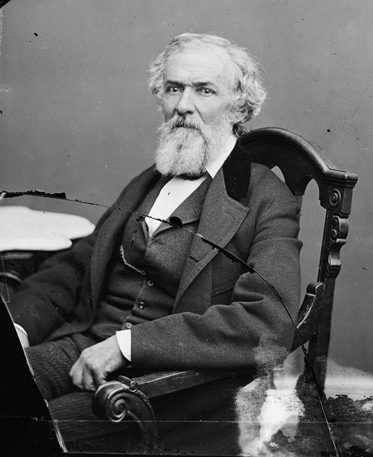
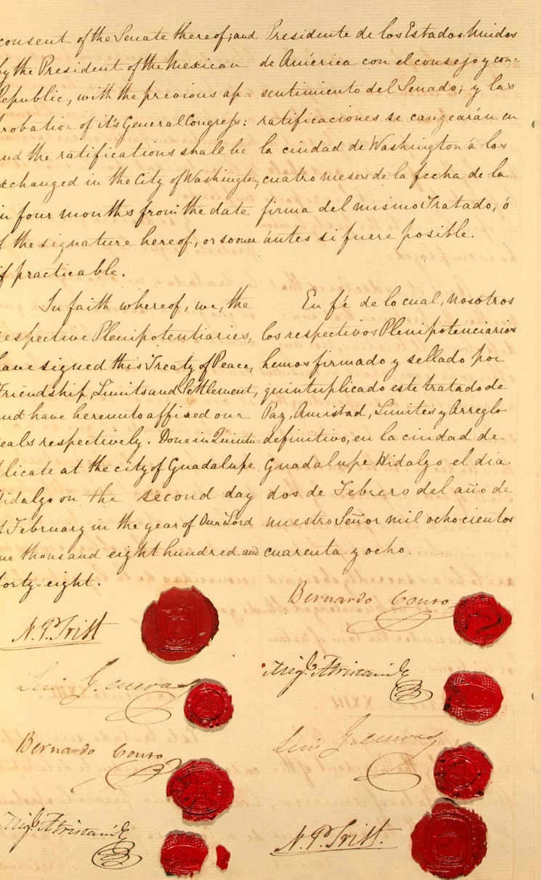
Cost us a $10,000 bribe to Santa Anna just to negotiate (he used the money for his defenses)
Polk sent Nicholas Trist to negotiate an armistice with Mexico

Slide 38
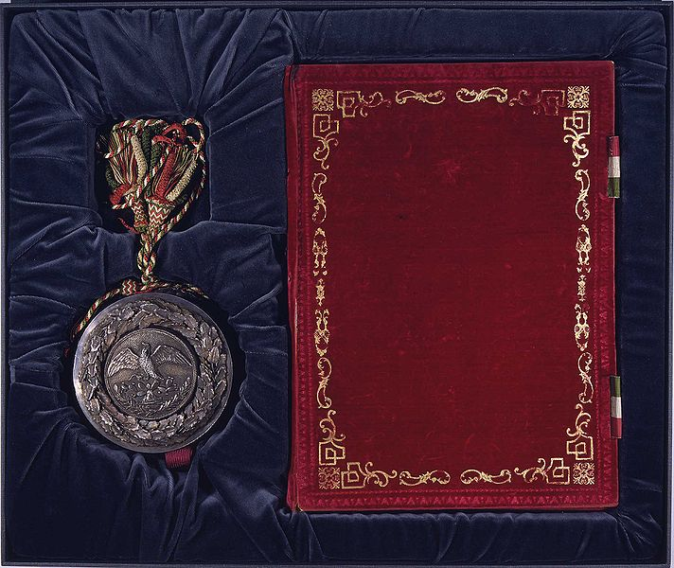
Trist negotiated the Treaty of Guadalupe Hidalgo (Feb, 1848)

Slide 39
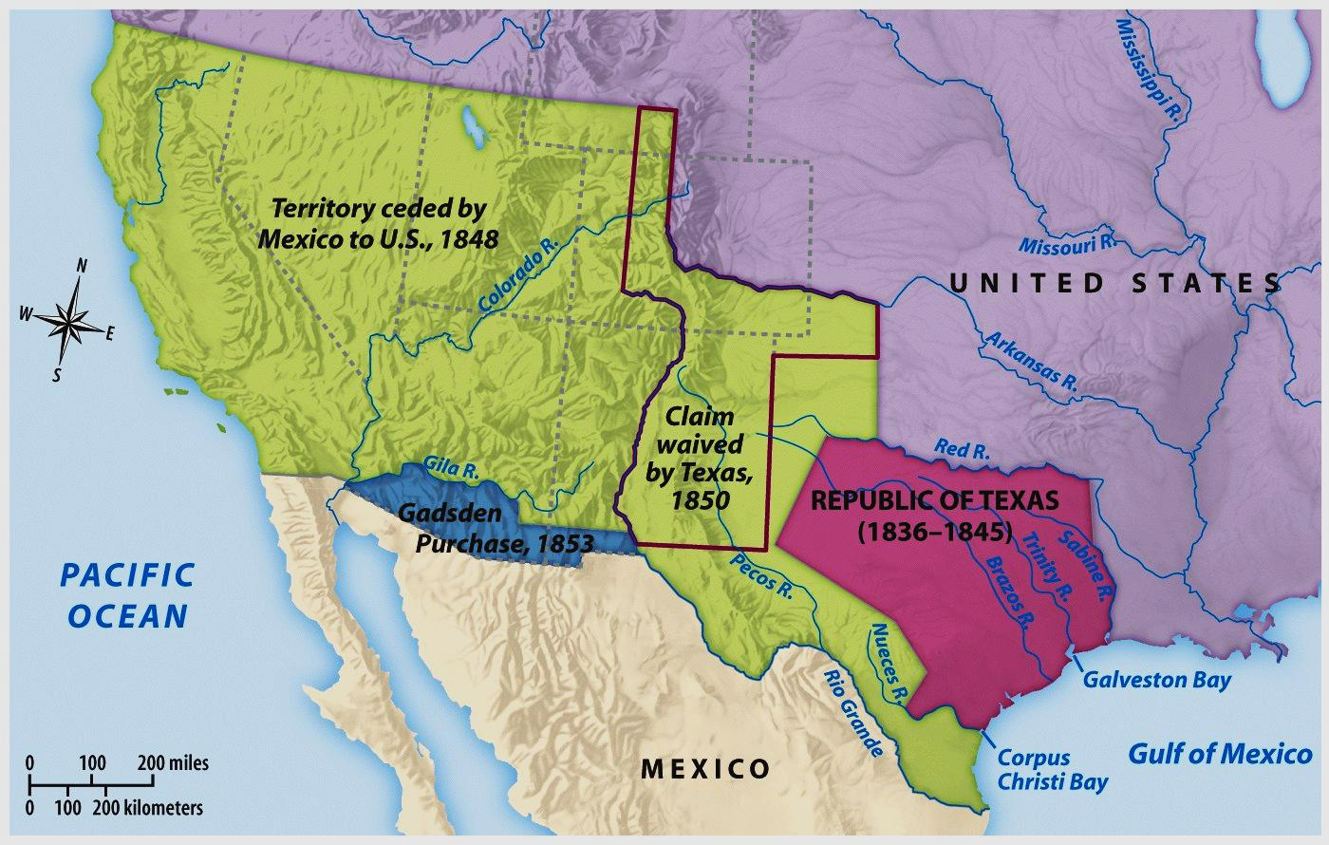
Mexico gave US all land north of the Rio Grande from CA to TX (cost only $15 million)

Slide 40
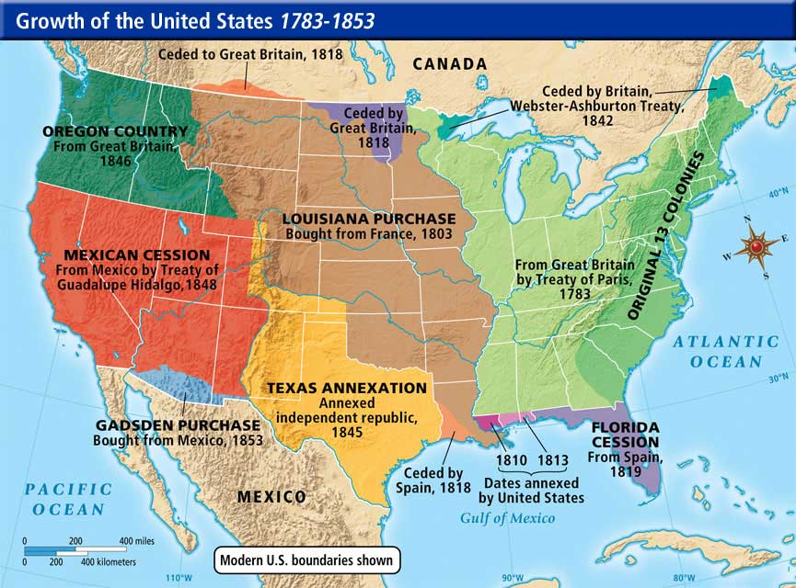
Some people in US wanted to end the war (northerners) while others wanted all of Mexico (many Southerners)

Slide 41
Polk speedily passed the bill to the Senate who approved it 38 to 14

Slide 42
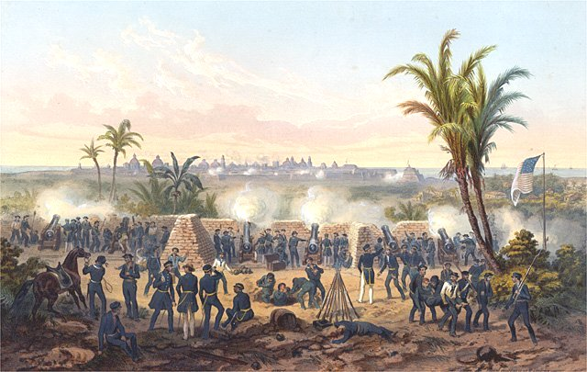
US lost 13,000 soldiers in the war (most by disease)

Slide 43
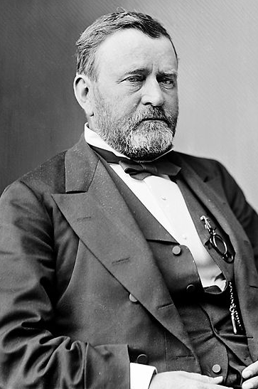
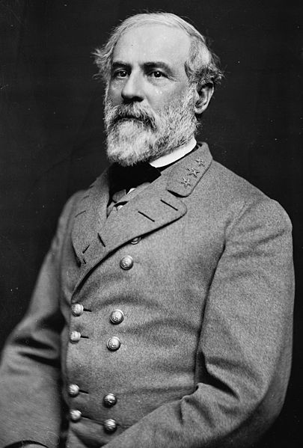
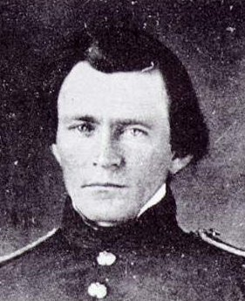
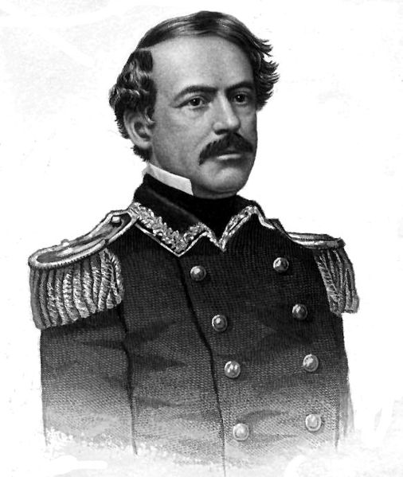
The war proved a practicing ground for the Civil War (Ulysses S. Grant and Robert E. Lee)

Slide 44
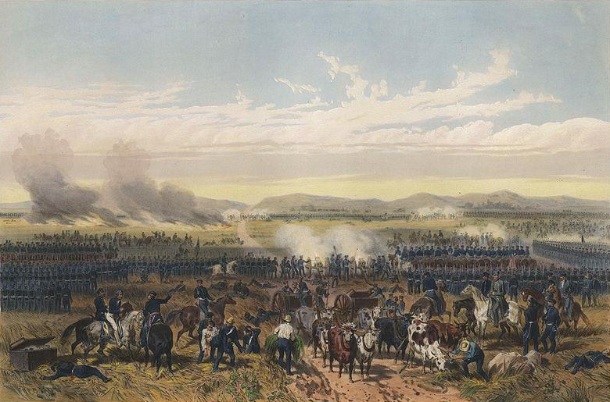
With no major blunders regarding Mexico, other countries now respected U.S. militarily

Slide 45
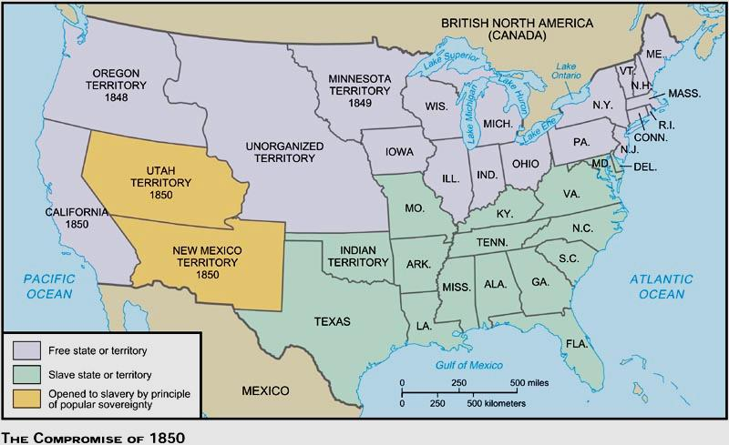
The acquisition of new territory in the West after the Mexican-American War led to a heated controversy over allowing or forbidding slavery in these territories

Slide 46
As overcultivation depleted arable land in the Southeast, slaveholders sought to relocate agricultural enterprises to the new Southwest (increasing sectional tensions)

Slide 47
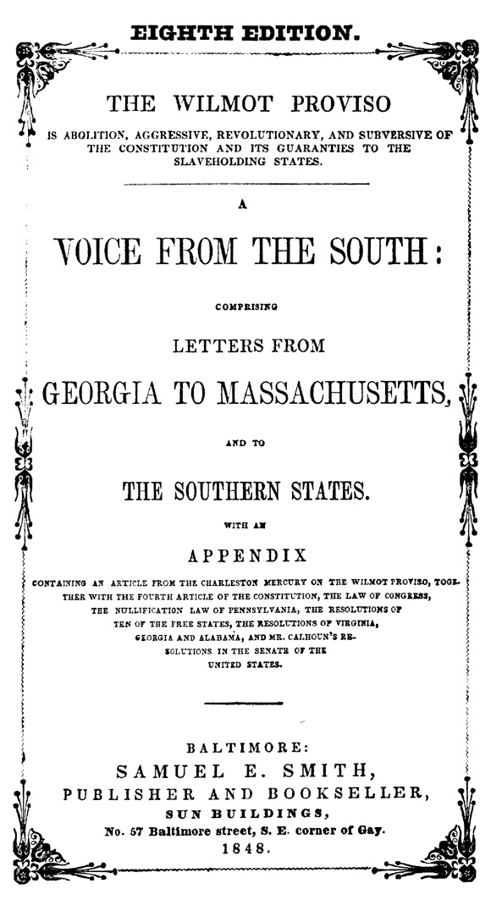
Provided,...as an express and fundamental condition to the acquisition of any (of the land from) the Republic of Mexico by the United States, by virtue of any treaty which may be negotiated between them,…neither slavery nor involuntary servitude shall ever exist in any part of said territory.
Northerners proposed the Wilmot Proviso hoping to ban slavery in the lands gained from Mexico

Slide 48
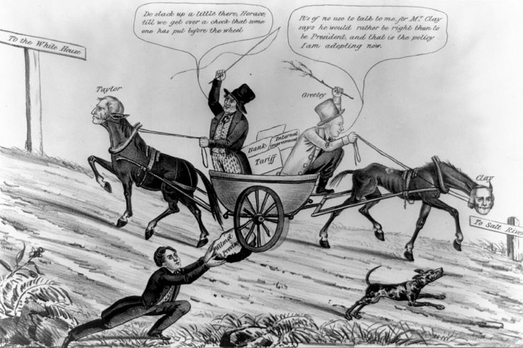
The Wilmot Proviso passed House of Reps. (controlled by North) twice but not the Senate

Slide 49
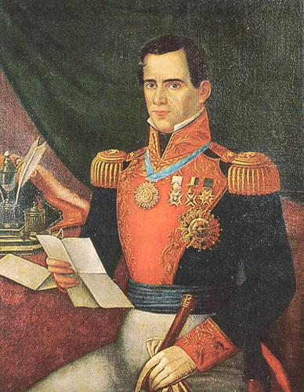
Mexico lost ½ its land in the war but took satisfaction that this land helped cause Civil War in U.S. (“Santa Anna’s Revenge”)

