Slide 1
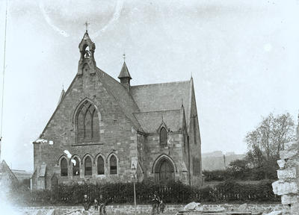
The Big Picture
The political democratization occurring in the US in the early 1800s ultimately affected religion as Americans were challenged as individual Christians to support the fundamental reform of society.
The Second Great Awakening

Slide 2
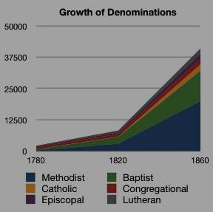
Church attendance was high (1850 = 75% pop.)

Slide 3
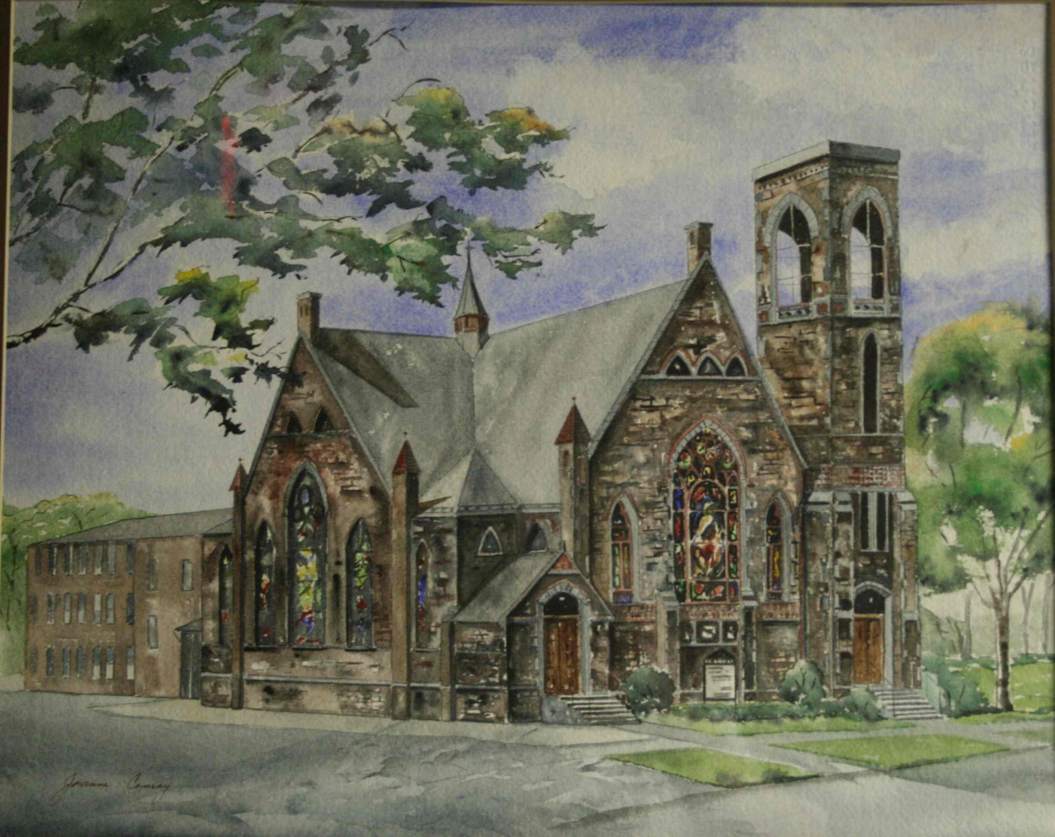
Political democratization led to religious democratization in US in early 1800s

Slide 4
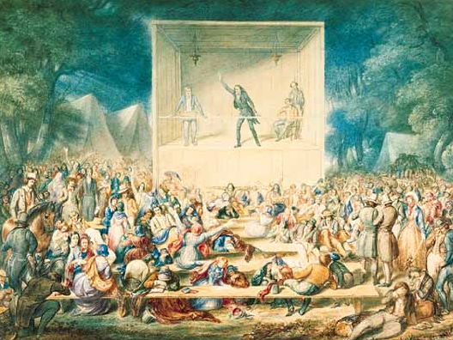
The Second Great Awakening was a religious revival of the 1820s and 1830s

Slide 5
“The only true church organization is when heads and hearts unite in working for the welfare of the human-race.”
-Lydia Maria Child
2nd Great Awakening encouraged Christians to improve the world (this conservative social reform called the “Benevolent Empire”)

Slide 6
The Second Great Awakening
“Spiritual Reform From Within” [Religious Revivalism]
Social Reforms & Redefining the Ideal of Equality
Temperance
Abolitionism
Education
Asylum & Prison Reform
Women’s Rights
This religious revival led to prison reform, church reform, temperance cause, women’s movement, abolition of slavery

Slide 7
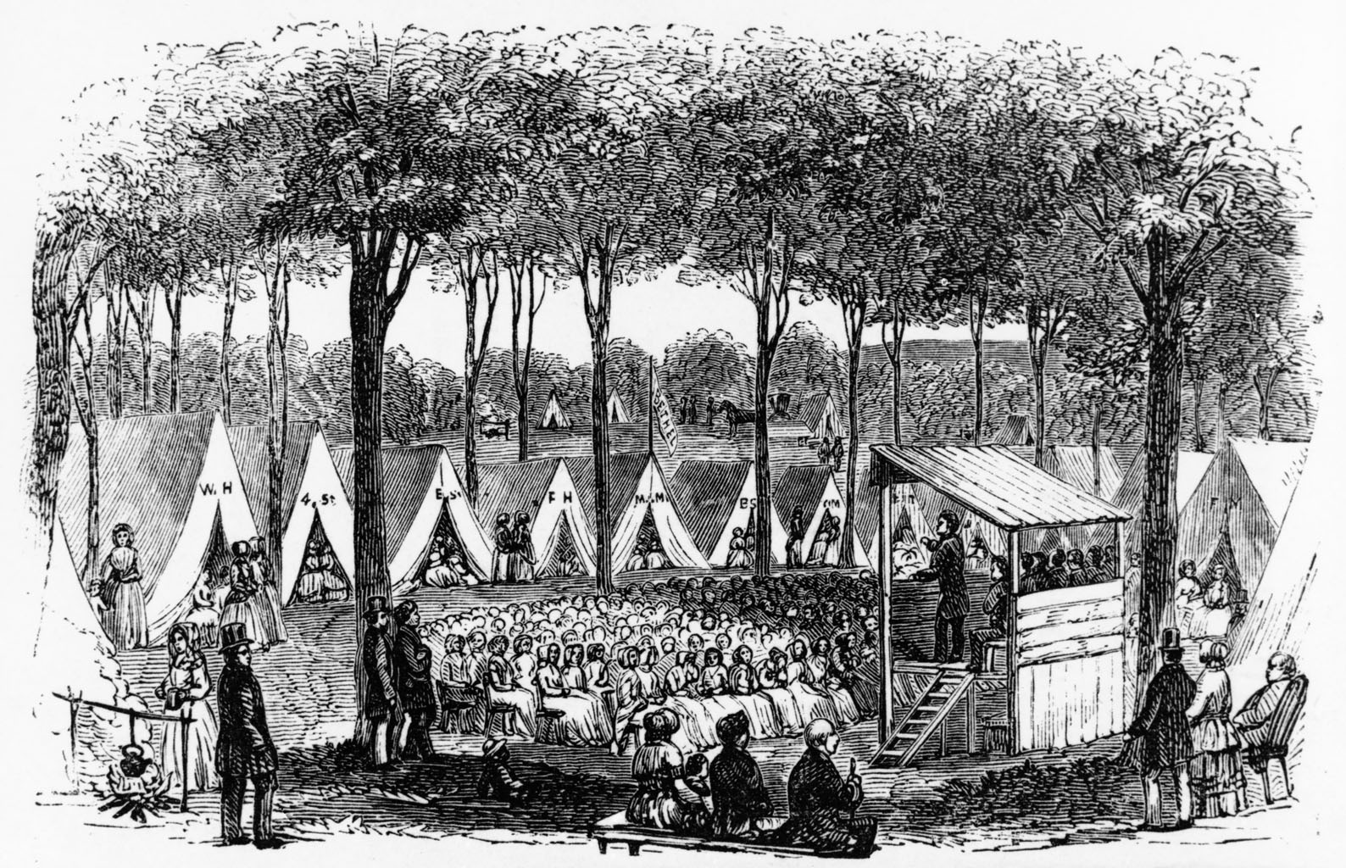
Religious revival spread to the masses through huge “camp meetings”

Slide 8
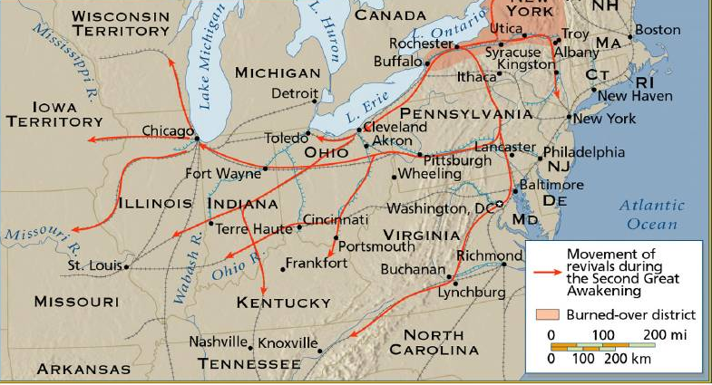
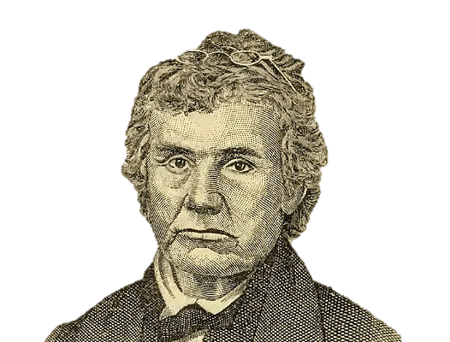
“Riding a hardy pony or horse” with their “Bible, hymn-book, and Discipline.”
Peter Cartwright was best known of the “circuit riders” (travelling preachers)

Slide 9
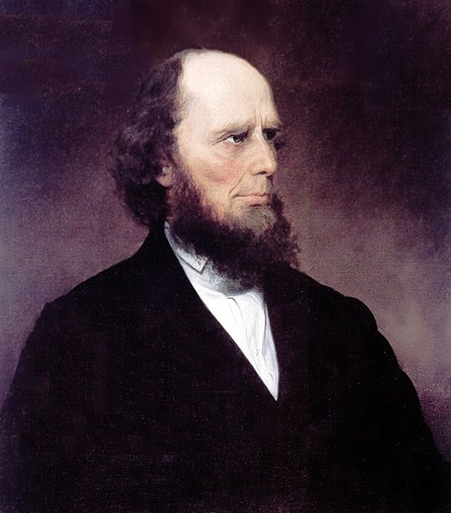
“God has made man a moral free agent.”
-Finney, describing Free Will
Charles Grandison Finney a famous preacher who led massive revivals in Rochester & NYC

Slide 10
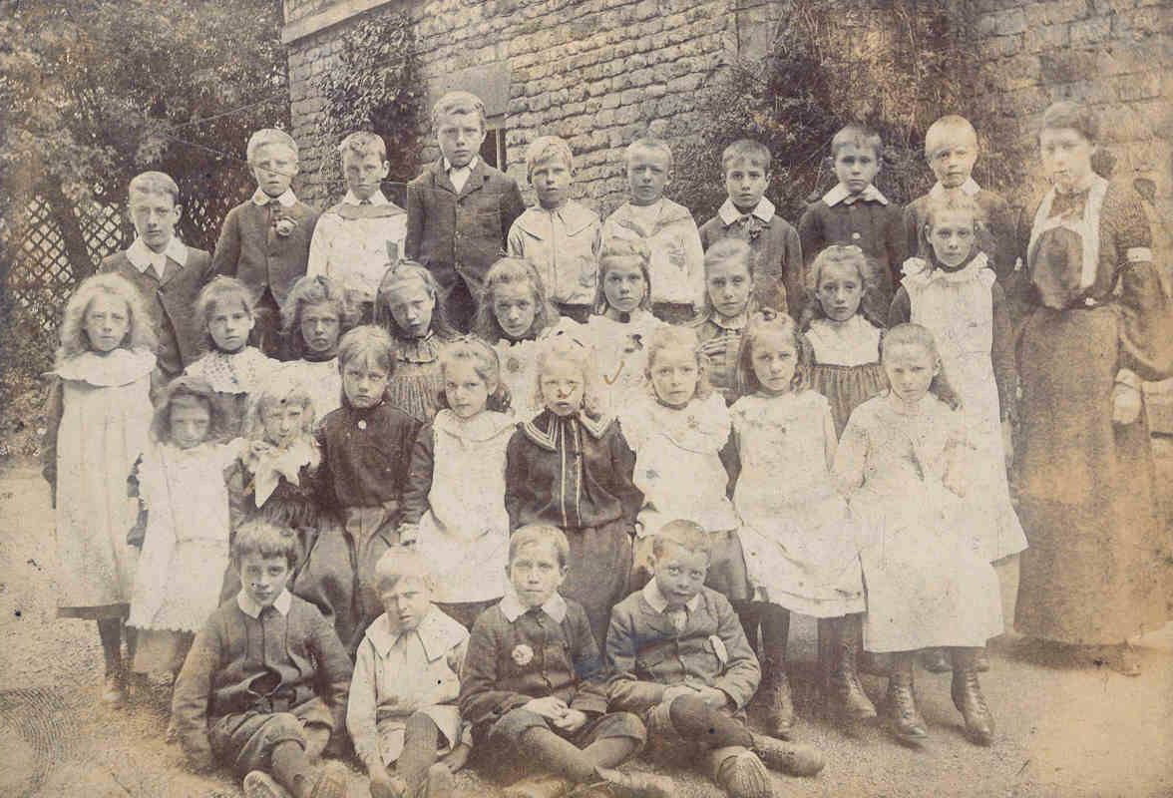
The Big Picture
Political democratization coupled with a zeal for reform emerging from the 2nd Great Awakening promoted massive improvements in the American education system, with the ultimate goal being the production of an informed and involved citizenry.
Education for a Free People

Slide 11
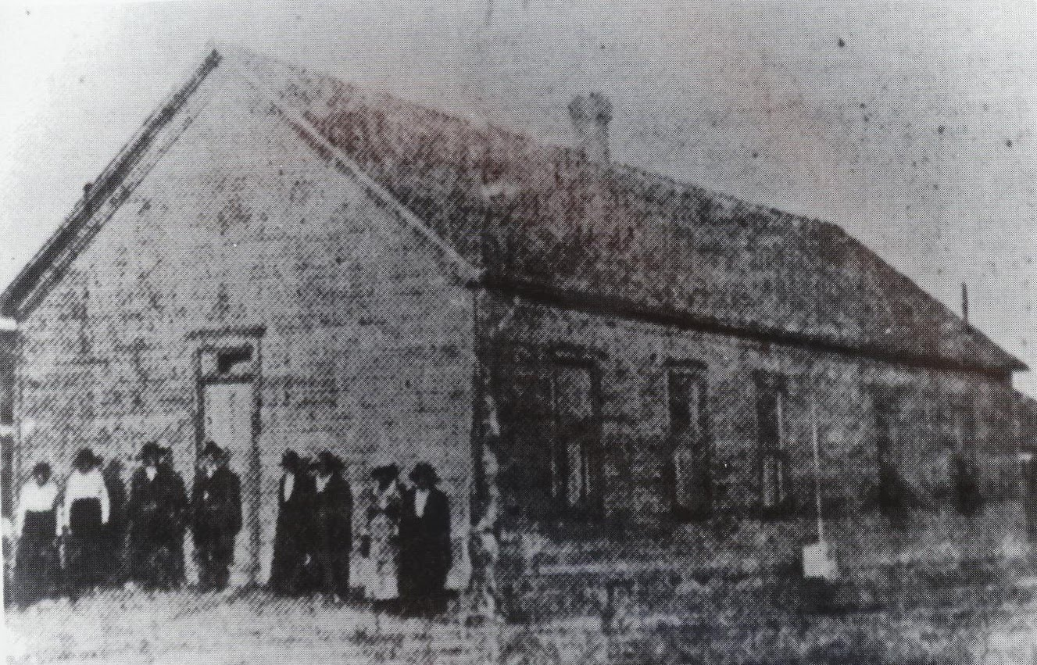
Tax-supported primary school was opposed because poor people might benefit without paying

Slide 12
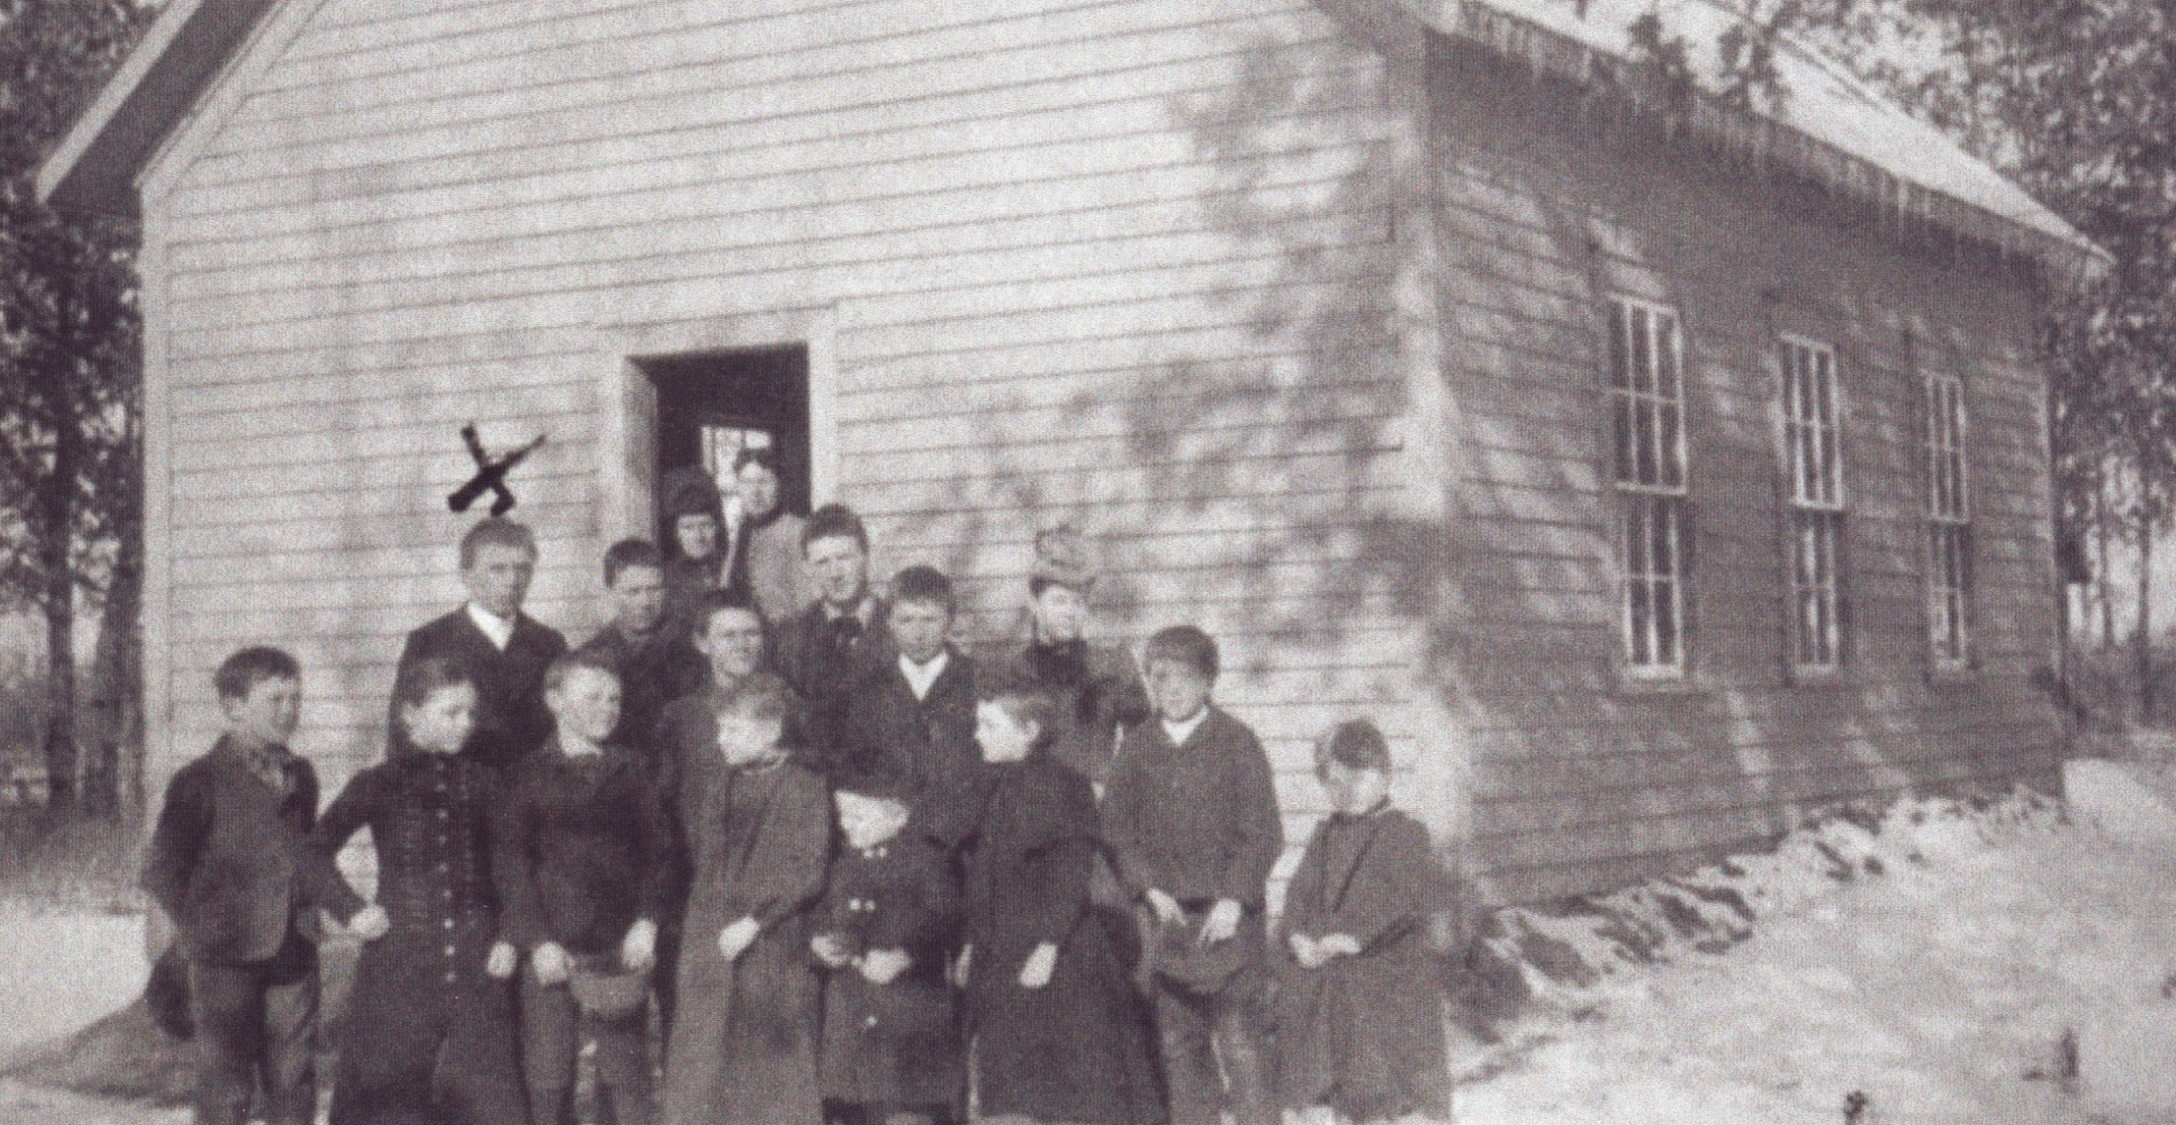
“We were taught every day and in every way that ours was the freest, the happiest, and soon to be the greatest and most powerful country of the world.”
-Thomas Low, NH
Public education gained support once the poor allowed to vote (they needed to be educated)

Slide 13
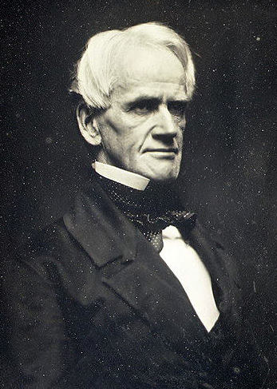
“Father of
American Education”
children are clay in the hands of teachers and school officials
children should be “molded” into a state of perfection
discouraged corporal punishment
established state teacher-training programs
Horace Mann fought for better schools (improve quality of teachers)

Slide 14
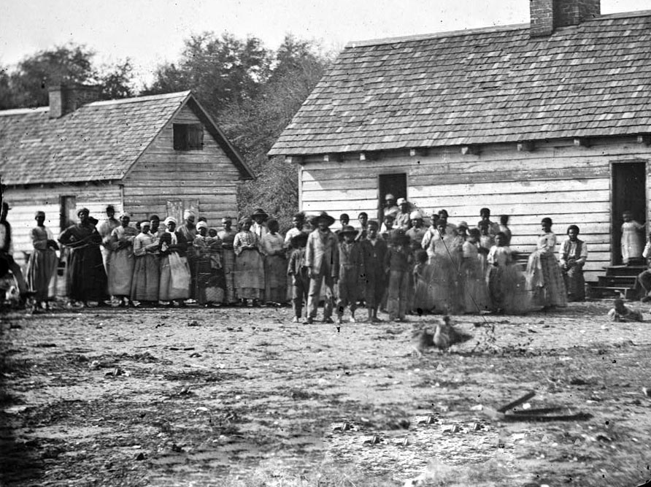
“None of us was ‘lowed to see a book but we gits hold of that Webster’s old speller and we studies it.”
-slave
Schools too expensive for many communities (blacks exempted from education)

Slide 15
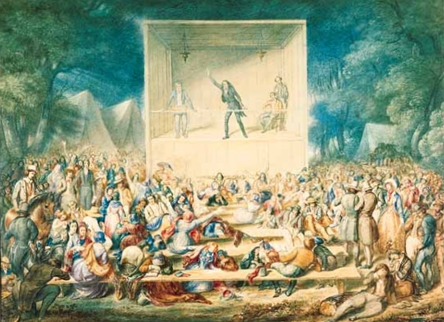
2nd Great Awakening led to building of small colleges in South and West

Slide 16
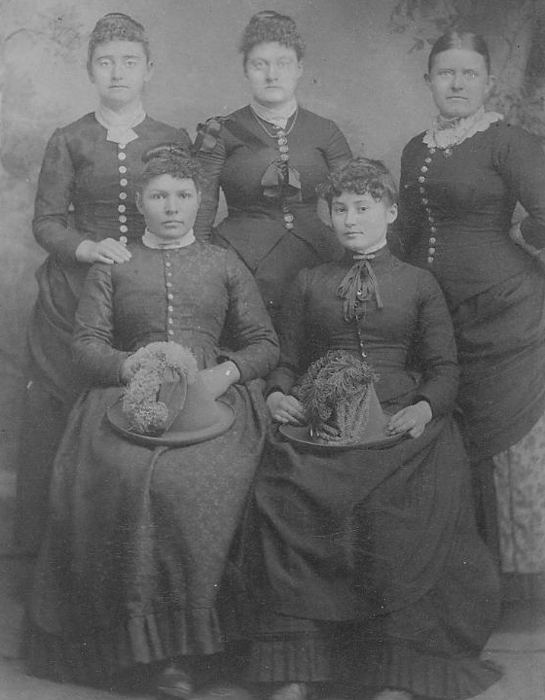
Women were discouraged from becoming too educated

Slide 17
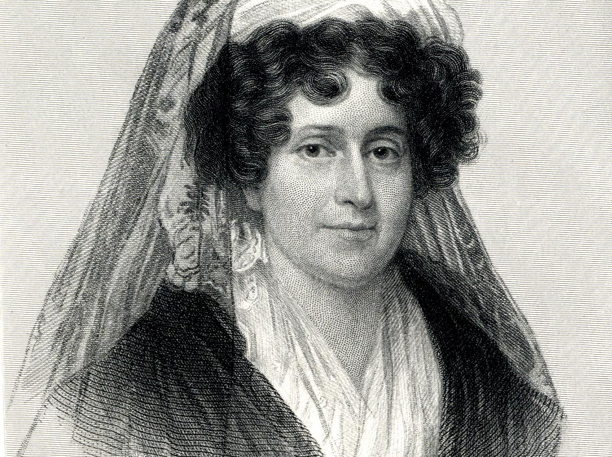
Emma Willard established Tory Female Seminary (1821) and Mount Holyoke Seminary (1837) to promote women’s education

Slide 18
Libraries, public lectures, magazines flourished

Slide 19
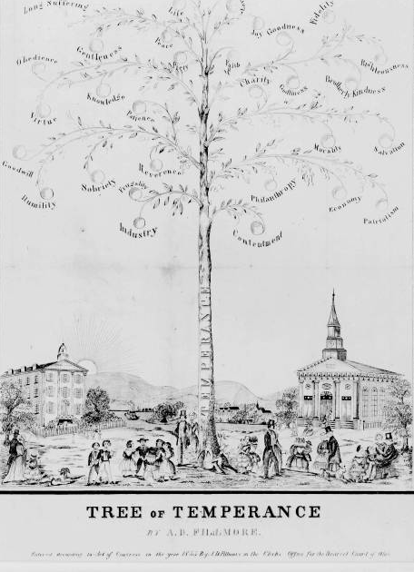
“The spirit of reform is everywhere. The laborer with a family says ‘reform the common schools’; the merchant and the planter say ‘reform the tariff’; the lawyer ‘reform the laws’; the politician ‘reform the government’; the abolitionist ‘reform the slave laws’; the moralist ‘reform intemperance,’…the ladies wish their legal privileges extended, and in short, the whole country is wanting reform.”
-David Dudley Field, Gazette magazine, 1842
The Big Picture
The 2nd Great Awakening unleashed a liberal reform movement that saw Christians hoping to make the country a better place.
An Age of Reform

Slide 20
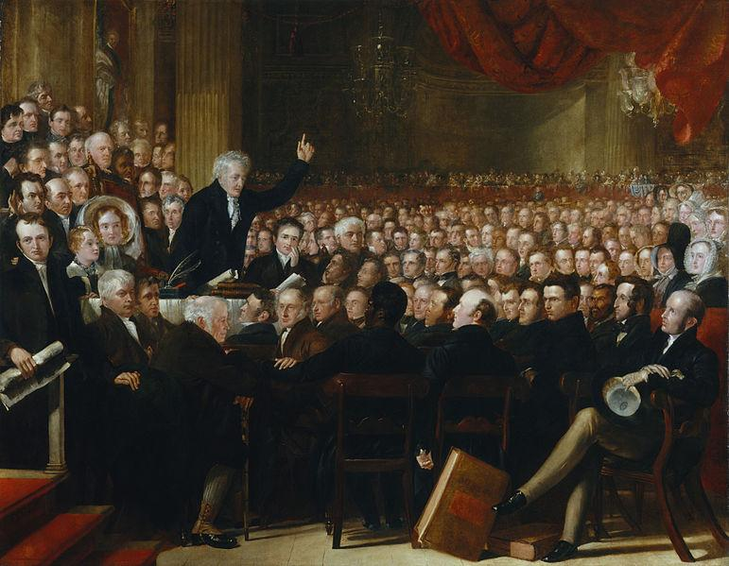
“A peaceable man can hardly venture to eat or drink, …to correct his child or kiss his wife, without obtaining the permission…of some moral or other reform society.”
-Henry Bellows, Unitarian minister
2nd Great Awakening inspired reformers to combat tobacco, alcohol, profanity, transit of mail on Sabbath, women’s rights, polygamy, medicines

Slide 21
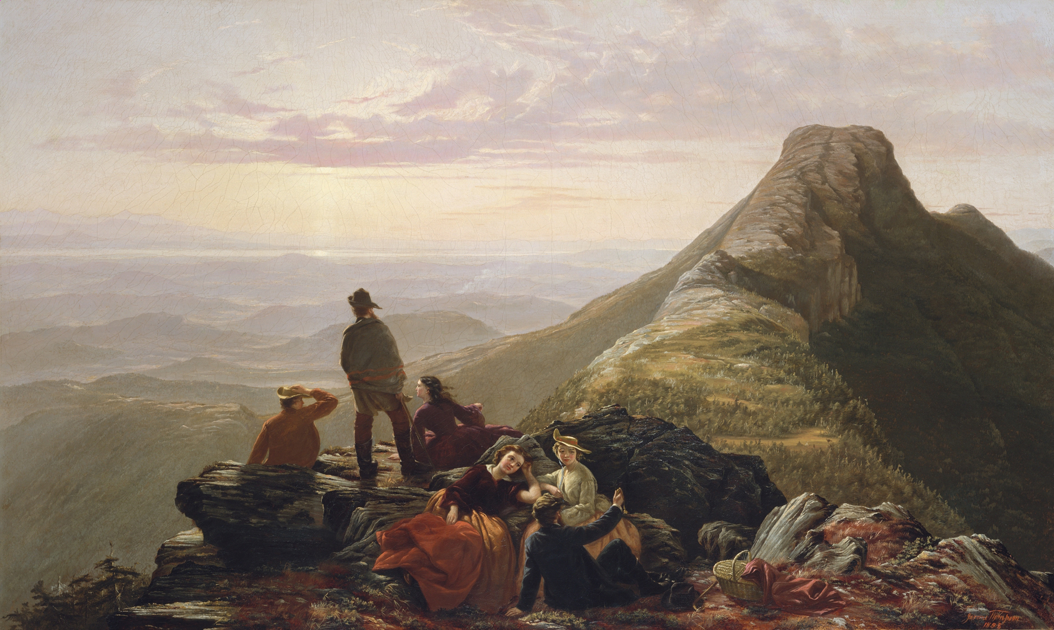
Reformers were optimistic that society could be perfected (Perfectionism)

Slide 22
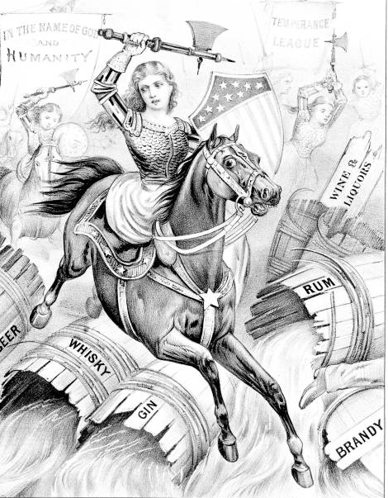
Women were important part of many reform movements

Slide 23
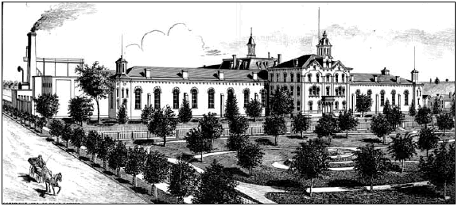
Reformers successfully helped close debtor’s prisons

Slide 24
Criminal codes were softened & reformatories built

Slide 25
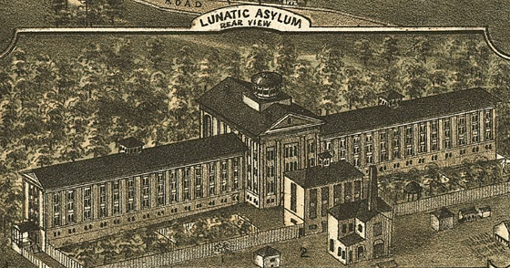
"I proceed, Gentlemen, briefly to call your attention to the present state of Insane Persons confined within this Commonwealth, in cages, stalls, pens! Chained, naked, beaten with rods, and lashed into obedience."
Dorothea Dix fought to improve treatment of mentally insane

Slide 26
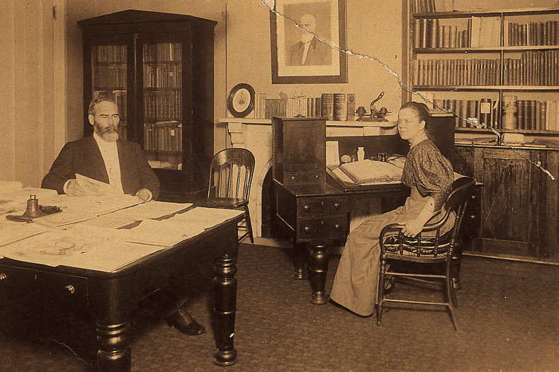
American Peace Society sought to end fighting and war

Slide 27
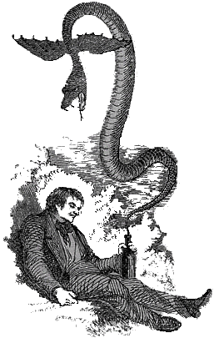
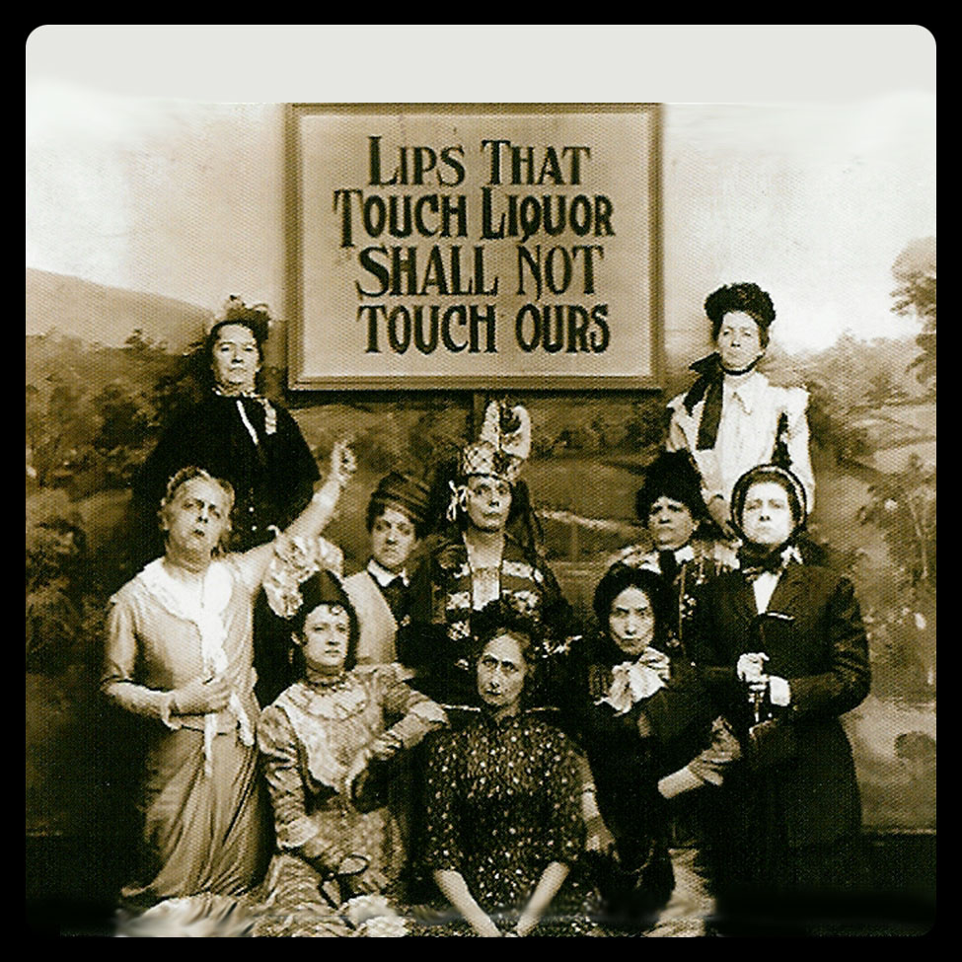
(1826) American Temperance Society formed to oppose drunkenness in US (caused disease, domestic abuse, financial ruin of families)

Slide 28
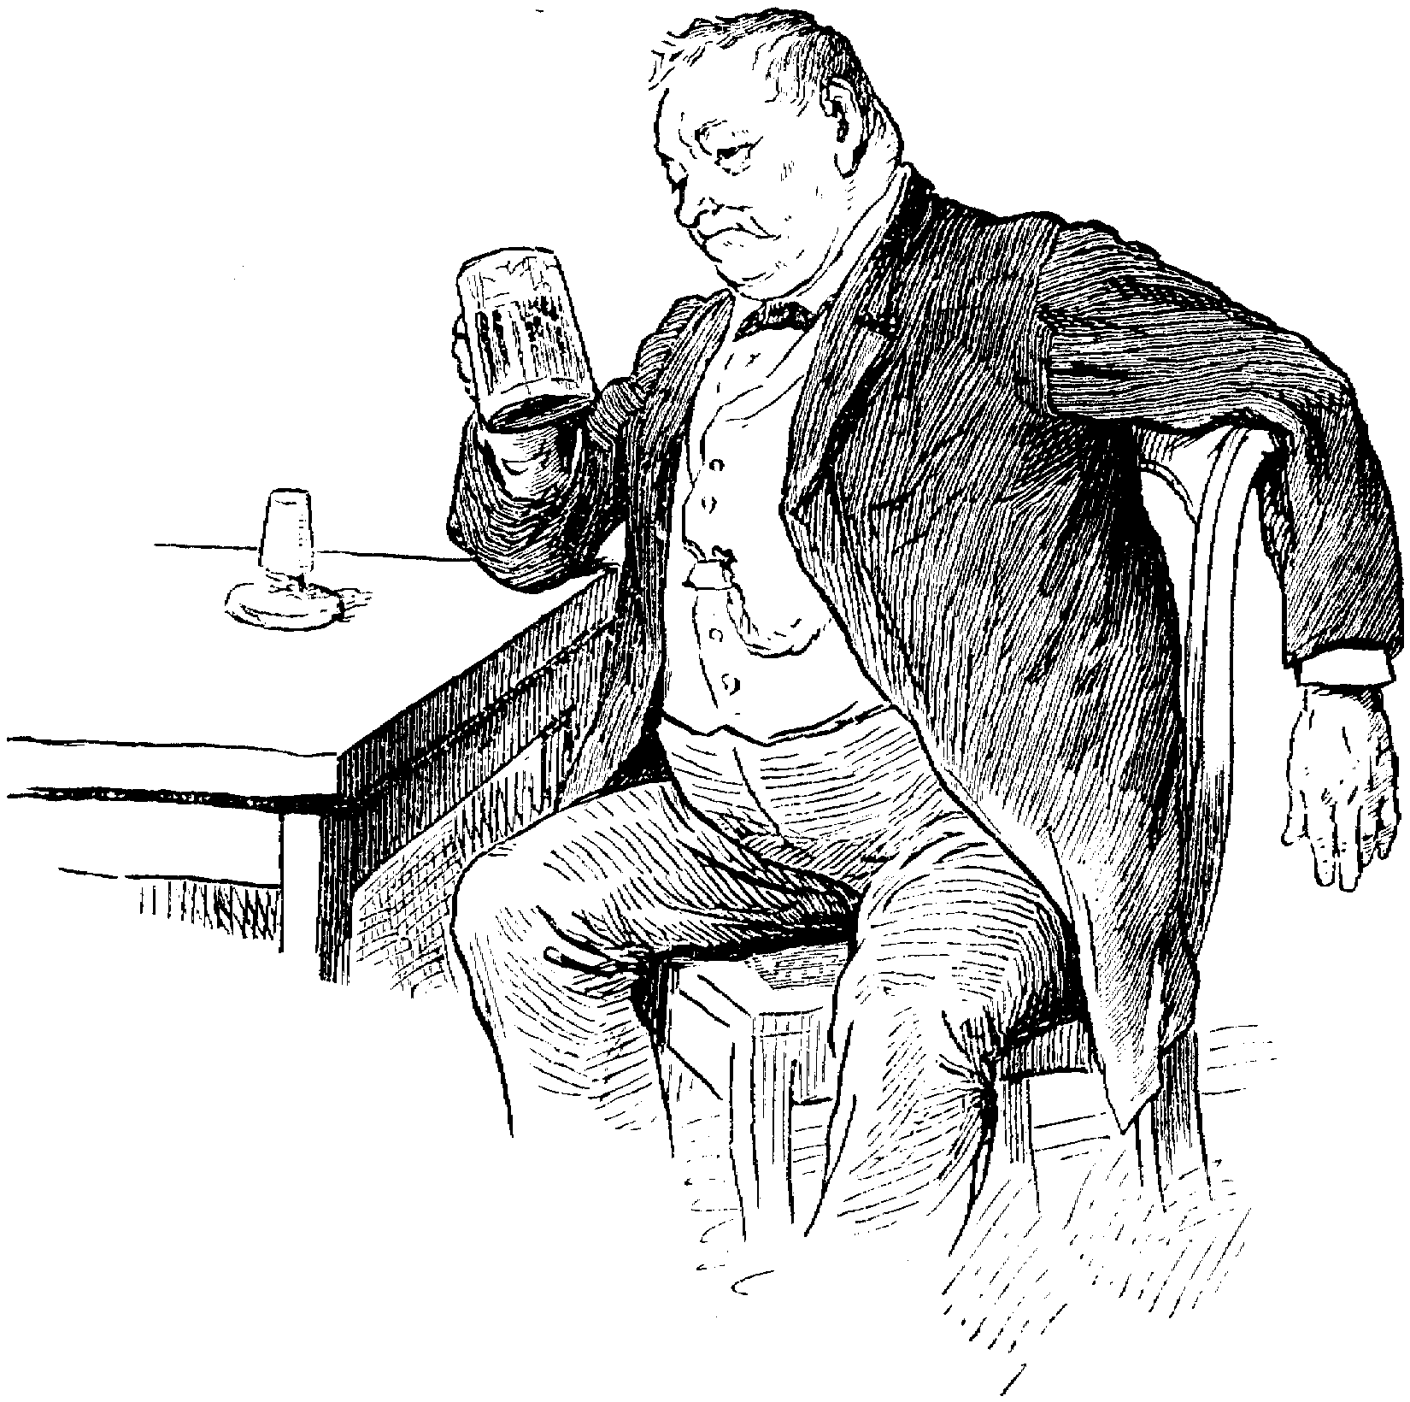
Temperance movement the most widely active of early 19th century reform movements

Slide 29
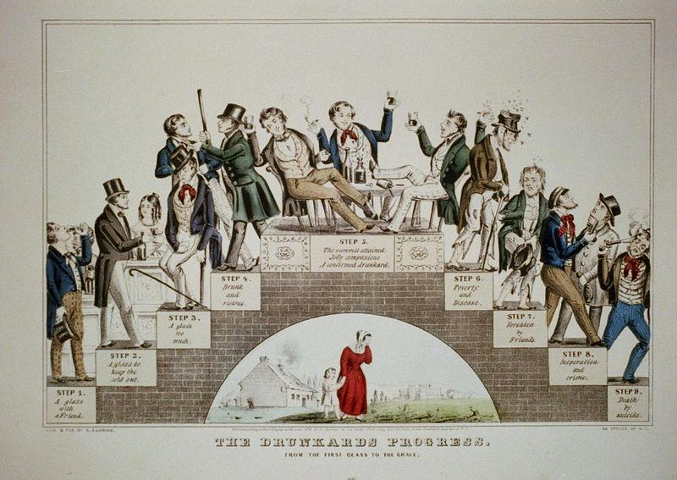
The Temperance Movement

Slide 30
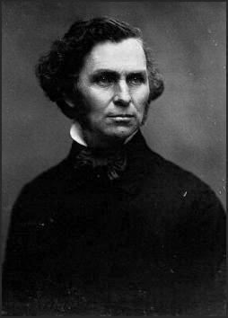
Neal S. Dow “Father of Prohibition”
Temperance (an individual’s will to resist) aided by local or state laws prohibiting alcohol (Maine briefly banned alcohol in 1851)

Slide 31
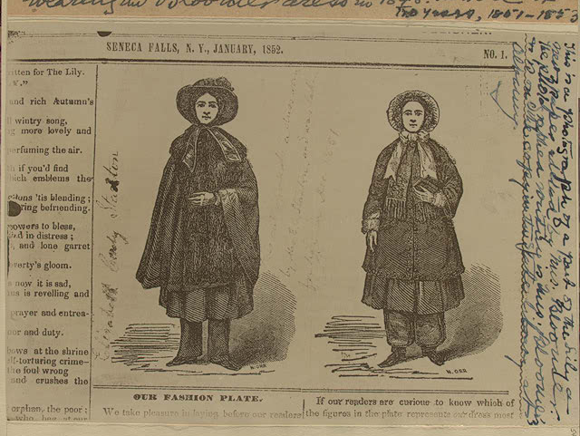
“The time of action is now. We have to sow the fields—the harvest is sure. The greatest triumph of this progression is redeeming woman from her inferior position and placing her side by side with man, a help-mate for him in all his pursuits.”
-Sarah Hale, 1846
The Big Picture
Women were heavily involved in Antebellum reform movements and sought to integrate their gender into the political democratization of the age by extending suffrage to women.
Women in Revolt

Slide 32
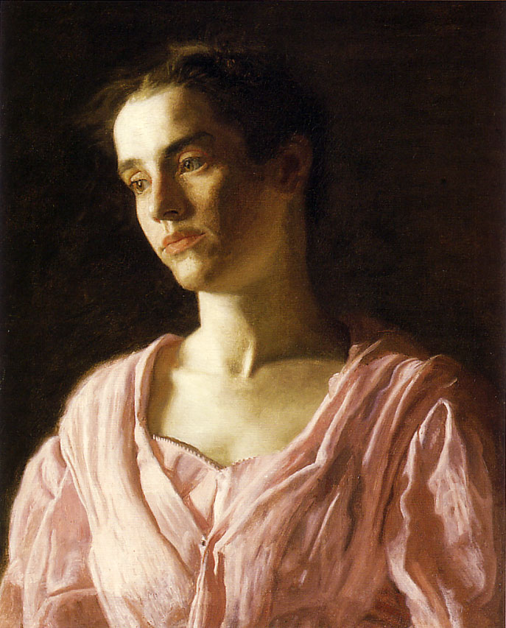
Women stayed home without voting rights (but better than European women in 1800s)

Slide 33
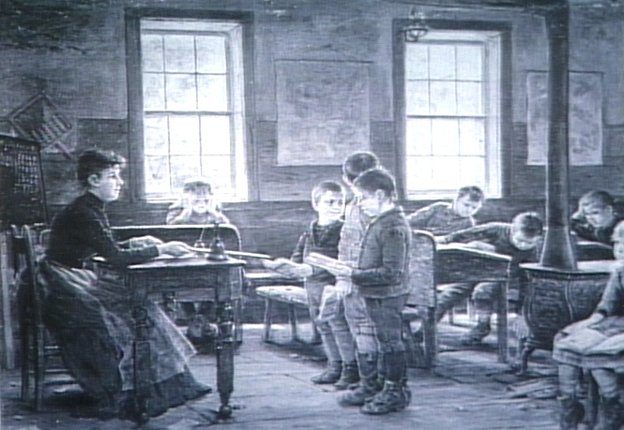
Gender differences existed in the workplace (women seen as physically & emotionally weak)

Slide 34
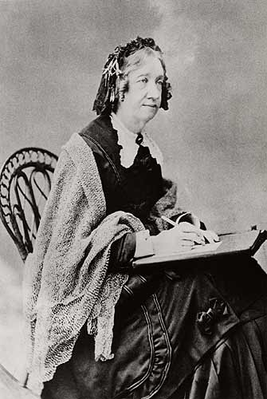
Home considered a woman’s sphere (even reformer Catherine Beecher argued that but some women wanted more)

Slide 35
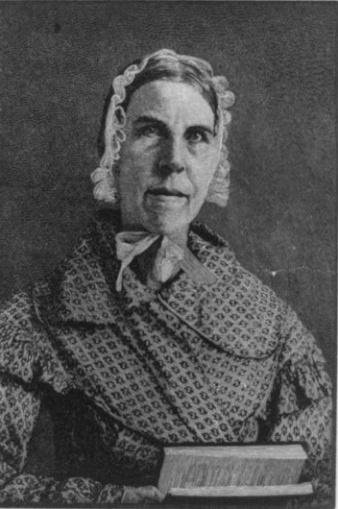
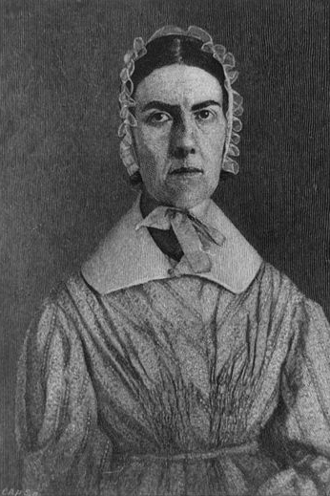
Women were very active in abolitionist movements (Grimke sisters)

Slide 36
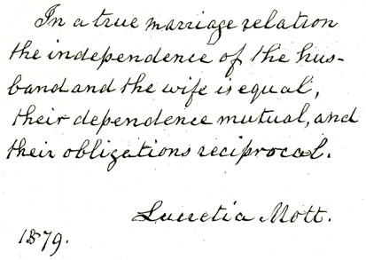
“America’s First Feminist”
Women’s movement led by Lucretia Mott,

Slide 37
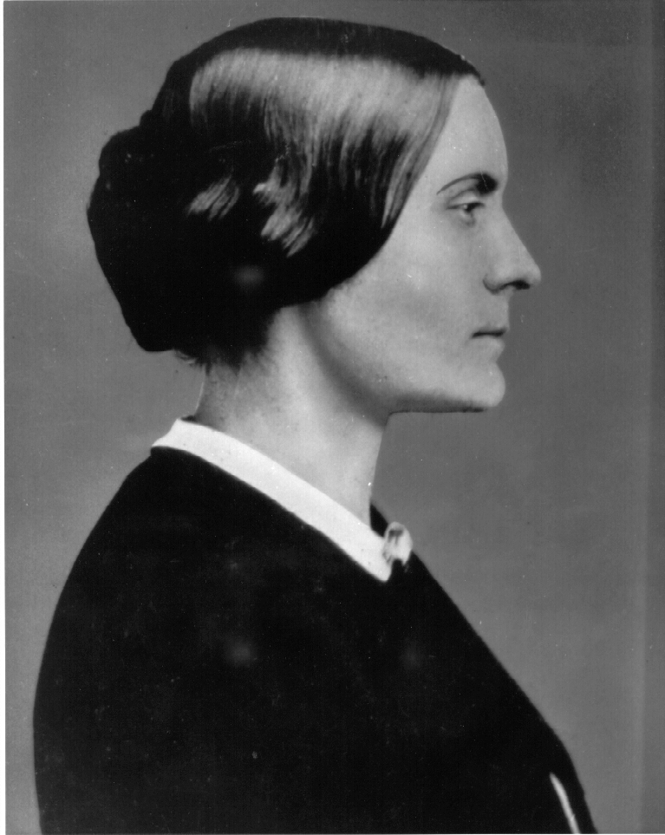
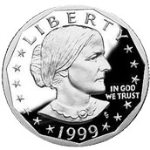
"Where, under our Declaration of Independence, does the Saxon man get his power to deprive all women and Negroes of their inalienable rights?"
Susan B. Anthony

Slide 38
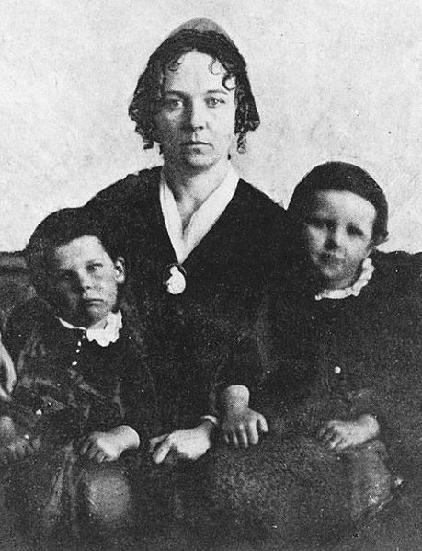
“The prejudice against color, of which we hear so much, is no stronger than that against sex. It is produced by the same cause, and manifested very much in the same way.”
Elizabeth Cady Stanton

Slide 39
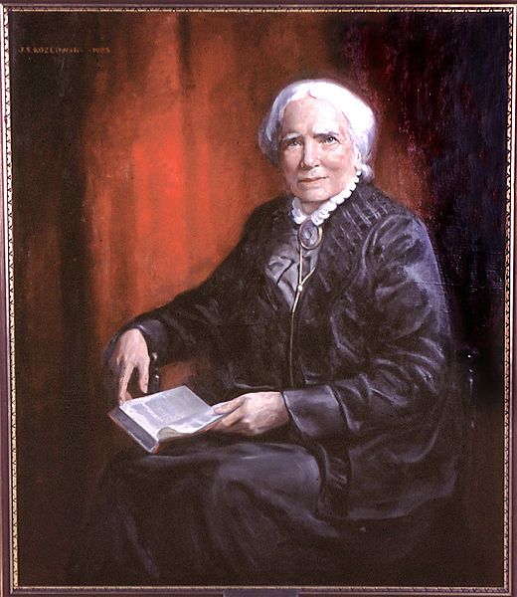
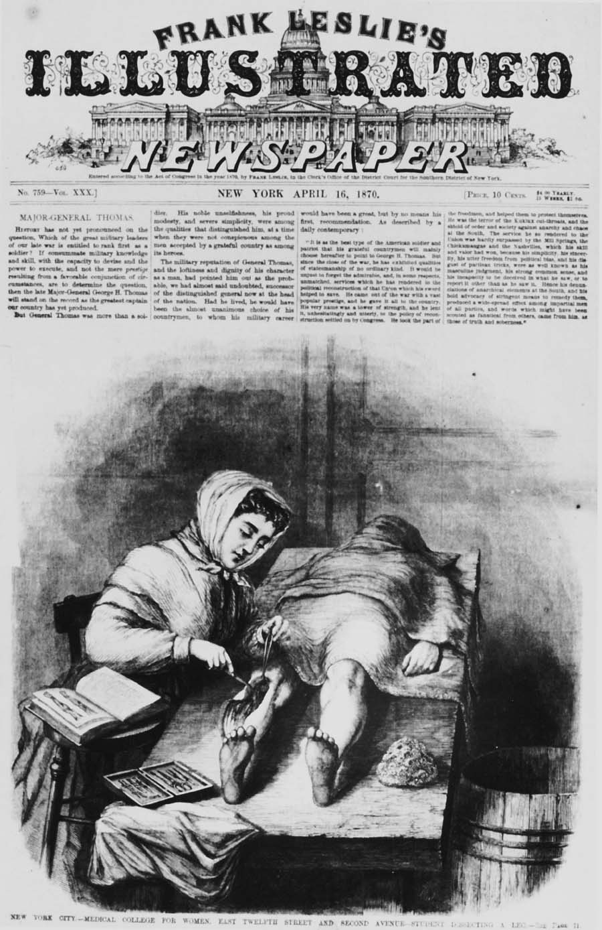
Elizabeth Blackwell (1st female med. graduate),

Slide 40
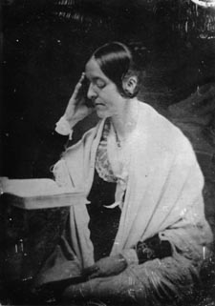
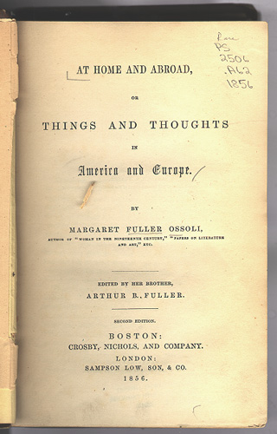
“If you ask me what offices [women] may fill, I reply—any. I do not care what case you put; let them be sea captains, if you will.”
Margaret Fuller

Slide 41
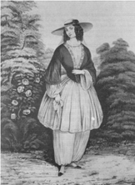
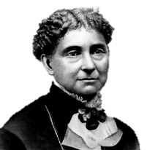
“The costume of women should be suited to her wants and necessities. It should conduce at once to her health, comfort, and usefulness; and, while it should not fail also to conduce to her personal adornment, it should make that end of secondary importance.”
Amelia Bloomer (semi-short skirts)

Slide 42
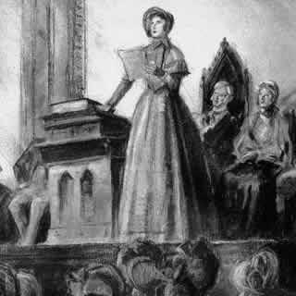
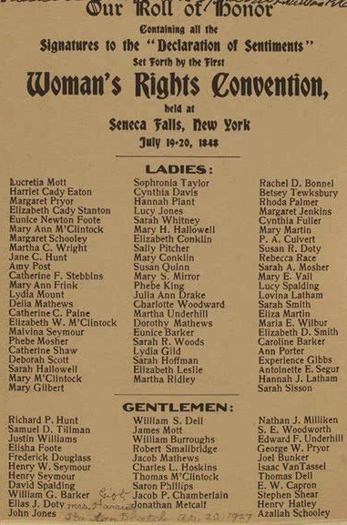
“Women, generally, are neither by nature, nor habit, nor education, nor by their necessary condition in society fitted to perform this duty (voting) with credit to themselves or advantage to the public.”
-NJ State Assembly
(1848) Women’s Rights Convention in Seneca Falls, NY demanded voting rights

Slide 43
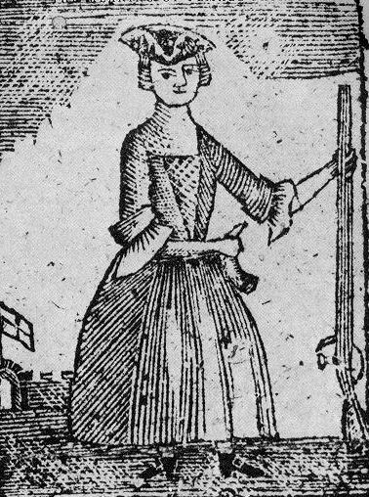
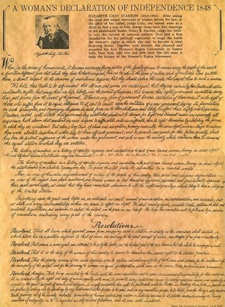
“The history of mankind is a history of repeated injuries and usurpations on the part of man toward woman, having in direct object the establishment of an absolute tyranny over her. To prove this, let facts be submitted to a candid world. He has never permitted her to exercise her inalienable right to the elective franchise. …He has made her, if married, in the eye of the law, civilly dead. …He has denied her the facilities for obtaining a thorough education, all colleges being closed against her…”
-Declaration of Sentiments
Declaration of Sentiments (spirit of Dec. of Ind. = “all men & women created equal”)

Slide 44
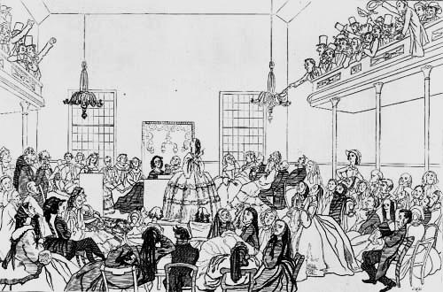
Essay
Essential Question
To what extent and in what ways did the roles of women change in American society between 1790 and 1860? Respond with reference to the following areas: domestic, economic, political, social.
Seneca Fall’s Convention launched the modern women’s rights movement

Slide 45
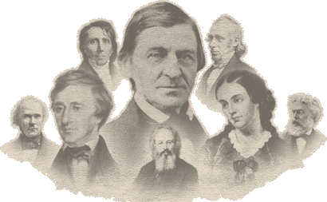
The Big Picture
The Transcendentalist movement was a uniquely American philosophy that encouraged people to rise above secular and religious guidelines & norms in an attempt to find inner-peace.
Transcendentalism

Slide 46
Literature of 1830s heavily influenced by transcendentalist movement

Slide 47
Hoped to “transcend” the limits of intellect and allow the emotions (the soul) to create an original relationship with the universe

Slide 48
Rejected John Locke’s idea of knowledge through reason and experience (lacked emotion)

Slide 49
The Transcendentalist Agenda
Give freedom to the slave.
Give well-being to the poor and the miserable.
Give learning to the ignorant.
Give health to the sick.
Give peace and justice to society.

Slide 50
Transcendentalists stressed individualism, search for inner truth (non-conformity)

Slide 51
“We live in…division, in parts, in particles. Meantime within man is the soul of the whole; the wise silence; the universal beauty, to which every part and particle is equally related, the eternal ONE. We see the world piece by piece, as the sun, the moon, the animal, the tree; but the whole, of which these are shining parts, is the soul.”
Ralph Waldo Emerson very popular because his ideals paralleled American ideals (self-reliance, self-government)

Slide 52
Henry David Thoreau opposed slavery, promoted civil disobedience against unjust laws

Slide 53
On the Duty of Civil Disobedience
Disobedience is the true foundation of liberty. The obedient must be slaves.
If the machine of government is of such a nature that it requires you to be the agent of injustice to another, then, I say, break the law.

Slide 54
The Big Picture
the Perfectionist aspirations unleashed by the Second Great Awakening inspired an increasingly more radical abolitionist movement in the North.
The Abolitionist Movement

Slide 55
The Abolitionists
Harriet
Beecher Stowe
Sojourner
Truth
Speeches, Newspapers and Books Were Used to Oppose Slavery
Frederick
Douglass
William
Garrison
John Brown
Harriet Tubman

Slide 56
Early Emancipation in the North

Slide 57
(1817) the American Colonization Society founded to transport blacks back to Africa (Liberia)

Slide 58
Most Americanized blacks had no desire to return to Africa

Slide 59
Despite no slavery in the North free blacks faced prejudice and hostility

Slide 60
Northerners liked the race but not the individual.
Southerners hated the race but not the individual.
Several states denied blacks entrance, right to vote, and barred them from public schools

Slide 61
“One-sixth of the population of the United States are slaves, looked upon as property, as nothing but property. The cash value of these slaves, at a moderate estimate, is two billion dollars. This amount of property value has vast influence on the minds of its owners, very naturally. The same amount of property would have an equal influence upon us if owned in the North. Human nature is the same-people at the South are the same as those at the North, barring the difference in circumstances.”
-Abraham Lincoln
By 1850, American slaves were worth $1.3 billion, one-fifth of the nation's wealth.
Abolitionism was stunted because many feared ending slavery would cause economic disaster (emancipation plans often included financial compensation to slave owners for their losses)

Slide 62
The “immense amount of capital which is invested in slave property…is owned by widows and orphans, by the aged and infirm, as well as the sound and vigorous. It is the subject of mortgages, deeds of trust, and family settlements. I know that there is a visionary dogma, which holds that negro slaves cannot be the subject of property. I shall not dwell long on this speculative abstraction. That is property which the law declares to be property.”
-Henry Clay

Slide 63
The South owed northern banks $300 million by the late 1850s (northern factories depended on southern cotton)

Slide 64
“I maintain that men and women are equal. But we are much in the situation of the slave. Man has asserted and assumed authority over us.”
-Sarah Grimke
By 1840 abolitionism took off with 2nd Great Awakening

Slide 65
Abolitionists (a minority even in North) mounted a highly visible campaign against slavery (resistance included fierce arguments, aiding escaped slaves and violence)

Slide 66
Many historians regard Weld as the most important figure in the abolitionist movement…, but his passion for anonymity long made him an unknown figure in American history.
Theodore Dwight Weld preached against slavery (wrote American Slavery As It Is)

Slide 67
The US Constitution is “A covenant with death and an agreement with Hell” because it implicitly accepted racial bondage.
-William Lloyd Garrison
(1831) William Lloyd Garrison published The Liberator (an abolitionist newspaper that triggered a 30-year war of words over slavery)

Slide 68
“I am aware, that many object to the severity of my language; but is there not cause for severity? I will be as harsh as truth, and as un-compromising as justice. On this subject, I do not wish to think, or speak, or write, with moderation. No! no! Tell a man whose house is on fire, to give a moderate alarm; tell him to moderately rescue his wife from the hands of the ravisher; tell the mother to gradually extricate her babe from the fire into which it has fallen; – but urge me not to use moderation in a cause like the present. I am in earnest- I will not equivocate- I will not excuse- I will not retreat a single inch- AND I WILL BE HEARD.”
-William Lloyd Garrison, 1st Edition of The Liberator

Slide 69
Many dedicated abolitionists rallied around Garrison and his paper

Slide 70
“The experience of the fifty years...shows us the slaves trebling in numbers-slaveholders monopolizing the offices and dictating the policy of the Government, trampling on the rights of the free States, and making the courts of the country their tools. To continue this disastrous alliance longer is madness. The trial of fifty years only proves that it is impossible for free and slave States to unite on any terms, without all becoming partners in the guilt and responsible for the sin of slavery. Why prolong the experiment? Let every honest man join in the outcry of the American Anti-Slavery Society.”
Famed abolitionist speaker Wendell Phillips refused to eat sugar or wear cotton cloth (made by slaves)

Slide 71
“Let no man of us budge one step, and let slave-holders come to beat us from our country. America is more our country, than it is the whites — we have enriched it with our blood and tears. The greatest riches in all America have arisen from our blood and tears: — and will they drive us from our property and homes, which we have earned with our blood?”
Georgia offered a reward of $10,000 to anyone who would deliver Walker alive and $1,000 to anyone who would kill him.
In 1830, Walker was found dead near the doorway of his shop in Boston.
(1829) David Walker (black abolitionist) wrote Appeal to the Colored Citizens of the World calling for bloody end to slavery

Slide 72
Isabella Baumfree
“I know that it feels a kind o’ hissin’ and ticklin’ like to see a colored woman get up and tell you about things, and Women’s Rights. We have all been thrown down so low that nobody thought we’d get up again; but…we will come up again, and now I’m here. …We’ll have our rights, see if we don’t; and you can’t stop us from them; see if you can. You may hiss as much as you like, but it’s comin’. …I am sittin’ among you to watch; and every once and awhile I will come out and tell you what time of night it is…”
-Sojourner Truth responding to boos and threats during her speech at the 4th National Woman’s Rights Convention in NYC, 1853
Sojourner Truth (freed black woman) fought for black emancipation and women’s rights

Slide 73
Martin Delaney seriously reconsidered black relocation to Africa

Slide 74
Frederick Douglass was greatest black abolitionist

Slide 75
Douglass was an escaped slave who became a renowned speaker and champion of black cause despite being beaten and harassed

Slide 76
"I assert most unhesitatingly, that the religion of the South is a mere covering for the most horrid crimes - a justifier of the most appalling barbarity, a sanctifier of the most hateful frauds, and a dark shelter under which the darkest, foulest, grossest, and most infernal deeds of slaveholders find the strongest protection.“
The Narrative of the Life of Frederick Douglass depicted his remarkable struggle and his origins

Slide 77
When I was a child, I had a number of thoughts. “Why am I a slave? Why are some people slaves, and others masters? Was there ever a time when this was not so? How did the relation commence?
Once, however, engaged in the inquiry, I was not very long in finding out the true solution of the matter. It was not color, but crime, not God, but man, that afforded the true explanation of the existence of slavery; nor was I long in finding out another important truth; …what man can make, man can unmake.
I distinctly remember being, even then, most strongly impressed with the idea of being a free man some day. This cheering assurance was an inborn dream of my human nature-a constant menace to slavery-and one which all the powers of slavery were unable to silence or extinguish.”
-Frederick Douglass

Slide 78
While Garrison seemed concerned with his own righteousness Douglass increasingly looked to politics to solve the slavery problem

Slide 79
Frederick Douglass’ 4th of July Speech
“Fellow-citizens, pardon me, allow me to ask, why am I called upon to speak here to-day? What have I, or those I represent, to do with your national independence? What, to the American slave, is your 4th of July? I answer; a day that reveals to him, more than all other days in the year, the gross injustice and cruelty to which he is the constant victim. To him, your celebration is a sham; your boasted liberty, an unholy license; your national greatness, swelling vanity; your sounds of rejoicing are empty and heartless; your denunciation of tyrants, brass fronted impudence; your shouts of liberty and equality, hollow mockery; your prayers and hymns, your sermons and thanksgivings, with all your religious parade and solemnity, are, to Him, mere bombast, fraud, deception, impiety, and hypocrisy-a thin veil to cover up crimes which would disgrace a nation of savages. There is not a nation on the earth guilty of practices more shocking and bloody than are the people of the United States, at this very hour. Go where you may, search where you will, roam through all the monarchies and despotisms of the Old World, travel through South America, search out every abuse, and when you have found the last, lay your facts by the side of the everyday practices of this nation, and you will say with me, that, for revolting barbarity and shameless hypocrisy, America reigns without a rival.”

Slide 80
“I am a Republican, a black, dyed in the wool Republican, and I never intend to belong to any other party than the party of freedom and progress."
Douglass (and other blacks) supported the Liberty Party (1840), the Free Soil Party (1848) and the Republican Party (1850s)

Slide 81
Montrose, Owego,
Newark Valley, Ithaca
The Underground Railroad was a secret organization that led runaway slaves to Canada

Slide 82
“I should fight for…liberty as long as my strength lasted and when the time came for me to go, the Lord would let them take me.”
-Harriet Tubman
Harriet Tubman freed more than 300 slaves during 19 trips to the South

Slide 83
The South demanded a stricter fugitive slave law

Slide 84
Immediate emancipation with NO compensation.
Slavery was a moral, not an economic issue.
For many years radicals like Garrison were unpopular (many people were raised valuing the slavery compromises in the Constitution)

Slide 85
By the 1850s abolitionists were impacting minds in the north and beginning to sway more people toward their side

Slide 86
“So this is the lady who started the Civil War.” -Abraham Lincoln
(1852) Harriet Beecher Stowe published Uncle Tom’s Cabin (popular book that awakened the passions of North towards evils of slavery)

Slide 87
Sold 300,000 copies in the first year.
2 million in a decade!

Slide 88
Hinton R. Helper wrote The Impending Crisis of the South

Slide 89
Helper (a Southerner) showed how non-slave owning Southerners were hurt by slavery

Slide 90
Once abolition became a widespread position in the North the moral objection to slavery no longer allowed for compromises that extended its reach or existence

Slide 91
"an American who gave his life that millions of other Americans might be free"
"In the late 1850s a new type of political assassin appeared in the United States. He did not murder the mighty--but the obscure. his purposes were…to force the nation into a new political pattern by creating terror."
"America's first domestic terrorist"
"Brown's action was one of great idealism and placed him in the company of the great liberators of mankind."
Brown was "simply part of a very violent world.” He was “a bad tactician, a bad strategist, he's a bad planner, he's not a very good general-but he's not crazy"
Brown was “fanatical, monomaniacal, a zealot, and psychologically unbalanced.”
John Brown clearly reflected the radicalization of the abolitionist movement

Slide 92
Brown planned to invade the South, seize weapons, encourage slaves to revolt, take over the South and free the slaves

Slide 93
"I think that for once the Sharp's rifles and the revolvers were employed in a righteous cause. The tools were in the hands of one who could use them… He has a spark of divinity in him.“
^{-Henry David Thoreau}
He led a raid on Harper’s Ferry, VA (slaves didn’t revolt, he was captured, convicted of treason and sentenced to death)

Slide 94
Brown was insane (but not stupid) and wanted to be a martyr against slavery

Slide 95
"I John Brown am now quite certain that the crimes of this guilty land: will never be purged away; but with Blood."
Brown became martyr for abolitionists (Northerners rallied around his memory)

Slide 96
The North "has sanctioned and applauded theft, murder, and treason."
-De Bow's Review
The South applauded his execution and grew nervous about the radical turn of abolitionism

Slide 97
In the end, many abolitionists supported war as the price of emancipation

