Slide 1
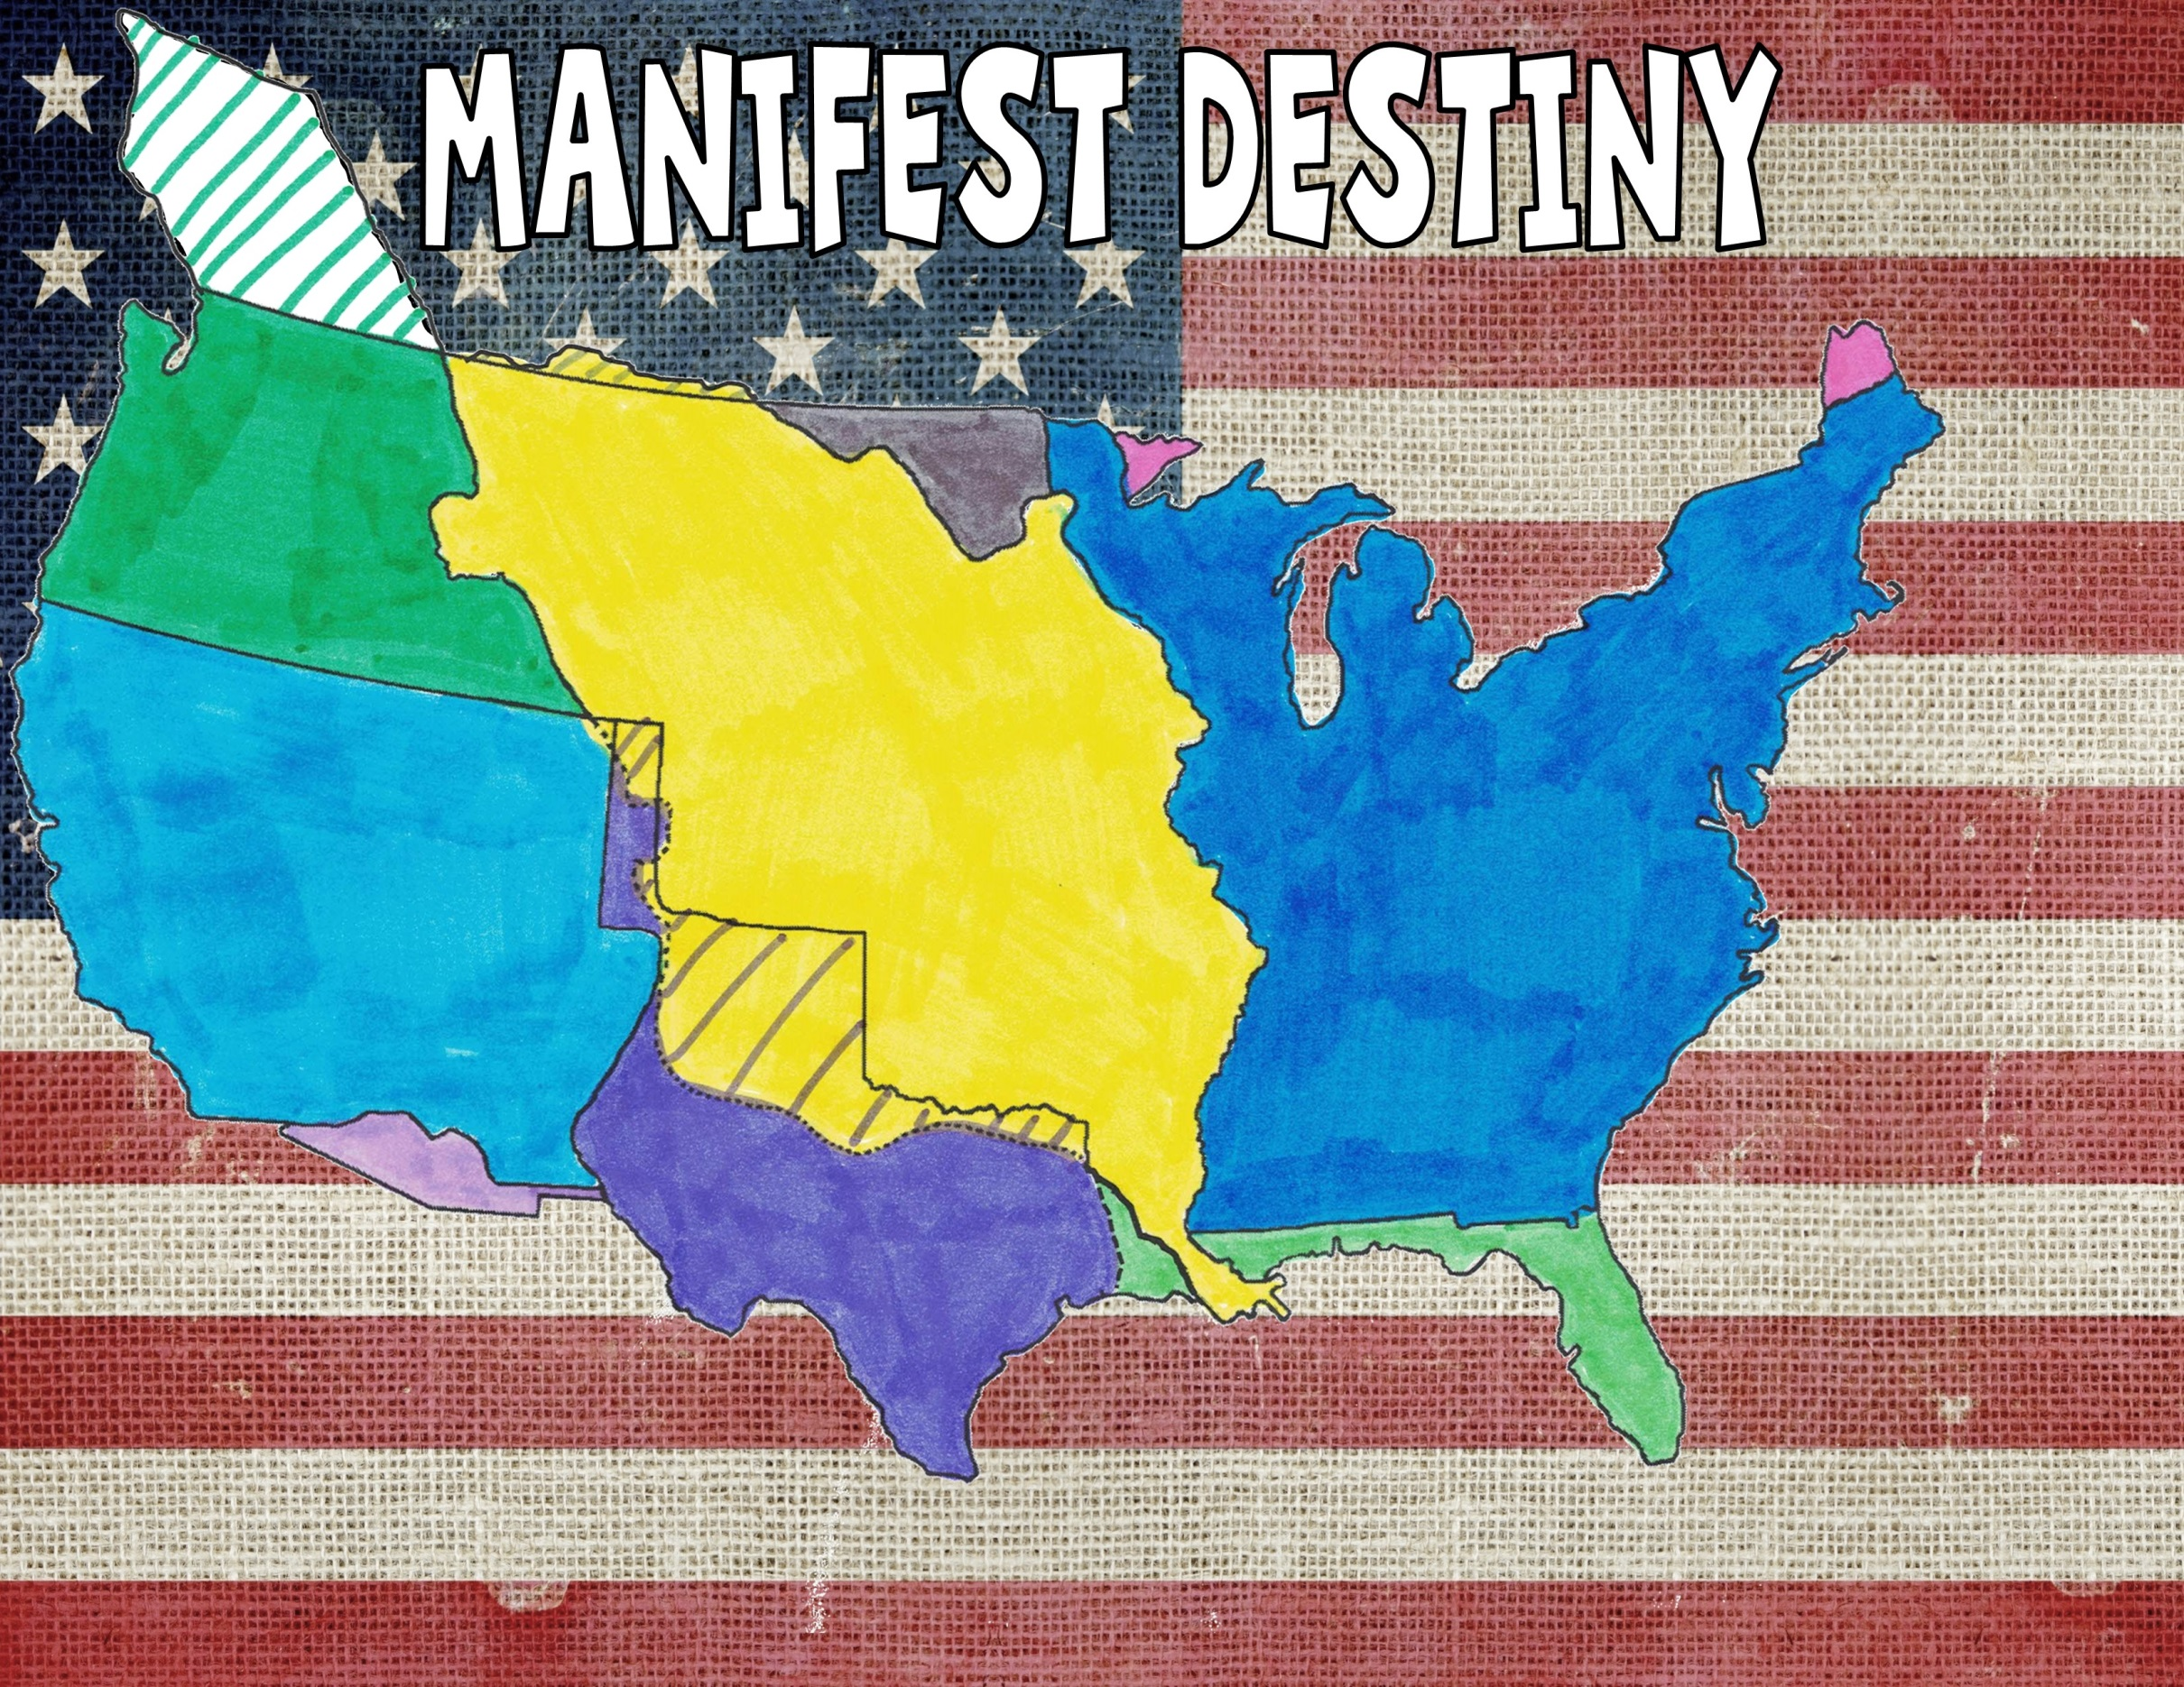
Manifest Destiny Explained in 5 minutes
It’s the belief that the United States was destined to stretch from the Atlantic to the Pacific Coast

Slide 2
Who Won the American Revolution Crash Course
The treaty ended the American Revolution. The British recognized the sovereignty and independence of the United States with generous boundaries from the Great Lakes to the Mississippi River to Spanish Florida.

Slide 3
Louisiana Purchase in a Nutshell
An attempt to buy New Orleans and a little strip of land from the French resulted in the U.S. buying the entire Louisiana Territory from France for $15 million.

Slide 4
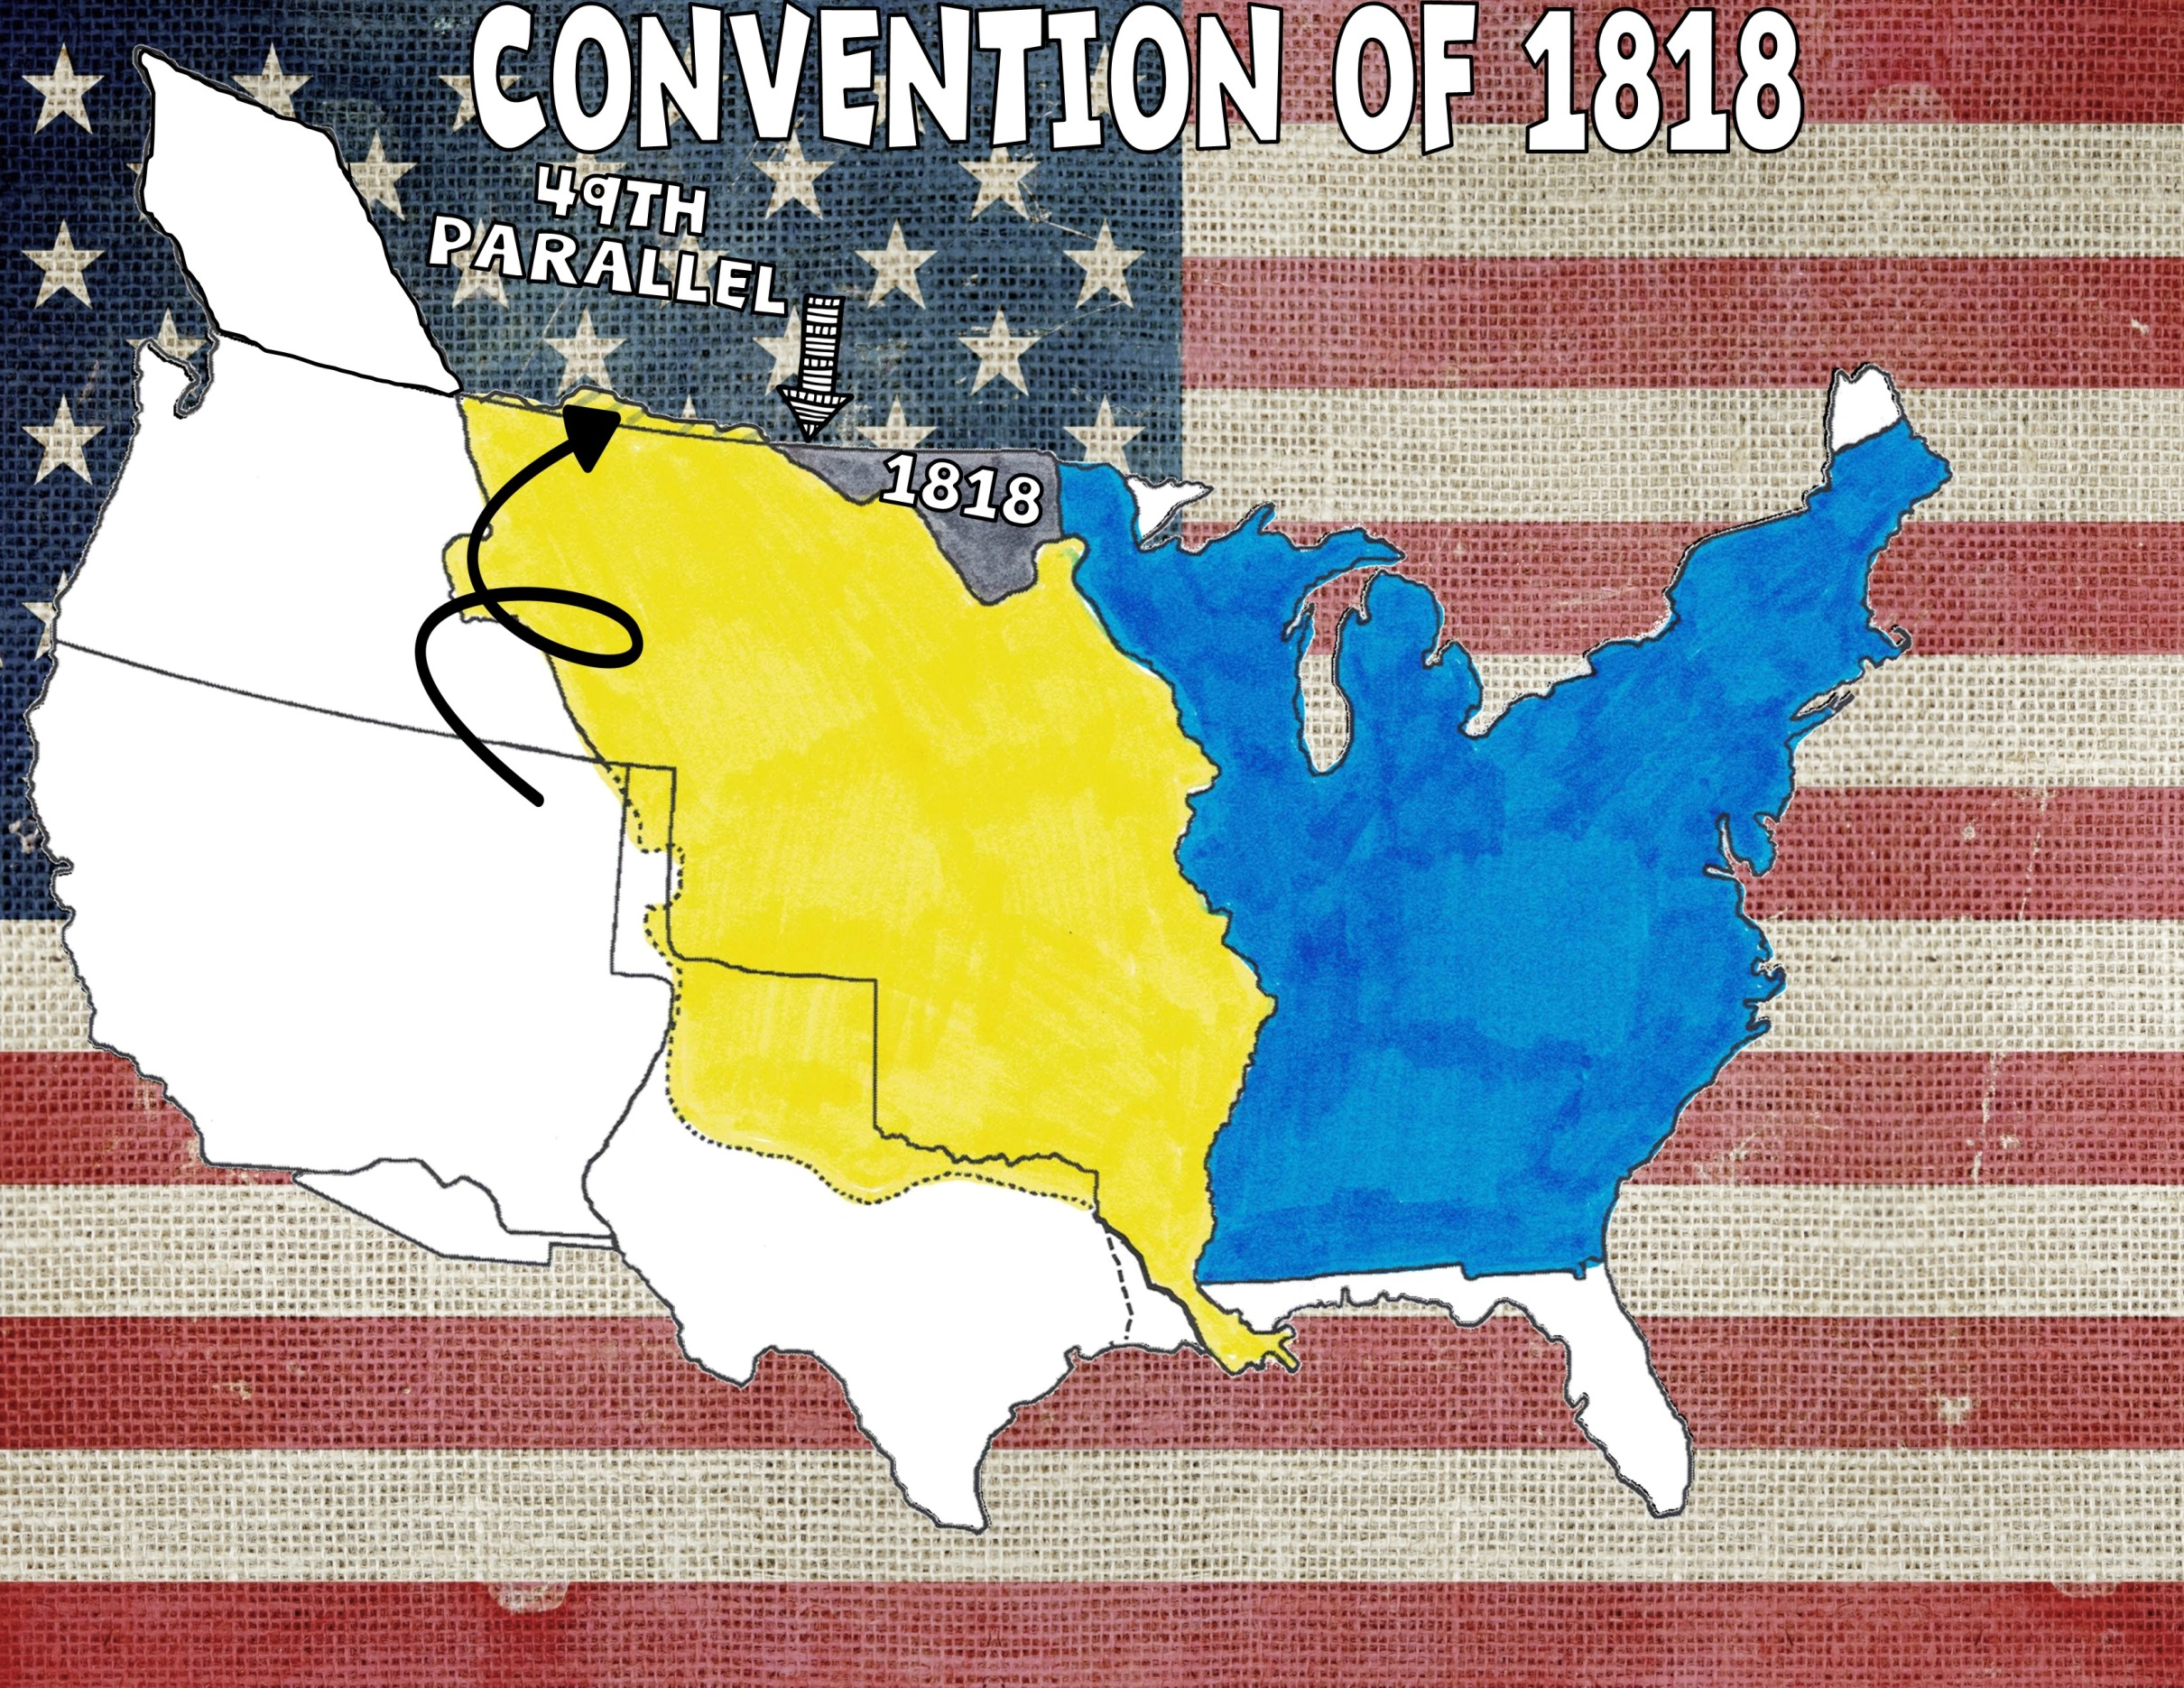
Territory ceded (given up) to Great Britain
This set the boundary between the United States and British North America at the 49th Parallel. The U.S. ceded land north of the boundary to Great Britain and Great Britain ceded the Red River Basin to the United States.

Slide 5
Treaty with Spain
The Spanish Cession gave the U.S. Spanish Florida and set the boundary between the U.S. and New Spain, giving the U.S. a little more land in what will become the state of Louisiana. Spain also gave up claims to Oregon Territory.

Slide 6
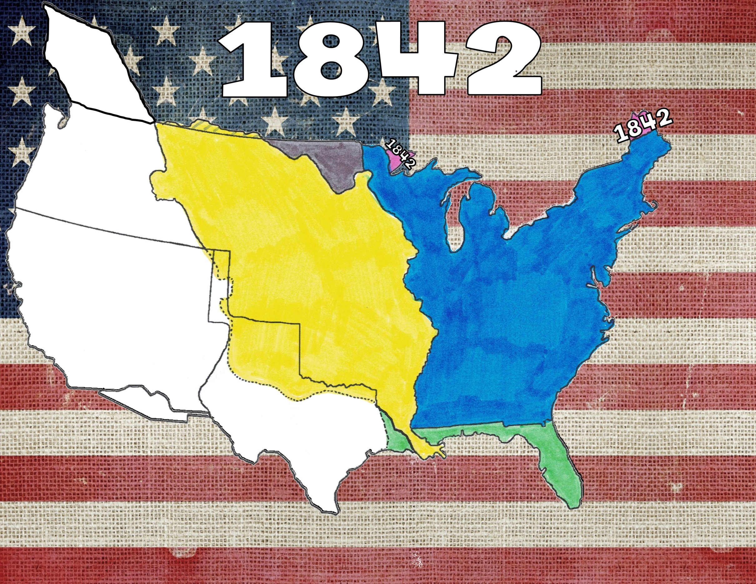
How Maine Got its Shape
The Webster- Ashburton Treaty with Great Britain set the boundary of Maine and Lake Superior.

Slide 7
Now part of Texas
War and Expansion Crash Course
In 1836, Texas declared its independence from Mexico. In 1845, the Texas Republic joined the U.S. as the 28th state.

Slide 8
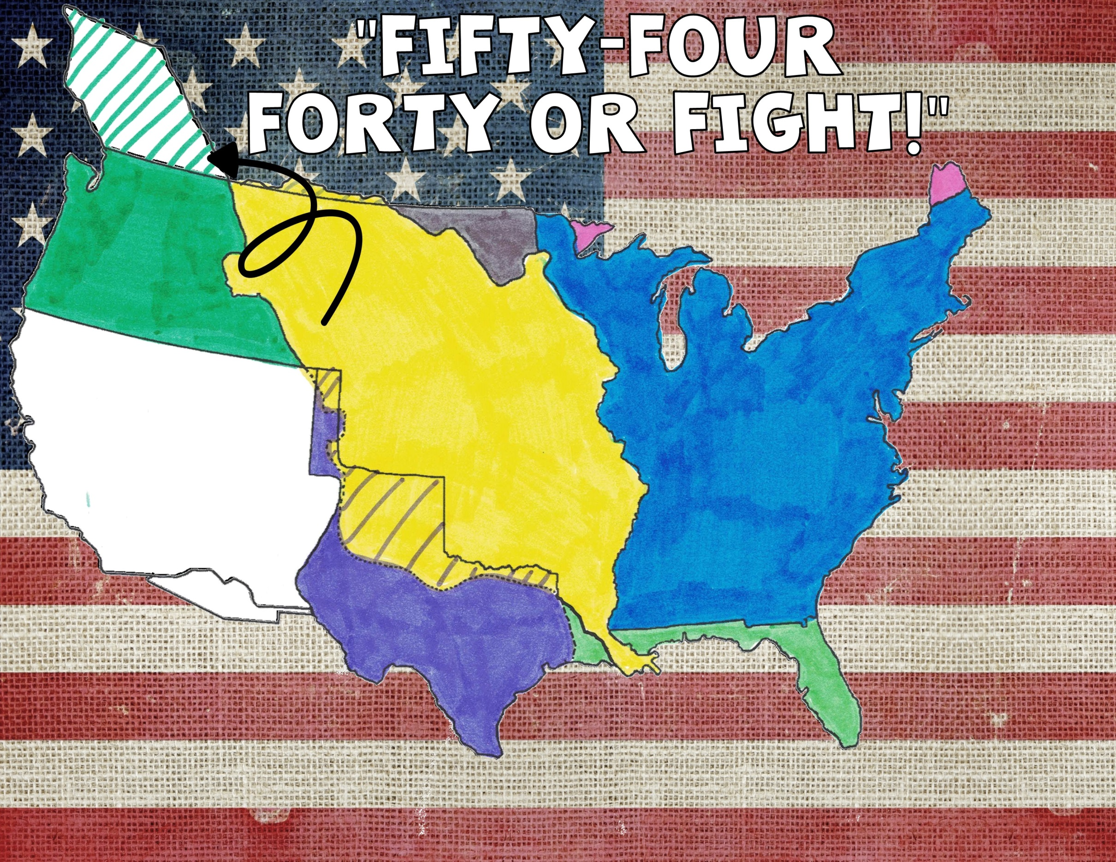
Territory ceded (given up) to Great Britain
Oregon Territory
54’40” or Fight!
Oregon Treaty between the U.S. and Great Britain set the boundary at the 49th parallel.

Slide 9
Mexican American War
The Treaty of Guadalupe Hidalgo ended the Mexican-American War and Mexico ceded the
Southwest to the United States.

Slide 10
Jimmy Fallon: Gadsden Purchase
U.S. paid Mexico $10 million for a strip of land needed to build a southern transcontinental railroad.

