Slide 1
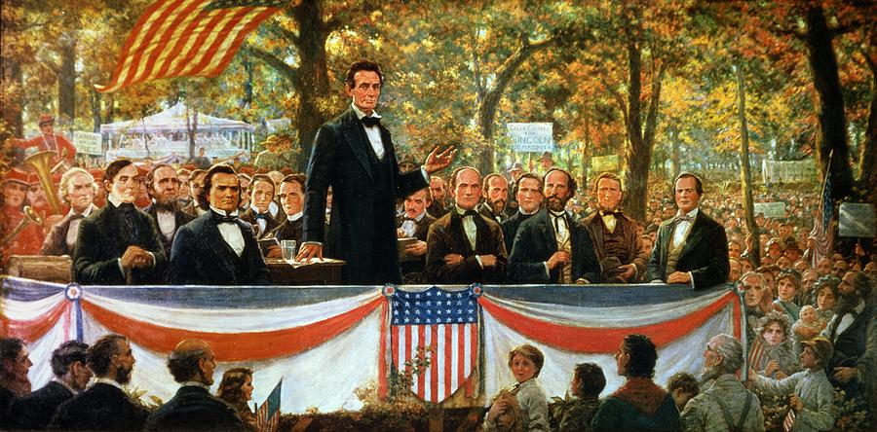
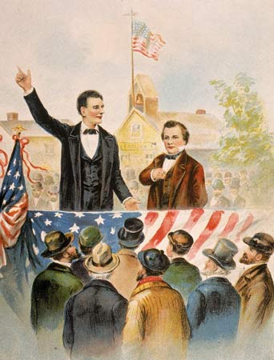
LINCOLN-DOUGLAS DEBATES
Lincoln & Douglas both running for the U.S. Senate in Illinois.
Lincoln & Douglas both running for the U.S. Senate in Illinois.
The debates were followed by the country because both candidates were interested in running for the Presidency in 1860.
Lincoln & Douglas both running for the U.S. Senate in Illinois.
The debates were followed by the country because both candidates were interested in running for the Presidency in 1860.
Slavery was the issue.
Lincoln & Douglas both running for the U.S. Senate in Illinois.
The debates were followed by the country because both candidates were interested in running for the Presidency in 1860.
Slavery was the issue.
“Honest Abe” | “The Little Giant”
Lincoln & Douglas both running for the U.S. Senate in Illinois.
The debates were followed by the country because both candidates were interested in running for the Presidency in 1860.
Slavery was the issue.
“Honest Abe” | “The Little Giant”
Lincoln stated: “A house divided against itself cannot stand.” | Douglas believed that slavery should be decided by the people.
Lincoln & Douglas both running for the U.S. Senate in Illinois.
The debates were followed by the country because both candidates were interested in running for the Presidency in 1860.
Slavery was the issue.
“Honest Abe” | “The Little Giant”
Lincoln stated: “A house divided against itself cannot stand.” | Douglas believed that slavery should be decided by the people.
Lincoln was against the expansion of slavery. | Popular sovereignty.

Slide 2
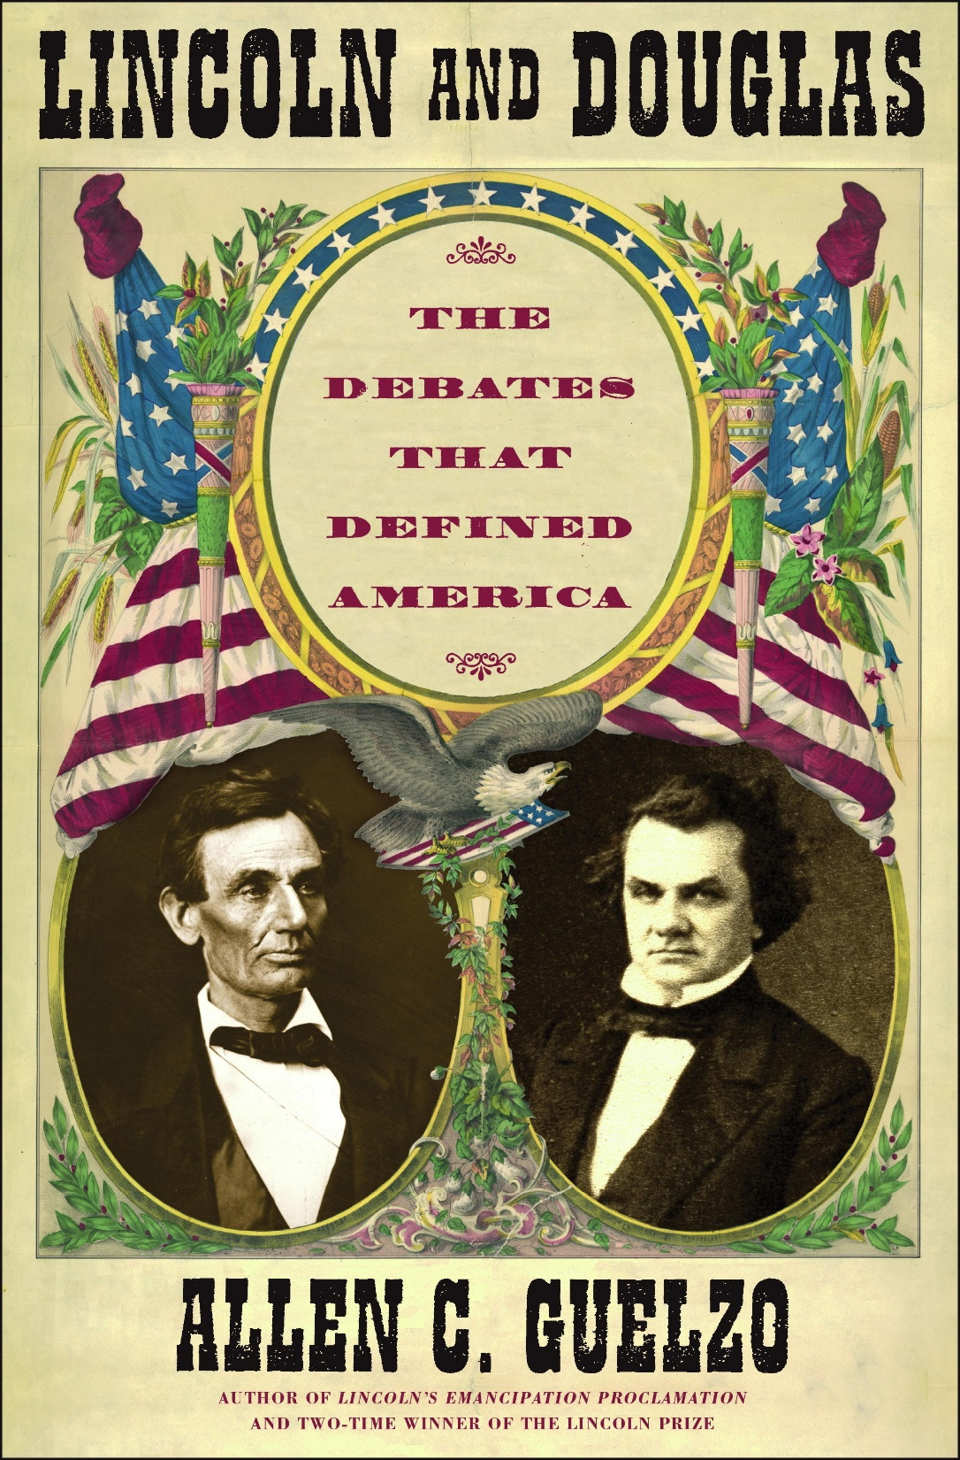
WHAT WE
LEARNED TODAY:
What developments deepened the divisions between the North and South?

Slide 3
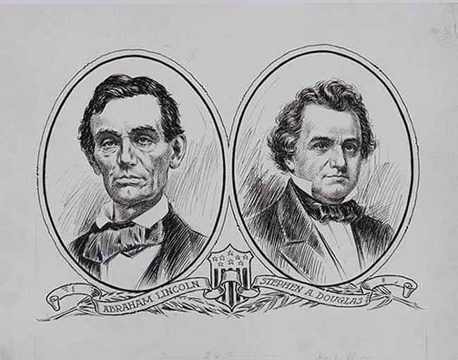
THE UNION IN CRISIS
(1846-1861)
1860 to Fort Sumter

Slide 4
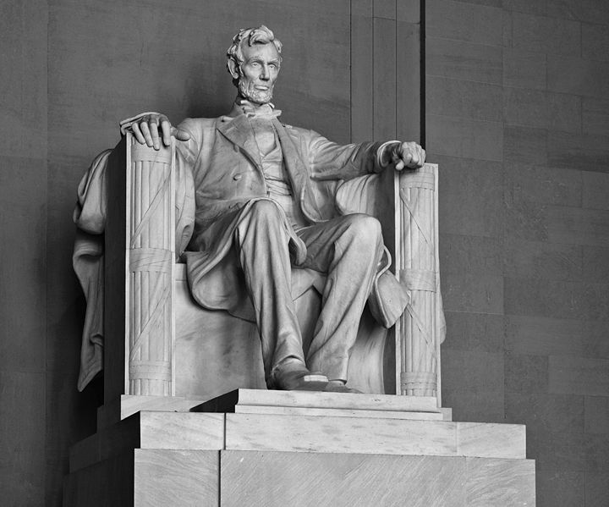
LINCOLN, SECESSION, & WAR

Slide 5
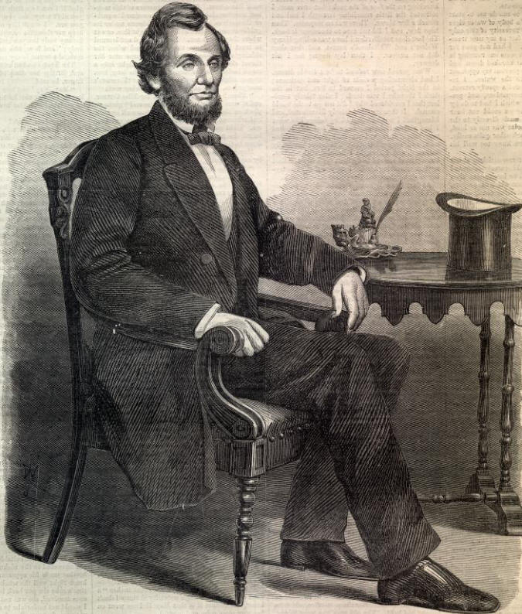
WHAT WE WILL
LEARN TODAY:
How did the Union finally collapse into a civil war?

Slide 6
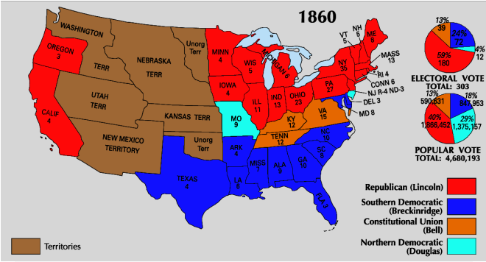
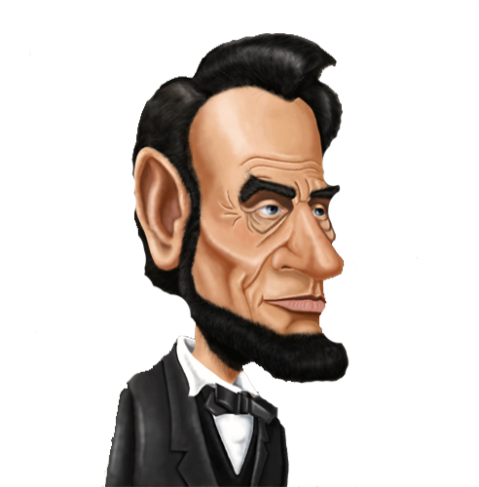
ELECTION OF 1860
Country is polarized (divided) over the issue of slavery. Once Lincoln is elected at president, South Carolina will secede from the U.S. along with several other southern states.
They will form the Confederate States of America (CSA).
If the Democrats split the party… I should be able to win this thing!
303 total electoral votes. Need 152 to win.

Slide 7
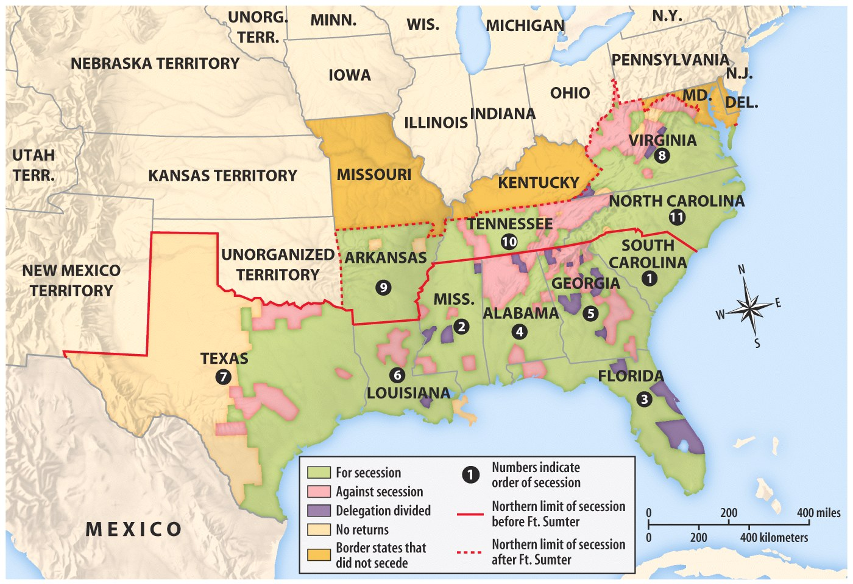

Slide 8
THE UNION COLLAPSES
SECESSION
CAUSES
EVENTS
EFFECTS
South worries that northern radicals may try to eliminate slavery in original 13 states.
Democratic Party nominates two presidential candidates.
South Carolina secedes.
Six other states secede as well.
Lincoln wins the election without a single southern electoral vote.
Confederate States of America formed.
Democrats split into two parties.
Republicans nominate Lincoln & call for an end of slavery in territories.
Confederates defeat Union at Fort Sumter.

Slide 9
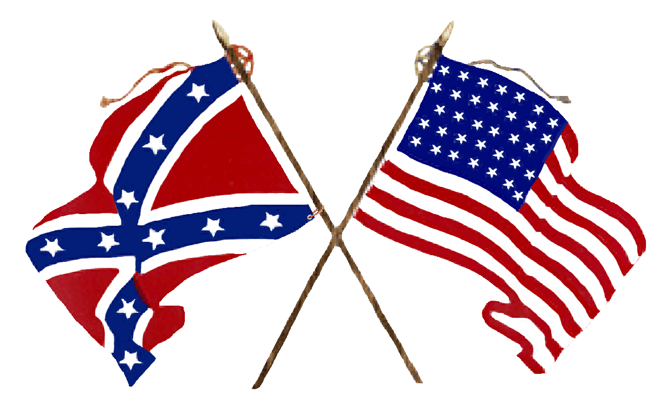
LINCOLN'S INAUGURATION ADDRESS:
“I have no purpose, directly or indirectly, to interfere with the institution of slavery in the states where it exists.”
But he did intend to preserve the Union.
“No state, upon its own mere action, can lawfully get out of the Union.”
Lincoln will not allow the southern states to leave. He is going to keep the country together, even if it means a war.

Slide 10
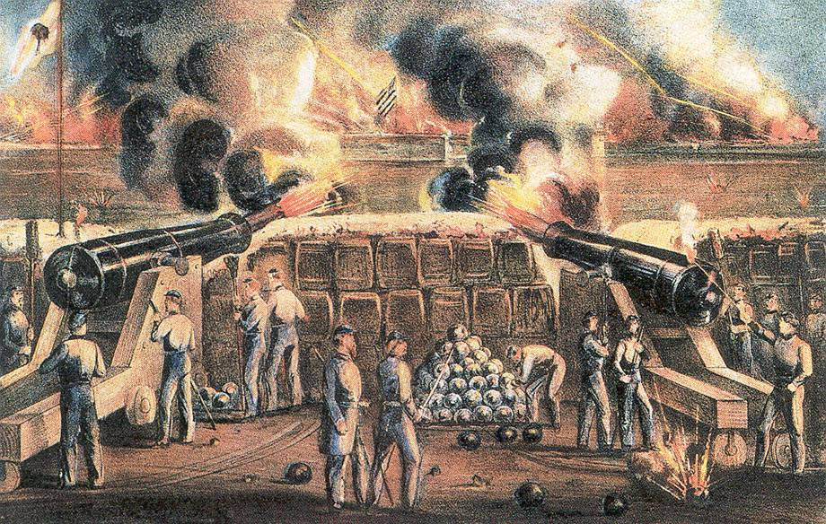
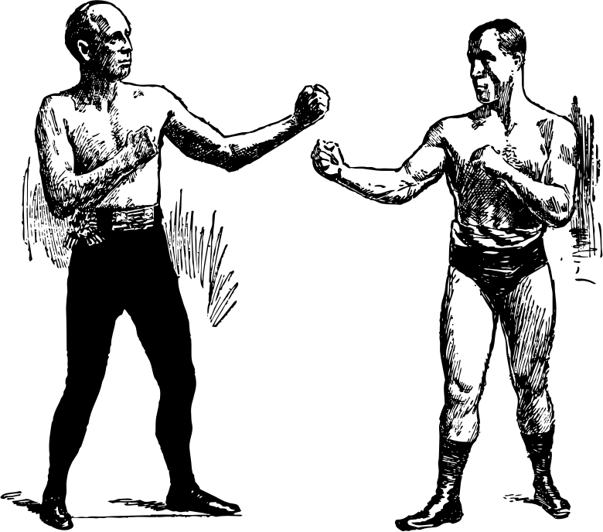
SOUTH FIRES OF FORT SUMTER
Confederates had taken over forts in the South, except for Fort Sumter.
Fort Sumter was important because it guarded an important harbor at Charleston, S.C.
WHO GETS BLAMED FOR A FIGHT?
Federal troops at the fort needed food and supplies. Lincoln notified South Carolina that he was sending supplies – food only, no arms – to the fort.

Slide 11
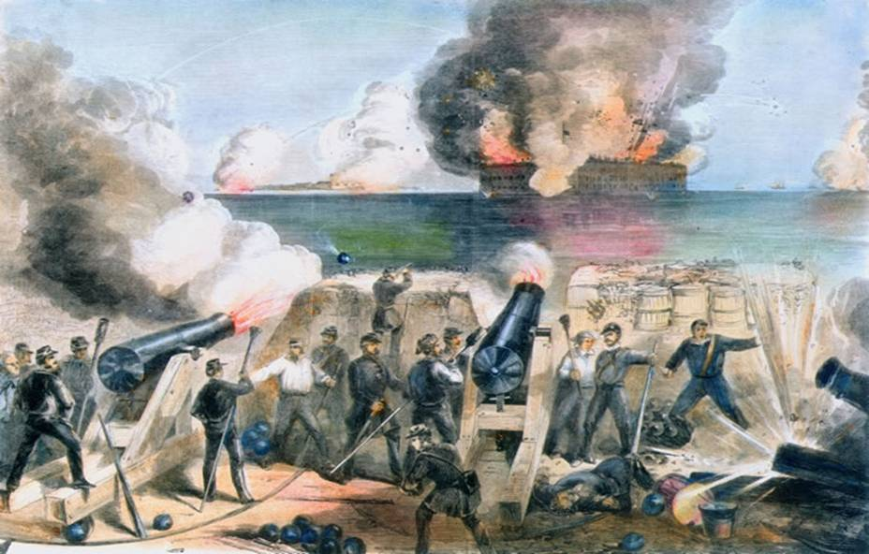
SOUTH FIRES OF FORT SUMTER
South Carolina was suspicious of Lincoln’s motives and ordered the federal troops to surrender to the Confederacy.
The troops refused, so the Confederates fired on the fort…
THE CIVIL WAR BEGINS

Slide 12
