Slide 1
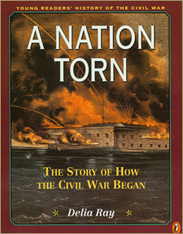
EVENTS LEADING TO THE CIVIL WAR

Slide 2
Missouri Compromise, 1820
Missouri became a slave state.
Maine became a free state.
Congress drew an imaginary line across the Louisiana Territory at 36 30.
North of the line-slavery was banned except in Missouri.
South of the line-slavery was permitted
It kept the Union together, but nobody really liked it.

Slide 3
Missouri Compromise, 1820

Slide 4
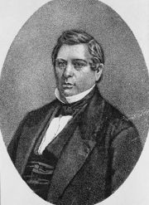
Wilmot Proviso, 1856-57
Representative David Wilmot tried to outlaw slavery in new U.S. territories.The issue was passed by the House of Representatives but dropped by the Senate.
It created many debates and made slavery an even more explosive issue.

Slide 5
Compromise of 1850
California became a free state.
New Mexico and Utah became territories open to slavery.
Slave trade (but not slavery) was abolished in Washington, D.C..
A strong Fugitive Slave Law was supposed to be enforced in the North and the South.

Slide 7
Fugitive Slave Law, 1850
Part of the Compromise of 1850 - Required people in the North and the South to turn in runaway slaves.
Some Northerners openly defied it, creating more conflict between North and South.

Slide 8
Uncle Tom's Cabin by Harriet Beecher Stowe, 1852
This best-selling book told of the horrors of slavery in an emotional way.
It turned many people against slavery and infuriated many Southerners.

Slide 9
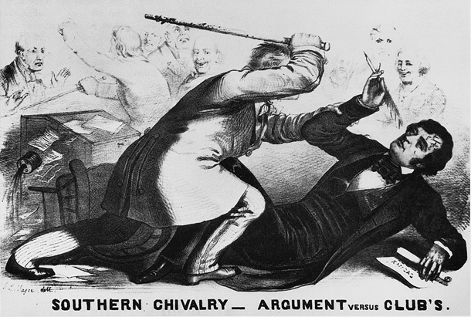
Kansas-Nebraska Act, 1854
This act of Congress overturned the Missouri Compromise because the issue of slavery in territories of Kansas & Nebraska was to be decided by popular sovereignty (state citizen vote).
Bleeding Kansas-Border Ruffians snuck across to Kansas and voted for slavery, which was not reflective of the state vote. Bloody battles begin. Resulting in Kansas in a Civil War.
Mad at the outcome Abolitionist John Brown killed 5 pro-slavery people in Kansas.
Senator Charles Sumner condemned slavery was beat by another senator (in the Chamber).

Slide 10
Kansas Nebraska Act

Slide 11
The Dred Scott Case, 1857
Dred Scott, a slave who lived in Missouri (a slave state), moved with his master to Illinois, then to Wisconsin, both free states. When his master died, some abolitionist lawyers sued for his freedom saying that by living in a free state he was then free.

Slide 12
The Dred Scott Case, 1857
The U.S. Supreme Court ruled:
Scott could not sue for freedom because he was not a citizen.
No African American (slave or free) was a citizen.
The Missouri Compromise was unconstitutional because it banned slavery in some areas.
When Congress bans slavery it takes property from slave holders.
The 5th Amendment to the Constitution says property cannot be taken from people. Slaves are property; therefore, the Missouri Compromise is unconstitutional.

Slide 13
Lincoln-Douglas Debates, 1858
Abe Lincoln ran against Stephen Douglas for the Senate. They challenged each other in a series of historic debates which brought to light more clearly the issues of proslavery and antislavery.
Lincoln wanted to end slavery in the territories.
Douglas argued for popular sovereignty (state citizen vote).

Slide 14
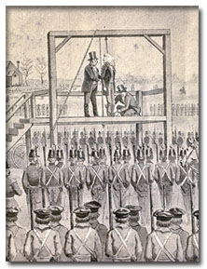
John Brown's raid on Harper's Ferry, Virginia arsenal, 1859
John Brown was an abolitionist (a person who demanded an immediate and no-compromise end to slavery) who planned to capture guns and ammunition, distribute them to slaves, and have them break free.
John Brown was captured and hanged.
To most Southerners, John Brown was a dangerous criminal. To most Northerners, he was a hero.

Slide 16
Lincoln is elected President; South Carolina secedes in December 1860

Slide 17
Secession of six more Southern states, 1861
The union of the U.S. was challenged when Southern states threatened secession (withdrawal from the union).
Southern states based their right to leave the union on the fact that the original 13 states had existed separately before they joined together to form the U.S. They argued the doctrine of states’ rights - states had the right to join the union or leave the union

Slide 19
Secession of six more Southern states, 1861
They believed they could nullify (ignore) a federal law they did not consider constitutional.
The South seceded for more than states’ rights. They also seceded because they were loyal to the region and economically dependent on the slave system.

Slide 20
Secession, of six more Southern states, 1861
When Lincoln was running for president, he said he was against slavery, but would not interfere where it already existed. He said he did not want slavery extended. He also said he would defend the Constitution and keep the union together.
The Southern seceding states formed the Confederate States of America (the Confederacy).

Slide 21
Fort Sumter attacked by South Carolina rebels; Civil War began, April 12, 186l (p.371)

Slide 22
Five more Southern states secede and join the Confederacy, April, 1861

